Slide 1
Berkshire Monthly Economic Briefing
January 2023

Slide 2
Key contents of this month’s briefing
Updated global and UK economic forecasts
Monthly Spotlight – Levelling Up Secretary’s speech to the Convention of the North
Key points from the latest Labour Force Survey data
Latest claimant count figures by Local Authority
Latest remote working figures for Berkshire
Latest ‘notable business news’ by Local Authority
Latest job posting analytics by Local Authority

Slide 3
Global and National Economy
January 2023

Slide 4
January 2023
Global inflation will fall in 2023 and 2024 amid subpar economic growth
Global growth is projected to fall from an estimated 3.4 percent in 2022 to 2.9 percent in 2023, then rise to 3.1 percent in 2024. The forecast for 2023 is 0.2 percentage point higher than predicted in the October 2022 World Economic Outlook (WEO) but below the historical (2000–19) average of 3.8 percent.
Global inflation is expected to fall from 8.8 percent in 2022 to 6.6 percent in 2023 and 4.3 percent in 2024, still above pre-pandemic (2017–19) levels of about 3.5 percent.
The balance of risks remains tilted to the downside, but adverse risks have moderated since the October 2022 WEO. On the upside, a stronger boost from pent-up demand in numerous economies or a faster fall in inflation are plausible.
On the downside, severe health outcomes in China could hold back the recovery, Russia’s war in Ukraine could escalate, and tighter global financing costs could worsen debt distress. Financial markets could also suddenly reprice in response to adverse inflation news, while further geopolitical fragmentation could hamper economic progress.
Source: IMF, January 2023

Slide 5
January 2023
Global inflation will fall in 2023 and 2024 amid subpar economic growth
The rise in central bank rates to fight inflation and Russia’s war in Ukraine continue to weigh on economic activity. The rapid spread of COVID-19 in China dampened growth in 2022, but the recent reopening has paved the way for a faster-than-expected recovery.
In most economies, amid the cost-of-living crisis, the priority remains achieving sustained disinflation. With tighter monetary conditions and lower growth potentially affecting financial and debt stability, it is necessary to deploy macroprudential tools and strengthen debt restructuring frameworks.
Accelerating COVID-19 vaccinations in China would safeguard the recovery, with positive cross-border spillovers. Fiscal support should be better targeted at those most affected by elevated food and energy prices, and broad-based fiscal relief measures should be withdrawn.
Stronger multilateral cooperation is essential to preserve the gains from the rules-based multilateral system and to mitigate climate change by limiting emissions and raising green investment.
Source: IMF, January 2023

Slide 6
January 2023
A global slowdown is underway, but recessions could still be avoided in major economies.
The global economy is edging closer to a recession as it remains under severe pressure from elevated inflation, the rapid tightening of global monetary policy, the war in Ukraine and synchronized economic slowdowns across the world’s three largest economies — the United States, mainland China and the Eurozone.
Still, near-term risks are skewed to the upside with extremely mild temperatures in Europe dispelling immediate energy crisis concerns, a resilient labor market supporting consumer spending in the US and mainland China’s sudden reopening potentially supporting growth beyond the immediate economic hit from increased COVID-19 infections.
Global inflation is also showing some signs of peaking, though it remains a heavy burden for consumers and businesses. Our view is that global GDP growth will slow from 3.1% in 2022 to only 2% in 2023 — the weakest pace in two decades outside of the global financial crisis and the pandemic.
Source: EY, January 2023

Slide 7
January 2023
World Economic Forum Global Risks Report 2023
The economic aftereffects of COVID-19 and the war in Ukraine have ushered in skyrocketing inflation, a rapid increase in interest rates and started a low-growth, low-investment era which will have significant ramifications for governments, businesses and individuals.
Governments and central banks could face stubborn inflationary pressures over the next two years, given the potential for a prolonged war in Ukraine, continued bottlenecks from a lingering pandemic, and economic warfare. Continued supply-driven inflation, combined with unprecedented levels of government debt, could lead to stagflation.
On a positive note, spurred by state expenditure as well as private investment, research and development into emerging technologies will continue at pace over the next decade, yielding advancements in AI, quantum computing and biotechnology, which will provide solutions to health threats, food security and climate mitigation.
However, the next decade will be characterized by environmental and societal crises, driven by underlying geopolitical and economic trends. As current crises divert resources from risks arising over the medium to longer term, the burdens on natural ecosystems will grow given their still undervalued role in the global economy.
Source: WEF, January 2023

Slide 8
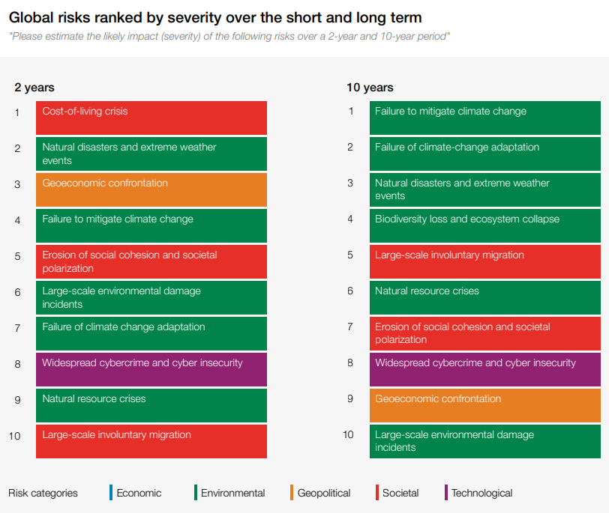
January 2023
World Economic Forum Global Risks Report 2023
Nine risks are featured in the top 10 rankings over both the short and the long term, including “Geoeconomic confrontation” and “Erosion of social cohesion and societal polarisation”, alongside two new entrants to the top rankings: “Widespread cybercrime and cyber insecurity” and “Large-scale involuntary migration”.
“Cost-of-living crisis” is ranked as the most severe global risk over the next two years.
Climate action failure dominates global risks in the next decade as 6 of the top 10 risks over the next 10 years are environmental risks.
Source: WEF, January 2023

Slide 9
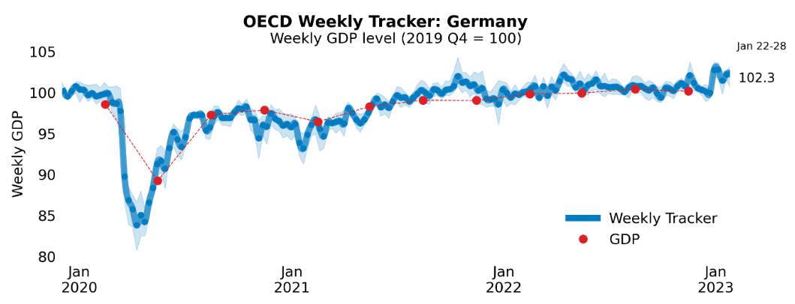
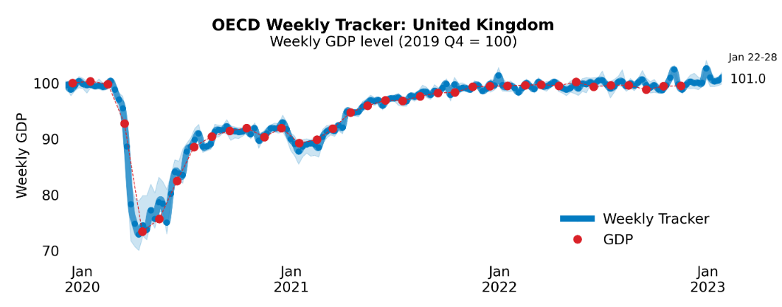
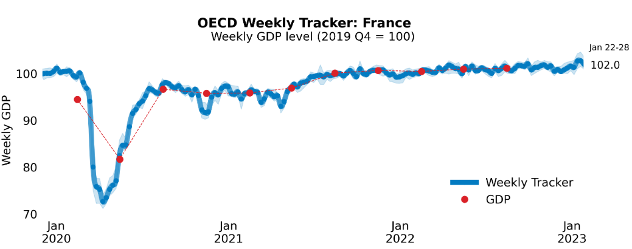
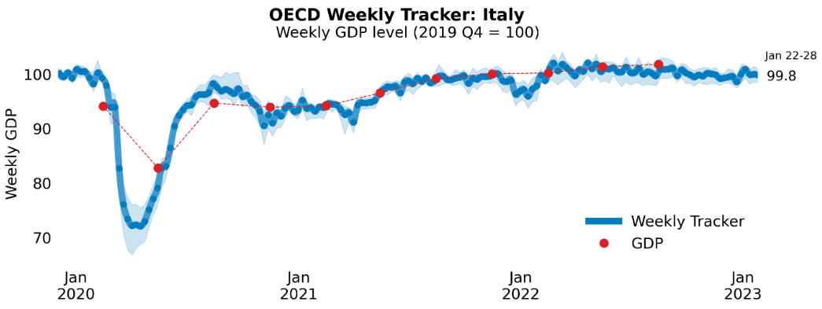
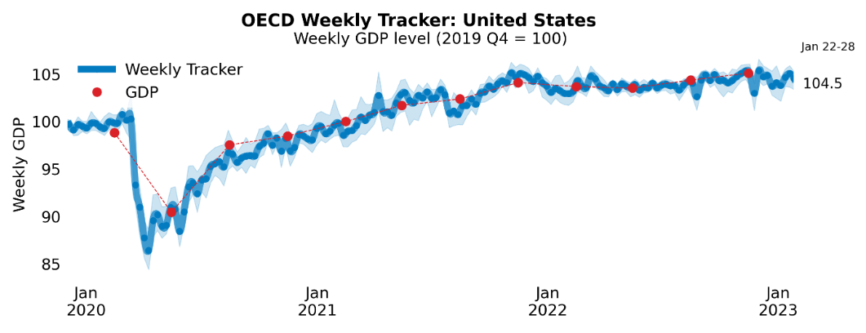
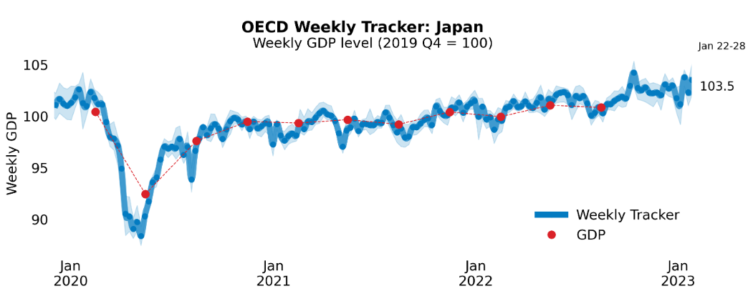
Global Economy
OECD GDP Tracker
The Weekly Tracker is an estimate of weekly GDP relative to the pre-crisis trend, which is proxied by the OECD Economic Outlook forecasts.
Source: OECD, January 2023

Slide 10
December 2022
British workers face return to 2006 real-term wages as UK faces challenging outlook for happiness and the housing market
PwC forecasts that UK real wages in 2023 are set to fall back to 2006 levels.
Cost of living pressures will continue to intensify through 2023, with the weekly food shop rising to £100 - double the rate at the turn of the century.
The housing market is also facing a challenging outlook with house prices set to decline by 8% - the second sharpest fall in seventy years - while the number of house sales could fall below one million for the first time in a decade.
The UK population may record the lowest levels of happiness since records began in 2013, driven primarily by high inflation rates and rising unemployment, although it may start to increase again in 2024.
More than 300,000 UK workers could re-join the labour market in 2023, closing the economic inactivity gap compared to the US and reducing staff shortages in highly skilled sectors. In addition, increased immigration to the UK could also directly contribute £19bn to the economy, driving 1% of GDP growth even as the whole economy contracts.
Source: PwC, December 2022
Notes:
data

Slide 11
January 2023
Business insights and impact on the UK economy
In December 2022, 30% of trading businesses reported turnover was lower compared with November 2022, while 13% reported their turnover was higher; the wholesale and retail trade industry reported the largest percentage of businesses whose turnover was lower, at 46%.
17% trading businesses reported that they expect their turnover to decrease in February 2023, while 14% expect their turnover to increase.
41% trading businesses reported an increase in the prices of goods or services bought in December 2022 compared with November 2022, down from 42% reported between October and November 2022.
Energy prices remain the top reason businesses are considering raising their prices in February 2023 with 35% of trading businesses reporting this; the accommodation and food service activities industry reported the largest proportion, at 78%.
23% of businesses reported their overall performance such as pricing, trading and workforce had decreased in December 2022 compared with December 2021.
In mid-January 2023, 25% of businesses reported an increase in their staffing costs over the last three months.
Source: ONS, January 2023
Notes:
data

Slide 12
Employment in the UK
Labour Force Survey – January 2023
Key points:
September to November 2022 estimates show an increase in the unemployment rate compared with the previous three-month period (June to August 2022) and a decrease in the economic inactivity rate, while the employment rate remained largely unchanged.
Total hours worked decreased compared with the previous three-month period and remain below pre-coronavirus (COVID-19) pandemic levels.
The UK employment rate was estimated at 75.6%, largely unchanged compared with the previous three-month period and 1.0 percentage point lower than before the coronavirus pandemic (December 2019 to February 2020).
The UK unemployment rate was estimated at 3.7%, 0.2 percentage points higher than the previous three-month period and 0.3 percentage points below pre-coronavirus levels.
The UK economic inactivity rate was estimated at 21.5%, 0.1 percentage points lower than the previous three-month period and 1.3 percentage points higher than before the coronavirus pandemic.
Source: ONS, January 2023

Slide 13
January 2023
Monthly Spotlight: Levelling Up Secretary’s speech to the Convention of the North
The Secretary of State for Levelling Up, Michael Gove, gave a keynote speech to the Convention of the North in January.
Gove spoke of the so-called ‘North-South Divide’, arguing that “Wealth, influence, innovation, high-productivity firms, high-wage jobs and high- quality schools have been disproportionately concentrated in the South-East quarter of the country”.
Describing initiatives by various Ministers to direct investment and resources to other parts of the UK, Gove added:
  “And all these initiatives work best, most fruitfully and sustainably, when we are working in partnership with empowered, strengthened, economically ambitious local leaders who are our equal partners in our shared national endeavour.”

Slide 14
January 2023
Monthly Spotlight: Levelling Up Secretary’s speech to the Convention of the North
Michael Gove argued that Margaret Thatcher, champion of the free market, had supported government intervention, specifically in Docklands.
Recalling that the original vision for regeneration of the area - from the Treasury - was based on cutting taxes and deregulation, Gove argued that whilst these were important, they were not enough.
So Michael Heseltine, a true believer in government intervention, was tasked with regenerating the area through land reclamation, new transport links, new housing and eventually cultural, sporting and educational investment.

Slide 15
January 2023
Monthly Spotlight: Levelling Up Secretary’s speech to the Convention of the North
This spirit, according to Michael Gove, is there most vividly in Government plans for new Investment Zones. Gove argued that the UK has no shortage of growth industries or of world class universities, but we have underperformed in our ability to leverage their success in support of communities in need of regeneration. Gove said: “That is my guiding mission for Investment Zones.”
The Government’s approach would be guided by three principles.
  Government cannot create clusters, but it can create the conditions for them to succeed.
  Success requires fiscal support along with a wider range of interventions.
  Investment zones can only happen in partnership with strong local leadership.

Slide 16
January 2023
Monthly Spotlight: Levelling Up Secretary’s speech to the Convention of the North
Michael Gove announced the setting-up of the Office for Local Government, OfLog, which will monitor the performance of local leaders.
OfLog will produce detailed and precise comparisons of delivery across local authorities and mayoral combined authorities.
Value for money and effectiveness of service would be measured more effectively than ever before, “monitored and analysed so we can learn from the best and support others to improve.”

Slide 17
January 2023
Monthly Spotlight: Levelling Up Secretary’s speech to the Convention of the North
Michael Gove acknowledged that the mayoral model has its critics and sceptics.
Gove also recognized that there are communities geographically beyond the boundaries of mayoral combined authorities, and relatively distant from faster growing cities, which require specific, bespoke attention.
There would be a further round of investment from the Levelling Up Fund after the March Budget.
And whilst competitive bidding for funding can help drive innovation, there is also a need to reduce bureaucracy, so Gove was working with the Chancellor to simplify funding allocations and, again, there would be more details in the March Budget.

Slide 18
January 2023
Monthly Spotlight: Levelling Up Secretary’s speech to the Convention of the North
The Levelling Up agenda was very much identified with Boris Johnson’s Premiership and the political importance of so-called Red Wall seats.
Questions have been asked about Rishi Sunak’s attitude towards Levelling Up.
Clearly from this speech, Michael Gove remains a believer in Levelling Up.
However, Gove’s speech is based on the idea of a poor North and a rich South. The Levelling Up White Paper, referred to in the speech, recognizes that deprivation is local and there are many deprived communities in the South of England.

Slide 19
Economic and Labour Market Insight: Implications for Berkshire

Slide 20
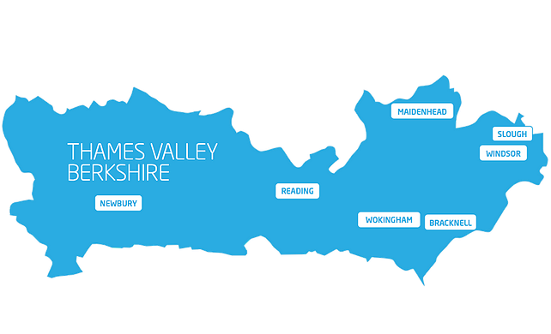
Claimant Count
(Latest data - December 2022)
Total of 16,575 claimants (2.9% of the working age population) in Berkshire.
1,630 claimants (2.0% of the working age population) in Bracknell Forest UA
4,340 claimants (4.1% of the working age population) in Reading UA
4,750 claimants (5.0% of the working age population) in Slough UA
2,070 claimants (2.2% of the working age population) in West Berkshire UA
2,045 claimants (2.2% of the working age population) in Windsor and Maidenhead UA
1,740 claimants (1.6% of the working age population) in Wokingham UA
Across Berkshire, claimant unemployment has fallen significantly from 19,750 in December 2021 to 16,575 in December 2022. Slough had 5.0% of its working age population claim unemployment in December 2022, down significantly from 6.1% in December 2021.
Source: ONS, January 2023

Slide 21
Strategic Issues – Heathrow
Heathrow 'staff shortage' threat if Ultra Low Emission Zone fee kicks in
Heathrow may face staff shortages if certain staff are made to pay a charge under the Ultra Low Emission Zone expansion, the union GMB has warned.
The Mayor of London, Sadiq Khan, confirmed that ULEZ will be expanding across the outer boroughs of London, including Heathrow Airport. From August, the staff who can’t use public transport will not only be hit by the expensive parking and drop-off charges, but they will also have to pay £12.50 to comply with ULEZ if they don’t have an environmentally-friendly car.
Trevlyn McLeod, GMB London Region Organiser said: “GMB understands how important it is to tackle air pollution, but the ULEZ extension will affect our Heathrow members who aren’t earning huge great salaries, who are already struggling to support themselves and their families because of the cost of living, and now face being financially penalised for going to work, having more of their limited income taken from them via another stealth tax. The idea that our members ditch their cars and all jump on a local bus is absurd, the local transport infrastructure isn’t set up to support the extra carriage. Many of our members have very early starts and very late finishes, there isn’t public transport that can be used during these unsociable hours.”
Source: Berkshire Live, January 2023

Slide 22
Remote working
In January 2023, there were 3,979 unique active job postings for remote positions at companies based in Berkshire, rising from 2,899 in January 2022 – a 37.3% increase. There were 1,567 unique new job postings for remote positions at companies based in Berkshire, up from 1,306 in January 2022 – a rise of around 20.0%.
Compare this with the South-East, in January 2023 there were 19,970 unique active job postings for remote positions; rising from 15,751 in January 2022 – an increase of 26.8%. There were 8,069 unique new job postings for remote positions in January 2023, up from 7,130 in January 2022 – a rise of around 13.2%.
A rise can also be seen at national level, with a recorded 141,927 unique active remote job postings in England in January 2023, rising from 117,139 in January 2022 – an increase of 21.2%. There were 53,456 unique new job postings for remote positions in January 2023, rising from 51,938 in January 2022 – an increase of 2.9%.
From these figures it’s apparent that the boost in job postings for explicitly remote roles prompted by the COVID-19 pandemic has somewhat persisted despite the reduction in cases and has seen a rise across all geographies in January. Berkshire continued to see a larger increase in vacancies which are remote-based than the South East and England overall.
Source: EMSI, January 2023

Slide 23
Local Profiles

Slide 24
Bracknell Forest

Slide 25
Unemployment figures and notable business news - January 2023
Claimant unemployment to December 2022 (latest)
1,630 claimants (2.0% of the working age population) in Bracknell Forest UA
Notable business news:
Bracknell Forest Council have developed a Climate Change webpage to support businesses with climate change information. The webpage will allow businesses to access a variety of tools to help signpost businesses with information relating to climate change, such as financial support, education and training opportunities, green business development opportunities and pledges. The page is suitable for a wide range of businesses. - LINK.

Slide 26
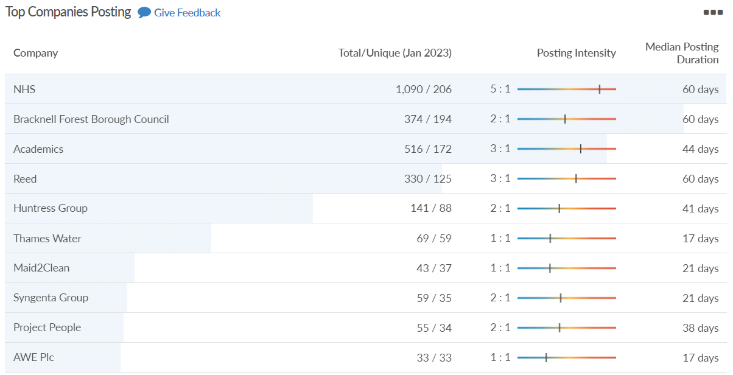
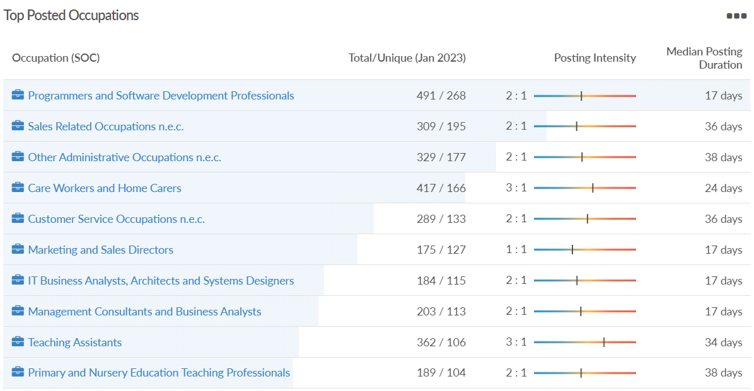
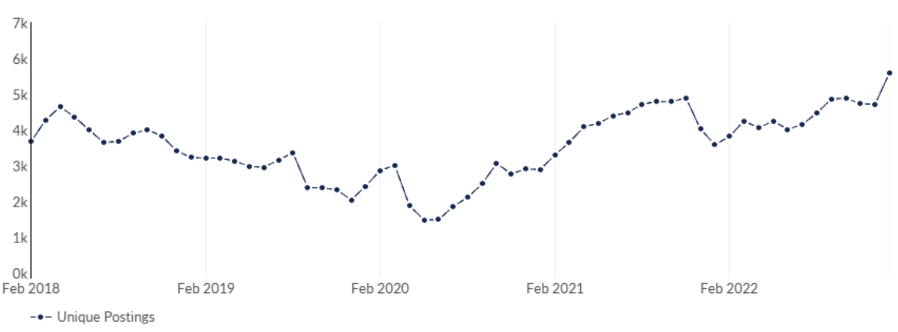
Bracknell Forest
Job posting analytics
(Active postings)
Source: EMSI, January 2023
Unique job postings | 5,600
Total job postings | 11,404
Job posting intensity | 2:1
Unique job postings (January 2022) | 3,580

Slide 27
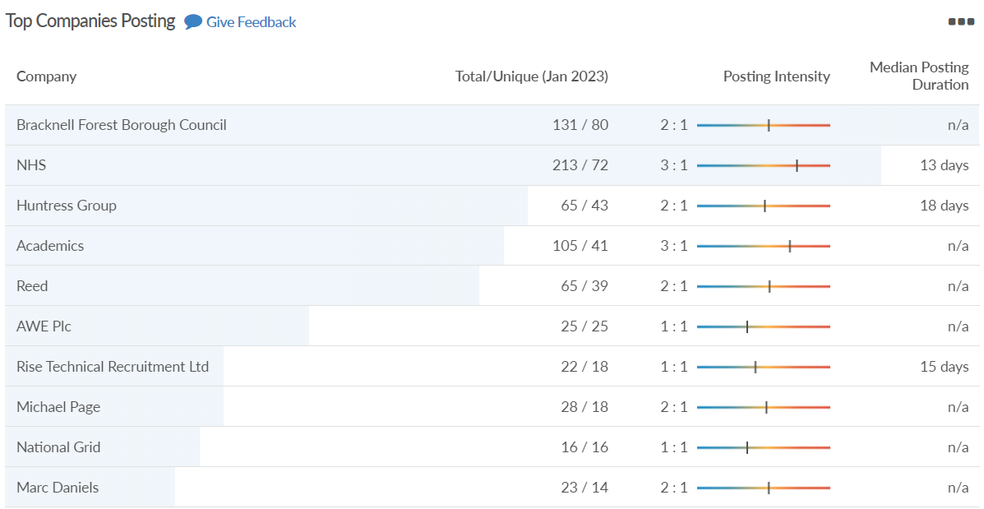
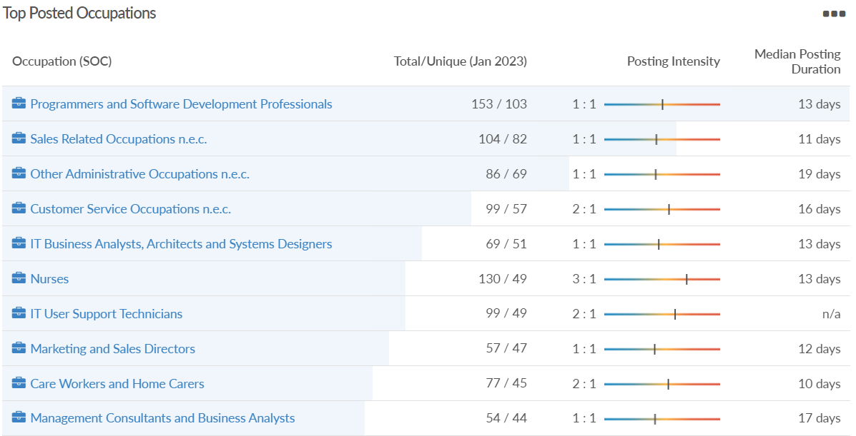
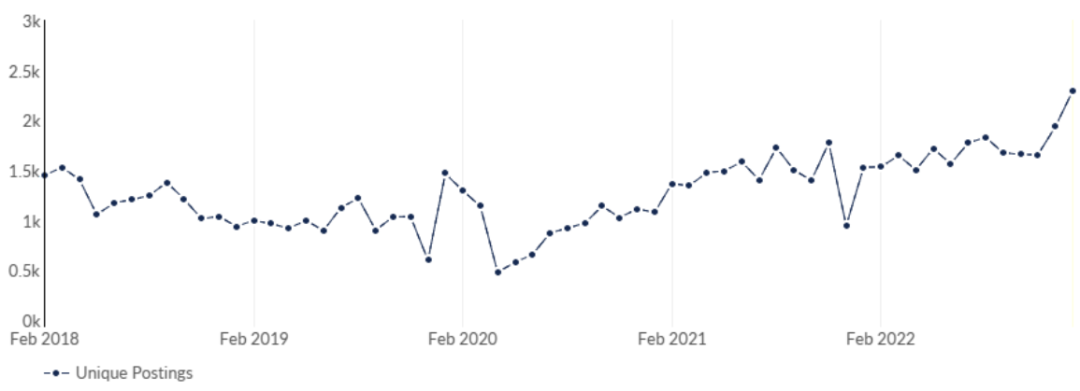
Bracknell Forest
Job posting analytics
(Newly posted)
Source: EMSI, January 2023
Unique job postings | 2,295
Total job postings | 3,424
Job posting intensity | 1:1
Unique job postings (January 2022) | 1,530

Slide 28
Reading

Slide 29
Unemployment figures and notable business news - January 2023
Claimant unemployment to December 2022 (latest)
4,340 claimants (4.1% of the working age population) in Reading UA
Notable business news:
A new study from CMC Markets has revealed Reading to be home to the UK’s most successful new businesses. Nigel Horton-Baker, Executive Director at Reading’s Economy and Destination Agency (REDA), said: “This latest report highlights Reading as a hotspot for talented entrepreneurs and a location which nurtures successful business growth. Of the nearly 7000 new businesses constituted in Reading between 2017 and 2022, just 0.13% failed, underling strong economic growth factors such as a skilled workforce, excellent connectivity, diverse business eco systems and a strong demand for goods and services locally, as well as the creativity within the diverse business environment. – LINK.

Slide 30
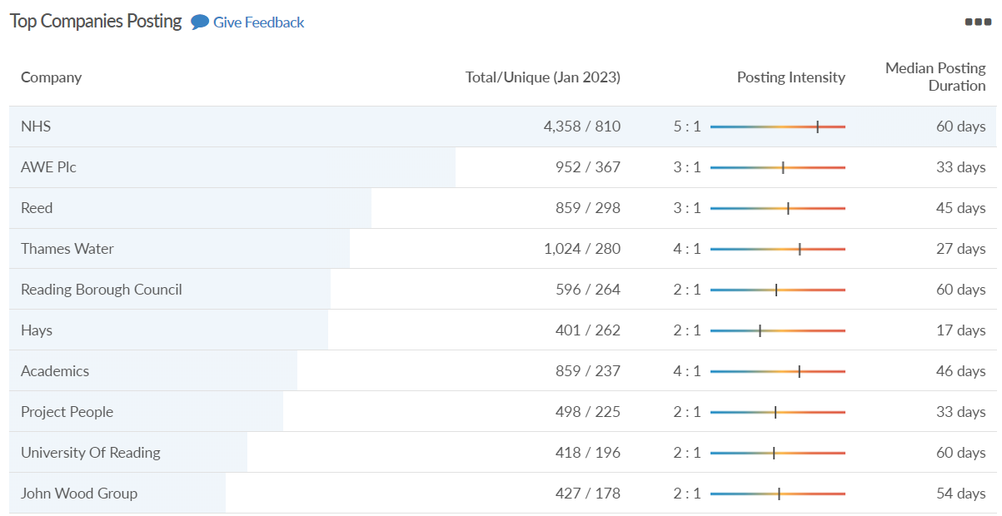
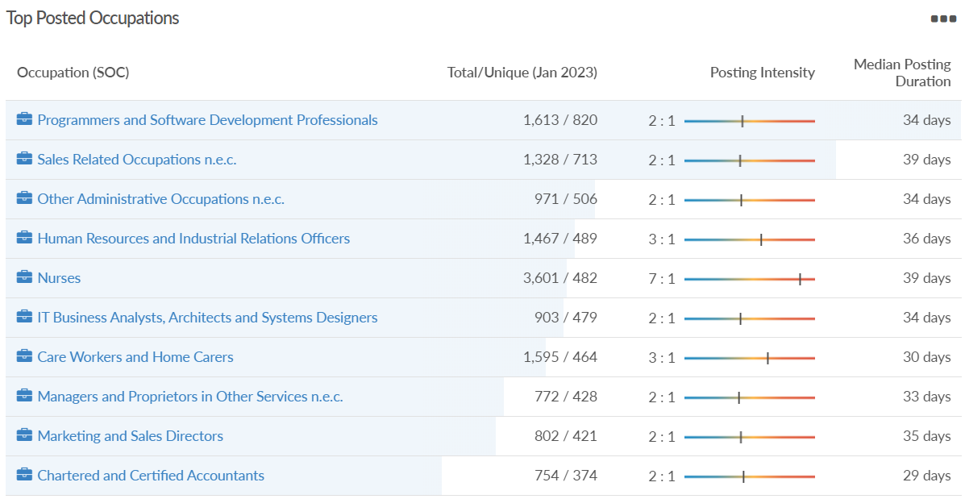
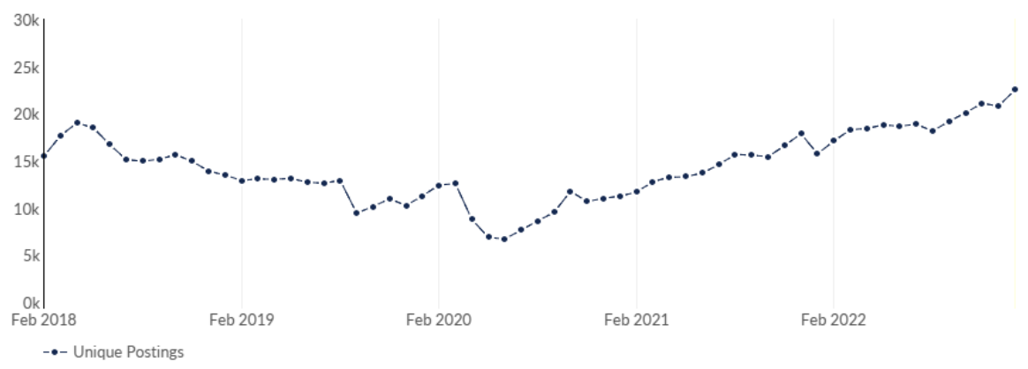
Reading
Job posting analytics
(Active postings)
Source: EMSI, January 2023
Unique job postings | 22,515
Total job postings | 52,765
Job posting intensity | 2:1
Unique job postings (January 2022) | 15,727

Slide 31
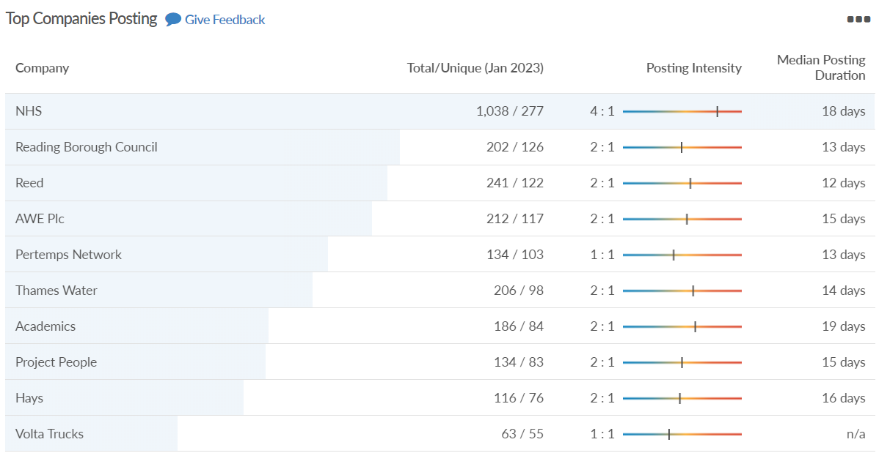
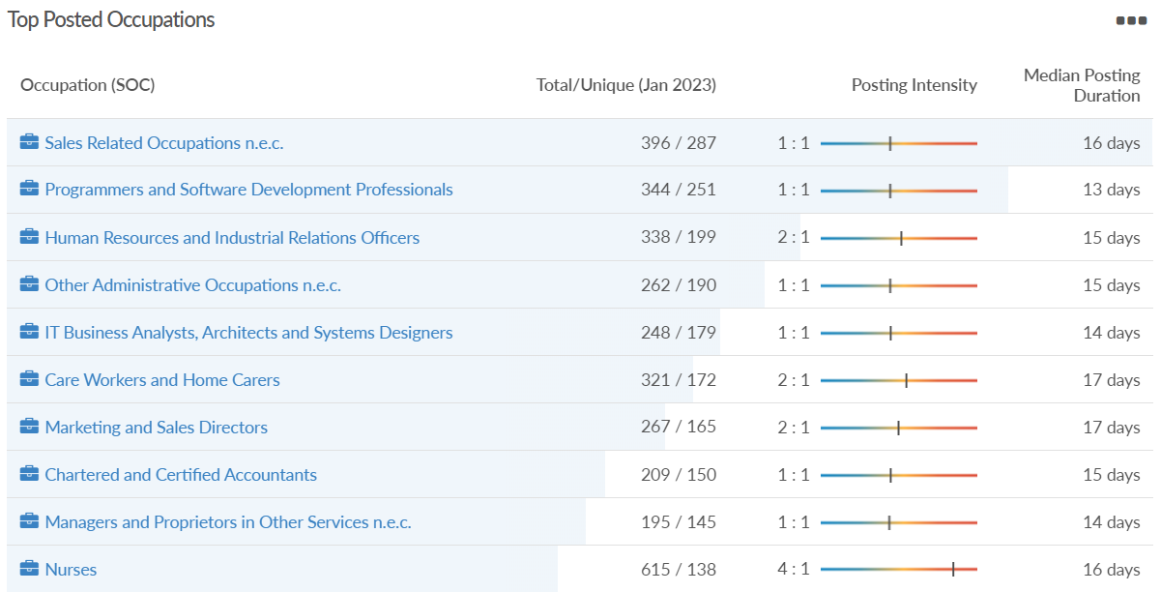
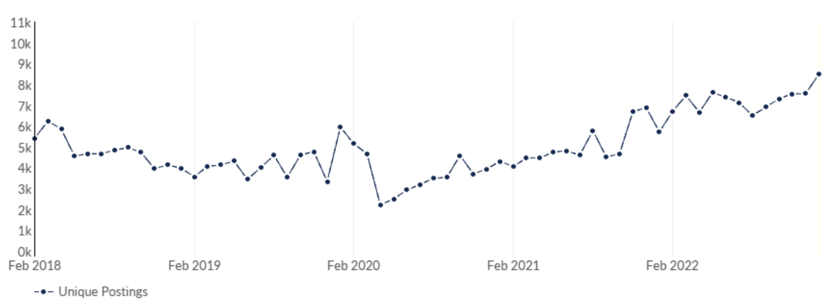
Reading
Job posting analytics
(Newly posted)
Source: EMSI, January 2023
Unique job postings | 8,489
Total job postings | 14,123
Job posting intensity | 2:1
Unique job postings (January 2022) | 5,728

Slide 32
Slough

Slide 33
Unemployment figures and notable business news - January 2023
Claimant unemployment to December 2022 (latest)
4,750 claimants (5.0% of the working age population) in Slough UA
Notable business news:
SEGRO, the real estate investment trust company who are the backbone of Slough Trading Estate, acquired the Slough Retail Park on Wednesday, January 11 in a £120.25million deal. The land a spokesperson for SEGRO said: "Land suitable for industrial development is in high demand and short supply in the Thames Valley, so as a business with a strong, long-term commitment to the region, the site which is located next to our Slough Trading Estate provided us with an excellent opportunity to grow our portfolio. The park includes 10 retail warehouse units, roughly one-third of which are currently vacant thereby providing us with immediate opportunities for asset management or redevelopment initiatives.” – LINK.

Slide 34
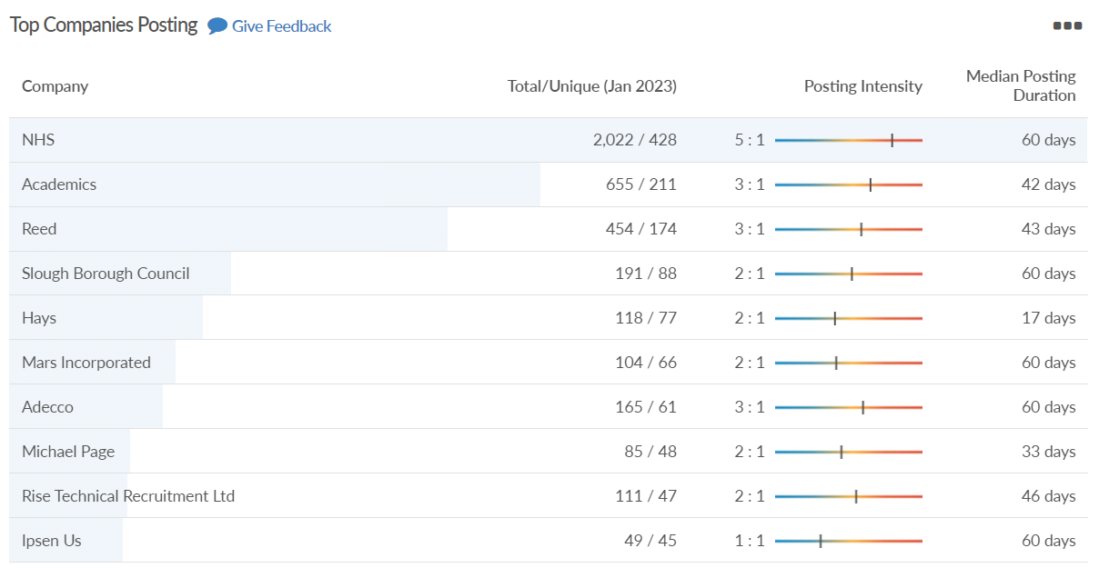
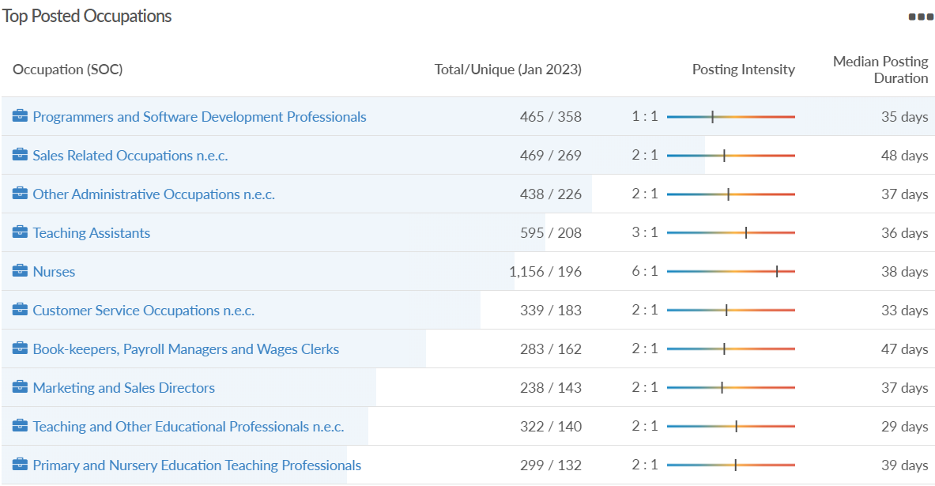
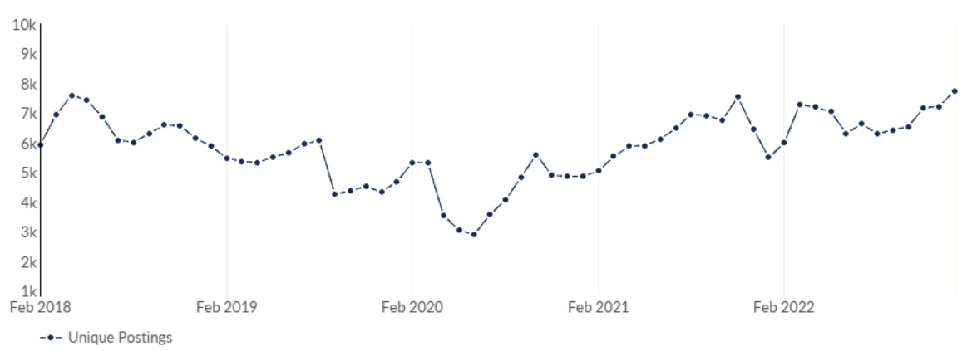
Slough
Job posting analytics
(Active postings)
Source: EMSI, January 2023
Unique job postings | 7,753
Total job postings | 16,064
Job posting intensity | 2:1
Unique job postings (January 2022) | 5,485

Slide 35
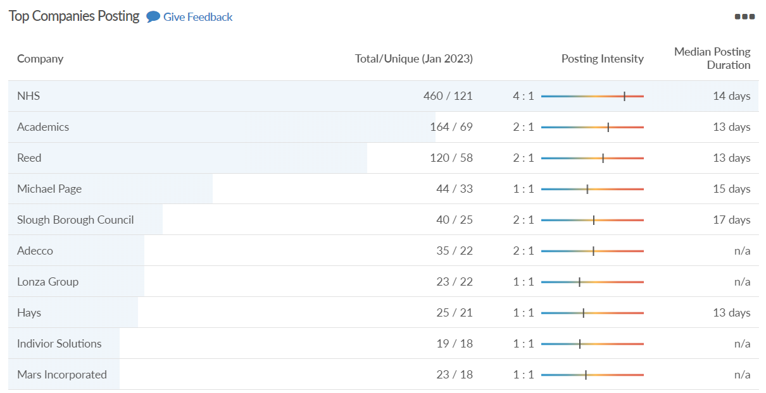
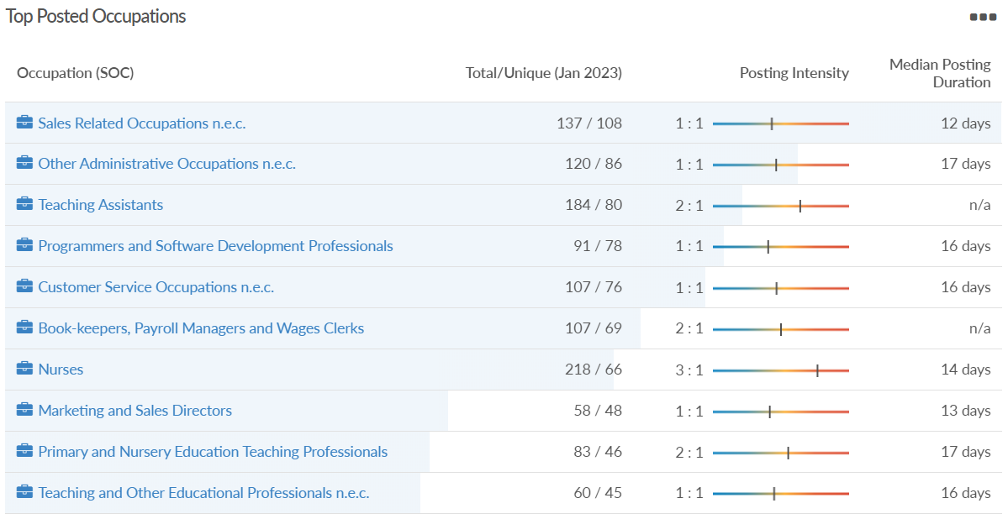
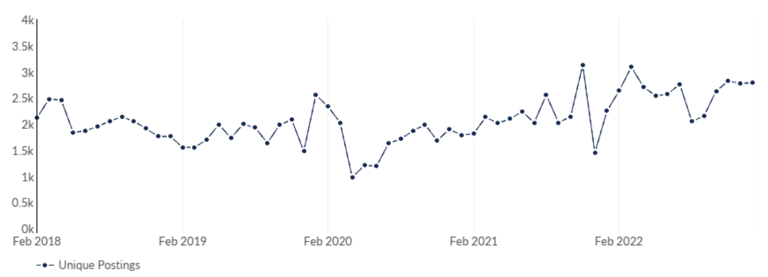
Slough
Job posting analytics
(Newly posted)
Source: EMSI, January 2023
Unique job postings | 2,783
Total job postings | 4,399
Job posting intensity | 2:1
Unique job postings (January 2022) | 2,246

Slide 36
West Berkshire

Slide 37
Unemployment figures and notable business news - January 2023
Claimant unemployment to December 2022 (latest)
2,070 claimants (2.2% of the working age population) in West Berkshire UA
Notable business news:
After nearly three years absence due to the pandemic, the Newbury Weekly News Best In Business Awards 2023 awards evening will be held on Friday, March 31, 2023, at Newbury Racecourse. Categories include Best Independent Retailer (sponsored by Parkway Shopping), Best New Business (sponsored by West Berkshire Council), Best Online Business (sponsored by Bare Naked Money), Best Green Business (sponsored by Fidelity Energy), Best Business Innovation (sponsored by James Cowper Kreston), Best Hospitality Award (sponsored by Visit Newbury), Employer of the Year (sponsored by The HR Dept) and the overall winner West Berkshire’s Business of 2022/23 (sponsored by Apple Print & Creative). – LINK.

Slide 38
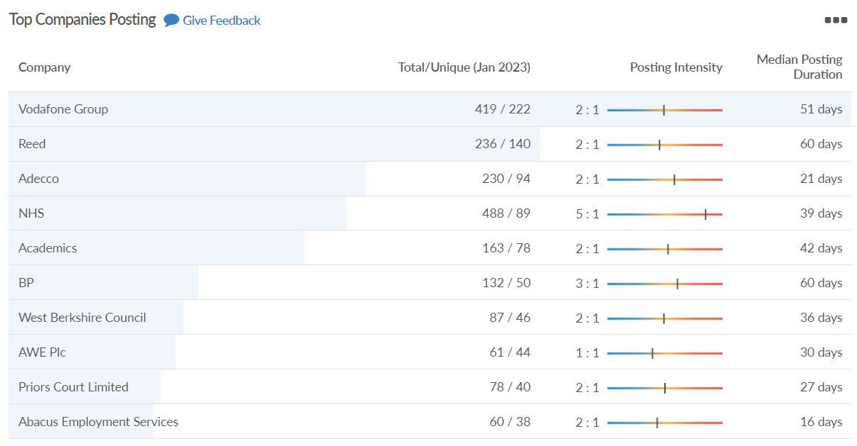
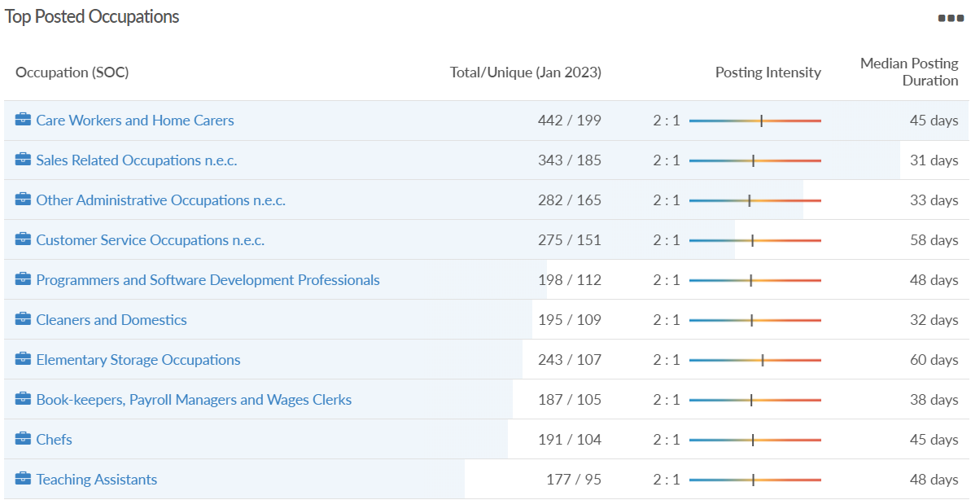
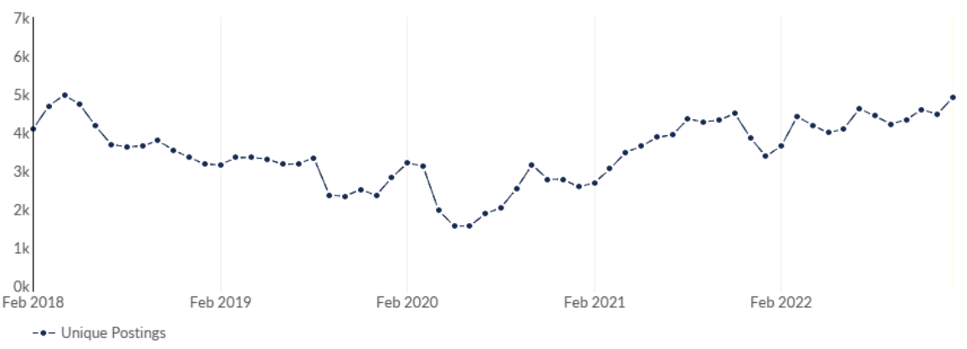
West Berkshire
Job posting analytics
(Active postings)
Source: EMSI, January 2023
Unique job postings | 4,920
Total job postings | 9,669
Job posting intensity | 2:1
Unique job postings (January 2022) | 3,369

Slide 39
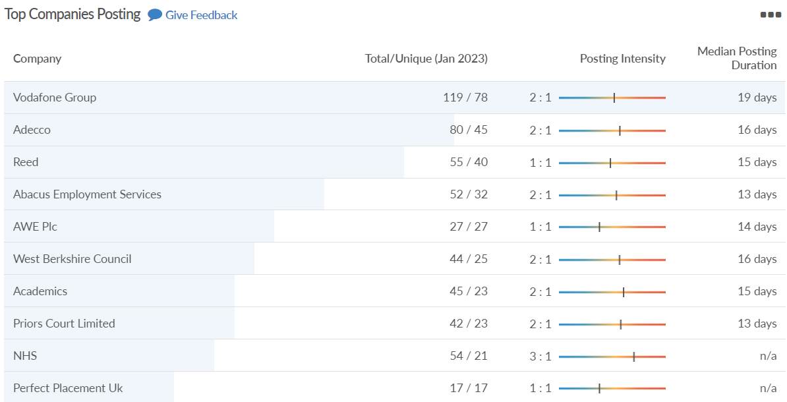
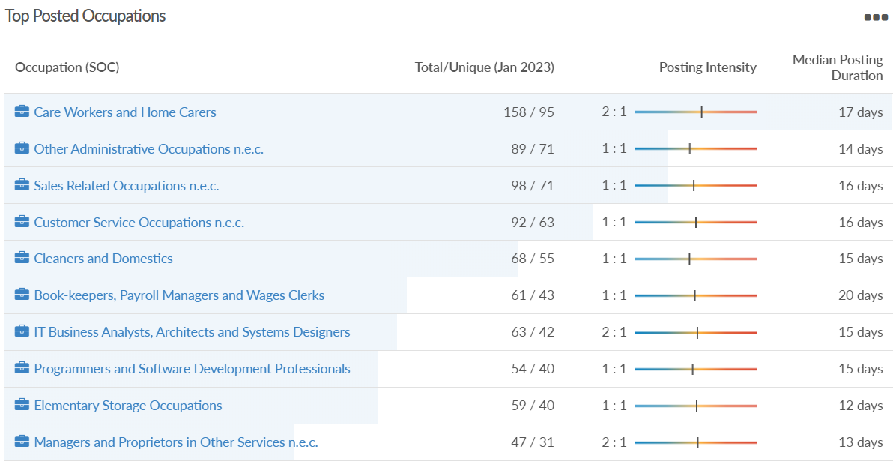
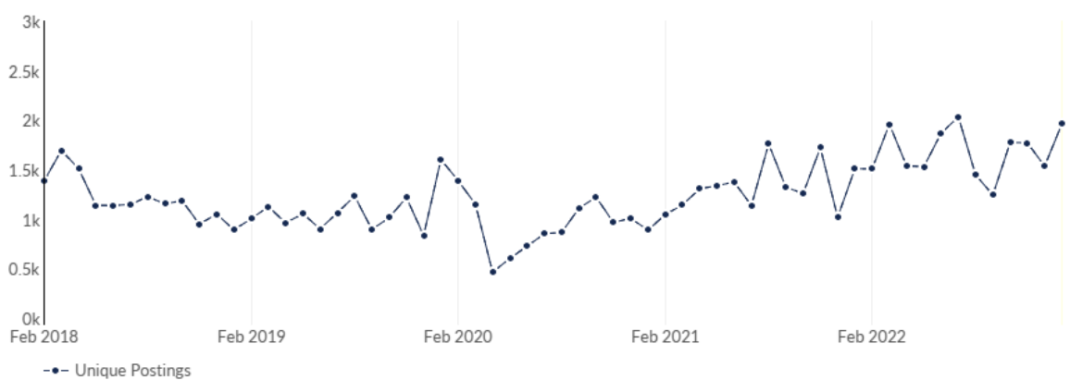
West Berkshire
Job posting analytics
(Newly posted)
Source: EMSI, January 2023
Unique job postings | 1,962
Total job postings | 2,951
Job posting intensity | 1:1
Unique job postings (January 2022) | 1,509

Slide 40
Windsor and Maidenhead

Slide 41
Unemployment figures and notable business news - January 2023
Claimant unemployment to December 2022 (latest)
2,045 claimants (2.2% of the working age population) in Windsor and Maidenhead UA
Notable business news:
IHG Hotels & Resorts, one of the world’s leading hotel companies, has formally opened its new global headquarters in Windsor, UK. Having started life as FTSE-listed company in Windsor in 2003, IHG returns to the historic town for its next chapter after being based for the past 15 years in Denham, Buckinghamshire. The building represents not only the company’s global headquarters, but also the head of its Europe, Middle East, Asia and Africa region, helping serve an international business that has more than 6,000 hotels across more than 100 countries around the world. – LINK.

Slide 42
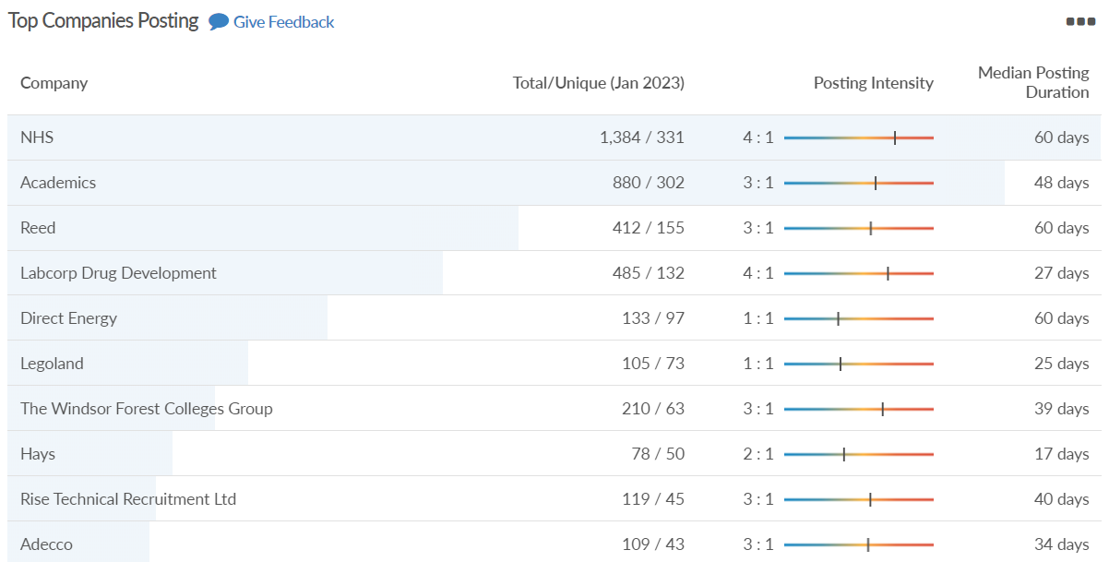
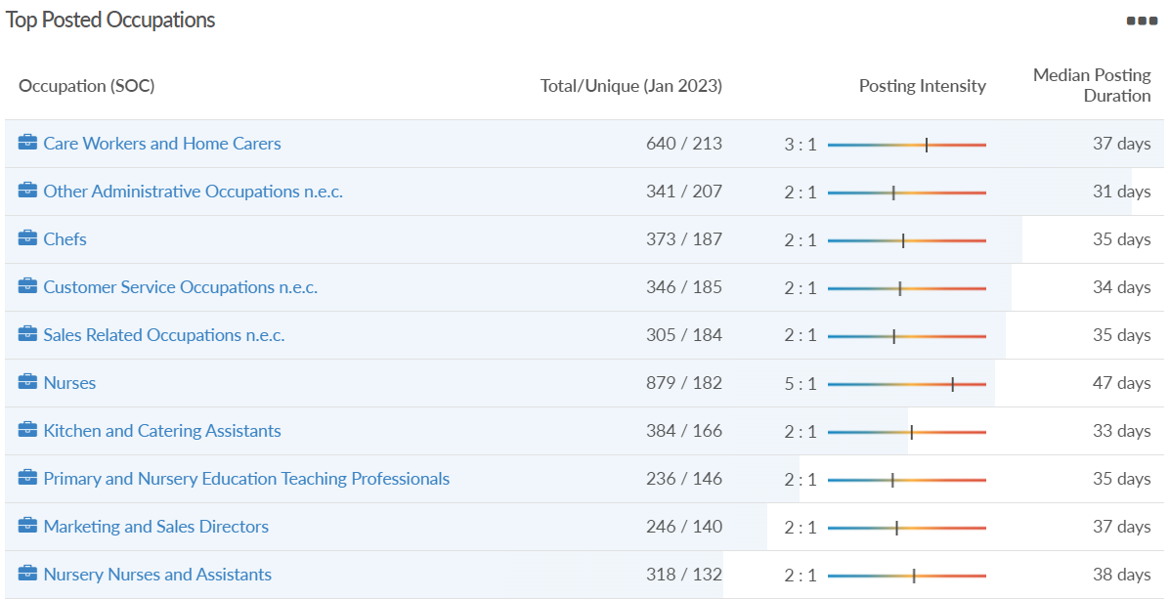
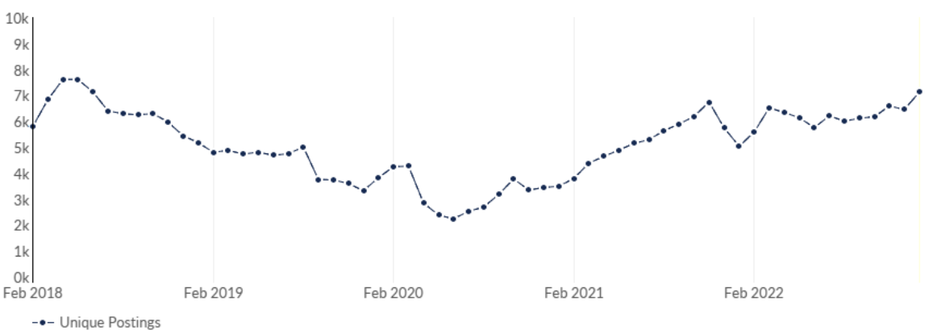
Windsor and Maidenhead
Job posting analytics
(Active postings)
Source: EMSI, January 2023
Unique job postings | 7,138
Total job postings | 15,343
Job posting intensity | 2:1
Unique job postings (January 2022) | 5,038

Slide 43
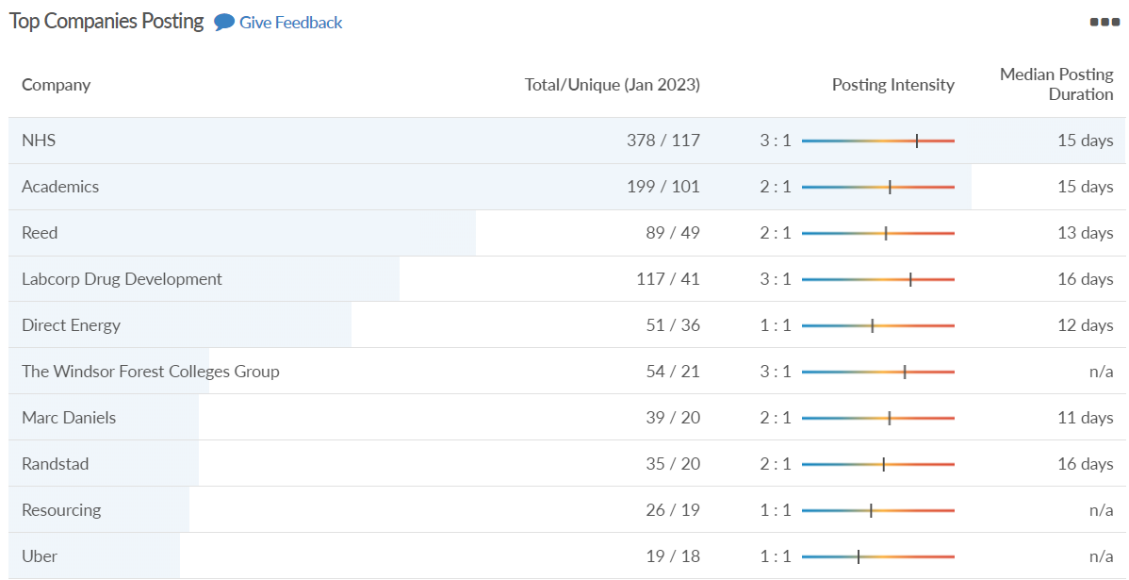
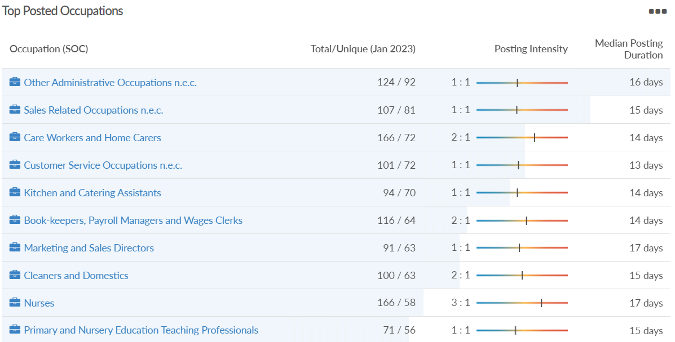
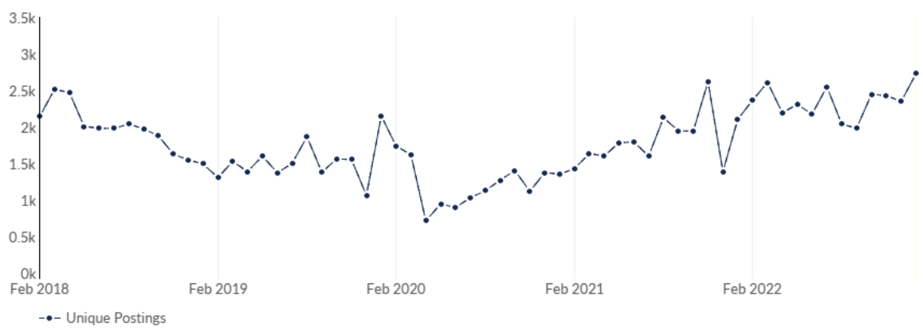
Windsor and Maidenhead
Job posting analytics
(Newly posted)
Source: EMSI, January 2023
Unique job postings | 2,728
Total job postings | 4,385
Job posting intensity | 2:1
Unique job postings (January 2022) | 2,105

Slide 44
Wokingham

Slide 45
Unemployment figures and notable business news - January 2023
Claimant unemployment to December 2022 (latest)
1,740 claimants (1.6% of the working age population) in Wokingham UA
Notable business news:
Wokingham Borough Council wants to add extra classrooms to The Emmbrook, The Piggott and St Crispin's schools. The authority said the expansions were needed to meet an increase in the number of pupils entering secondary school for the next five years. Under the £27m proposals it said it planned to use "modular buildings" to allow for installation later this year. Funding for the work will come from a grant from the Department for Education, along with developers' contributions from new housing in the borough, the council said. – LINK.

Slide 46
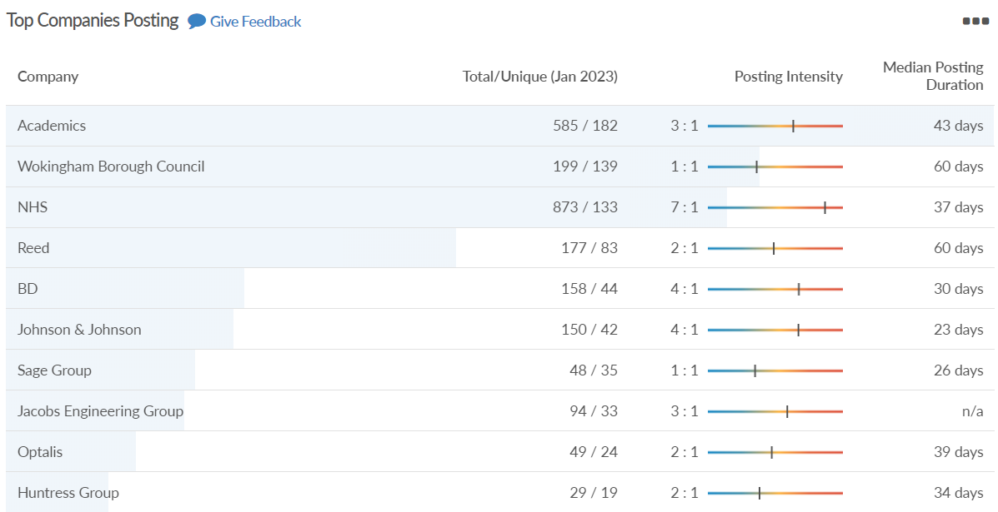
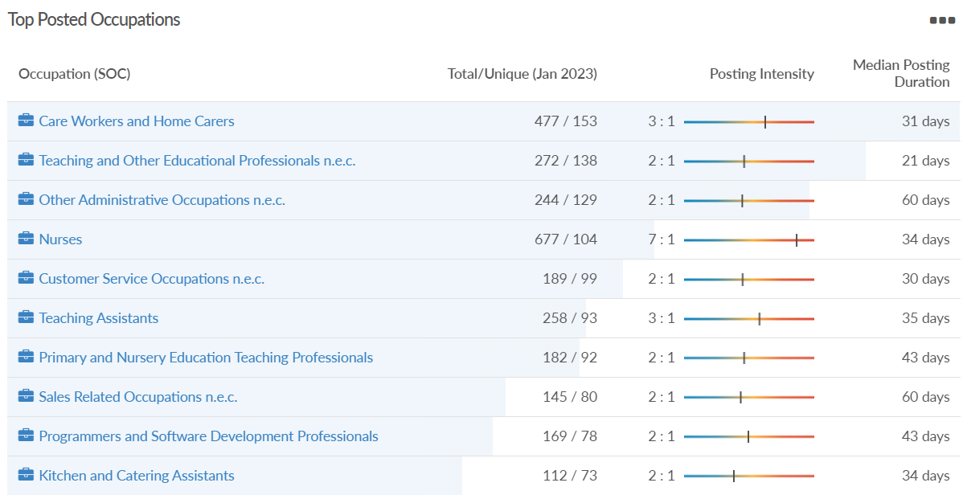
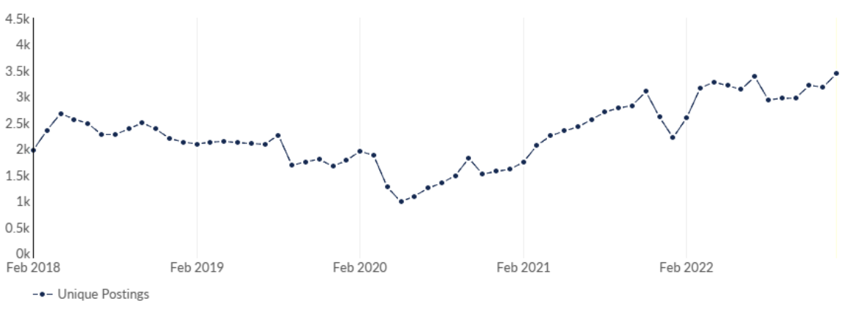
Wokingham
Job posting analytics
(Active postings)
Source: EMSI, January 2023
Unique job postings | 3,434
Total job postings | 7,645
Job posting intensity | 2:1
Unique job postings (January 2022) | 2,208

Slide 47
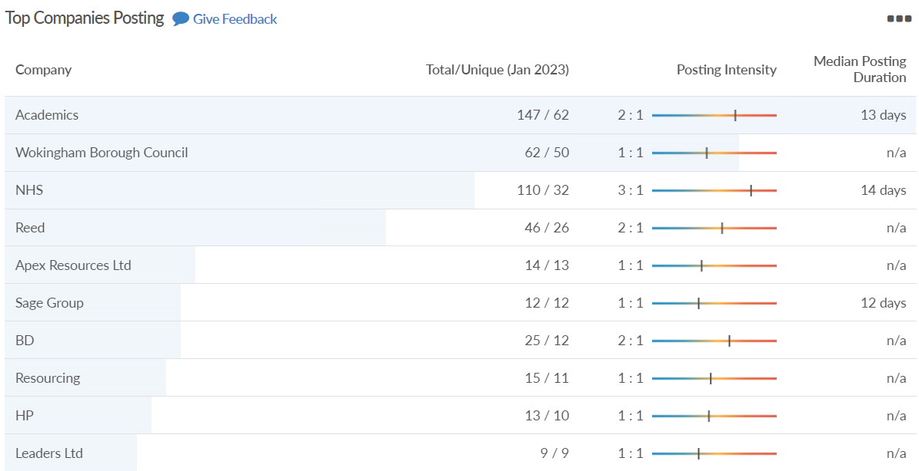
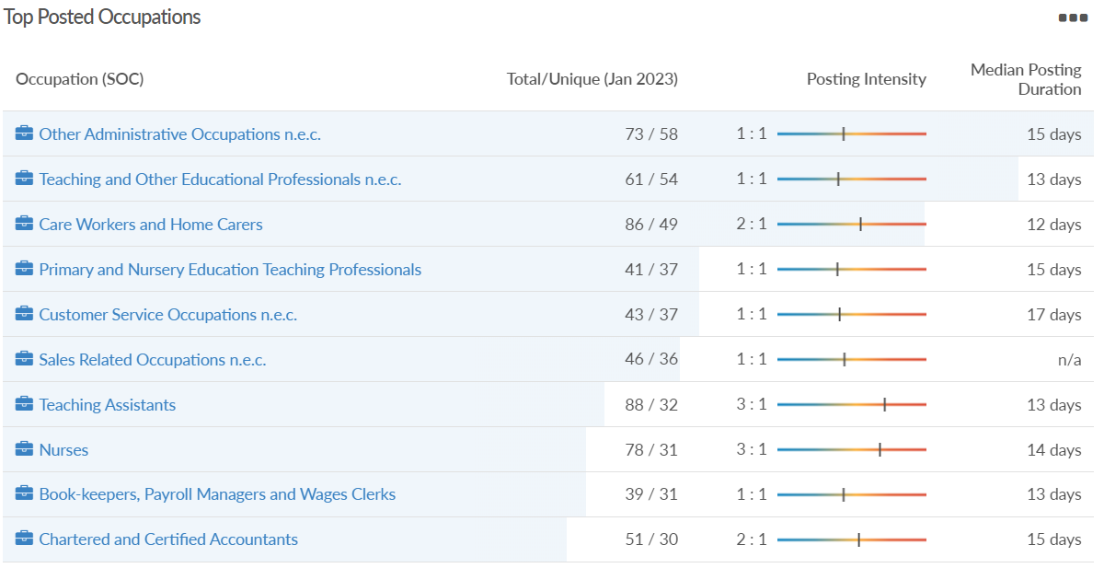
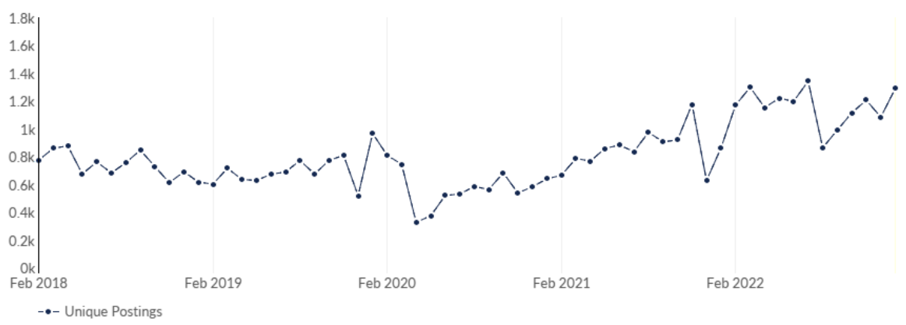
Wokingham
Job posting analytics
(Newly posted)
Source: EMSI, January 2023
Unique job postings | 1,290
Total job postings | 1,932
Job posting intensity | 1:1
Unique job postings (January 2022) | 863

