Slide 1
Thames Valley Berkshire
Monthly Economic Briefing
October 2022

Slide 2
2022 Refresh
Following on from stakeholder feedback as well as discussions within the LEP over the course of the last year, we have decided to make some additions to the content of our economic briefings, whilst still continuing to report on the bulk of the areas we were last year.
Each month, we aim to have a themed feature. This month, we will be discussing the themes explored in economist Ha-Joon Chang’s new book ‘Edible Economics: A Hungry Economist Explains the World’.
These monthly economic briefings are constantly evolving documents and their content is dictated in part by data/information requests from our readers.
If there is an economic aspect not currently covered within these reports which you think would be beneficial to include/ expand upon (or you have any queries), we will do our best to help. Please contact Dex or Aishwarya in the LEP’s research team at dexterlevick@thamesvalleyberkshire.co.uk or aishwaryachakravarty@thamesvalleyberkshire.co.uk.

Slide 3
Key contents of this month’s briefing
Updated global and UK economic forecasts
Monthly Spotlight – Edible Economics: A Hungry Economist Explains the World
Key points from the latest Labour Force Survey data
Latest claimant count figures by Local Authority
Latest remote working figures for Thames Valley Berkshire
Latest ‘notable business news’ by Local Authority
Latest job posting analytics by Local Authority

Slide 4
Global and National Economy
October 2022

Slide 5
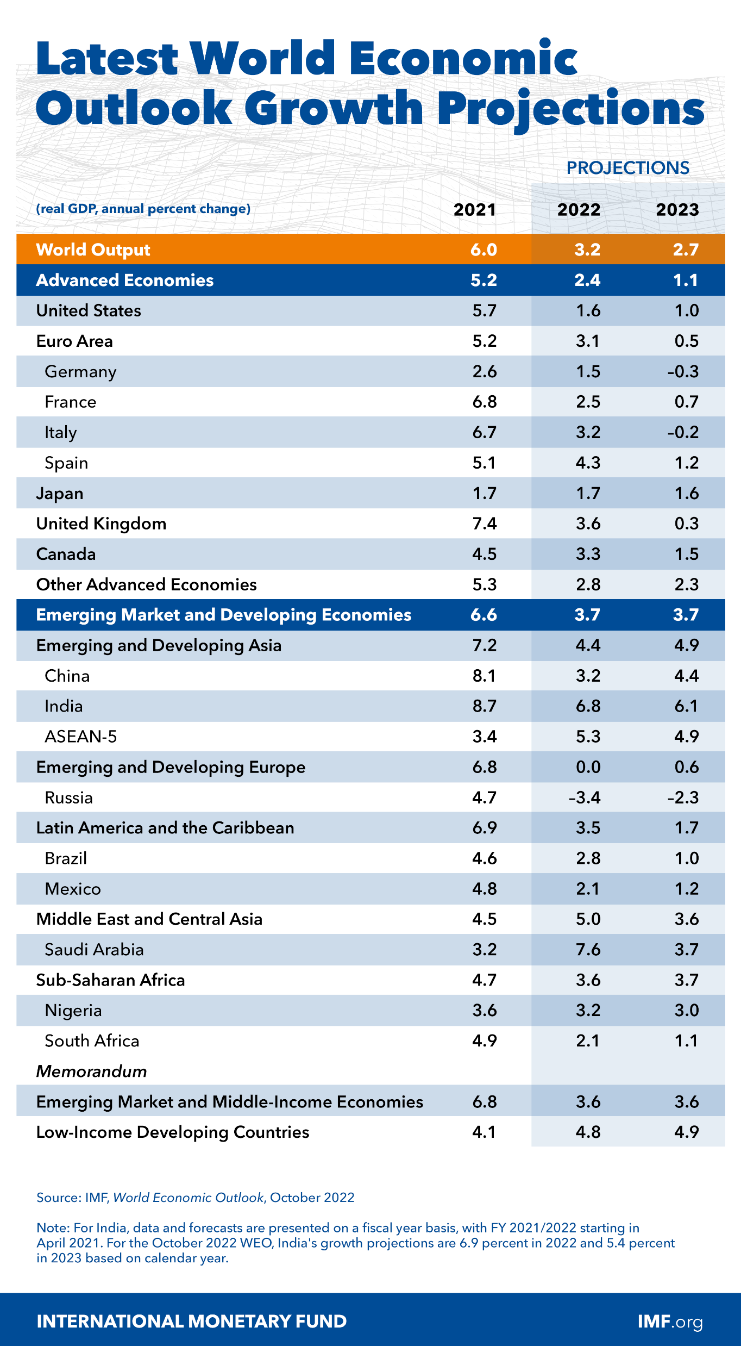
October 2022
OECD World Economic Outlook
The global economy is experiencing a number of turbulent challenges. Inflation higher than seen in several decades, tightening financial conditions in most regions, Russia’s invasion of Ukraine, and the lingering COVID-19 pandemic all weigh heavily on the outlook.
Global growth is forecast to slow from 6.0 percent in 2021 to 3.2 percent in 2022 and 2.7 percent in 2023. This is the weakest growth profile since 2001 except for the global financial crisis and the acute phase of the COVID-19 pandemic and reflects significant slowdowns for the largest economies.
Global inflation is forecast to rise from 4.7 percent in 2021 to 8.8 percent in 2022 but to decline to 6.5 percent in 2023 and to 4.1 percent by 2024.
Source: OECD, October 2022

Slide 6
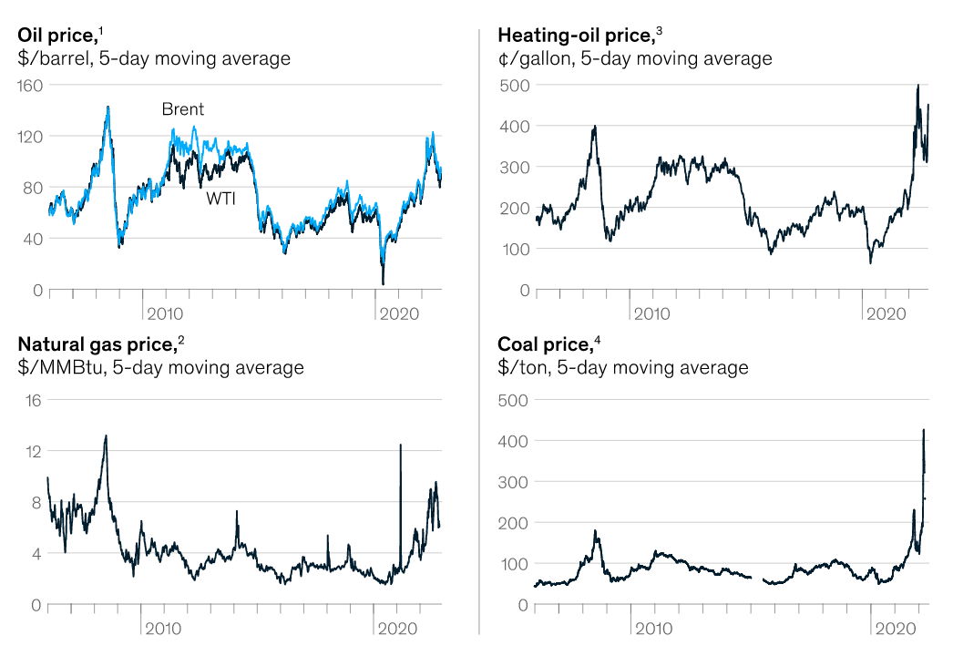
October 2022
Global Economics Intelligence executive summary
The US GDP grew at 1.8% year over year in the third quarter of 2022 after two quarters of contraction, supported largely by consumption and exports. China’s economy expanded at a rate of 3.9% in the third quarter, a significant acceleration since the sluggish performance in the previous quarter. Closer to home, Eurozone GDP expanded 2.1% year over year - the weakest GDP growth since the second quarter of 2021.
The International Energy Agency (IEA) released the World Energy Outlook 2022, warning that the world is facing its first-ever global energy crisis. The report emphasizes that the burden of this crisis will fall disproportionately on poorer populations and societies and that the response globally must go far beyond short-term measures, toward diversifying supply and accelerating the transition to a green-energy economy.
The prices of most commodities declined in October. Although energy prices have lately come down from ultrahigh levels, prices are still very high.
Source: McKinsey, October 2022

Slide 7
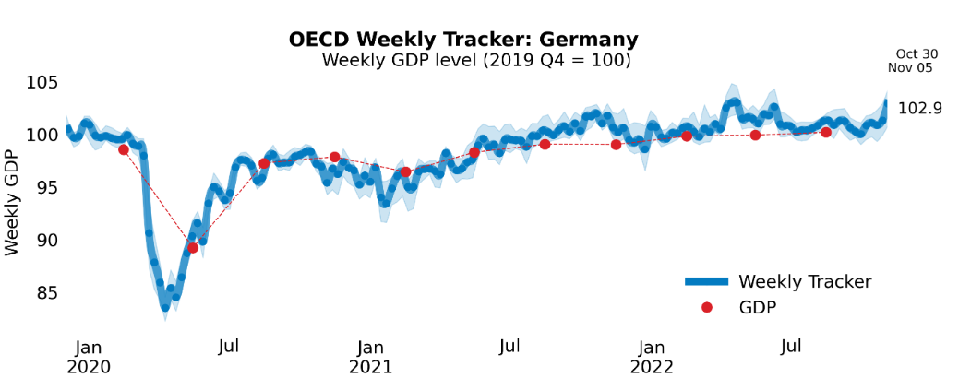
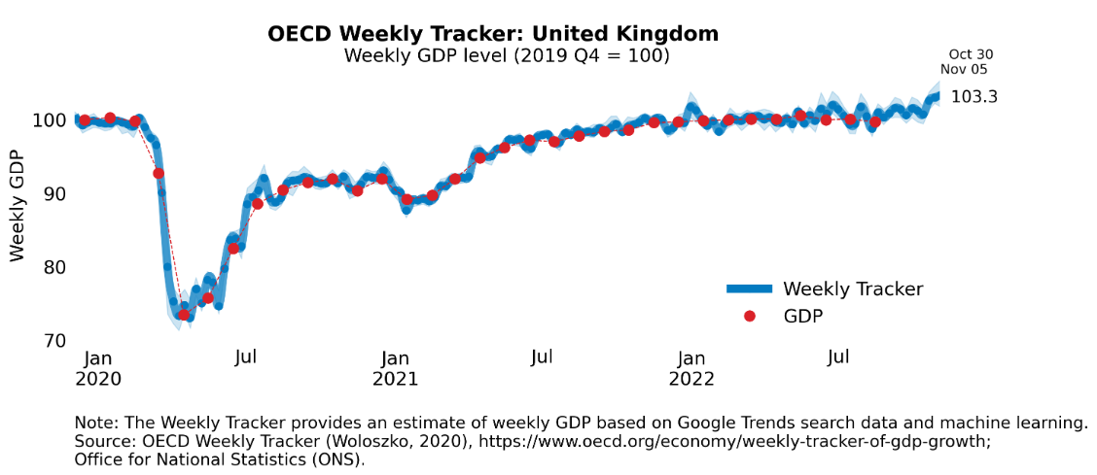
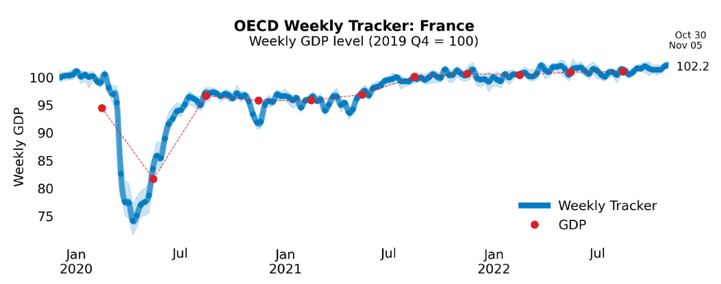
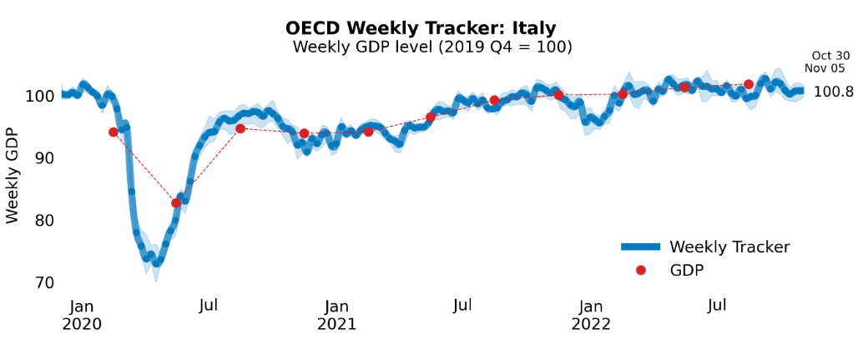
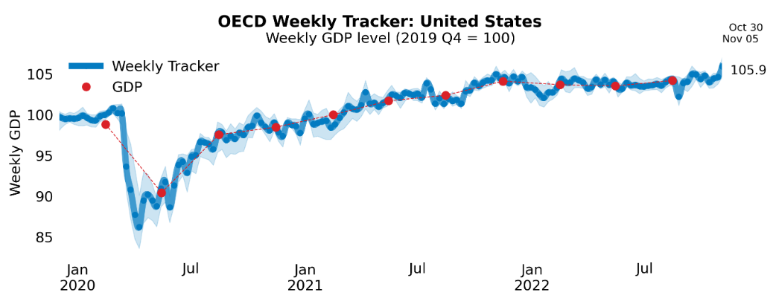
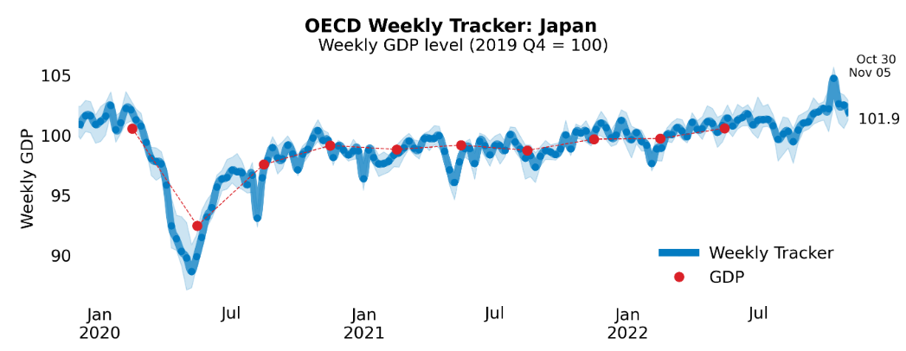
Global Economy
OECD GDP Tracker
The Weekly Tracker is an estimate of weekly GDP relative to the pre-crisis trend, which is proxied by the OECD Economic Outlook forecasts.
Source: OECD, October 2022

Slide 8
October 2022
Bank of England Financial Policy Summary, 2022 Q3
Looking at global economic developments, since July 2022, the global economic outlook has continued to deteriorate significantly, and by more than had been expected, while geopolitical risks have remained heightened.
Inflationary pressures have intensified further, driven in part by a sharp reduction in gas supply from Russia to Europe. That followed steep rises in energy and other commodity prices after Russia’s illegal invasion of Ukraine in February 2022, which had already exacerbated inflationary pressures arising from the pandemic. Household real incomes and the profit margins of some businesses have fallen this year as a result.
Financial conditions have tightened further, and financial markets have remained volatile in recent months, with significant rises in government bond yields, large moves in exchange rates, and falls in risky asset prices.
Overall, the adjustment in global market prices has been consistent with higher interest rates globally and further deterioration in the economic outlook. Global financial markets were affected by spillovers from dysfunction in the market for long-dated UK government debt in response to which the Bank announced measures to support UK financial stability.
Source: Bank of England, October 2022
Notes:
data

Slide 9
October 2022
Business insights and impact on the UK economy
For trading businesses with 10 or more employees who had imported/exported in September 2022, changes in exchange rates presented an increased challenge for 39% of importing businesses and 29% of exporting businesses compared with August 2022.
In September 2022, one in five (20%) businesses with 10 or more employees reported experiencing global supply chain disruption; the wholesale and retail trade; repair of motor vehicles and motorcycles industry reported the highest proportion of businesses who experienced disruption, at 31%.
In late October 2022, two in five (40%) businesses had taken some form of action to reduce their energy costs over the last three months, while 39% of businesses plan to act in November 2022 to reduce their energy costs.
Looking ahead to November 2022, input price inflation and energy prices remain the top two concerns reported by businesses, at 25% and 22%, respectively.
Source: ONS, October 2022
Notes:
Data source

Slide 10
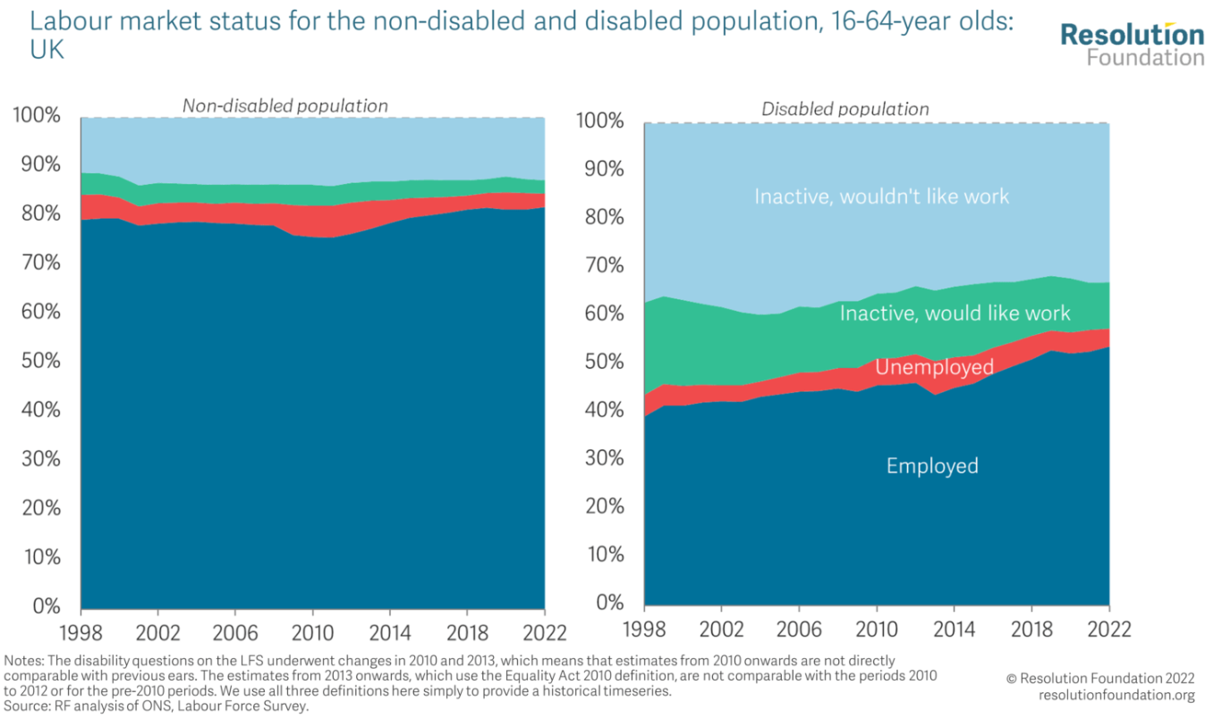
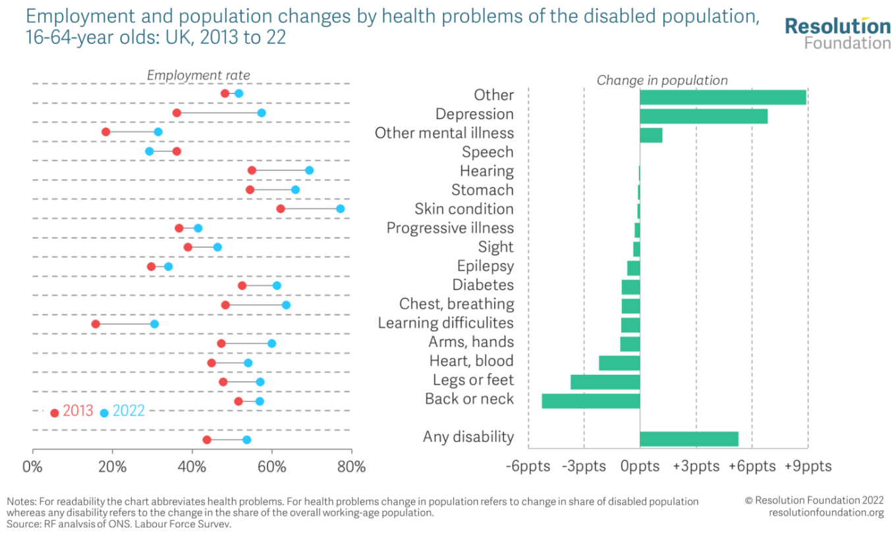
October 2022
Labour Market Outlook: Q3 2022
There has been a large increase in the number of working-age disabled people (up 2.3 million), with most of that driven by those in employment (1.9 million). More than half of the increase in disabled people in employment has been driven by an increase in disability, rather than an increase in the disabled employment rate.
Only mental health illnesses and ‘other’ health problems (which likely reflects reporting of Covid-19) have seen an increase in the share that they contribute to the overall disabled population since 2013. On the flipside, the share of the working-age disabled population accounted for by those with physical conditions has fallen by 10 percentage points over the same time period.
Source: Resolution Foundation, October 2022
Notes:
Data source

Slide 11
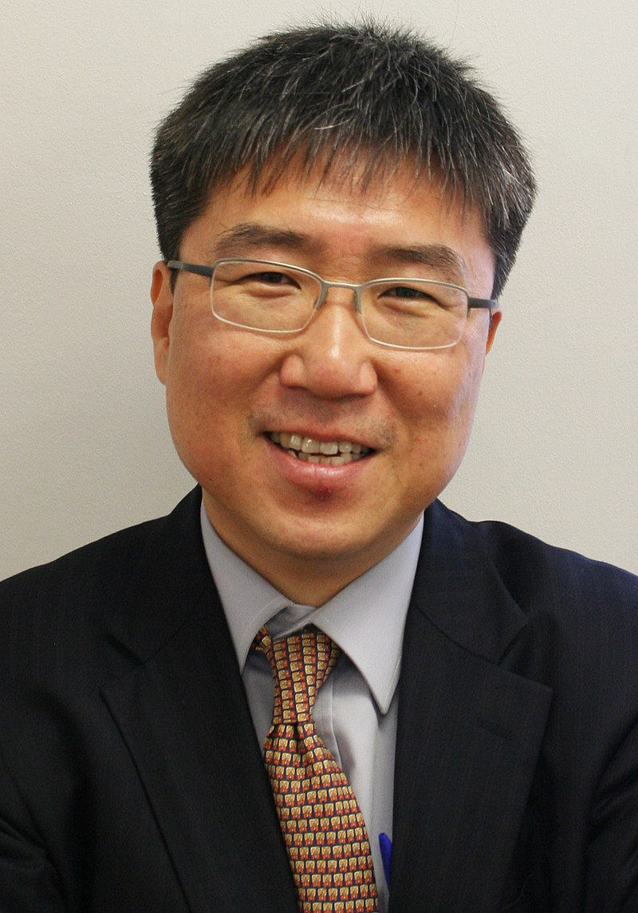
October 2022
Monthly Spotlight: Edible Economics
About Ha-Joon Chang
Ha-Joon Chang is a South Korean institutional economist, specialising in development economics, and is known for his criticism of free-market economics and western development policy. He teaches economics at SOAS University of London. His books include Economics: The User's Guide, Bad Samaritans and 23 Things They Don't Tell You About Capitalism, which was a no.1 bestseller. He featured on Prospect Magazine’s World Thinkers 2014 list.
He has served as a consultant to the World Bank, the Asian Development Bank, the European Investment Bank, as well as to Oxfam and various United Nations agencies. He is also a fellow at the Center for Economic and Policy Research in Washington, D.C. In addition, Chang serves on the advisory board of Academics Stand Against Poverty (ASAP).
Photograph: Discott/Wikimedia Commons

Slide 12
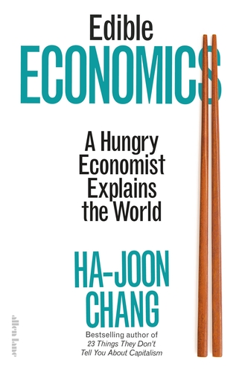
October 2022
Monthly Spotlight: Edible Economics
About his book Edible Economics:
When Ha-Joon Chang first arrived in Britain in 1986, he was struck by how overcooked, bland and homogeneous the British diet was. But it wasn’t just the food – in mainstream economic thinking too, there seemed to only be one item on the menu – the Neoclassical tradition. Whilst our diet has expanded and diversified since then, our economic preference has remained stubbornly singular.
Chang argues that just as a nourishing and appetising diet needs a variety of flavours and nutrients, our economics also needs to borrow from different traditions, economic perspectives and ways of thinking in order to produce the best results for the greatest number of people.
In Edible Economics, Chang makes challenging economic ideas more palatable by plating them alongside stories about food from around the world. He uses histories behind familiar food items - where they come from, how they are cooked and consumed, what they mean to different cultures - to explore economic theory.
Source: RSA, Penguin

Slide 13
October 2022
Monthly Spotlight: Edible Economics
Ha-Joon Chang’s Philosophy
“Economics has a very significant and immediate impact on our lives”. He claims that democracy is meaningless in a capitalist economy without all citizens understanding at least some economics. It is difficult to know what you are voting for without an understanding of the economic theories underlying political agendas. Collective decisions about almost every aspect of our lives (like jobs, working conditions, wages, repayment burdens) are justified based on economic theories which shape government policies on taxes, welfare spending, interest rate, labour market regulation etc. He strongly advocates that “Economics is for everyone”, captured wonderfully in this short RSA Animate video.
Chang’s philosophy is based on treating economic schools of thought as a buffet rather than a menu, with each school having its own strengths and weaknesses. He emphasises the need for a more diverse, sophisticated and multidimensional approach to solve problems of growth and inequality. “Not only do we need to look at outcomes (as emphasised by the socialists) and opportunities (as emphasised by the Right), we also need to look at needs and capabilities.” “We need to even understand the economy not purely from an economic point of view, but also from a political, social, psychological point of view.”
Source: RSA, The Guardian

Slide 14
October 2022
Monthly Spotlight: Edible Economics
Chang’s critique of Neoclassicism
Up to the 1970s, economics was populated by a diverse range of ‘schools’ containing different visions and research methodologies – classical, Marxist, neoclassical, Keynesian, developmentalist, Austrian, Schumpeterian, institutionalist and behaviouralist, to name only the most significant. Since the 1980s, economics has become the British food scene before the 1990s. One tradition – neoclassical economics – has become the only item on the menu. Like all other schools, it has its strengths; it also has serious limitations.”
Chang’s approach is informed by the powerful belief that successful economies are based on the endeavour of collectives of different types and sizes nurtured by nuanced political intervention rather than individualistic self-seeking behaviour in a small-state free-for-all which underlies the Neoclassical approach. “The individualist message is not only factually wrong but damaging because it makes us even less able to cooperate with one another.”
“Related to that is the fact that…you have to recognise how your society is changing, how what worked in the past may not be appropriate now. Industrialisation, for example, creates growth but leads to a to disintegration of the traditional family. At which point the nation has to act more as your family.”
Source: RSA, The Guardian

Slide 15
Employment in the UK
Labour Force Survey – October 2022
Key points:
Total hours worked decreased in June to August 2022 compared to the March to May 2022 period and are still below pre-coronavirus (COVID-19) pandemic levels.
The UK employment rate was estimated at 75.5%, which is 0.3 percentage points lower than the previous three-month period and 1.0 percentage points lower than before the pandemic (December 2019 to February 2020).
The UK unemployment rate was estimated at 3.5%, which is 0.3 percentage points lower than the previous three-month period and 0.5 percentage points below pre-pandemic levels.
The UK economic inactivity rate was estimated at 21.7%, which is 0.6 percentage points higher than the previous three-month period and 1.4 percentage points higher than before the pandemic.
Source: ONS, October 2022

Slide 16
Economic and Labour Market Insight: Implications for Thames Valley Berkshire

Slide 17
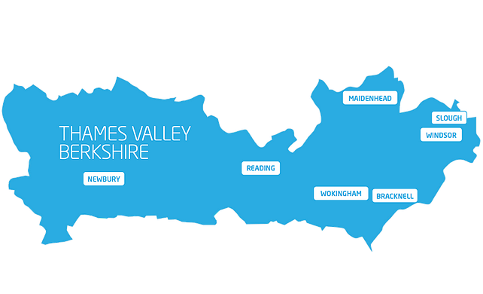
Claimant Count (Latest data - October 2022)
Total of 16,890 claimants (2.9% of the working age population) in Thames Valley Berkshire
1,645 claimants (2.1% of the working age population) in Bracknell Forest UA
4,410 claimants (4.2% of the working age population) in Reading UA
4,845 claimants (5.1% of the working age population) in Slough UA
2,150 claimants (2.2% of the working age population) in West Berkshire UA
2,090 claimants (2.3% of the working age population) in Windsor and Maidenhead UA
1,750 claimants (1.6% of the working age population) in Wokingham UA
Across Thames Valley Berkshire, claimant unemployment has fallen significantly from 21,365 in October 2021 to 16,890 in October 2022. Slough had 5.1% of its working age population claim unemployment in October 2022, down significantly from 6.4% in October 2021.
Source: ONS, October 2022

Slide 18
Strategic Issues
Heathrow Airport says no passenger limits over Christmas
Heathrow Airport has stated it will not re-introduce a cap on passenger numbers around Christmas. In July, Heathrow introduced a daily limit of 100,000 passengers to try to tackle the disruption customers were facing. Some airlines had to cancel flights to ensure they complied. The cap was extended until 29 October, but has now ended. However, the airport previously said it was working with airlines to agree a targeted way of "aligning supply and demand" on some peak days before Christmas.
Heathrow said it had seen a bigger increase in passenger numbers this year than any other airport in Europe. Nearly six million passengers used the airport in October - 84% of 2019 levels. It said businesses across the airport needed to recruit and train up to 25,000 people in October. In its latest update, it said firms had recruited around 16,000 workers over the last 12 months, and pre-pandemic levels of employment would be reached before next year's summer peak if the trend continued. It added that it was supporting Border Force and other organisations with contingency plans for any potential strike action.
Source: BBC, October 2022

Slide 19
An important note on the EMSI figures contained on the following slides: 20, 24, 27, 30, 33, 36 and 39
From February 2022, there has been a methodological change in how EMSI calculates job posting figures compared to those from prior months following a merger between EMSI and Burning Glass Technologies (now rebranded to Lightcast).
Those of you who have read previous economic briefings from Thames Valley Berkshire LEP may notice that the job posting figures contained in post-January 2022 briefings are lower across the board – in some cases quite significantly.
This change in methodology does not invalidate previous figures, but it is important to consider when reporting on job posting data longitudinally.

Slide 20
Remote working
In October of 2022, there were 3,485 unique job postings for remote positions at companies based in Berkshire, around 0.5% lower than the figure of 3,502 for the same period one year before.
Compare this with the South-East, in September 2022 there were 17,975 unique job job postings for remote positions; falling from 18,785 in October of the previous year – a decrease of 4.3%.
A rise can also be seen at national level, with a recorded 131,537 unique remote job postings in England in October of 2022, falling from 143,075 in October 2021 – a decrease of about 8%.
From these figures it’s apparent that the massive boost in job postings for explicitly remote roles prompted by the COVID-19 pandemic has somewhat persisted despite the reduction in cases but there seems to be a declining trend emerging across all geographies. Berkshire has seen a smaller decline in vacancies which are remote-based than the South-East and England overall.
Source: EMSI, October 2022

Slide 21
Local Profiles

Slide 22
Bracknell Forest

Slide 23
Unemployment figures and notable business news - October 2022
Claimant unemployment to October 2022 (latest)
1,645 claimants (2.1% of the working age population) in Bracknell Forest UA
Notable business news:
The Lexicon is set to welcome two new signings to Bracknell town centre. The first, independent retailer, FourState, offers a wide range of eco-friendly products and will move into The Avenue. It is due to open its doors towards the end of October. The second signing is Tortilla, the largest fast-casual Mexican restaurant group in the UK specialising in the sale of freshly made Californian-inspired Mexican cuisine. It is due to open its doors on the High Street, next to Brown Bag, in Spring 2023. Cllr Marc Brunel-Walker, executive member of economic development and regeneration, said: “Another two great additions to The Lexicon. In these tough times, it is great to see our town centre expanding and growing, thanks to the loyal support of our residents and visitors.” - LINK.

Slide 24
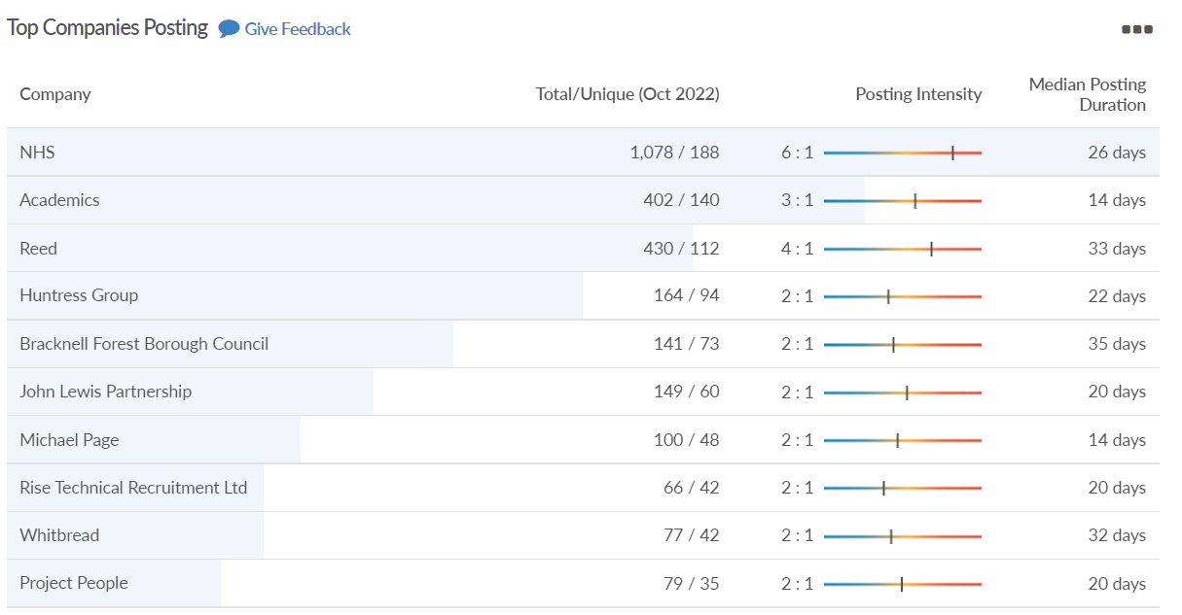
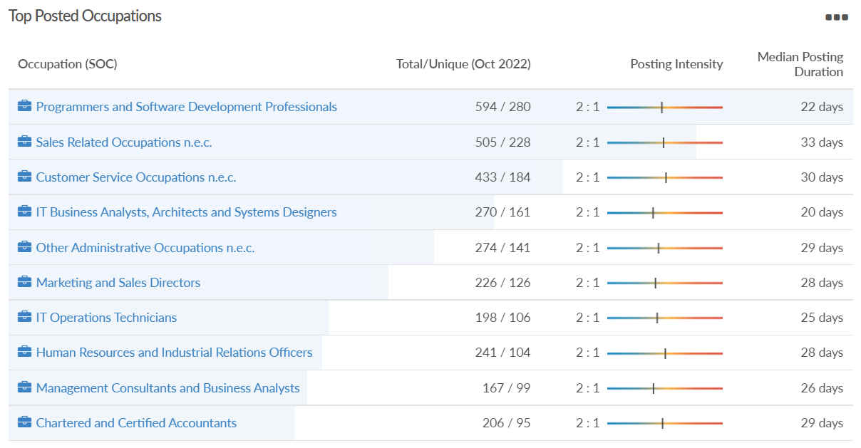
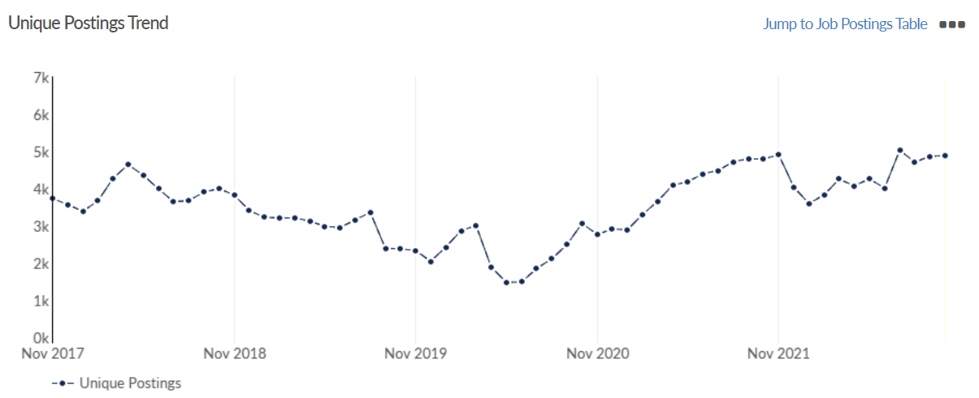
Job posting analytics
Source: EMSI, October 2022
Unique job postings: 4,887
Total job postings: 11,198
Job posting intensity: 2:1
Unique job postings (October 2021): 4,789

Slide 25
Reading

Slide 26
Unemployment figures and notable business news - October 2022
Claimant unemployment to October 2022 (latest)
4,410 claimants (4.2% of the working age population) in Reading UA
Notable business news:
‘Reading is a modern and forward-looking town which has grown into one of the most vibrant and economically significant urban centres in the country.’ This was just one of the headlines at the stakeholder launch of the new place brand for Reading which was unveiled at an immersive event to around 100 key stakeholders this week at the iconic Pavilion building on the Oxford Road. A large number of Reading organisations and businesses contributed to the showcase, including Purple Turtle, University of Reading Knowledge Transfer Centre, Occuity, Altitude Angels, Measurable Energy, Facilitation Partnership, Reading University Student Union, Reading Youth Council, Reading City of Sanctuary, Tutu’s Ethiopian Table and Ruchika’s Kitchen as well as many individuals who contributed to the films, audio recordings, facts, artifacts and in other ways. – LINK.

Slide 27
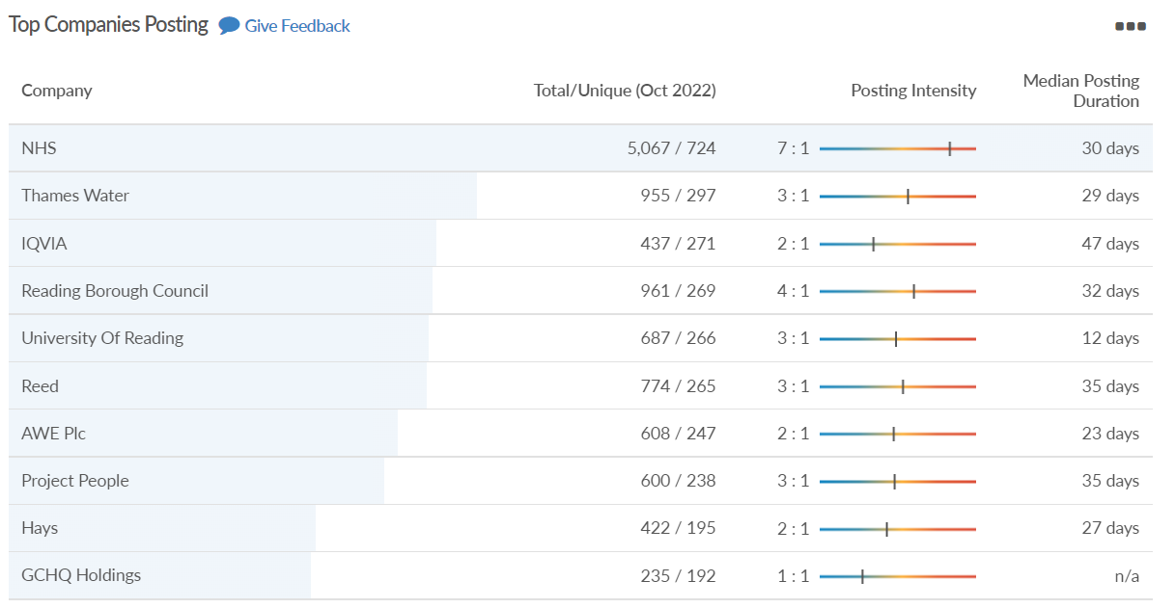
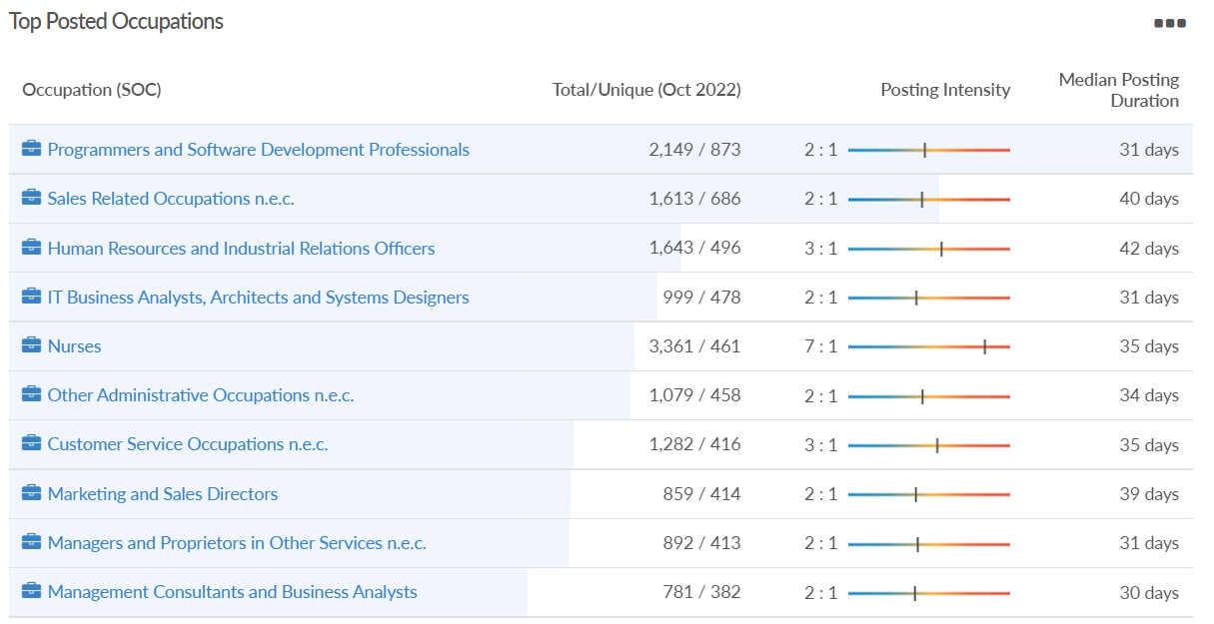
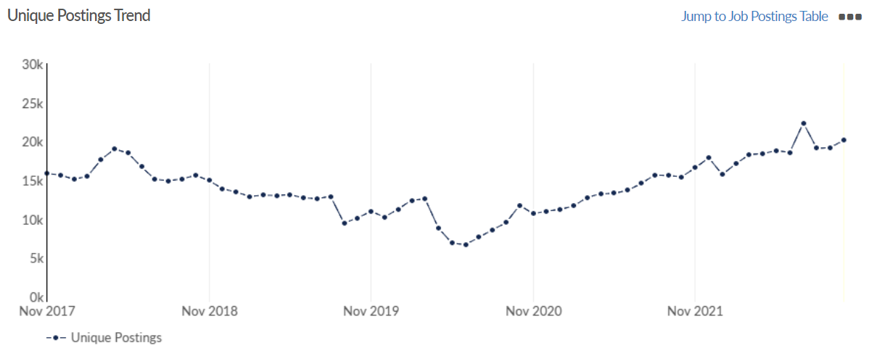
Job posting analytics
Source: EMSI, October 2022
Unique job postings: 20,171
Total job postings: 53,645
Job posting intensity: 3:1
Unique job postings (October 2021): 15,435

Slide 28
Slough

Slide 29
Unemployment figures and notable business news - October 2022
Claimant unemployment to October 2022 (latest)
4,845 claimants (5.1% of the working age population) in Slough UA
Notable business news:
Outline plans for the redevelopment of Slough's Queensmere shopping centre were approved by councillors. This included details such as the demolition plans and floorspace, with more detailed applications coming back at a later date, known as 'reserved matters’. Council officers had recommended the outline plans for approval subject to a number of conditions. The mixed-use scheme - which will be called Slough Central - will also feature pubs, wine bars and hot food takeaways, provision for a cinema and live music venue, while a multi-storey car park will have space for 685 vehicles. Developer British Land wants to eventually replace the complex with 1,600 homes, 40,000 sq. ft of offices and new space for shops and restaurants in what is planned to be a mass overhaul of the centre. The company aims to commence the demolition of the centre by late 2024. – LINK.

Slide 30
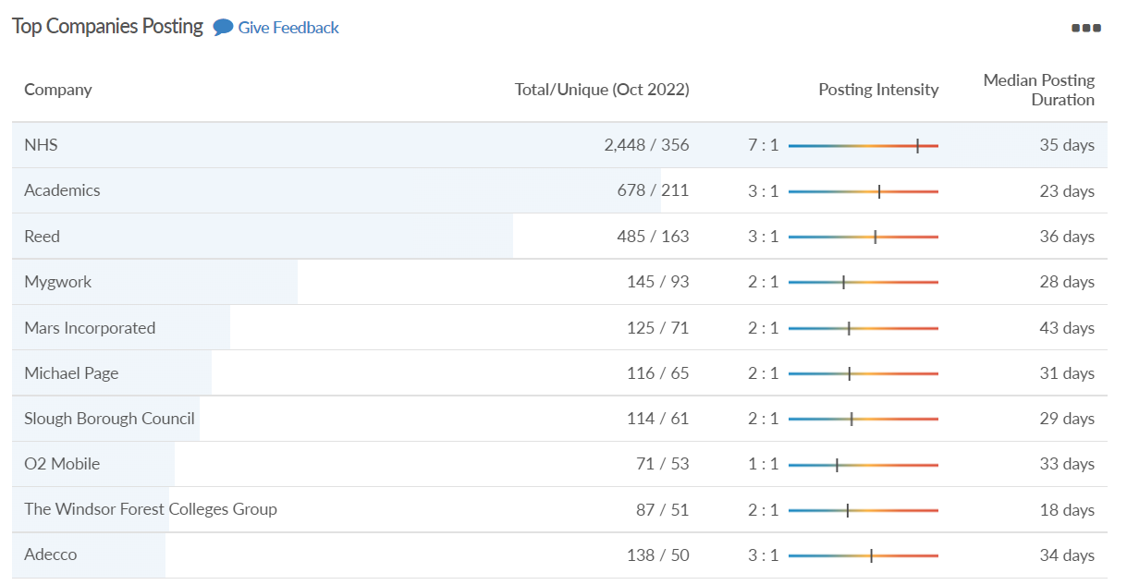
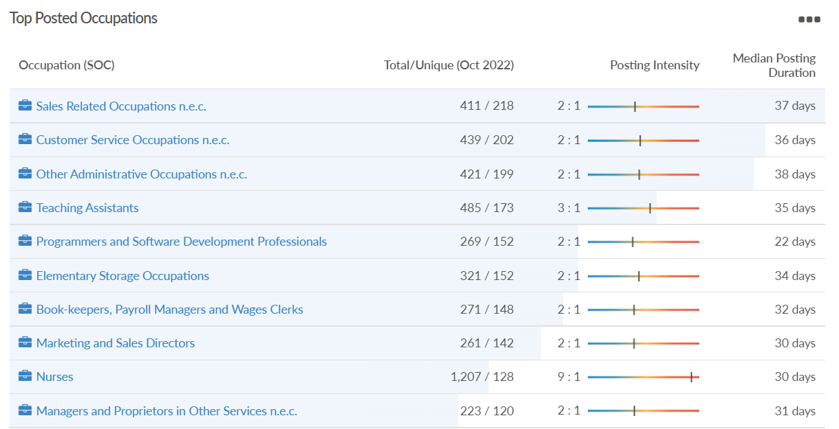
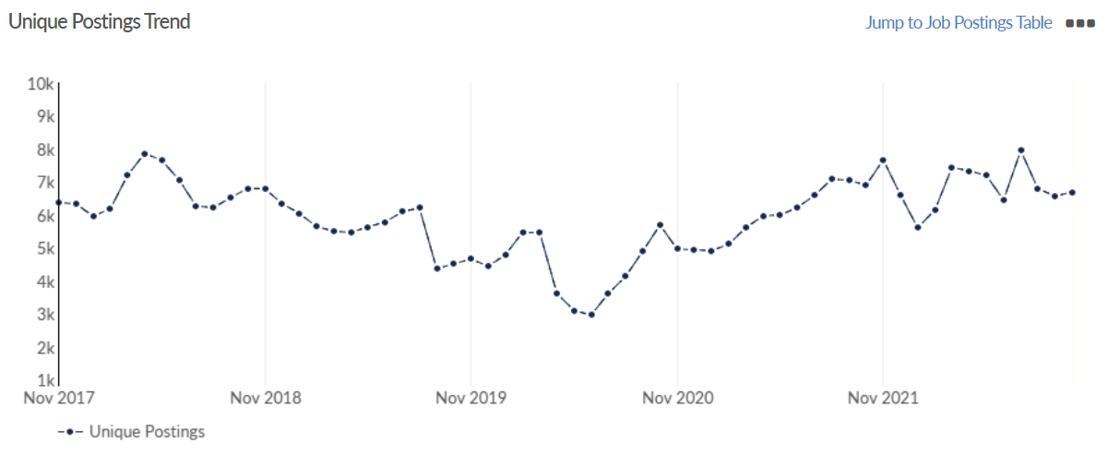
Job posting analytics
Source: EMSI, October 2022
Unique job postings: 6,689
Total job postings: 15,843
Job posting intensity: 2:1
Unique job postings (October 2021): 6,898

Slide 31
West Berkshire

Slide 32
Unemployment figures and notable business news - October 2022
Claimant unemployment to October 2022 (latest)
2,150 claimants (2.2% of the working age population) in West Berkshire UA
Notable business news:
It was recently announced that West Berkshire has been provisionally allocated a £597,994 share of the Rural England Prosperity Fund (REPF) - making it the only local authority in Berkshire to receive it. It is a top-up of the UK Shared Prosperity Fund, for the purpose of investing in capital projects in small businesses and community infrastructure in rural areas in order to improve productivity, connectivity and access to services. It is aimed at addressing the economic imbalances between rural and urban areas. – LINK.

Slide 33
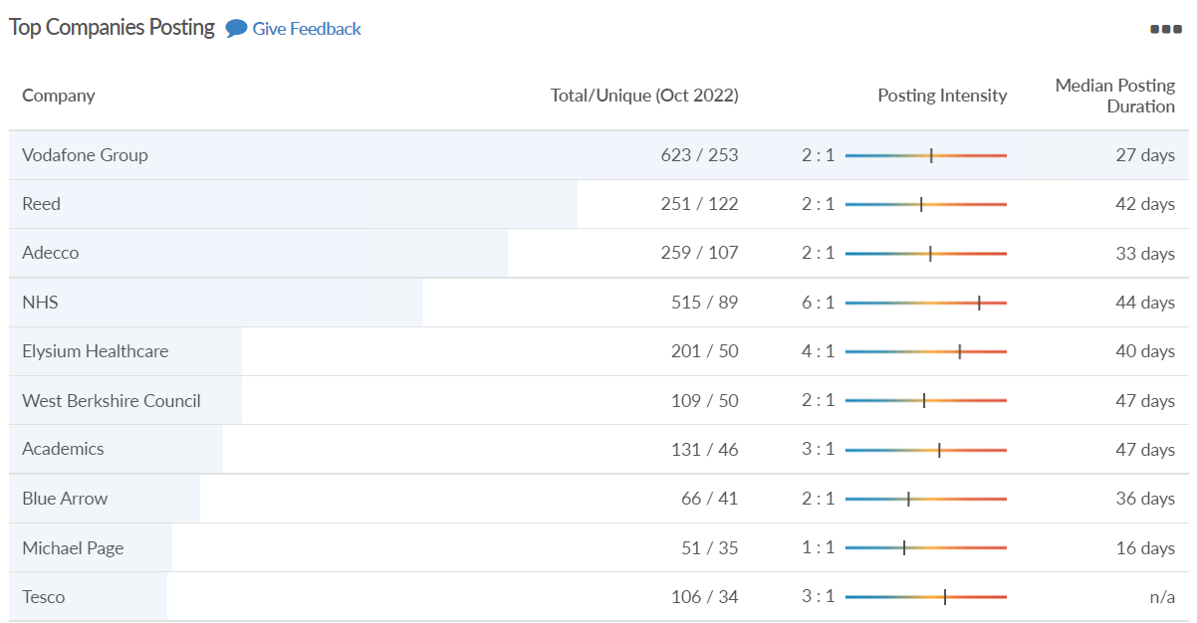
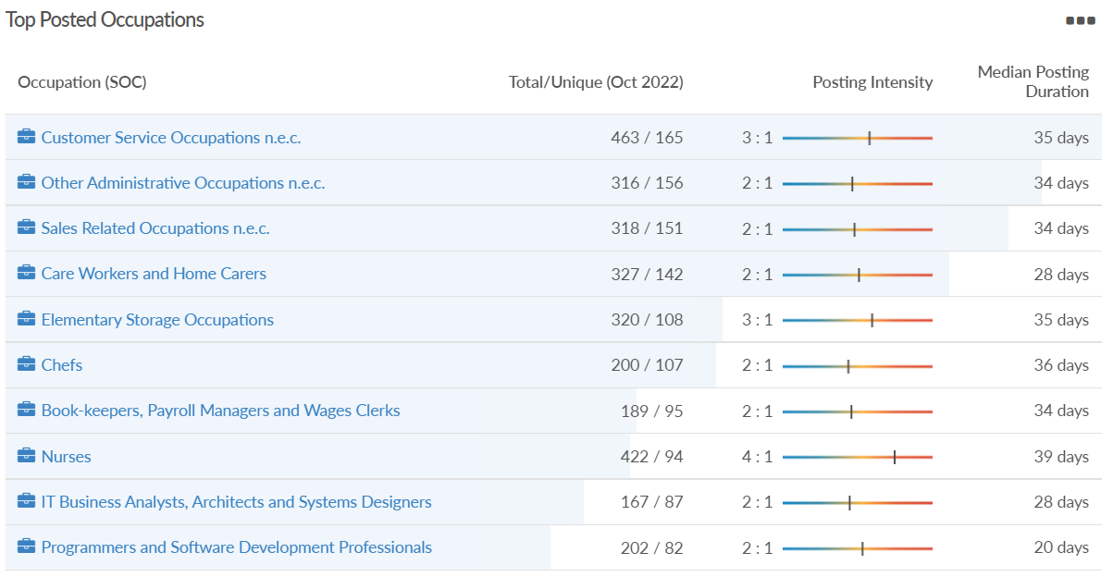
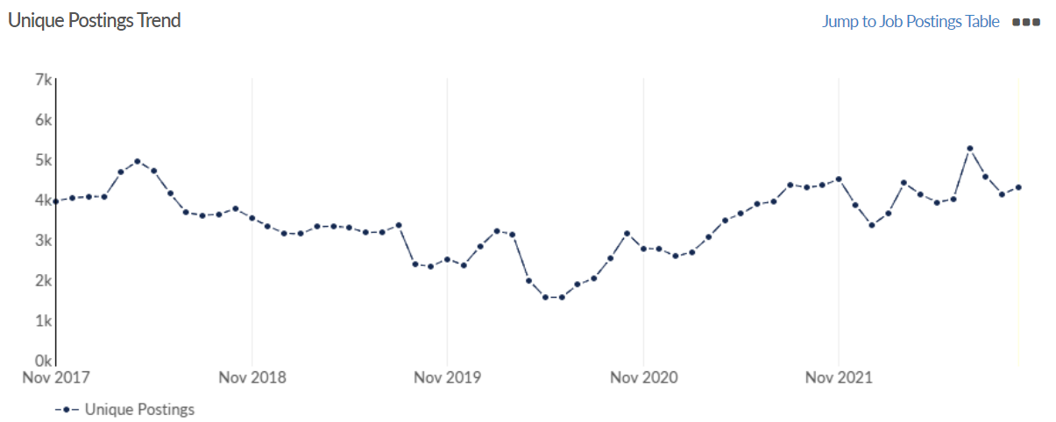
Job posting analytics
Source: EMSI, October 2022
Unique job postings: 4,295
Total job postings: 9,611
Job posting intensity: 2:1
Unique job postings (October 2021): 4,342

Slide 34
Windsor and Maidenhead

Slide 35
Unemployment figures and notable business news - October 2022
Claimant unemployment October 2022 (latest)
2,090 claimants (2.3% of the working age population) in Windsor and Maidenhead UA
Notable business news:
A Maidenhead-based co-working and office space firm has secured a £280,000 expansion loan as it looks to grow. MyWorkspot has been in operation in the area since 2017, providing flexible workspaces for established businesses, start-ups, and corporates. Its clients range from start-ups to employees of global brands including Google, Microsoft, Rack Space and Lexis Nexis. The company has been backed by the Thames Valley Berkshire Funding Escalator, which has helped it fit-out and launch a new site at York House in Maidenhead town centre. – LINK.

Slide 36
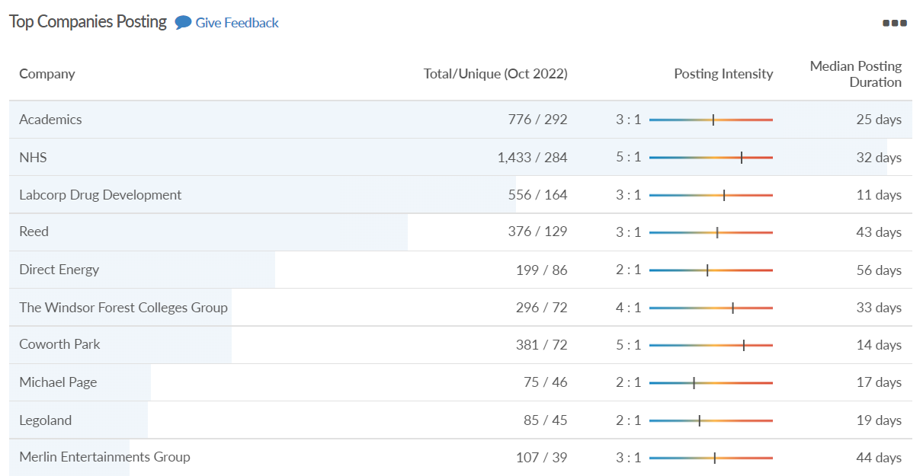
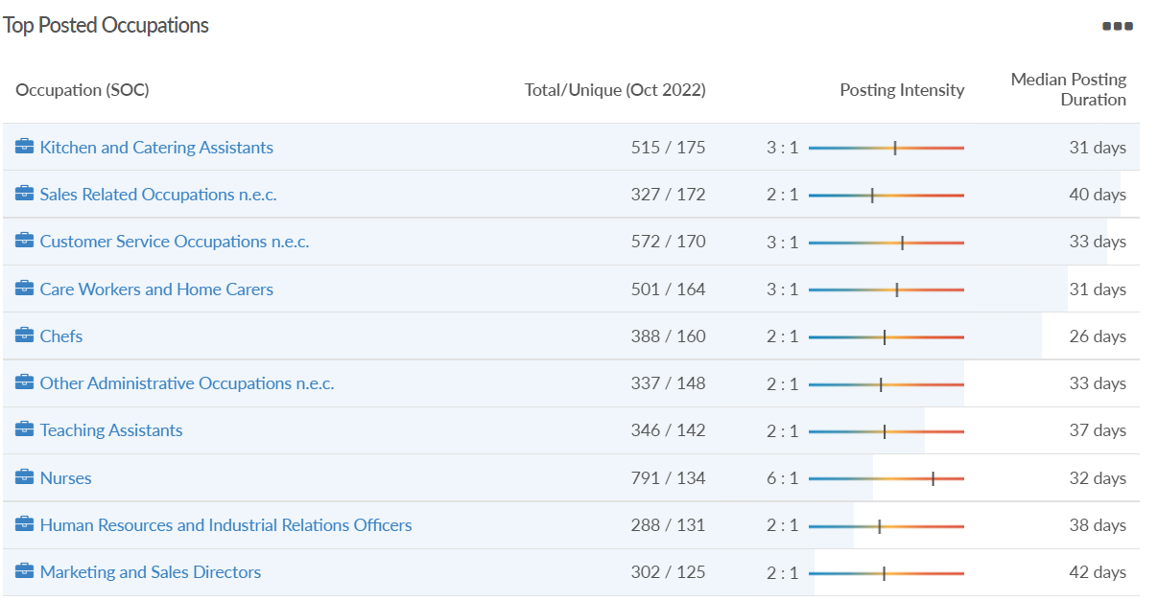
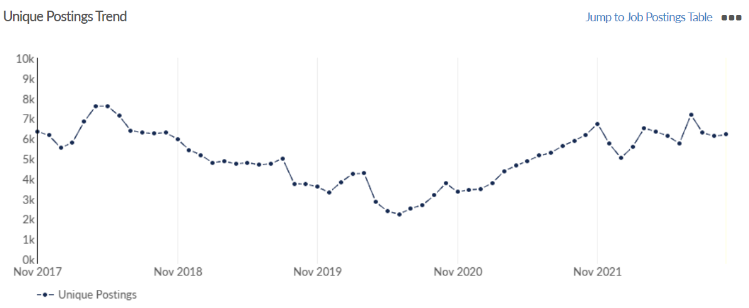
Job posting analytics
Source: EMSI, October 2022
Unique job postings: 6,199
Total job postings: 15,544
Job posting intensity: 3:1
Unique job postings (October 2021): 6,193

Slide 37
Wokingham

Slide 38
Unemployment figures and notable business news - October 2022
Claimant unemployment to October 2022 (latest)
1,750 claimants (1.6% of the working age population) in Wokingham UA
Notable business news:
Frasers Property (FPUK), who run Winnersh Triangle, has been awarded a four-star rating in the GRESB (Global Real Estate Sustainability Benchmark) rankings for the second year in a row for its work to ensure the estate meets some of the highest eco-standards. It says that in further recognition of its credentials in environmental sustainability and its commitment to reducing its carbon footprint across its property portfolio, FPUK was awarded an overall score of 83 – ahead of the average score in its peer group (69). And it scored 100% in the Management category, a first for the company. – LINK.

Slide 39
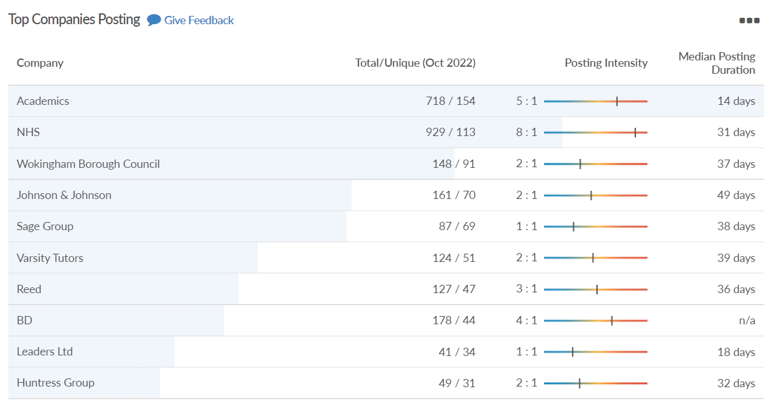
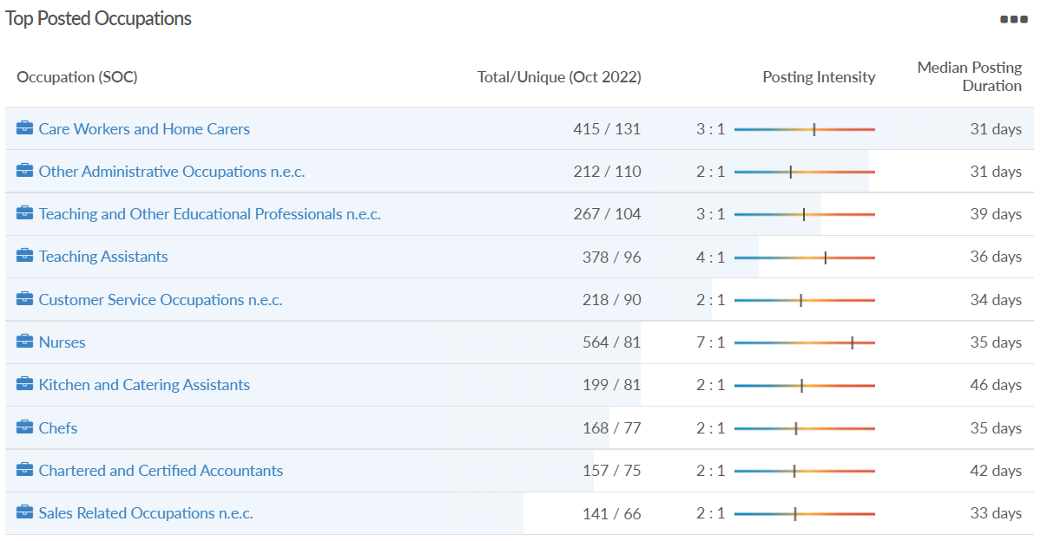
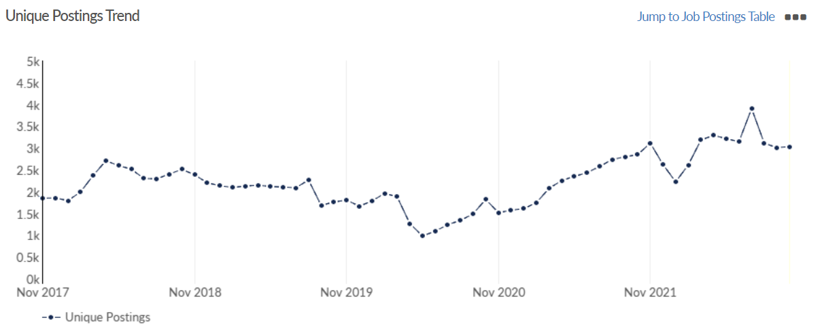
Job posting analytics
Source: EMSI, October 2022
Unique job postings: 3,033
Total job postings: 7,908
Job posting intensity: 3:1
Unique job postings (October 2021): 2,850

