Slide 1
Thames Valley Berkshire
Monthly Economic Briefing
July 2022

Slide 2
2022 Refresh
Following on from stakeholder feedback as well as discussions within the LEP over the course of the last year, we have decided to make some additions to the content of our economic briefings, whilst still continuing to report on the bulk of the areas we were last year.
Each month, we aim to have a themed feature. This month we will be reporting on ‘Stagnation Nation’, the interim report of the Resolution Foundation’s Economy 2030 inquiry.
These monthly economic briefings are constantly evolving documents and their content is dictated in part by data/information requests from our readers.
If there is an economic aspect not currently covered within these reports which you think would be beneficial to include/expand upon (or you have any queries), we will do our best to help. Please contact Dex in the LEP’s research team at dexterlevick@thamesvalleyberkshire.co.uk.

Slide 3
Key contents of this month’s briefing
Updated global and UK economic forecasts
Monthly Event Spotlight – ‘Stagnation Nation’, the interim report of the Resolution Foundation’s Economy 2030 inquiry.
Key points from the latest Labour Force Survey data
Latest claimant count figures by Local Authority
Latest remote working figures for Thames Valley Berkshire
Latest ‘notable business news’ by Local Authority
Latest job posting analytics by Local Authority

Slide 4
Global and National Economy
July 2022

Slide 5
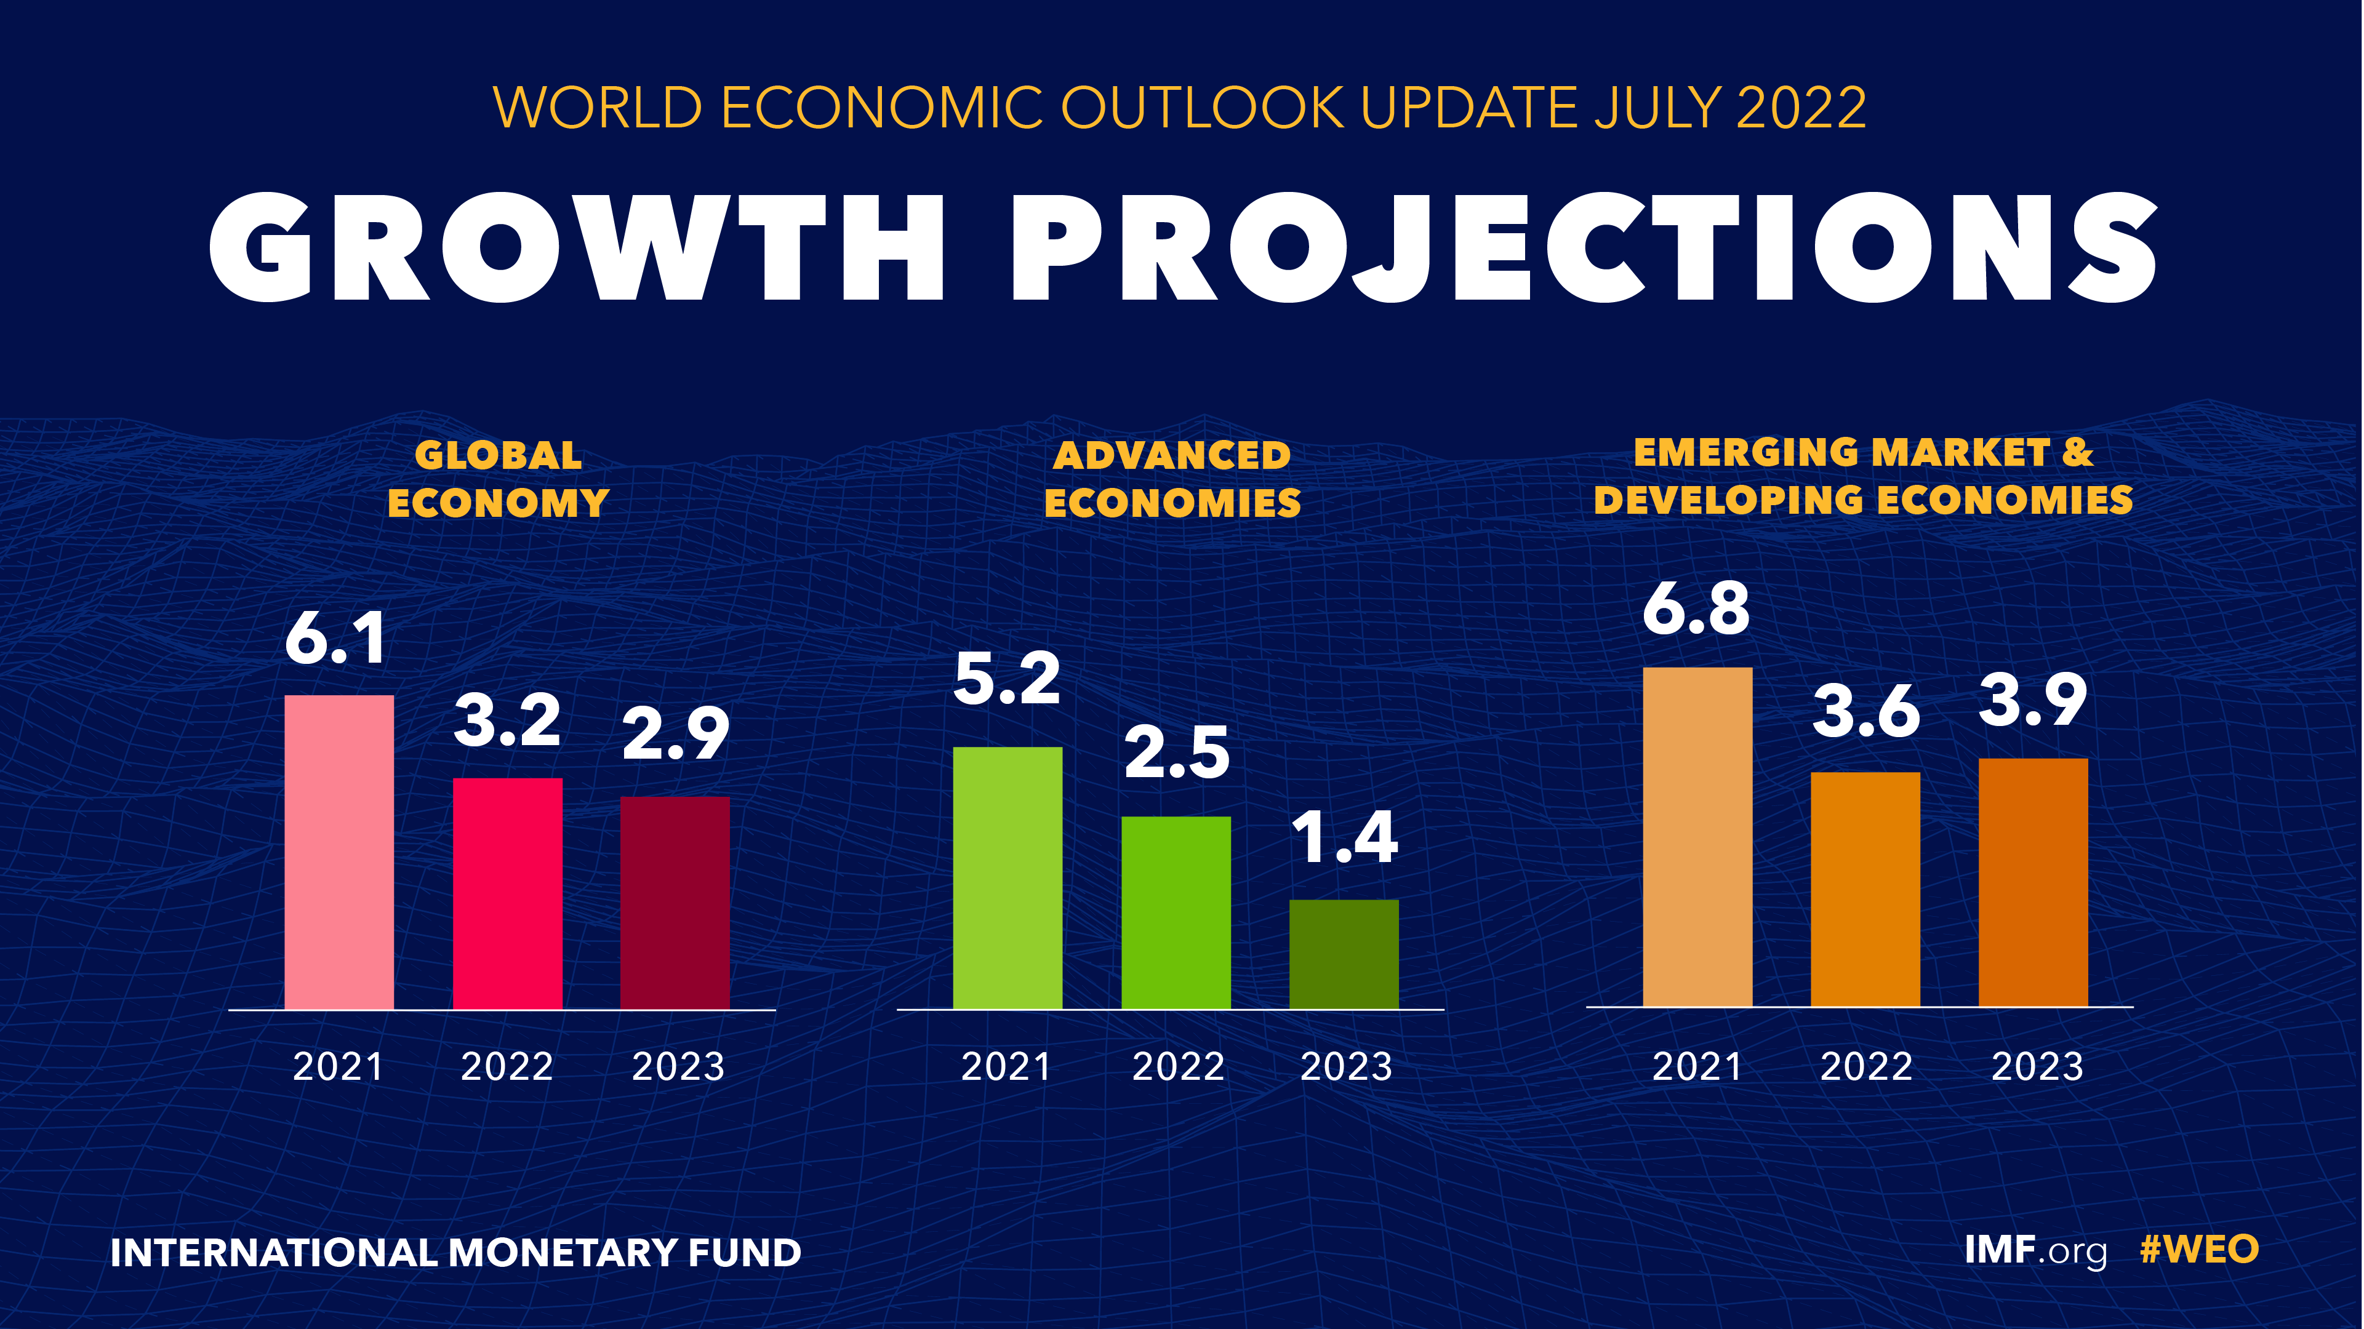
July 2022
IMF World Economic Outlook Update July 2022
A tentative recovery in 2021 has been followed by increasingly gloomy developments in 2022 as risks began to materialize.
Global output contracted in the second quarter of this year, owing to downturns in China and Russia, while US consumer spending undershot expectations.
Several shocks have hit a world economy already weakened by the pandemic: higher-than-expected inflation worldwide––especially in the United States and major European economies––triggering tighter financial conditions; a worse-than-anticipated slowdown in China, reflecting COVID- 19 outbreaks and lockdowns; and further negative spillovers from the war in Ukraine.
The baseline forecast is for growth to slow from 6.1 percent last year to 3.2 percent in 2022, 0.4 percentage point lower than in the April 2022 World Economic Outlook.
Source: IMF, July 2022

Slide 6
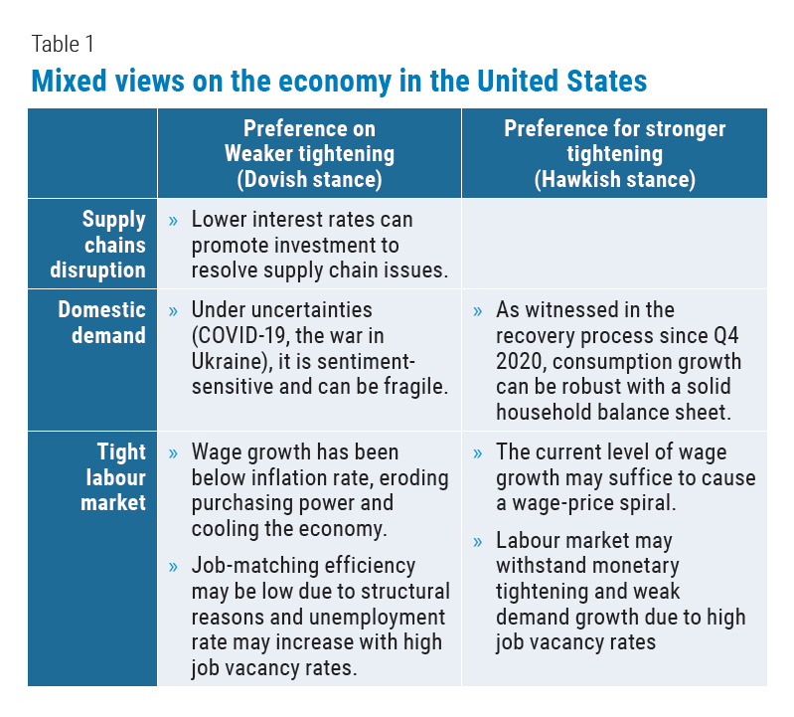
July 2022
UN World Economic Situation and Prospects July 2022
The global macroeconomic outlook continues to change amid growing uncertainties, pronounced monetary policy tightening and volatile financial markets.
The US dollar markets are likely to remain volatile in the near terms as market participants remain divided about whether monetary tightening would rein in inflation.
The turbulent bond market in the United States and rising yield spreads pose significant challenges to developing countries, especially to those highly vulnerable to any additional external shock.
Source: UN, July 2022

Slide 7
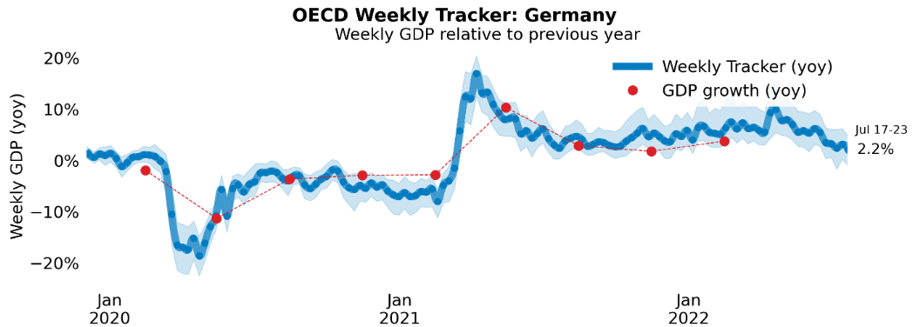
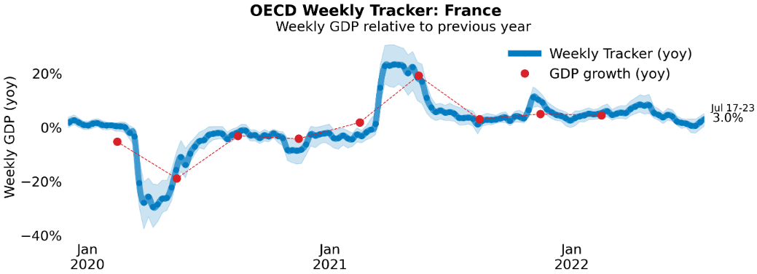
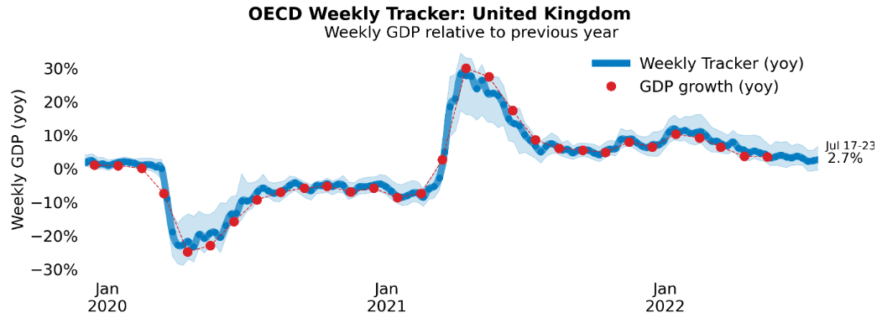
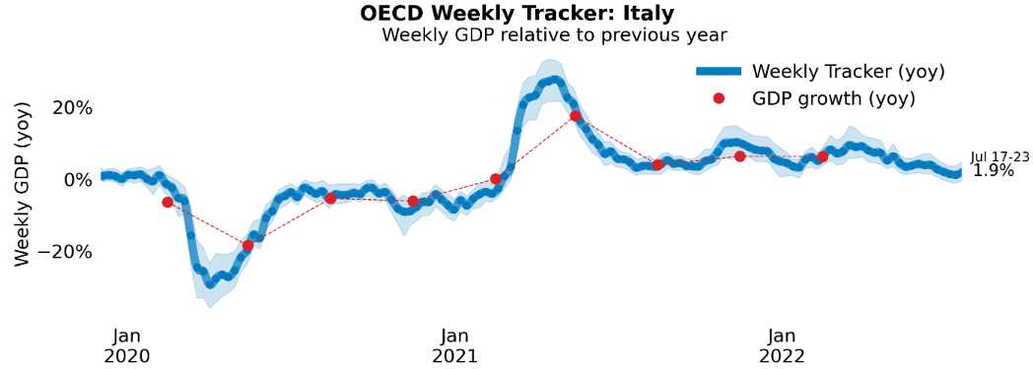
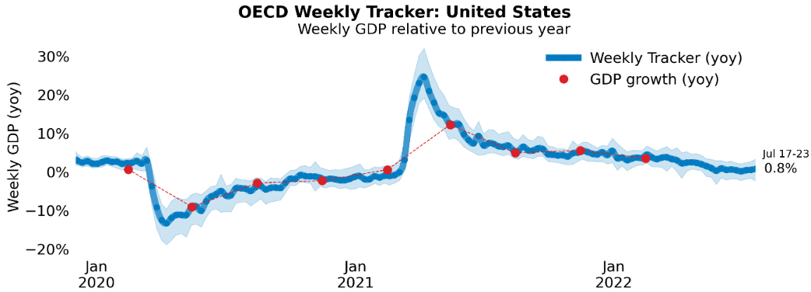
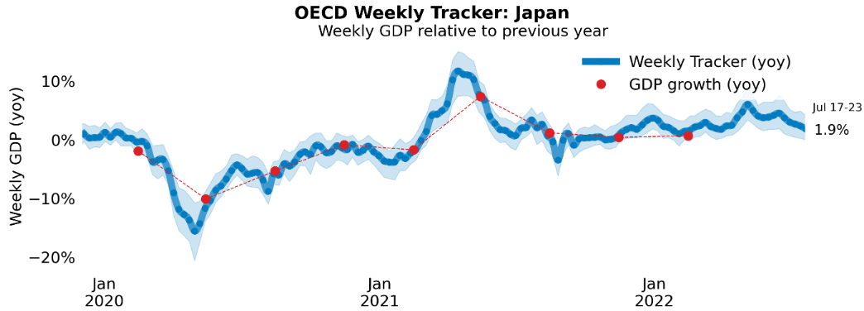
Global Economy
OECD GDP Tracker
The Weekly Tracker is an estimate of weekly GDP relative to the pre-crisis trend, which is proxied by the OECD Economic Outlook forecasts.
Source: OECD, July 2022

Slide 8
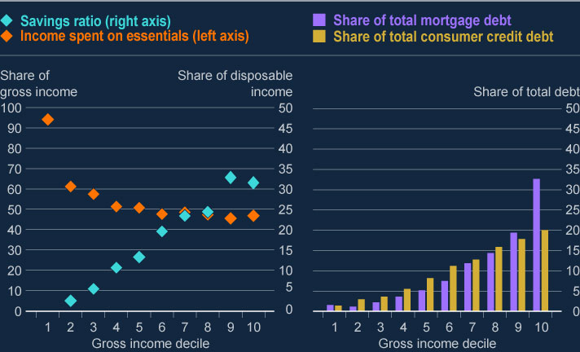
Bank of England Financial Stability Report – July 2022
Global economic conditions have worsened. This puts pressure on the finances of households and businesses
Prices of essential goods such as food and energy have risen sharply in the UK and globally, and the outlook for growth has worsened. This is largely a result of Russia’s illegal invasion of Ukraine.
Like other central banks around the world, we have increased interest rates to help slow down price increases. Markets have been volatile and financing conditions have tightened.
These higher prices, weaker growth and tighter financing conditions will make it harder for households and businesses to repay or refinance debt. Given this, we expect households and businesses to become more stretched over coming months. They will also be more vulnerable to further shocks.
Source: Bank of England, July 2022
Notes:
data

Slide 9
British Chambers of Commerce: Confidence drains from UK companies as economic woes mount – July 2022
British companies have turned increasingly glum about the outlook, with inflation surging and investment plans looking stagnant, according to the latest business survey that shows momentum rapidly draining from the economy.
The British Chambers of Commerce (BCC) said 54% of more than 5,700 companies it surveyed between May 16 and June 9 expected turnover to increase over the next 12 months. This is down from 63% in the previous survey and the lowest share since late 2020, when many businesses were under some form of COVID restrictions.
A record 65% of companies said they planned to raise their prices in the next three months. Forecasters like the IMF and OECD think Britain will be hit harder by rising prices than other countries.
Three quarters of firms said they had no plans to increase investment, and most no longer expected profits to rise.
A survey published by S&P Global on Friday showed reports of rising costs were more widespread among British manufacturers than anywhere else in Europe.
Source: Reuters, July 2022
Notes:
Data source

Slide 10
Monthly Spotlight: Stagnation Nation
July’s Monthly Spotlight reports on ‘Stagnation Nation’, the interim report of the Resolution Foundation’s Economy 2030 inquiry.
A conference to discuss the initial findings of the ‘Stagnation Nation’ report took place in London on 13 July.
The conference was broken into key themes, covering: the risk of stagnation; the decisive decade; and towards a renewed economic strategy for the 2020s.
The following slides capture some key points from the presentations and discussion, many of which have implications for the Berkshire economy.

Slide 11
Monthly Spotlight: Stagnation Nation
The risk of stagnation
Economic growth is essential; 0.1 per cent of growth makes everything better. We do not invest enough, both public and private sectors. We are heading towards a world where everybody will need to have a tertiary education in order to have a good life. Not necessarily university, but certainly in addition to secondary schools. (Minouche Shafik, London School of Economics)
Flexible labour markets are double-edged swords. France has higher levels of investment because they have inflexible labour markets - they invest in automation to avoid employing workers if possible.
Two significant occupational effects of the move to net zero; about 200,000 in maintenance and repair of vehicles will go, and we will need about the same number of plumbers and electricians to install heat pumps. Those changes are not particularly regionally concentrated.
To address the gap between the poor and the middle, we need to focus on the specific things that make people poor; energy prices, transport to work, disability. (Adair Turner, former Director General of the CBI)

Slide 12
Monthly Spotlight: Stagnation Nation
The decisive decade
There are three big trends this decade - Brexit, covid and net zero.
We think of advanced economies growing by growing the pie, but with UK inequality, we have the potential to catch up by equalising income across distributions and across regions. Services economy is intangible; not as rooted in place as manufacturing.
Why is UK business investment so low? The answers are: uncertainty and skills. We can’t produce more electric cars without more charging points in garages. The private sector can build charging points if regulation allows - that’s what we call ‘crowding in’.
People is the most important part of making local development work. Labour is not just about skills, but also about quantity. Those leaving labour force after Covid is a massive challenge. (Linda Yueh, Fellow in Economics, Oxford University)
Why do things happen in certain places? Lots of economic geography literature shows it happens there because ‘there’ is a nice place to be. (Nicholas Stern, Professor of Economics and Government, LSE)

Slide 13
Monthly Spotlight: Stagnation Nation
Towards a renewed economic strategy for the 2020s
Three things government could do: stop the policy churn and change; do fewer bigger things. restore some of the openness in the British economy. We need to fix our relationship with EU and resolve our relationships with emerging countries, such as China and Middle East. (Caroline Fairbairn, former Director General of the CBI)
Mega view is the performance of UK economy for much of period since WW2 shows we have neither strength of US businesses nor the common-sense policy making of social market economies. We need to raise the investment rate. We also need to raise savings - we can’t raise investment otherwise. And we need a serious unit trying to find a growth strategy. What will the world look like in 10 years time and what should we be doing to prepare for it? (Martin Wolf, Chief Economics Commentator, Financial Times)
A care worker faces poor pay and conditions wherever you are in the country. Inequality and poverty is not just a symptom but a driver of a broken economy. During the pandemic, many of us learned the true value of labour. We need an extension of collective bargaining, sectoral fair pay agreements, corporate governance reform and a proper industrial strategy. (Frances O’Grady, General Secretary, TUC)

Slide 14
Monthly Spotlight: Stagnation Nation
Implications for Berkshire Economy
The move to net zero will change the nature of some industries, but it will not be regionally concentrated, as was the case with deindustrialisation. This means that all communities will be affected but, with the right strategy, will also have the opportunity to create new jobs.
If the literature around economic geography shows that things happen in certain places because those are ‘nice’ places to be, this gives Berkshire, with its access to natural beauty and the countryside, an advantage.
Resolving our relationships with the EU and with emerging countries would benefit Berkshire, as the gateway to ‘Global Britain’ and with our international connections.
Martin Wolf asks: What will the world look like in 10 years time and what should we be doing to prepare for it? Berkshire LEP is asking exactly this question through our Berkshire Futures workstream.

Slide 15
Employment in the UK
Labour Force Survey – July 2022
Key points:
March to May 2022 estimates show a fall in the economic inactivity rate, particularly among those that said they did not want a job, and in the unemployment rate, with a corresponding increase in the employment rate, when compared with the previous three-month period (December 2021 to February 2022).
Total hours worked increased compared with the previous three-month period but are still just below pre-coronavirus (COVID-19) pandemic levels.
The UK employment rate was estimated at 75.9%, 0.4 percentage points higher than the previous three-month period but 0.7 percentage points lower than before the coronavirus pandemic (December 2019 to February 2020).
The UK unemployment rate was estimated at 3.8%, 0.1 percentage points lower than the previous three-month period, and 0.2 percentage points below pre-coronavirus pandemic levels.
The UK economic inactivity rate was estimated at 21.1%, 0.4 percentage points lower than the previous three-month period, but 0.9 percentage points higher than before the coronavirus pandemic.
Source: ONS, July 2022

Slide 16
Economic and Labour Market Insight: Implications for Thames Valley Berkshire

Slide 17
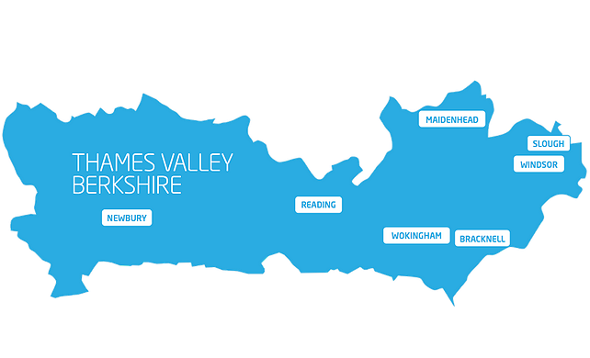
Claimant Count (Latest data - June 2022)
Total of 17,065 claimants (3% of the working age population) in Thames Valley Berkshire
1,600 claimants (2% of the working age population) in Bracknell Forest UA
5,200 claimants (5.5% of the working age population) in Slough UA
4,365 claimants (4.1% of the working age population) in Reading UA
1,635 claimants (1.5% of the working age population) in Wokingham UA
2,200 claimants (2.4% of the working age population) in Windsor and Maidenhead UA
2,060 claimants (2.1% of the working age population) in West Berkshire UA
Across Thames Valley Berkshire, claimant unemployment has fallen significantly from 25,310 in June 2021 to 17,065 in June 2022. Slough had 5.5% of its working age population claim unemployment in June 2022, down significantly from 7.5% in June 2021.
Source: ONS, July 2022

Slide 18
Strategic Issues
Global airlines chief slams new Heathrow restrictions
The head of a body representing global airlines hit out at new restrictions at London's Heathrow on Tuesday, saying the airport had under-estimated the speed of the recovery and was focused on profits at the expense of airlines that must now foot the bill.
Willie Walsh, director general of the International Air Transport Association (IATA), and a former head of Heathrow's biggest operator British Airways (BA), panned moves to tell airlines to restrict the number of seats they sell to try to limit summer disruption.
Heathrow rejected Walsh's comments - “aviation is under considerable pressure as demand ramps up - at Heathrow we've faced 40 years of growth in just four months and what we need is collaborative working and investment in services to protect passengers, not ill-informed comments from retired airline bosses," a spokesperson said.
The clash comes as the industry is recovering from a travel slump that drove UK traffic down to just 3% of normal levels at the low point in early 2020, according to IATA's estimates.
Source: Reuters, June 2022

Slide 19
An important note on the EMSI figures contained on the following slides: 20, 24, 27, 30, 33, 36 and 39
From February 2022, there has been a methodological change in how EMSI calculates job posting figures compared to those from prior months following a merger between EMSI and Burning Glass Technologies (rebranding to Lightcast).
Those of you who have read previous economic briefings from Thames Valley Berkshire LEP may notice that the job posting figures contained in post-January 2022 briefings are lower across the board – in some cases quite significantly.
This change in methodology does not invalidate previous figures, but it is important to consider when reporting on job posting data longitudinally.

Slide 20
Remote working
In July of 2022, there were 4,254 unique job postings for remote positions at companies based in Berkshire, around 33% more than the figure of 3,204 for the same period one year before.
Compare this with the South-East, in July 2022 there were 20,204 unique remote job postings for remote positions; rising from 15,627 in June of the previous year – an increase of over 29%.
A rise can also be seen at national level, with a recorded 164,106 unique remote job postings in England in July of 2022, rising from 106,020 in July 2021 – an increase of circa 55%.
From these figures it’s apparent that the COVID-19 pandemic has, somewhat unsurprisingly, prompted a massive boost in job postings for explicitly remote roles. Berkshire has seen a smaller boost in vacancies which are remote-based than England, but a larger one than in the South East overall.
Source: EMSI, July 2022

Slide 21
Local Profiles

Slide 22
Bracknell Forest

Slide 23
Unemployment figures and Notable Business News - July 2022
Claimant unemployment to June 2022 (latest)
1,600 claimants (2% of the working age population) in Bracknell Forest UA
Notable business news:
Bracknell Forest Giants win prestigious placemaking award: industry experts agreed that the Bracknell Forest Giants, which captured the hearts and imaginations of Bracknell town visitors last August, were the worthy winners of a prestigious Pineapple Award. Launched in 2019 by The Developer in partnership with Design Council, The Pineapples awards are unique in seeking to celebrate great places. They are awards that look for places that thrive, where people want to live, work, play, shop or learn. Bracknell Forest Council and The Lexicon were proud to submit an entry for last year’s event and humbled to have scooped the award for Activation – LINK.
Note: The LEP has been previously reporting on COVID-19 case rates in these monthly economic briefings. The dashboards containing this data have been shut down as of this month and, as a result, we will no longer be doing so.

Slide 24
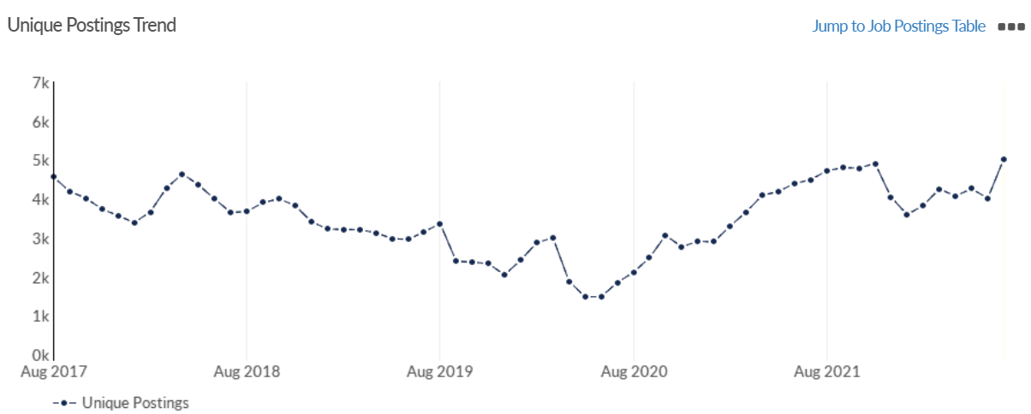
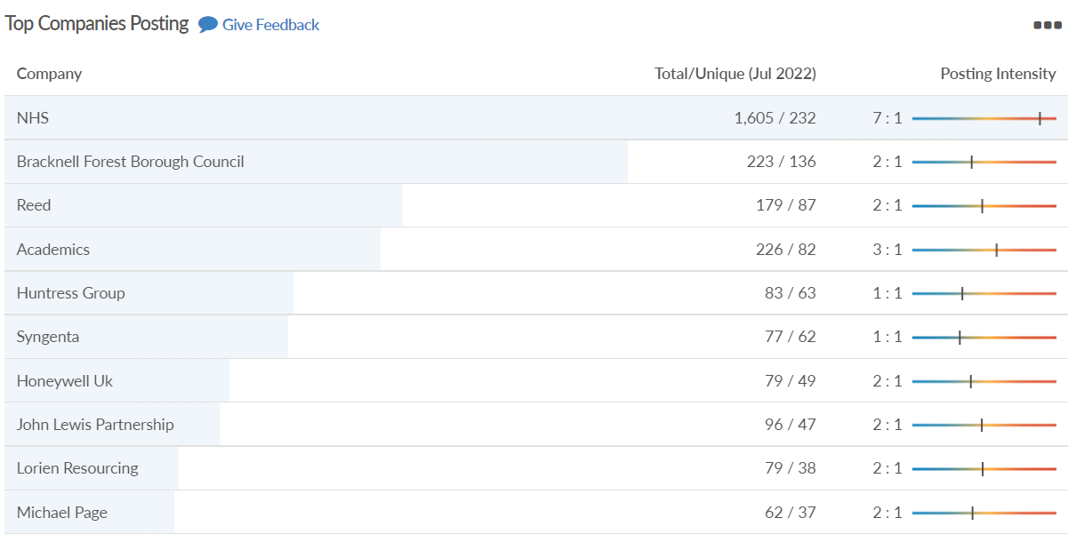
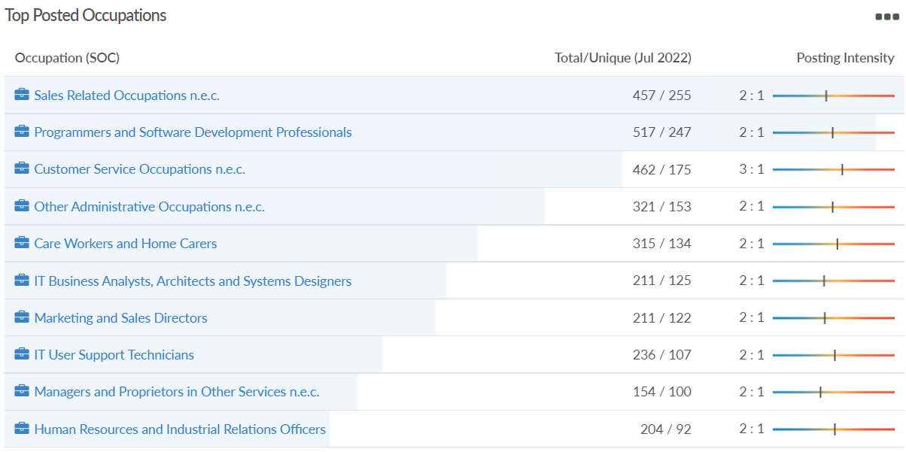
Job posting analytics (EMSI, July 2022)
Unique job postings: 5,025
Total job postings: 10,793
Job posting intensity: 2:1
Unique job postings (July 2021): 4,484

Slide 25
Slough

Slide 26
Unemployment figures and Notable Business News - July 2022
Claimant unemployment to June 2022 (latest)
5,200 claimants (5.5% of the working age population) in Slough UA
Notable business news:
SEGRO – the owner, developer and manager of the Slough Trading Estate – has officially launched its Community Investment Plan for Slough which will provide over £380,000 of investment during 2022 in skills, employment, environmental and economic programmes, benefitting more than 3,500 local people in Slough – LINK.
Note: The LEP has been previously reporting on COVID-19 case rates in these monthly economic briefings. The dashboards containing this data have been shut down as of this month and, as a result, we will no longer be doing so.

Slide 27
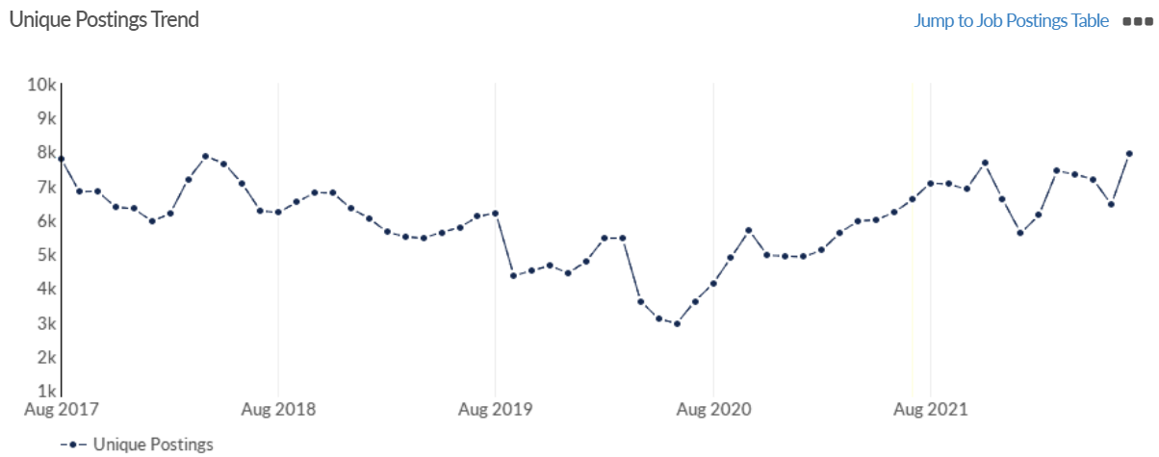
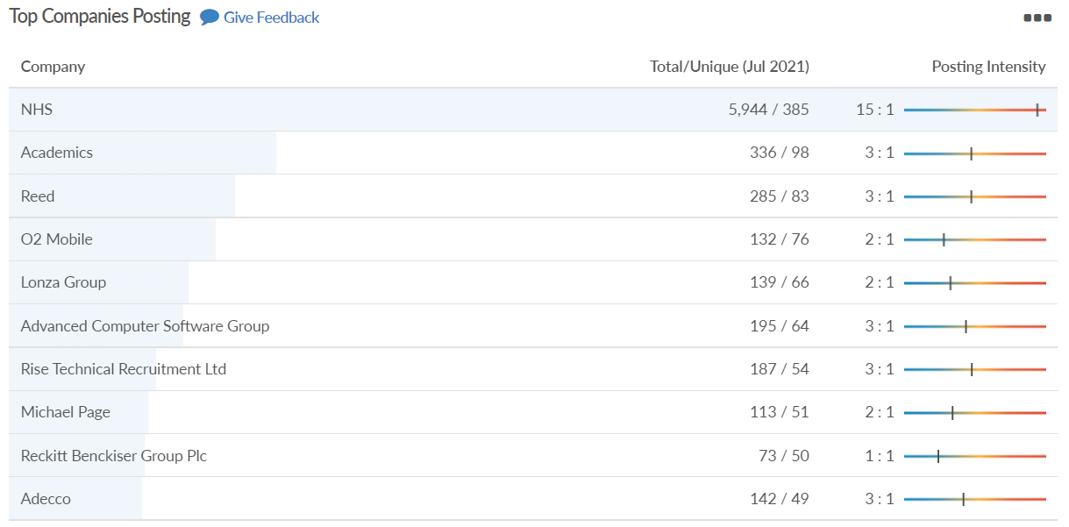
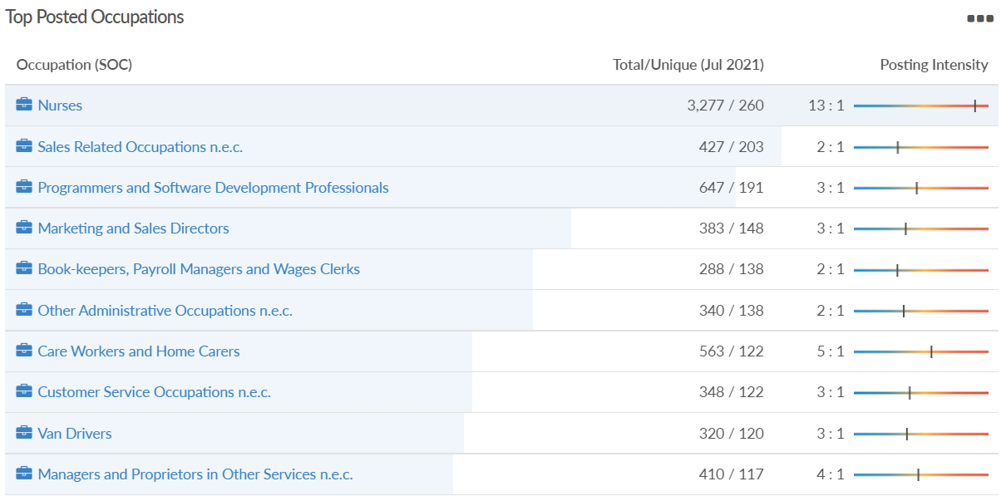
Job posting analytics (EMSI, July 2022)
Unique job postings: 7,949
Total job postings: 17,633
Job posting intensity: 2:1
Unique job postings (July 2021): 6,587

Slide 28
Reading

Slide 29
Unemployment figures and Notable Business News - July 2022
Claimant unemployment to June 2022 (latest)
4,365 claimants (4.1% of the working age population) in Reading UA
Notable business news:
Reading’s Shinfield Studios has secured £261 million in debt finance to construct the second phase of its development. The investment, which was secured by Shinfield Studios’ law firm Farrer & Co from Cain International, will fund the continued construction of the 18-stage project. The 85,000 square metre site will also host workshops, offices and facilities for cast and crew. It is expected to become a community hub, creating around 3,000 jobs in the area. Four temporary soundstages have already been completed and are let to high-end streaming and film companies including Disney, which is expected to run a major production from the site in late 2022 – LINK.
Note: The LEP has been previously reporting on COVID-19 case rates in these monthly economic briefings. The dashboards containing this data have been shut down as of this month and, as a result, we will no longer be doing so.

Slide 30
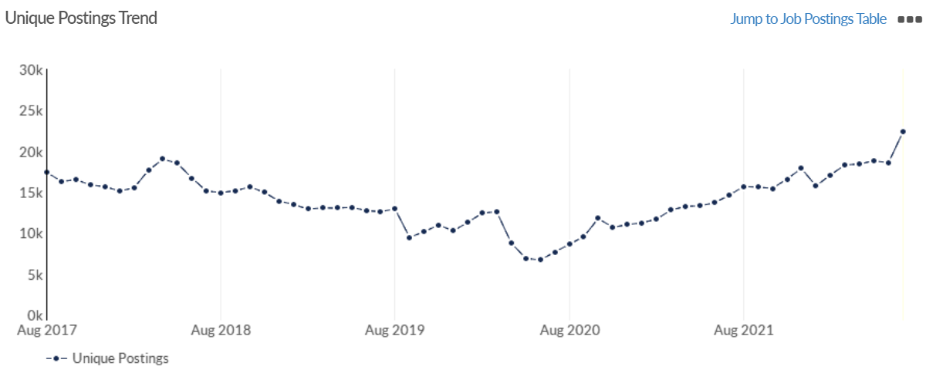
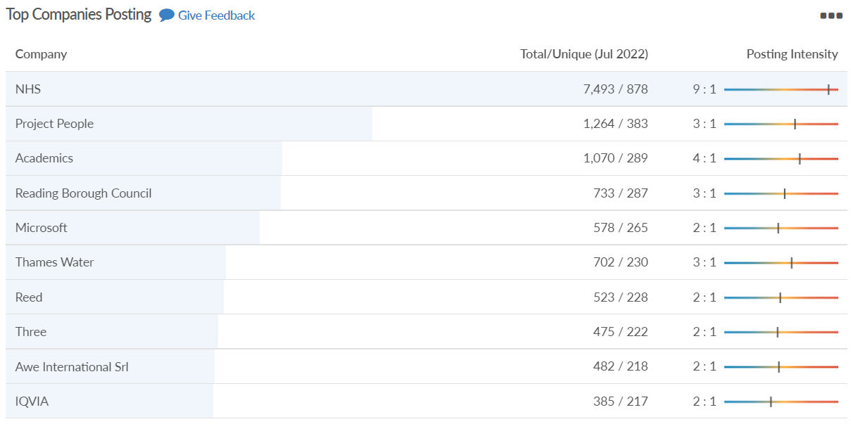
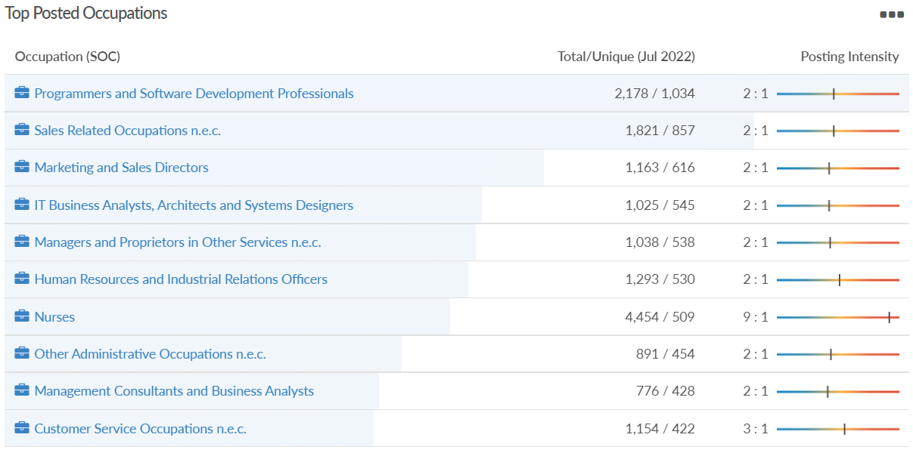
Job posting analytics (EMSI, July 2022)
Unique job postings: 22,364
Total job postings: 52,316
Job posting intensity: 2:1
Unique job postings (July 2021): 14,565

Slide 31
Wokingham

Slide 32
Unemployment figures and Notable Business News - July 2022
Claimant unemployment to June 2022 (latest)
1,635 claimants (1.5% of the working age population) in Wokingham UA
Notable business news:
Flexiss Group has opened of its first Net Zero carbon operating store for Legal & General at its newest site in Wokingham under the SureStore brand. The store on Molly Millars Lane covers a 1.5-acre brownfield site and will offer more than 50,000 sq ft of space. SureStore already has ten stores in Bolton, Cannock, Northwich, Bury, Lichfield, Stafford, Wigan, Burton, Trafford and Ashton-Under-Lyne, and has plans to expand with seven further locations due to open in the next 15 months – LINK.
Note: The LEP has been previously reporting on COVID-19 case rates in these monthly economic briefings. The dashboards containing this data have been shut down as of this month and, as a result, we will no longer be doing so.

Slide 33
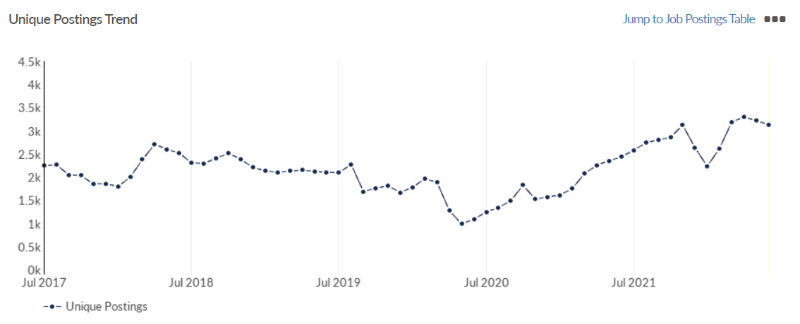
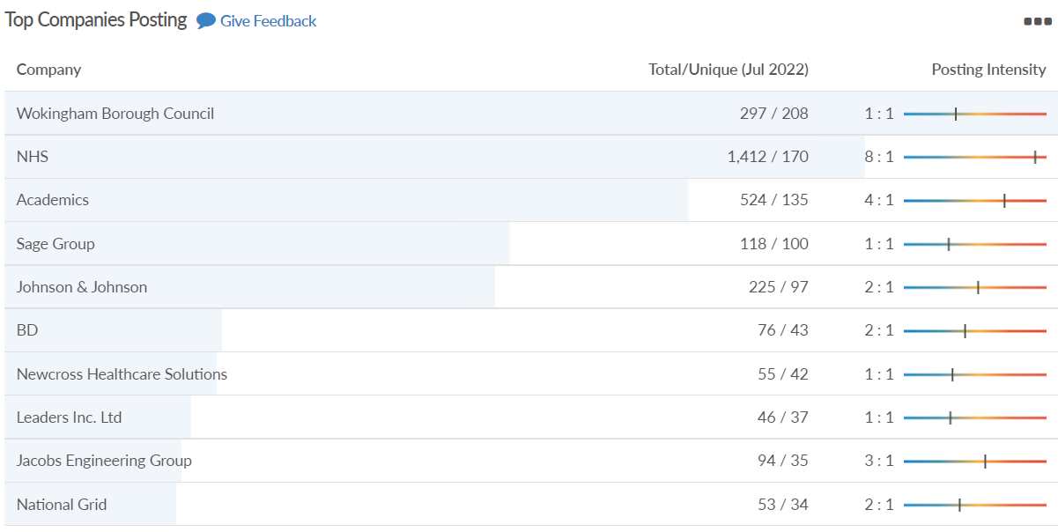
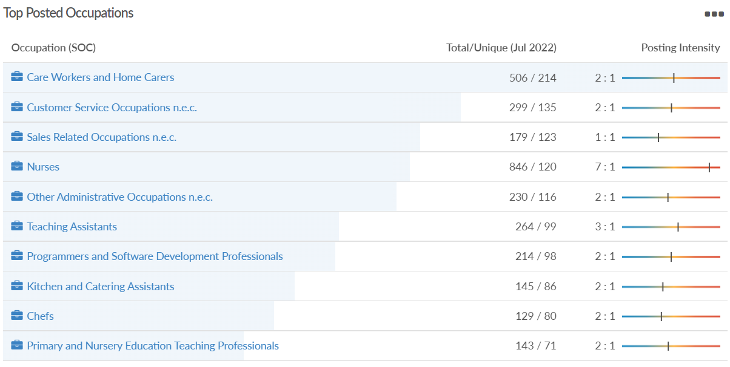
Job posting analytics (EMSI, July 2022)
Unique job postings: 3,911
Total job postings: 8,531
Job posting intensity: 2:1
Unique job postings (July 2021): 3,280

Slide 34
Windsor and Maidenhead

Slide 35
Unemployment figures and Notable Business News - July 2022
Claimant unemployment June 2022 (latest)
2,200 claimants (2.4% of the working age population) in Windsor and Maidenhead UA
Notable business news:
Maidenhead Festival: The 2022 two-day Maidenhead Festival took place over the weekend of 23rd & 24th July. The family-focused event featured music, fairground, stalls and side shows. The festival was centred around Kidwells Park but aimed to involve the whole of the town and local community. Admission was free over the weekend with charges applying to refreshments and some activities – LINK.
Note: The LEP has been previously reporting on COVID-19 case rates in these monthly economic briefings. The dashboards containing this data have been shut down as of this month and, as a result, we will no longer be doing so.

Slide 36
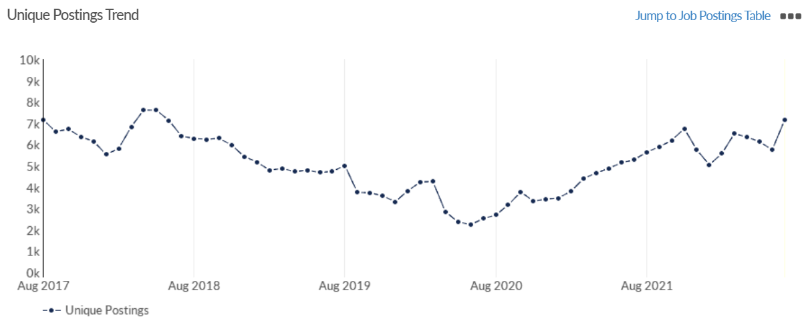
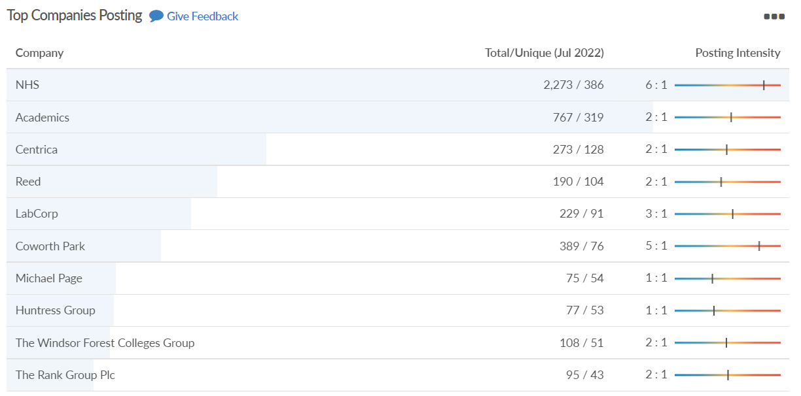
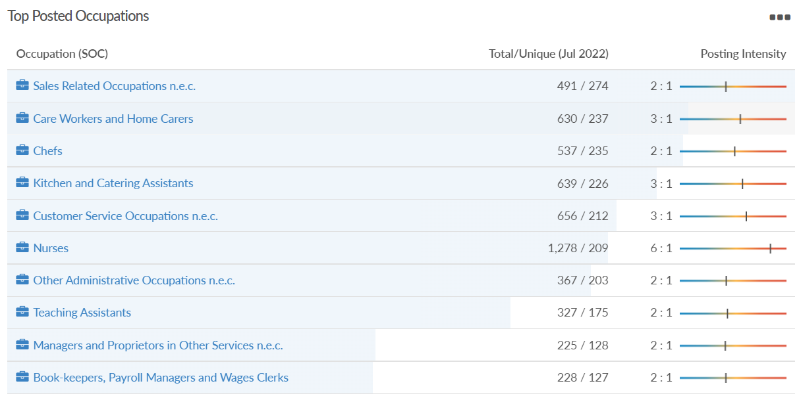
Job posting analytics (EMSI, July 2022)
Unique job postings: 7,181
Total job postings: 15,688
Job posting intensity: 2:1
Unique job postings (July 2021): 5,288

Slide 37
West Berkshire

Slide 38
Unemployment figures and Notable Business News - July 2022
Claimant unemployment to June 2022 (latest)
2,060 claimants (2.1% of the working age population) in West Berkshire UA
Notable business news:
iCollege in Calcot is to undergo a £2 million redevelopment, enlarging the offered learning provision. It is a West Berkshire Council service provided for children and young people unable to access mainstream education. Its five sites offer 84 learners opportunities to reach their potential. With the current site in Calcot now too small to offer the full curriculum to its students, it will be replaced with a purpose-built learning centre including classrooms, a kitchen for both meal preparation and lessons, group study areas, offices, and a new games court. Work will begin over the summer and is expected to take the full 22/23 academic year – LINK.
Note: The LEP has been previously reporting on COVID-19 case rates in these monthly economic briefings. The dashboards containing this data have been shut down as of this month and, as a result, we will no longer be doing so.

Slide 39
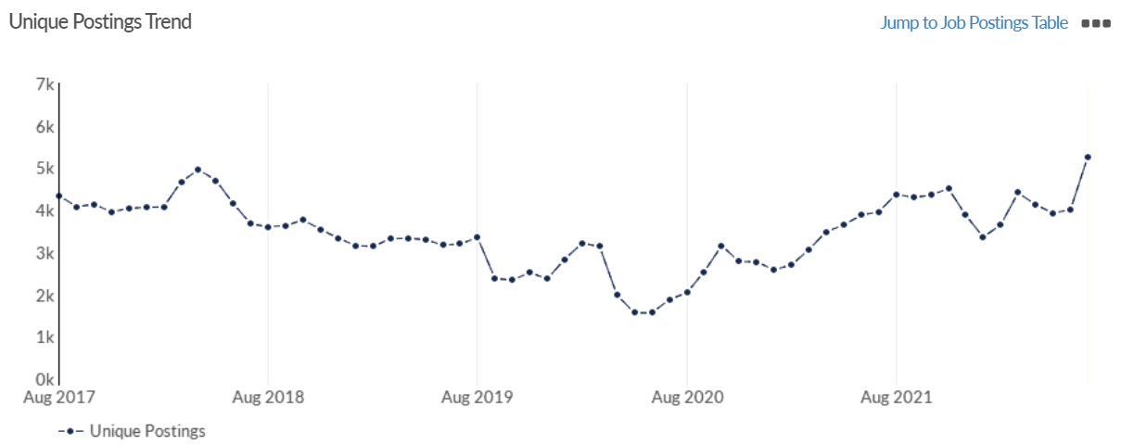
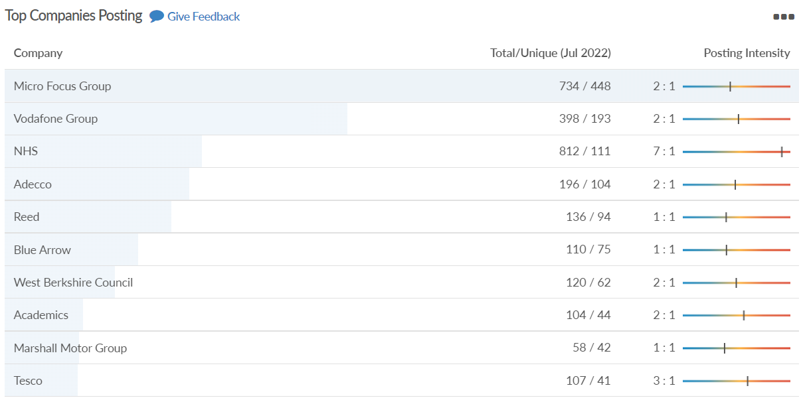
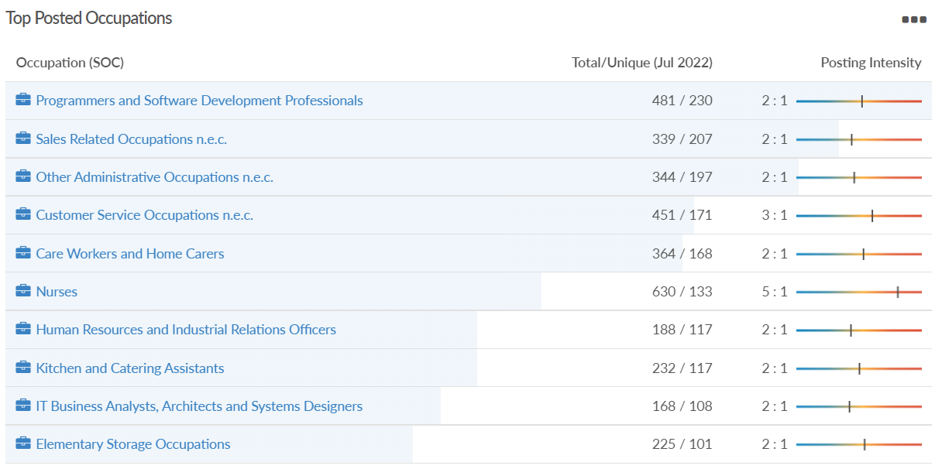
Job posting analytics (EMSI, July 2022)
Unique job postings: 5,263
Total job postings: 10,260
Job posting intensity: 2:1
Unique job postings (July 2021): 3,948

