Slide 1
Thames Valley Berkshire
Monthly Economic Briefing
August 2022

Slide 2
2022 Refresh
Following on from stakeholder feedback as well as discussions within the LEP over the course of the last year, we have decided to make some additions to the content of our economic briefings, whilst still continuing to report on the bulk of the areas we were last year.
Each month, we aim to have a themed feature. This month, in the absence of any major releases, we will be reporting on the recent ministerial changes affecting the LEP.
These monthly economic briefings are constantly evolving documents and their content is dictated in part by data/information requests from our readers.
If there is an economic aspect not currently covered within these reports which you think would be beneficial to include/expand upon (or you have any queries), we will do our best to help. Please contact Dex or Aishwarya in the LEP’s research team at dexterlevick@thamesvalleyberkshire.co.uk or aishwaryachakravarty@thamesvalleyberkshire.co.uk.

Slide 3
Key contents of this month’s briefing
Updated global and UK economic forecasts
Monthly Spotlight – Ministerial changes affecting the LEP
Key points from the latest Labour Force Survey data
Latest claimant count figures by Local Authority
Latest remote working figures for Thames Valley Berkshire
Latest ‘notable business news’ by Local Authority
Latest job posting analytics by Local Authority

Slide 4
Global and National Economy
August 2022

Slide 5
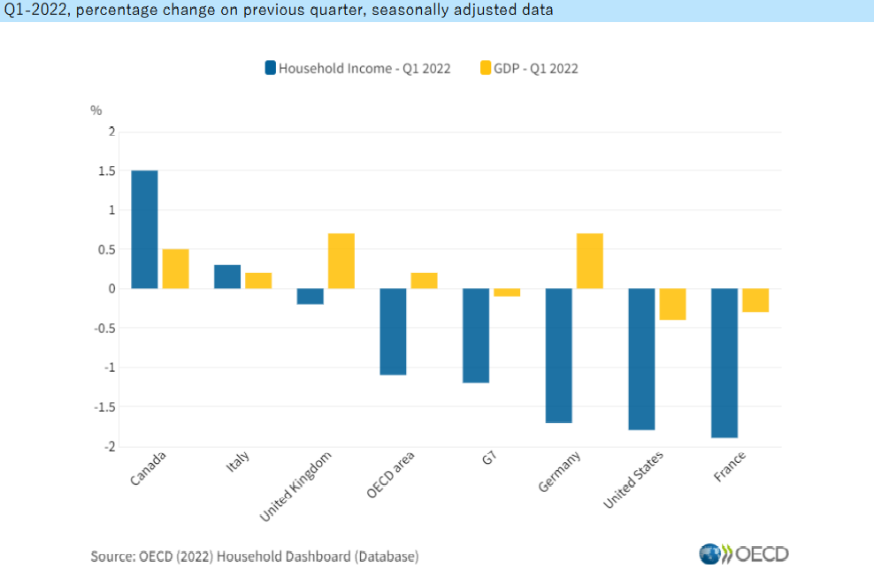
August 2022
OECD growth and economic well-being
Real GDP per capita grew but real household income declined in 2022 Q1: Real household income per capita fell by 1.1% in the OECD area in the first quarter of 2022, contrasting with growth of 0.2% in real GDP per capita.
Signs of recovery compared to pre-pandemic levels: Real household income is now 2.9% higher than it was in the fourth quarter of 2019, while real GDP is 1.6% higher.
The decline in real household income per capita in Q1 2022 was partly due to increases in consumer prices, which undermined household income in real terms.
Among the G7 economies, France and Germany posted the largest declines in real household income in 2022 Q1.
Source: OECD, August 2022

Slide 6
August 2022
Global Economics Intelligence executive summary
Globally, signs of slowing growth are proliferating. High inflation is eroding household budgets, leading to a decline in consumer sentiment and, outside the United States, static or declining retail sales in real terms. Production is flattening under persisting supply chain pressures, high input costs, and softening demand. Investor uncertainty over rising interest rates is roiling financial markets.
In the US economy, GDP contracted –0.6% on an annualized basis in the second quarter of the year, following a retreat of –1.6% in the first quarter.
GDP growth in China was 2.5% in the first half of 2022 but slowed to 0.4% in the second quarter, with output constrained by pandemic restrictions, softer external demand, and the financially troubled real-estate sector.
In the eurozone, GDP growth outpaced expectations at 0.6% in the second quarter and 1.1% for the first half.
Source: McKinsey, August 2022

Slide 7
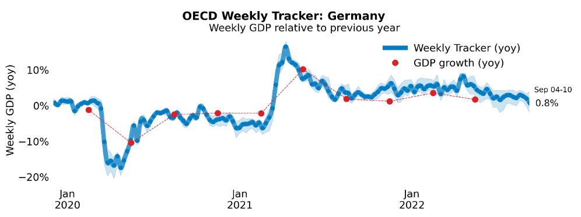
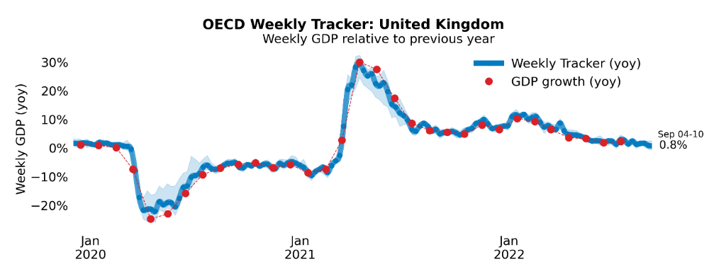
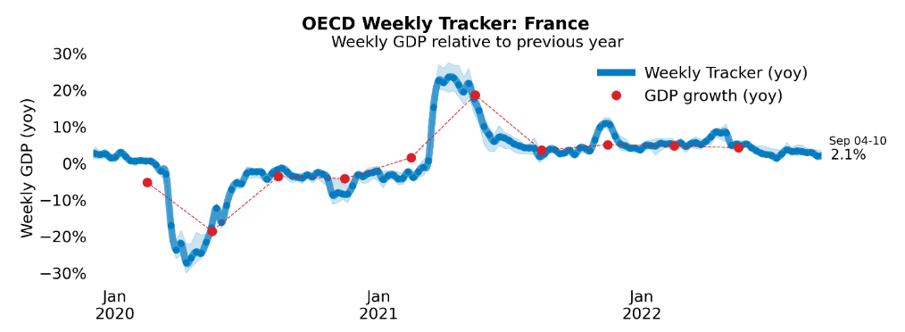
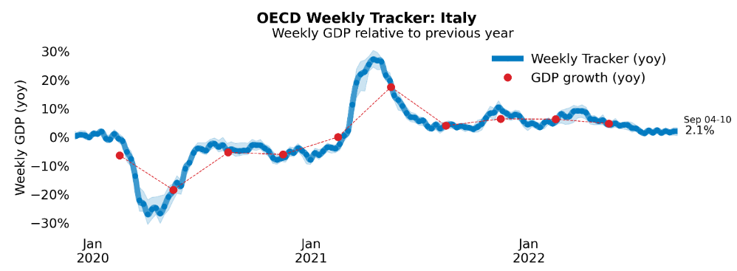
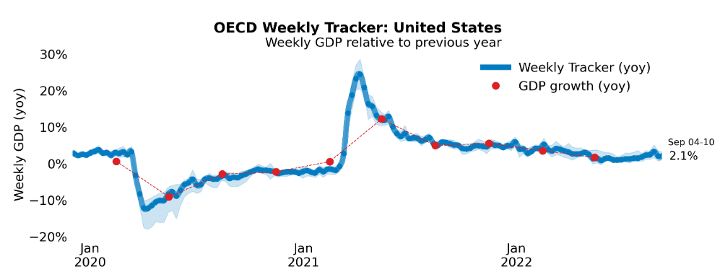
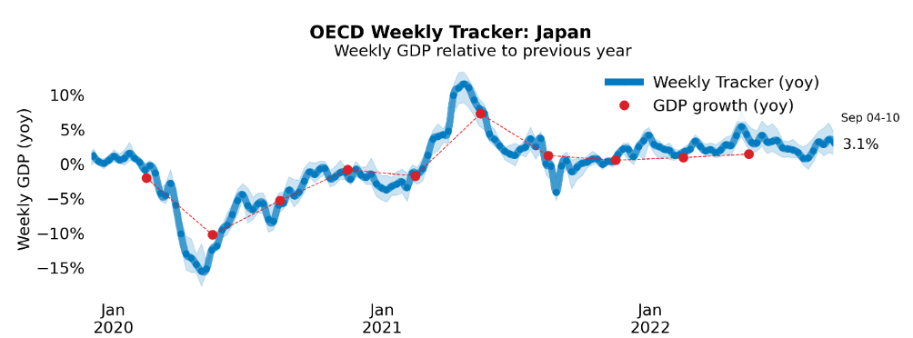
Global Economy
OECD GDP Tracker
The Weekly Tracker is an estimate of weekly GDP relative to the pre-crisis trend, which is proxied by the OECD Economic Outlook forecasts.
Source: OECD, August 2022

Slide 8
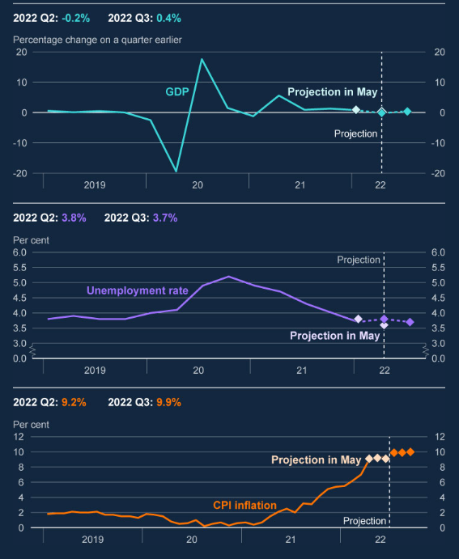
August 2022
Bank of England Monetary Policy Report
Inflationary pressures in the UK and the rest of Europe have intensified significantly, owing to Russia’s restriction of gas supplies to Europe and the risk of further curbs.
The UK is now projected to enter recession from the fourth quarter of this year. Real household post-tax income is projected to fall sharply in 2022 and 2023, while consumption growth turns negative.
The labour market has remained tight, with the unemployment rate at 3.8% in the three months to May and vacancies at historically high levels. There is a risk that a longer period of externally generated price inflation will lead to more enduring domestic price and wage pressures.
In view of these considerations, the Committee voted to increase Bank Rate by 0.5 percentage points, to 1.75%, at this meeting, the highest since the financial crisis in 2009.
Source: Bank of England, August 2022
Notes:
data

Slide 9
August 2022
Business insights and impact on the UK economy
A net 44% of trading businesses reported that the prices of goods or services bought had increased in July 2022 compared with June 2022; in contrast a net 22% of trading businesses reported the prices of goods or services sold had increased across the same period.
In early August 2022, 11% of businesses reported a moderate or severe risk of insolvency; this percentage is broadly stable with late May 2022, however, is down from the 17% reported in late November 2020 when the question was first asked.
A net 10% of businesses reported their turnover was lower in July 2022 compared with June 2022; this is broadly stable with a net 11% of businesses who reported lower turnover in June 2022 compared with May 2022.
Of businesses who had been affected by industrial action in July 2022, more than a quarter (28%) reported their workforce were unable to perform their roles, while 20% reported their workforce had to change their working location as a result.
Source: ONS, August 2022
Notes:
Data source

Slide 10
August 2022
Economic Survey of the United Kingdom
Supporting a sustainable recovery
The economy has recovered to pre-pandemic levels. High energy prices and rising cost of living are slowing growth. Monetary policy has started to tighten as inflation increased sharply and persistently.
Addressing fiscal challenges
Following the phasing out of extensive COVID-19 support measures, fiscal policy has to balance tax increases with supporting growth and meeting significant investment needs.
In the longer term, fiscal space is pressured by ageing related spending pressures and decreasing fiscal revenues as the economy is transitioning to net zero carbon emission.
Reaching net zero
Private incentives to reduce emissions are inconsistent across sectors and energy sources and too low in a number of sectors, including emission removals.
Recycling revenue to support clean technologies and infrastructure increases popular support for direct pricing instruments.
Source: OECD, August 2022
Notes:
Data source

Slide 11
August 2022
Economic Survey of the United Kingdom
Raising productivity
Local authorities face a fragmented funding landscape, which the 2021 Levelling Up White Paper committed to streamline and simplify. Poorer areas have not benefited to the same extent from the allocation of the first round of the new Levelling Up Fund.
Business investment has been slow on the back of Brexit and pandemic related uncertainty, contributing to low productivity growth.
The transition to net zero will provide new job opportunities and require new skills. Adding to existing skill-shortages, quickly rising demand for skills requires the need for re- and upskilling of the exiting workforce.
Women are highly educated but their skills are not fully utilised in the labour market and inequalities in earnings persist. Women adjust working hours to take over care responsibilities. Parental leave pay rates are low, providing little incentives to shift leave to fathers.
Source: OECD, August 2022
Notes:
Data source

Slide 12
Monthly Spotlight: Ministerial changes affecting economic policy
Elizabeth Truss was appointed Prime Minister on 6 September 2022. She was previously Secretary of State for Foreign, Commonwealth and Development Affairs from 15 September 2021. She has appointed her new cabinet, hours after taking over at 10 Downing Street - LINK.
Some of the key ministerial changes affecting economic policy are:
Minister | Position
The Rt Hon Elizabeth Truss MP | Prime Minister First Lord of the Treasury Minister for the Union Minister for the Civil Service
The Rt Hon Kwasi Kwarteng MP | Chancellor of the Exchequer
The Rt Hon Jacob Rees-Mogg MP | Secretary of State for Business, Energy and Industrial Strategy

Slide 13
Monthly Spotlight: Ministerial changes affecting economic policy
The ministerial changes at the Department for Levelling Up, Housing and Communities are:
Minister | Position | Responsibilities
The Rt Hon Simon Clarke MP | Secretary of State for Levelling Up, Housing and Communities | Strategic oversight of the Department’s business Cross-cutting responsibility for Levelling Up.
Paul Scully MP | Minister of State | Local resilience and emergencies Local Government policy, finance and improvement in England Foreign Affairs (Economic activity of publicly funded bodies) Bill and policy oversight Supporting Families and Changing Futures Programmes
Dehenna Davison MP | Parliamentary Under Secretary of State | Assistant to the Secretary of State and Minister of State in the Department for Levelling Up, Housing and Communities
Lee Rowley MP | Parliamentary Under Secretary of State | Assistant to the Secretary of State and Minister of State in the Department for Levelling Up, Housing and Communities

Slide 14
Monthly Spotlight: Ministerial changes affecting economic policy
The ministerial changes at the Department for Levelling Up, Housing and Communities are:
Minister | Position | Responsibilities
Lia Nici MP | Parliamentary Under Secretary of State (Minister for Levelling Up) | Levelling Up White Paper, LU cabinet committees, LU taskforce Devolution & county deals UK Shared Prosperity Fund City & growth deals Levelling Up Fund Community Ownership Fund High Streets, towns, commercial property and community assets Freeports Mayoral Combined Authorities/pan-regional bodies The Union & Constitution, and local govt engagement in Scotland, Wales and Northern Ireland UK Common Frameworks Legislation: Levelling Up & Regeneration Bill (joint with Housing Minister)

Slide 15
Employment in the UK
Labour Force Survey – August 2022
Key points:
April to June 2022 estimates show a small decrease in the employment rate compared with the previous three-month period (January to March 2022), and a corresponding small increase in the unemployment rate, while the economic inactivity rate remained largely unchanged.
Total hours worked decreased slightly compared with the previous three-month period and are still just below pre-coronavirus (COVID-19) pandemic levels.
The UK employment rate was estimated at 75.5%, which is 0.1 percentage points lower than the previous three-month period and 1.0 percentage points lower than before the coronavirus pandemic (December 2019 to February 2020).
The UK unemployment rate was estimated at 3.8%, which is 0.1 percentage points higher than the previous three-month period but 0.2 percentage points below pre-coronavirus pandemic levels.
The UK economic inactivity rate was estimated at 21.4%, which is largely unchanged compared with the previous three-month period but 1.2 percentage points higher than before the coronavirus pandemic.
Source: ONS, August 2022

Slide 16
Economic and Labour Market Insight: Implications for Thames Valley Berkshire

Slide 17
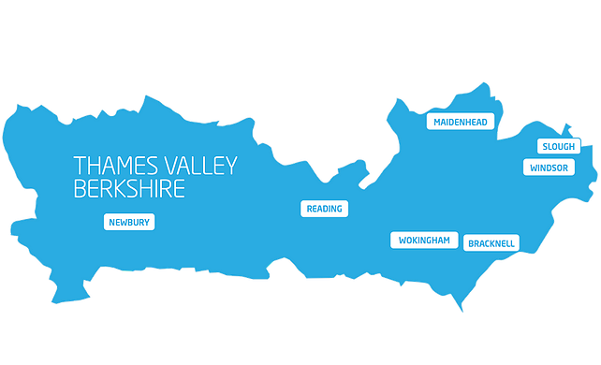
Claimant Count (Latest data - July 2022)
Total of 16,745 claimants (2.9% of the working age population) in Thames Valley Berkshire
1,615 claimants (2% of the working age population) in Bracknell Forest UA
4,930 claimants (5.2% of the working age population) in Slough UA
4,305 claimants (4.1% of the working age population) in Reading UA
1,655 claimants (1.6% of the working age population) in Wokingham UA
2,155 claimants (2.3% of the working age population) in Windsor and Maidenhead UA
2,085 claimants (2.2% of the working age population) in West Berkshire UA
Across Thames Valley Berkshire, claimant unemployment has fallen significantly from 23,545 in August 2021 to 16,745 in August 2022. Slough had 5.2% of its working age population claim unemployment in August 2022, down significantly from 7.0% in August 2021.
Source: ONS, August 2022

Slide 18
Strategic Issues
Heathrow owner Ferrovial studies options for stake in Britain's biggest airport -sources
Spain's Ferrovial is looking at options for its 25% stake in London's Heathrow, two sources told Reuters, and has held preliminary talks with external advisers on the future of its holding in Britain's biggest airport. Madrid-based Ferrovial has been invested in Heathrow airport for 16 years and ranks as its single largest investor.
The early-stage discussions come amid interest in Ferrovial's stake from private equity firm Ardian, which has held talks with its own advisers on a possible joint proposal with Saudi Arabia's Public Investment Fund (PIF), these sources and another person familiar with the matter said.
Insight Investment Research analyst Robert Crimes told Reuters the equity value of Ferrovial's 25% stake in Heathrow could be close to 2 billion euros. He added Ferrovial's stock had yet to reflect the post-pandemic recovery in traffic volumes and inflation-linked returns.
Heathrow, which Aviation data firm OAG said was the world's fifth busiest airport in July, was hard hit by coronavirus lockdowns, but raised its 2022 traffic forecast to 54.4 million passengers in June after a travel rebound.
Source: Reuters, August 2022

Slide 19
An important note on the EMSI figures contained on the following slides: 20, 24, 27, 30, 33, 36 and 39
From February 2022, there has been a methodological change in how EMSI calculates job posting figures compared to those from prior months following a merger between EMSI and Burning Glass Technologies (rebranding to Lightcast).
Those of you who have read previous economic briefings from Thames Valley Berkshire LEP may notice that the job posting figures contained in post-January 2022 briefings are lower across the board – in some cases quite significantly.
This change in methodology does not invalidate previous figures, but it is important to consider when reporting on job posting data longitudinally.

Slide 20
Remote working
In August of 2022, there were 3,529 unique job postings for remote positions at companies based in Berkshire, around 0.6% more than the figure of 3,507 for the same period one year before.
Compare this with the South-East, in August 2022 there were 17,065 unique remote job postings for remote positions; falling from 17,249 in August of the previous year – a decrease of just over 1%.
A rise can also be seen at national level, with a recorded 208,602 unique remote job postings in England in August of 2022, rising from 202,194 in August 2021 – an increase of about 3.2%.
From these figures it’s apparent that the massive boost in job postings for explicitly remote roles prompted by the COVID-19 pandemic has persisted despite the reduction in cases. Berkshire has seen a smaller boost in vacancies which are remote-based than England, but a larger one than in the South-East overall.
Source: EMSI, August 2022

Slide 21
Local Profiles

Slide 22
Bracknell Forest

Slide 23
Unemployment figures and notable business news - August 2022
Claimant unemployment to July 2022 (latest)
1,615 claimants (2% of the working age population) in Bracknell Forest UA
Notable business news:
Kier Property, a property investment company, has bought 5.15 acres of commercial land in Bracknell dedicated to sustainable facilities to include EV-charging point. It acquired the industrial and logistics site on Longshot Lane, Bracknell, from Reliance Worldwide Corporation, located in the heart of the commercial district. This will target sustainable infrastructure development (BREEAM) excellence and incorporate EV charging points, LED lighting and cycle storage facilities. Under the Logistics City brand, a grade A logistics unit will be built totalling 100,000 sq. ft, including a first-floor office - LINK.
Note: The LEP has been previously reporting on COVID-19 case rates in these monthly economic briefings. The dashboards containing this data have been shut down as April 2022 and, as a result, we will no longer be doing so.

Slide 24
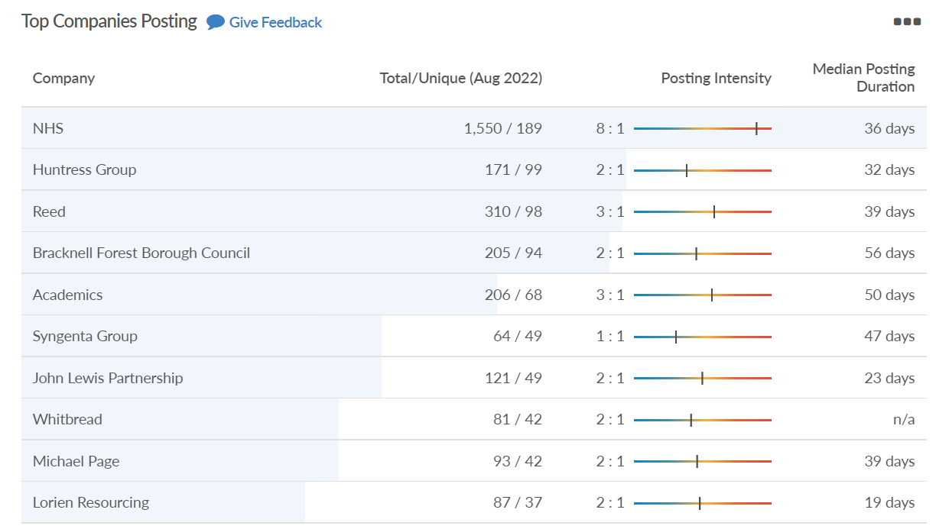
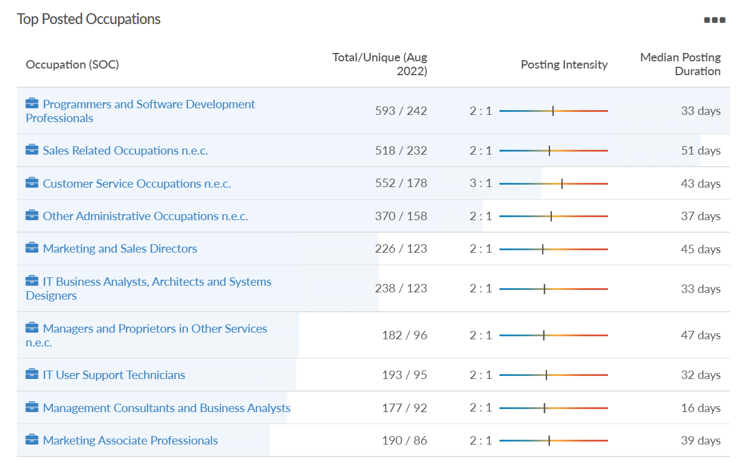
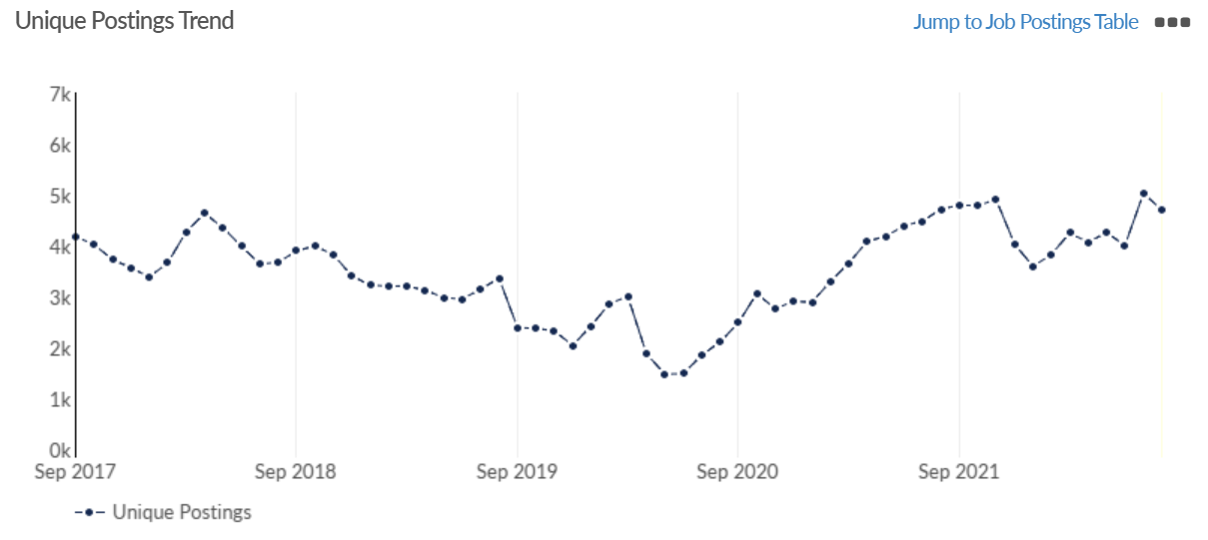
Job posting analytics
Source: EMSI, August 2022
Unique job postings: 4,710
Total job postings: 11,730
Job posting intensity: 2:1
Unique job postings (August 2021): 4,720

Slide 25
Slough

Slide 26
Unemployment figures and notable business news - August 2022
Claimant unemployment to July 2022 (latest)
4,930 claimants (5.2% of the working age population) in Slough UA
Notable business news:
SEGRO has agreed a second lease for one of Europe’s largest investors in renewable power, Octopus Energy, to expand its presence at the Slough Trading Estate to almost 50,000 sq. ft. The new hub will employ 40 people. It will be used for the storage and distribution of energy-related products, such as heat pumps and photovoltaic solar panels, as well as providing office space. The new unit complements Octopus Energy’s £10m flagship training and R&D centre on the Slough Trading Estate, which contains two replicas of full-size houses and aims to train around 1,000 plumbing and heating engineers to install air-source heat pumps, to help decarbonise Britain’s homes. The deal reflects the alignment between Octopus Energy’s sustainability ambitions and values and the Responsible SEGRO commitments to champion low carbon growth and to be net-zero carbon by 2030.– LINK.
Note: The LEP has been previously reporting on COVID-19 case rates in these monthly economic briefings. The dashboards containing this data have been shut down as April 2022 and, as a result, we will no longer be doing so.

Slide 27
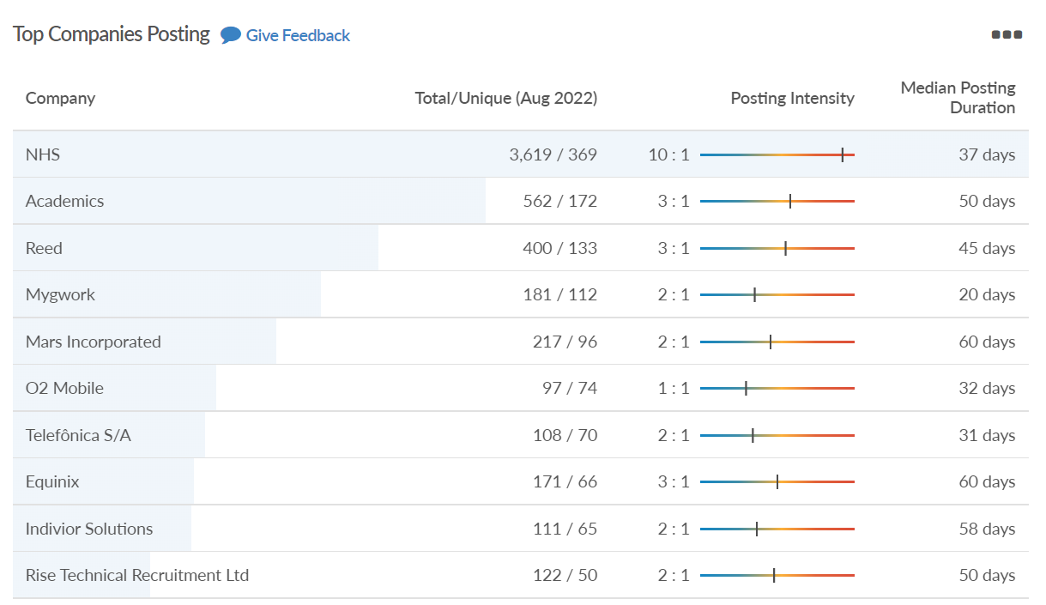
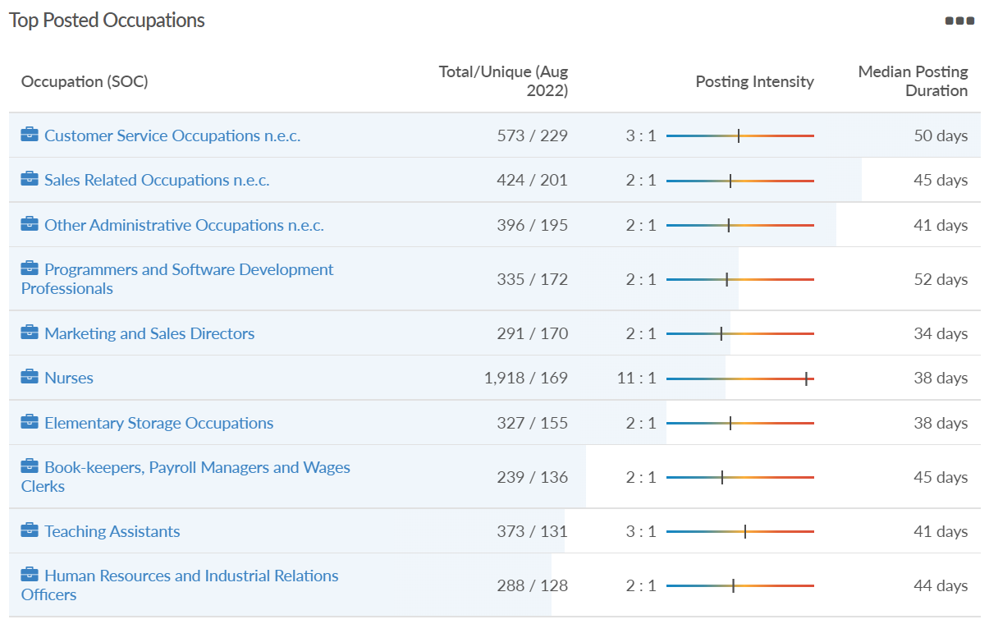
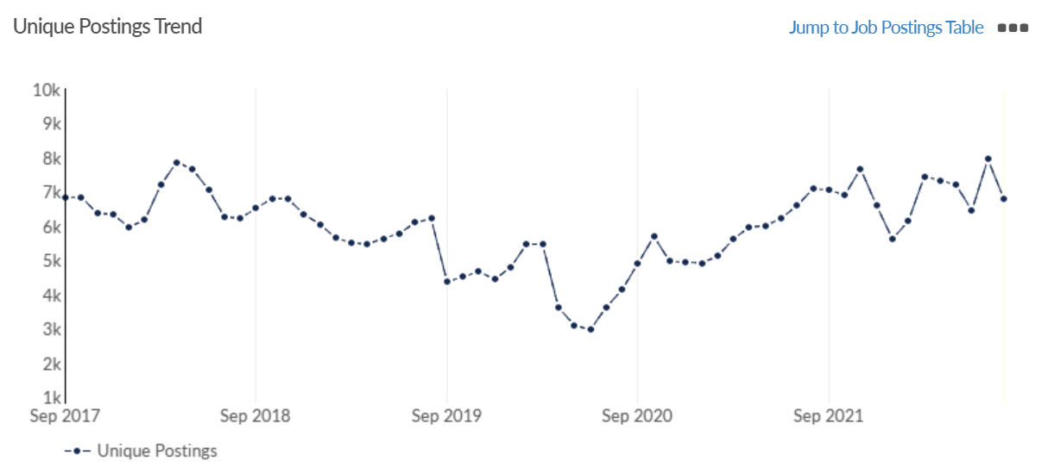
Job posting analytics
Source: EMSI, August 2022
Unique job postings: 6,792
Total job postings: 17,501
Job posting intensity: 3:1
Unique job postings (August 2021): 7,077

Slide 28
Reading

Slide 29
Unemployment figures and notable business news - August 2022
Claimant unemployment to July 2022 (latest)
4,305 claimants (4.1% of the working age population) in Reading UA
Notable business news:
From Sunday 6 November, Reading will connect with the central tunnels of the Elizabeth Line - opening up new direct journeys from Reading through the capital seven days a week. This means that people travelling to and from Reading will be able to travel directly to/from the West End, the City of London and Docklands without changing at Paddington. Reading is also connected to Heathrow Airport by the Elizabeth Line (changing at Hayes & Harlington). The frequency of services in the central section between Paddington and Whitechapel will increase from 12 trains per hour to up to 22 trains per hour in peak times and 16 trains per hour during off-peak.– LINK.
Note: The LEP has been previously reporting on COVID-19 case rates in these monthly economic briefings. The dashboards containing this data have been shut down as April 2022 and, as a result, we will no longer be doing so.

Slide 30
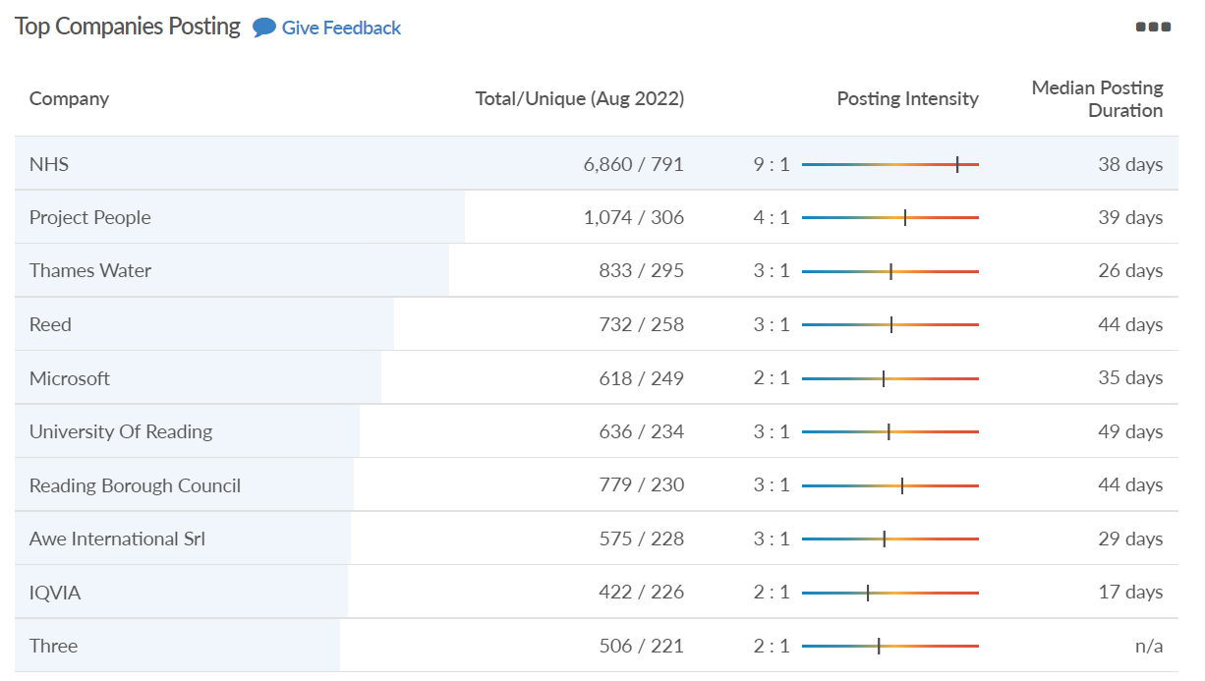
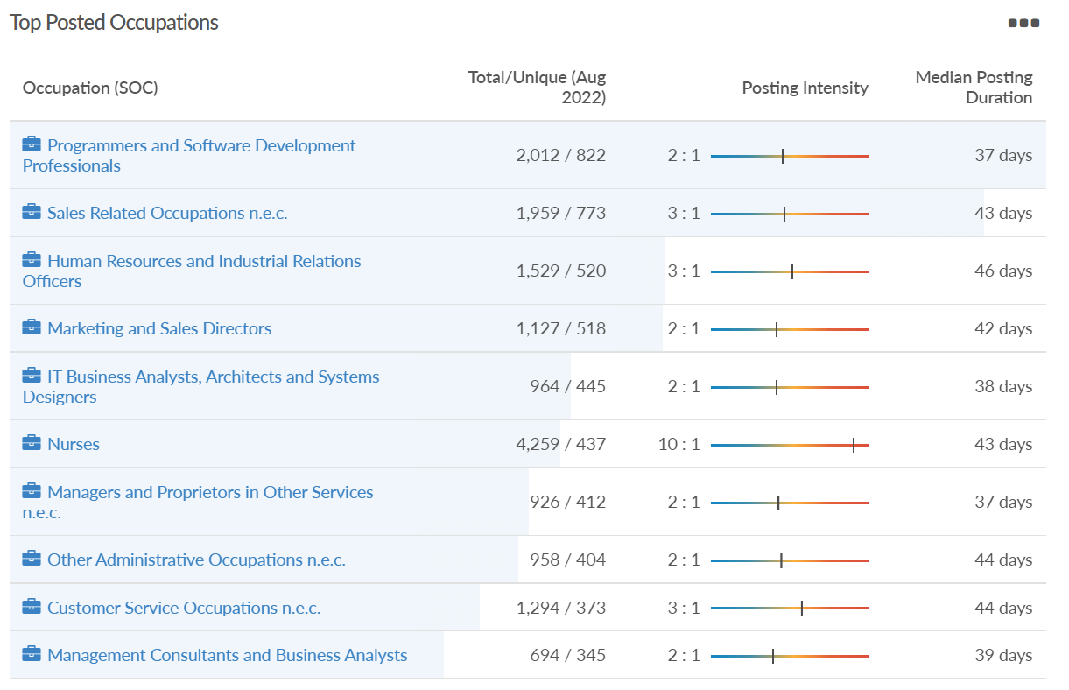
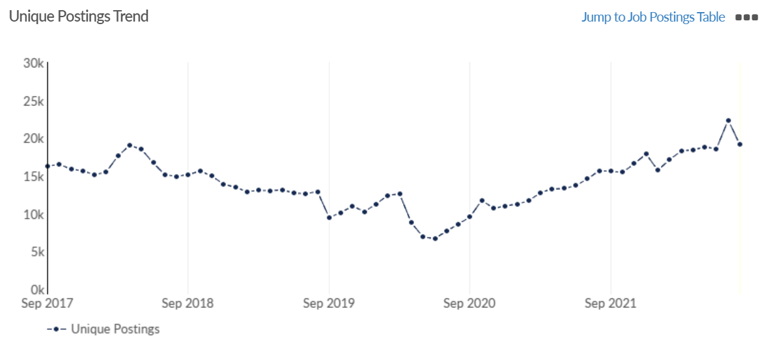
Job posting analytics
Source: EMSI, August 2022
Unique job postings: 19,099
Total job postings: 53,033
Job posting intensity: 3:1
Unique job postings (August 2021): 15,675

Slide 31
Wokingham

Slide 32
Unemployment figures and notable business news - August 2022
Claimant unemployment to July 2022 (latest)
1,655 claimants (1.6% of the working age population) in Wokingham UA
Notable business news:
Thames Valley Park (TVP) is to build new ‘social exchange’ places in response to companies finding it increasingly difficult to recruit. The project will involve the building of five timber pavilions situated around the business park, designed to be areas for events and where people can “gather and relax”, as well as “be in contact with nature”. Thames Valley Park Management Ltd applied for permission to construct the first pavilion, named ‘The Garden’, which has been approved by Wokingham Borough Council and planned for delivery in 2022/23. There are allocated spaces for mobile vendors to supply food and drinks to the site – which the application states will be operated by “local businesses and social enterprises”. – LINK.
Note: The LEP has been previously reporting on COVID-19 case rates in these monthly economic briefings. The dashboards containing this data have been shut down as April 2022 and, as a result, we will no longer be doing so.

Slide 33
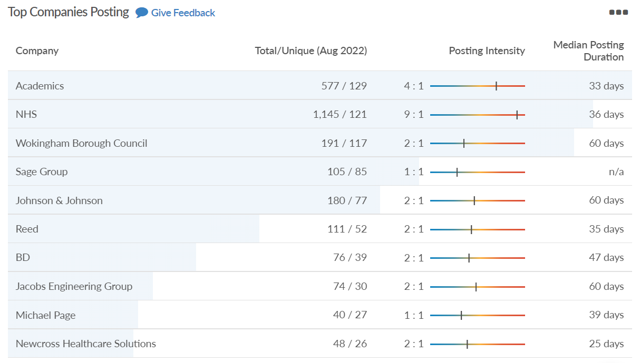
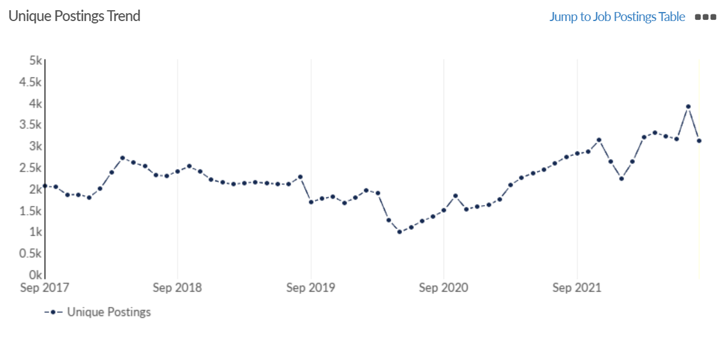
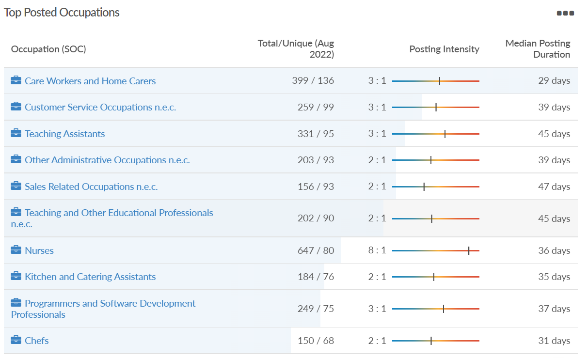
Job posting analytics
Source: EMSI, August 2022
Unique job postings: 3,111
Total job postings: 8,019
Job posting intensity: 3:1
Unique job postings (August 2021): 2,737

Slide 34
Windsor and Maidenhead

Slide 35
Unemployment figures and notable business news - August 2022
Claimant unemployment July 2022 (latest)
2,155 claimants (2.3% of the working age population) in Windsor and Maidenhead UA
Notable business news:
Recognising the unsung heroes during the pandemic will be one of the key outcomes of the Maidenhead & Windsor Business & Community Awards next year. The awards, which will be held at The Castle Hotel in Windsor, is headline sponsored by Sorbon Estates and aims to showcase excellence in businesses of all sizes. Several new community awards will also recognise individuals who have gone the extra mile during what has been a tough few years. The awards aim to recognise excellence in businesses of all sizes across the borough and are organised by Baylis Community Media CIC, the Maidenhead and District Chamber of Commerce and event management company Lime Blue Solutions.– LINK.
Note: The LEP has been previously reporting on COVID-19 case rates in these monthly economic briefings. The dashboards containing this data have been shut down as April 2022 and, as a result, we will no longer be doing so.

Slide 36
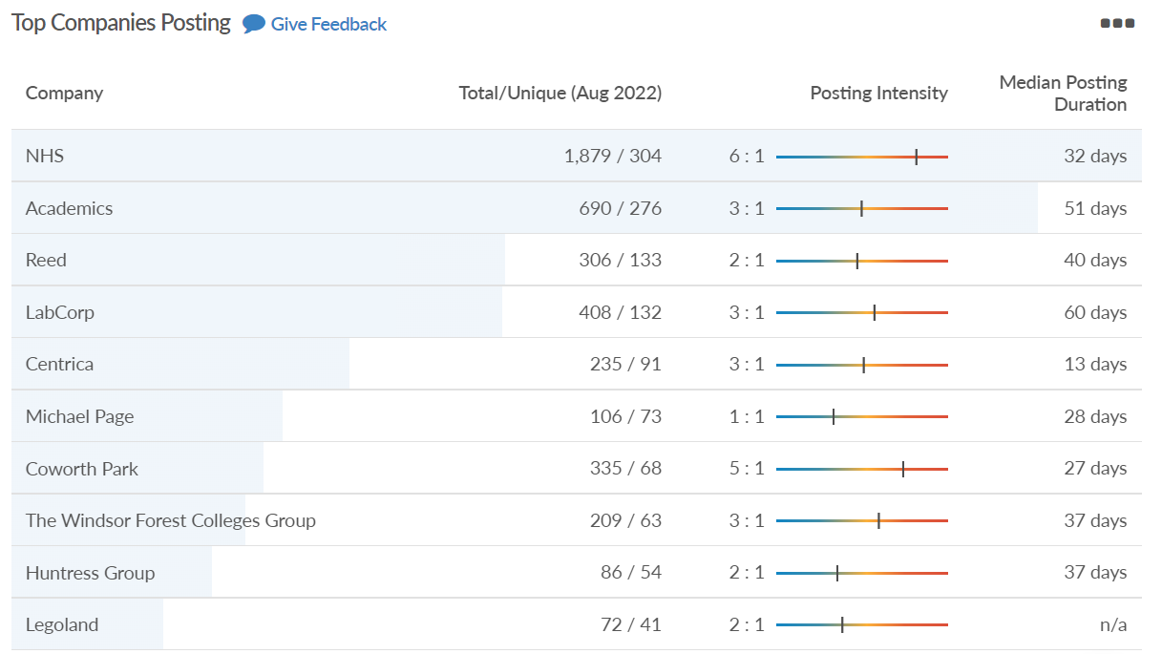
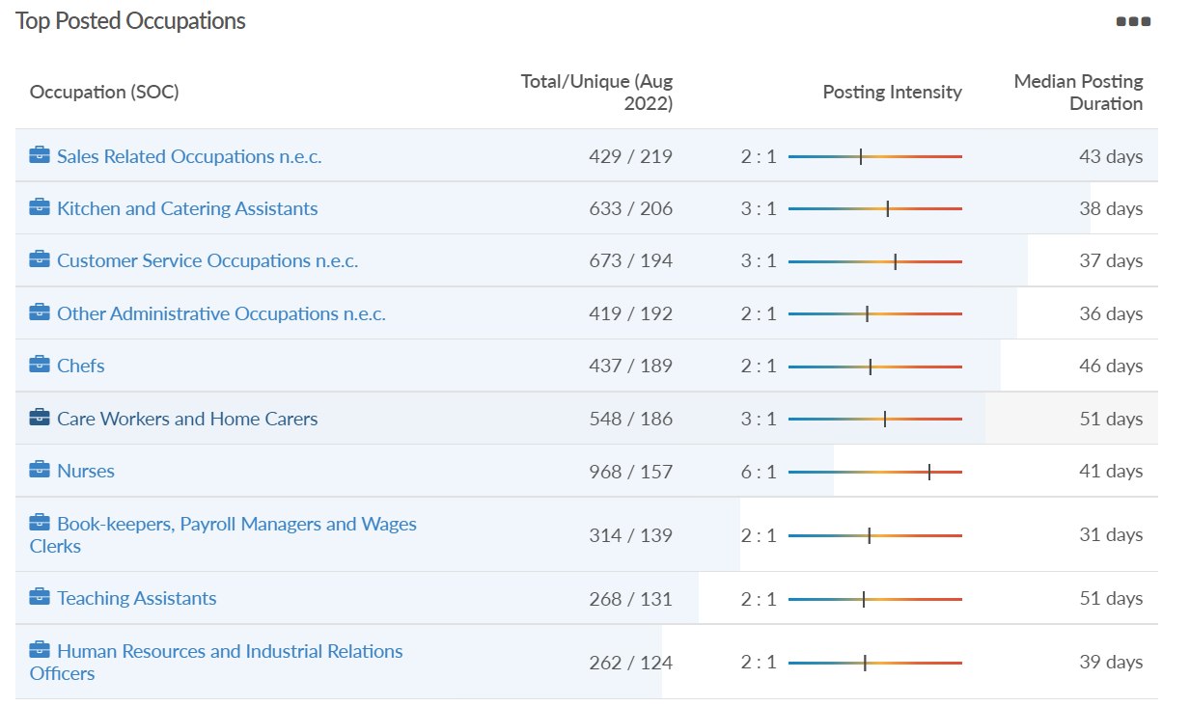
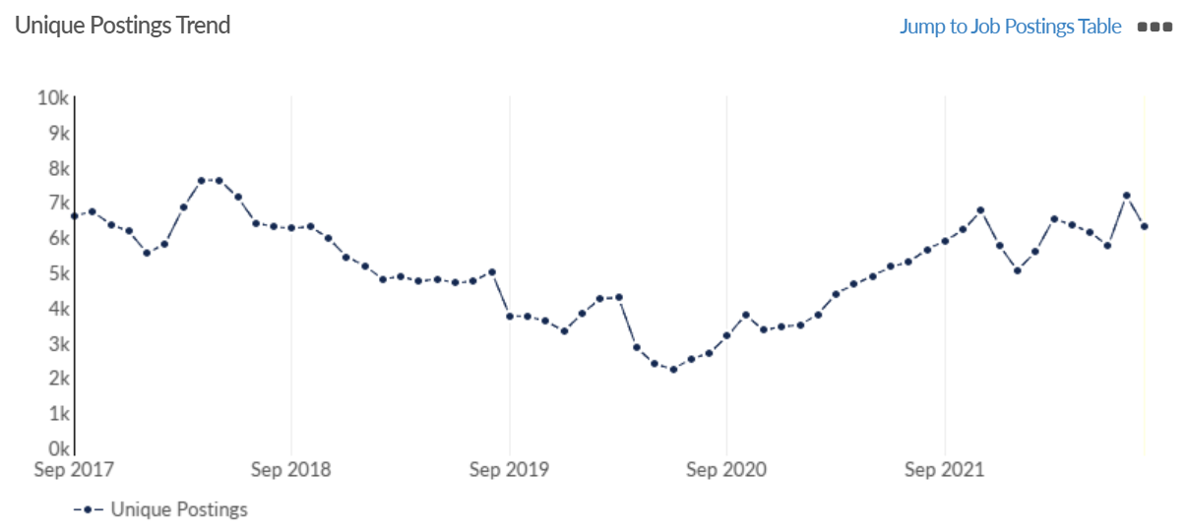
Job posting analytics
Source: EMSI, August 2022
Unique job postings: 6,293
Total job postings: 15,784
Job posting intensity: 3:1
Unique job postings (August 2021): 5,642

Slide 37
West Berkshire

Slide 38
Unemployment figures and notable business news - August 2022
Claimant unemployment to July 2022 (latest)
2,085 claimants (2.2% of the working age population) in West Berkshire UA
Notable business news:
Plans for a waste incinerator plant in Burghfield were conditionally approved at meeting of West Berkshire Council. The council is now waiting for the Department for Levelling Up, Housing and Communities to determine whether the Secretary of State will call the decision in. If approved the plant would run 24 hours a day. The 64,000 sq. m (690,000 sq. ft) site would provide electricity to the national grid by burning 150,000 tonnes of waste from the Reading Quarry landfill. A total of 30 permanent jobs are expected to be created as part of the £280m investment.– LINK.
Note: The LEP has been previously reporting on COVID-19 case rates in these monthly economic briefings. The dashboards containing this data have been shut down as April 2022 and, as a result, we will no longer be doing so.

Slide 39
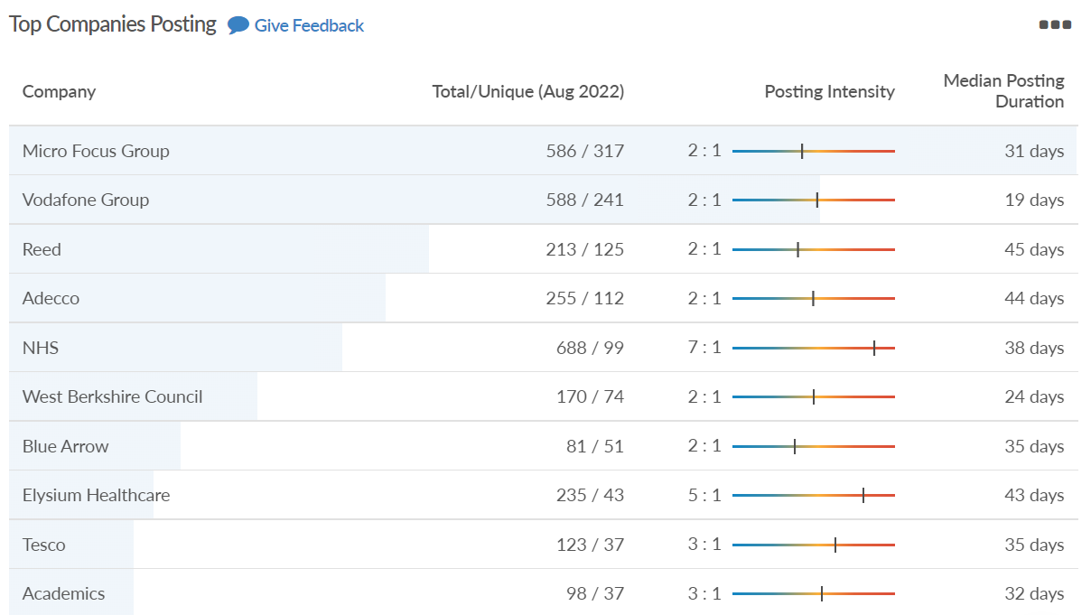
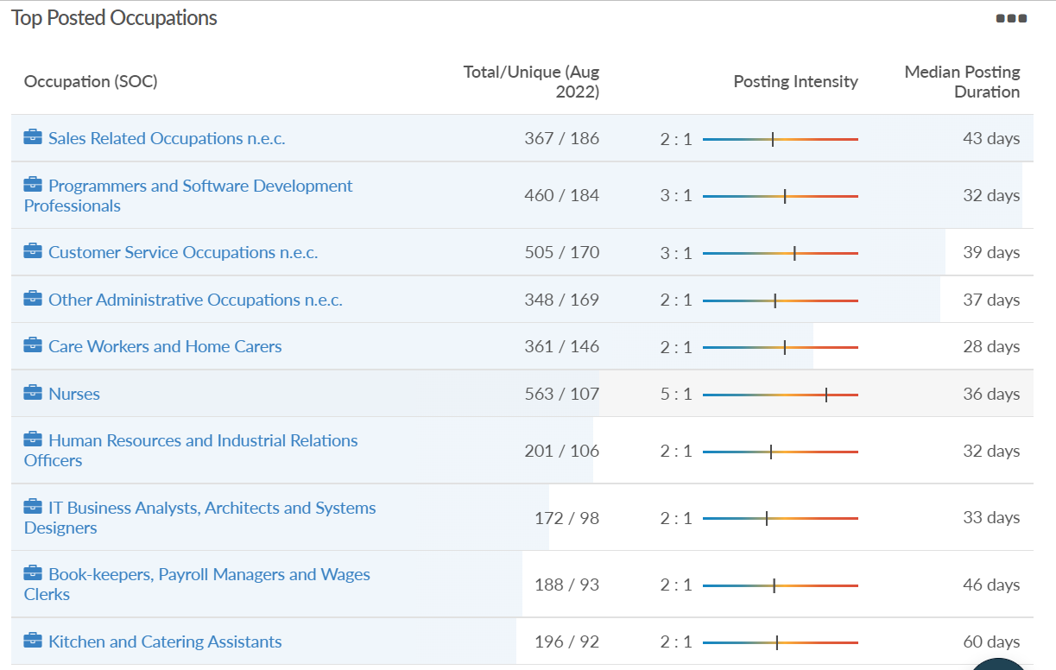
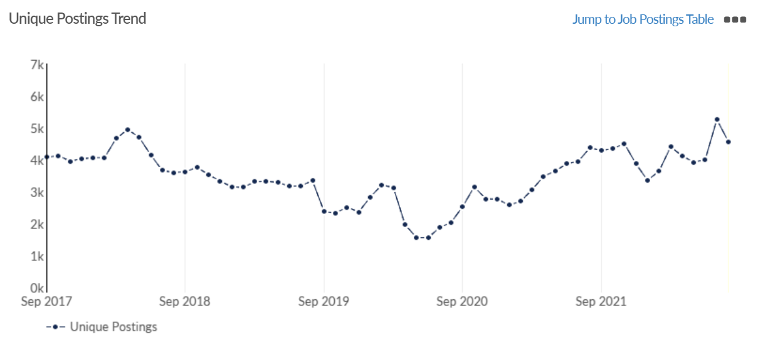
Job posting analytics
Source: EMSI, August 2022
Unique job postings: 4,570
Total job postings: 10,427
Job posting intensity: 2:1
Unique job postings (August 2021): 4,369

