Slide 1
Berkshire Monthly Economic Briefing
November 2022

Slide 2
2022 Refresh
Following on from stakeholder feedback as well as discussions within the LEP over the course of the last year, we have decided to make some additions to the content of our economic briefings, whilst still continuing to report on the bulk of the areas we were last year.
Each month, we aim to have a themed feature. This month, we will be discussing the announcements made by the Chancellor during the Autumn Statement.
These monthly economic briefings are constantly evolving documents and their content is dictated in part by data/information requests from our readers.
If there is an economic aspect not currently covered within these reports which you think would be beneficial to include/ expand upon (or you have any queries), we will do our best to help. Please contact Dex or Aishwarya in the LEP’s research team at dexterlevick@thamesvalleyberkshire.co.uk or aishwaryachakravarty@thamesvalleyberkshire.co.uk.

Slide 3
Key contents of this month’s briefing
Updated global and UK economic forecasts
Monthly Spotlight – Autumn Statement 2022
Key points from the latest Labour Force Survey data
Latest claimant count figures by Local Authority
Latest remote working figures for Berkshire
Latest ‘notable business news’ by Local Authority
Latest job posting analytics by Local Authority

Slide 4
Global and National Economy
November 2022

Slide 5
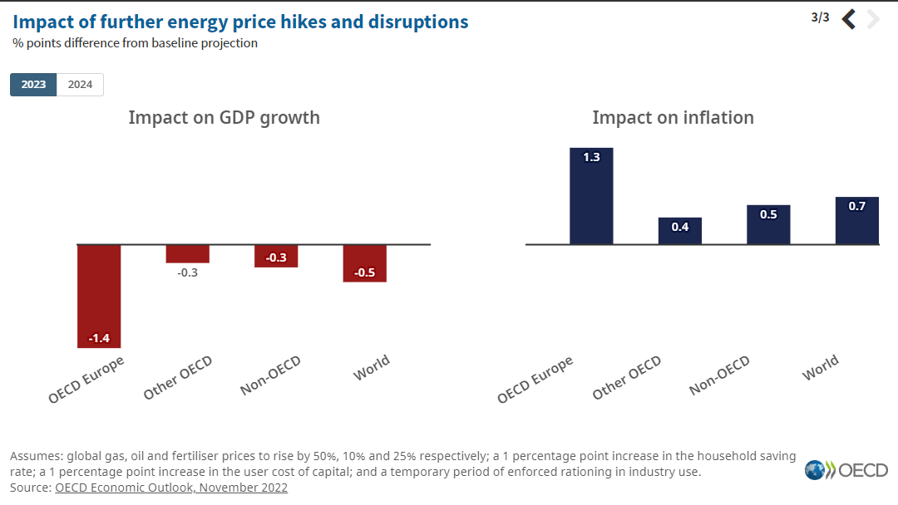
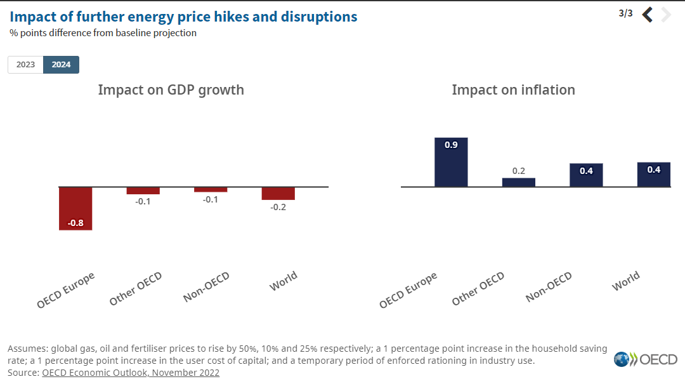
November 2022
OECD Economic Outlook
The global economy is facing significant challenges. Growth has lost momentum, high inflation has broadened out across countries and products, and is proving persistent.
The world is coping with a massive energy price shock. The increase in energy prices (which will worsen if European gas storage runs short) could force rationing in Europe and hurt countries worldwide as global gas prices are pushed higher.
Growth has been slowing. The United States and Europe are slowing sharply and the major Asian emerging-market economies are expected to account for close to three-quarters of global GDP growth in 2023.
Inflation will remain high in 2023, but will moderate due to higher interest rates and slowing growth.
Source: OECD, November 2022

Slide 6
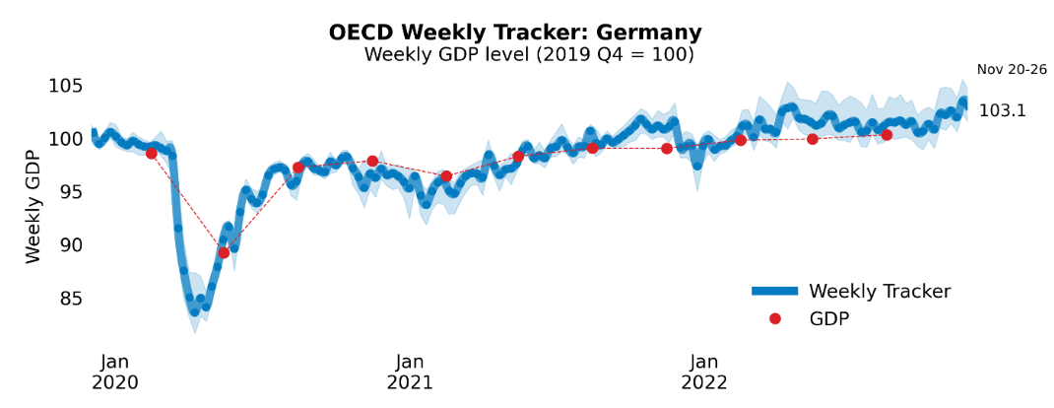
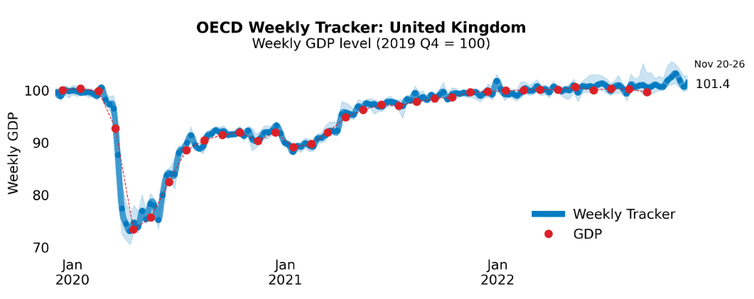
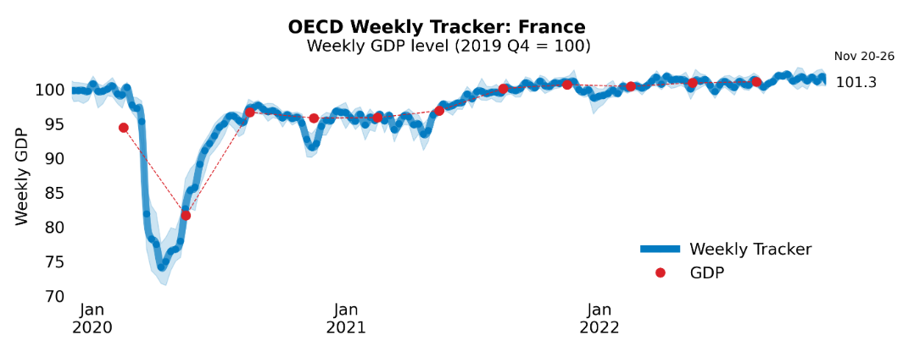
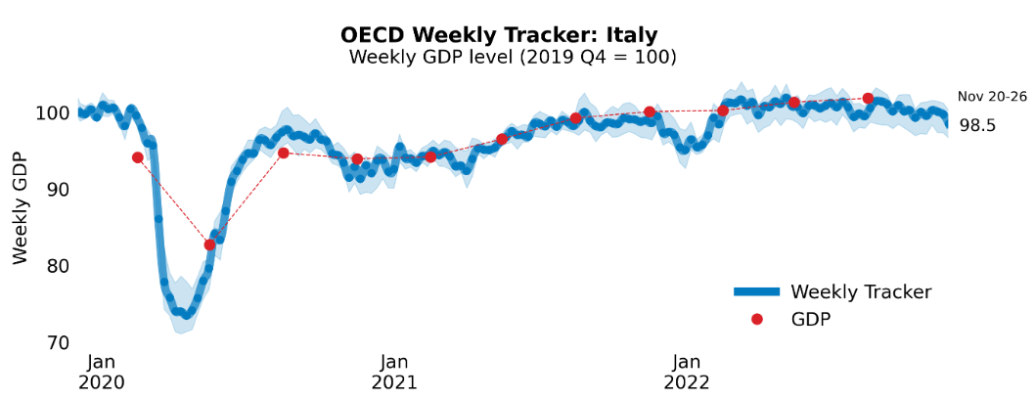
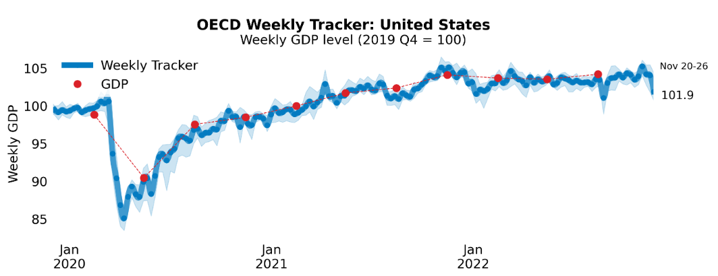
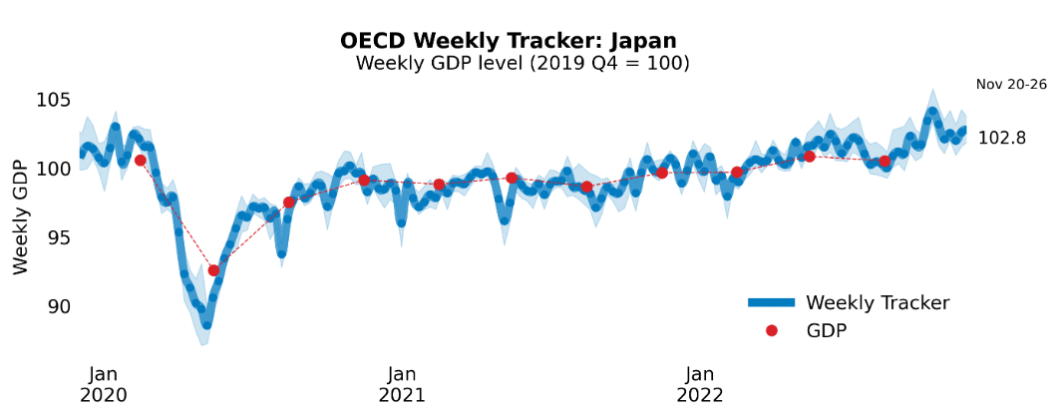
Global Economy
OECD GDP Tracker
The Weekly Tracker is an estimate of weekly GDP relative to the pre-crisis trend, which is proxied by the OECD Economic Outlook forecasts.
Source: OECD, November 2022

Slide 7
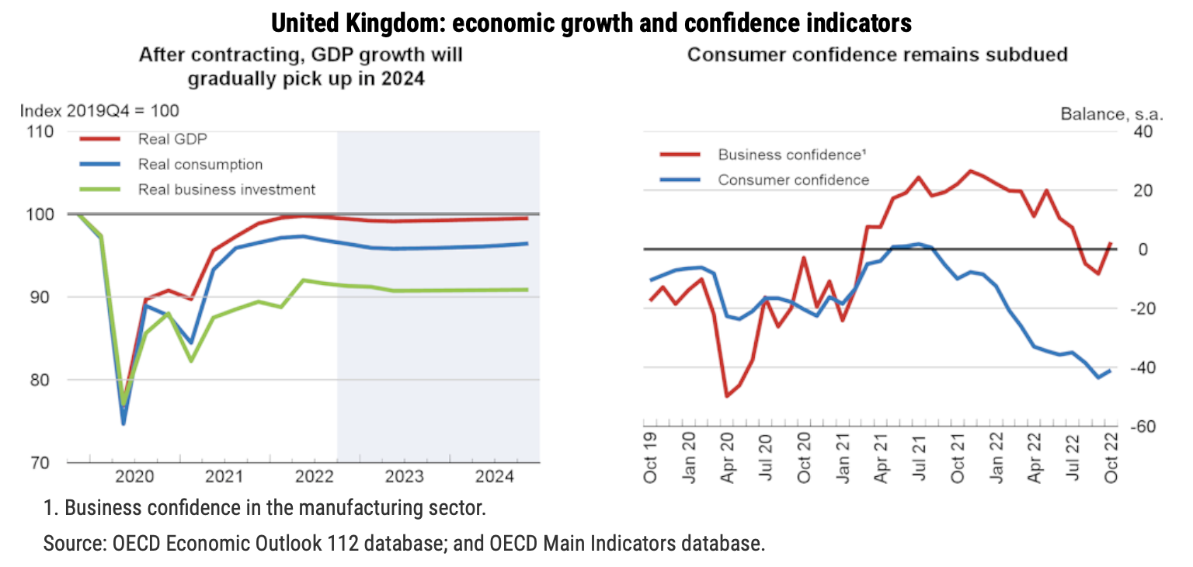
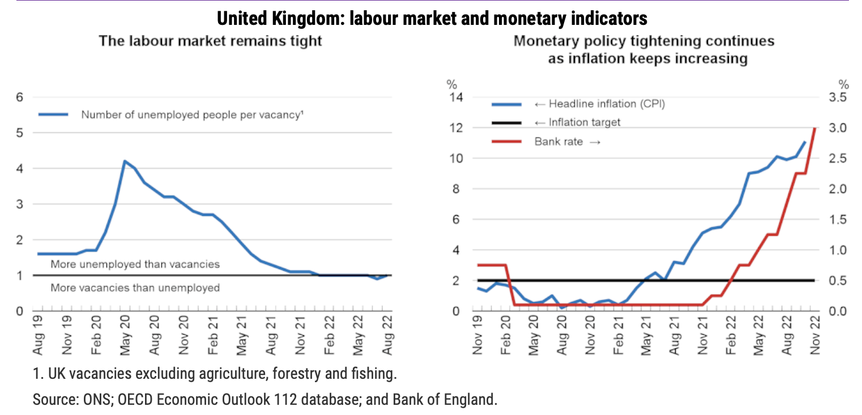
November 2022
OECD Economic Outlook
United Kingdom
Following a contraction of 0.4% in 2023, GDP is projected to increase by 0.2% in 2024.
Consumer price inflation will peak at around 10% in late 2022 due to high energy prices and continuing labour and goods supply shortages, before gradually declining to 2.7% by the end of 2024.
Private consumption is expected to slow owing to rising living costs, but will be aided by a 9.7% increase in the minimum wage and the usual uprating of welfare benefits and pensions in April 2023.
Public investment is set to rebound in 2023 and 2024 as supply bottlenecks ease, in line with government plans.
The unemployment rate is expected to rise to 5% by the end of 2024.
Source: OECD, November 2022

Slide 8
November 2022
OECD Economic Outlook
United Kingdom
Complying with the fiscal plan and ensuring that future changes to fiscal targets follow a transparent and clearly defined process would maintain fiscal policy credibility and mitigate concerns about debt sustainability.
Fiscal support measures to help with high energy prices are warranted, but should ensure that incentives for energy reduction remain intact. Better targeting of measures to cushion the impact of high energy prices would lower the budgetary cost, better-preserve incentives to save energy, and reduce the pressure on demand at a time of high inflation.
Accelerating progress towards net zero is fundamental to enhance energy security and reduce dependence on fossil fuels. The policies in place are not yet sufficient to deliver the net zero target. The government can stimulate investment by being clearer about its approach to the transition to a net zero economy and developing an economy-wide plan with specific deadlines, policies and priorities, in line with a target-consistent emission pricing trajectory.
Raising productivity will be key to sustained growth. To ensure sustainable growth, the government should also continue to implement its productivity enhancing “Plan for Growth” to support a shift towards greener and more inclusive growth through large-scale public investment in infrastructure, skills and innovation.
Source: OECD, November 2022

Slide 9
November 2022
Bank of England Monetary Policy Committee meeting
Since the MPC’s previous forecast, there have been significant developments in fiscal policy.
Due to government interventions, uncertainty around the forecast for UK retail energy prices has fallen to some extent but there have been large moves in UK asset prices since August.
Overall, the BoE interest rate is projected to be around 2.25 percentage points higher over the next three years than was predicted in August. These partly reflect global developments, although UK-specific factors have played a very significant role during this period.
GDP is expected to decline by around 0.75% during the second half of 2022, in part reflecting the squeeze on real incomes from higher global energy and tradable goods prices. The fall in activity around the end of this year is expected to be less marked than was predicted in August, reflecting support from the Energy Price Guarantee (EPG).
The labour market remains tight, although there are signs that labour demand has begun to ease.
In view of these considerations, the Committee has voted to increase the Bank Rate by 0.75 percentage points, to 3%, at this meeting. The Committee will take account the Government’s Autumn Statement at its December meeting and in its next forecast in February.
Source: Bank of England, November 2022
Notes:
data

Slide 10
November 2022
Business insights and impact on the UK economy
Approximately two in five (41%) trading businesses with 10 or more employees that had imported in October 2022 reported they had experienced an increase in transportation costs compared with September 2022; this was 35% for exporting businesses.
Almost a third (32%) of businesses with 10 or more employees reported they were experiencing a shortage of workers, with the human health and social work activities industry reporting the highest proportion of businesses affected, at 54%.
When looking ahead to December 2022, input price inflation and energy prices remain the top two concerns reported by businesses, at 25% and 19%, respectively, with energy price concerns being at the lowest level reported since late February 2022 (15%).
One in eight (13%) businesses had been affected by industrial action in October 2022; more than a quarter (27%) of those businesses reported they were unable to obtain necessary goods for their business.
Source: ONS, November 2022
Notes:
data

Slide 11
Employment in the UK
Labour Force Survey – November 2022
Key points:
July to September 2022 estimates show a decrease in the unemployment rate compared with the previous three-month period (April to June 2022), and a largely unchanged employment rate, while the economic inactivity rate increased.
Total hours worked decreased compared with the previous three-month period and are still below pre-coronavirus (COVID-19) pandemic levels.
The UK employment rate was estimated at 75.5%, largely unchanged compared with the previous three-month period and 1.1 percentage points lower than before the pandemic (December 2019 to February 2020).
The UK unemployment rate was estimated at 3.6%, which is 0.2 percentage points lower than the previous three-month period and 0.4 percentage points below pre-pandemic levels.
The UK economic inactivity rate was estimated at 21.6%, which is 0.2 percentage points higher than the previous three-month period and 1.4 percentage points higher than before the pandemic.
Source: ONS, November 2022

Slide 12
November 2022
Monthly Spotlight: Autumn Statement 2022
The Autumn Statement sets out the government’s plan to ensure that national debt falls as a proportion of the economy over the medium term.
To achieve this aim, the government has reversed nearly all the measures in the Growth Plan 2022.
The Autumn Statement reduces the income tax additional rate threshold from £150,000 to £125,140, increasing taxes for those on high incomes.
Income tax, National Insurance and Inheritance Tax thresholds will be maintained at their current levels for a further two years, to April 2028.
The government will also reduce the Dividend Allowance and Capital Gains Tax Annual Exempt Amount.
The Autumn Statement confirms that total departmental spending will grow in real terms at 3.7% a year on average over the current Spending Review period. Within this, departments will identify savings to manage pressures from higher inflation, supported by an Efficiency and Savings Review.
While delivering overall spending restraint, the government is prioritising further investment in the NHS and social care, and in schools. Supporting these two public services is the government’s priority for public spending.

Slide 13
November 2022
Monthly Spotlight: Autumn Statement 2022
The Energy Price Guarantee (EPG) will be maintained through the winter, limiting typical energy bills to £2,500 per year. From April 2023 the EPG will rise to £3,000.
On top of this, to protect the most vulnerable, in 2023-24 an additional Cost of Living Payment of £900 will be provided to households on means-tested benefits, of £300 to pensioner households, and of £150 to individuals on disability benefits.
The government will also raise benefits, including working age benefits and the State Pension, in line with inflation from April 2023, ensuring they increase by over 10%.
The Autumn Statement sets out measures to boost growth and productivity by investing in people, infrastructure, and innovation. These include additional support to increase labour market participation; increasing public investment in infrastructure across this Parliament; delivering planned skills reforms; and supporting R&D by increasing public funding to £20 billion in 2024-25.
The government will ensure that those sectors which have the most potential for growth - such as digital, green technology and life sciences - will be supported through measures to reduce unnecessary regulation and boost innovation and growth.

Slide 14
November 2022
Help today, squeeze tomorrow
Putting the 2022 Autumn Statement in context
The Office for Budget Responsibility’s (OBR) new forecasts point to unemployment rising by 500,000 and the economy being no bigger at the end of this parliament than its start. Overall, these changes leave borrowing £270 billion cumulatively higher over the coming five years than was expected in March.
The Chancellor announced a £55 billion a year fiscal tightening to meet his (considerably loosened) fiscal target of getting debt falling as a share of GDP by 2027-28 - the biggest fiscal tightening since 2010.
Tax as a share of GDP is rising steeply, reaching its highest level since the Second World War (37.5 per cent by 2024-25). Higher-income households will face higher tax hikes as a proportion of their income: 70 per cent of the new taxes for individuals announced in the Autumn Statement will be paid by the richest fifth of households.
Public Sector Net Investment (PSNI) will be frozen in cash terms from 2025-26. This implies cuts to unprotected departments like transport, policing and local government of around 0.8 per cent per year between 2024-25 and 2027-28. Such cuts are likely to be undeliverable, according to the Resolution Foundation, requiring years of holding down public sector wages below those in the private sector.
Source: Resolution Foundation, November 2022
Notes:
data

Slide 15
November 2022
Help today, squeeze tomorrow
Putting the 2022 Autumn Statement in context
Average real household disposable incomes are forecast to fall by £1,700 per household over this year and next– returning to 2014 levels. That is despite government policy offering significant support, with uprating of all benefits in line with inflation (10.1 per cent), and measures announced since the spring providing an average £1,300 boost to the lowest income households (mainly via targeted Cost of Living Payments) and highest income households (driven by the scrapping of the Health and Social Care Levy, partially offset by the lowering of threshold for the 45p rate of income tax to £125,000).
To support households with energy bills next year, the Government will combine a slightly more generous repeat of Rishi Sunak’s lump-sum Cost of Living Payments for those on benefits and pensioners, with a more modest form of Liz Truss’ Energy Price Guarantee.
Accounting for all announcements this Parliament, policy decisions – and the freeze to personal tax thresholds in particular – are deepening the squeeze for all but the poorest quarter of the population (who gain more from increases to Universal Credit generosity than they lose from tax rises). While the poorest fifth will be £350 better off on average, typical households see their incomes reduced by £1,100 in 2027-28, rising to a £4,200 loss for the top decile.
Source: Resolution Foundation, November 2022
Notes:
data

Slide 16
Economic and Labour Market Insight: Implications for Berkshire

Slide 17
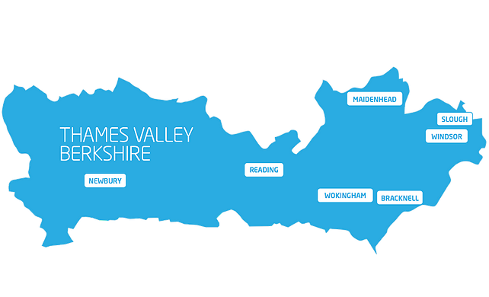
Claimant Count
(Latest data - October 2022)
Total of 16,890 claimants (2.9% of the working age population) in Berkshire.
1,645 claimants (2.1% of the working age population) in Bracknell Forest UA
4,410 claimants (4.2% of the working age population) in Reading UA
4,845 claimants (5.1% of the working age population) in Slough UA
2,150 claimants (2.2% of the working age population) in West Berkshire UA
2,090 claimants (2.3% of the working age population) in Windsor and Maidenhead UA
1,750 claimants (1.6% of the working age population) in Wokingham UA
Across Berkshire, claimant unemployment has fallen significantly from 21,365 in October 2021 to 16,890 in October 2022. Slough had 5.1% of its working age population claim unemployment in October 2022, down significantly from 6.4% in October 2021.
Source: ONS, October 2022

Slide 18
Strategic Issues
Heathrow sees minimal impact from planned Border Force strikes
Heathrow Airport has said that it expected the vast majority of travellers will be unaffected by this month's planned strikes by Border Force workers.
Britain faces an unprecedented number of strikes in the run up to and during the Christmas holiday period, including nurses, ambulance staff and rail workers, as labour unions demand higher pay for their members to keep up with soaring inflation.
“We are doing everything we can to protect a full flight schedule on strike days, so departing passengers should expect to travel as normal," Heathrow said. Border Force has contingency measures to ensure other arriving passengers are cleared safely and as quickly as possible.
Heathrow also gave an update on recent traffic flows. It said 5.6 million people had travelled through the airport in November, down from 5.9 million in October. Over 55 million people had travelled through Heathrow so far this year - nearly 70% of 2019 levels. Heathrow added that it expected December to be busy.
Source: Reuters, November 2022

Slide 19
An important note on the EMSI figures contained on the following slides: 24, 25, 28, 29, 32, 33, 36, 37, 40, 41, 44 and 45
From February 2022, there has been a methodological change in how EMSI calculates job posting figures compared to those from prior months following a merger between EMSI and Burning Glass Technologies (now rebranded to Lightcast).
Those of you who have read previous economic briefings from Berkshire LEP may notice that the job posting figures contained in post-January 2022 briefings are lower across the board – in some cases quite significantly.
This change in methodology does not invalidate previous figures, but it is important to consider when reporting on job posting data longitudinally.
November 2022 onwards, Berkshire LEP will be reporting using two unique views of job postings:
  Active Postings shows all postings that were live within the selected timeframe (even if originally posted in a previous month but left active by the employer).
  Newly Posted shows all postings that were posted within the selected timeframe.

Slide 20
Remote working
In November of 2022, there were 3,439 unique active job postings for remote positions at companies based in Berkshire, around 3.7% lower than the figure of 3,571 for the same period one year before.
Compare this with the South-East, in November 2022 there were 18,836 unique active job postings for remote positions; falling from 19,455 in November of the previous year – a decrease of 3.2%.
A fall can also be seen at national level, with a recorded 136,397 unique active remote job postings in England in November of 2022, falling from 149,559 in November 2021 – a decrease of about 8.8%.
From these figures it’s apparent that the massive boost in job postings for explicitly remote roles prompted by the COVID-19 pandemic has somewhat persisted despite the reduction in cases but there seems to be a declining trend emerging across all geographies. Berkshire has seen a slightly larger decline in vacancies which are remote-based than the South East but a smaller decline in such vacancies than England overall.
Source: EMSI, November 2022

Slide 21
Local Profiles

Slide 22
Bracknell Forest

Slide 23
Unemployment figures and notable business news - November 2022
Claimant unemployment to October 2022 (latest)
1,645 claimants (2.1% of the working age population) in Bracknell Forest UA
Notable business news:
The Bracknell Forest Cambium Partnership, made up of Bracknell Forest Council and Countryside, held a ground-breaking event at the Coopers Hill to mark the start of the building work to create the new homes, a small park, landscaping, cycle lanes and new walkways. The site is part of the overarching plan to fully regenerate Bracknell town centre and will enable more individuals, couples and families to live with the shops, restaurants and leisure facilities of The Lexicon and Bracknell bus and train stations right on their doorstep. The site will also include environmentally friendly features to help reduce climate change, including solar panels on the roofs of all apartments, electric vehicle charging points, AAA rated appliances in all homes, 122 cycle parking bays, sustainable drainage systems and new paths and cycle lanes directly into the town centre- LINK.

Slide 24
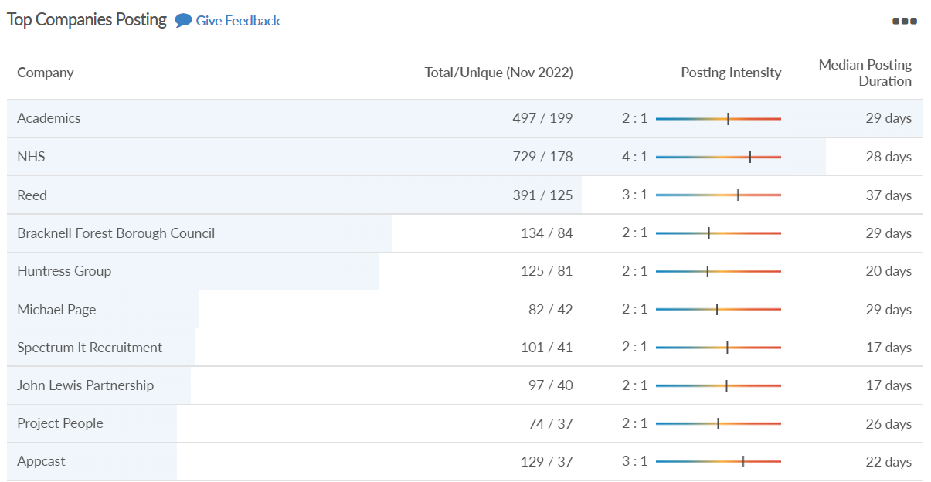
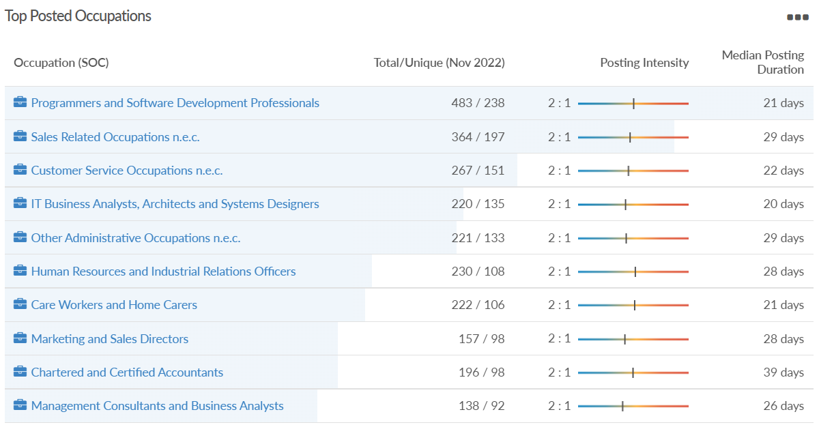
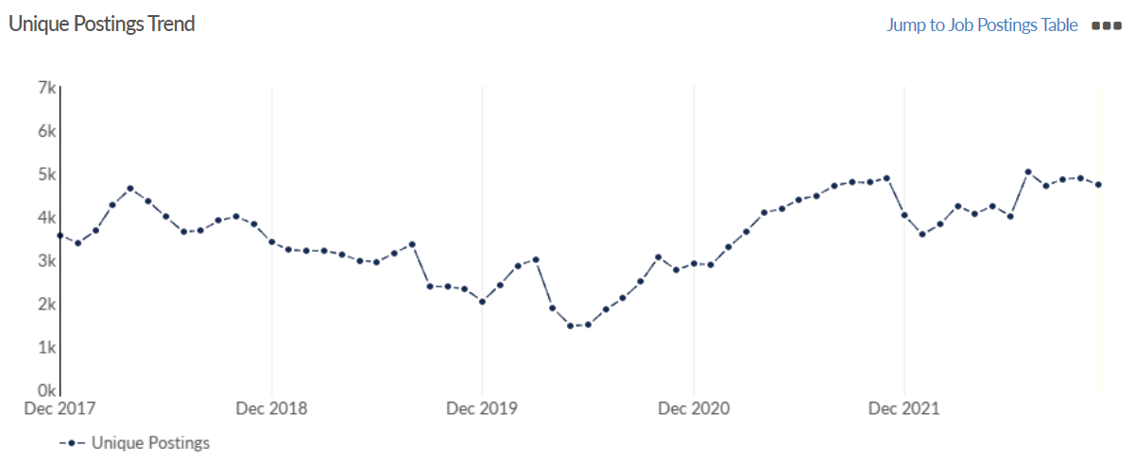
Job posting analytics
(Active postings)
Source: EMSI, November 2022
Unique job postings: 4,735
Total job postings: 9,505
Job posting intensity: 2:1
Unique job postings (November 2021): 4,896

Slide 25
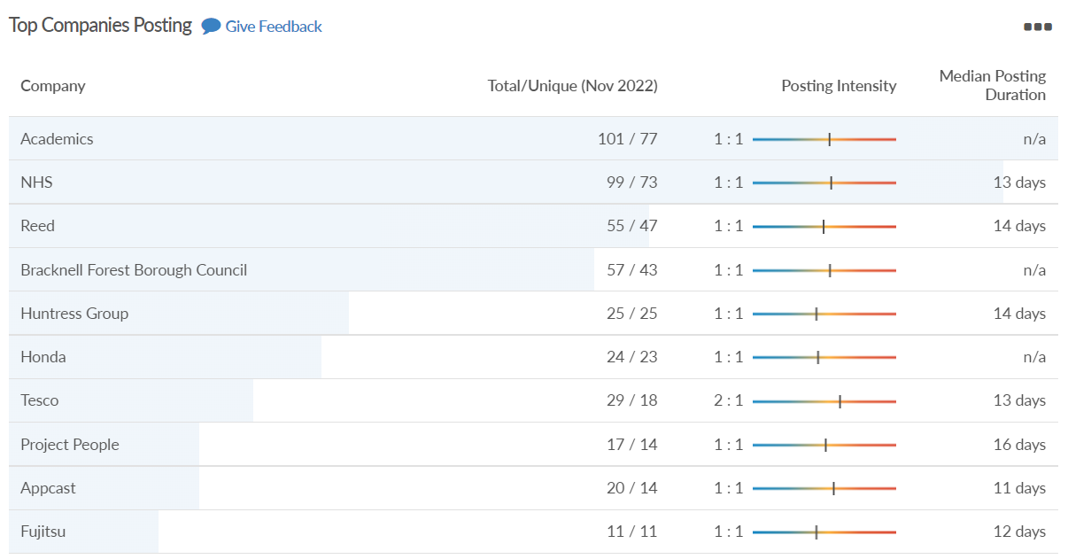
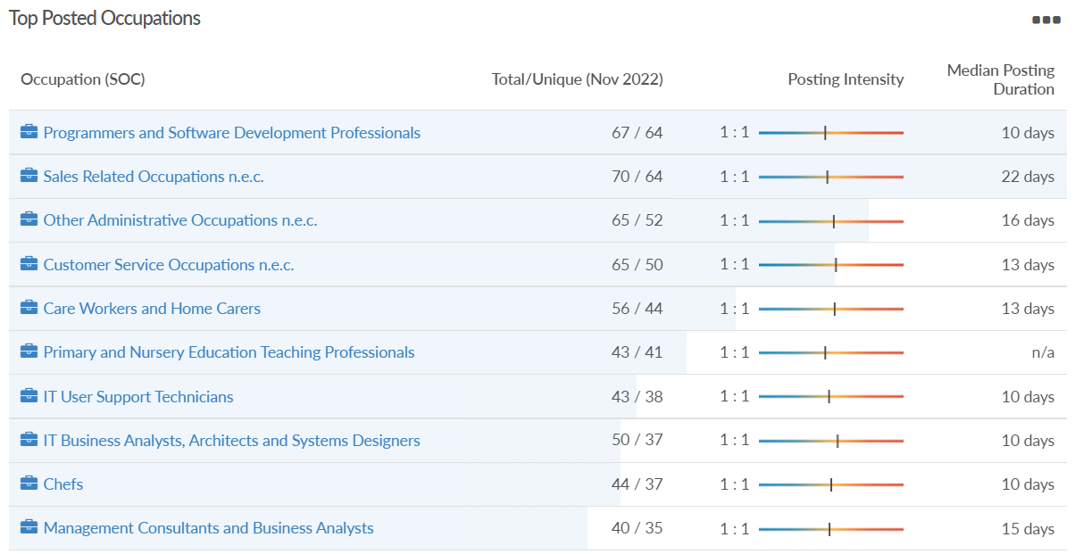
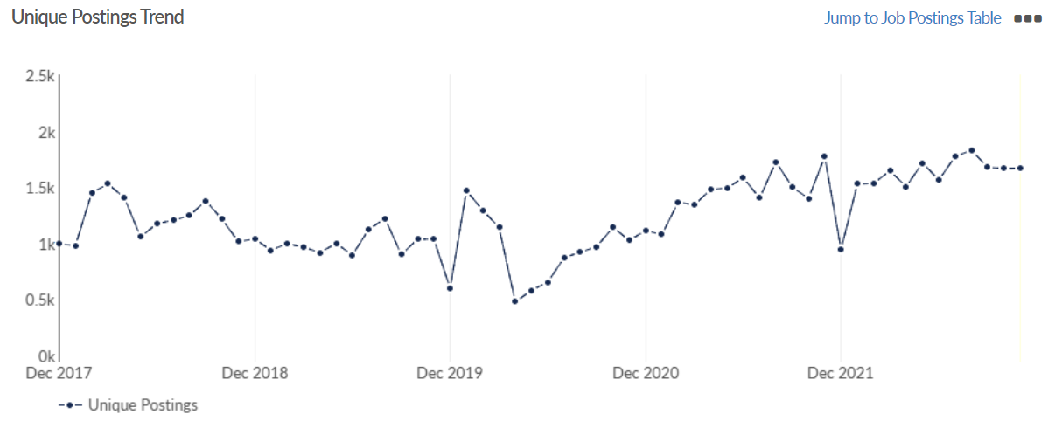
Job posting analytics
(Newly posted)
Source: EMSI, November 2022
Unique job postings: 1,669
Total job postings: 1,972
Job posting intensity: 1:1
Unique job postings (November 2021): 1,773

Slide 26
Reading

Slide 27
Unemployment figures and notable business news - November 2022
Claimant unemployment to October 2022 (latest)
4,410 claimants (4.2% of the working age population) in Reading UA
Notable business news:
From Sunday 6 November, the Elizabeth Line, London's newest tube line, began direct services from stations in central London to Reading without the need to change trains. The new line makes Reading an easy to reach new day trip leisure destination from London with its many cultural, heritage and retail experiences on the banks of the River Thames and Kennett and Avon Canal. The line also seamlessly links Reading to the major business centres of The City, Docklands and the West End and makes Reading a brilliantly connected location for one to two day business meetings and conferences. – LINK.

Slide 28
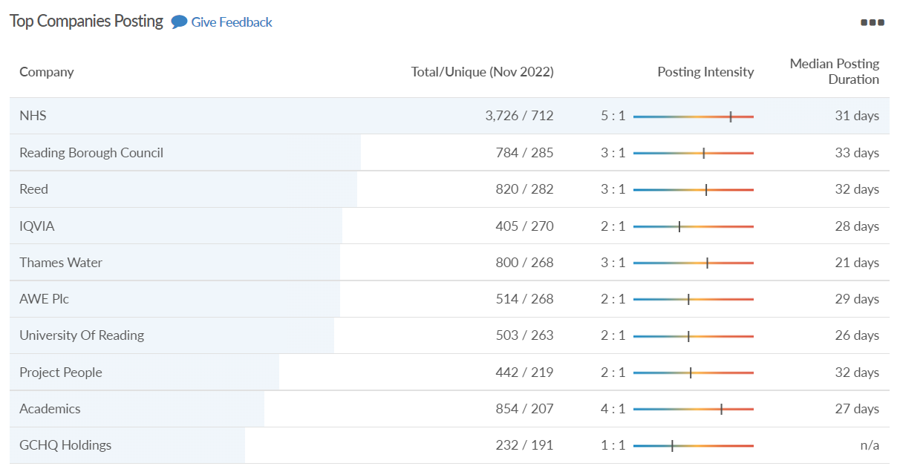
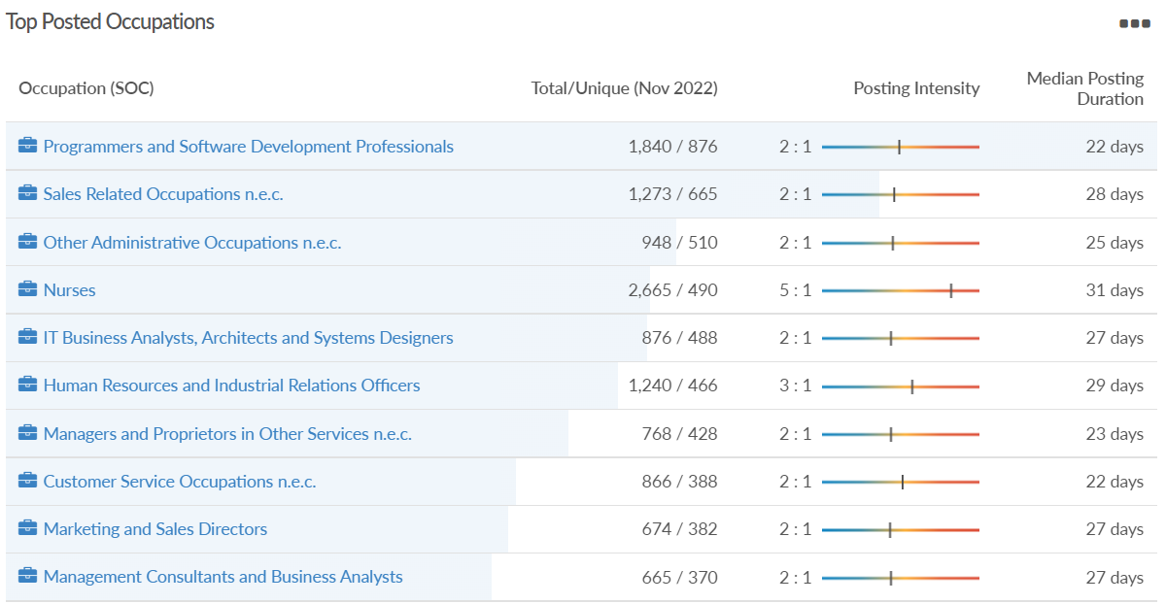
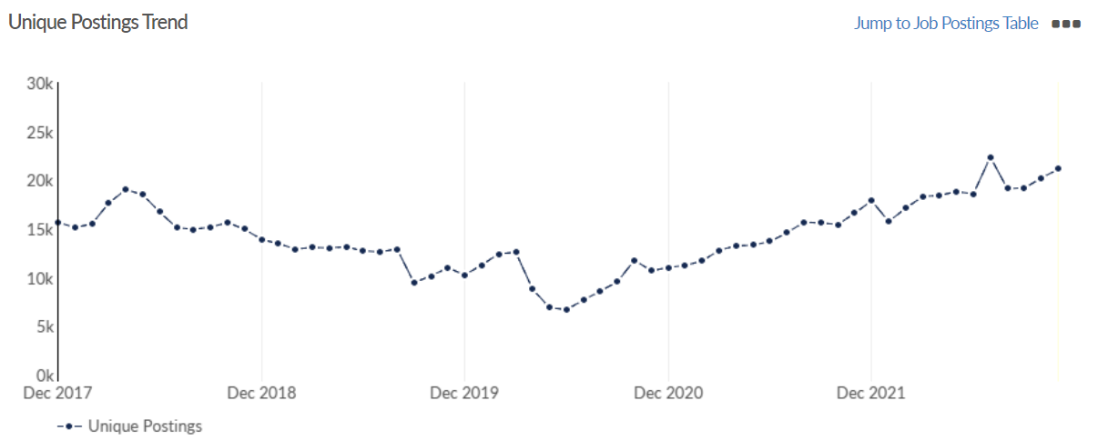
Job posting analytics
(Active postings)
Source: EMSI, November 2022
Unique job postings: 21,132
Total job postings: 45,467
Job posting intensity: 2:1
Unique job postings (November 2021): 16,853

Slide 29
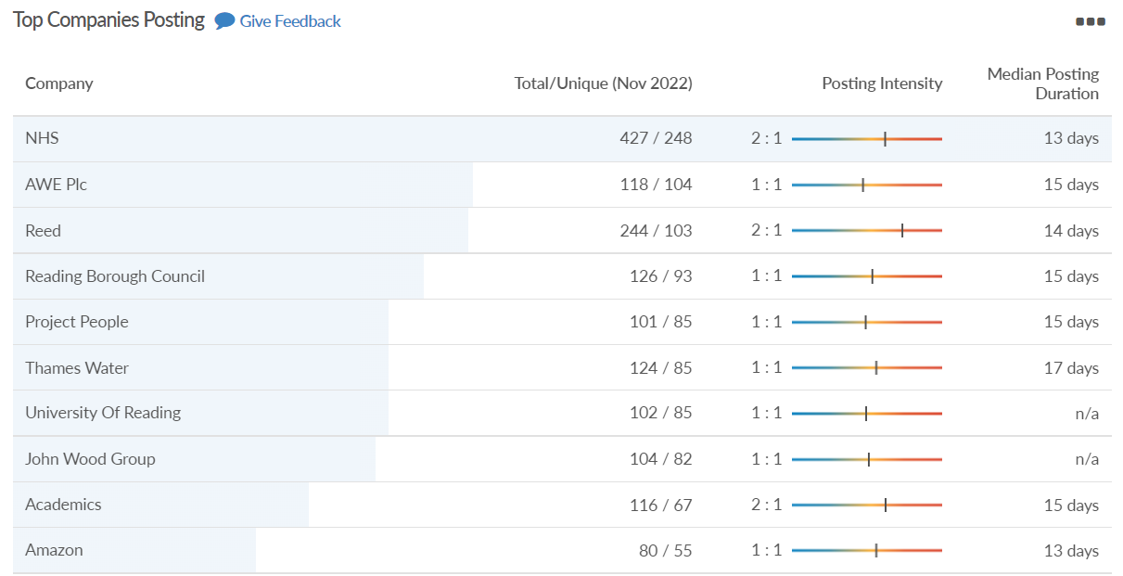
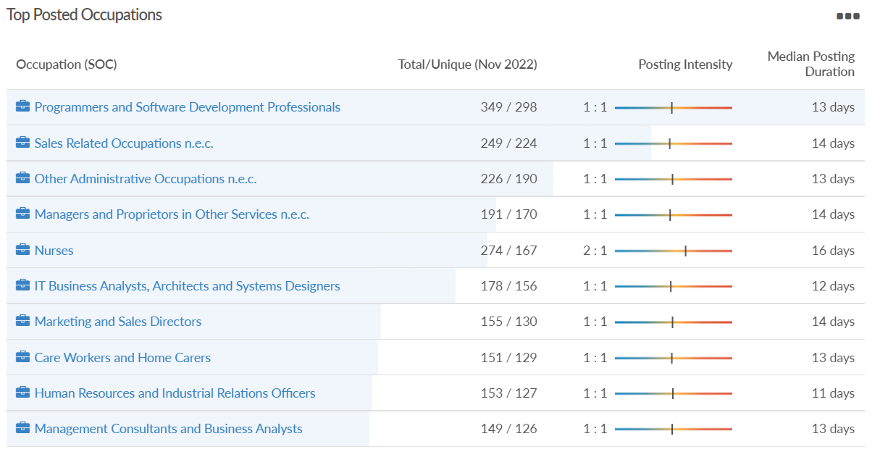
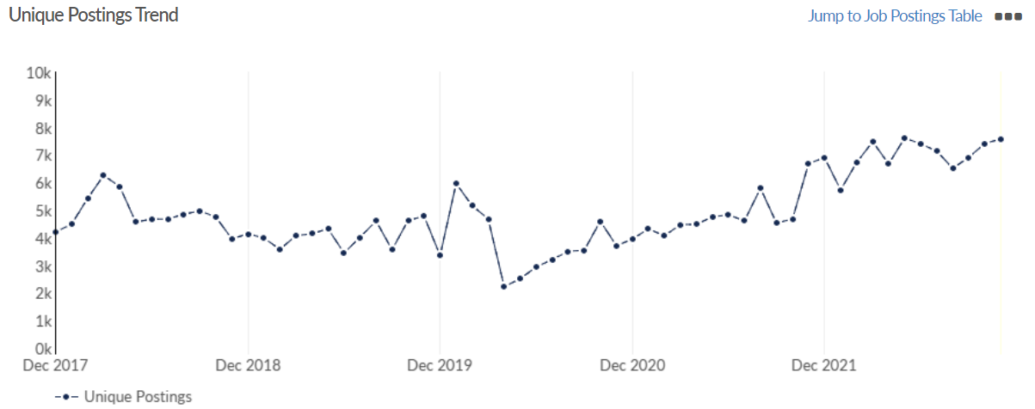
Job posting analytics
(Newly posted)
Source: EMSI, November 2022
Unique job postings: 7,573
Total job postings: 9,229
Job posting intensity: 1:1
Unique job postings (November 2021): 6,686

Slide 30
Slough

Slide 31
Unemployment figures and notable business news - November 2022
Claimant unemployment to October 2022 (latest)
4,845 claimants (5.1% of the working age population) in Slough UA
Notable business news:
Thomson Reuters myPay Solutions, a Slough-based provider of accountancy services, has expanded with the acquisition of a US group. It is an online payroll processing service which has been bought by IRIS Software Group. It provides outsourced payroll and associated banking and tax services via certified public accounting (CPA) firms to small and medium-sized businesses across all 50 US states. Elona Mortimer-Zhika, chief executive of IRIS Software Group, said: "IRIS is committed to delivering the best-of-breed software solutions accounting firms require to successfully manage and grow their firm in today’s evolving business landscape, and myPay Solutions is an ideal addition to our payroll solutions portfolio.” – LINK.

Slide 32
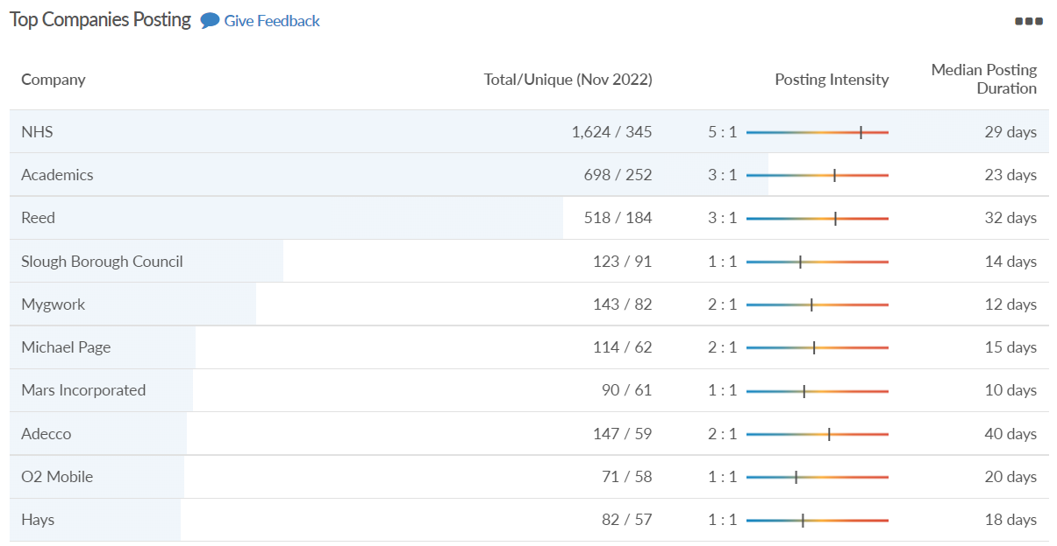
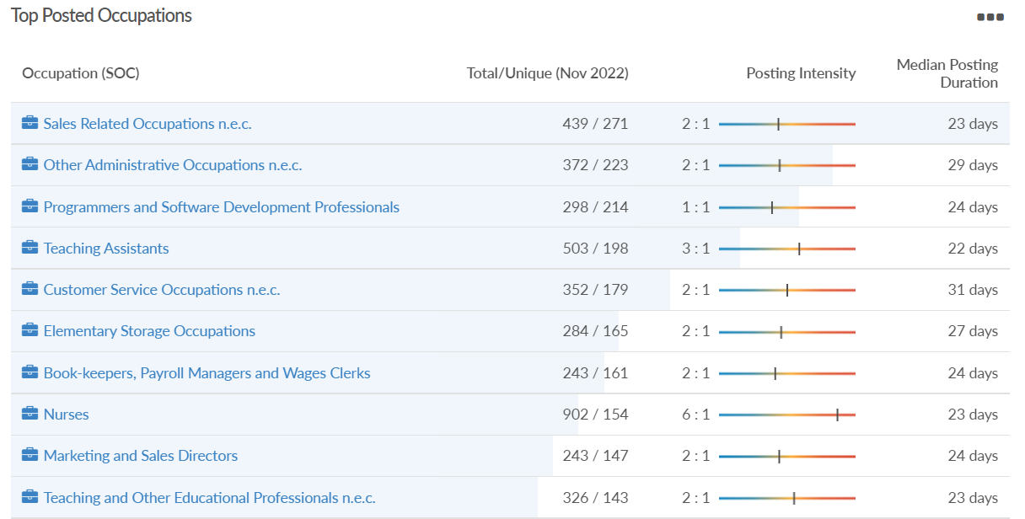
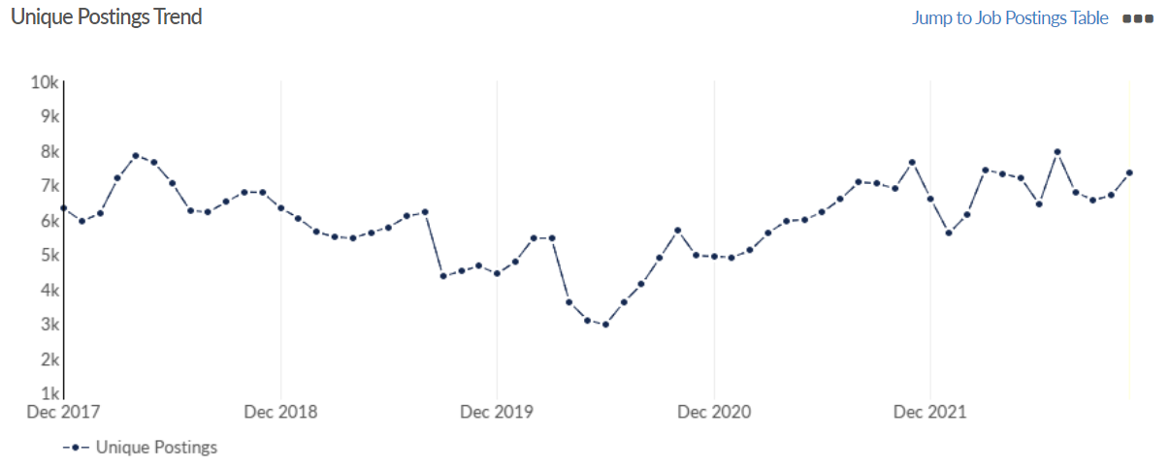
Job posting analytics
(Active postings)
Source: EMSI, November 2022
Unique job postings: 7,339
Total job postings: 14,407
Job posting intensity: 2:1
Unique job postings (November 2021): 7,663

Slide 33
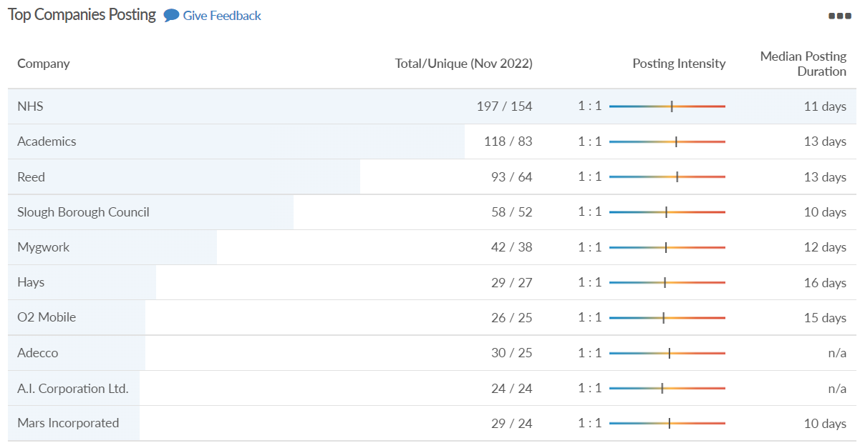
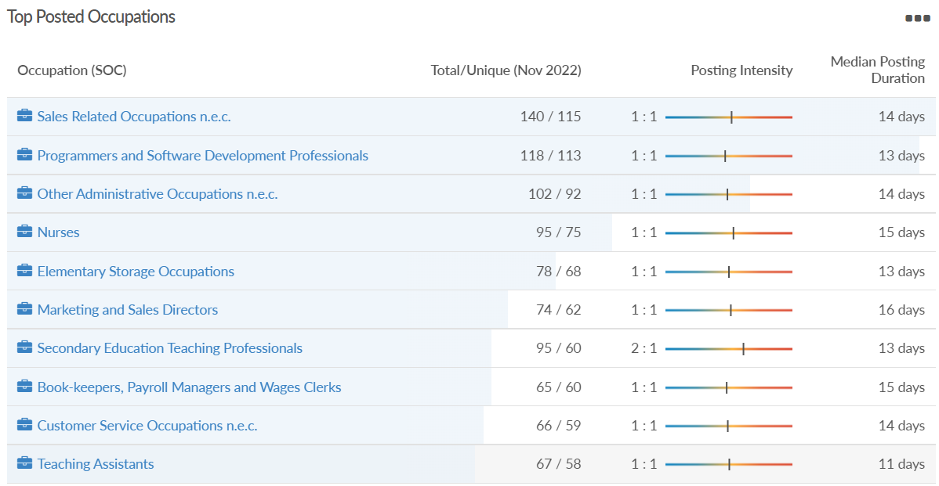
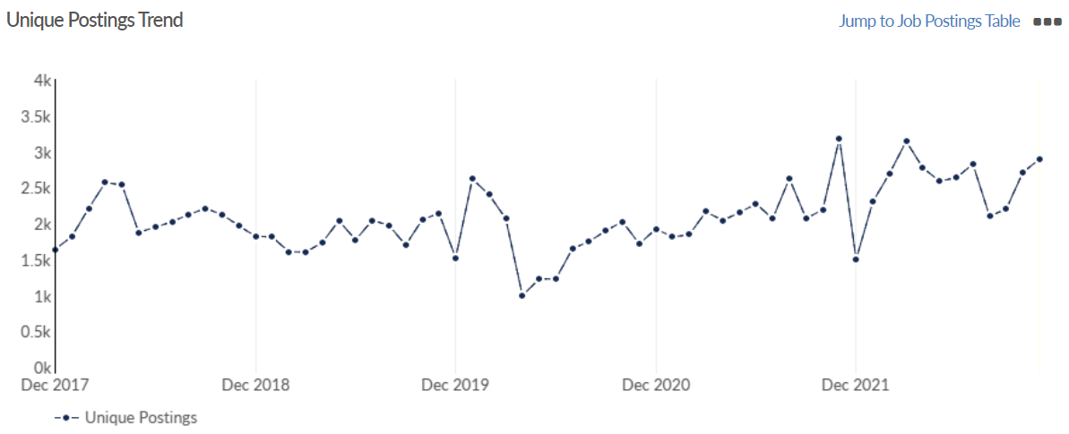
Job posting analytics
(Newly posted)
Source: EMSI, November 2022
Unique job postings: 2,893
Total job postings: 3,295
Job posting intensity: 1:1
Unique job postings (November 2021): 3,182

Slide 34
West Berkshire

Slide 35
Unemployment figures and notable business news - November 2022
Claimant unemployment to October 2022 (latest)
2,150 claimants (2.2% of the working age population) in West Berkshire UA
Notable business news:
On Friday 4 November, West Berkshire Council held the first Rural Business Forum in Shaw House, Newbury. The aim of the event was to bring rural businesses in West Berkshire together and discuss the challenges and opportunities that could be explored with the council; including development, environment and rural community prosperity. The event was attended by a range of sectors including Estates, Farms, Horse Racing, Vineyards and Land Managers. – LINK.

Slide 36
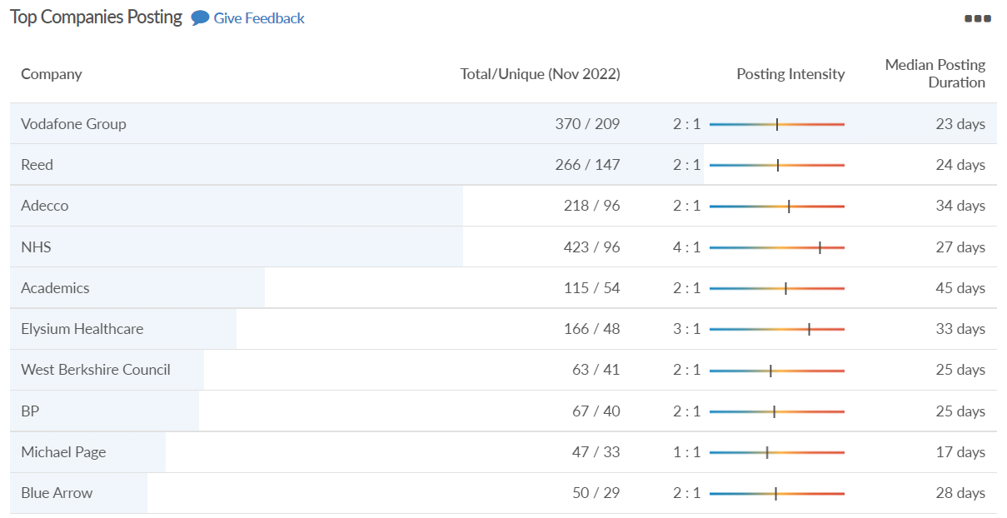
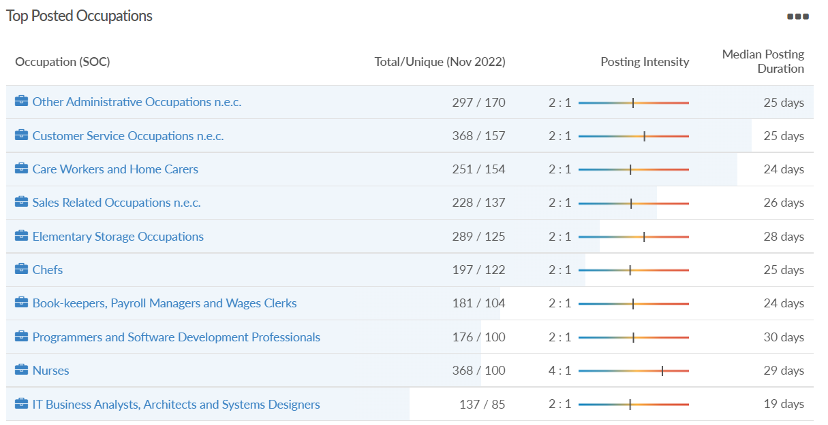
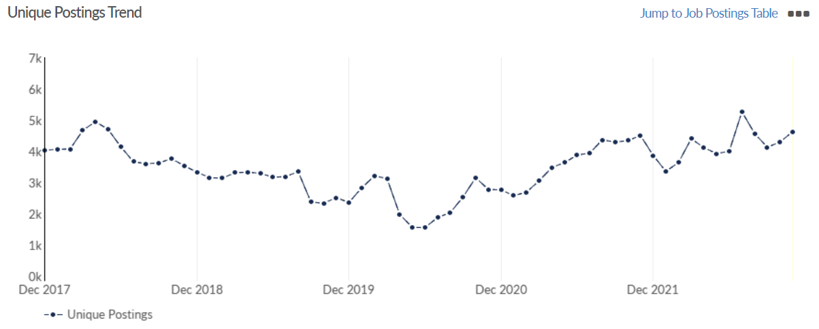
Job posting analytics
(Active postings)
Source: EMSI, November 2022
Unique job postings: 4,627
Total job postings: 8,184
Job posting intensity: 2:1
Unique job postings (November 2021): 4,502

Slide 37
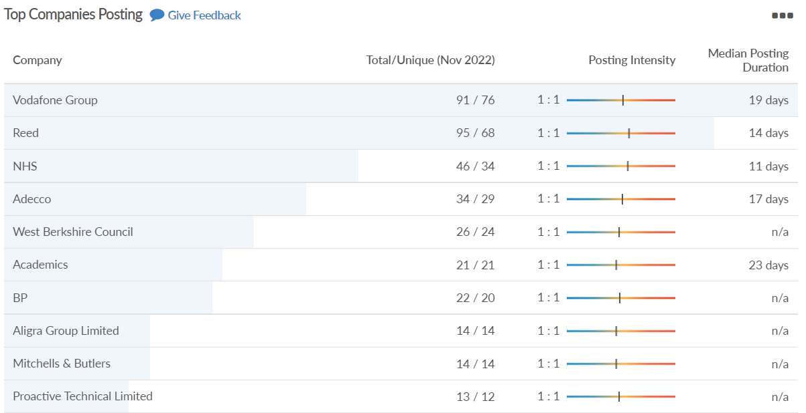
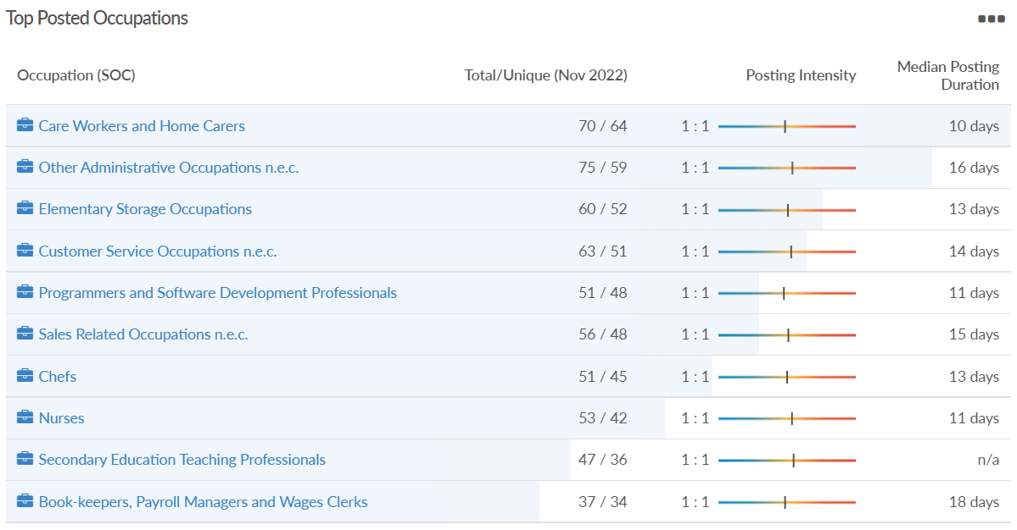
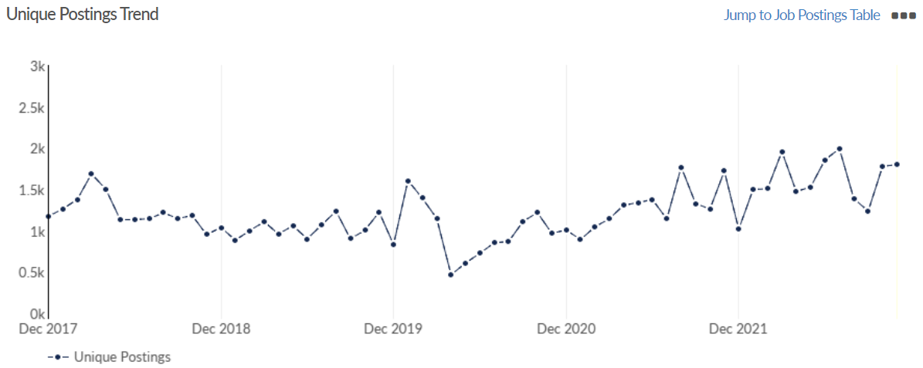
Job posting analytics
(Newly posted)
Source: EMSI, November 2022
Unique job postings: 1,801
Total job postings: 2,040
Job posting intensity: 1:1
Unique job postings (November 2021): 1,721

Slide 38
Windsor and Maidenhead

Slide 39
Unemployment figures and notable business news - November 2022
Claimant unemployment October 2022 (latest)
2,090 claimants (2.3% of the working age population) in Windsor and Maidenhead UA
Notable business news:
Norden Farm in Maidenhead has teamed up with The Curve in Slough after receiving £977,046 in funding from Arts Council England. The funding will support a new partnership to develop the venue at The Curve in Slough as a 'key cultural community hub' for the town. The project aims to develop creativity to people in Slough and the Royal Borough from a wider range of backgrounds, with a main focus on children, young people and families. Norden Farm will work with its partners to reach disadvantaged children and families in the local area, with participants given access to a free programme of creativity workshops led by experienced practitioners. – LINK.

Slide 40
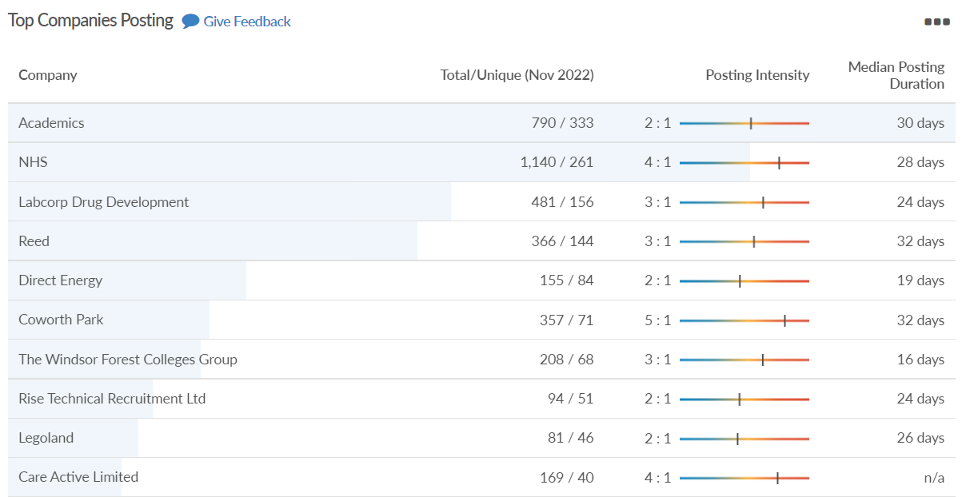
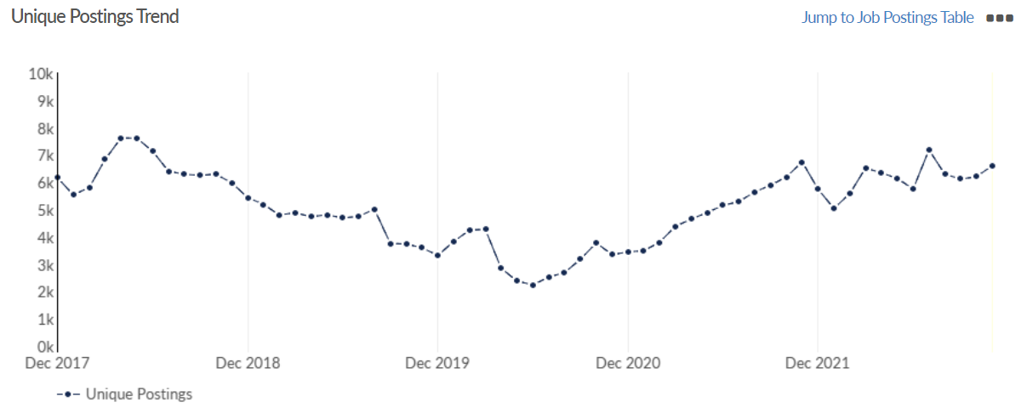
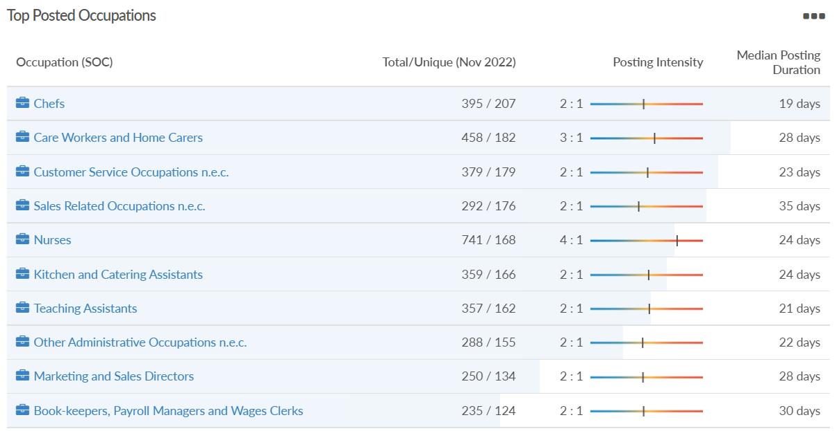
Job posting analytics
(Active postings)
Source: EMSI, November 2022
Unique job postings: 6,612
Total job postings: 13,541
Job posting intensity: 2:1
Unique job postings (November 2021): 6,742

Slide 41
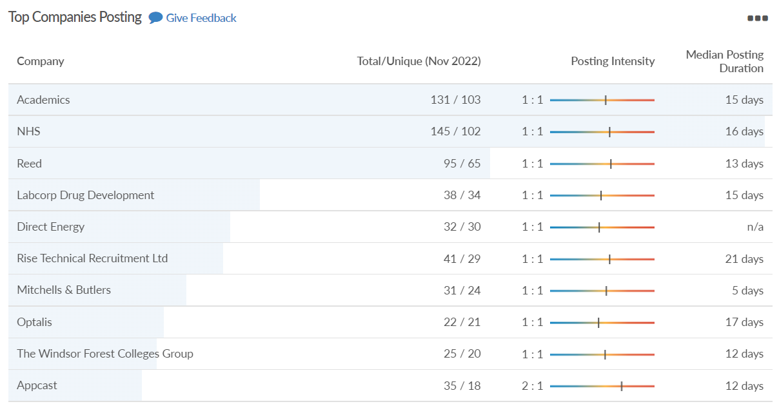
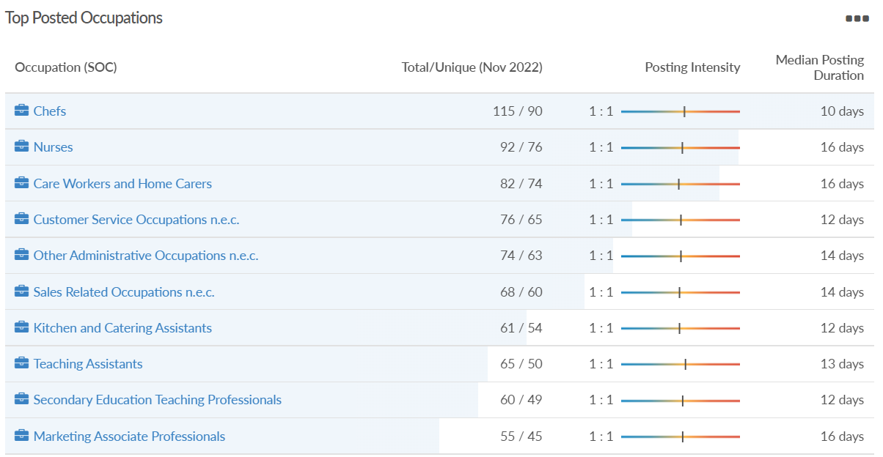
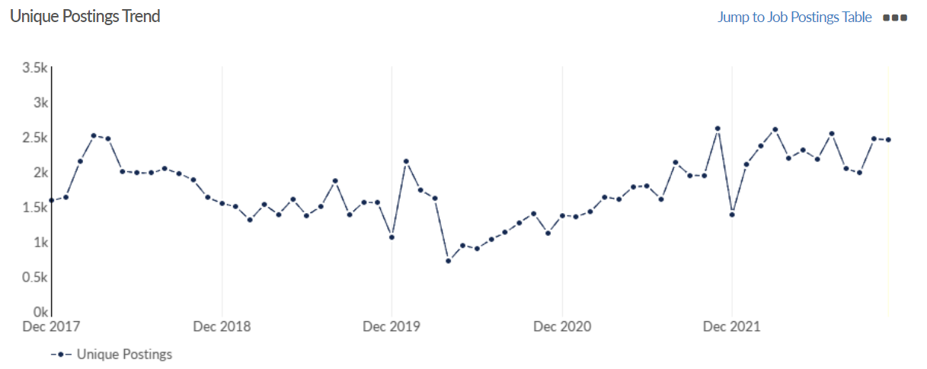
Job posting analytics
(Newly posted)
Source: EMSI, November 2022
Unique job postings: 2,455
Total job postings: 2,835
Job posting intensity: 1:1
Unique job postings (November 2021): 2,619

Slide 42
Wokingham

Slide 43
Unemployment figures and notable business news - November 2022
Claimant unemployment to October 2022 (latest)
1,750 claimants (1.6% of the working age population) in Wokingham UA
Notable business news:
Wokingham start-up company Helios Energy Systems is looking to help lower income homes get energy efficient heating solutions, after winning fresh financial backing. Comprising a team of three, it has developed a new technology that enables heat exchanger storage units to safely operate at higher temperatures and store more energy at a lower cost, making them cheaper than current battery storage systems. Ebico’s Ignite scheme was launched in August, and provides firms offering innovations in affordable heating with funding between £5,000 and £10,000. Four firms secured the scheme’s Innovation Support Award, including Helios. – LINK.

Slide 44
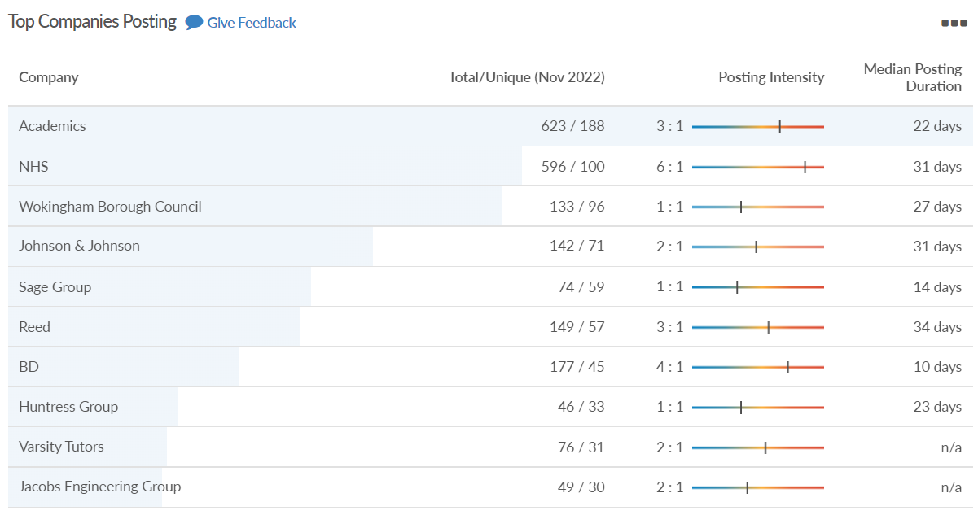
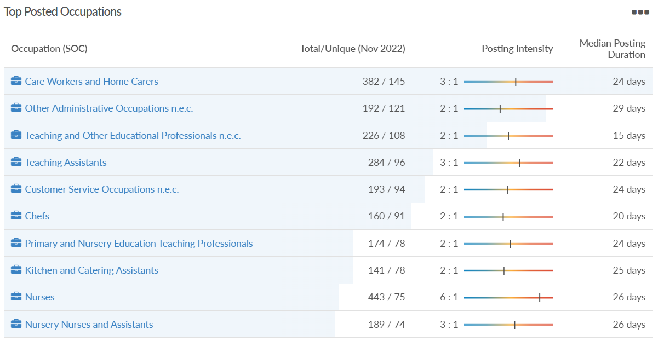
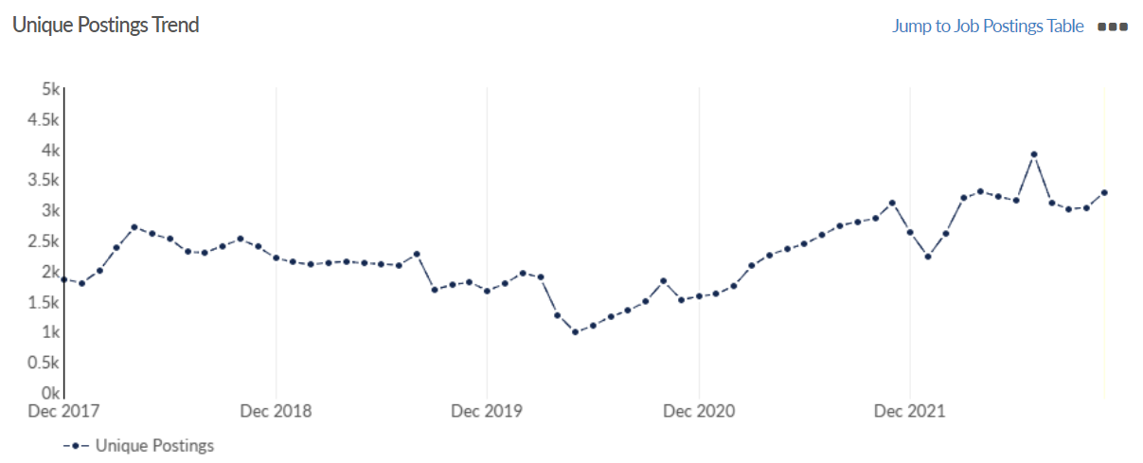
Job posting analytics
(Active postings)
Source: EMSI, November 2022
Unique job postings: 3,287
Total job postings: 6,848
Job posting intensity: 2:1
Unique job postings (November 2021): 3,114

Slide 45
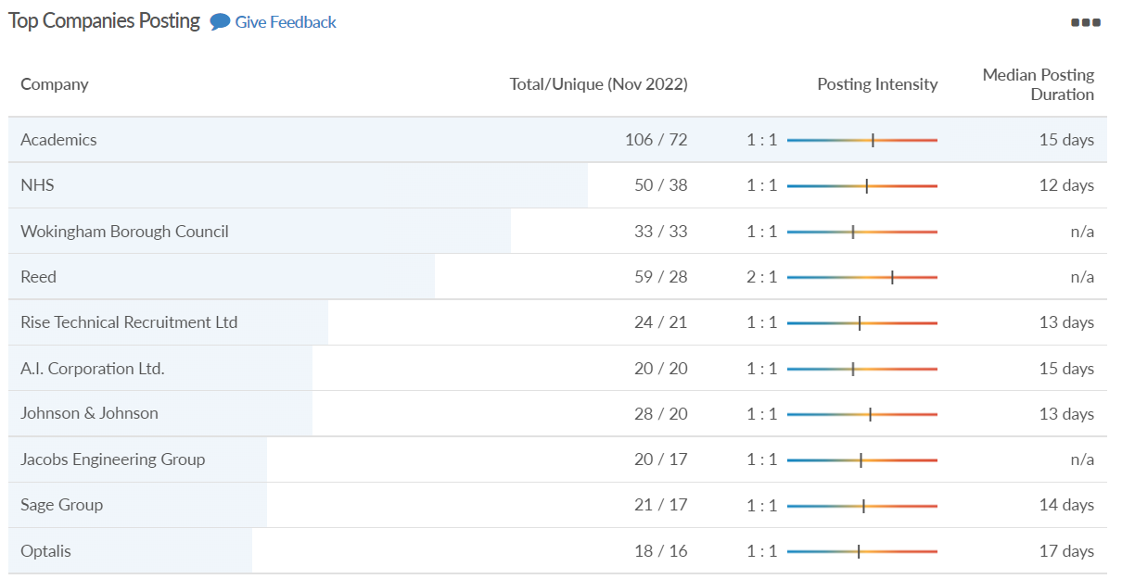
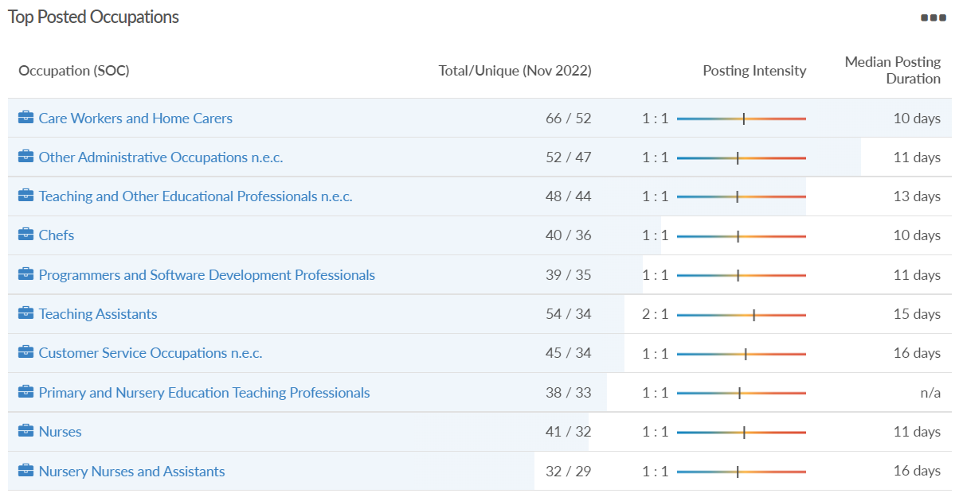
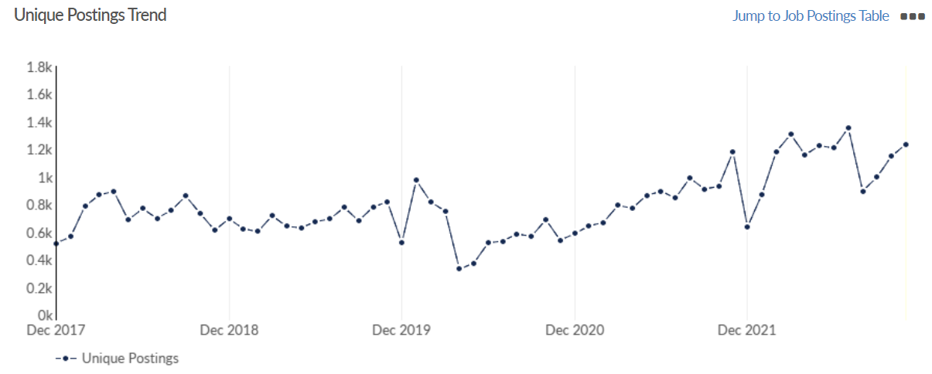
Job posting analytics
(Newly posted)
Source: EMSI, November 2022
Unique job postings: 1,236
Total job postings: 1,482
Job posting intensity: 1:1
Unique job postings (November 2021): 1,181

