Slide 1
Thames Valley Berkshire
Monthly Economic Briefing
January 2021

Slide 2
Global and National Economy
January 2021

Slide 3
Global Economy
The global economy is expected to expand 4% in 2021 (after a 4.3% contraction in 2020), assuming an initial COVID-19 vaccine rollout becomes widespread throughout the year.
A recovery, however, will likely be subdued, unless policy makers move decisively to tame the pandemic and implement investment-enhancing reforms
Although the global economy is growing again after a 4.3% contraction in 2020, the pandemic has caused a heavy toll of deaths and illness, plunged millions into poverty, and may depress economic activity and incomes for a prolonged period.
Top near-term policy priorities are controlling the spread of COVID-19 and ensuring rapid and widespread vaccine deployment. To support economic recovery, authorities also need to facilitate a re-investment cycle aimed at sustainable growth that is less dependent on government debt.
Source: World Bank, Jan 2021
The world economy in 2020 was dominated by a massive economic slump in the spring, followed by a rapid recovery in the summer. Then the rising number of infections in the fall halted the recovery process. Economic development in 2021, as it did in 2020, will depend to a large extent on the Coronavirus pandemic.
Developed economies will not reach pre-crisis economic levels until 2022 - In the International Monetary Fund (IMF) forecast published in June 2020, the IMF assumed a global GDP decline of almost 5 percent for 2020! . Although economic output was expected to increase in 2021, Germany and other industrialized countries are not expected to return to their pre-corona pandemic GDP levels until 2022.
Source: Global Economic Dynamics, Jan 2021
Risk of high unemployment:
The OECD area unemployment rate continued to decline in November 2020, to 6.9%, from 7.1% in October, but remained 1.7 percentage points above the level observed in February 2020, before the COVID19 pandemic hit the labour market. It continued to decline faster among women (to 7.0% in November, from 7.2% in October) than among men (to 6.8%, from 6.9%). Similar declines were observed for the youth (aged 15 to 24) (to 14.3%, from 14.4% in October) and for people aged 25 and above (to 6.0%, from 6.1%). 45.5 million persons were unemployed in the OECD area, 10.7 million more than in February.
Source: OECD, January 2021

Slide 4
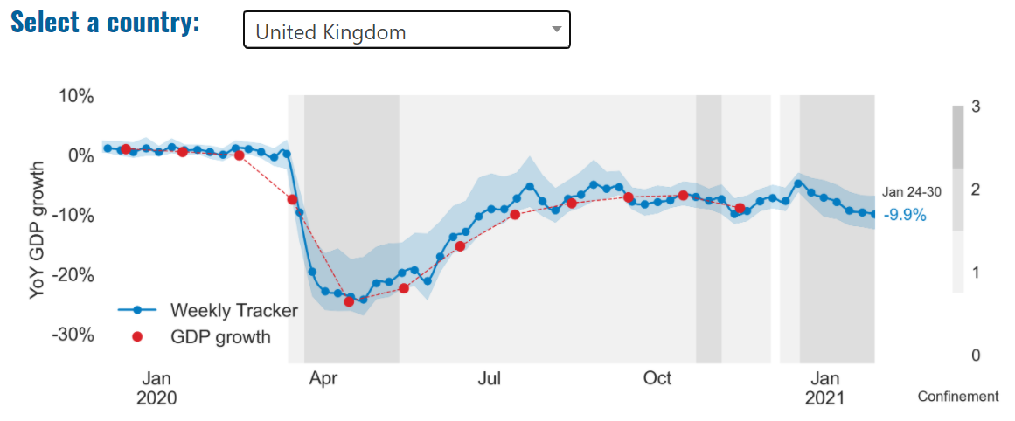
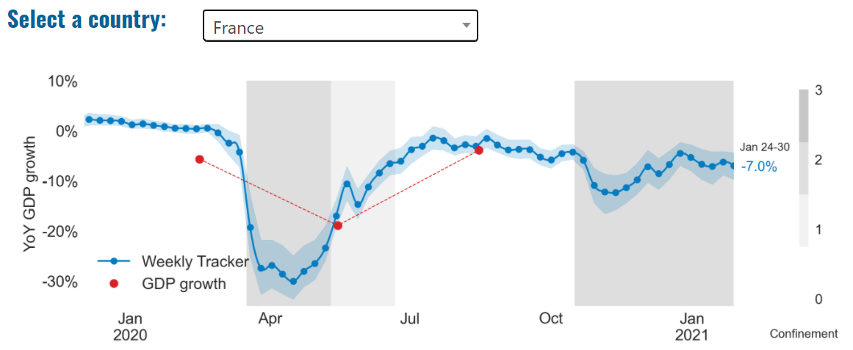
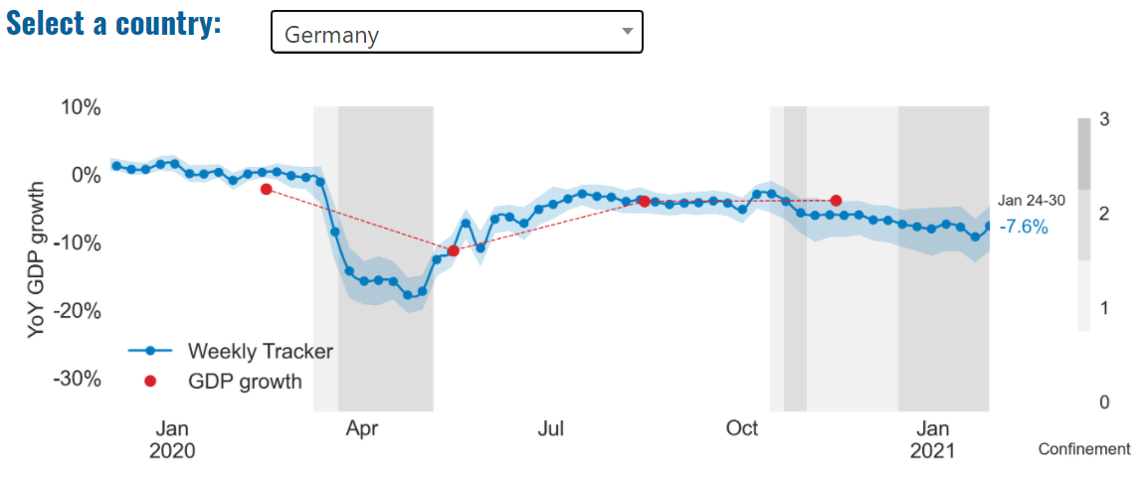
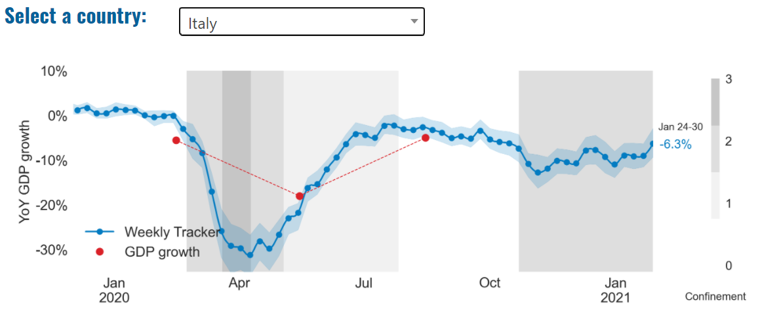
Global Economy – OECD GDP Tracker

Slide 5
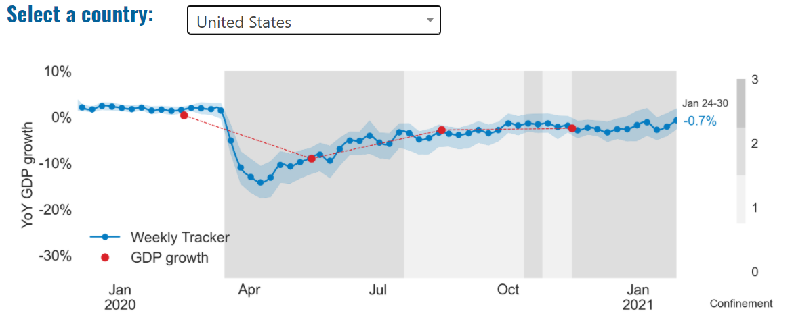
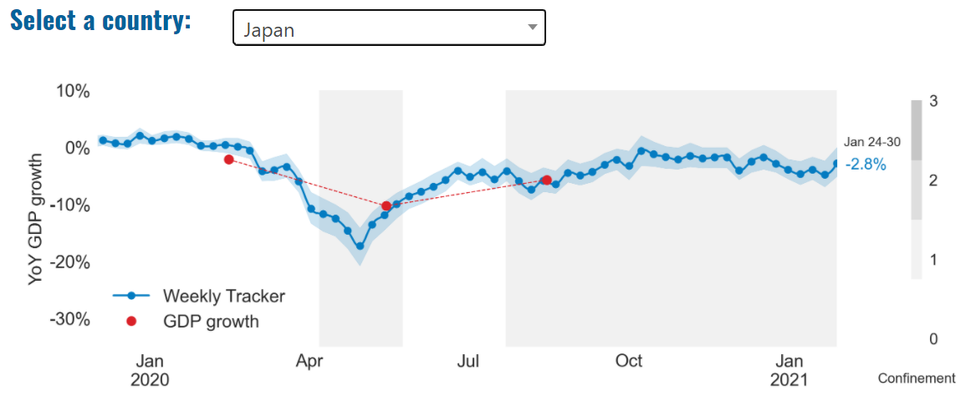
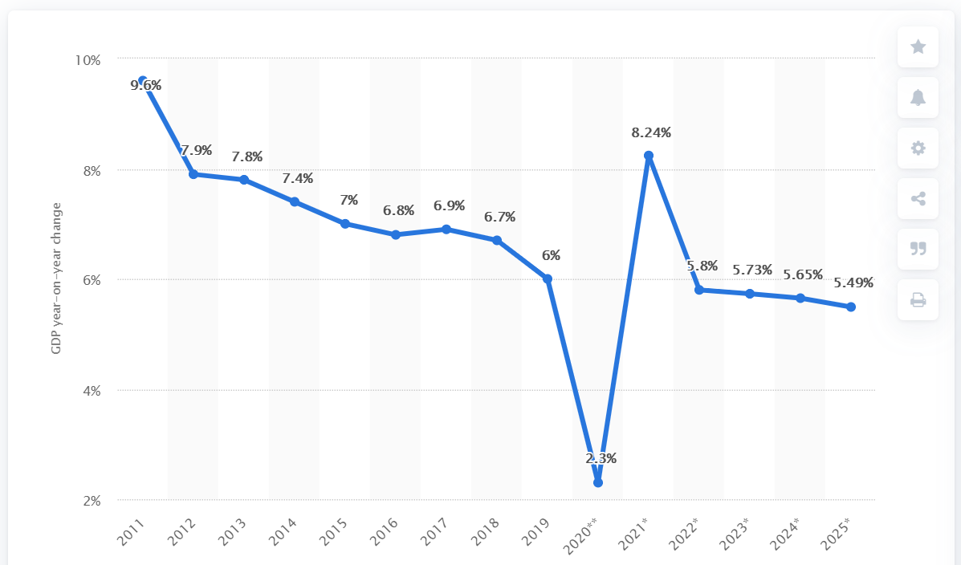
Global Economy – OECD GDP Tracker Continued
China
China is not included within the OECD GDP tracker and so the graph on the left has been compiled using statistics from the IMF and National Bureau of Statistics of China. The 2021 figure is a preliminary figure published by the National Bureau of Statistics of China in January 2021.
Note: The blue confidence band shows 95% confidence intervals. The darkness of the grey background reflects stay-at-home confinement requirement based on the Oxford Blavatnik database (0 - no measures, 1 - recommend not leaving house, 2 - require not leaving house with exceptions, 3 - require not leaving house with minimal exceptions).
Source: OECD, January 2021

Slide 6
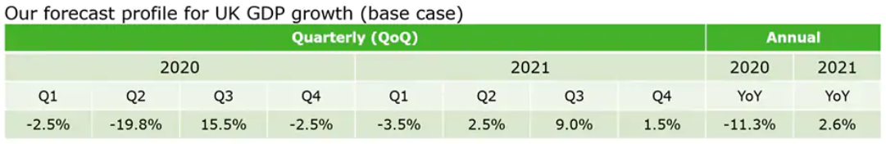
UK Economy
“Looking forward, we have revised our projections for the UK economy. Under our ‘slow recovery’ and ‘quick recovery’ scenarios, the expected annual GDP growth rates range from around 2.2% to 4.8% in 2021, accelerating to around 5.1% to 6.3% in 2022 before slowing down to about 1.7% and 2.0% in 2023. Under the ‘quick recovery’ scenario we expect 2021 to be an important year in which most of the output loss caused by the first national lockdown would be recovered.
However, there is still significant uncertainty over the pace and the path of the recovery in 2021, including the speed of the vaccine rollout and its effectiveness in limiting the spread of the virus, especially its new variants. Additional key risks include the duration of England’s third national lockdown, the extent to which businesses adapt to new trading arrangements with the EU, the outcome of the US-UK trade negotiations, and the degree of economic scarring.”
Source: PwC, Jan 2021
“We have revised our UK GDP numbers to reflect the impact on activity of restrictions needed to contain the new COVID-19 variant. The main change is a larger contraction in the first quarter, but we expect the downturn in GDP to be smaller than in the first half of 2020, given increased business preparedness and continued fiscal and monetary support. In the second quarter we expect the rollout of the vaccine and warmer weather to allow for a modest easing of restrictions, followed by a strong bounce in the third quarter as vaccine coverage exceeds 50% of the population.”
Source: Deloitte, Jan 2021

Slide 7
UK Economy Continued
“The contraction in Q1 this year will be significantly milder than at the start of the pandemic.
The prospect of vaccines reaching all vulnerable groups by April could herald a gradual easing of social restrictions with a return to normal by the autumn in our main scenario. This could see GDP grow by 4.2% in 2021. While the UK managed to secure a deal with the EU, avoiding significant disruptions to trade, the realities of the new trading relationship will dampen economic growth for a while.
Uncertainty about progress in combating the pandemic could see growth oscillate between 5.6% in our upside scenario and 2.2% in our downside scenario in 2021.
Government intervention, and in particular its Job Retention Scheme, should help keep unemployment relatively low considering the size of the negative shock experienced by the economy. Unemployment could peak at 6.3% this summer and average 6% this year.
The expiry of the VAT cut to hospitality businesses should see inflation rise in April, although we expect the headline inflation rate will remain below the Bank of England’s 2% target over the next two years.
A lack of significant inflationary pressures will provide room for monetary policy to support the economic recovery through further quantitative easing while base interest rate is expected to remain unchanged.
The deficit for the current fiscal year, which ends in March 2021, could reach nearly £380bn. While it should fall in fiscal year 2021-22, next year’s expected figure of £188bn remains substantial.”
Source: KPMG, January 2021

Slide 8
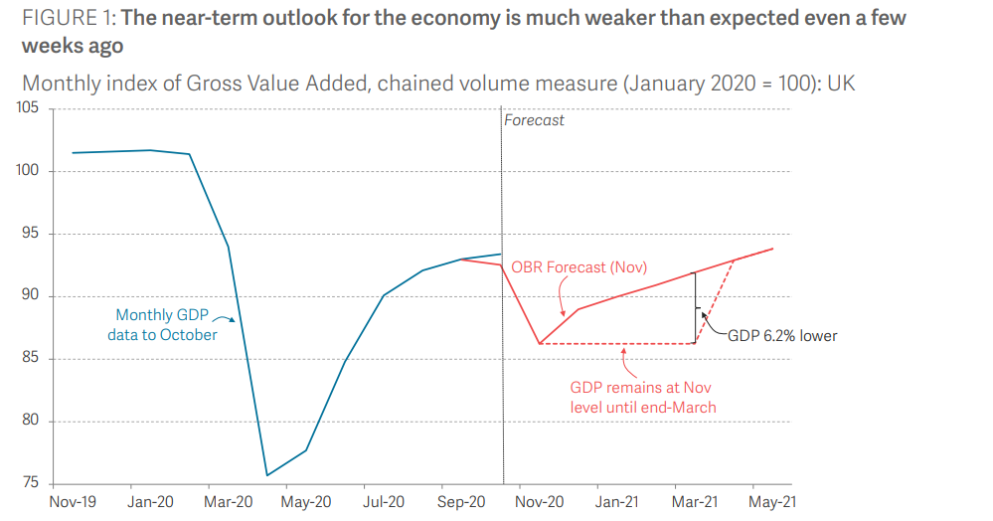
UK Economy – Projected GVA
To illustrate a plausible path for the economy, Figure 1 takes the OBR’s November forecast and assumes that monthly output remains at its November level (reflecting the fact that Tier 4 is the equivalent of repeating the second lockdown) until Easter before returning to its forecast path (which included the impact of some ongoing restrictions). This would see the economy being 6 per cent smaller by Easter than forecast by the OBR just last month and reduce growth for 2021 as a whole from 5.5 to 4.3 per cent. Note this assumes a Brexit deal is done. Clearly even maintaining the levels of output seen in November would be unlikely amidst the widespread disruption and higher unemployment of a no deal Brexit. Note this OBR forecast was based on a Brexit deal being done so is the right baseline for this thought experiment.
Source: Resolution Foundation analysis of ONS; OBR, December 2020

Slide 9
Coronavirus and Recession: Implications for Thames Valley Berkshire

Slide 10
Furloughing (October 2020 – latest data)
4,500 jobs (7% of total eligible employments) furloughed in Bracknell Forest UA
7,800 jobs (10% of total eligible employments) furloughed in Slough UA
6,100 jobs (6% of total eligible employments) furloughed in Reading UA
5,400 jobs (6% of total jobs) furloughed in Wokingham UA
6,200 jobs (9% of total jobs) furloughed in Windsor and Maidenhead
4,900 jobs (6% of total jobs) furloughed in West Berkshire
Source: HMRC, December 2020
Berkshire has a lower-than-average number of furloughed workers, compared to the rest of the UK, because of its relative strength in sectors of industry that can be continued by workers from home.

Slide 11
SEISS (November 2020 – latest data)
Total value of claims made for Bracknell Forest UA – SEISS 1: £17,000,000
SEISS 2: £13,400,000
Total value of claims made for Slough UA – SEISS 1: £20,500,000
SEISS 2: £16,500,000
Total value of claims made for Reading UA – SEISS 1: £18,100,000
SEISS 2: £14,100,000
Total value of claims made for Wokingham – SEISS 1: £19,400,000
SEISS 2: £14,900,000
Total value of claims made for Windsor and Maidenhead – SEISS 1: £17,200,000
SEISS 2: £13,400,000
Total value of claims made in West Berkshire – SEISS 1: £19,800,000
SEISS 2: £14,900,000
Source: HMRC, November 2020

Slide 12
Claimant Count (December 2020)
Total of 29,985 claimants in December 2020 in Berkshire
3,420 claimants (4.3% of the working age population) in Bracknell Forest UA
8,080 claimants (8.5% of the working age population) in Slough UA
6,880 claimants (6.4% of the working age population) in Reading UA
3,550 claimants (3.4% of the working age population) in Wokingham UA
4,270 claimants (4.6% of the working age population) in Windsor and Maidenhead UA
3,795 claimants (3.9% of the working age population) in West Berkshire UA
Across Thames Valley Berkshire, claimant unemployment has almost tripled in the last year, rising from 10,510 in December 2019 to 29,985 in December 2020. Slough had 8.5% of its working age population claimant unemployed in December 2020, up from 2.8% in December 2019.
Source: ONS, December 2020

Slide 13
Strategic Issues: Aviation
Heathrow Airport:
London Heathrow lost its top spot among European airports last year as travel curbs tied to the coronavirus pandemic kept passengers away. Heathrow’s 73% drop left it trailing both Istanbul’s new hub, which attracted 23.4 million travelers in its first full calendar year of operation, and Paris Charles de Gaulle, which retained the No. 2 spot.
76,000 people work in over 400 business across Heathrow Airport. Many of these people live in Slough, in Berkshire. Sources: Bloomberg, January 2021 and Heathrow local recovery plan, 2020
Aviation:
Industry leaders have said the UK’s aviation sector urgently needs more government support if it is to survive another lengthy period of travel restriction, as they warn of a deepening financial crisis over the coming months. From Monday, international arrivals to the UK will be required to quarantine for 10 days, in an effort to stem the spread of any new coronavirus variants amid a worsening incidence of transmission around the world.
Aviation has an estimated value of £28 billion to the UK economy, employing 230,000 workers at over 40 commercial airports.
There were 5,800 passenger flights in April 2020 compared to 201,000 a year earlier: a reduction of 97%. The impact is several times more severe than the aftermath of the global financial crisis in 2008, when passenger flights reduced by around 67,000 to 134,000 per month.
The UK aviation industry has been hit harder than any European country by the pandemic with IATA calculating that the “coronavirus crisis will cost 780,000 British jobs and cost £46bn in lost GDP.”
Sources: The Guardian (Jan 2021), House of Commons Transport Committee (June 2020) and International Air Transport Association (2020)

Slide 14
Demand and Supply Conditions: Businesses, Hiring, Restructuring, Investment, Labour and Skills Supply

Slide 15
Household/Consumer Demand
High street retail sales rose slightly in January 2021 from the 2020 baseline around Christmas, yet spend is still incredibly low in both Reading and Slough – peaking on the spend index in January at 23 and 41 for Reading and Slough respectively.
Source: Centre for Cities, January 2021
A record total of 31.4% of shopping was done online in November 2020.
Despite the above, at a national level there has been the biggest fall in UK retail sales since 1995, with the impact of COVID lockdowns and shifting spending habits resulting in 0.3% drop from 2019 level. However, the overall drop in spending masks an explosion in sales for some shops, and a dramatic collapse for others. Amid a decline in spending in pubs, restaurants and hotels during the crisis, sales of food bought from shops increased by 5.4% on the year. However, sales of all other products fell 5% from a year earlier.
Source: Guardian, January 2021
Demand for increased digital capability has been exacerbated by the pandemic, with Statistics suggesting that up to 1.78 million students faced challenges with home schooling due to a lack of access to internet connections or devices during the previous lockdowns. This is supported by our recent (serendipitously timed) Nominet research which found that half of British parents worry that their children’s education will be impacted due to a lack of tech in the home, and only one in four parents (26%) are able to provide their children with uninterrupted access to the internet for home learning.
Sources: Children’s Commissioner, August 2020 and Nominet, January 2021

Slide 16
Industries at Risk
MANUFACTURING
28,000 people work in manufacturing in Berkshire – with 11,000 in West Berkshire alone and 2,487,000 across the whole of Great Britain (ONS, 2020)
Half of all UK manufacturing firms have made redundancies. A further 20% plan to make more redundancies in the next six months (Make UK, October 2020)
37% of manufacturers think it will take more than a year to return to normal trading conditions (Make UK, October 2020)
HOSPITALITY & TOURISM
The hospitality and tourism sector in Berkshire employed 35,842 people in 2020 – an increase of 0.8% on the previous year (EMSI, 2021)
In June, ‘Pathways to Recovery’, a report by the All Party Parliamentary Group on Hospitality and Tourism, found that just 11% of hospitality businesses had been able to operate normally during the first lockdown and international tourist arrivals were likely to be down 59% for the year.
Kate Nicholls, CEO of UK Hospitality, told the BBC (December 2020) that 30,000 hospitality businesses – most of them SMEs and one-third of the total – could be lost by the end of 2020.
According to Sky News in December, at least 38,653 hospitality jobs had been lost during the pandemic.
CONSTRUCTION
21,000 people work in construction in Berkshire – with only 1,500 of these working in Bracknell Forest and 2,164,000 across the whole of Great Britain (ONS, 2020)
The level of construction output in August 2020 was 10.8% below the February 2020 level (ONS, 2020)
Construction output grew by 18.5% in the three months to August 2020 compared with the previous three-month period, but this followed 10 consecutive periods of decline (ONS, 2020)
NON-FOOD RETAIL & WHOLESALE
More than 45,000 people work in non-motor vehicle retail in Berkshire – with 12,500 of them working in Reading (EMSI, 2021). The offline retail sector has struggled during the pandemic. At least 39,000 jobs had been lost in retail as of 3 December. Redundancy announcements include 7,000 at Marks and Spencer (August), 4,000 at Debenhams (August) and 4,000 at Boots (July) - Sky News, 2020.
The pre-pandemic trend of on-line shopping has strengthened in 2020; a record total of 31.4% of shopping was done on line in November 2020 (ONS, 2020), a trend that will have profound implications for the high street.
In November, retail sales volume decreased by 3.8% (vs October figures) as a result of COVID-19. Despite this, overall sales remain above their pre-pandemic levels (ONS, 2020).
ARTS, ENTERTAINMENT & RECREATION
12,000 people work in arts, entertainment and recreation in Berkshire. 4,500 of them – more than one third – work in Windsor and Maidenhead and 925,000 across the whole of Great Britain (ONS, 2020)
Between 19 Nov and 1 Dec, 24 per cent of arts, entertainment and recreation venues had temporarily closed or paused trading. (ONS, 2020)
52% of eligible employments in arts, entertainment and recreation were on furlough on 31 July 2020 – a figure that had fallen to 24% as at 31 October. (HMRC, 2020)
AVIATION
Aviation has an estimated value of £28 billion to the UK economy, employing 230,000 workers at over 40 commercial airports. (House of Commons Transport Committee, June 2020)
76,000 people work in over 400 business across Heathrow Airport. Many of these people live in Slough, in Berkshire. (Heathrow local recovery plan, 2020)
There were 5,800 passenger flights in April 2020 compared to 201,000 a year earlier: a reduction of 97%. The impact is several times more severe than the aftermath of the global financial crisis in 2008, when passenger flights reduced by around 67,000 to 134,000 per month. (House of Commons Transport Committee, June 2020)
The UK aviation industry has been hit harder than any European country by the pandemic with IATA calculating that the “coronavirus crisis will cost 780,000 British jobs and cost £46bn in lost GDP.” (International Air Transport Association, 2020).
ADMINISTRATION & SUPPORT
More than 51,000 people in Berkshire work in admin and support services – including 10,000 in Wokingham and 10,000 in West Berkshire and 2,752,000 across the whole of Great Britain (ONS, 2020)
More than 600,000 admin and support workers – 27% of the total – were furloughed as at 31 October (HMRC, 2020)

Slide 17
Industries more likely to be resilient/grow – IT and Communications
Certain subsectors of the IT and Communications sector such as virtual communication technologies (Teams, Zoom, Google Hangouts etc.) have exploded in users throughout the pandemic, with Microsoft Teams (UK HQ based on Thames Valley Park in Wokingham) having seen a growth in users from 20 million in November 2019, to 115 million one year later.
Source: Business of Apps, 2020
In addition to this, another sub-sector coming under the ‘tech umbrella’ which has demonstrated enormous growth throughout the pandemic is that of e-commerce, with a record total of 31.4% of shopping being done online in November 2020 (ONS, 2020). While this indicates clear growth for this sector within Berkshire – it has certainly come as a detriment to the high street within the area – as outlined by both Bracknell and Slough being cited as being in the top 10 most vulnerable places in England post COVID in terms of high street resilience by KPMG - Study warns of huge jobs losses in retail in England after pandemic | Retail industry | The Guardian. It is thought that 400k retail jobs will be lost with the forecast that Bracknell will lose 1,500 of those.
Source: KPMG, January 2021
The above finding is further compounded by a Centre for Cities report which has Reading in the bottom 10 British cities for high street spend – much of which can be attributed to the massive growth of e-commerce not just within Berkshire, but across Britain.
Source: Centre for Cities, January 2021

Slide 18
Supply of labour and skills
The young and lowest earners:
The young and lowest earners will be hardest hit given their work most often cannot be done from home. Furlough rates will rise, and while the numbers will not hit the peaks of April and May 2020 given that far more of construction and manufacturing will remain open, they will certainly surpass the 4 million we estimate were furloughed during November’s lockdown.
Women:
Women were almost twice as likely to cut hours of work to care for children than men when schools were closed. Moreover, mothers were around one-third more likely to have lost their job than fathers during the first lockdown, whereas among non-parents, job losses were gender-balanced. It is clear that this trend is driven significantly by the closure of schools: the gap between male and female parents closed by September of 2020 when schools reopened.
Source: Resolution Foundation, January 2021

Slide 19
Remote working
Between January and December of 2020, there were 6,632 unique job postings for remote positions at companies based in Berkshire, 71.6% more than the figure of 3,865 for the same period one year previous.
Compare this with the South East, in 2019 there were 23,004 unique job postings; rising to 40,315 in the following year – a 75.3% increase.
A similar rise can be seen at national level, with a recorded 159,123 unique job postings in England in 2019, rising to 268,783 in 2020 – an increase of 68.9%.
From these figures it’s apparent that the COVID-19 pandemic has, somewhat unsurprisingly, prompted a massive boost in job postings for explicitly remote roles. Berkshire has seen a larger boost in vacancies which are remote-based than England by 2.7% but is 3.7% behind the South East.
Source: EMSI, January 2021

Slide 20
Local Profiles

Slide 21
Bracknell Forest

Slide 22
Impact of COVID-19 up to 18th January 2021
COVID-19 cases (to 18th January 2021) – Source: Public Health Berkshire COVID-19 Dashboard, January 2021
5,601 total cases
53 new cases daily
Claimant unemployment (to 31st December 2020)
3,420 claimants (4.3% of the working age population) in Bracknell Forest UA
Notable business news
KPMG looked at the impact of the pandemic on town centres and studied how the shift to home working and online shopping will affect the likes of The Lexicon in Bracknell. The town could see around 27 per cent of its office workers continuing to work from home, which will, in turn, have a massive impact on retail in the town. KPMG calculated the impact of home working and the loss of retail outlets and the strength of the town's cultural offerings to come up with an index of vulnerability. Bracknell was deemed the most vulnerable town of all, finishing bottom of the table in 109th place with a rating of -2.55.
Source: KPMG, January 2021

Slide 23
Industries hit hardest by COVID shutdown
As illustrated by the above graph, Bracknell Forest has suffered marginally less than Great Britain in terms of the percentage of jobs within industries which have been hit hardest by COVID shutdowns. Thames Valley Berkshire area has seen around an additional 1.5% of jobs of jobs affected worst by the COVID shutdowns.
Source: EMSI, January 2021 (definition for industries hit hardest provided on slide 51)

Slide 24
Industry risks and opportunities (2020-2021)
Critical industries
Food and drink retail: 3,234 employees (1% below the national average)
Energy/utilities: 257 employees (65% below the national average)
Health and social care: 6,193 employees (25% below the national average)
Freight/logistics: 515 employees (70% below the national average)
Insurance: 186 employees (69% below the national average)
Banking and financial services: 1,291 employees (13% below the national average)
Sectors most impacted
Hospitality and tourism: 3,743 employees (26% below the national average)
Arts, entertainment and recreation: 1,148 (24% below the national average)
Admin and support: 2,694 (21% below the national average)
Aviation: 0 employees
Non-food retail and wholesale: 8,508 (75% above the national average)
Manufacturing: 1,549 (69% below the national average)
Construction: 1,771 (40% below the national average)
Source: EMSI, January 2021

Slide 25
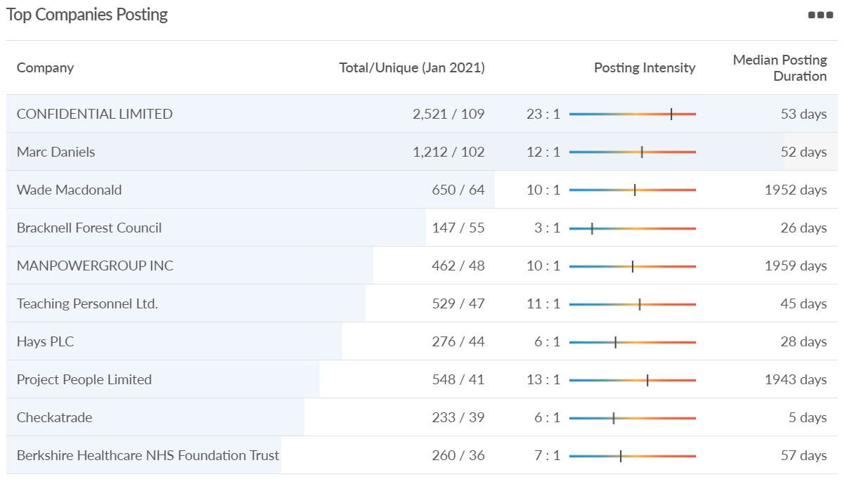
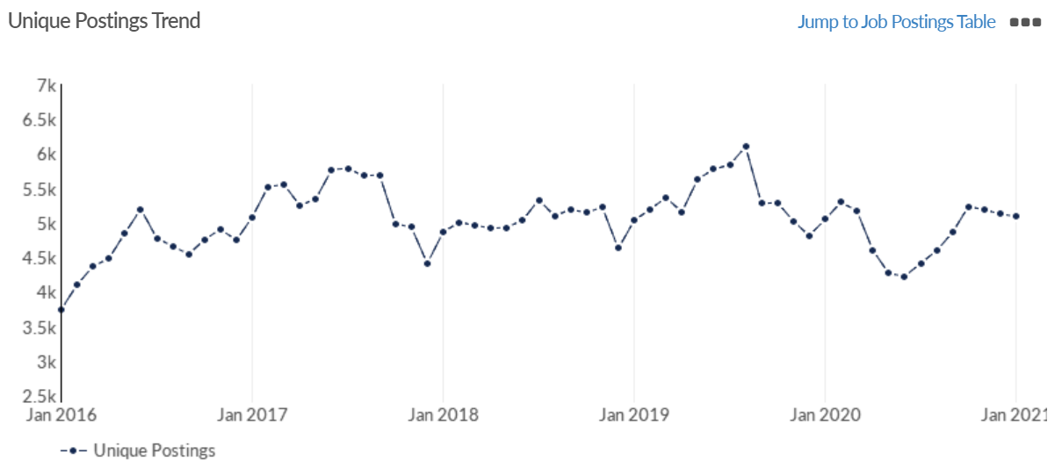
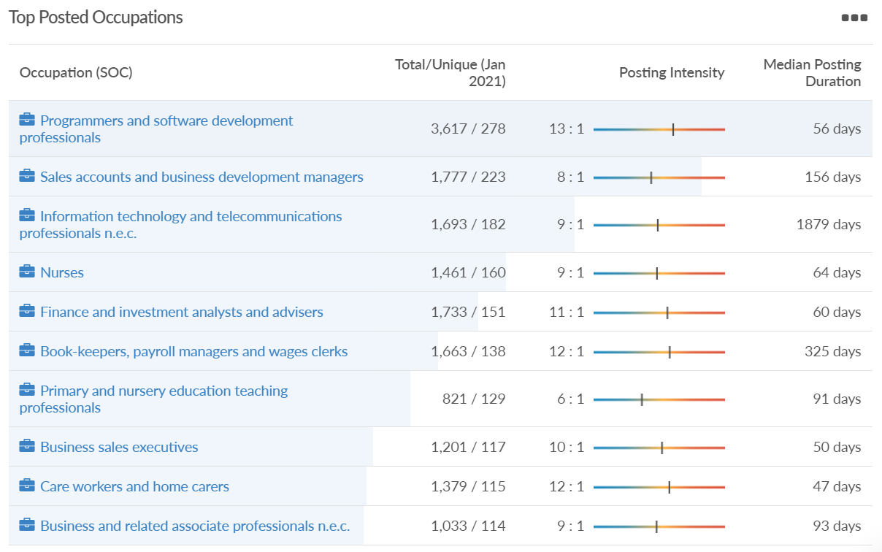
Job posting analytics (EMSI, January 2021)
Unique job postings: 5,089
Total job postings: 48,808
Job posting intensity: 10:1
Unique job postings (Jan 2020): 5,046

Slide 26
Slough

Slide 27
Impact of COVID-19 up to 18th January 2021
COVID-19 cases (to 18th January 2021) – Source: Public Health Berkshire COVID-19 Dashboard, January 2021
11,610 total cases
157 new cases daily
Claimant unemployment (to 31st December 2020)
8,080 claimants (8.5% of the working age population) in Slough UA
Notable business news
Rail minister Chris Heaton-Harris said the 90 Arterio trains, originally due to start running in 2019, were now not expected to be in service until early summer. The fleet is part of the operator's plans to provide more capacity and quicker journey times on its Berkshire, Surrey and south-west London routes. South Western Railway said the delay was due to the impact of Covid-19. In a written reply to Slough MP and Shadow Transport Minister Tan Dhesi, Mr Heaton-Harris said: "This timeline is contingent upon there being no further delays in the delivery and acceptance of the new trains, a risk that is heightened with the current situation with Covid-19, and the completion of the associated training for the train crew to enable the trains to be operated in passenger service.“ He added that a full roll-out of the new trains was expected in the 12 months after the predicted early summer launch.
Source: BBC, January 2021

Slide 28
Industries hit hardest by COVID shutdown
When compared to both Thames Valley Berkshire and Great Britain, Slough has seen a significantly lower percentage of jobs affected by COVID shutdowns – perhaps somewhat surprising given the LA’s proximity to Heathrow and the almost complete shutdown of the aviation sector.
Source: EMSI, January 2021 (definition for industries hit hardest provided on slide 51)

Slide 29
Industry risks and opportunities (2020-2021)
Critical industries
Food and drink retail: 6,656 employees (47% above the national average)
Energy/utilities: 2,820 employees (174% above the national average)
Health and social care: 8,201 employees (28% below the national average)
Freight/logistics: 4,640 employees (93% above the national average)
Insurance: 121 employees (86% below the national average)
Banking and financial services: 731 employees (65% below the national average)
Sectors most impacted
Hospitality and tourism: 3,780 employees (46% below the national average)
Arts, entertainment and recreation: 442 (79% below the national average)
Admin and support: 9,765 (107% above the national average)
Aviation: 262 employees (16% above the national average)
Non-food retail and wholesale: 6,719 (0% above the national average)
Manufacturing: 5,071 (28% below the national average)
Construction: 2,620 (36% below the national average)
Source: EMSI, January 2021

Slide 30
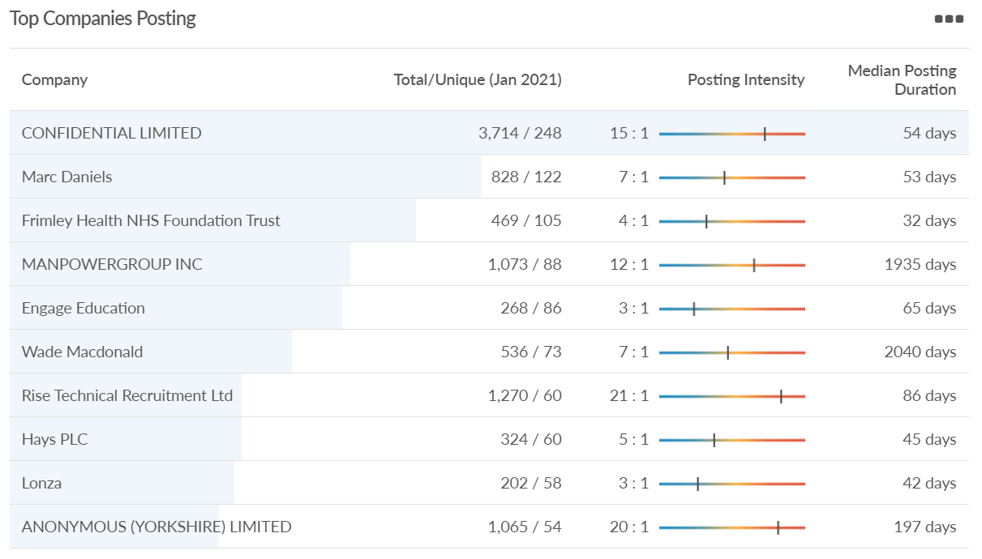
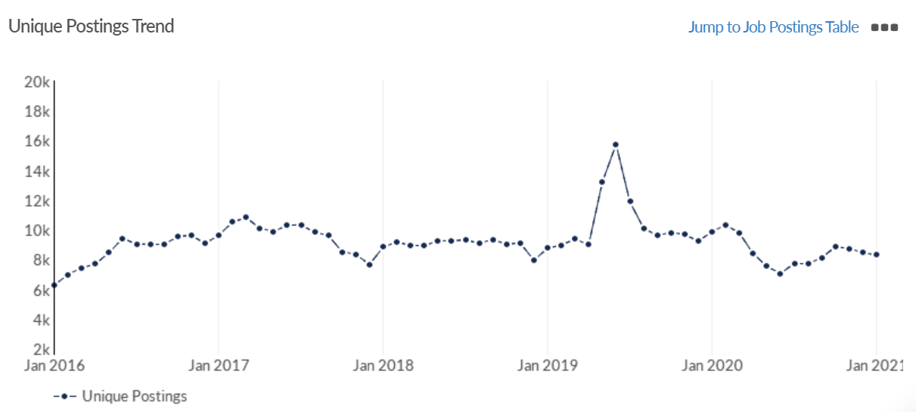
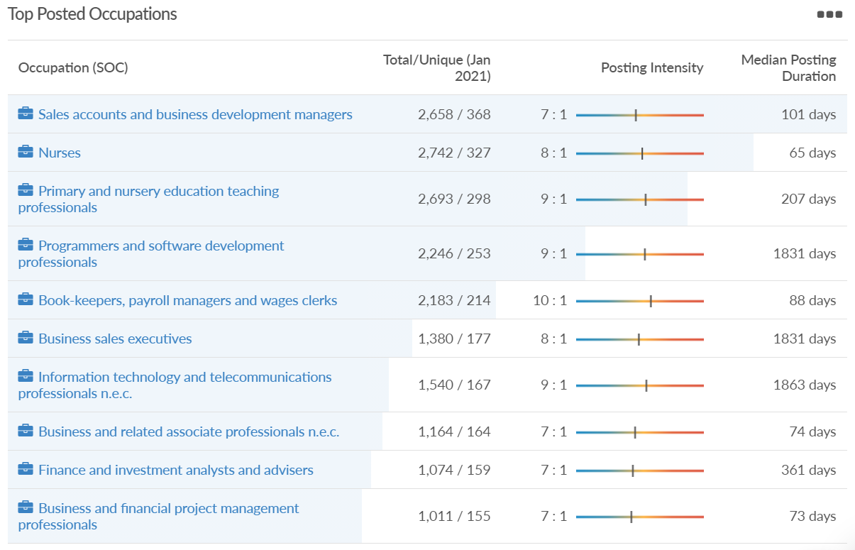
Job posting analytics (EMSI, January 2021)
Unique job postings: 8,297
Total job postings: 65,948
Job posting intensity: 8:1
Unique job postings (Jan 2020): 9,869

Slide 31
Reading

Slide 32
Impact of COVID-19 up to 18th January 2021
COVID-19 cases (to 18th January 2021) – Source: Public Health Berkshire COVID-19 Dashboard, January 2021
8,322 total cases
111 new cases daily
Claimant unemployment (to 31st December 2020)
6,880 claimants (6.4% of the working age population) in Reading UA
Notable business news
Reading’s tech-led economy is quietly withstanding the pandemic and the 'town' looks better set for the future than many UK cities. The town of Reading had a smaller economic contraction than any other UK city in the third quarter of 2020, according to research published by law firm Irwin Mitchell. While Manchester’s gross value added (GVA) declined 9.1% and that of Birmingham fell 9%, Reading’s GVA was down just 6.8% year-on-year.
A Reading retail park that has struggled to adapt to the “dramatic shift to online shopping” could be demolished and replaced with warehouses. Plans have been submitted that would see the Brunel Retail Park on Rose Kiln Lane transformed into two logistics warehouses, replacing stores including Halfords, Pets at Home, Next and Go Outdoors. A flexible planning application has been submitted by planning consultancy Quod, on behalf of owner Mayfair Capital Investment Management Limited.
Sources: Investment Monitor, January 2021 and Berkshire Live, January 2021
CoStar News has reported that Amazon is scouring the M4 corridor for 100,000 sq ft of offices and suggests its search – being handled by Colliers International – is honing in on Reading’s out-of-town market.
Source: UK Property Forums, January 2021

Slide 33
Industries hit hardest by COVID shutdown
Reading has been very similarly affected by the COVID shutdowns as Great Britain has on average, with circa 15.5% of jobs within industries which have been most severely impacted by the shutdowns. The Local Authority is around 1.5% better off than the average of the Thames Valley Berkshire area.
Source: EMSI, January 2021 (definition for industries hit hardest provided on slide 51)

Slide 34
Industry risks and opportunities (2020-2021)
Critical industries
Food and drink retail: 6,192 employees (11% above the national average)
Energy/utilities: 3,350 employees (163% above the national average)
Health and social care: 13,464 employees (5% below the national average)
Freight/logistics: 1,513 employees (49% below the national average)
Insurance: 2,076 employees (100% above the national average)
Banking and financial services: 1,688 employees (34% below the national average)
Sectors most impacted
Hospitality and tourism: 6,567 employees (25% below the national average)
Arts, entertainment and recreation: 1,811 (31% below the national average)
Admin and support: 9,212 (58% above the national average)
Aviation: <10 employees
Non-food retail and wholesale: 8,626 (18% above the national average)
Manufacturing: 2,000 (77% below the national average)
Construction: 2,273 (55% below the national average)
Source: EMSI, January 2021

Slide 35
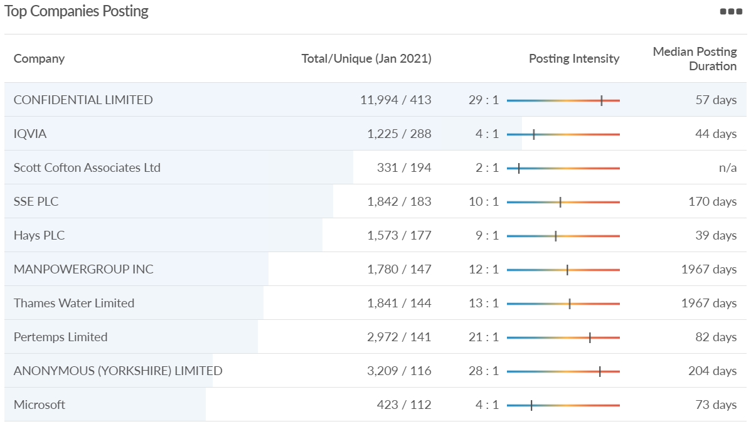
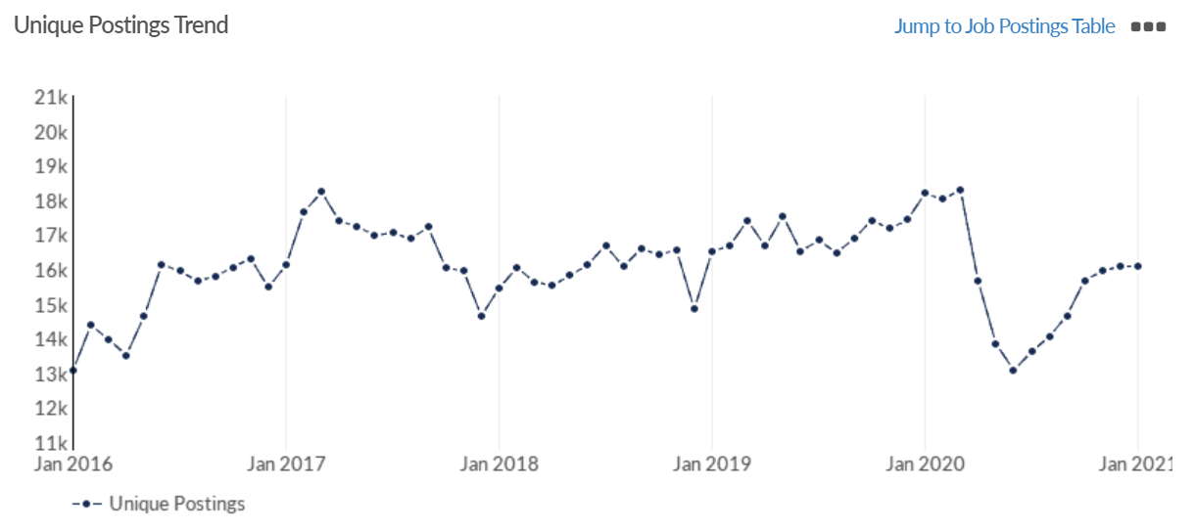
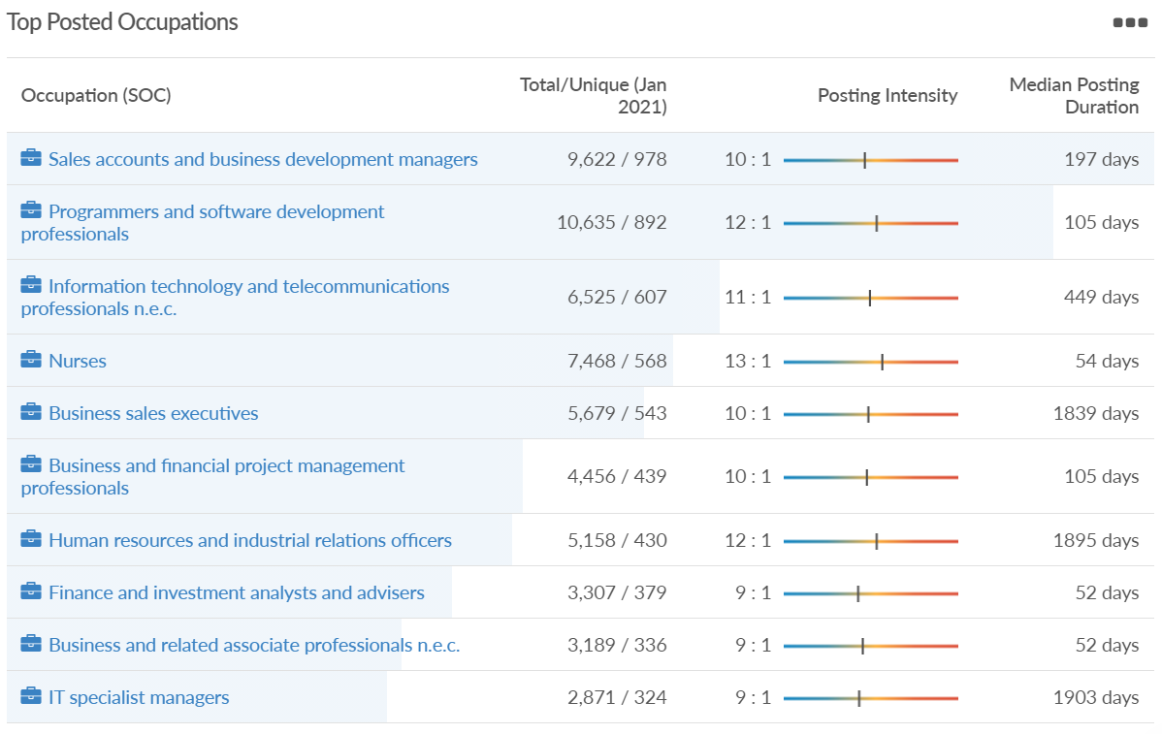
Job posting analytics (EMSI, January 2021)
Unique job postings: 16,084
Total job postings: 174,545
Job posting intensity: 11:1
Unique job postings (Jan 2020): 18,185

Slide 36
Wokingham

Slide 37
Impact of COVID-19 up to 18th January 2021
COVID-19 cases (to 18th January 2021) – Source: Public Health Berkshire COVID-19 Dashboard, January 2021
6,592 total cases
53 new cases daily
Claimant unemployment (to 31st December 2020)
3,540 claimants (3.4% of the working age population) in Wokingham UA
Notable business news
Another bank is pulling out of Woodley’s town centre as part of a restructuring operation. HSBC has said that its Crockhamwell Road branch will shut on Friday, June 18, following on the heels of its near-neighbour Santander which closed in July 2019.
A Reading resident has been named one of the UK’s next ‘young innovators’. 23-year-old Christopher Elliot is the founder of Untrapped, a one-stop student rental portal which manages the process for students and landlords. He hopes it will save money and improve renting standards. Mr Elliot was named an award-winner in this year’s Young Innovators Awards, which recognise young people up and down the country who have the potential to become future leaders in business.
Source: Wokingham Today, January 2021

Slide 38
Industries hit hardest by COVID shutdown
Wokingham is in a similar position to Slough in that is has been significantly less affected by the COVID shutdowns than both the Thames Valley Berkshire area and Great Britain as a whole. This is likely due to the high levels of employment from the Tech sector (Microsoft etc. based at TVP) as this industry is able to work well from home.
Source: EMSI, January 2021 (definition for industries hit hardest provided on slide 51)

Slide 39
Industry risks and opportunities (2020-2021)
Critical industries
Food and drink retail: 3,883 employees (17% below the national average)
Energy/utilities: 1,434 employees (35% above the national average)
Health and social care: 7,283 employees (38% below the national average)
Freight/logistics: 886 employees (64% below the national average)
Insurance: 453 employees (48% below the national average)
Banking and financial services: 423 employees (80% below the national average)
Sectors most impacted
Hospitality and tourism: 5,410 employees (25% below the national average)
Arts, entertainment and recreation: 1,831 (16% below the national average)
Admin and support: 6,432 (33% above the national average)
Aviation: 0 employees
Non-food retail and wholesale: 6,494 (6% below the national average)
Manufacturing: 3,731 (48% below the national average)
Construction: 3,115 (26% below the national average)
Source: EMSI, January 2021

Slide 40
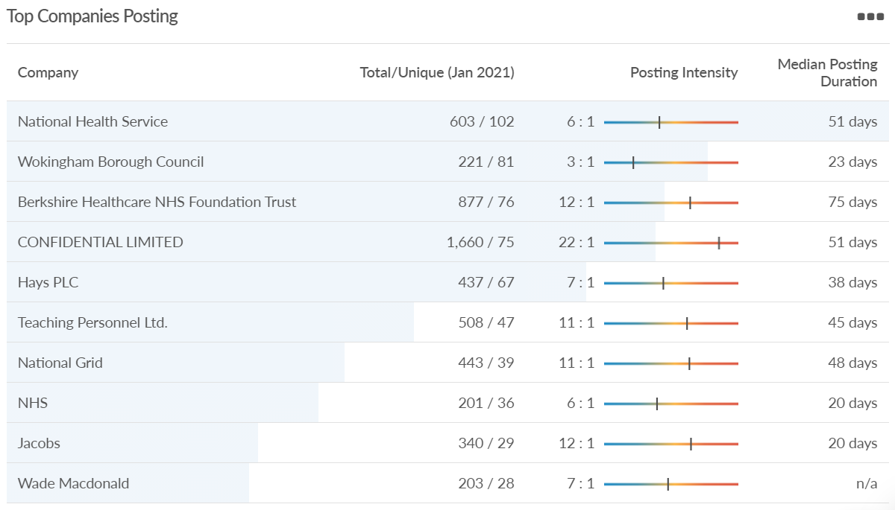
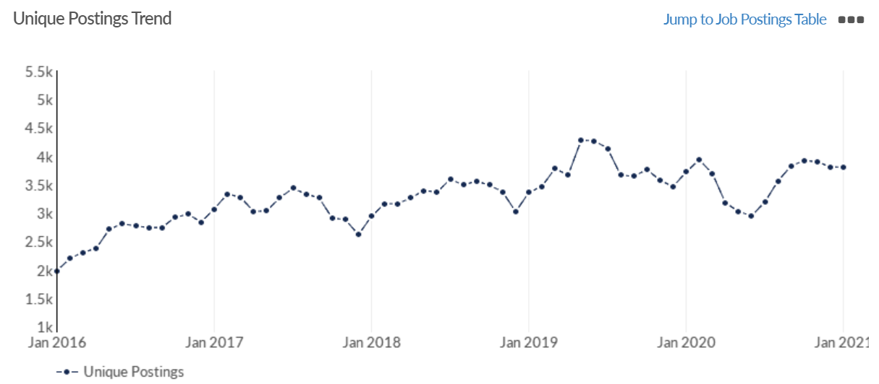
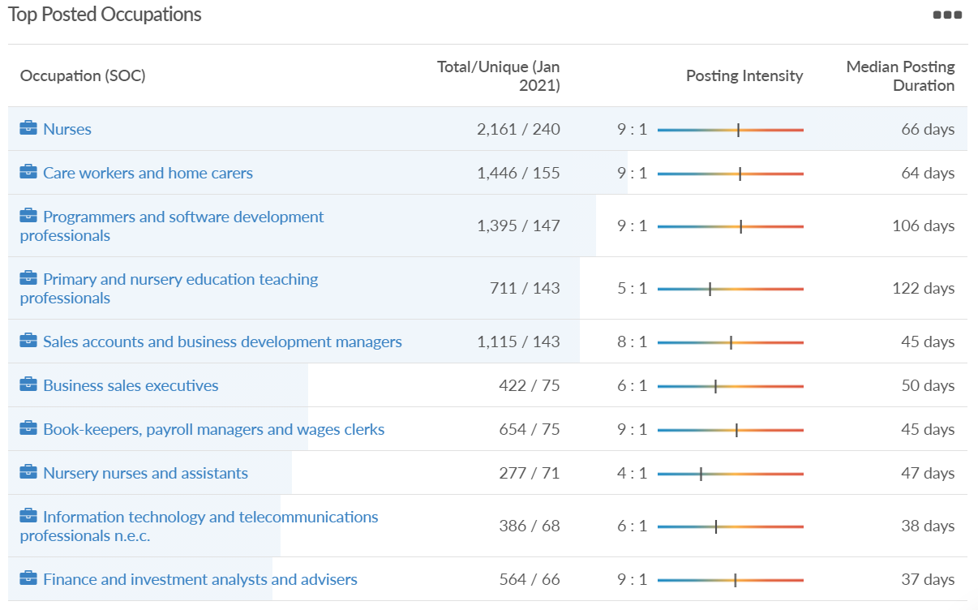
Job posting analytics (EMSI, January 2021)
Unique job postings: 3,807
Total job postings: 29,420
Job posting intensity: 8:1
Unique job postings (Jan 2020): 3,718

Slide 41
Windsor and Maidenhead

Slide 42
Impact of COVID-19 up to 18th January 2021
COVID-19 cases (to 18th January 2021) – Source: Public Health Berkshire COVID-19 Dashboard, January 2021
6,759 total cases
59 new cases daily
Claimant unemployment (to 31st December 2020)
4,270 claimants (4.6% of the working age population) in Windsor and Maidenhead UA
Notable business news
Mobile phone firm Three will move its Maidenhead operation to its existing Reading base at Great Brighams Mead this year but has a longer term requirement of 90,000 sq ft in the town.
Source: Source: UK Property Forums, January 2021

Slide 43
Industries hit hardest by COVID shutdown
Windsor and Maidenhead appears to be the most severely affected of all the Local Authorities which make up Berkshire in terms of percentage of jobs hit hardest by the COVID shutdowns. This is likely due in part to the enormous hit the leisure/tourism sector has taken and how key of an employer Legoland Windsor to the region.
Source: EMSI, January 2021 (definition for industries hit hardest provided on slide 51)

Slide 44
Industry risks and opportunities (2020-2021)
Critical industries
Food and drink retail: 3,733 employees (17% below the national average)
Energy/utilities: 882 employees (13% below the national average)
Health and social care: 8017 employees (29% below the national average)
Freight/logistics: 748 employees (68% below the national average)
Insurance: 434 employees (48% below the national average)
Banking and financial services: 1,252 employees (39% below the national average)
Sectors most impacted
Hospitality and tourism: 9,437 employees (35% above the national average)
Arts, entertainment and recreation: 4,516 (117% above the national average)
Admin and support: 4,207 (10% below the national average)
Aviation: 11 employees (95% below the national average)
Non-food retail and wholesale: 7,834 (18% above the national average)
Manufacturing: 2,523 (64% below the national average)
Construction: 6,201 (54% above the national average)
Source: EMSI, January 2021

Slide 45
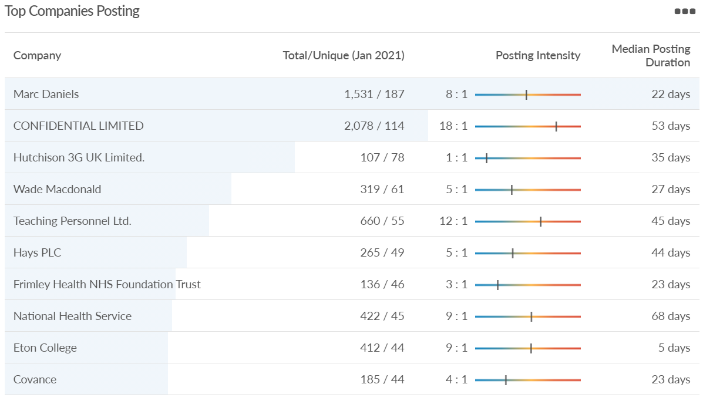
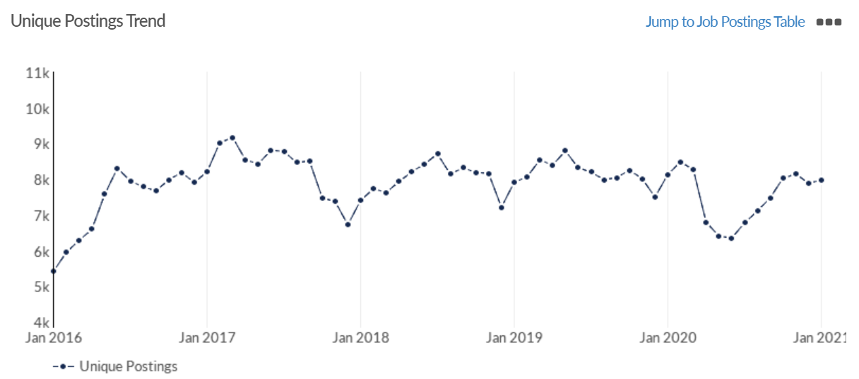
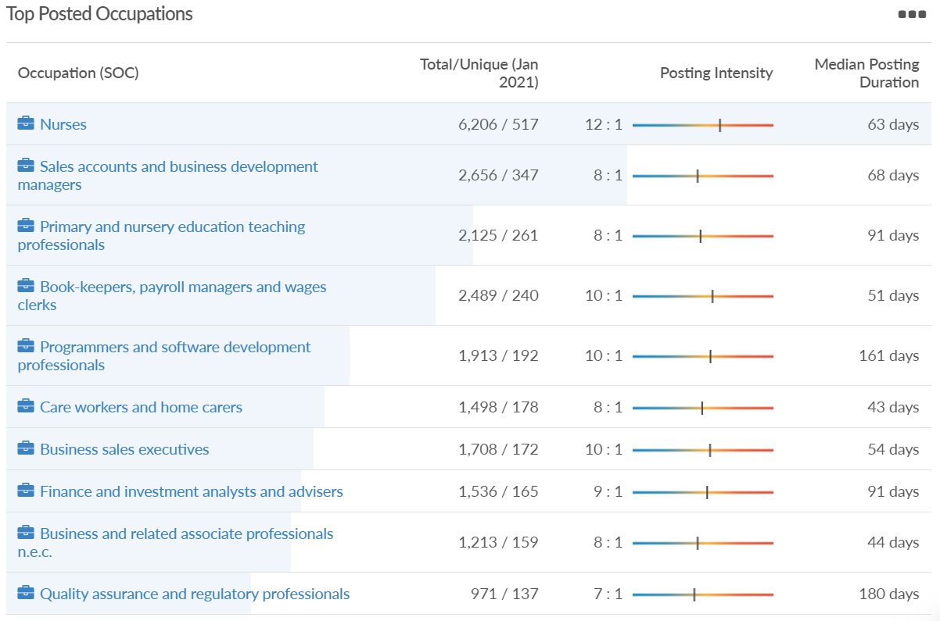
Job posting analytics (EMSI, January 2021)
Unique job postings: 7,973
Total job postings: 68,055
Job posting intensity: 9:1
Unique job postings (Jan 2020): 8,132

Slide 46
West Berkshire

Slide 47
Impact of COVID-19 up to 18th January 2021
COVID-19 cases (to 18th January 2021) – Source: Public Health Berkshire COVID-19 Dashboard, January 2021
4,769 total cases
53 new cases daily
Claimant unemployment (to 31st December 2020)
3,795 claimants (3.9% of the working age population) in West Berkshire UA
Notable business news
West Berkshire Training Consortium welcomes apprenticeship incentive scheme extension to March. In July 2020 Chancellor Rishi Sunak announced a Government incentive scheme that was designed to encourage businesses to recruit new apprentices. Organisations could qualify for an up to £3,000 cash bonus if they took on a new apprentice before the end of January 2021. In the recent spending review, the deadline was extended to the end of March 2021. Matt Garvey said: “We are very pleased that the Chancellor has decided to extend the incentive schemes for employers. We are still living in very uncertain times and any support like this that businesses can get is invaluable. We have young people ready and available to do apprenticeships and we hope that this extension will encourage more businesses to take on a new apprentice.” Source: Newbury Today, January 2021

Slide 48
Industries hit hardest by COVID shutdown
While West Berkshire hasn’t been as fortunate as Slough and Wokingham in terms of how great of a percentage of jobs have been directly affected by the COVID shutdown, it has fared significantly better than the Thames Valley Berkshire area and better than Great Britain.
Source: EMSI, January 2021 (definition for industries hit hardest provided on slide 51)

Slide 49
Industry risks and opportunities (2020-2021)
Critical industries
Food and drink retail: 4,289 employees (17% below the national average)
Energy/utilities: 1,343 employees (14% above the national average)
Health and social care: 6,773 employees (48% below the national average)
Freight/logistics: 1,574 employees (43% below the national average)
Insurance: 262 employees (73% below the national average)
Banking and financial services: 692 employees (71% below the national average)
Sectors most impacted
Hospitality and tourism: 6,617 employees (18% below the national average)
Arts, entertainment and recreation: 2,674 (10% above the national average)
Admin and support: 4,803 (11% below the national average)
Aviation: <10 employees
Non-food retail and wholesale: 8,432 (9% above the national average)
Manufacturing: 11,330 (41% above the national average)
Construction: 4,813 (3% above the national average)
Source: EMSI, January 2021

Slide 50
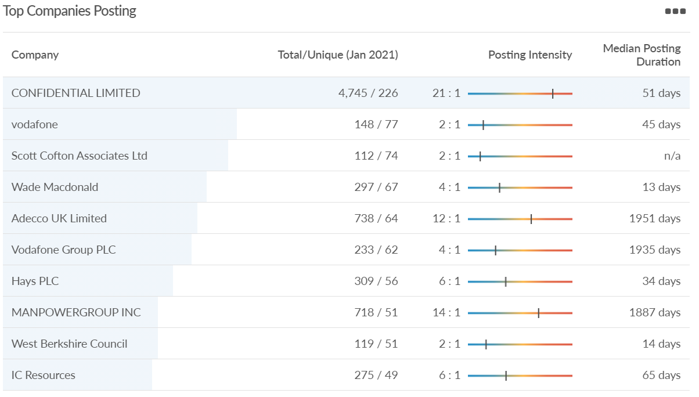
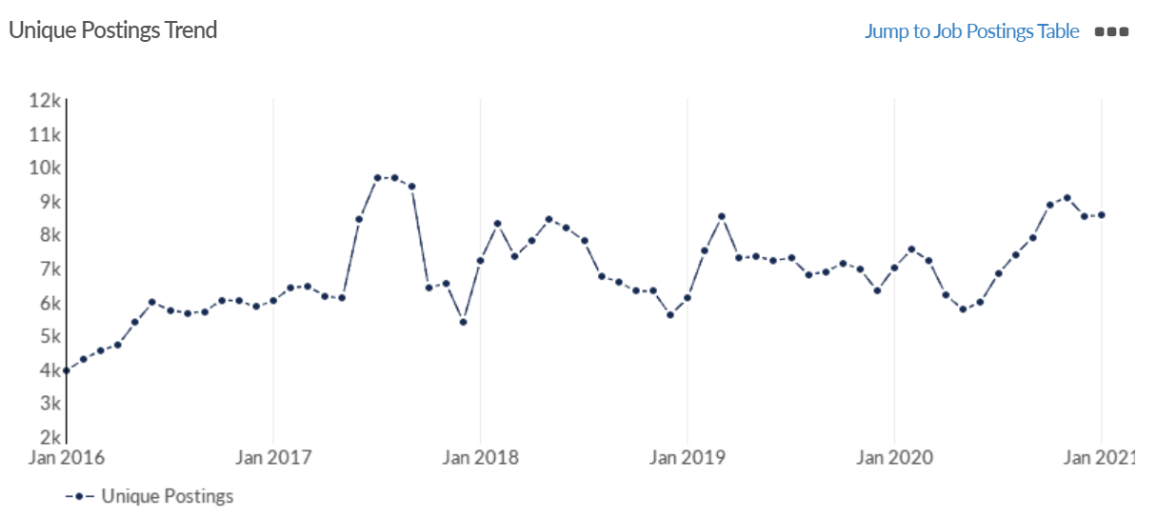
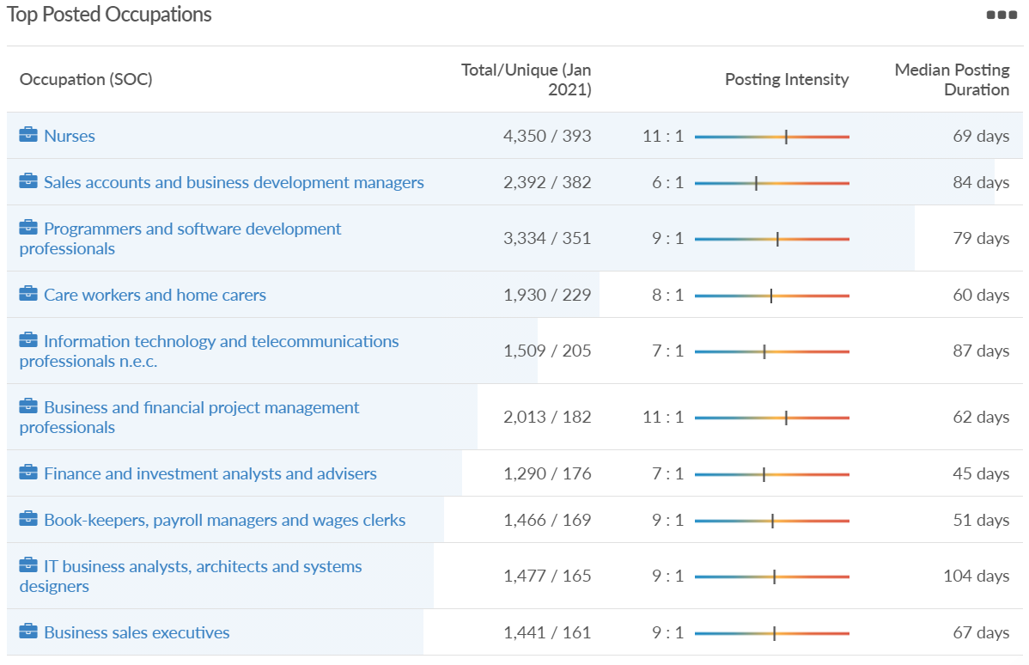
Job posting analytics (EMSI, January 2021)
Unique job postings: 8,552
Total job postings: 73,045
Job posting intensity: 9:1
Unique job postings (Jan 2020): 7,014

Slide 51
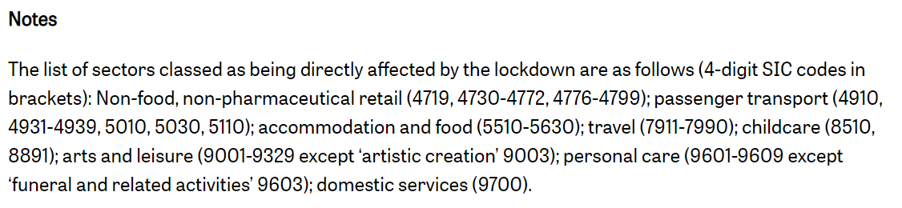
Definitions
Source: Institute for Fiscal Studies, April 2020

