Slide 1
Berkshire Monthly Economic Briefing
February 2023

Slide 2
Key contents of this month’s briefing
Updated global and UK economic forecasts
Monthly Spotlight – Martin Wolf: ‘The Crisis of Democratic Capitalism’
Key points from the latest Labour Force Survey data
Latest claimant count figures by Local Authority
Latest remote working figures for Berkshire
Latest ‘notable business news’ by Local Authority
Latest job posting analytics by Local Authority

Slide 3
Global and National Economy
February 2023

Slide 4
January 2023
Global Economic Prospects
Global growth is expected to decelerate sharply to 1.7 percent in 2023 from 3% expected six months ago—the third weakest pace of growth in nearly three decades, overshadowed only by the global recessions caused by the pandemic and the global financial crisis.
The sharp downturn in growth is expected to be widespread, with forecasts in 2023 revised down for 95% of advanced economies and nearly 70% of emerging market and developing economies.
Growth in advanced economies is projected to slow from 2.5% in 2022 to 0.5% in 2023. Over the next two years, per-capita income growth in emerging market and developing economies is projected to average 2.8%—a full percentage point lower than the 2010-2019 average.
The combination of slow growth, high inflation, financial stress, heavy indebtedness and rising geopolitical tensions is likely to weaken investment and trigger corporate defaults and could push the global economy into recession.
Source: World Bank, January 2023

Slide 5
February 2023
Global Economics Intelligence executive summary
Recent global economic data have been mixed, reflecting both improved conditions and persisting downside risks.
Despite the year’s high inflation and energy uncertainty, world economic performance in 2022 almost certainly exceeded earlier, more pessimistic expectations. Recently upgraded forecasts suggest that the pace of global GDP growth in 2022 was 3.2% (International Monetary Fund, Conference Board). In most analyses, a slowdown of short duration is predicted for 2023, resulting mainly from stagnation in the developed economies, with a rebound in 2024.
Downside risks largely center on inflation and geopolitical uncertainty. Inflation has begun to slow in both developed and emerging economies. Energy prices have come down, but core inflation readings remain high, and central banks are sustaining a course of hiking interest rates.
Unemployment rates in most surveyed economies remain stable and relatively low by country or region: 3.5% in the United States, 3.7% in the United Kingdom, 6.5% in the eurozone, and 8.1% in Brazil.
Source: McKinsey, February 2023

Slide 6
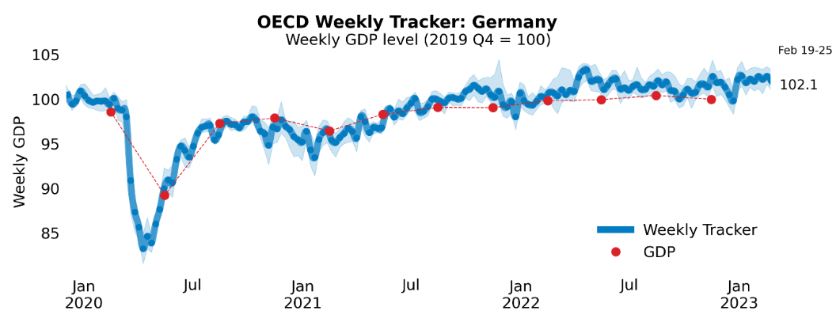
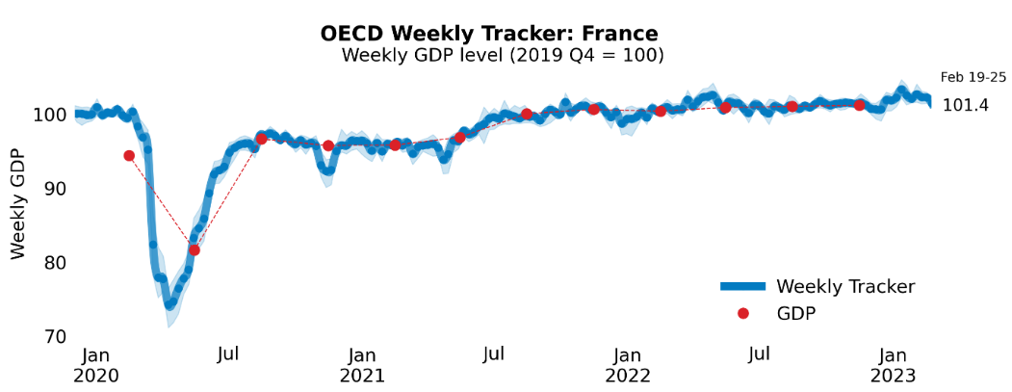
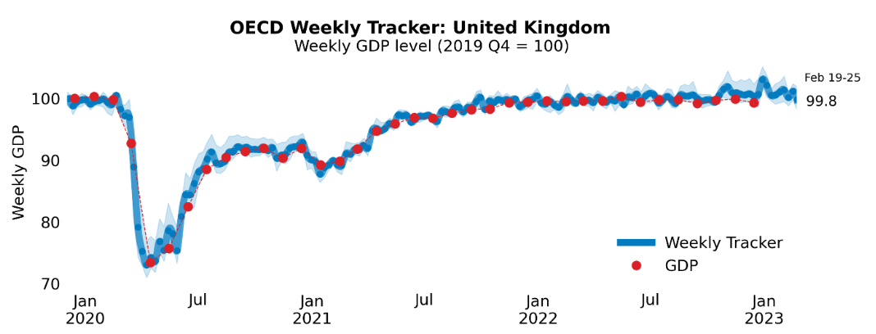
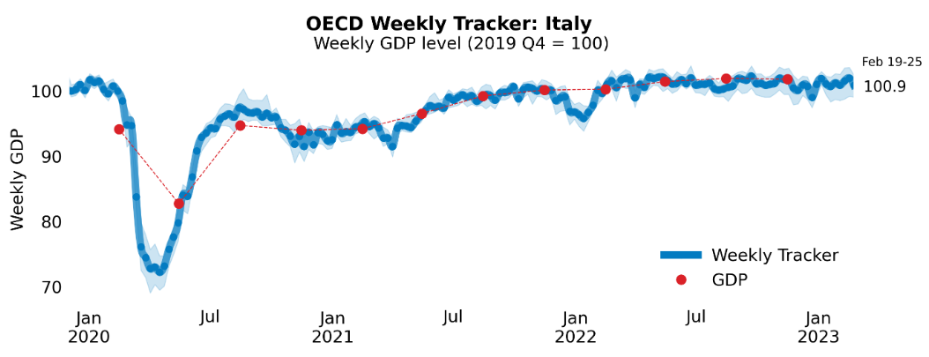
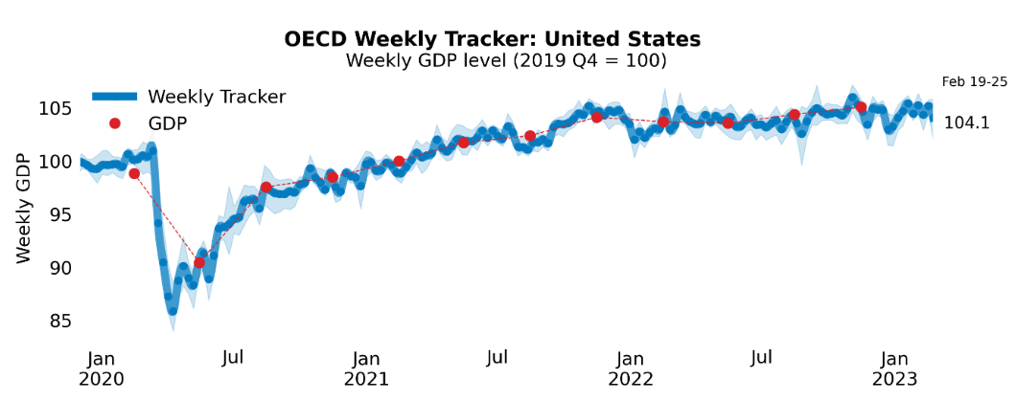
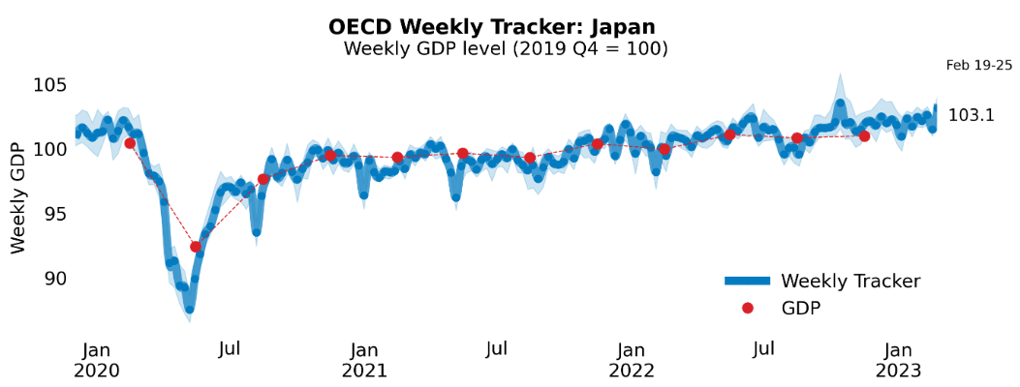
Global Economy
OECD GDP Tracker
The Weekly Tracker is an estimate of weekly GDP relative to the pre-crisis trend, which is proxied by the OECD Economic Outlook forecasts.
Source: OECD, February 2023

Slide 7
February 2023
Bank of England Monetary Policy Report - February 2023
Inflation has begun to fall. But in December, prices were still 10.5% higher than a year ago, well above the 2% target. The main reasons for this are:
  Higher energy prices, led by Russia’s invasion of Ukraine.
  Higher prices for the goods we buy from abroad caused by supply shortages in response to the increased demand for goods during the COVID pandemic.
  In the UK, Businesses are charging more for their products because of the higher costs they face. There are lots of job vacancies, as fewer people are seeking work following the pandemic. That means that employers are having to offer higher wages to attract job applicants. Prices for services have risen markedly.
Households have less to spend. As a result, the UK economy is not growing.
Inflation is expected to fall quickly in 2023 due to falling energy prices, higher interest rates, and easing production difficulties for imported goods.
To help inflation return to the 2% target, the Bank of England raised interest rates to 4% in February 2023. This is expected to encourage saving and slow down the rise in prices.
Source: Bank of England, February 2023
Notes:
data

Slide 8
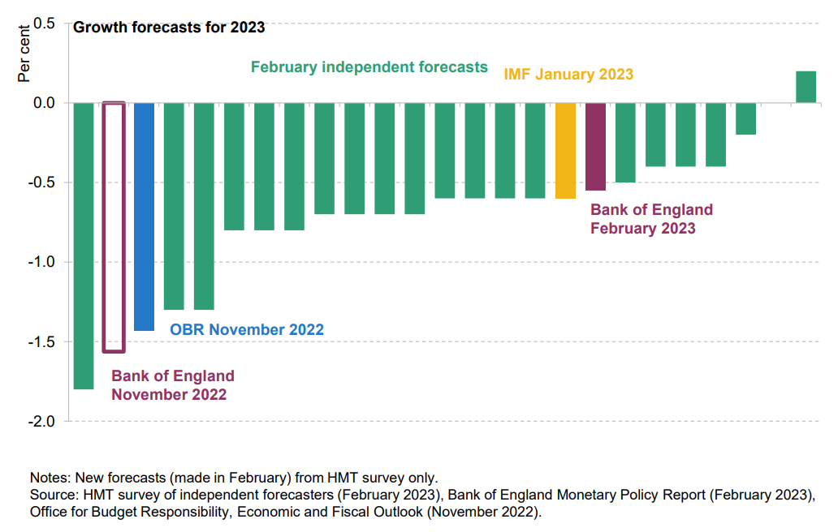
February 2023
Spring Budget 2023: the challenges ahead
Recent forecasts from the IMF and Bank of England predict a shallower recession as compared to the forecasts from November 2022.
There has been a sizable reduction in borrowing in the short term, running £31 billion below forecast for 2022-23: three times the average gap.
Tax revenue has been stronger than expected, particularly income tax and national insurance contributions.
Debt interest payments and subsidies (like energy support schemes) have been cheaper than anticipated last year.
Source: Institute for Fiscal Studies, February 2023
Notes:
data

Slide 9
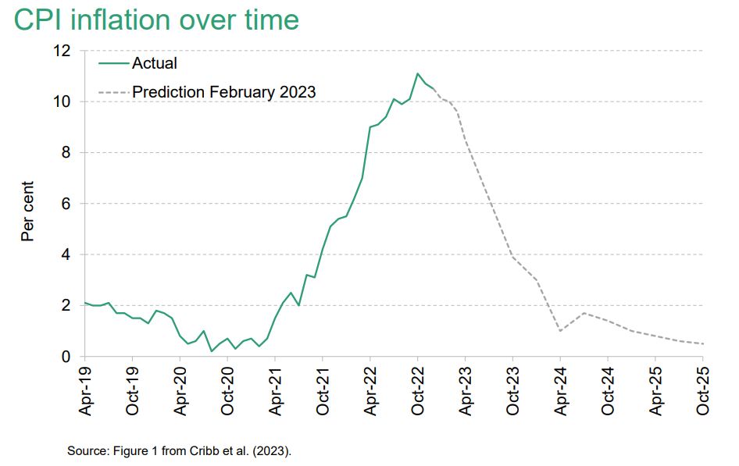
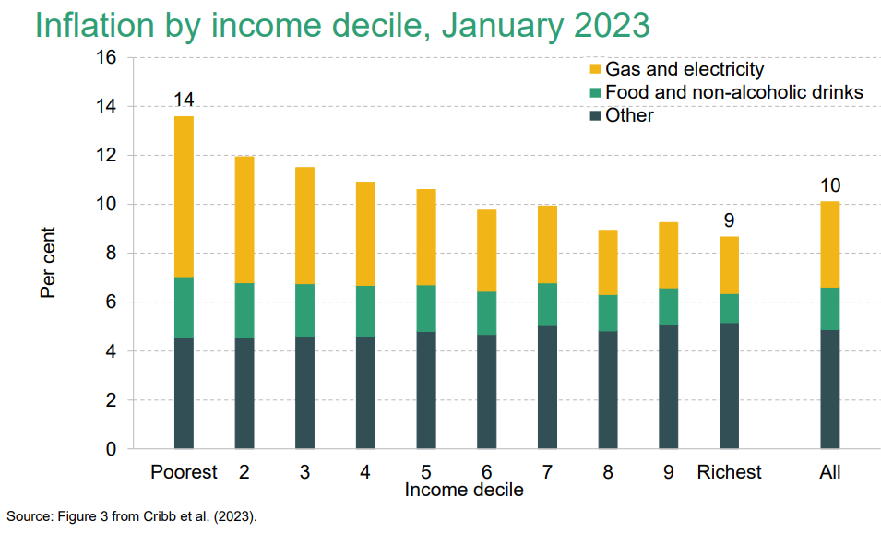
February 2023
Spring Budget 2023: the challenges ahead
Inflation has been rising rapidly but likely to have peaked. However, large differences remain in the rates of inflation experienced by different income groups.
Since the poorest income groups spend a higher proportion of their income on gas and electricity, the rising energy prices have meant that these groups experience a much higher rate of inflation than the national average – 14% for the poorest tenth vs 9% for the richest tenth of the population.
Source: Institute for Fiscal Studies, February 2023
Notes:
data

Slide 10
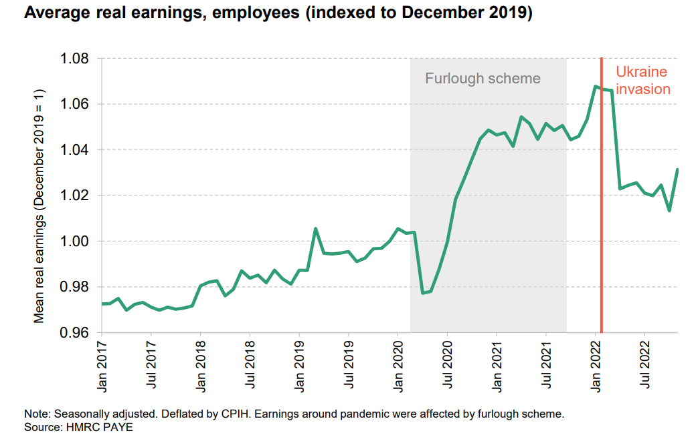
February 2023
Spring Budget 2023: the challenges ahead
Before the pandemic, there was very little growth in real earnings.
After the pandemic, this trend reversed significantly. In March 2022, average real earnings were 7% higher than in December 2019.
However, the high inflation after the Ukraine invasion has eroded the gains in real earnings. On average, real earnings were only 1-2% higher in December 2022 than they were in December 2019.
On a similar note, average real benefit entitlements have remained below pre-pandemic levels despite uprating and are expected to remain so until April 2025.
Source: Institute for Fiscal Studies, February 2023
Notes:
data

Slide 11
February 2023
Business insights and impact on the UK economy
In January 2023, 29% of trading businesses reported lower turnover compared with December 2022, while 16% reported that their turnover was higher.
Businesses were more optimistic about their turnover for March 2023 as 21% of trading businesses reported that they expect their turnover to increase, up from 10% reported for January 2023; the accommodation and food service activities industry reported the largest proportion, at 29%.
Of trading businesses, 39% reported an increase in the prices of goods or services bought in January 2023 compared with December 2022; this percentage has gradually fallen each month.
25% of trading businesses expect to raise the prices of goods or services they sell in March 2023; energy prices remain the top reason these businesses are considering doing so, with 35% reporting this. 34% of businesses reported they had passed on their input price increases to customers over the last six months; the manufacturing industry reported the largest proportion, at 58%.
28% of businesses with 10 or more employees reported they experienced difficulties recruiting employees in January 2023.
Source: ONS, February 2023
Notes:
data

Slide 12
Employment in the UK
Vacancies and jobs in the UK – February 2023
Key points:
The number of vacancies in November 2022 to January 2023 was 1,134,000, which is a decrease of 76,000 from August to October 2022, and a decrease of 135,000 from the level of a year ago, although it was 338,000 above the pre-coronavirus January to March 2020 levels.
The fall in the number of vacancies reflects uncertainty across industries, as survey respondents continue to cite economic pressures as a factor in holding back on recruitment.
The industry sectors displaying the largest falls in vacancy numbers were administration and support service activities, manufacturing, and education. The two industries to show growth on the quarter were mining and quarrying, and financial and insurance activities.
Quarterly growth in vacancies fell for the seventh consecutive period to negative 6.3% in November 2022 to January 2023, with vacancies falling in 16 out of 18 industry sectors.
In October to December 2022, the number of unemployed people per vacancy was at 1.1, which is up from the previous quarter (July to September 2022) because of significant falls in the number of vacancies in recent periods.
Source: ONS, February 2023

Slide 13
Employment in the UK
Labour Force Survey – February 2023
Key points:
October to December 2022 estimates show an increase in the employment and unemployment rates compared with the previous three-month period (July to September 2022) and a decrease in the economic inactivity rate.
Total hours worked decreased compared with the previous three-month period and remain below pre-pandemic levels.
The UK employment rate was estimated at 75.6%, 0.2 percentage points higher than the previous three-month period and 0.9 percentage points lower than before the pandemic (December 2019 to February 2020).
The UK unemployment rate was estimated at 3.7%, 0.1 percentage points higher than the previous three-month period and 0.2 percentage points below pre-coronavirus levels.
The UK economic inactivity rate was estimated at 21.4%, 0.3 percentage points lower than the previous three-month period and 1.2 percentage points higher than before the pandemic.
Source: ONS, February 2023

Slide 14
February 2023
Monthly Spotlight: The Crisis of Democratic Capitalism
In February, Martin Wolf, Chief Economics Commentator at The Financial Times, published ‘The Crisis of democratic Capitalism’. Wolf’s book forms this month’s Monthly Spotlight.
Wolf describes capitalism and democracy as ‘symbiotic twins’. The two grew up together. Before capitalism, democracy was a strange idea, but the core belief underpinning a market economy is the right to change jobs, create businesses, lend and borrow money, and spend how and where we wish. If we have these rights, how could we not also have equal rights of political representation?
The relationship between the capitalism and democracy, however, is one of tension. Market economics is self-serving, while democracy is based on representation of a wider pool of people. Unlike under previous systems, economic power cannot buy political power, or vice versa, at least in theory.
This system has delivered unparalleled wealth and prosperity, but it is now in danger. Coming from a Jewish family that fled Nazism, Wolf writes: “Democracy has disappeared in the past. It would be silly to assume it could not do so again.”
So what has gone wrong? Trust in democratic institutions and the global market economy has faded in recent years, leading to protectionism, hostility to immigration and populism.

Slide 15
February 2023
Monthly Spotlight: The Crisis of Democratic Capitalism
This trust has faded following the hollowing out of the middle class – identified by Aristotle as the core constituency for a constitutional democracy almost 2,500 years ago.
Specifically, high inequality countries like the US and UK have lower intergenerational economic mobility. In other words, a son’s place in the earnings distribution is correlated with his father’s, rather than him expecting a higher standard of living.
Manufacturing industry has declined, having previously generated large numbers of relatively well paid and secure jobs for less-educated men.
In a country with stagnant productivity, such as the UK in the last decade and a half, the standard of living can only rise for some at the expense of others – this becomes a ‘zero-sum’ economy.
Hostility to immigration rises during times of economic crisis.
The culturally dominant element of left of centre parties increasingly consists of graduates, academics, public sector workers, the young and ethnic minorities. Older, more socially conservative and disadvantaged members of the working class see little in those parties to attract them.

Slide 16
February 2023
Monthly Spotlight: The Crisis of Democratic Capitalism
Financialization – “the idea of the economy as just a bunch of tradable contracts” – has led to ‘rent’ extraction – money that could disappear without affecting production – rather than productive improvements. It also led directly to the financial crisis of 2007-12.
Adam Smith warned 200 years ago that incumbent businesses will pursue restraints on competition with great enthusiasm. It is now too easy for incumbents to buy political and regulatory protection.
Tax avoidance by multinational corporations is a huge problem.
In this economic environment, populists contrast the virtuous and downtrodden “real” people against corrupt and oppressive elites.
Thomas Piketty speaks of the ‘Merchant Right’, made up of high-income voters, versus the ‘Brahmin Left’, made up of high education voters. The Brahmin Left tries to point out the exploitative behaviour of the commercial elite, but many erstwhile left of centre voters see an attitude that dislikes their histories, traditions and values. The Merchant elite points out the cultural arrogance of the left in support of the votes of the poor and less-educated.
Social media amplifies this divide, making it easier to spread rumour. This leads to widespread cynicism about what we are told and allows the weaponization of outrage, since that is how one gains attention.

Slide 17
February 2023
Monthly Spotlight: The Crisis of Democratic Capitalism
So what is to be done? Martin Wolf calls on government to act strategically, with a focus on scientific research and innovation. Economic development must be sustainable in the light of climate change.
Economic stability is important – we have seen the anxiety created by instability in recent years!
We must have a debate on immigration, which needs to be seen as fair if we are to avoid a political backlash.
Policy must create good jobs – and place-based policies, building on local identities, loyalties and capabilities can enhance the opportunities of most places, regardless of their level of development or economic position. People should be paid properly for the work they do.
Equality of opportunity should and could be pursued and a universal welfare system is a source of social cohesion. Special privileges for the few, including the ability to avoid paying tax, must be addressed.
Democracy must also be renewed, with an emphasis of reciprocity among citizens – we have obligations towards each other. Meritocracy has its limits – decency, reliability, honesty, kindness must also be valued.
Government reforms could include both devolution to local levels and an upward transfer of governance to bodies such as the UN, the IMF and the World Trade Organisation where appropriate.
Democratic reforms might include voting systems, compulsory voting, party funding and sortition techniques such as citizens juries.

Slide 18
February 2023
Monthly Spotlight: The Crisis of Democratic Capitalism
Martin Wolf’s book is a sweeping look at the struggles in which market economies and modern democracies find themselves.
He offers many observations and recommendations. Very few of us will agree with all of them.
After the last 15 years, many will crave the economic stability which is stressed in Wolf’s book. At a time of high inflation, low growth and stagnant productivity, there is a strong case for doing the basics well.
One of the biggest challenges that business faces is the so-called ‘great resignation’. This was the outcome from Covid-19 that nobody predicted.
Some of this early retirement is caused by ill health. Martin Wolf’s call for a universal welfare system – not only health services but also social care, and we could add better childcare – would help some return to work.
Perhaps most interesting is Wolf’s call for good jobs, which has not been part of the mainstream conversation in the UK. Some of those not returning to work will have wanted to avoid a life of drudgery.
Berkshire is blessed with many excellent employers, offering good jobs. Activities pursued by the LEP – on innovation, inward investment and skills, to name but a few, are designed to attract and create more of them. Place based policies, as advocated by Wolf, are vital if this is to succeed.

Slide 19
Economic and Labour Market Insight: Implications for Berkshire

Slide 20
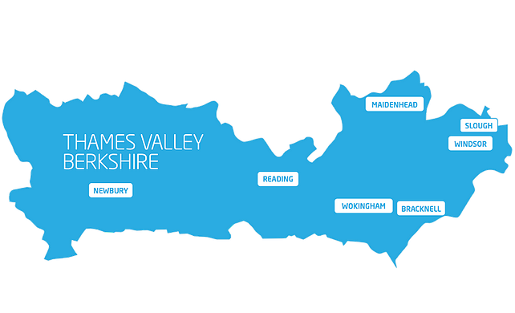
Claimant Count
(Latest data - January 2023)
Total of 16,190 claimants (2.7% of the working age population) in Berkshire.
1,620 claimants (2.0% of the working age population) in Bracknell Forest UA
4,245 claimants (3.6% of the working age population) in Reading UA
4,620 claimants (4.5% of the working age population) in Slough UA
2,000 claimants (2.0% of the working age population) in West Berkshire UA
1,985 claimants (2.1% of the working age population) in Windsor and Maidenhead UA
1,720 claimants (1.6% of the working age population) in Wokingham UA
Across Berkshire, claimant unemployment has fallen significantly from 19,160 in January 2022 to 16,190 in January 2023. Slough had 4.5% of its working age population claim unemployment in January 2023, down significantly from 5.3% in January 2022.
Source: ONS, February 2023

Slide 21
Strategic Issues – Heathrow
Heathrow grew more than any other airport in the world last year
Britain’s busiest airport, London Heathrow, claims to have grown faster than any other in the world during 2022.
Passenger numbers trebled after the UK’s severe Covid travel restrictions were lifted – despite a controversial self-imposed cap on passenger numbers during the peak summer season. Last year 61.6 million travellers passed through the airport, compared with 19.4 million in 2021.
Financial losses almost halved in 2022 compared with the previous year, but still amounted to £684m – equivalent to £22 per second. The airport said inflation, lower passenger numbers and “insufficient regulated charges” were responsible for the loss.
The figures also reveal Heathrow made £260m from retail, £59m from catering and £143m from car parking during 2022.
Heathrow says in its financial results for 2022 that “feedback from the vast majority of passengers was that they received great service”. The airport’s chief executive, John Holland-Kaye, said: “2022 may have been a year of recovery, but 2023 is shaping up to be a year of renewal for Heathrow.”
Source: The Independent, February 2023

Slide 22
Remote working
In February 2023, there were 3,992 unique active job postings for remote positions at companies based in Berkshire, rising from 3,039 in February 2022 – a 31.4% increase. There were 1,624 unique new job postings for remote positions at companies based in Berkshire, up from 1,231 in February 2022 – a rise of 31.9%.
Compare this with the South-East, in February 2023 there were 18,892 unique active job postings for remote positions; rising from 17,166 in February 2022 – an increase of around 10.0%. There were 7,540 unique new job postings for remote positions in February 2023, up from 7,214 in February 2022 – a rise of 4.5%.
A rise can also be seen at national level, with a recorded 134,128 unique active remote job postings in England in February 2023, rising from 125,258 in February 2022 – an increase of 7.0%. There were 55,097 unique new job postings for remote positions in February 2023, rising from 52,733 in February 2022 – an increase of 4.5%.
From these figures it’s apparent that the boost in job postings for explicitly remote roles prompted by the COVID-19 pandemic has somewhat persisted despite the reduction in cases and has seen a rise across all geographies in January. Berkshire continued to see a larger increase in vacancies which are remote-based than the South East and England overall.
Source: EMSI, February 2023

Slide 23
Local Profiles

Slide 24
Bracknell Forest

Slide 25
Unemployment figures and notable business news - February 2023
Claimant unemployment to January 2023 (latest)
1,620 claimants (2.0% of the working age population) in Bracknell Forest UA
Notable business news:
Bracknell BID organised a Business Breakfast event themed around the Energy Crisis, for Bracknell-based businesses. The event was hosted at Fujitsu, Lovelace Road, in the Southern Business Area. Gareth Jones, Head of Climate Change and Sustainability, from Bracknell Forest Council, provided an insightful presentation on what businesses can do to reduce their energy bills, and why businesses should take climate action. Panellists engaged with some key questions from the audience, including a discussion from each speaker on practical advice on how businesses can review energy efficiency and measure energy consumption within their buildings. - LINK.

Slide 26
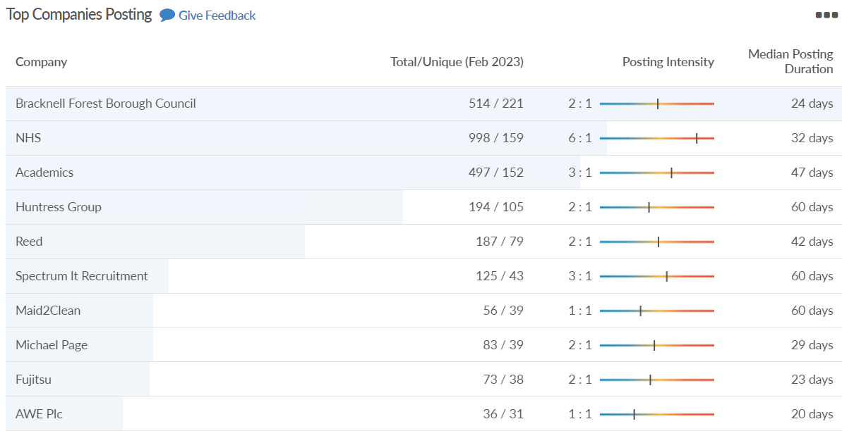
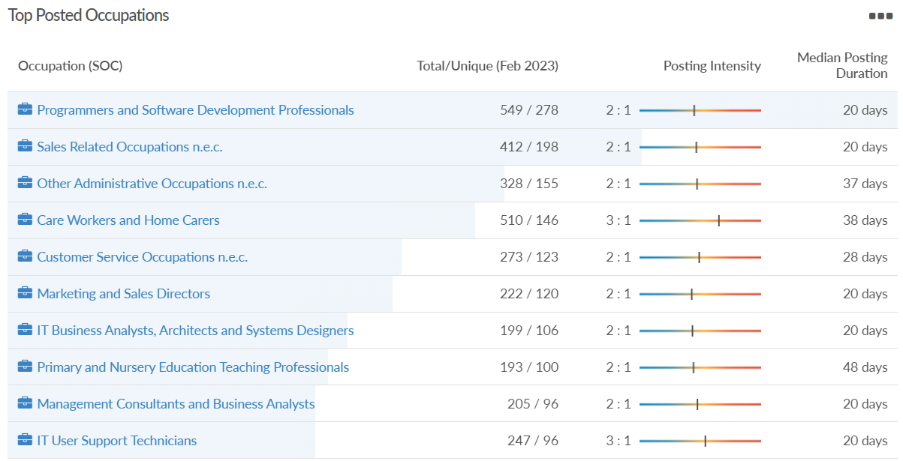
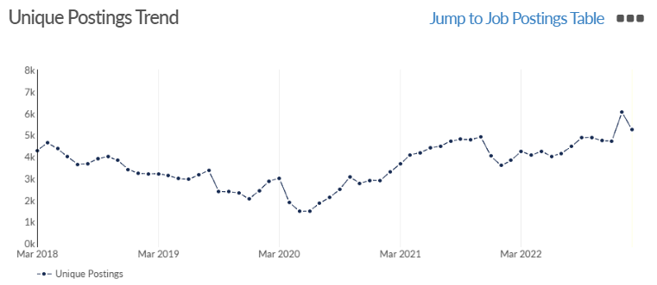
Bracknell Forest
Job posting analytics
(Active postings)
Source: EMSI, February 2023
Unique job postings | 5,237
Total job postings | 11,907
Job posting intensity | 2:1
Unique job postings (February 2022) | 3,816

Slide 27
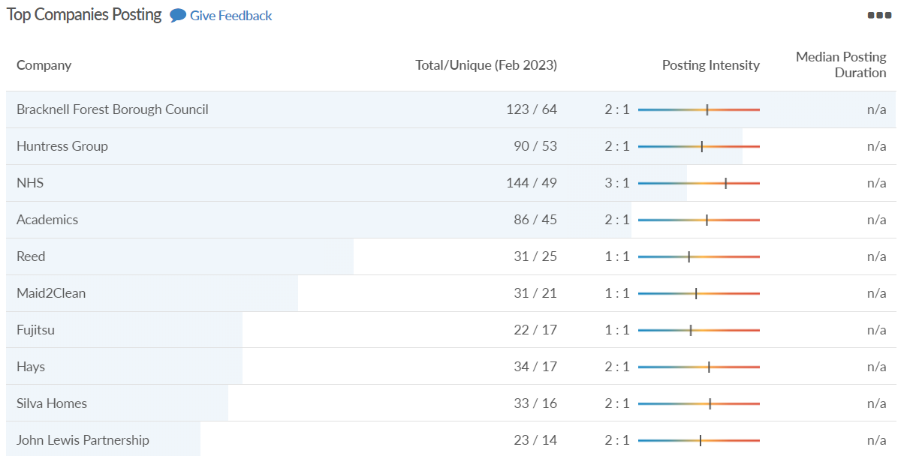
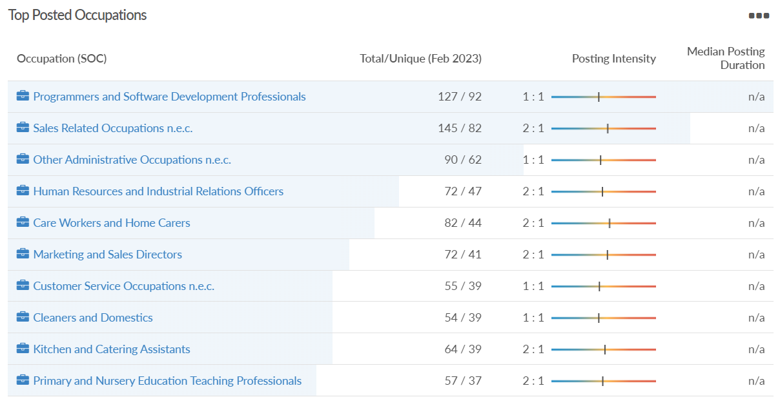
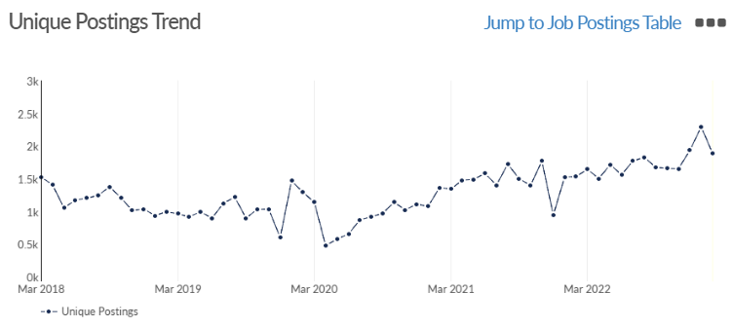
Bracknell Forest
Job posting analytics
(Newly posted)
Source: EMSI, February 2023
Unique job postings | 1,889
Total job postings | 2,986
Job posting intensity | 2:1
Unique job postings (February 2022) | 1,534

Slide 28
Reading

Slide 29
Unemployment figures and notable business news - February 2023
Claimant unemployment to January 2023 (latest)
4,245 claimants (3.6% of the working age population) in Reading UA
Notable business news:
Reading town centre businesses are officially celebrating after receiving news that its vibrant night-time economy (ENTE) has been awarded the prestigious Purple Flag accreditation. Areas awarded the Purple Flag are recognised for providing a vibrant and diverse mix of dining, entertainment and culture while promoting the safety and wellbeing of visitors and local residents. Purple Flag assessors said that highlights from Reading’s submission included evidence of a strong partnership with clear buy-in from both the public and private sector, engaged and responsible attitudes towards customer care from the hospitality venues, and a good mix of activity and offer. – LINK.

Slide 30
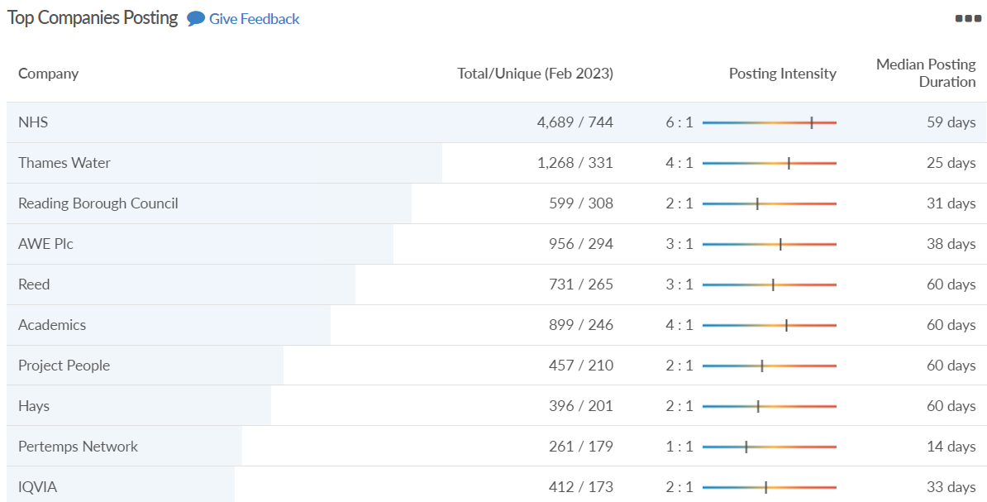
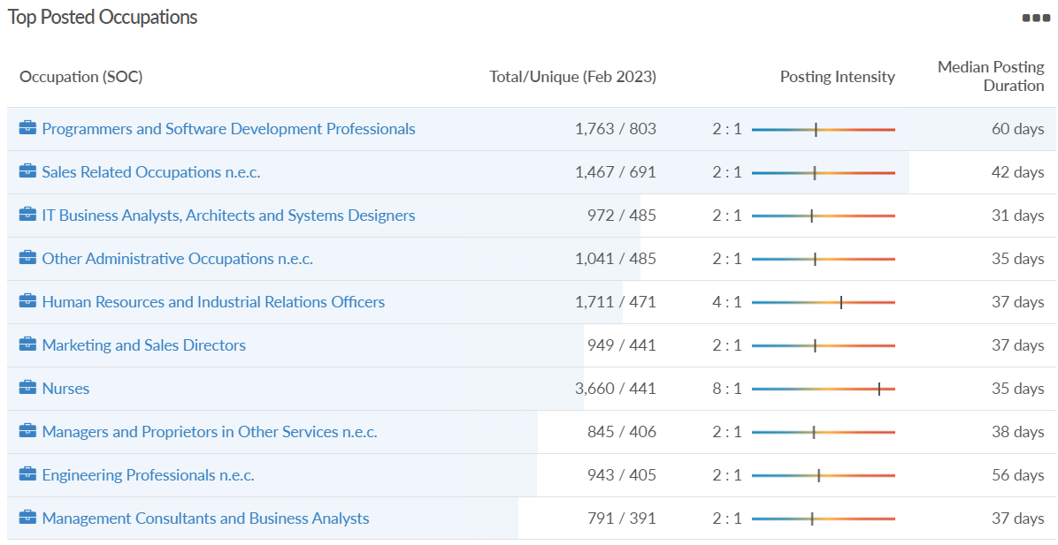
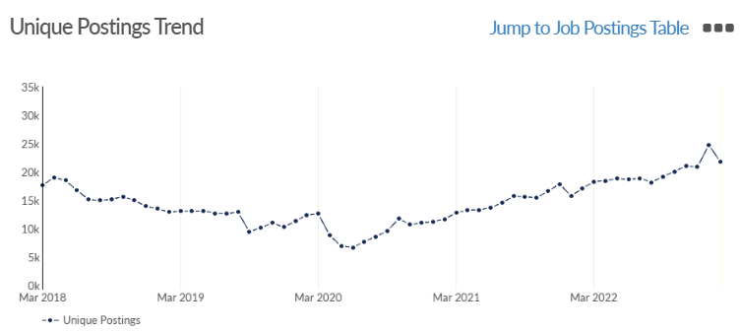
Reading
Job posting analytics
(Active postings)
Source: EMSI, February 2023
Unique job postings | 21,722
Total job postings | 55,473
Job posting intensity | 3:1
Unique job postings (February 2022) | 17,083

Slide 31
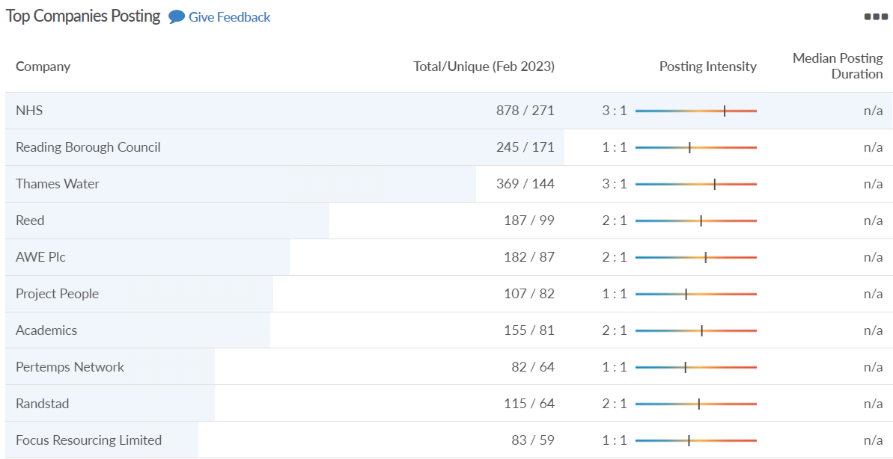
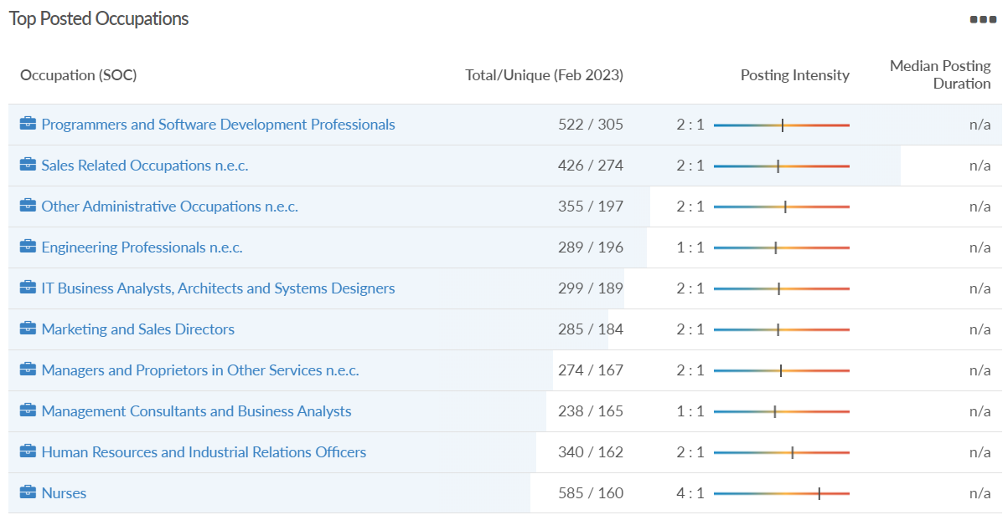
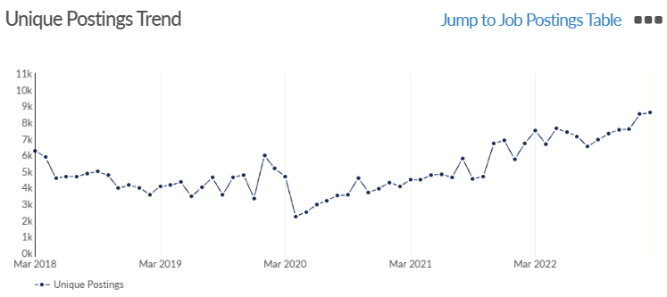
Reading
Job posting analytics
(Newly posted)
Source: EMSI, February 2023
Unique job postings | 8,575
Total job postings | 14,306
Job posting intensity | 2:1
Unique job postings (February 2022) | 6,719

Slide 32
Slough

Slide 33
Unemployment figures and notable business news - February 2023
Claimant unemployment to January 2023 (latest)
4,620 claimants (4.5% of the working age population) in Slough UA
Notable business news:
Slough Borough Council has received £1million to help support a programme of activities for start-up and established businesses in Slough. The funding from the UK Shared Prosperity Fund is spread across three years until 2025. As part of this, a new local start-up programme has been created, and is being delivered by the Berkshire Growth Hub. It has been launched to nurture emerging new businesses across Slough – taking them from entrepreneur to ‘enterprise ready’. – LINK.

Slide 34
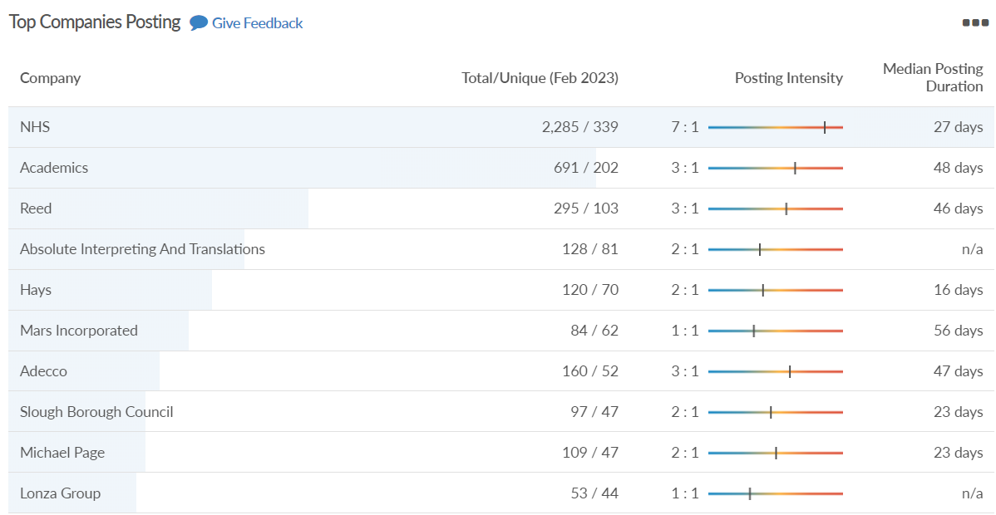
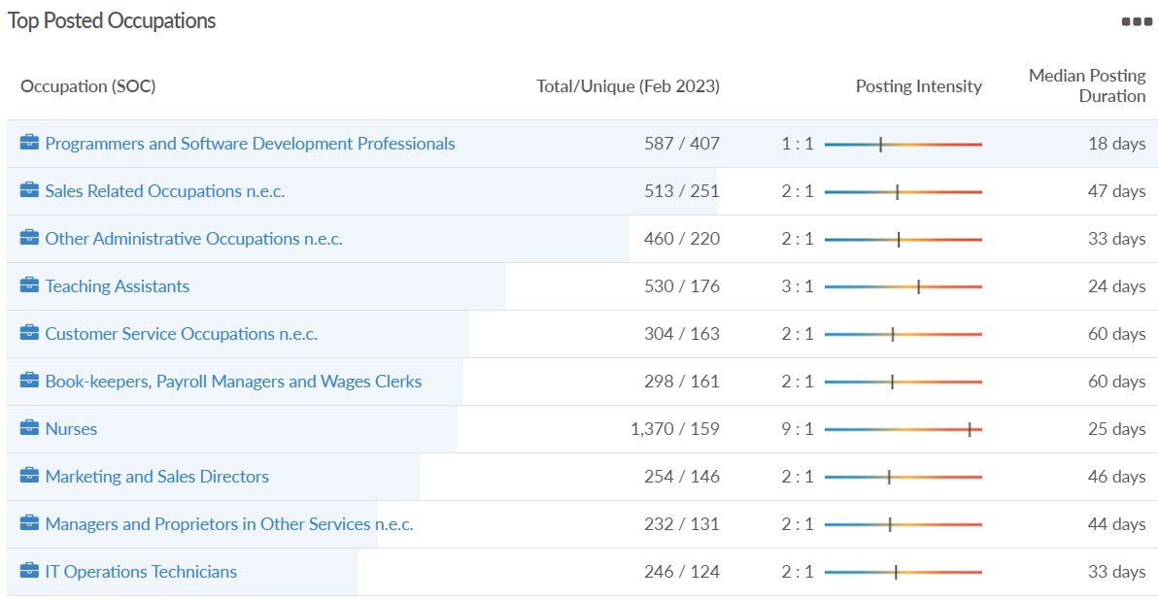
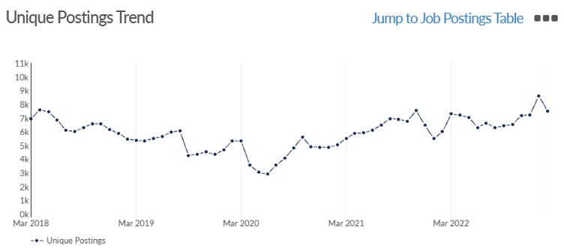
Slough
Job posting analytics
(Active postings)
Source: EMSI, February 2023
Unique job postings | 7.510
Total job postings | 17,129
Job posting intensity | 2:1
Unique job postings (February 2022) | 5,990

Slide 35
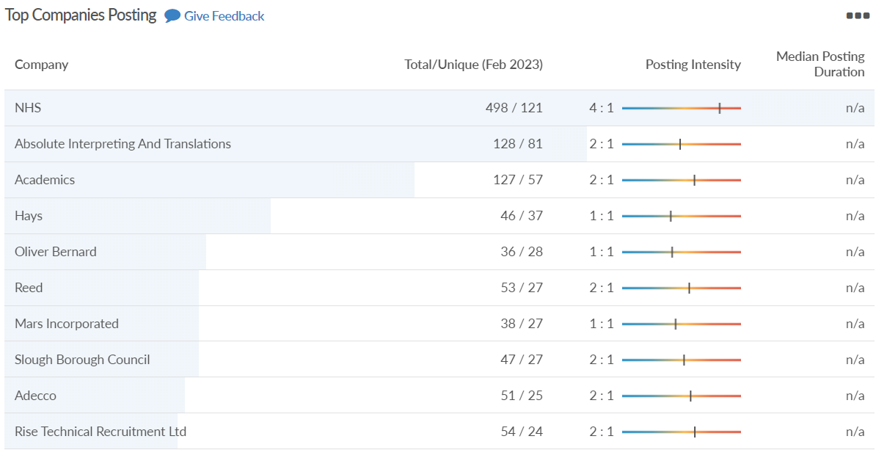
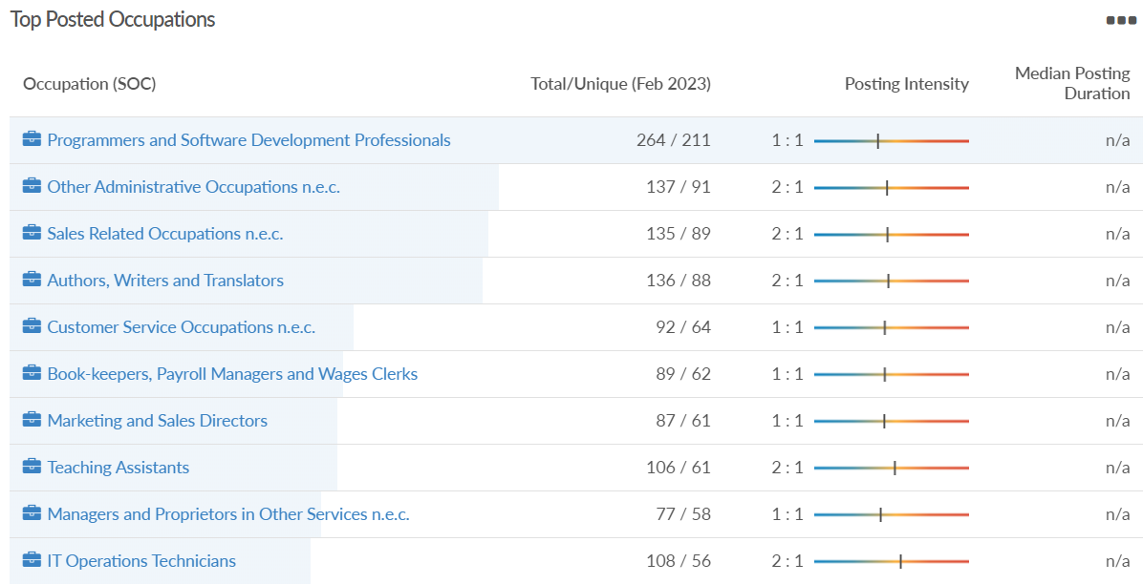
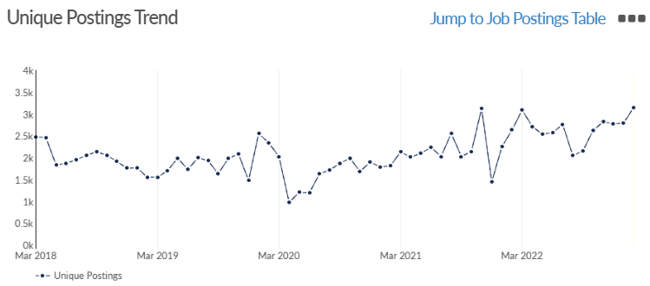
Slough
Job posting analytics
(Newly posted)
Source: EMSI, February 2023
Unique job postings | 3,144
Total job postings | 5,124
Job posting intensity | 2:1
Unique job postings (February 2022) | 2,632

Slide 36
West Berkshire

Slide 37
Unemployment figures and notable business news - February 2023
Claimant unemployment to January 2023 (latest)
2,000 claimants (2.0% of the working age population) in West Berkshire UA
Notable business news:
West Berkshire Council hosted a Sustainable Hospitality Webinar on Wednesday 1 March. As the energy costs amongst businesses continue to rise, the aim is to share the best practices for businesses to be more sustainable, but also save on their essential costs in the long run. Topics will include energy, transport, supply chain, funding, and the lessons learnt from navigating these areas. Andy Kershaw, Director of Property at Marstons, will be giving the perspective from a national chain, and Colline, from Colline’s Kitchen, will be talking about her experience as a local independent café owner and caterer. – LINK.

Slide 38
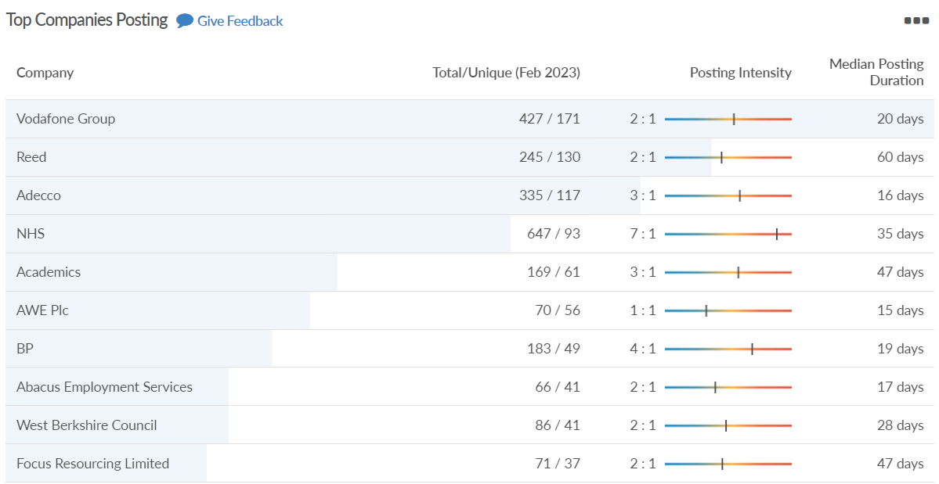
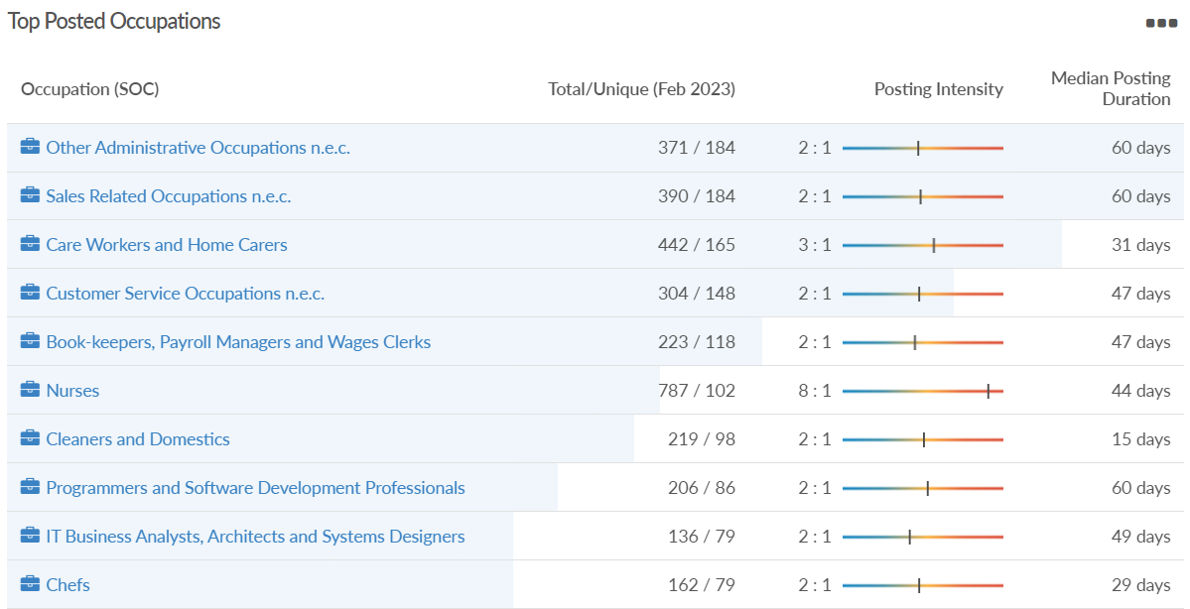
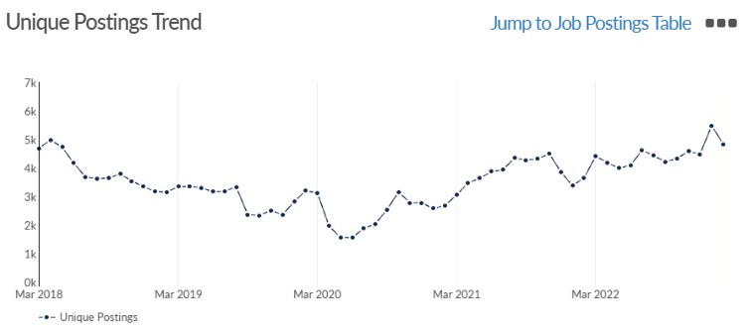
West Berkshire
Job posting analytics
(Active postings)
Source: EMSI, February 2023
Unique job postings | 4,838
Total job postings | 10,616
Job posting intensity | 2:1
Unique job postings (February 2022) | 3,651

Slide 39
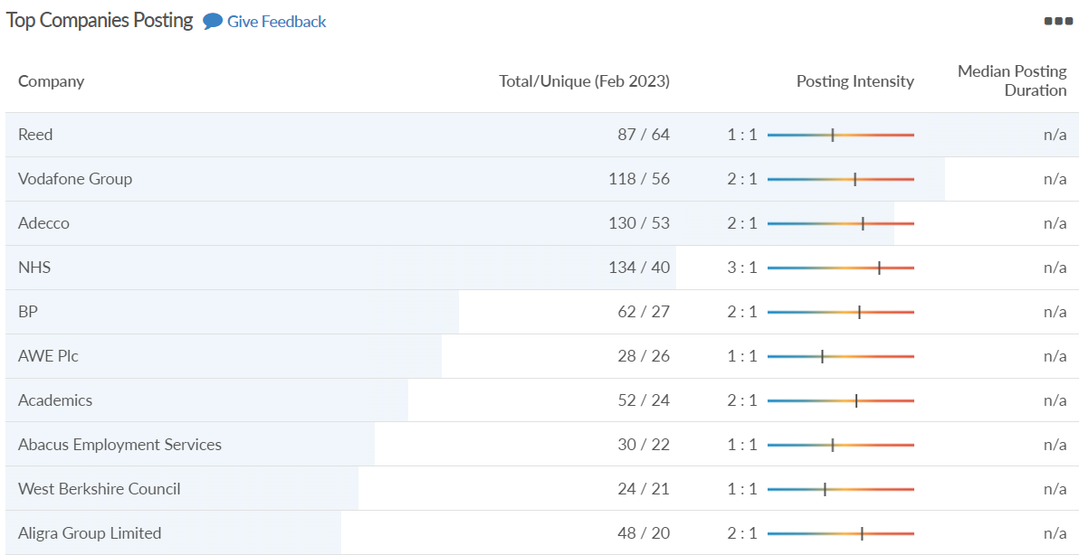
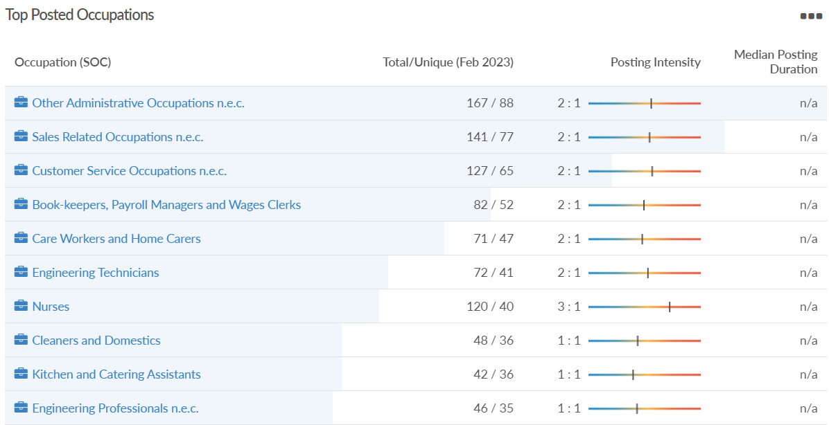
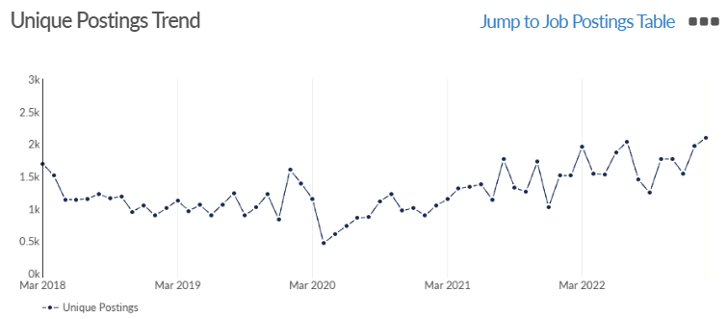
West Berkshire
Job posting analytics
(Newly posted)
Source: EMSI, February 2023
Unique job postings | 2,094
Total job postings | 3,353
Job posting intensity | 2:1
Unique job postings (February 2022) | 1,508

Slide 40
Windsor and Maidenhead

Slide 41
Unemployment figures and notable business news - February 2023
Claimant unemployment to January 2023 (latest)
1,985 claimants (2.1% of the working age population) in Windsor and Maidenhead UA
Notable business news:
The Royal Borough’s Cabinet has agreed a vibrant Vision for Windsor which is supported by five vision statements, alongside potential strategies and actions for their delivery. These are:
  The Local Community – Create a thriving local economy of business and community partnerships that benefit from Windsor’s global brand
  The Global Community – Deliver a world class visitor experience supported by a strong, diverse and resilient hospitality sector
  Transport and Movement - Develop sustainable, convenient and affordable travel options to travel into Windsor town centre for both residents and visitors
  The Built Environment - Protect and enhance the heritage, character and identity of Windsor
  The Natural Environment – Promote, activate and improve access to natural assets and resources. – LINK.

Slide 42
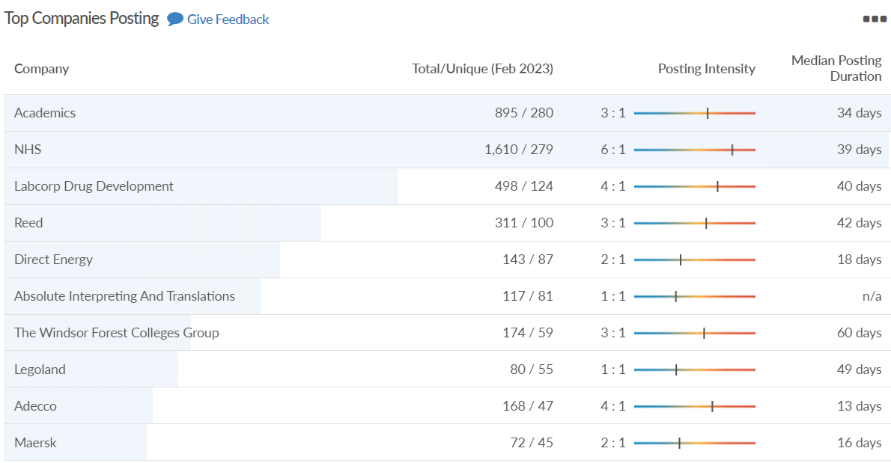
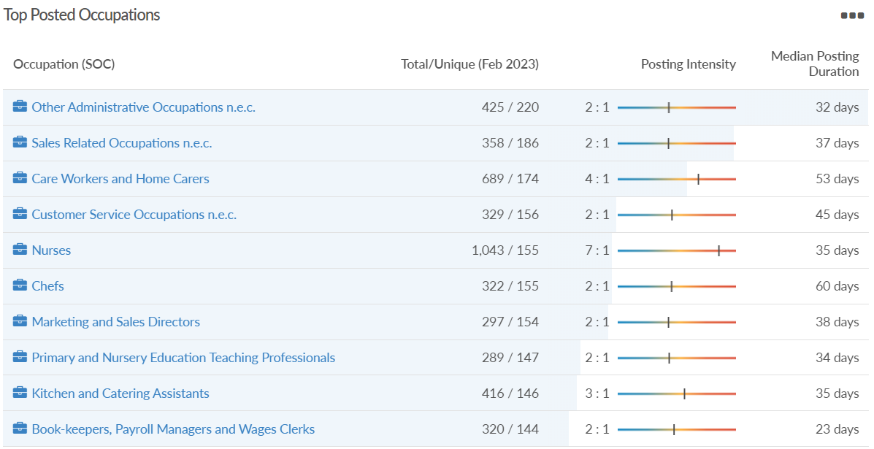
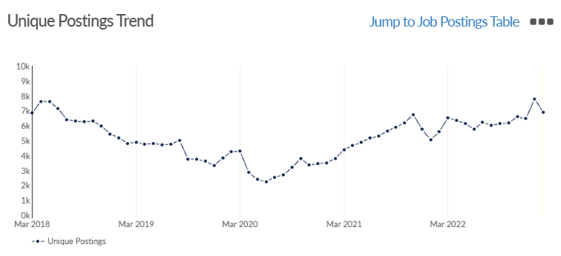
Windsor and Maidenhead
Job posting analytics
(Active postings)
Source: EMSI, February 2023
Unique job postings | 6,890
Total job postings | 16,321
Job posting intensity | 2:1
Unique job postings (February 2022) | 5,582

Slide 43
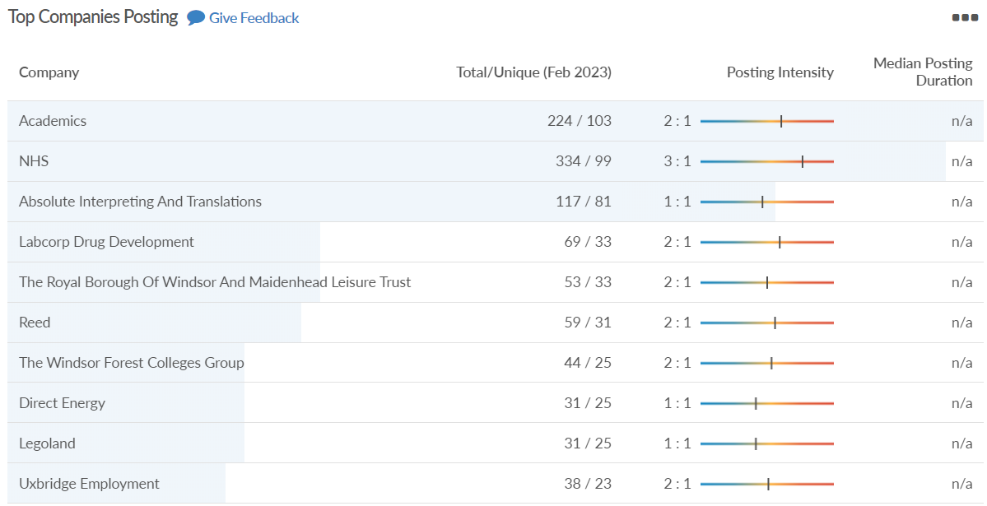
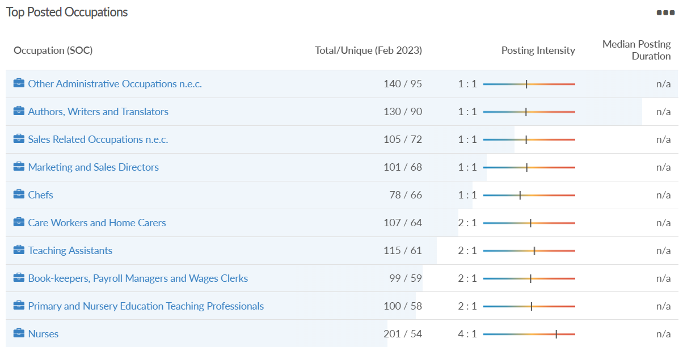
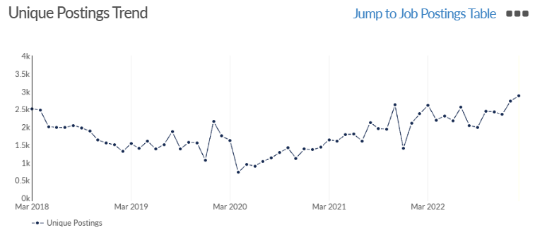
Windsor and Maidenhead
Job posting analytics
(Newly posted)
Source: EMSI, February 2023
Unique job postings | 2,870
Total job postings | 4,595
Job posting intensity | 2:1
Unique job postings (February 2022) | 2,365

Slide 44
Wokingham

Slide 45
Unemployment figures and notable business news - February 2023
Claimant unemployment to January 2023 (latest)
1,720 claimants (1.6% of the working age population) in Wokingham UA
Notable business news:
Frasers Property UK has completed the development of a 57,000 sq. ft warehouse, known as Building 820, at Winnersh Triangle. It has been let to film and TV studio operator Stage Fifty and will provide workshop space and offices. Stage Fifty has exchanged contracts to pre-lease two new sound stages totalling 50,000 sq. ft as part of a larger overall scheme, reflecting the demand for premium film and studio space. Rupert Batho, commercial director of Frasers Property UK, said: “The planned, phased expansion of Stage Fifty’s Winnersh Film studios significantly supports the UK’s international reputation as a destination for television and film production.” – LINK.

Slide 46
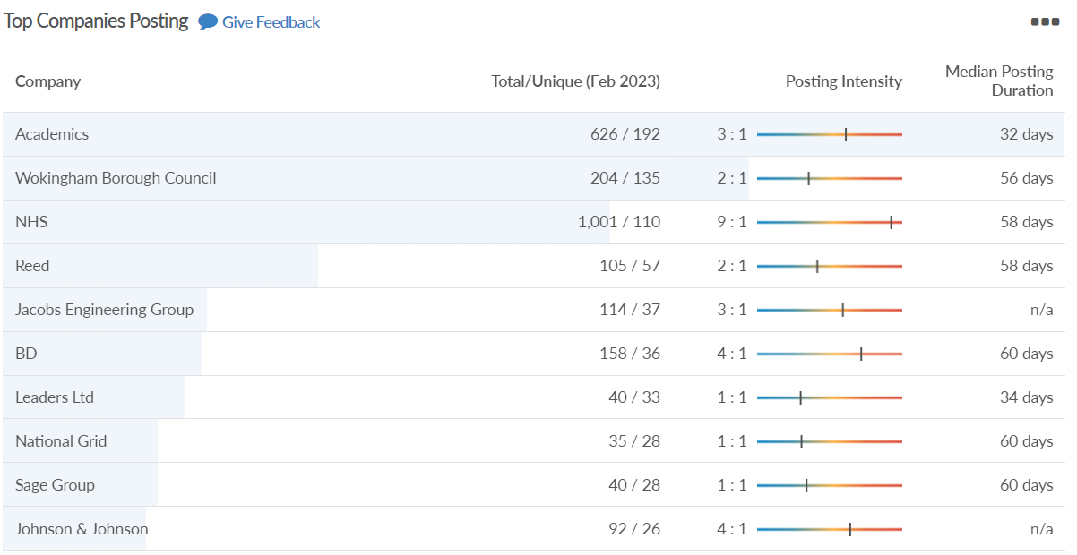
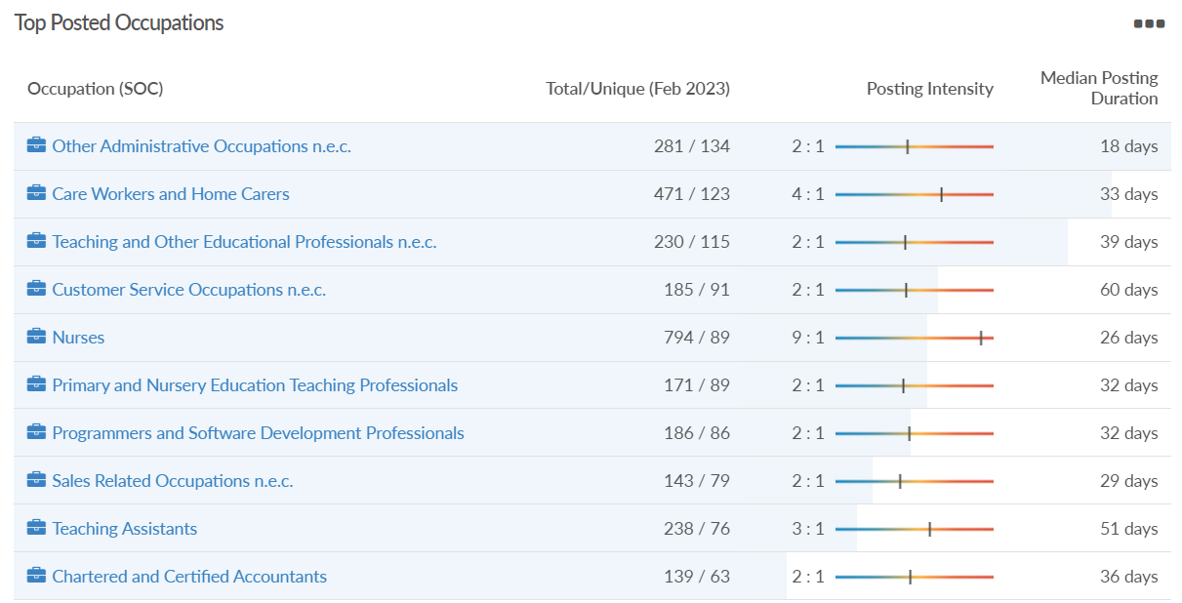
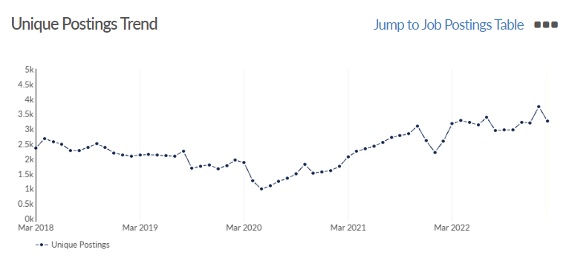
Wokingham
Job posting analytics
(Active postings)
Source: EMSI, February 2023
Unique job postings | 3,247
Total job postings | 7,708
Job posting intensity | 2:1
Unique job postings (February 2022) | 2,590

Slide 47
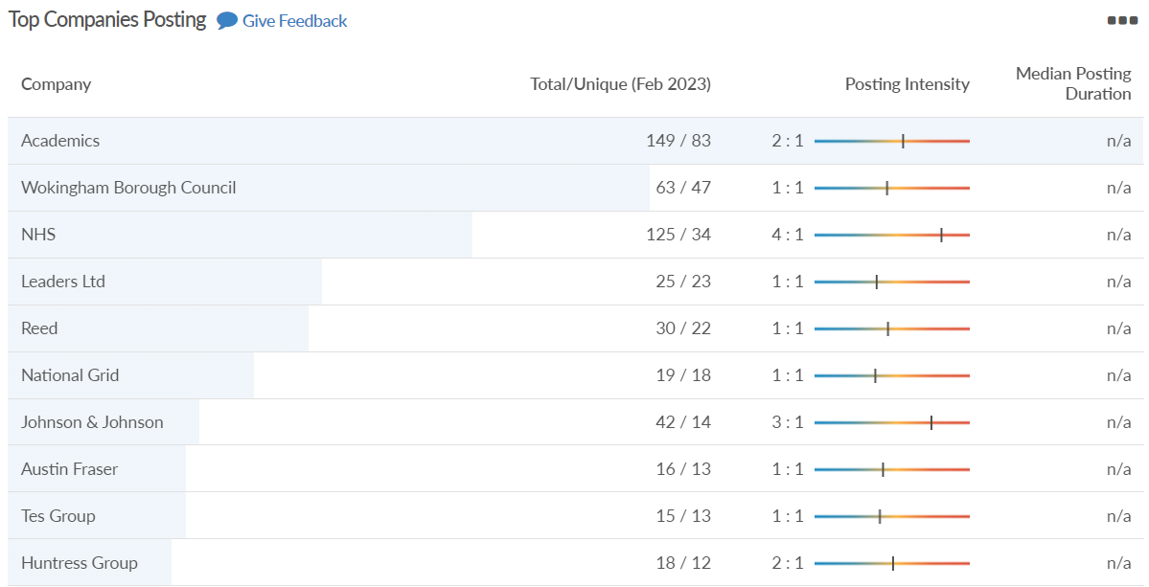
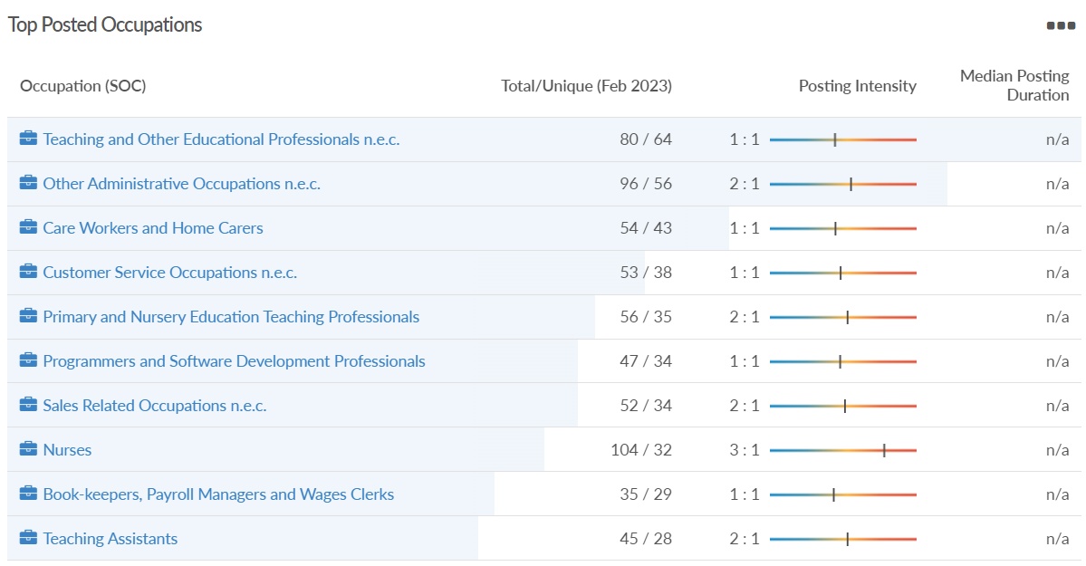
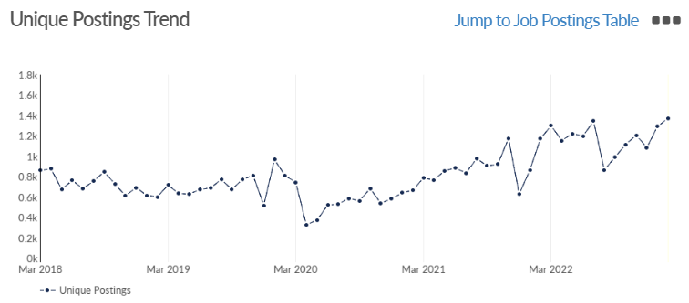
Wokingham
Job posting analytics
(Newly posted)
Source: EMSI, February 2023
Unique job postings | 1,372
Total job postings | 2,013
Job posting intensity | 1:1
Unique job postings (February 2022) | 1,170

