Slide 1
Thames Valley Berkshire
Monthly Economic Briefing
January 2022

Slide 2
2022 Refresh
Following on from stakeholder feedback as well as discussions within the LEP over the course of the last year, we have decided to make some additions to the content of our economic briefings, whilst still continuing to report on the bulk of the areas that were covered last year.
Each month, we aim to have a themed feature. This month we will be looking at skills and employment across Berkshire.
These monthly economic briefings are constantly evolving documents and their content is dictated in part by data/information requests from our readers.
If there is an economic aspect not currently covered within these reports which you think would be beneficial to include/expand upon (or you have any queries), we will do our best to help. Please contact Dex in the LEP’s research team at dexterlevick@thamesvalleyberkshire.co.uk.

Slide 3
Key contents of this month’s briefing
Updated global and UK economic forecasts
Monthly Event Spotlight – Cities Outlook 2021 Launch
Key points from the latest Labour Force Survey data
Latest claimant count figures by Local Authority
Latest remote working figures for Thames Valley Berkshire
Latest ‘notable business news’ by Local Authority
Latest job posting analytics by Local Authority

Slide 4
Global and National Economy
January 2022

Slide 5
Global Economy
The global economy enters 2022 in a weaker position than previously expected. As the new Omicron COVID-19 variant spreads, countries have reimposed mobility restrictions. Rising energy prices and supply disruptions have resulted in higher and more broad-based inflation than anticipated, notably in the United States and many emerging market and developing economies.
Global growth is expected to moderate from 5.9 in 2021 to 4.4 percent in 2022—half a percentage point lower for 2022 than in the IMF’s October World Economic Outlook (WEO), largely reflecting forecast markdowns in the two largest economies.
In China, pandemic-induced disruptions related to the zero-tolerance COVID-19 policy and protracted financial stress among property developers have induced a 0.8 percentage-point downgrade. Global growth is expected to slow to 3.8 percent in 2023.
The forecast is conditional on adverse health outcomes declining to low levels in most countries by end-2022, assuming vaccination rates improve worldwide and therapies become more effective. Source: IMF, January 2022

Slide 6
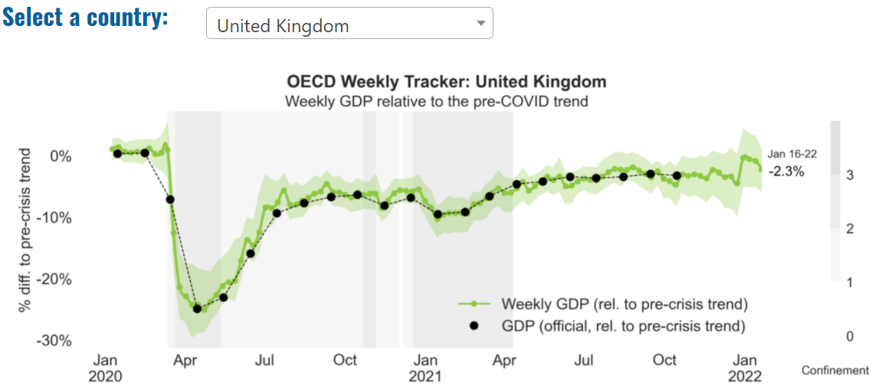
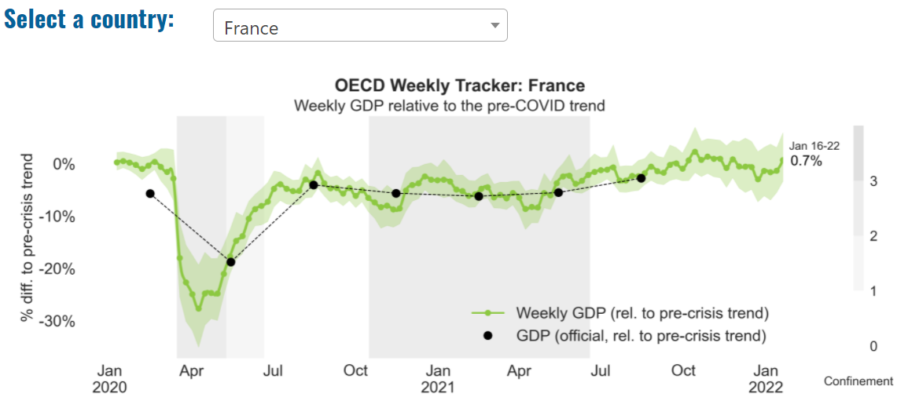
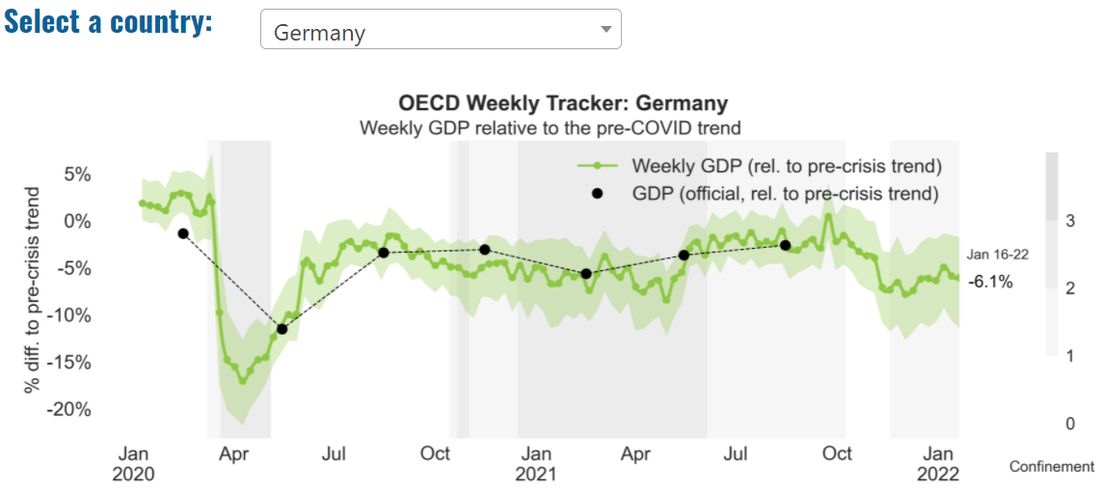
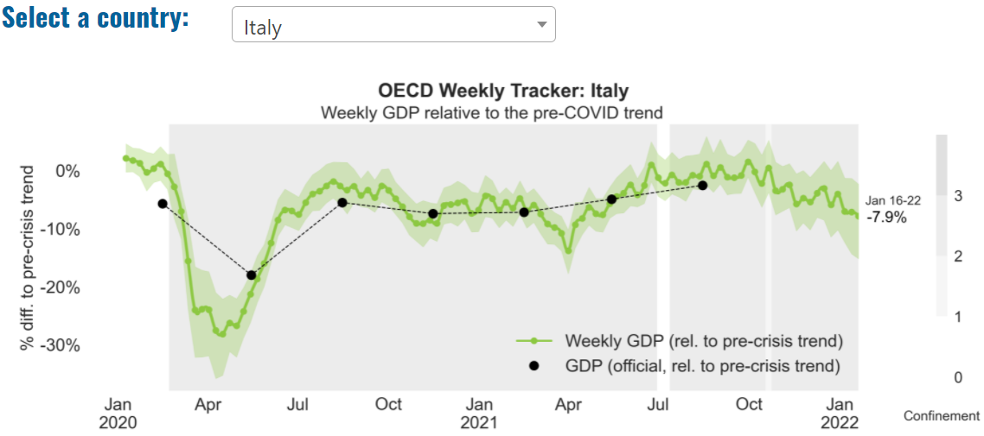
Global Economy – OECD GDP Tracker

Slide 7
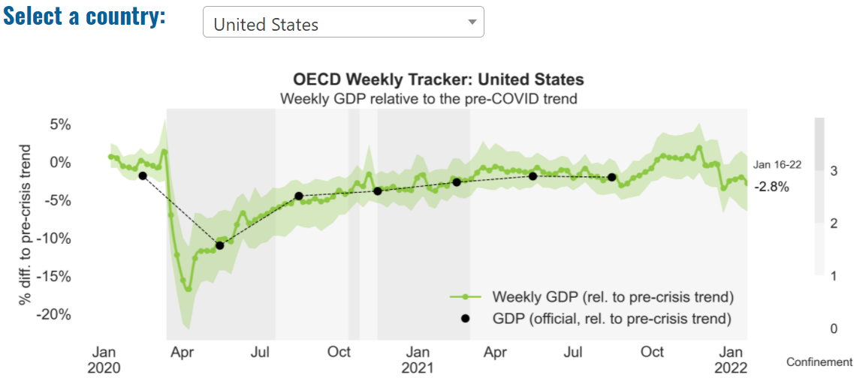
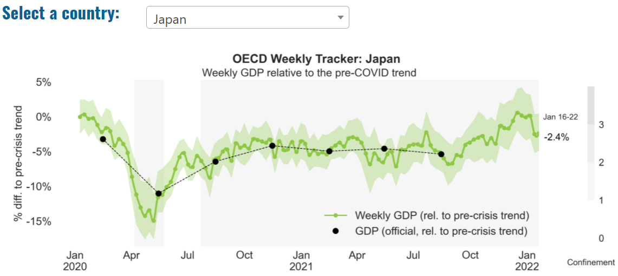
Global Economy – OECD GDP Tracker Continued
Note: The green confidence band shows 95% confidence intervals. The Weekly Tracker is an estimate of weekly GDP relative to the pre-crisis trend, which is proxied by the November 2019 OECD Economic Outlook forecasts. The darkness of the grey background reflects stay-at-home confinement requirement based on the Oxford Blavatnik database (0 - no measures, 1 - recommend not leaving house, 2 - require not leaving house with exceptions, 3 - require not leaving house with minimal exceptions).
Source: OECD, January 2022

Slide 8
UK Economy
As more information emerges about the Omicron variant, the latest expectations are that the surge in COVID infections will subside relatively quickly. That could see the current guidance to work from home where possible relaxed, with global restrictions on international travel possibly lifted from the second quarter of this year.
The less severe burden of the Omicron variant and its implications for the economic outlook broadly coincide with the upside scenario that was published in our December report. With the UK economy now on the cusp of pre-COVID levels, growth momentum will no longer be able to simply rely on the rebound effect to propel it.
We expect economic growth to gradually; rising taxes and borrowing costs, as well as elevated inflation, will squeeze households’ purchasing power. At the same time, the lingering effects of supply chain bottlenecks together with a persistent shortage of labour could constrain production this year.
Nonetheless, after a relatively weak start to 2022 brought about by Omicron, growth should pick up from March, with overall GDP growth in 2022 reaching around half the rate of last year.
Inflation is expected to remain elevated this year, and to peak at around 6.5% in April. However, as energy prices gradually stabilise and supply chains recover, we expect inflation to moderate significantly by the end of this year and to approach the Bank of England’s 2% target by the start of Q2 next year.
Source: KPMG, January 2022

Slide 9
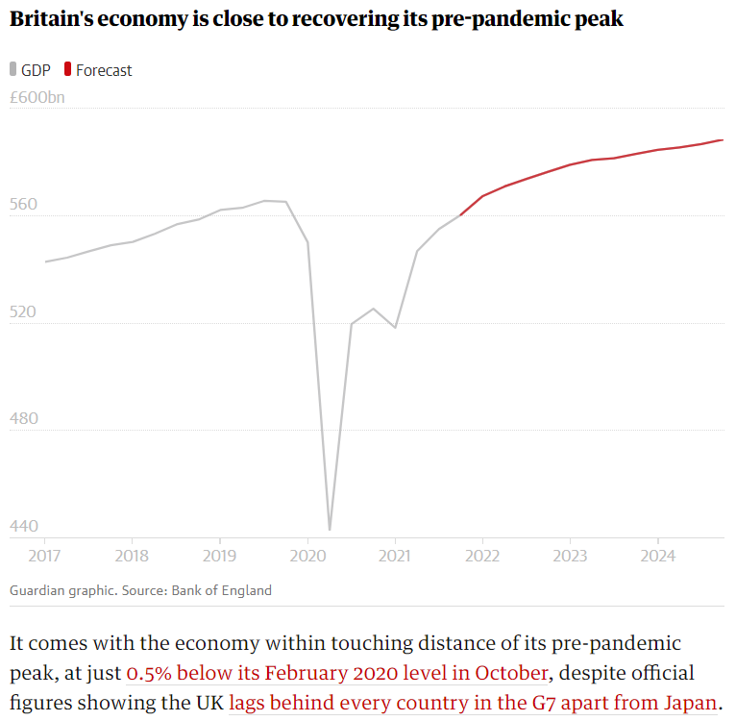
UK Economy 2
Britain’s economy is beginning 2022 on the back foot as record numbers of coronavirus infections and tougher restrictions driven by the Omicron variant cloud the outlook for growth.
It comes after a weaker pace of growth at the end of last year as businesses and households come under mounting pressure from rising energy bills pushing up inflation, as well as shortages of workers and materials.
Economic activity has slumped since the emergence of the coronavirus Omicron variant, with people choosing to be cautious due to high infection rates and renewed government restrictions weighing on growth.
Economists warn a sustained hit would lead gross domestic product (GDP) to fall in the first few months of 2022.
Source: The Guardian, January 2022

Slide 10
UK Economy 3
The UK – and indeed global – economy remains under the shadow of COVID-19. Concerns over new variants of the virus have once again forced policymakers to make tough choices aimed at striking the right balance between economic security and the health of the population.
At the same time, the consequences of surging demand coming up against supply-chain constraints have stoked price inflation to its highest level in many years. While central banks strive to assess how long the upward pressure on prices will continue, business are grappling with shortages and soaring costs, and households’ budgets are being squeezed.
Against this generally sombre background, the jobs market coming out of the crisis has continued to exhibit a surprising degree of strength. Joblessness has fallen close to pre-pandemic levels and job vacancies and hiring are at record highs. Early indications suggest that the closure of the furlough scheme in September had only a modest effect on unemployment.
As 2022 gets underway, the hope is that the accelerated vaccine roll-out brings the virus under control, while inflationary pressures start to subside as supply chains adapt. However, the past two years have shown us that this rosy scenario should not be taken for granted. The initial rebound from the pandemic now appears to be largely behind us; before us lies the bumpy road to recovery and sustainable growth.
Source: EY, January 2022

Slide 11
Monthly Event Spotlight: Cities Outlook 2022 Launch event by the Centre for Cities, 24 January 2022
Key points:
  Not all high streets were struggling pre-COVID, contrary to what was being reported in the press
  Smaller areas, especially in the North East of England, were primarily the ones that were struggling
  Average loss of sales over lockdown for retail was 34 weeks – the high street in London lost a year of sales
  Weaker city centres saw a smaller increase in vacancy rates when compared to stronger areas
  Big cities with larger catchment areas shrunk as a result of COVID
  Non-essential outlets were forced to close – this was a larger percentage of spend in stronger city centres when compared to weaker ones
  Stronger city centres had a much larger amount of jobs based there which were pulling people from a wider catchment area in when compared to weaker city centres
  Government grants didn’t stretch as far in stronger city centres in terms of average grant per business in retail, hospitality and recreation (partially because of lower business rents in weaker city centres)
  Focus on recovery needs to be long terms from a policy standpoint
  Full report available here: Cities Outlook 2022: Centre for Cities

Slide 12
Employment in the UK: Labour Force Survey – January 2022
Key points:
September to November 2021 estimates showed a continuing recovery in the labour market, with an increase in the employment rate and a decrease in the unemployment rate compared with the previous three-month period (June to August 2021).
Total hours worked decreased slightly compared with the previous three-month period and are still below pre-coronavirus pandemic levels, despite the loosening of coronavirus (COVID-19) restrictions.
The UK employment rate was estimated at 75.5%, 1.1 percentage points lower than before the coronavirus pandemic (December 2019 to February 2020), but 0.2 percentage points higher than the previous three-month period (June to August 2021).
The UK unemployment rate was estimated at 4.1%, 0.1 percentage points higher than before the pandemic, but 0.4 percentage points lower than the previous three-month period.
The UK economic inactivity rate was estimated at 21.3%, 1.0 percentage point higher than before the pandemic, and 0.2 percentage points higher than the previous three-month period.
  Source: ONS, January 2022

Slide 13
Further education and skills, Apprenticeship, Education and training, and Community Learning provision by local authority in 2021/22, reported to date – Slide 1
 |  |  | Total | 19-24 | 25+ | Under 19
Apprenticeships: Apprenticeships in the overall FE and skills numbers | Bracknell Forest | Achievements | 50 | 20 | 20 | 10
 |  | Participation | 1,150 | 430 | 550 | 170
 |  | Starts | 280 | 90 | 100 | 90
 | Reading | Achievements | 90 | 30 | 50 | 10
 |  | Participation | 1,580 | 520 | 870 | 180
 |  | Starts | 380 | 130 | 160 | 90
 | Slough | Achievements | 40 | 10 | 20 | 10
 |  | Participation | 1,150 | 400 | 620 | 120
 |  | Starts | 270 | 100 | 100 | 70
 | West Berkshire | Achievements | 70 | 20 | 30 | 20
 |  | Participation | 1,670 | 640 | 760 | 280
 |  | Starts | 400 | 140 | 110 | 150
 | Windsor and Maidenhead | Achievements | 60 | 20 | 30 | 10
 |  | Participation | 1,100 | 450 | 500 | 140
 |  | Starts | 240 | 90 | 80 | 70
 | Wokingham | Achievements | 70 | 20 | 40 | 10
 |  | Participation | 1,460 | 620 | 640 | 200
 |  | Starts | 360 | 140 | 120 | 100
Community Learning: Community learning includes a range of community based and outreach learning opportunities, primarily managed and delivered by local authorities and general further education colleges designed to bring together adults (often of different ages and backgrounds) | Bracknell Forest | Achievements | 210 | 10 | 210 | no data
 |  | Participation | 410 | 30 | 390 | no data
 |  | Starts | N/A | N/A | N/A | no data
 | Reading | Achievements | 80 | ~ | 70 | ~
 |  | Participation | 270 | 30 | 240 | ~
 |  | Starts | N/A | N/A | N/A | N/A
 | Slough | Achievements | 60 | 10 | 60 | no data
 |  | Participation | 170 | 10 | 160 | no data
 |  | Starts | N/A | N/A | N/A | no data
 | West Berkshire | Achievements | 140 | 20 | 120 | ~
 |  | Participation | 400 | 20 | 380 | ~
 |  | Starts | N/A | N/A | N/A | N/A
 | Windsor and Maidenhead | Achievements | 30 | ~ | 30 | no data
 |  | Participation | 220 | 10 | 210 | no data
 |  | Starts | N/A | N/A | N/A | no data
 | Wokingham | Achievements | 60 | ~ | 60 | no data
 |  | Participation | 260 | 20 | 240 | no data
 |  | Starts | N/A | N/A | N/A | no data

Slide 14
Further education and skills, Apprenticeship, Education and training, and Community Learning provision by local authority in 2021/22, reported to date - Slide 2
 |  |  | Total | 19-24 | 25+ | Under 19
Education and training: Includes classroom, distance and e-learning, traineeships and learning funded by advanced learner loans | Bracknell Forest | Achievements | 80 | ~ | 70 | no data
 |  | Participation | 680 | 200 | 480 | no data
 |  | Starts | N/A | N/A | N/A | no data
 | Reading | Achievements | 100 | 10 | 90 | no data
 |  | Participation | 1,370 | 390 | 980 | no data
 |  | Starts | N/A | N/A | N/A | no data
 | Slough | Achievements | 160 | ~ | 160 | no data
 |  | Participation | 1,570 | 410 | 1,160 | no data
 |  | Starts | N/A | N/A | N/A | no data
 | West Berkshire | Achievements | 100 | 10 | 80 | no data
 |  | Participation | 720 | 210 | 510 | no data
 |  | Starts | N/A | N/A | N/A | no data
 | Windsor and Maidenhead | Achievements | 50 | 10 | 40 | no data
 |  | Participation | 570 | 180 | 390 | no data
 |  | Starts | N/A | N/A | N/A | no data
 | Wokingham | Achievements | 70 | 10 | 70 | no data
 |  | Participation | 670 | 220 | 460 | no data
 |  | Starts | N/A | N/A | N/A | no data
Further education and skills: This comprises adult (aged 19 and over) government-funded further education (excluding schools and higher education) comprising: - education and training - basic skills - community learning | Bracknell Forest | Achievements | 360 | 50 | 320 | no data
 |  | Participation | 1,970 | 620 | 1,350 | no data
 |  | Starts | N/A | N/A | N/A | no data
 | Reading | Achievements | 260 | 50 | 220 | no data
 |  | Participation | 2,900 | 910 | 1,990 | no data
 |  | Starts | N/A | N/A | N/A | no data
 | Slough | Achievements | 310 | 40 | 270 | no data
 |  | Participation | 2,720 | 820 | 1,910 | no data
 |  | Starts | N/A | N/A | N/A | no data
 | West Berkshire | Achievements | 330 | 70 | 270 | no data
 |  | Participation | 2,480 | 860 | 1,620 | no data
 |  | Starts | N/A | N/A | N/A | no data
 | Windsor and Maidenhead | Achievements | 130 | 30 | 90 | no data
 |  | Participation | 1,700 | 630 | 1,070 | no data
 |  | Starts | N/A | N/A | N/A | no data
 | Wokingham | Achievements | 190 | 40 | 150 | no data
 |  | Participation | 2,120 | 830 | 1,290 | no data
 |  | Starts | N/A | N/A | N/A | no data

Slide 15
Coronavirus and Recession: Implications for Thames Valley Berkshire

Slide 16
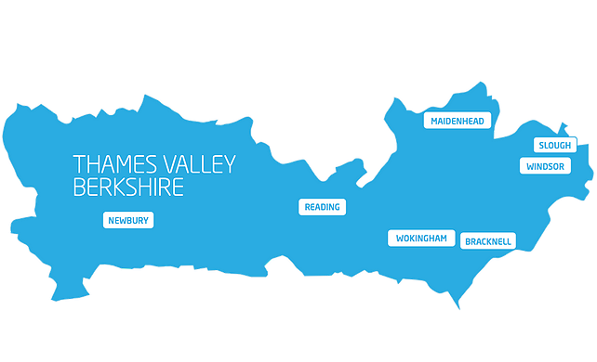
Claimant Count (Latest data - December 2021)
Total of 20,150 claimants (3.5% of the working age population) in Thames Valley Berkshire
2,050 claimants (2.6% of the working age population) in Bracknell Forest UA
5,870 claimants (6.2% of the working age population) in Slough UA
5,045 claimants (4.8% of the working age population) in Reading UA
2,060 claimants (1.9% of the working age population) in Wokingham UA
2,570 claimants (2.8% of the working age population) in Windsor and Maidenhead UA
2,550 claimants (2.7% of the working age population) in West Berkshire UA
Across Thames Valley Berkshire, claimant unemployment has fallen significantly from 29,720 in December 2020 to 20,150 in December 2021. Slough had 6.2% of its working age population claim unemployment in December 2021, down significantly from 8.5% in December 2020.
Source: ONS, January 2021

Slide 17
Strategic Issues: Heathrow
Heathrow Airport:
At least 600,000 passengers cancelled plans to fly from Heathrow in December due to the Omicron coronavirus strain and the introduction of tougher travel restrictions, the airport said. Fears over the Covid variant meant that, from late November, all travelers arriving in the UK were required to take a pre-departure lateral flow test and self-isolate until they received a negative result from a post-arrival PCR test. This led to many people scrapping their travel plans over the festive period. There are currently travel restrictions, such as testing, on all Heathrow routes.
A total of 19.4 million people travelled through Heathrow across the whole of last year. This was less than a quarter of the pre-pandemic level in 2019, and 12.3% down on 2020. Heathrow chief executive John Holland-Kaye said: “There are currently travel restrictions, such as testing, on all Heathrow routes. The aviation industry will only fully recover when these are all lifted and there is no risk that they will be reimposed at short notice, a situation which is likely to be years away.”
Source: Express and Star, January 2022

Slide 18
Strategic Issues: Aviation
Aviation:
The UK Government supports an aviation sector recovery with airport slot alleviation for summer 2022.
This move gives the aviation sector flexibility and protects environment as airlines will not have to operate ghost flights to retain airport slots.
The Government extends alleviation of airport slots usage rules with adjusted ratio of 70:30 for the summer 2022 season
Airlines will have to use their slots 70% of the time to retain their rights to them, providing support as demand for flights continues to returns to pre-pandemic levels
This change provides further support for aviation sector recovery, increases flexibility and protects the environment as airlines will not have to operate carbon-inefficient ‘ghost flights’ to retain their slots where markets are substantively closed
Source: Aviation24, January 2022

Slide 19
Demand and Supply Conditions: Businesses, Hiring, Restructuring, Investment, Labour and Skills Supply

Slide 20
Household/Consumer Demand
Slough had an overall recovery index score of 80 at the end of August, putting it in a weaker position in terms of recovery (closer to pre-lockdown levels) than Reading which had a recovery index score of 84.
Source: Centre for Cities, December 2021 (latest release)
Retail sales volumes fell by 3.7% in December 2021 but were 2.6% higher than their pre-coronavirus (COVID-19) February 2020 levels.
Non-food stores sales volumes fell by 7.1% in December 2021, with falls in each of its sub-sectors (department stores, clothing stores, other non-food stores and household stores) following strong sales in November; the Omicron variant, which increased rapidly during December, was reported by some retailers as impacting retail footfall.
Automotive fuel sales volumes fell by 4.7% in December 2021 as increased home working in December 2021 reduced travel; sales volumes were 6.6% below their February 2020 levels.
Food store sales volumes fell by 1.0% in December 2021; despite the fall in December, volumes were 2.0% above levels in February 2020.
The proportion of retail sales online rose slightly to 26.6% in December 2021 from 26.3% in November, substantially higher than the 19.7% in February 2020 before the coronavirus pandemic.
Between 2020 and 2021 the volume of retail sales rose by 5.1%, which is the strongest growth since 2004 (when it was also 5.1%); it was last higher in 2002 (5.7%). However, growth between 2020 and 2021 should be interpreted with caution given restrictions on travel and non-essential retail which contributed to a fall in sales during 2020. Source: ONS, December 2021 (latest release)

Slide 21
Remote working
In January of 2022, there were 4,784 unique job postings for remote positions at companies based in Berkshire, around 191% more than the figure of 1,642 for the same period one year before.
Compare this with the South East, in January 2022 there were 31,502 unique remote job postings for remote positions; rising from 11,752 in January of the previous year – an increase of over 168%.
A rise can also be seen at national level, with a recorded 193,834 unique remote job postings in England in January of 2022, rising from 73,284 in January 2021 – an increase of over 164%.
From these figures it’s apparent that the COVID-19 pandemic has, somewhat unsurprisingly, prompted a massive boost in job postings for explicitly remote roles. Berkshire has seen a larger boost in vacancies which are remote-based than both England and the South East.
Source: EMSI, January 2022

Slide 22
Local Profiles

Slide 23
Bracknell Forest

Slide 24
Impact of COVID-19 up to 9th February 2022
COVID-19 cases (to 9th February 2022) – Source: Public Health Berkshire COVID-19 Dashboard, 9th February 2022
34,102 total cases
145 new cases daily
Claimant unemployment (to December 2021)
2,050 claimants (2.6% of the working age population) in Bracknell Forest UA
Notable business news:
Bracknell-based Cawood, a UK independent provider of analytical laboratory testing services for the land-based industries, has acquired independent testing laboratory Chemtech Environmental. The addition of Chemtech expands Cawood’s waste testing, soil analysis, and environmental contamination testing services, extending its capacity and capability in these areas. ‘We are looking forward to continuing to provide fast, accurate, and reliable reporting to our customer base as well as working together to grow both our businesses,’ added John Campbell, Co-Owner and Director of Chemtech – LINK.

Slide 25
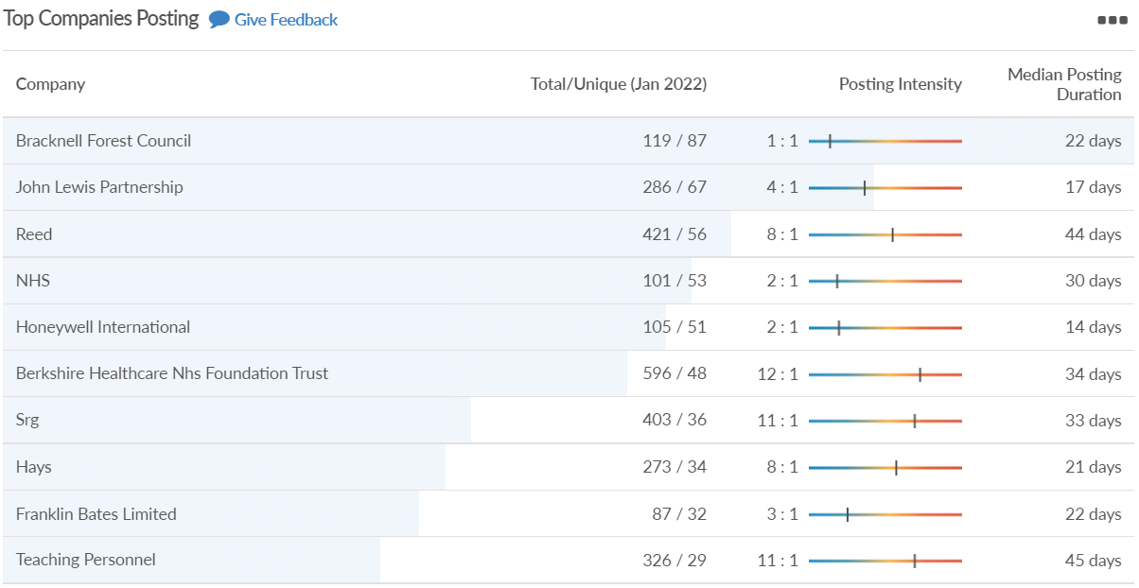
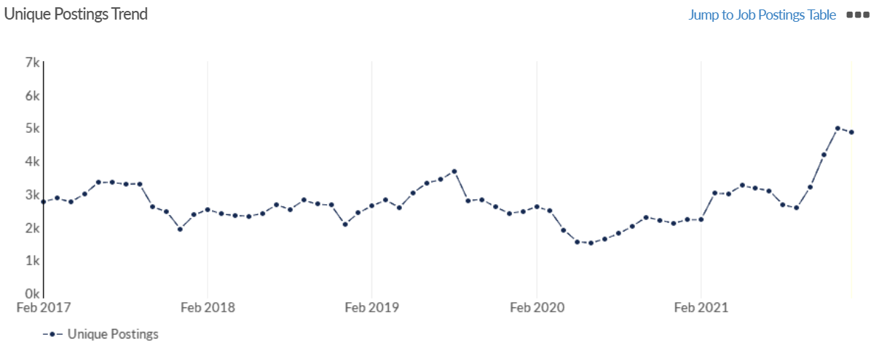
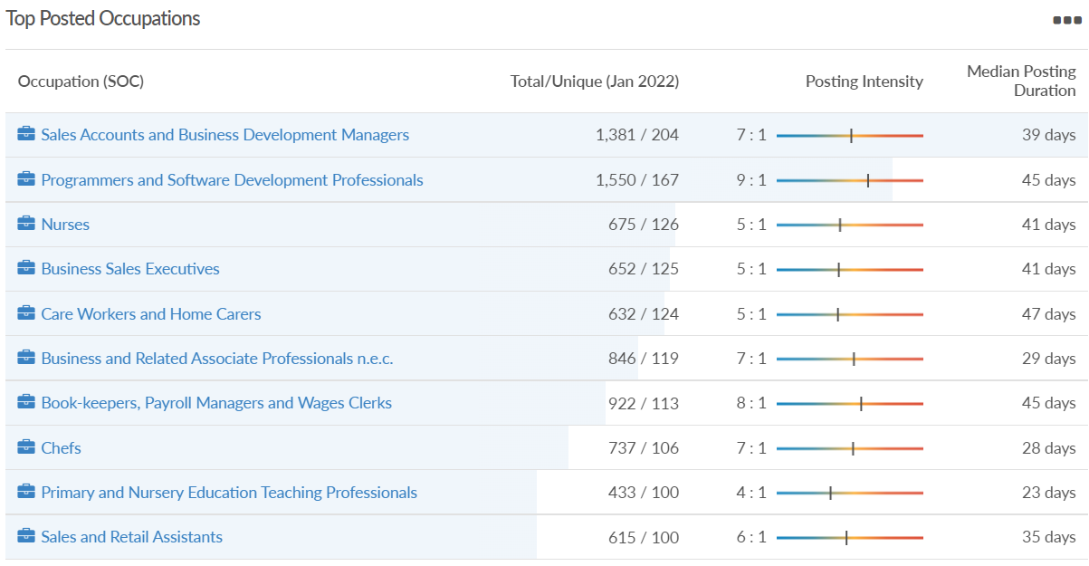
Job posting analytics (EMSI, January 2022)
Unique job postings: 4,864
Total job postings: 31,826
Job posting intensity: 7:1
Unique job postings (January 2021): 2,216

Slide 26
Slough

Slide 27
Impact of COVID-19 up to 9th February 2022
COVID-19 cases (to 9th February 2022) – Source: Public Health Berkshire COVID-19 Dashboard, 9th February 2022
45,901 total cases
192 new cases daily
Claimant unemployment (to December 2021)
5,870 claimants (6.2% of the working age population) in Slough UA
Notable business news:
SEGRO plc has acquired a portfolio of offices on the Bath Road, Slough, from clients of AEW for £425 million. The portfolio represents 89,000 sq m of built space spread across 39 acres of land with a passing rent of £20 million, reflecting a net initial yield of 4.6 per cent. UK Real Estate Investment Trust, SEGRO previously developed the office portfolio and sold it as part of its strategy to dispose of non-core assets, with the proceeds reinvested into the Group’s highly profitable development pipeline. Since January 2016, when the office portfolio was sold, the Slough Trading Estate has delivered capital value growth of 59 per cent and was valued at £2.2 billion as of June 2021 – LINK.

Slide 28
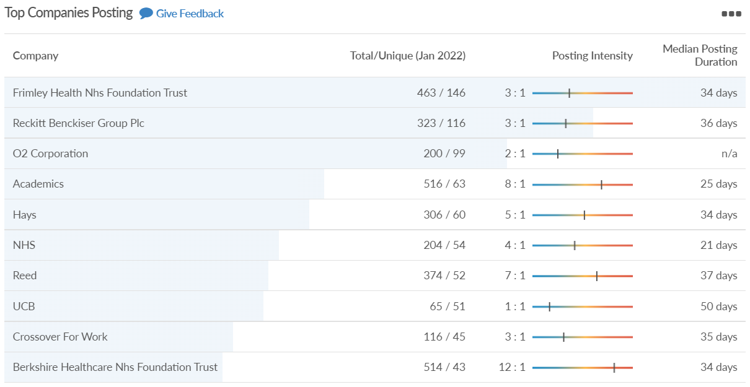
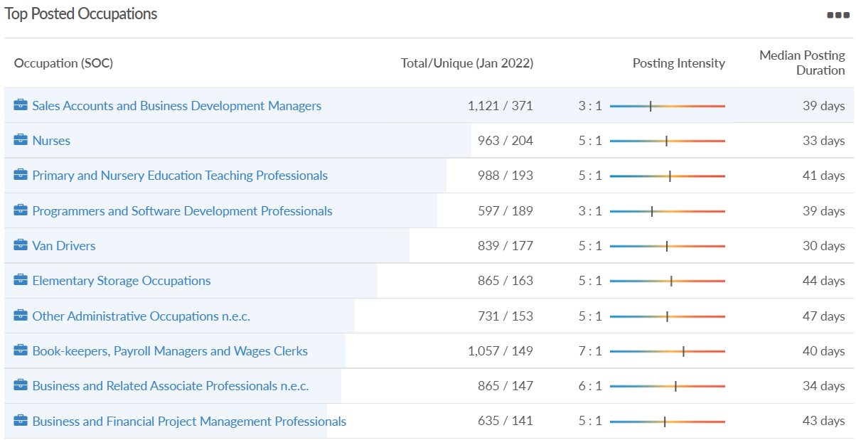
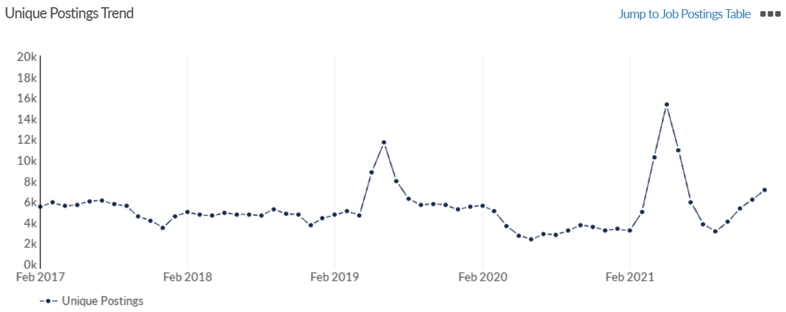
Job posting analytics (EMSI, January 2022)
Unique job postings: 7,113
Total job postings: 34,208
Job posting intensity: 5:1
Unique job postings (January 2021): 3,354

Slide 29
Reading

Slide 30
Impact of COVID-19 up to 9th February 2022
COVID-19 cases (to 9th February 2022) – Source: Public Health Berkshire COVID-19 Dashboard, 9th February 2022
47,453 total cases
251 new case daily
Claimant unemployment (to November 2021)
5,045 claimants (4.8% of the working age population) in Reading UA
Notable business news:
Power supplier XP Power has acquired two German firms to help cement its European footprint. The Reading-based firm announced today that has bought FuG Elektronik GmbH (FuG) and Guth High Voltage GmbH (Guth) from Dr Simon Consulting GmbH in cash for a fee of £32.8m. The two companies have around 150 employees at sites near Stuttgart and Munich. The purchase was funded using XP Power's existing debt facilities with FuG and Guth both generating close to £15m in revenue in 2021 and adjusted EBITDA of around £3.7m – LINK.

Slide 31
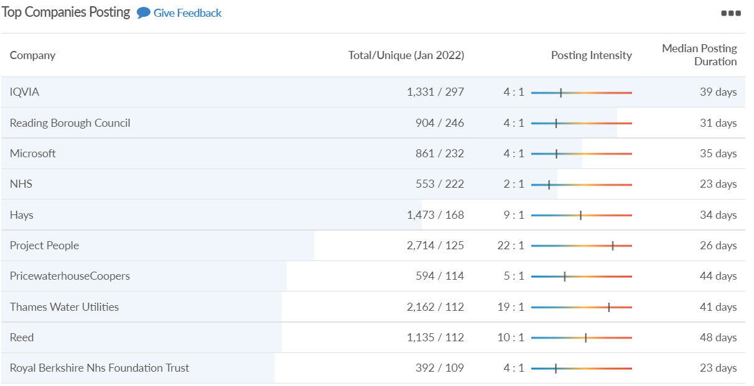
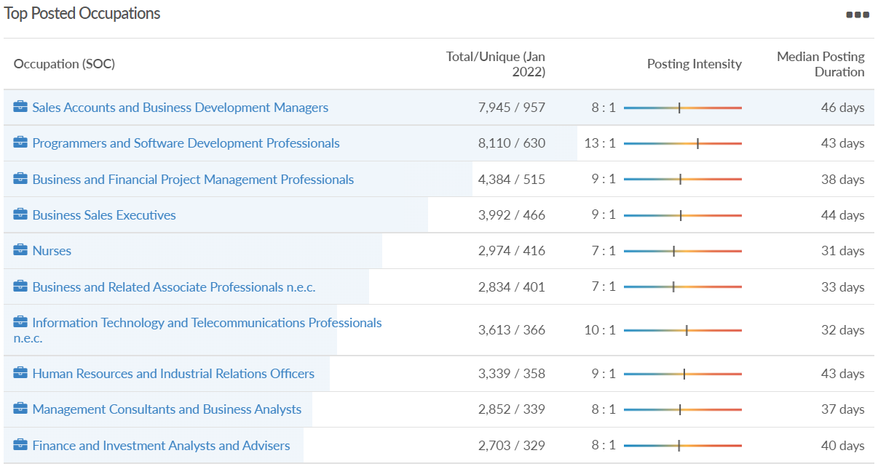
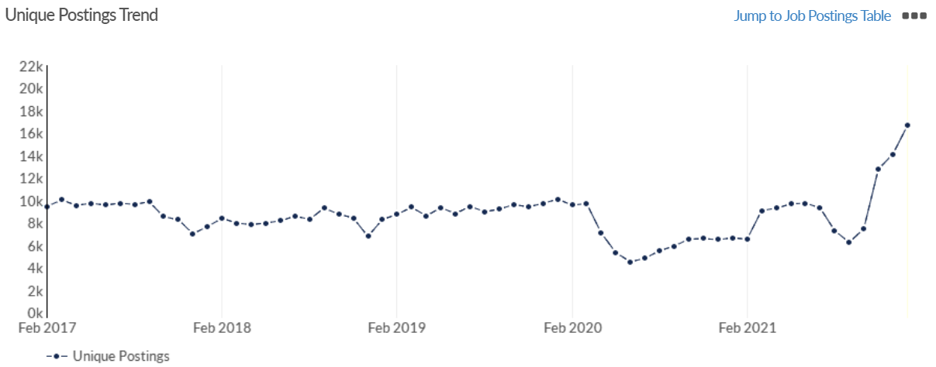
Job posting analytics (EMSI, January 2022)
Unique job postings: 16,677
Total job postings: 149,786
Job posting intensity: 9:1
Unique job postings (January 2021): 6,644

Slide 32
Wokingham

Slide 33
Impact of COVID-19 up to 9th February 2022
COVID-19 cases (to 9th February 2022) – Source: Public Health Berkshire COVID-19 Dashboard, 9th February 2022
46,703 total cases
207 new cases daily
Claimant unemployment (to November 2021)
2,060 claimants (1.9% of the working age population) in Wokingham UA
Notable business news:
One of the largest property services firms in the UK, Leaders Romans Group (LRG), has been acquired by a private equity firm. US-based Platinum Equity has signed a definitive agreement to acquire LRG from London private equity house Bowmark Capital. Wokingham-based LRG specialises in residential property lettings, sales and associated professional services, including planning and surveying. It has a nationwide network of 210 branches and offices and manages over 62,000 properties across the UK. Platinum Equity Partner Louis Samson said: "LRG plays an important role in the UK property market and has grown steadily for decades” – LINK.

Slide 34
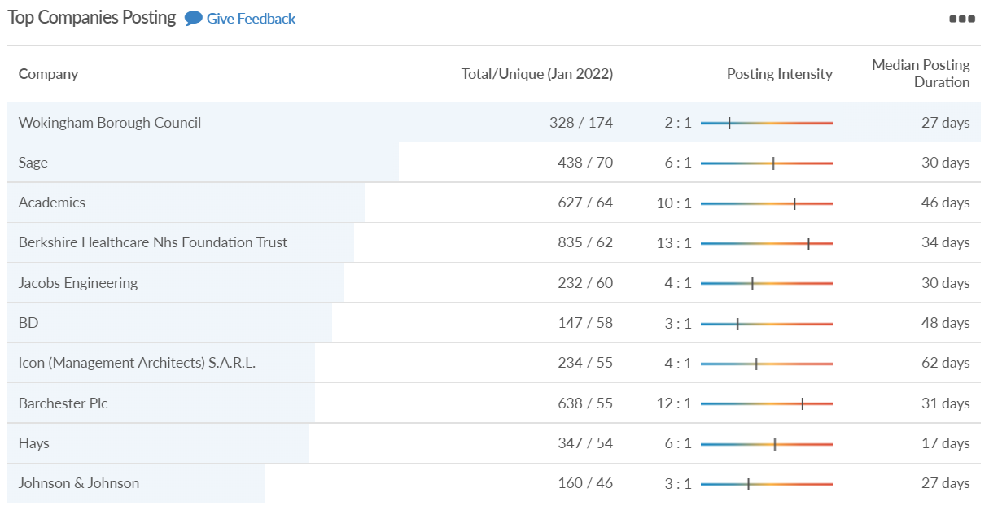
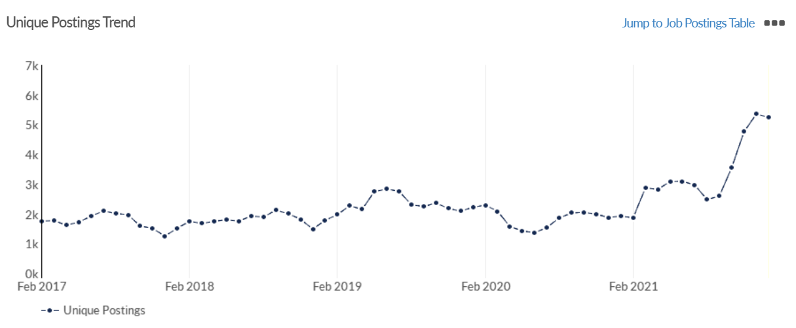
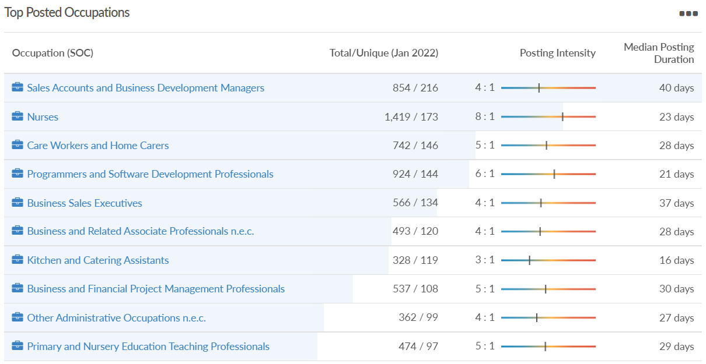
Job posting analytics (EMSI, January 2022)
Unique job postings: 5,249
Total job postings: 28,234
Job posting intensity: 5:1
Unique job postings (January 2021): 1,928

Slide 35
Windsor and Maidenhead

Slide 36
Impact of COVID-19 up to 9th February 2022
COVID-19 cases (to 9th February 2022) – Source: Public Health Berkshire COVID-19 Dashboard, 9th February 2022
41,400 total cases
198 new cases daily
Claimant unemployment (to December 2021)
2,570 claimants (2.8% of the working age population) in Windsor and Maidenhead UA
Notable business news:
Maidenhead-based Food delivery marketplace ‘Cook My Grub’ is embarking on its next funding round, eyeing a £1.5m boost. The platform allows home chefs to develop personal profiles before preparing healthy meals that are delivered to their locals' doors. It has provided a new source of income for those in the food industry who have been hit hard over the last two years. With the aim of reaching a £3m gross merchandise value before the end of 2022, the next phase of growth will see some of the best home cooks from across the country aggregated by the company, providing them with expert training, more opportunities to earn and new career prospects – LINK.

Slide 37
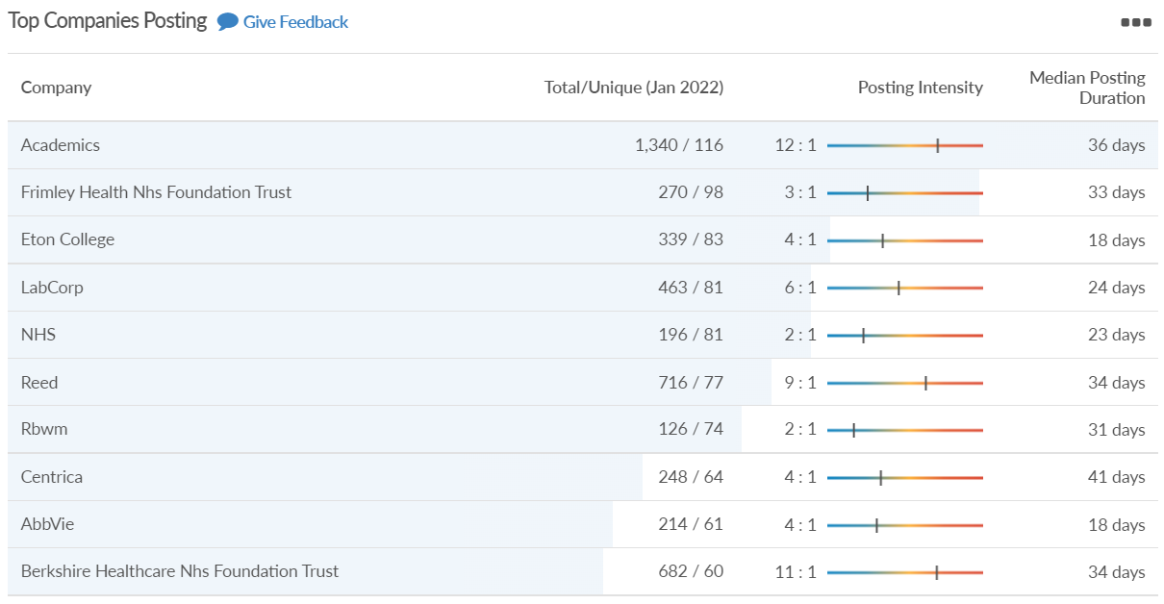
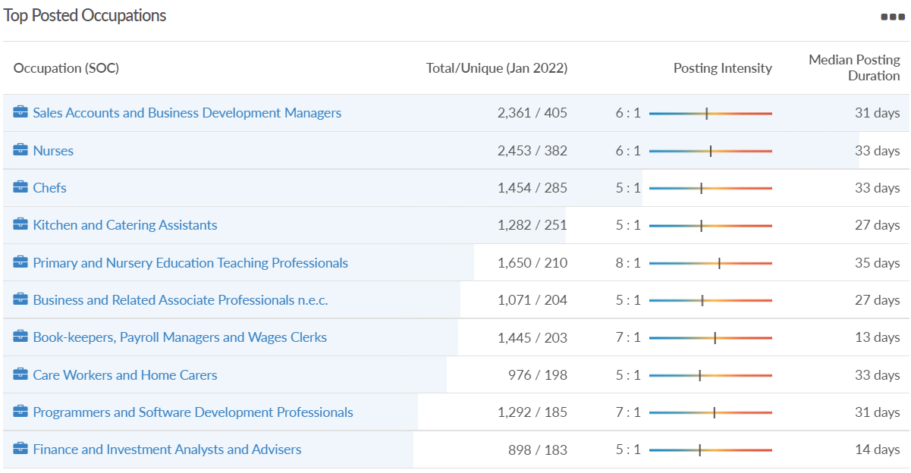
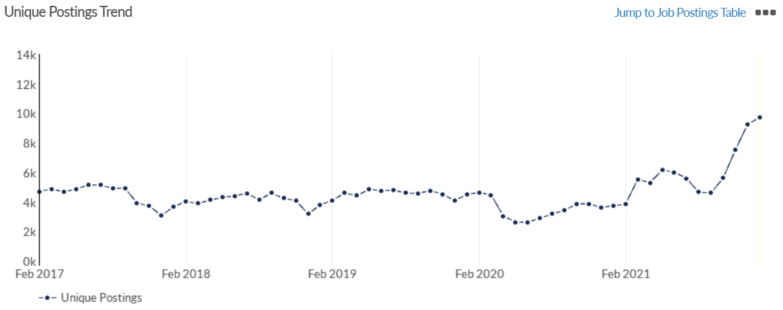
Job posting analytics (EMSI, January 2021)
Unique job postings: 9,733
Total job postings: 62,385
Job posting intensity: 6:1
Unique job postings (January 2021): 3,757

Slide 38
West Berkshire

Slide 39
Impact of COVID-19 up to 9th February 2022
COVID-19 cases (to 9th February 2022) – Source: Public Health Berkshire COVID-19 Dashboard, 9th February 2022
37,044 total cases
244 new case daily
Claimant unemployment (to December 2021)
2,550 claimants (2.7% of the working age population) in West Berkshire UA
Notable business news:
The mixed-use Mayfield Point planning application on land next to Newbury College has been submitted. NCII Ltd, a joint venture involving the Greenham Trust and the Feltham Group in partnership with Aldi and the college, has submitted a hybrid planning application for full permission for an 1,800 sq. m store with access and 128 parking spaces, and outline permission for a care home with up to 70 beds, a hospice, up to 85 homes and an electric vehicle charging area. Thirty per cent of the homes will be affordable. Funds raised through the development, which is on 3.66 hectares to the east of the college, will support both the work of the college and charities and community groups through the trust – LINK.

Slide 40
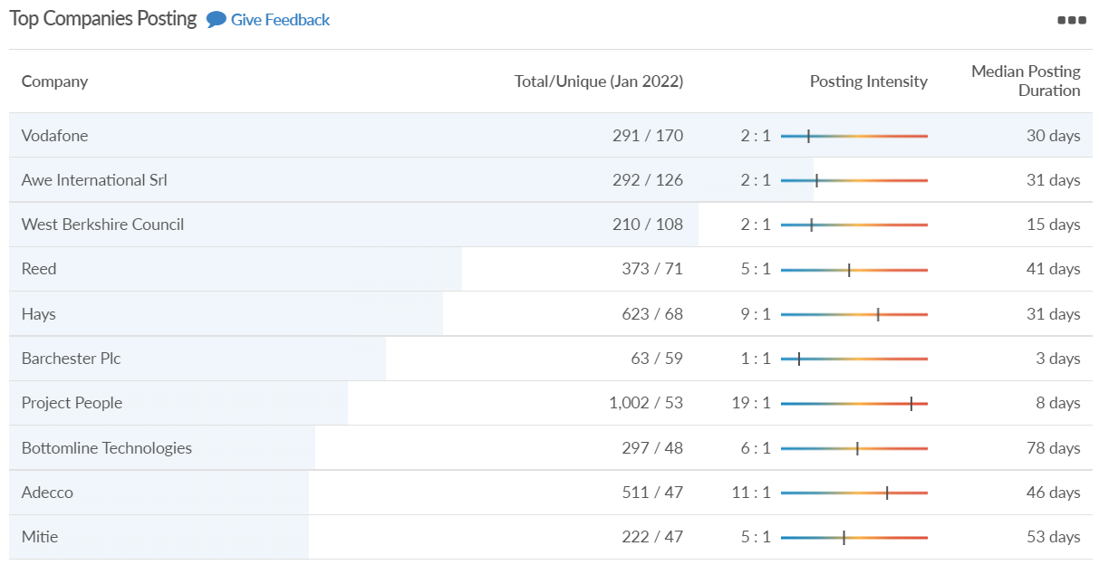
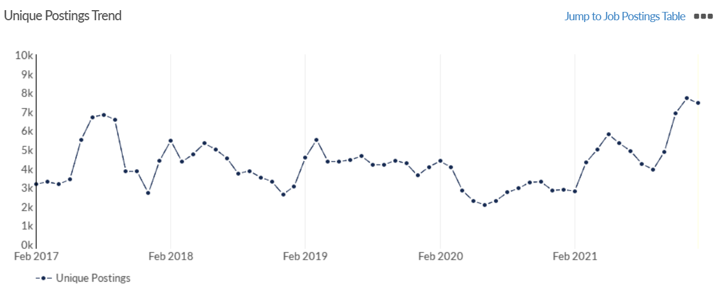
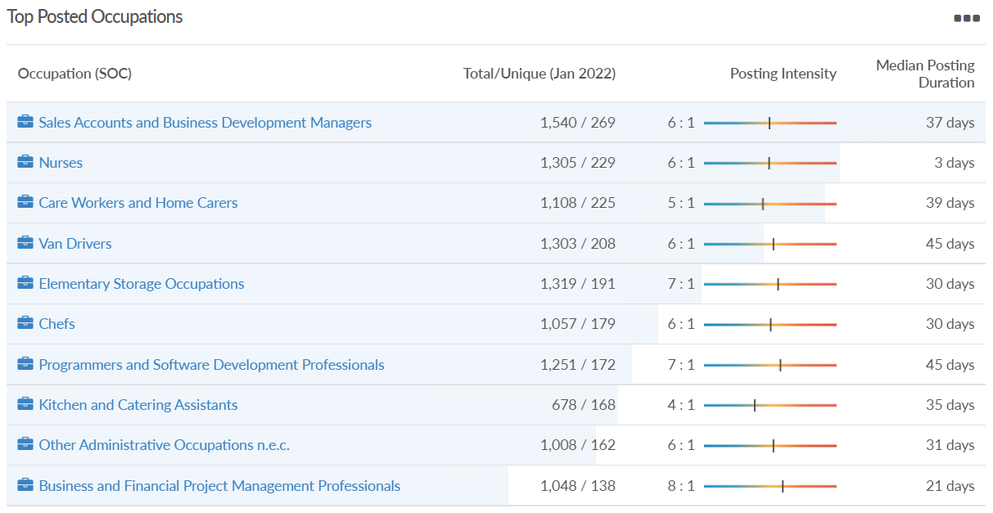
Job posting analytics (EMSI, January 2022)
Unique job postings: 7,445
Total job postings: 43,240
Job posting intensity: 6:1
Unique job postings (January 2021): 2,883

