Slide 1
Thames Valley Berkshire
Monthly Economic Briefing
October 2021

Slide 2
Key contents of this month’s briefing
Updated global and UK economic forecasts
Latest furlough, SEISS and claimant count figures by Local Authority
Latest remote working figures for Thames Valley Berkshire
Latest ‘notable business news’ by Local Authority
Latest job posting analytics by Local Authority

Slide 3
Global and National Economy
October 2021

Slide 4
Global Economy
The COVID-19 pandemic has taken a turn for the worse in some parts of the world, and the global economy is projected to grow by 5.9 percent in 2021 and by 4.9 percent in 2022. This is according to the IMF’s Regional Economic Outlook for Asia and the Pacific for October 2021.
Vaccine access has emerged as the principal fault line along which the global recovery splits into those that can look forward to further normalization of activity (mostly advanced economies) and those that face mounting hospitalizations and death tolls because of resurgent infections.
The Asian outlook for 2021 has been downgraded by more than 1 percent to 6.5 percent compared with the April 2021 World Economic Outlook, because of new peaks of the pandemic cycle. As vaccination rates accelerate, the region is expected to grow slightly faster in 2022 than anticipated earlier.
Although Asia and Pacific remains the fastest growing region in the world, the divergence between Asian advanced economies and emerging market and developing economies is deepening, reflecting vaccination coverage and policy support. Source: IMF, October 2021

Slide 5
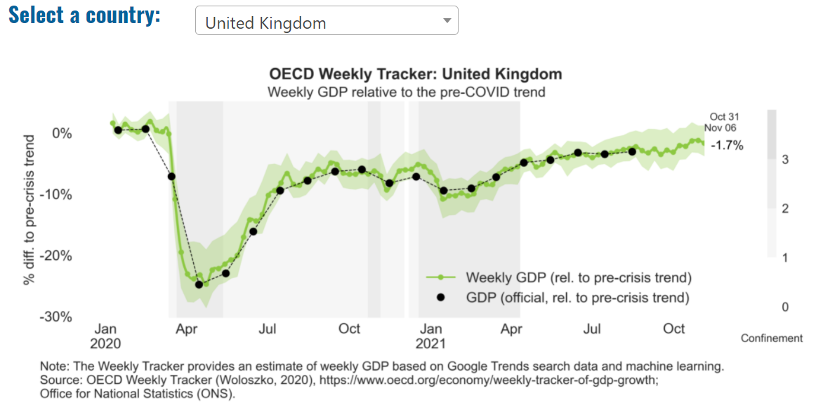
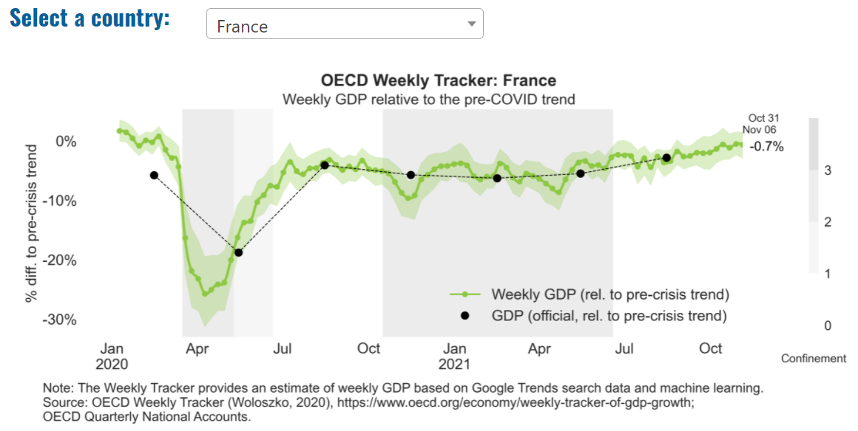
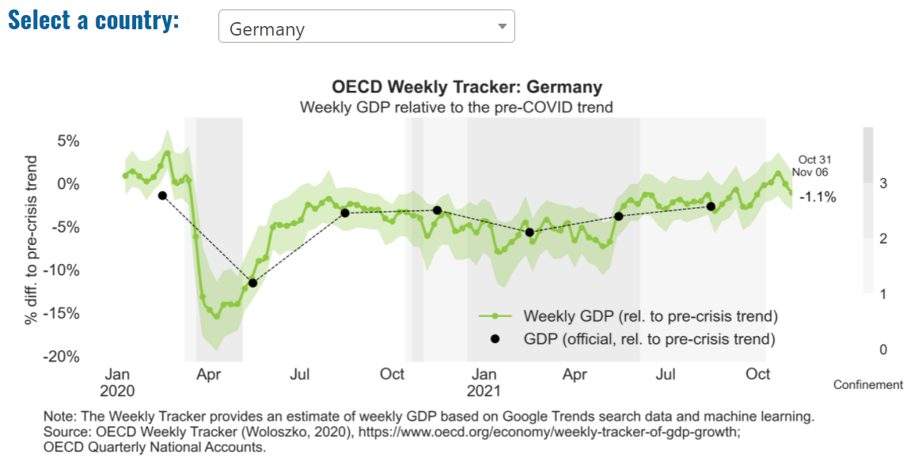
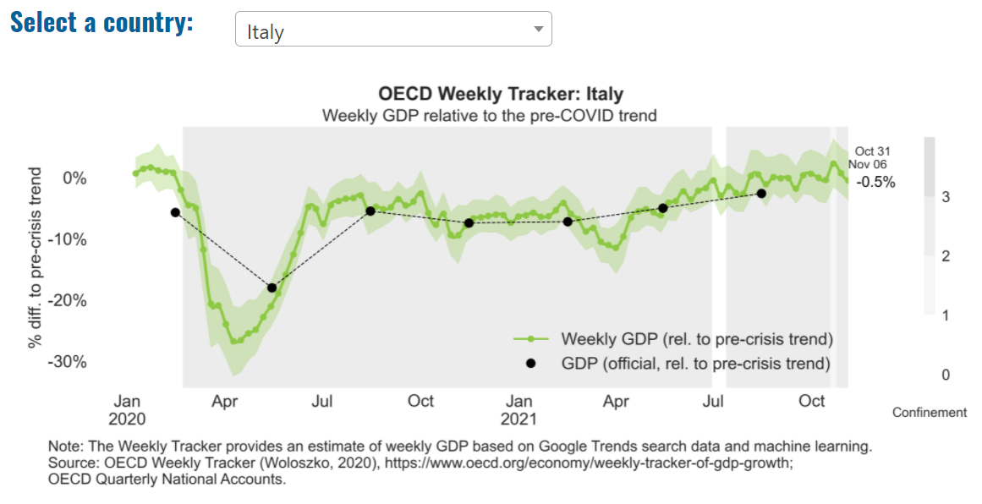
Global Economy – OECD GDP Tracker

Slide 6
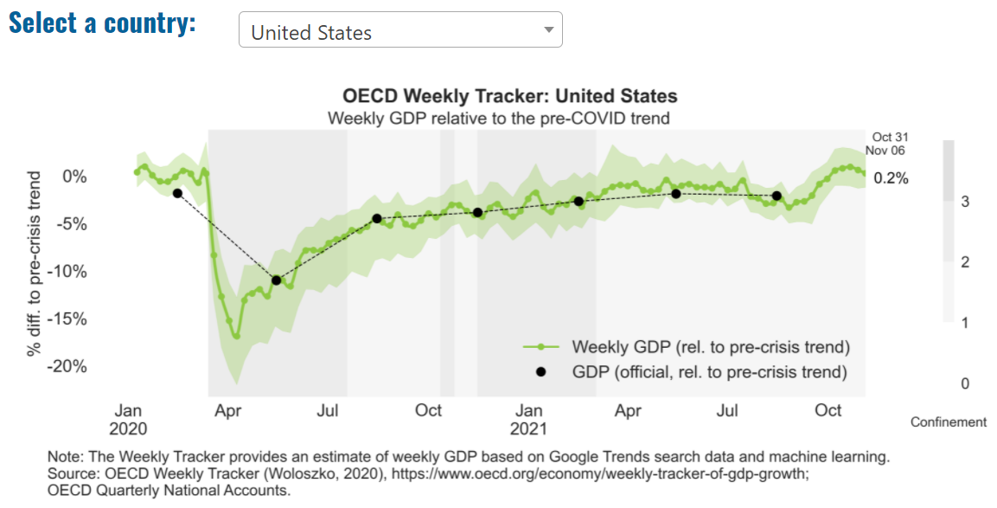
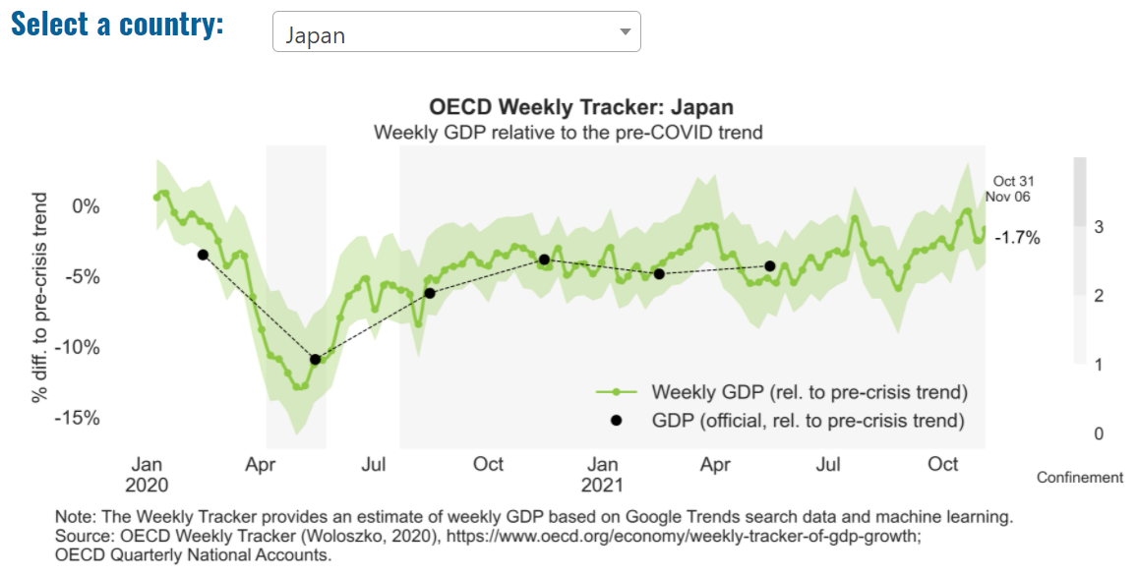
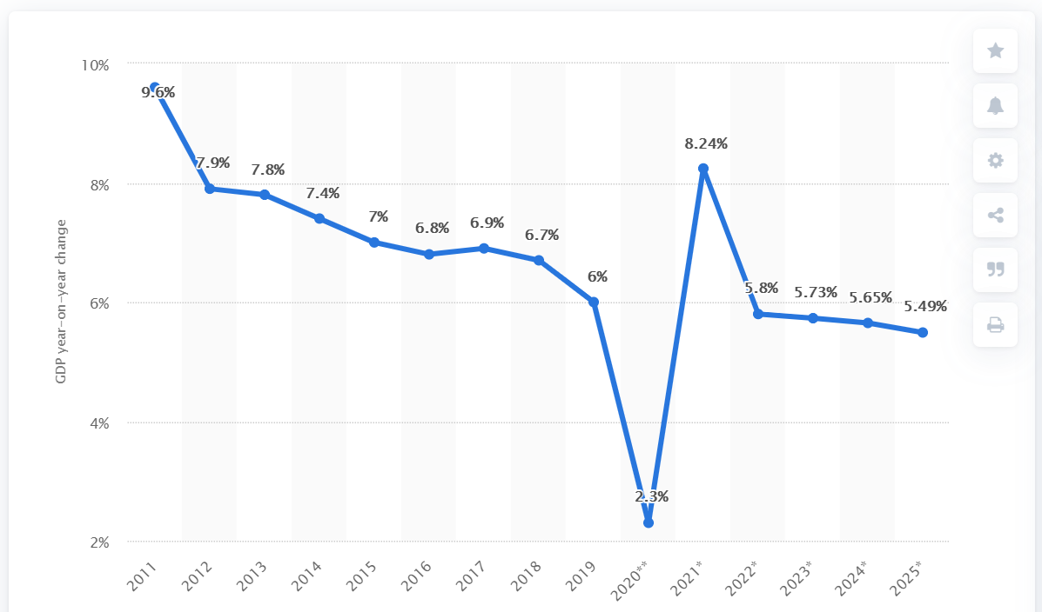
Global Economy – OECD GDP Tracker Continued
China
China is not included within the OECD GDP tracker and so the graph on the left has been compiled using statistics from the IMF and National Bureau of Statistics of China. The 2021 figure is a preliminary figure published by the National Bureau of Statistics of China in January 2021.
Note: The green confidence band shows 95% confidence intervals. The Weekly Tracker is an estimate of weekly GDP relative to the pre-crisis trend, which is proxied by the November 2019 OECD Economic Outlook forecasts. The darkness of the grey background reflects stay-at-home confinement requirement based on the Oxford Blavatnik database (0 - no measures, 1 - recommend not leaving house, 2 - require not leaving house with exceptions, 3 - require not leaving house with minimal exceptions).
Source: OECD, October 2021

Slide 7
UK Economy
October saw publication of the Annual Budget and Spending Review by the Chancellor of the Exchequer, Rishi Sunak. The latest Office for Budget Responsibility (OBR) economic forecast was also published in October.
According to the OBR, GDP growth this year is expected to be 6.5 per cent, which would be the fastest growth in nearly half a century.
The reason for this higher than expected growth is, simply, vaccines. It was a surprise how effective these have been, allowing economic life to go back faster to what is was pre-pandemic.
The OBR now expects unemployment to peak at 5.2 per cent in Q42021, down from a 6.5 per cent forecast in March.
We do not expect such good news on living standards, however. In 2022, the OBR forecasts growth in average earnings to be 3.9 per cent. With inflation forecast to reach four per cent, that means a real terms pay cut.
According to the Resolution Foundation, in the 16 years leading to 2008, average earnings grew by 36 per cent; by 2024, i.e. 16 years after 2008, the OBR expects real wages to have risen by just 2.4 per cent in total.

Slide 8
UK Economy
A combination of stronger growth and higher inflation means lower borrowing by a cumulative £141bn over the next four years. That is a substantial windfall.
In 2024-25, day to day spending will be focused on reversing the cuts to overseas aid, and on preventing rising NHS spending leading to further cuts for unprotected departments.
However, only one-third of the post-2010 cuts to unprotected departments in real terms will be reversed by 2024-25 so public expenditure remains limited.
For example, the UK education budget will have risen 3 per cent by 2025 against 2010 levels, compared with a 40 per cent increase on spending for health. Paul Johnson, Director of the Institute for Fiscal Studies, called this a “remarkable lack of priority”.
The Spending Review provides English councils with £1.6 billion of new grant funding in each of the next three years, on top of the funding to implement social care reform. This may look generous, but a recent report from the Health Foundation indicating that the public health budget has been cut by 24% per capita since 2015-2016, with the biggest impact falling on the most deprived communities.

Slide 9
UK Economy
The impact of Brexit on the UK economy will be worse than that caused by the pandemic, according to Richard Hughes, Chairman of the OBR.
Hughes said the OBR had assumed leaving the EU would “reduce our long run GDP by around 4%”, adding in comments to the BBC: “We think that the effect of the pandemic will reduce that (GDP) output by a further 2%.”
Gross domestic product – or GDP – is a measure of the size of the economy. “In the long term it is the case that Brexit has a bigger impact than the pandemic”.
Hughes told the BBC the OBR expected inflation to reach 4.4%, while warning it could hit “the highest rate seen in the UK for three decades”.
The Guardian, October 2021
Sources: The Guardian, October 2021;

Slide 10
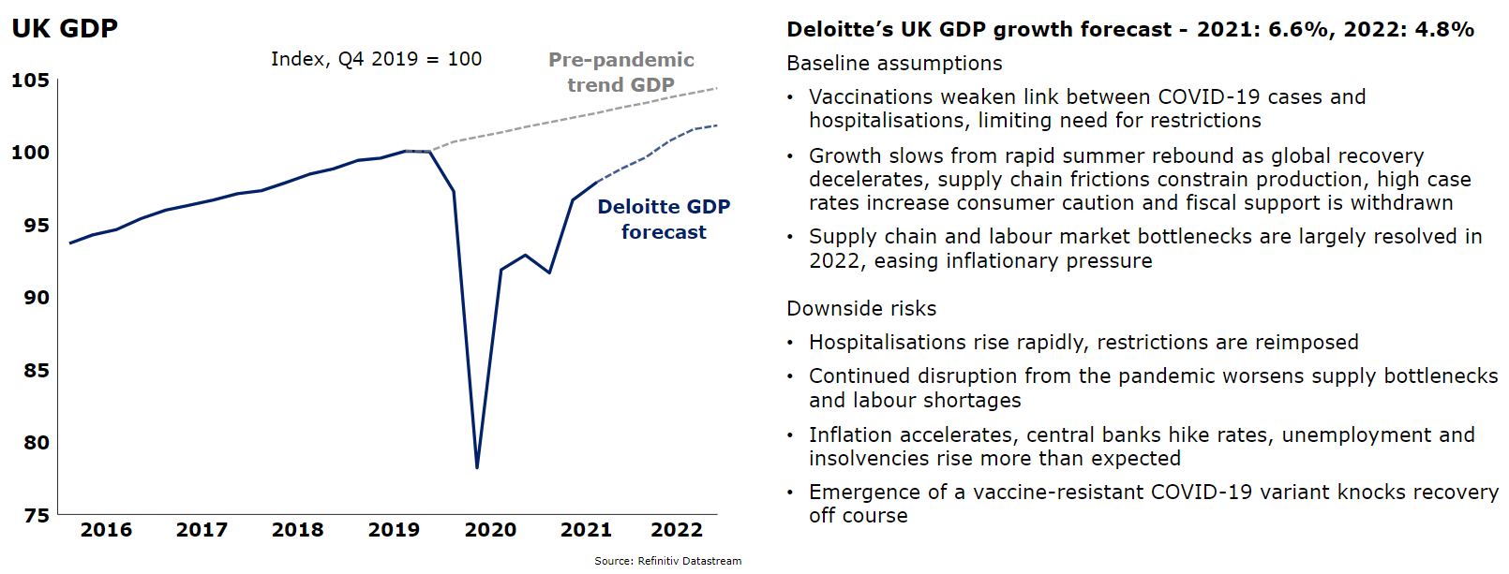
UK Economy
Deloitte, October 2021

Slide 11
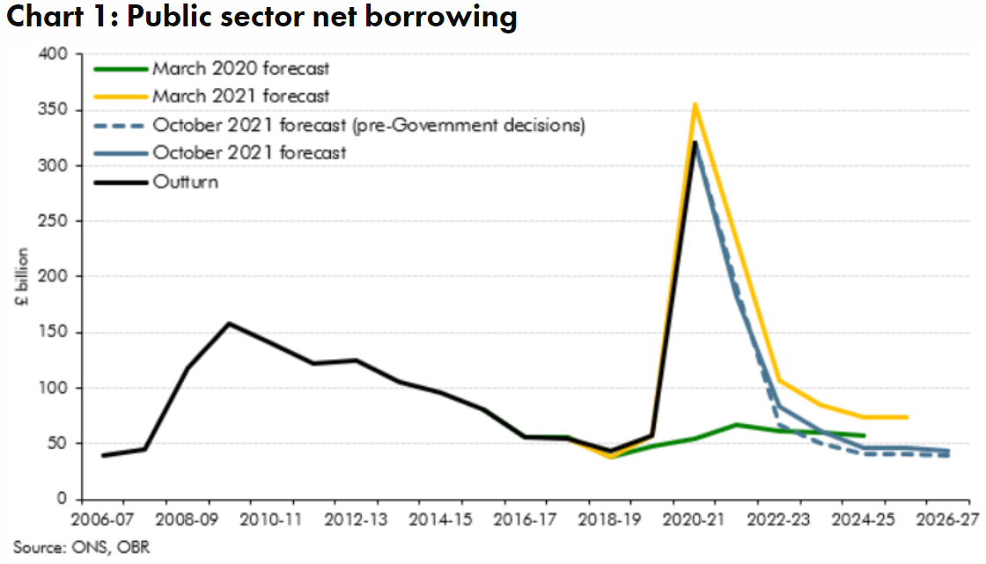
UK Economy
The successful vaccine rollout has allowed the economy to reopen largely on schedule, despite continuing high numbers of coronavirus cases.
The vaccines’ high degree of effectiveness has meant that output this year has recovered faster than the OBR expected in March, boosting tax revenues in the process.
But the strength of the rebound in demand in the UK and internationally has led it to bump up against supply constraints in several markets. In the UK, these supply bottlenecks have been exacerbated by changes in the migration and trading regimes following Brexit.
Energy prices have soared, labour shortages have emerged in some occupations, and there have been blockages in some supply chains. These can be expected to hold back output growth in the coming quarters, while raising prices and putting pressure on wages.
Source: OBR, October 2021
Taking account of both forecast and policy changes announced since March, borrowing falls back below £100 billion next year, declining more slowly thereafter to stabilise at around £44 billion (1.5 per cent of GDP) in the medium term. (Chart 1).

Slide 12
Coronavirus and Recession: Implications for Thames Valley Berkshire

Slide 13
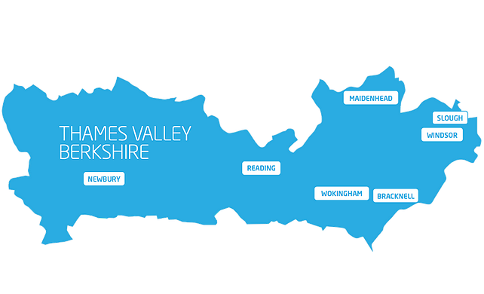
Furloughing (Latest data - October 2021)
18,500 jobs furloughed across Thames Valley Berkshire
2,300 jobs (4% of total eligible employments) furloughed in Bracknell Forest UA
4,700 (7% of total eligible employments) furloughed in Slough UA
2,800 jobs (3% of total eligible employments) furloughed in Reading UA
3,000 jobs (4% of total jobs) furloughed in Wokingham UA
3,500 jobs (5% of total jobs) furloughed in Windsor and Maidenhead
2,200 jobs (3% of total jobs) furloughed in West Berkshire
Across the UK, 1,143,600 people were furloughed (4% of total eligible employments)
Berkshire has a slightly lower-than-average number of furloughed workers, compared to the rest of the UK, because of its relative strength in sectors of industry that can be continued by workers from home.
Source: HMRC, November 2021

Slide 14
SEISS (Latest data - October 2021)
Total value of claims made across Thames Valley Berkshire: £414,200,000
Total value of claims made for Bracknell Forest UA – All SEISS: £64,100,000
Total value of claims made for Slough UA – All SEISS: £82,200,000
Total value of claims made for Reading UA – All SEISS: £66,300,000
Total value of claims made for Wokingham – All SEISS: £68,800,000
Total value of claims made for Windsor and Maidenhead – All SEISS: £63,700,000
Total value of claims made in West Berkshire – All SEISS: £69,100,000
Total value of claims made for the whole of the United Kingdom: £28,102,000,000
Source: HMRC, November 2021

Slide 15
Claimant Count (Latest data - September 2021)
Total of 22,625 claimants (3.9% of the working age population) in Thames Valley Berkshire
2,415 claimants (3% of the working age population) in Bracknell Forest UA
6,310 claimants (6.7% of the working age population) in Slough UA
5,660 claimants (5.3% of the working age population) in Reading UA
2,470 claimants (2.3% of the working age population) in Wokingham UA
2,870 claimants (3.1% of the working age population) in Windsor and Maidenhead UA
2,905 claimants (3% of the working age population) in West Berkshire UA
Across Thames Valley Berkshire, claimant unemployment has fallen significantly from 30,290 in September 2020 to 22,625 in September 2021. Slough had 6.7% of its working age population claim unemployment in September 2021, down slightly from 8.4% in September 2020.
Source: ONS, September 2021

Slide 16
Strategic Issues: Heathrow
Heathrow Airport
Heathrow will be allowed to significantly raise its landing charges from next summer, the aviation regulator has announced, although it has ruled out the near-doubling of charges proposed by the airport.
Airlines reacted with dismay at the Civil Aviation Authority’s proposals, which could allow the UK’s biggest airport to increase charges by up to 56% by 2023 as it seeks to recoup losses from the pandemic.
The CAA has launched a consultation on a range of airport charges per passenger from £24.50 to £34.40, an increase from £22 per passenger in 2020. It said it sought to protect consumers against unfair charges and that it would work closely with Heathrow, airlines and others to narrow this range over the next few months.
The range will come into effect from summer 2022, with an interim cap of £30 for next year.
Heathrow said in July that its total losses since the start of the pandemic had reached £2.9bn. In September, passenger numbers were 38% of pre-pandemic levels. Source: Reuters, September 2021

Slide 17
Strategic Issues: Aviation
Aviation:
In the Budget, the Chancellor of the Exchequer reduced Air Passenger Duty (APD) on domestic flights within the UK while introducing increasing APD of long-haul flights of over 5,500 nautical miles from London. The changes do not take effect until April 2023.
The domestic rate of APD will be cut in half for economy-class passengers, falling from £13 ($17) to £6.50. The ultra-long-haul duty—which will mainly impact flights to Asia, Australasia, southern Africa, and Latin America—will now have an economy-class rate of £91 (up from £82). Business and first-class passengers will pay significantly more.
IATA condemned the increases as undermining the UK airline industry as it struggles to recover from the Covid pandemic.
Sunak said that funding for the Aerospace Technology Institute’s support for new aviation technology will continue, but he declined to provide details about future funding levels, a day after UK Aviation Minister Robert Courts confirmed that the government’s so-called Jet Zero strategy will not be finalized until 2022.
Source: AIN Online, October 2021

Slide 18
Demand and Supply Conditions: Businesses, Hiring, Restructuring, Investment, Labour and Skills Supply

Slide 19
Household/Consumer Demand
Slough had an overall recovery index score of 62 at the end of August, putting it in a weaker position in terms of recovery (closer to pre-lockdown levels) than Reading which had a recovery index score of 72.
Source: Centre for Cities, September 2021 (latest release)
Retail sales volumes fell by 0.2% in September 2021, following an upwardly-revised 0.6% fall in August; despite the fall in September, volumes were 4.2% higher than their pre-coronavirus (COVID-19) pandemic February 2020 levels.
Non-food stores reported a fall of 1.4% in sales volumes in September 2021, because of falls in household goods stores (negative 9.3%), such as furniture and lighting stores, and other non-food stores (negative 1.7%) such as sports equipment stores.
Automotive fuel sales volumes rose by 2.9% in September 2021 as demand towards the end of September increased sales; volumes were 1.8% above their pre-pandemic February 2020 levels.
Food store sales volumes rose by 0.6% in September 2021 and were 3.9% above pre-coronavirus pandemic levels in February 2020.
Despite relaxation of COVID-19 restrictions in summer 2021, in-store retail sales remain subdued; the proportion of retail sales online rose to 28.1% in September 2021 from 27.9% in August, substantially higher than 19.7% in February 2020, i.e. before the pandemic. Source: ONS, October 2021 (latest release)

Slide 20
Industries at Risk
MANUFACTURING
28,000 people work in manufacturing in Berkshire – with 11,000 in West Berkshire alone and 2,487,000 across the whole of Great Britain (ONS, 2020)
Half of all UK manufacturing firms have made redundancies. A further 20% plan to make more redundancies in the next six months (Make UK, October 2020)
37% of manufacturers think it will take more than a year to return to normal trading conditions (Make UK, October 2020)
HOSPITALITY & TOURISM
The hospitality and tourism sector in Berkshire employed 35,842 people in 2020 – an increase of 0.8% on the previous year (EMSI, 2021)
In June, ‘Pathways to Recovery’, a report by the All Party Parliamentary Group on Hospitality and Tourism, found that just 11% of hospitality businesses had been able to operate normally during the first lockdown and international tourist arrivals were likely to be down 59% for the year.
Kate Nicholls, CEO of UK Hospitality, told the BBC (December 2020) that 30,000 hospitality businesses – most of them SMEs and one-third of the total – could be lost by the end of 2020.
According to Sky News in December, at least 38,653 hospitality jobs had been lost during the pandemic.
CONSTRUCTION
21,000 people work in construction in Berkshire – with only 1,500 of these working in Bracknell Forest and 2,164,000 across the whole of Great Britain (ONS, 2020)
The level of construction output in August 2020 was 10.8% below the February 2020 level (ONS, 2020)
Construction output grew by 18.5% in the three months to August 2020 compared with the previous three-month period, but this followed 10 consecutive periods of decline (ONS, 2020)
NON-FOOD RETAIL & WHOLESALE
More than 45,000 people work in non-motor vehicle retail in Berkshire – with 12,500 of them working in Reading (EMSI, 2021). The offline retail sector has struggled during the pandemic. At least 39,000 jobs had been lost in retail as of 3 December. Redundancy announcements include 7,000 at Marks and Spencer (August), 4,000 at Debenhams (August) and 4,000 at Boots (July) - Sky News, 2020.
The pre-pandemic trend of on-line shopping has strengthened in 2020; a record total of 31.4% of shopping was done on line in November 2020 (ONS, 2020), a trend that will have profound implications for the high street.
In November, retail sales volume decreased by 3.8% (vs October figures) as a result of COVID-19. Despite this, overall sales remain above their pre-pandemic levels (ONS, 2020).
ARTS, ENTERTAINMENT & RECREATION
12,000 people work in arts, entertainment and recreation in Berkshire. 4,500 of them – more than one third – work in Windsor and Maidenhead and 925,000 across the whole of Great Britain (ONS, 2020)
Between 19 Nov and 1 Dec, 24 per cent of arts, entertainment and recreation venues had temporarily closed or paused trading. (ONS, 2020)
52% of eligible employments in arts, entertainment and recreation were on furlough on 31 July 2020 – a figure that had fallen to 24% as at 31 October. (HMRC, 2020)
AVIATION
Aviation has an estimated value of £28 billion to the UK economy, employing 230,000 workers at over 40 commercial airports. (House of Commons Transport Committee, June 2020)
76,000 people work in over 400 business across Heathrow Airport. Many of these people live in Slough, in Berkshire. (Heathrow local recovery plan, 2020)
There were 5,800 passenger flights in April 2020 compared to 201,000 a year earlier: a reduction of 97%. The impact is several times more severe than the aftermath of the global financial crisis in 2008, when passenger flights reduced by around 67,000 to 134,000 per month. (House of Commons Transport Committee, June 2020)
The UK aviation industry has been hit harder than any European country by the pandemic with IATA calculating that the “coronavirus crisis will cost 780,000 British jobs and cost £46bn in lost GDP.” (International Air Transport Association, 2020).
ADMINISTRATION & SUPPORT
More than 51,000 people in Berkshire work in admin and support services – including 10,000 in Wokingham and 10,000 in West Berkshire and 2,752,000 across the whole of Great Britain (ONS, 2020)
More than 600,000 admin and support workers – 27% of the total – were furloughed as at 31 October (HMRC, 2020)

Slide 21
Remote working
In October of 2021, there were 3,853 unique job postings for remote positions at companies based in Berkshire, around 159% more than the figure of 1,487 for the same period one year before.
Compare this with the South East, in October 2021 there were 25,468 unique remote job postings for remote positions; rising from 9,253 in October of the previous year – an increase of over 175%.
A rise can also be seen at national level, with a recorded 158,262 unique remote job postings in England in October of 2021, rising from 60,845 in October 2020 – an increase of over 160%.
From these figures it’s apparent that the COVID-19 pandemic has, somewhat unsurprisingly, prompted a massive boost in job postings for explicitly remote roles. Berkshire has seen a slightly smaller boost in vacancies which are remote-based than both England and the South East.
Source: EMSI, October 2021

Slide 22
Local Profiles

Slide 23
Bracknell Forest

Slide 24
Impact of COVID-19 up to 13th November 2021
COVID-19 cases (to 13th November 2021) – Source: Public Health Berkshire COVID-19 Dashboard, 13th November 2021
15,771 total cases
87 new cases daily
Claimant unemployment (to September 2021)
2,415 claimants (3% of the working age population) in Bracknell Forest UA
Notable business news:
The Department for Work & Pensions (DWP) has taken the entire ground floor of refurbished Phoenix House in Bracknell, the biggest office letting in the town this year. To attract the DWP into town is significant in that it will not only create jobs, but offer an opportunity for the possible retraining of people affected by the pandemic - https://ukpropertyforums.com/biggest-deal-in-bracknell-this-year/

Slide 25
Industries hit hardest by COVID shutdown
As illustrated by the above graph, Bracknell Forest has suffered very similarly to Great Britain in terms of the percentage of jobs within industries which have been hit hardest by COVID shutdowns. Thames Valley Berkshire area has seen an additional 0.77% of jobs of jobs affected worst by the COVID shutdowns when compared to Bracknell Forest.
Source: EMSI, March 2021 (definition for industries hit hardest provided on slide 53)

Slide 26
Industry risks and opportunities (2020-2021)
Critical industries
Food and drink retail: 3,234 employees (1% below the national average)
Energy/utilities: 257 employees (65% below the national average)
Health and social care: 6,193 employees (25% below the national average)
Freight/logistics: 515 employees (70% below the national average)
Insurance: 186 employees (69% below the national average)
Banking and financial services: 1,291 employees (13% below the national average)
Sectors most impacted
Hospitality and tourism: 3,743 employees (26% below the national average)
Arts, entertainment and recreation: 1,148 (24% below the national average)
Admin and support: 2,694 (21% below the national average)
Aviation: 0 employees
Non-food retail and wholesale: 8,508 (75% above the national average)
Manufacturing: 1,549 (69% below the national average)
Construction: 1,771 (40% below the national average)
Source: EMSI, January 2021

Slide 27
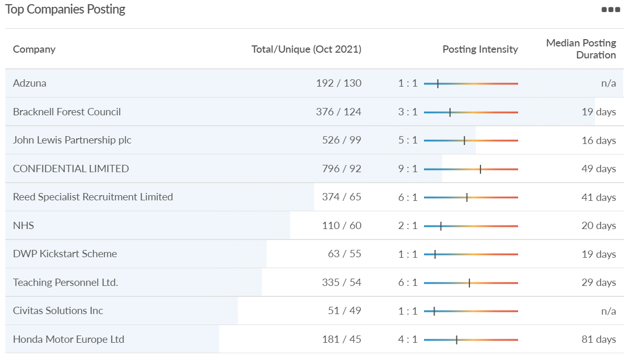
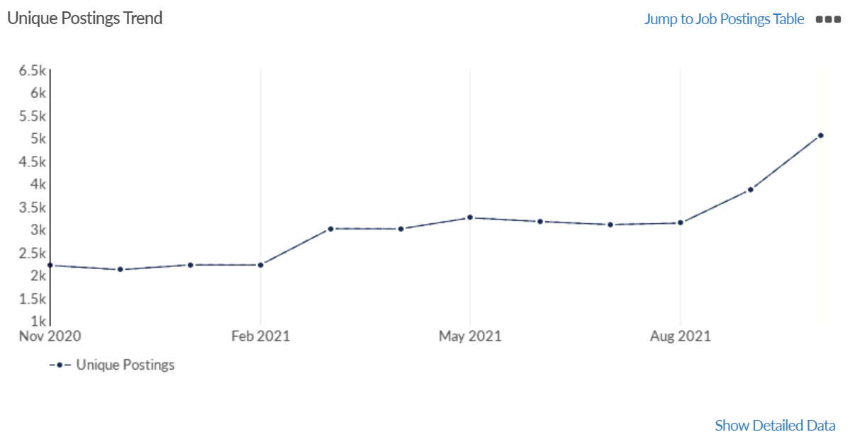
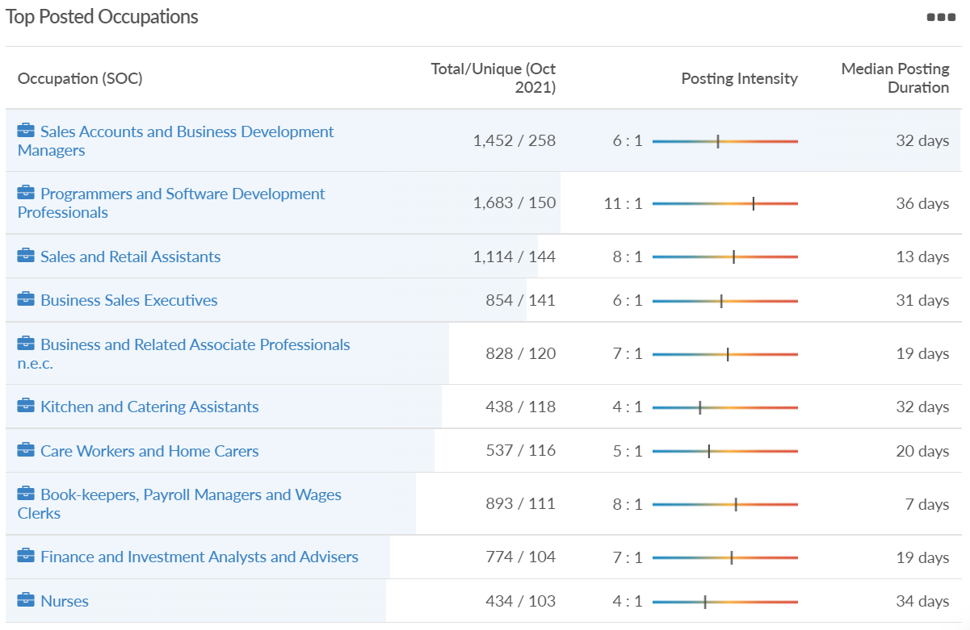
Job posting analytics (EMSI, October 2021)
Unique job postings: 5,063
Total job postings: 33,022
Job posting intensity: 7:1
Unique job postings (October 2020): 2,296

Slide 28
Slough

Slide 29
Impact of COVID-19 up to 13th November 2021
COVID-19 cases (to 13th November 2021) – Source: Public Health Berkshire COVID-19 Dashboard, 13th November 2021
25,326 total cases
86 new cases daily
Claimant unemployment (to September 2021)
6,310 claimants (6.7% of the working age population) in Slough UA
Notable business news:
Successful trials of an electric waste collection vehicle mean Colnbrook-based Grundon Waste Management is set to invest well over half a million pounds in converting two of its existing fleet from diesel to electric. This initial commitment is part of Grundon’s ongoing annual £5 million investment programme to improve its fleet –
Grundon commits £600,000 to electric collection vehicles after successful trials | Thames Valley Chamber of Commerce

Slide 30
Industries hit hardest by COVID shutdown
When compared to both Thames Valley Berkshire and Great Britain, Slough has seen a significantly lower percentage of jobs affected by COVID shutdowns – perhaps somewhat surprising given the LA’s proximity to Heathrow and the almost complete shutdown of the aviation sector.
Source: EMSI, March 2021 (definition for industries hit hardest provided on slide 53)

Slide 31
Industry risks and opportunities (2020-2021)
Critical industries
Food and drink retail: 6,656 employees (47% above the national average)
Energy/utilities: 2,820 employees (174% above the national average)
Health and social care: 8,201 employees (28% below the national average)
Freight/logistics: 4,640 employees (93% above the national average)
Insurance: 121 employees (86% below the national average)
Banking and financial services: 731 employees (65% below the national average)
Sectors most impacted
Hospitality and tourism: 3,780 employees (46% below the national average)
Arts, entertainment and recreation: 442 (79% below the national average)
Admin and support: 9,765 (107% above the national average)
Aviation: 262 employees (16% above the national average)
Non-food retail and wholesale: 6,719 (0% above the national average)
Manufacturing: 5,071 (28% below the national average)
Construction: 2,620 (36% below the national average)
Source: EMSI, January 2021

Slide 32
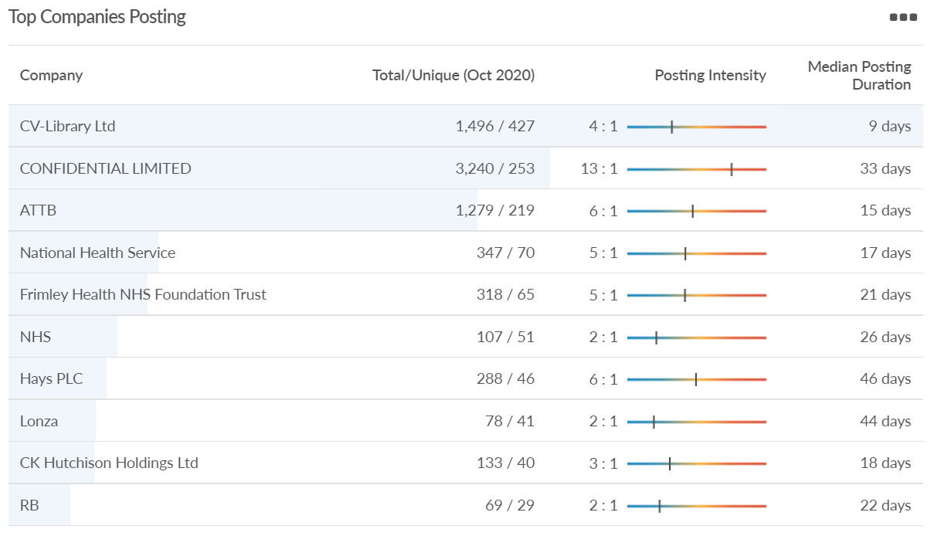
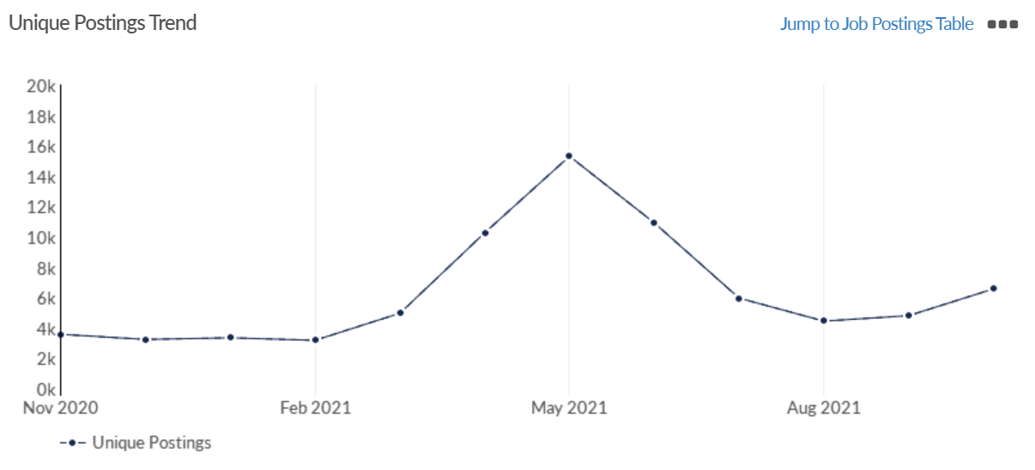
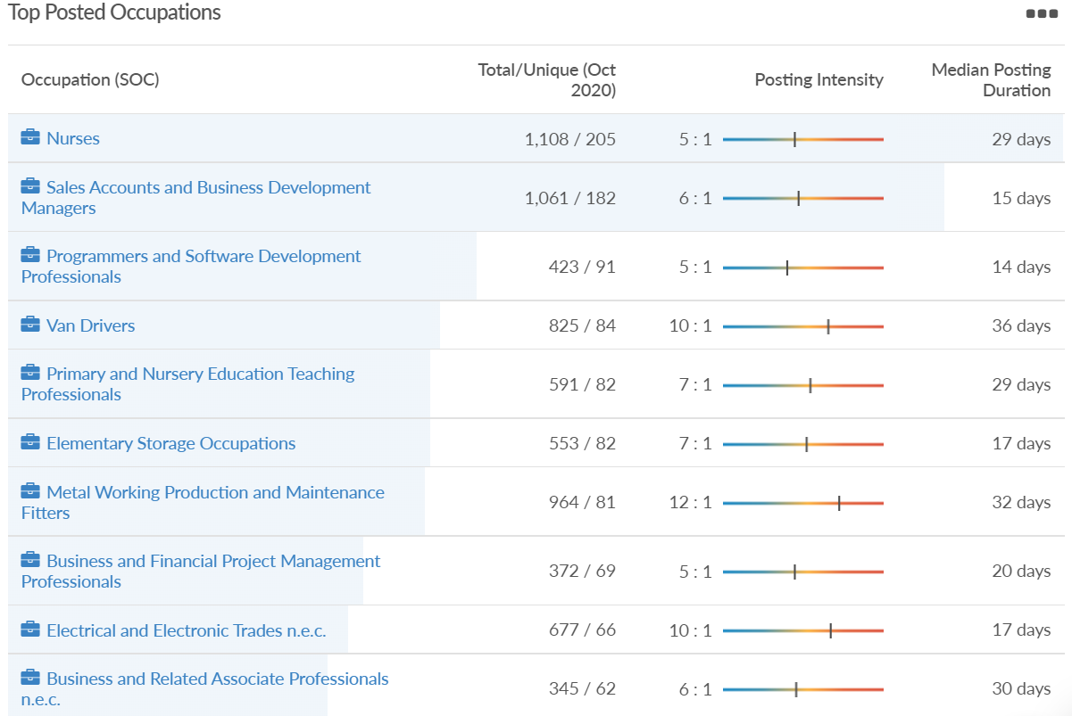
Job posting analytics (EMSI, October 2021)
Unique job postings: 6,580
Total job postings: 31,223
Job posting intensity: 5:1
Unique job postings (October 2020): 3,752

Slide 33
Reading

Slide 34
Impact of COVID-19 up to 13th November 2021
COVID-19 cases (to 13th November 2021) – Source: Public Health Berkshire COVID-19 Dashboard, 13th November 2021
22,910 total cases
58 new case daily
Claimant unemployment (to September 2021)
5,660 claimants (5.3% of the working age population) in Reading UA
Notable business news:
Reading-based Isotropic Systems has secured more than $37 million in additional Series B funding to facilitate the development of its unique multi-link antenna through to product launch in 2022 - https://www.businessinnovationmag.co.uk/reading-based-isotropic-systems-secures-37m-in-funding-for-antenna/

Slide 35
Industries hit hardest by COVID shutdown
Reading has been marginally less affected by the COVID shutdowns as Great Britain has on average, with 15.16% of jobs within industries which have been most severely impacted by the shutdowns. The Local Authority is 1.26% better off than the average of the Thames Valley Berkshire area.
Source: EMSI, March 2021 (definition for industries hit hardest provided on slide 53)

Slide 36
Industry risks and opportunities (2020-2021)
Critical industries
Food and drink retail: 6,192 employees (11% above the national average)
Energy/utilities: 3,350 employees (163% above the national average)
Health and social care: 13,464 employees (5% below the national average)
Freight/logistics: 1,513 employees (49% below the national average)
Insurance: 2,076 employees (100% above the national average)
Banking and financial services: 1,688 employees (34% below the national average)
Sectors most impacted
Hospitality and tourism: 6,567 employees (25% below the national average)
Arts, entertainment and recreation: 1,811 (31% below the national average)
Admin and support: 9,212 (58% above the national average)
Aviation: <10 employees
Non-food retail and wholesale: 8,626 (18% above the national average)
Manufacturing: 2,000 (77% below the national average)
Construction: 2,273 (55% below the national average)
Source: EMSI, January 2021

Slide 37
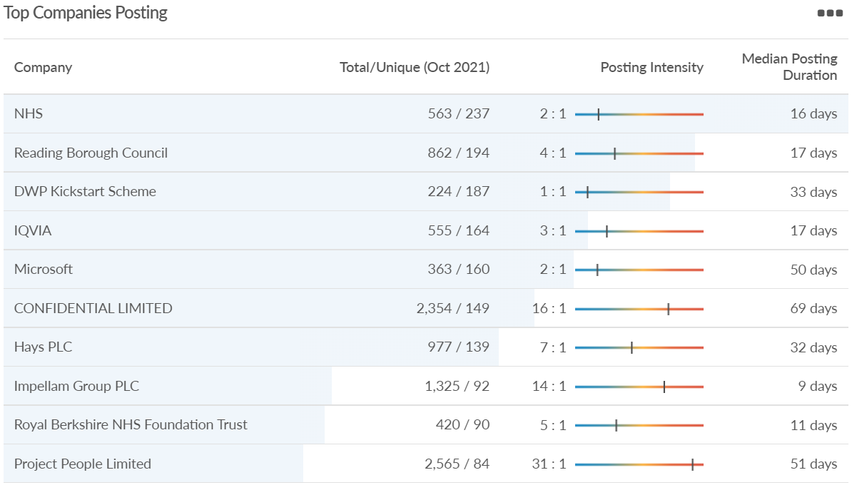
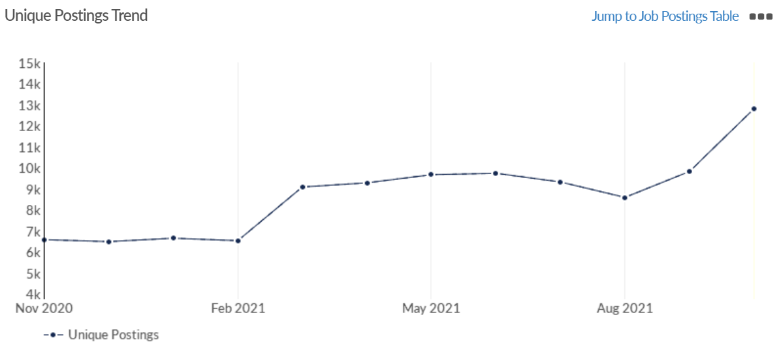
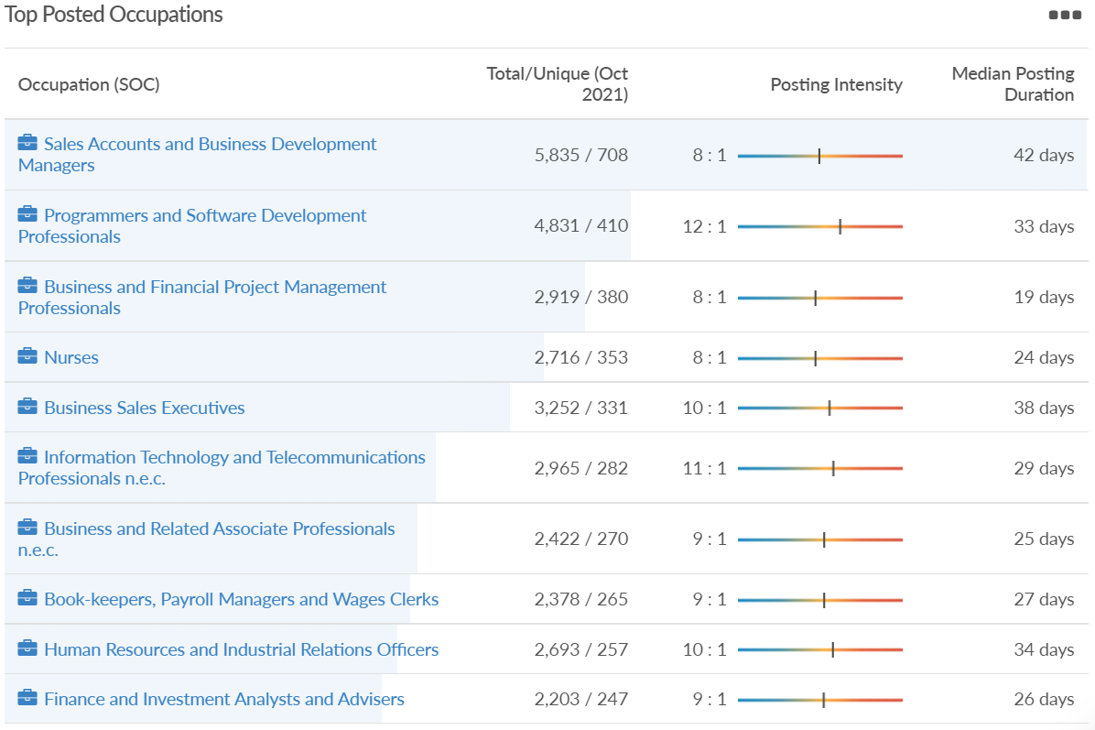
Job posting analytics (EMSI, October 2021)
Unique job postings: 12,811
Total job postings: 107,162
Job posting intensity: 8:1
Unique job postings (October 2020): 6,533

Slide 38
Wokingham

Slide 39
Impact of COVID-19 up to 13th November 2021
COVID-19 cases (to 13th November 2021) – Source: Public Health Berkshire COVID-19 Dashboard, 13th November 2021
20,831 total cases
92 new cases daily
Claimant unemployment (to September 2021)
2,470 claimants (2.3% of the working age population) in Wokingham UA
Notable business news:
Councillors in Wokingham look set to vote through plans for the massive new Shinfield Studios. Wokingham Borough Council’s planning committee has been recommended to grant permission for the 85,000 sq. m development across 65 acres at the University of Reading’s Thames Valley Science Park. The scheme of 18 sound stages was submitted in May and will bring some of the world’s biggest productions to the Thames Valley. Shinfield Studios will be a major part of Cine Valley, a major creative hub for the region - Shinfield Studios set for approval - UK Property Forums

Slide 40
Industries hit hardest by COVID shutdown
Wokingham is in a similar position to Slough in that is has been significantly less affected by the COVID shutdowns than both the Thames Valley Berkshire area and Great Britain as a whole. This is likely due to the high levels of employment from the Tech sector (Microsoft etc. based at TVP) as this industry is able to work well from home.
Source: EMSI, March 2021 (definition for industries hit hardest provided on slide 53)

Slide 41
Industry risks and opportunities (2020-2021)
Critical industries
Food and drink retail: 3,883 employees (17% below the national average)
Energy/utilities: 1,434 employees (35% above the national average)
Health and social care: 7,283 employees (38% below the national average)
Freight/logistics: 886 employees (64% below the national average)
Insurance: 453 employees (48% below the national average)
Banking and financial services: 423 employees (80% below the national average)
Sectors most impacted
Hospitality and tourism: 5,410 employees (25% below the national average)
Arts, entertainment and recreation: 1,831 (16% below the national average)
Admin and support: 6,432 (33% above the national average)
Aviation: 0 employees
Non-food retail and wholesale: 6,494 (6% below the national average)
Manufacturing: 3,731 (48% below the national average)
Construction: 3,115 (26% below the national average)
Source: EMSI, January 2021

Slide 42
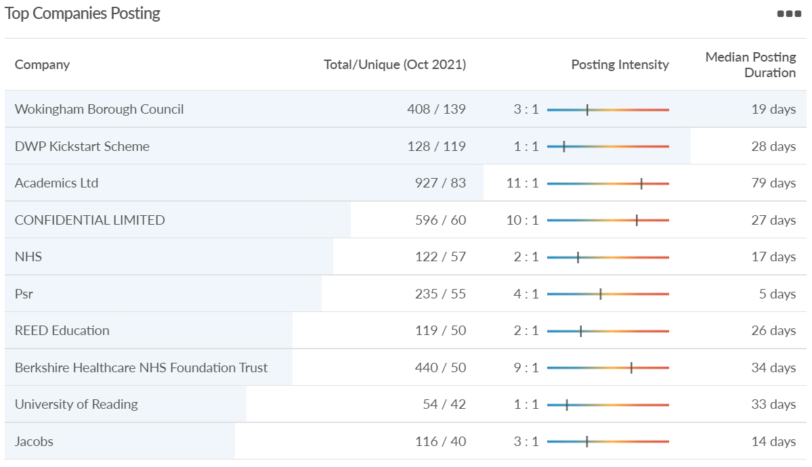
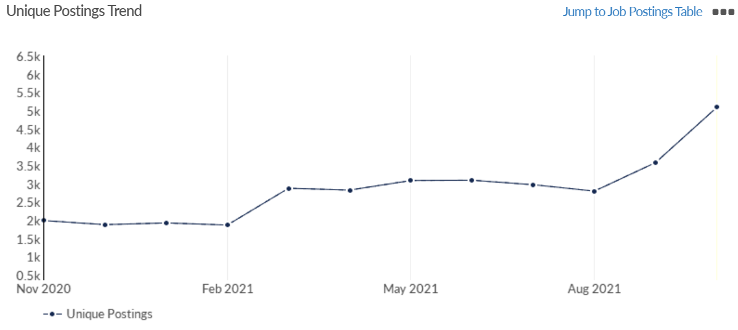
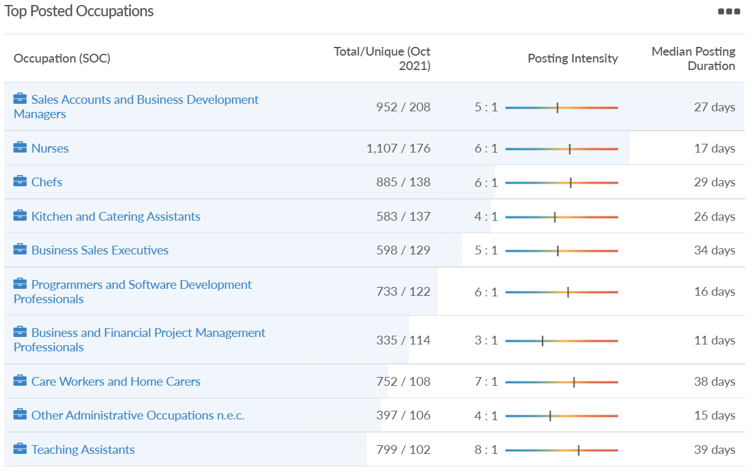
Job posting analytics (EMSI, October 2021)
Unique job postings: 5,090
Total job postings: 26,051
Job posting intensity: 5:1
Unique job postings (September 2020): 2,053

Slide 43
Windsor and Maidenhead

Slide 44
Impact of COVID-19 up to 13th November 2021
COVID-19 cases (to 13th November 2021) – Source: Public Health Berkshire COVID-19 Dashboard, 13th November 2021
19,474 total cases
94 new cases daily
Claimant unemployment (to September 2021)
2,870 claimants (3.1% of the working age population) in Windsor and Maidenhead UA
Notable business news:
A landmark £155m deal has been agreed with build-to-rent operator Get Living to forward-fund the first phase of a scheme designed to revitalise central Maidenhead. The agreement is developer HUB's ninth and largest to date. It is also the company's first with Get Living, and the first time the latter has backed a scheme outside the UK's major cities. The deal – which was also struck with Smedvig – will enable the partners to bring forward 429 homes and 23,000 sq ft of ground floor retail space, as well as car parking and extensive new public realm on a prominent 3.5-acre site - Landmark deal to forward-fund Maidenhead regeneration | South East Property News | Insider Media

Slide 45
Industries hit hardest by COVID shutdown
Windsor and Maidenhead appears to be the most severely affected of all the Local Authorities which make up Berkshire in terms of percentage of jobs hit hardest by the COVID shutdowns. This is likely due in part to the enormous hit the leisure/tourism sector has taken and how key of an employer Legoland Windsor to the region.
Source: EMSI, March 2021 (definition for industries hit hardest provided on slide 53)

Slide 46
Industry risks and opportunities (2020-2021)
Critical industries
Food and drink retail: 3,733 employees (17% below the national average)
Energy/utilities: 882 employees (13% below the national average)
Health and social care: 8017 employees (29% below the national average)
Freight/logistics: 748 employees (68% below the national average)
Insurance: 434 employees (48% below the national average)
Banking and financial services: 1,252 employees (39% below the national average)
Sectors most impacted
Hospitality and tourism: 9,437 employees (35% above the national average)
Arts, entertainment and recreation: 4,516 (117% above the national average)
Admin and support: 4,207 (10% below the national average)
Aviation: 11 employees (95% below the national average)
Non-food retail and wholesale: 7,834 (18% above the national average)
Manufacturing: 2,523 (64% below the national average)
Construction: 6,201 (54% above the national average)
Source: EMSI, January 2021

Slide 47
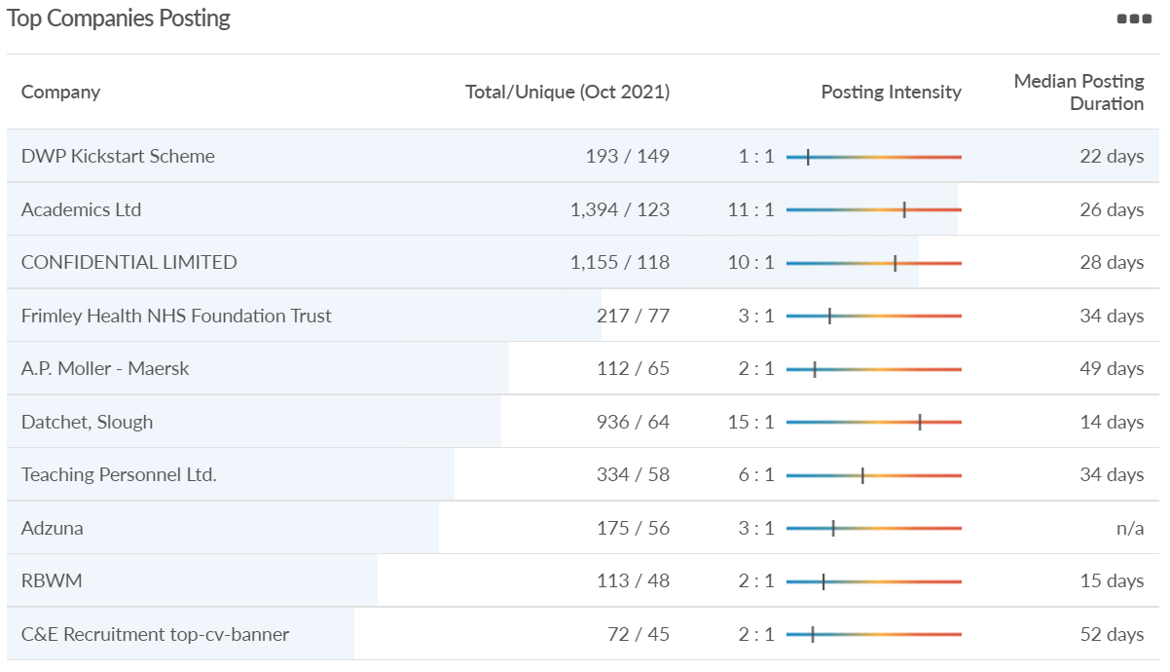
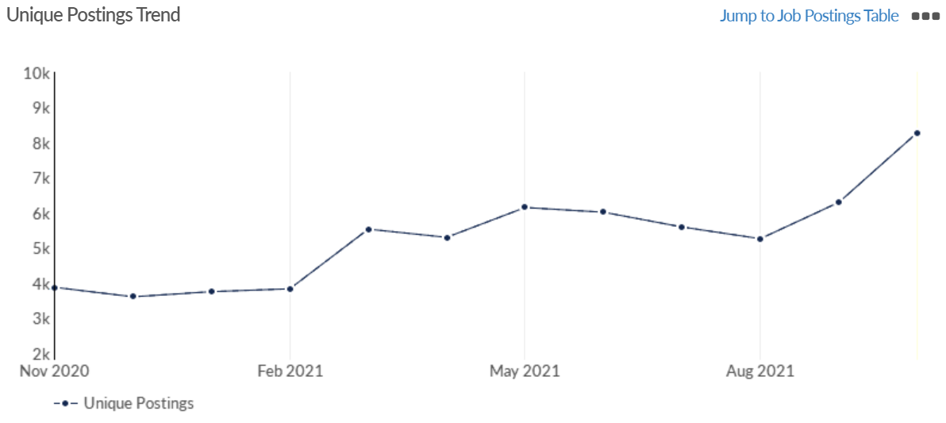
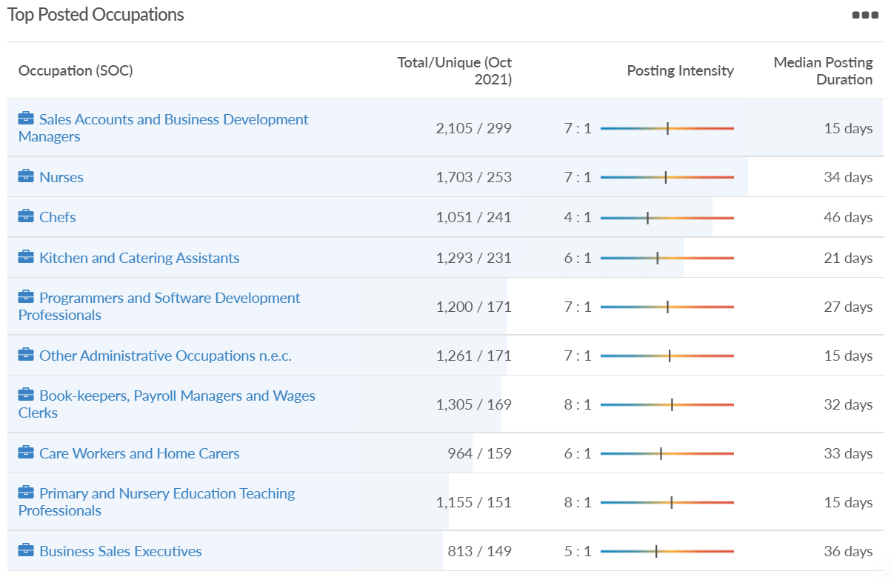
Job posting analytics (EMSI, October 2021)
Unique job postings: 8,283
Total job postings: 57,598
Job posting intensity: 7:1
Unique job postings (September 2020): 3,864

Slide 48
West Berkshire

Slide 49
Impact of COVID-19 up to 13th November 2021
COVID-19 cases (to 13th November 2021) – Source: Public Health Berkshire COVID-19 Dashboard, 13th November 2021
17,380 total cases
87 new case daily
Claimant unemployment (to September 2021)
2,905 claimants (3% of the working age population) in West Berkshire UA
Notable business news:
Home Bargains opened a new store in Newbury in October. The 19,978 sq ft store, which has created 45 new jobs in the area, will offer shoppers a range of products, including homewares, health and beauty essentials, sweets, snacks and drinks, as well as fresh and frozen food - Home Bargains opens at Newbury Retail Park this weekend (newburytoday.co.uk)

Slide 50
Industries hit hardest by COVID shutdown
While West Berkshire hasn’t been as fortunate as Slough in terms of how great of a percentage of jobs have been directly affected by the COVID shutdown, it has fared significantly better than the Thames Valley Berkshire area and better than Great Britain.
Source: EMSI, March 2021 (definition for industries hit hardest provided on slide 53)

Slide 51
Industry risks and opportunities (2020-2021)
Critical industries
Food and drink retail: 4,289 employees (17% below the national average)
Energy/utilities: 1,343 employees (14% above the national average)
Health and social care: 6,773 employees (48% below the national average)
Freight/logistics: 1,574 employees (43% below the national average)
Insurance: 262 employees (73% below the national average)
Banking and financial services: 692 employees (71% below the national average)
Sectors most impacted
Hospitality and tourism: 6,617 employees (18% below the national average)
Arts, entertainment and recreation: 2,674 (10% above the national average)
Admin and support: 4,803 (11% below the national average)
Aviation: <10 employees
Non-food retail and wholesale: 8,432 (9% above the national average)
Manufacturing: 11,330 (41% above the national average)
Construction: 4,813 (3% above the national average)
Source: EMSI, January 2021

Slide 52
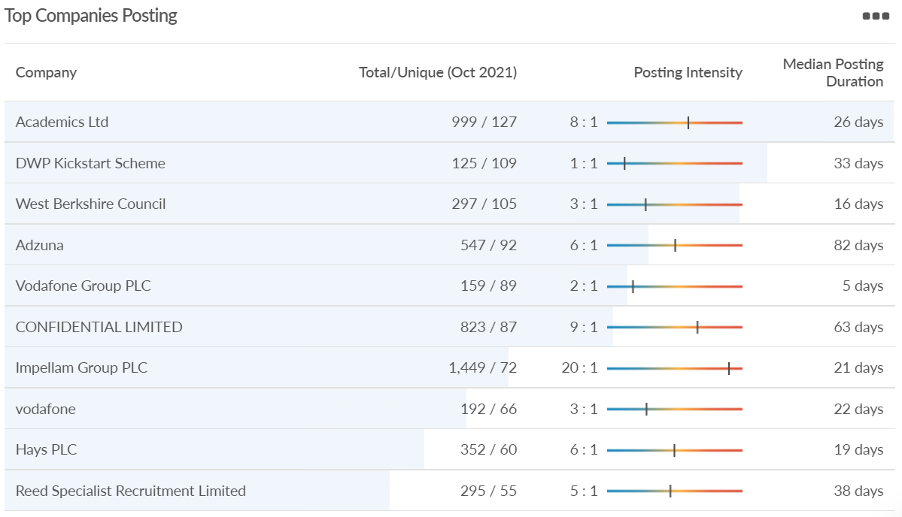
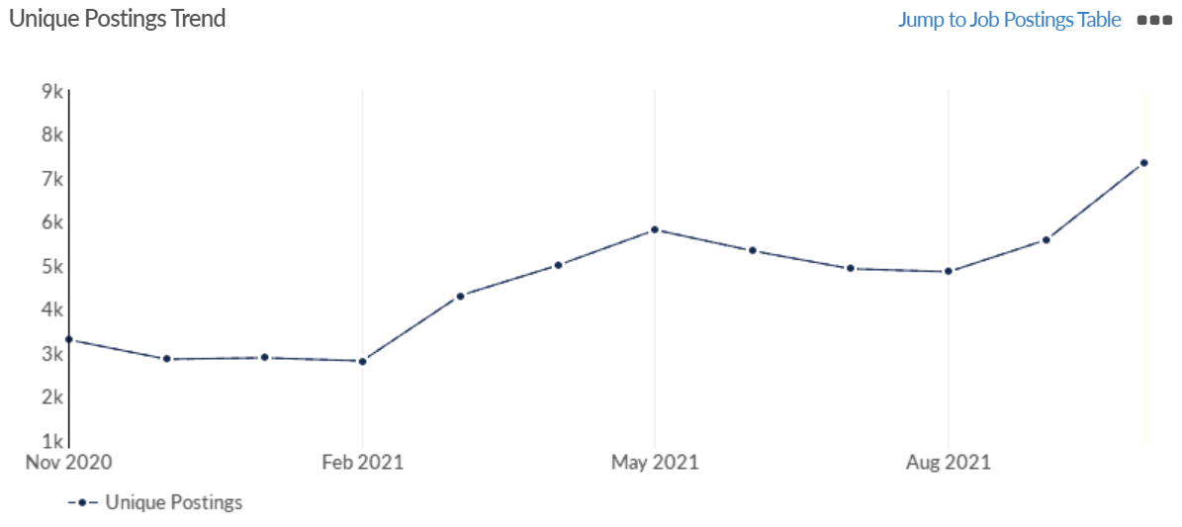
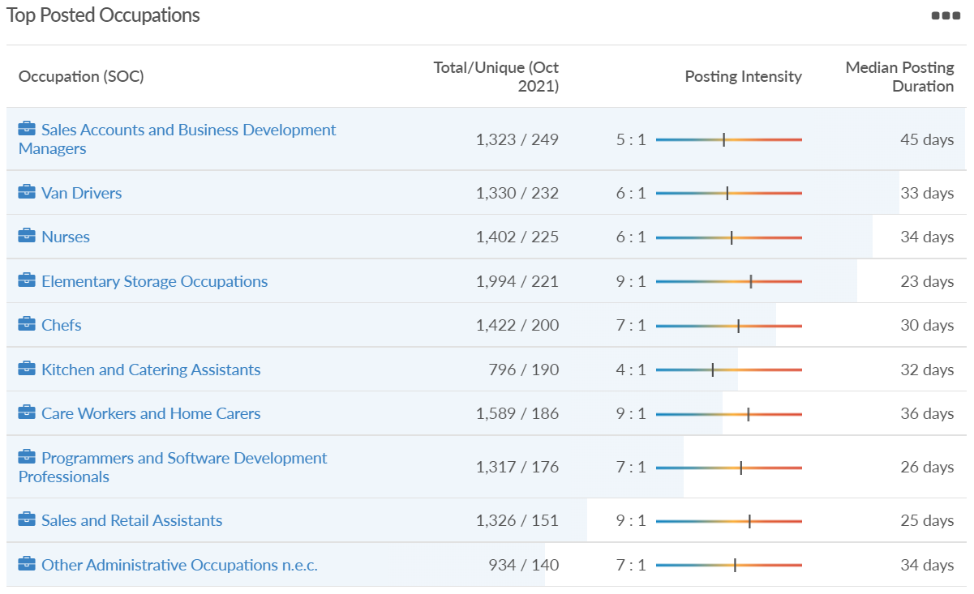
Job posting analytics (EMSI, October 2021)
Unique job postings: 7,348
Total job postings: 43,232
Job posting intensity: 6:1
Unique job postings (October 2020): 3,280

Slide 53
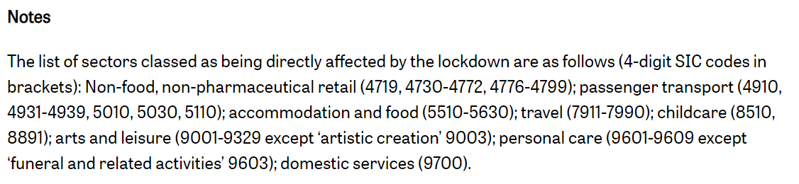
Definitions
Source: Institute for Fiscal Studies, April 2020

