Slide 1
Thames Valley Berkshire
Monthly Economic Briefing
April 2021

Slide 2
Key contents of this month’s briefing
Updated global and UK economic forecasts
Economic policy announcements in the Queen’s Speech
Latest furlough, SEISS and claimant count figures by Local Authority
Latest remote working figures for Thames Valley Berkshire
Latest ‘notable business news’ by Local Authority
Latest job posting analytics by Local Authority

Slide 3
Global and National Economy
March 2021

Slide 4
Global Economy
The International Monetary Fund is expecting a stronger economic recovery in 2021 as Covid-19 vaccine rollouts get underway, but it warns of “daunting challenges” given the different rates of administering shots across the globe.
The organization said it expects the world economy to grow by 6% in 2021, up from its 5.5% forecast in January. Looking further ahead, global GDP for 2022 is seen increasing by 4.4%, higher than an earlier estimate of 4.2%. “Even with high uncertainty about the path of the pandemic, a way out of this health and economic crisis is increasingly visible,” IMF chief economist Gita Gopinath said in the latest World Economic Outlook report. The latest round of fiscal stimulus in the U.S., along with the vaccine rollouts across the world, have made the group more confident about the global economy this year.
“Nonetheless, the outlook presents daunting challenges related to divergences in the speed of recovery both across and within countries and the potential for persistent economic damage from the crisis,” Gopinath added. The IMF estimated growth of 5.1% for advanced economies this year, with the United States expanding by 6.4%. The group’s forecast for emerging and developing economies’ growth is 6.7% for 2021, with India expected to expand by as much as 12.5%.
Source: CNBC, April 2021

Slide 5
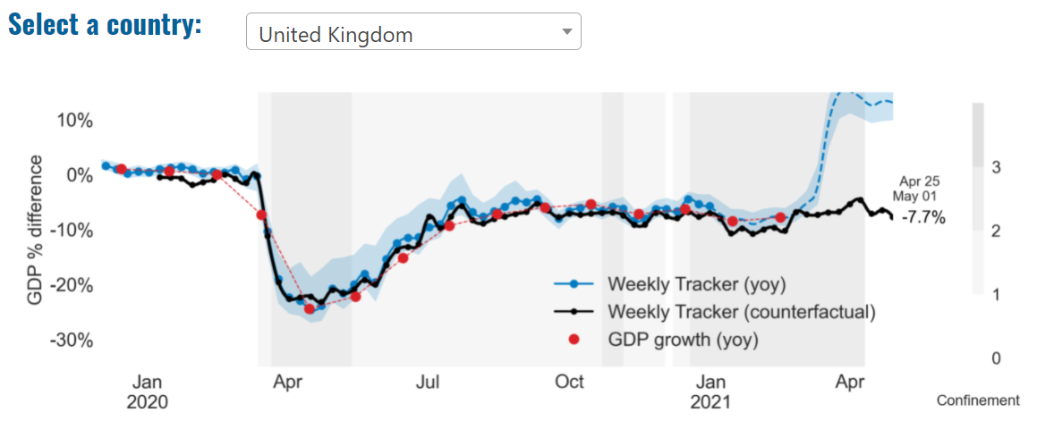
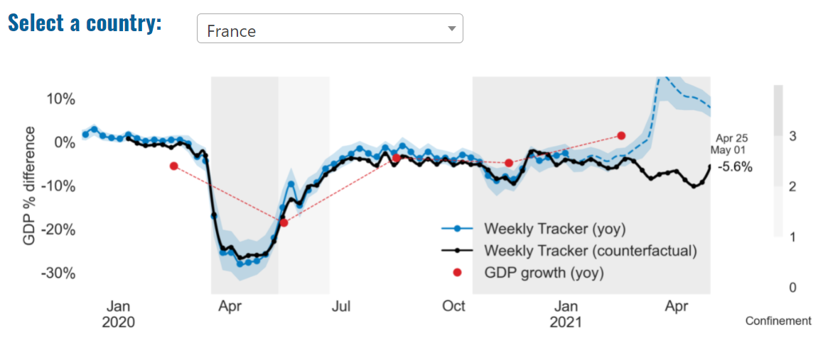
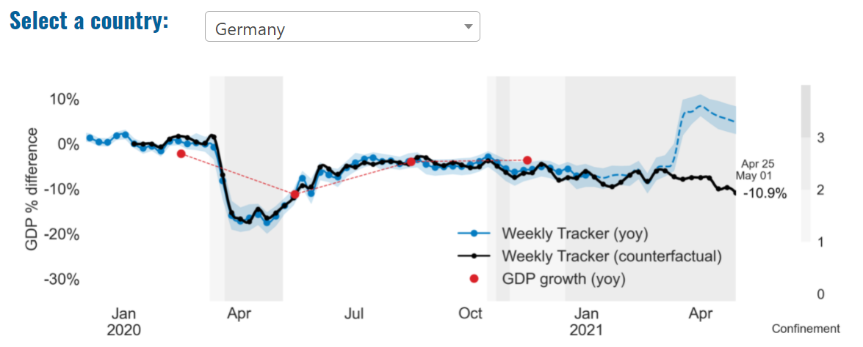
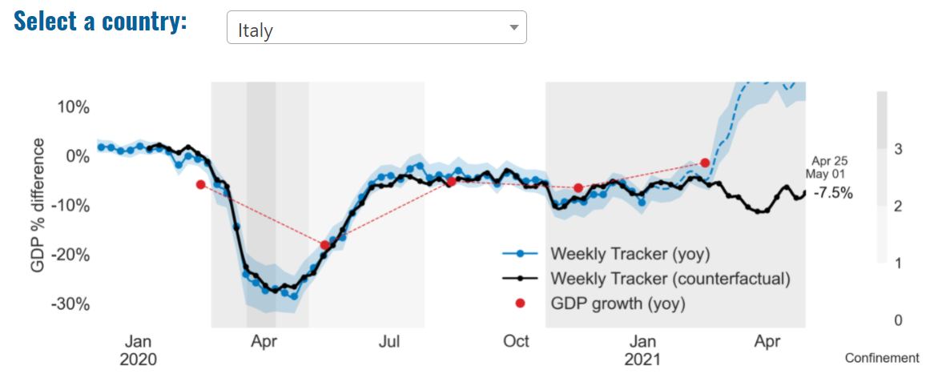
Global Economy – OECD GDP Tracker

Slide 6
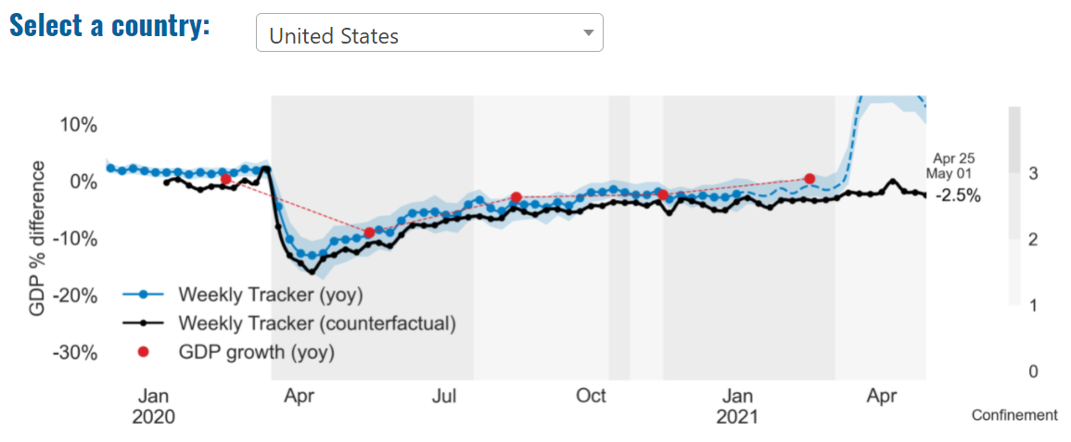
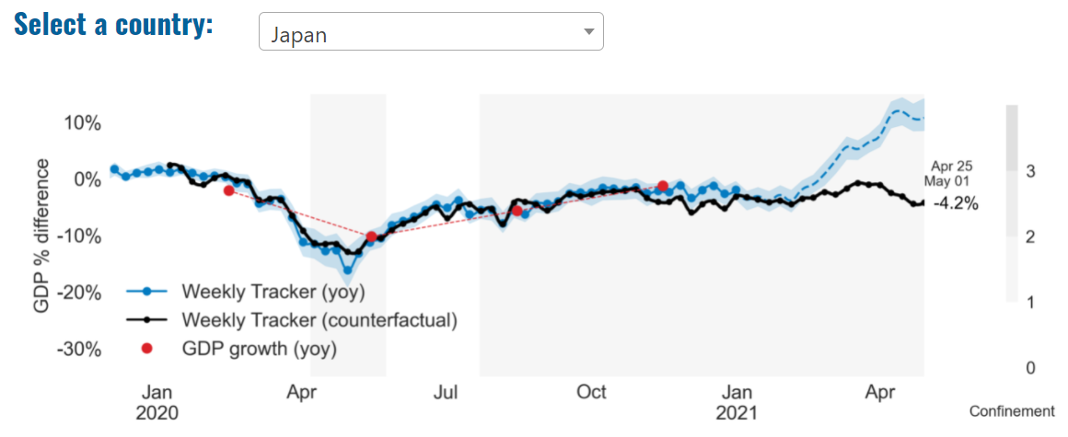
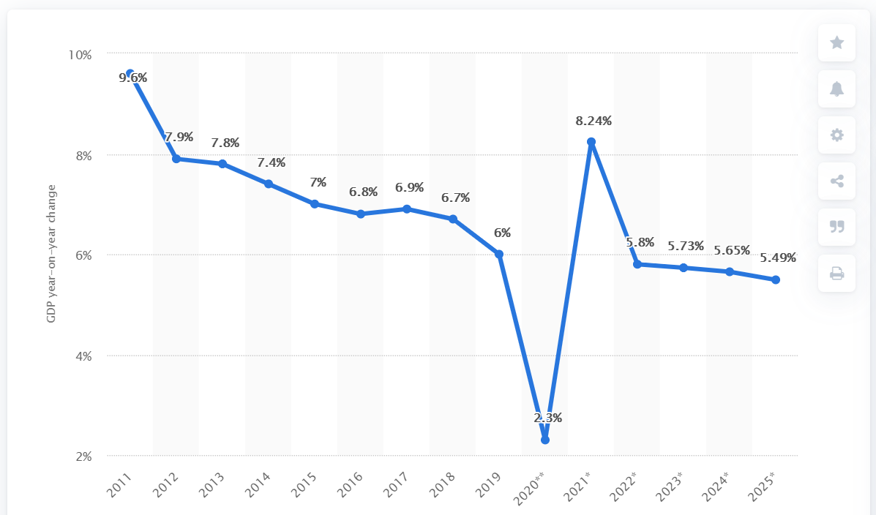
Global Economy – OECD GDP Tracker Continued
China
China is not included within the OECD GDP tracker and so the graph on the left has been compiled using statistics from the IMF and National Bureau of Statistics of China. The 2021 figure is a preliminary figure published by the National Bureau of Statistics of China in January 2021.
Note: The blue confidence band shows 95% confidence intervals. The darkness of the grey background reflects stay-at-home confinement requirement based on the Oxford Blavatnik database (0 - no measures, 1 - recommend not leaving house, 2 - require not leaving house with exceptions, 3 - require not leaving house with minimal exceptions).
Source: OECD, April 2021

Slide 7
UK Economy – The Queen’s Speech
On Wednesday 12 May, the House of Commons debated the economic and employment aspects of the Queen’s Speech.
Speaking of “the nobility of work”, the Chancellor, Rishi Sunak, told MPs: “When the furlough scheme ends in September, we will have helped to pay people’s wages for a year and a half, supporting, at its peak, the jobs of almost 9 million people. We have protected the incomes of more than 2.7 million self-employed people; backed businesses to keep people in work with tens of billions of pounds of loans, grants and tax cuts; and supported the most vulnerable through the crisis with a strengthened safety net, increased funding for local authorities and public services, and help for the charity sector.”
Key points made by the Chancellor included:
Over the last year and this, the government’s plan for jobs is providing over £407 billion of support for British people and businesses—a historic package of economic support unmatched in peacetime.
The Bank of England said in the week prior to the Queen’s Speech that it now expects the economy to return to its pre-crisis level by the end of this year—earlier than it previously thought.

Slide 8
UK Economy – The Queen’s Speech
At the start of the crisis, unemployment was expected to reach 12% or more. It is now expected to peak at about half of that level.
Real household disposable incomes in the last quarter of last year were only 0.2% below the same period the year before.
Whilst many families are facing profound difficulties, some people have saved more, with household savings last year £140 billion higher than the year before. Surveys show that consumer confidence is returning to its pre-crisis levels.
The number of businesses becoming insolvent fell by nearly a quarter last year compared to the year before.
The kickstart scheme has created almost 200,000 job placements for young people in record time.
To help people of all ages to get back into work, the government has doubled the number of work coaches in jobcentres and provided over £3.5 billion to help people to search for work or retrain, and we are launching the restart programme, with £2.9 billion to provide intensive support to over 1 million people who are long-term unemployed.

Slide 9
UK Economy – The Queen’s Speech
The levelling up White Paper will set out “bold new interventions” to improve livelihoods and opportunities.
The government is turning Britain into a science superpower, with our plan for growth making this country the best place in the world for inventors, innovators and engineers.
The skills guarantee will give every adult flexible access to fully-funded, high-quality education throughout their lives, and this will have a transformational impact on people’s lives and livelihoods.
Opposition MPs were not impressed.
Labour’s Rachel Reeves said: “…for too many people wages have stalled over the past decade; household debt is rising and too many people live pay cheque to pay cheque. And many of those people do the crucial everyday jobs that keep our economy running and our public services going. They have been overlooked and undervalued. The Government have done nothing for them and nor does this Queen’s Speech.”

Slide 10
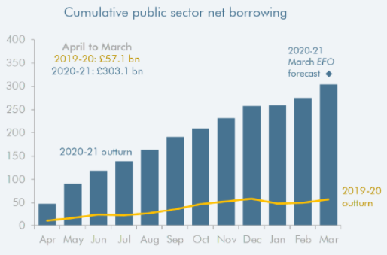
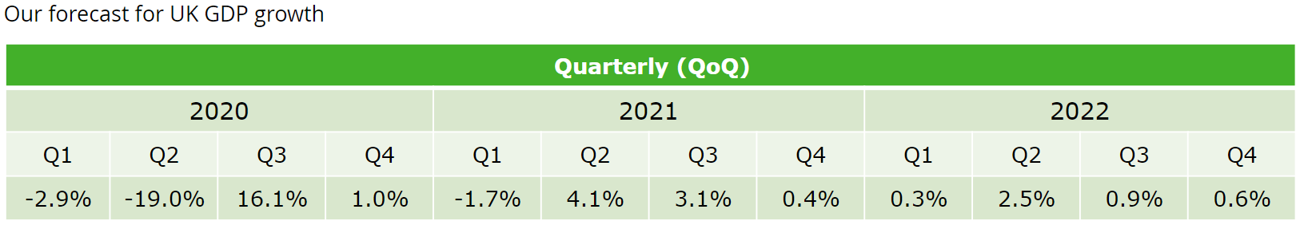
UK Economy
According to the Office for Budget Responsibility, the initial estimate of government borrowing for the 2020-21 fiscal year of £303.1 billion is roughly double the previous record set at the height of the financial crisis in 2009-10 (£157.7 billion). But it is £24.3 billion below the OBR’s March forecast on a like-for-like basis (and £51.5 billion below it including loan write-offs that are not yet recorded in outturn).
In Deloitte’s latest forecast for UK GDP, a smaller contraction in the first quarter of 2021 is expected than previously projected, in light of positive monthly GDP growth in February and strong survey data in March. Deloitte continues to expect the economy to rebound strongly as restrictions are eased gradually over the second and third quarters, supported by the vaccine rollout, extended UK fiscal support and the boost to global growth from the large US fiscal stimulus.
Sources: Source: OBR, April 2021; Deloitte, April 2021

Slide 11
UK Economy 2
Britain’s economy is forecast to grow at the fastest rate since the second world war this year after businesses adapted better to coronavirus restrictions and consumer spending booms as lockdown measures are relaxed. With businesses and households preparing for looser controls this spring, the EY Item Club said it had upgraded its growth forecasts for 2021 after a stronger start to the year than expected and as rapid progress with the vaccine programme enables a swift return to relative normality.
The group said it now expected GDP to grow by 6.8% in 2021 – a sharp upgrade on the 5% growth rate it had estimated in January – which would mark the fastest annual growth in national income since 1941. The UK economy shrank by 9.8% in 2020, the worst performance in the G7. It said the improved near-term outlook means the UK economy is expected to attain its pre-pandemic peak by the middle of next year, helped by a boom in consumer spending after a rise in saving by wealthier households during lockdown. Source: Guardian, April 2021

Slide 12
UK Economy 3
Britain looks set to see faster economic growth than the United States this year as the country races ahead with its vaccination programme after its slump in 2020, Goldman Sachs said on Sunday. The bank said in a note to clients that it now expects British gross domestic product to grow by a "striking" 7.8% this year, "above our expectations for the U.S.“ Previously, Goldman had expected Britain's economy would grow by 7.1% this year and its forecast for U.S. growth in 2021 stands at 7.2%, helped by U.S. President Joe Biden's huge fiscal stimulus programme.
A Reuters poll of analysts published on April 13 showed an average forecast for growth of 5.0% in the UK, the world's fifth-biggest economy, in 2021. The International Monetary Fund has projected a 5.3% expansion. But since those forecasts were made there have been signs of an acceleration in the pace of recovery with the country now having given a first coronavirus vaccine to more than half of its total population.
Sources: Reuters, April 2021

Slide 13
Coronavirus and Recession: Implications for Thames Valley Berkshire

Slide 14
Furloughing (Latest data - February 2021)
9,500 jobs (15% of total eligible employments) furloughed in Bracknell Forest UA
13,200 jobs (18% of total eligible employments) furloughed in Slough UA
12,800 jobs (14% of total eligible employments) furloughed in Reading UA
10,900 jobs (13% of total jobs) furloughed in Wokingham UA
11,500 jobs (17% of total jobs) furloughed in Windsor and Maidenhead
10,700 jobs (14% of total jobs) furloughed in West Berkshire
Source: HMRC, March 2021
Berkshire has a lower-than-average number of furloughed workers, compared to the rest of the UK, because of its relative strength in sectors of industry that can be continued by workers from home.

Slide 15
SEISS (Latest data - January 2021)
Total value of claims made for Bracknell Forest UA – SEISS 3: £14,200,000
Total value of claims made for Slough UA – SEISS 3: £18,200,000
Total value of claims made for Reading UA – SEISS 3: £14,700,000
Total value of claims made for Wokingham – SEISS 3: £15,300,000
Total value of claims made for Windsor and Maidenhead – SEISS 3: £13,900,000
Total value of claims made in West Berkshire – SEISS 3: £15,400,000
Source: HMRC, February 2021

Slide 16
Claimant Count (Latest data - March 2021)
Total of 31,090 claimants (5.4% of the working age population) in Thames Valley Berkshire
3,510 claimants (4.4% of the working age population) in Bracknell Forest UA
8,520 claimants (9% of the working age population) in Slough UA
7,255 claimants (6.7% of the working age population) in Reading UA
3,570 claimants (3.4% of the working age population) in Wokingham UA
4,335 claimants (4.7% of the working age population) in Windsor and Maidenhead UA
3,900 claimants (4.1% of the working age population) in West Berkshire UA
Across Thames Valley Berkshire, claimant unemployment has almost tripled in the last year, rising from 11,050 in March 2020 to 31,090 in March 2021. Slough had 9% of its working age population claim unemployment in March 2021, up from 3% in March 2020.
Source: ONS, March 2021

Slide 17
Strategic Issues: Heathrow
Heathrow Airport
In April 2021, air traffic in London Heathrow Airport (LHR) remained 92.1% lower than before the pandemic,. The decline is equal to 6.2 million passengers per month. During the month, 116,000 metric tonnes of cargo traveled through Heathrow, which is a 12% decline when compared to 132,000 in April 2019.
Heathrow Chief Executive, John Holland-Kaye said: "The government's green list is very welcome but they need to expand it massively in the next few weeks to include other low-risk markets such as the US, and remove the need for fully-vaccinated passengers to take two expensive PCR tests.“
Border Force director-general Paul Lincoln warned that arriving passengers must accept there will be increased delays, and it could take up to 15 times longer to process people than before the pandemic due to extra checks being carried out.
Sources: Aerotime, May 2021; London South East, May 2021

Slide 18
Strategic Issues: Aviation
Aviation:
With the next stage of the U.K. government’s expected easing of restrictions due to come into effect on 17 May, the commercial airline industry is anticipating the recommencement of international travel for U.K. citizens and residents. A recently announced ‘traffic light (signal)’ system of various levels of requirements upon return for travelers there is still no clarity on which countries U.K. tourists can travel to and which will be designated ‘red’, ‘amber’ or ‘green’.
With over 64 percent of those over the age of 18 having received their first vaccination jab and 25 percent receiving both injections, industry bodies are optimistic that pent-up passenger demand and confidence will convert to bookings over the summer. Thomas Cook chief executive Alan French told Sky News: “I’m confident that we will see travel opening up on 17 May – it was predicated on a number of things happening, most of which have happened…” Source: Airline Geeks, April 2021
This forecast was, of course, made before the seriousness of the India variant of Covid-19 was fully appreciated.

Slide 19
Demand and Supply Conditions: Businesses, Hiring, Restructuring, Investment, Labour and Skills Supply

Slide 20
Household/Consumer Demand
Slough had an overall recovery index score of 41 at the start of March, putting them in a stronger position in terms of recovery (closer to pre-lockdown levels) than Reading which had a recovery index score of 23.
Source: Centre for Cities, April 2021
Retail sales volumes continued to recover in March 2021, with an increase of 5.4% when compared with the previous month reflecting the effect of the easing of coronavirus (COVID-19) restrictions on consumer spending; sales were 1.6% higher than February 2020 before the impact of the coronavirus pandemic. Non-food stores provided the largest positive contribution to the monthly growth in March 2021 sales volumes, aided by strong increases of 17.5% and 13.4% in clothing stores and other non-food stores respectively.
Food stores reported monthly growth of 2.5% in March 2021, with strong growth in specialist food stores (butchers and bakers) likely reflecting the continued closure of the hospitality sector during the Easter period. Automotive fuel retailers also reported strong monthly growth of 11.1% as travel restrictions were eased towards the end of the reporting period. Despite strong March figures, retail sales for the quarter have been subdued overall; in the three months to March 2021, retail sales volume fell by 5.8% when compared with the previous three months, with strong declines in both clothing stores and other non-food stores as a result of the tighter lockdown restrictions in place. Source: ONS, April 2021

Slide 21
Industries at Risk
MANUFACTURING
28,000 people work in manufacturing in Berkshire – with 11,000 in West Berkshire alone and 2,487,000 across the whole of Great Britain (ONS, 2020)
Half of all UK manufacturing firms have made redundancies. A further 20% plan to make more redundancies in the next six months (Make UK, October 2020)
37% of manufacturers think it will take more than a year to return to normal trading conditions (Make UK, October 2020)
HOSPITALITY & TOURISM
The hospitality and tourism sector in Berkshire employed 35,842 people in 2020 – an increase of 0.8% on the previous year (EMSI, 2021)
In June, ‘Pathways to Recovery’, a report by the All Party Parliamentary Group on Hospitality and Tourism, found that just 11% of hospitality businesses had been able to operate normally during the first lockdown and international tourist arrivals were likely to be down 59% for the year.
Kate Nicholls, CEO of UK Hospitality, told the BBC (December 2020) that 30,000 hospitality businesses – most of them SMEs and one-third of the total – could be lost by the end of 2020.
According to Sky News in December, at least 38,653 hospitality jobs had been lost during the pandemic.
CONSTRUCTION
21,000 people work in construction in Berkshire – with only 1,500 of these working in Bracknell Forest and 2,164,000 across the whole of Great Britain (ONS, 2020)
The level of construction output in August 2020 was 10.8% below the February 2020 level (ONS, 2020)
Construction output grew by 18.5% in the three months to August 2020 compared with the previous three-month period, but this followed 10 consecutive periods of decline (ONS, 2020)
NON-FOOD RETAIL & WHOLESALE
More than 45,000 people work in non-motor vehicle retail in Berkshire – with 12,500 of them working in Reading (EMSI, 2021). The offline retail sector has struggled during the pandemic. At least 39,000 jobs had been lost in retail as of 3 December. Redundancy announcements include 7,000 at Marks and Spencer (August), 4,000 at Debenhams (August) and 4,000 at Boots (July) - Sky News, 2020.
The pre-pandemic trend of on-line shopping has strengthened in 2020; a record total of 31.4% of shopping was done on line in November 2020 (ONS, 2020), a trend that will have profound implications for the high street.
In November, retail sales volume decreased by 3.8% (vs October figures) as a result of COVID-19. Despite this, overall sales remain above their pre-pandemic levels (ONS, 2020).
ARTS, ENTERTAINMENT & RECREATION
12,000 people work in arts, entertainment and recreation in Berkshire. 4,500 of them – more than one third – work in Windsor and Maidenhead and 925,000 across the whole of Great Britain (ONS, 2020)
Between 19 Nov and 1 Dec, 24 per cent of arts, entertainment and recreation venues had temporarily closed or paused trading. (ONS, 2020)
52% of eligible employments in arts, entertainment and recreation were on furlough on 31 July 2020 – a figure that had fallen to 24% as at 31 October. (HMRC, 2020)
AVIATION
Aviation has an estimated value of £28 billion to the UK economy, employing 230,000 workers at over 40 commercial airports. (House of Commons Transport Committee, June 2020)
76,000 people work in over 400 business across Heathrow Airport. Many of these people live in Slough, in Berkshire. (Heathrow local recovery plan, 2020)
There were 5,800 passenger flights in April 2020 compared to 201,000 a year earlier: a reduction of 97%. The impact is several times more severe than the aftermath of the global financial crisis in 2008, when passenger flights reduced by around 67,000 to 134,000 per month. (House of Commons Transport Committee, June 2020)
The UK aviation industry has been hit harder than any European country by the pandemic with IATA calculating that the “coronavirus crisis will cost 780,000 British jobs and cost £46bn in lost GDP.” (International Air Transport Association, 2020).
ADMINISTRATION & SUPPORT
More than 51,000 people in Berkshire work in admin and support services – including 10,000 in Wokingham and 10,000 in West Berkshire and 2,752,000 across the whole of Great Britain (ONS, 2020)
More than 600,000 admin and support workers – 27% of the total – were furloughed as at 31 October (HMRC, 2020)

Slide 22
Industries more likely to be resilient/grow – Digital tech, logistics and home improvement
Telecoms
Cybersecurity and data management
eCommerce
Logistics and delivery services
Subscription services
eLearning
Streaming and gaming services
Online casinos
Health and home fitness
Gardening and DIY
Sources: Talk Business, April 2021.
From this analysis, it is apparent that (as alluded to in previous monthly reports) IT, and e-commerce by extension, as well as home improvement and fitness related industries and those which have so far demonstrated the greatest resilience in the face of the COVID-19 pandemic and are predicted to see some of the highest growth throughout 2021.

Slide 23
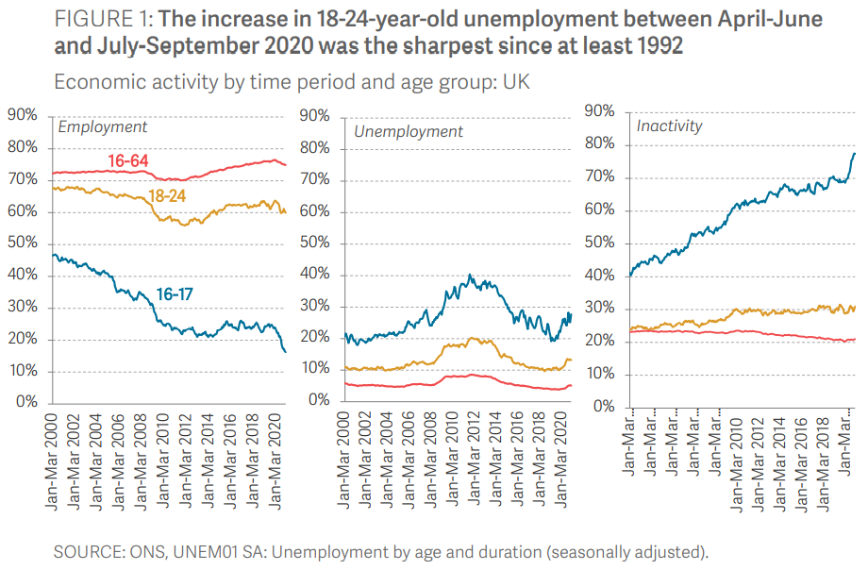
Supply of labour and skills
In order to reduce the spread of Covid-19, and thereby save lives, large sectors of the UK economy were temporarily shut down during parts of 2020 and 2021. Although unemployment rose by less than anticipated during this period, with the unemployment rate among people aged 16 and older rising by just over one percentage point in the past year, young people have been badly affected.
Source: Resolution Foundation, April 2021
The Resolution Foundation finds that 16-24-year-olds have accounted for a disproportionately large share (57 per cent) of the fall in employment that’s occurred over the past year. But the impact of the Covid-19 crisis is also unequally spread within generations. Before the onset of Covid-19 (Q2-Q4 2019), one-in-four (25 per cent) economically active Black 16-24-year-olds were unemployed, compared to one-in-ten (10 per cent) of their White counterparts. By Q2-Q4 2020, the unemployment rate rose to 34 per cent (a 9-percentage point increase) among Black young people and to 13 per cent (a 2-point rise) among White young people.

Slide 24
Remote working
In April of 2021, there were 4,522 unique job postings for remote positions at companies based in Berkshire, almost 400% more than the figure of 918 for the same period one year previous.
Compare this with the South East, in April 2021 there were 24,016 unique remote job postings for remote positions; rising from 5,717 in April of the previous year – an of 320%.
A rise can also be seen at national level, with a recorded 149,884 unique remote job postings in England in April of 2021, rising from 39,187 in April 2020 – an increase of over 280%.
From these figures it’s apparent that the COVID-19 pandemic has, somewhat unsurprisingly, prompted a massive boost in job postings for explicitly remote roles. Berkshire has seen a larger boost in vacancies which are remote-based than both England and the South East.
Source: EMSI, April 2021

Slide 25
Local Profiles

Slide 26
Bracknell Forest

Slide 27
Impact of COVID-19 up to 10th May 2021
COVID-19 cases (to 10th May 2021) – Source: Public Health Berkshire COVID-19 Dashboard, May 2021
7113 total cases
1 new cases daily
Claimant unemployment (to February 2021)
3,615 claimants (4.6% of the working age population) in Bracknell Forest UA
Notable business news
A Bracknell-based customer experience firm has its sights set across the pond. Redwood Technologies Group, which works with cloud provider Content Guru, has acquired US firm Potomac Integration and Consulting (PIC) as it grows its global presence. Established in 2006, PIC supports high-profile government clients with communications solutions. Sean Taylor, CEO of Redwood Technologies Group, said his firm has worked with PIC for more than 10 years. “We felt that the company was well-aligned to the group’s mission of creating outstanding customer experience through seamless engagement and data-driven insights,” he said.
Source: Wokingham Today, April 2021

Slide 28
Industries hit hardest by COVID shutdown
As illustrated by the above graph, Bracknell Forest has suffered very similarly to Great Britain in terms of the percentage of jobs within industries which have been hit hardest by COVID shutdowns. Thames Valley Berkshire area has seen an additional 0.77% of jobs of jobs affected worst by the COVID shutdowns when compared to Bracknell Forest.
Source: EMSI, March 2021 (definition for industries hit hardest provided on slide 56)

Slide 29
Industry risks and opportunities (2020-2021)
Critical industries
Food and drink retail: 3,234 employees (1% below the national average)
Energy/utilities: 257 employees (65% below the national average)
Health and social care: 6,193 employees (25% below the national average)
Freight/logistics: 515 employees (70% below the national average)
Insurance: 186 employees (69% below the national average)
Banking and financial services: 1,291 employees (13% below the national average)
Sectors most impacted
Hospitality and tourism: 3,743 employees (26% below the national average)
Arts, entertainment and recreation: 1,148 (24% below the national average)
Admin and support: 2,694 (21% below the national average)
Aviation: 0 employees
Non-food retail and wholesale: 8,508 (75% above the national average)
Manufacturing: 1,549 (69% below the national average)
Construction: 1,771 (40% below the national average)
Source: EMSI, January 2021

Slide 30
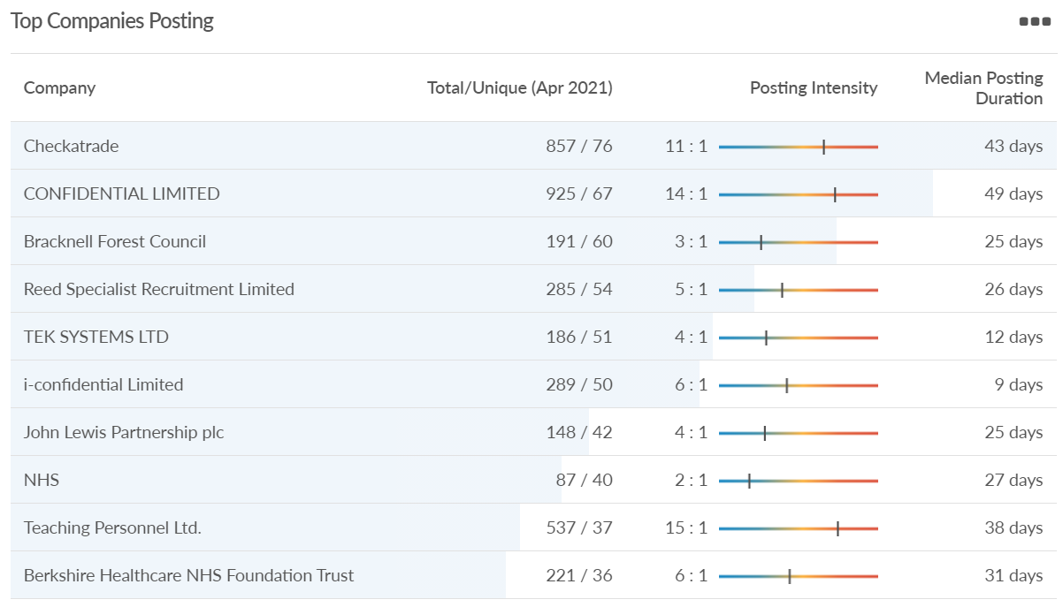
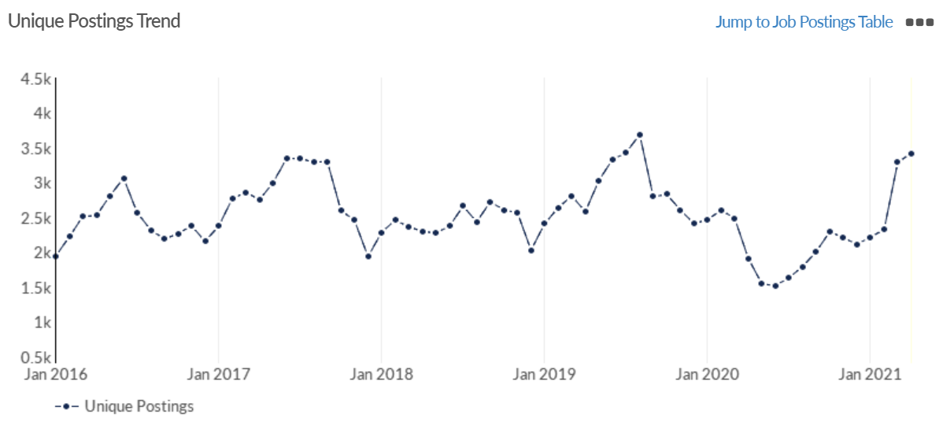
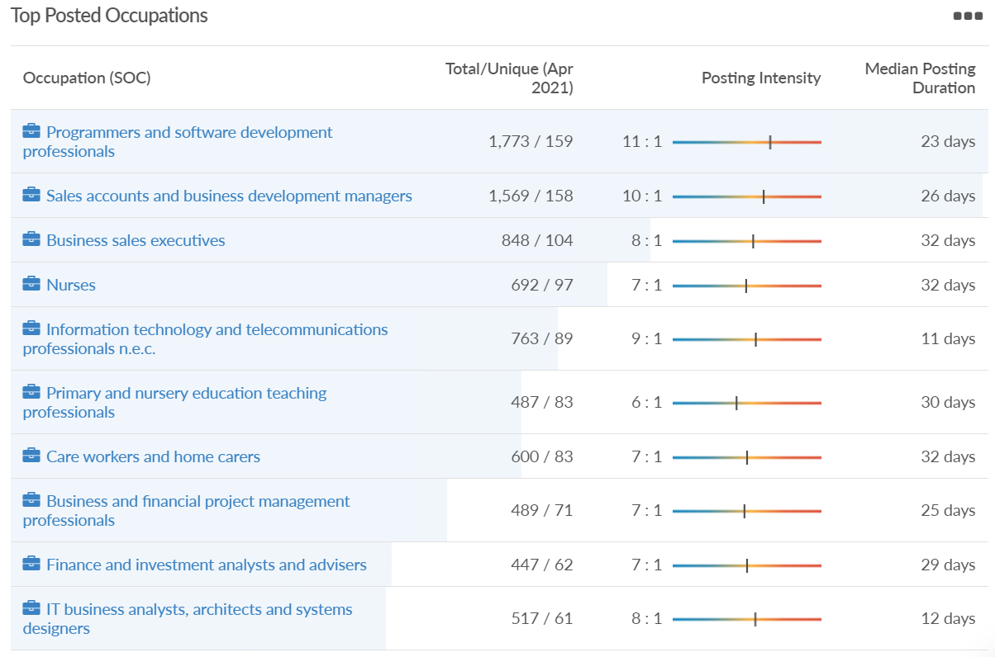
Job posting analytics (EMSI, April 2021)
Unique job postings: 3,422
Total job postings: 24,657
Job posting intensity: 7:1
Unique job postings (April 2020): 1,911

Slide 31
Slough

Slide 32
Impact of COVID-19 up to 10th May 2021
COVID-19 cases (to 10th May 2021) – Source: Public Health Berkshire COVID-19 Dashboard, 10th May 2021
15,594 total cases
6 new cases daily
Claimant unemployment (to February 2021)
8,505 claimants (9% of the working age population) in Slough UA
Notable business news
Slough Council for Voluntary Service (CVS) was shortlisted for the Thames Valley Awards – Business & Community Charity of The Year Award. This is a huge achievement as they had over 1,000 nominations and 127 entries within this category! The Awards celebrate the achievements of businesses, charities and inspirational individuals throughout the region.
Sources: Slough CVS, April 2021

Slide 33
Industries hit hardest by COVID shutdown
When compared to both Thames Valley Berkshire and Great Britain, Slough has seen a significantly lower percentage of jobs affected by COVID shutdowns – perhaps somewhat surprising given the LA’s proximity to Heathrow and the almost complete shutdown of the aviation sector.
Source: EMSI, March 2021 (definition for industries hit hardest provided on slide 56)

Slide 34
Industry risks and opportunities (2020-2021)
Critical industries
Food and drink retail: 6,656 employees (47% above the national average)
Energy/utilities: 2,820 employees (174% above the national average)
Health and social care: 8,201 employees (28% below the national average)
Freight/logistics: 4,640 employees (93% above the national average)
Insurance: 121 employees (86% below the national average)
Banking and financial services: 731 employees (65% below the national average)
Sectors most impacted
Hospitality and tourism: 3,780 employees (46% below the national average)
Arts, entertainment and recreation: 442 (79% below the national average)
Admin and support: 9,765 (107% above the national average)
Aviation: 262 employees (16% above the national average)
Non-food retail and wholesale: 6,719 (0% above the national average)
Manufacturing: 5,071 (28% below the national average)
Construction: 2,620 (36% below the national average)
Source: EMSI, January 2021

Slide 35
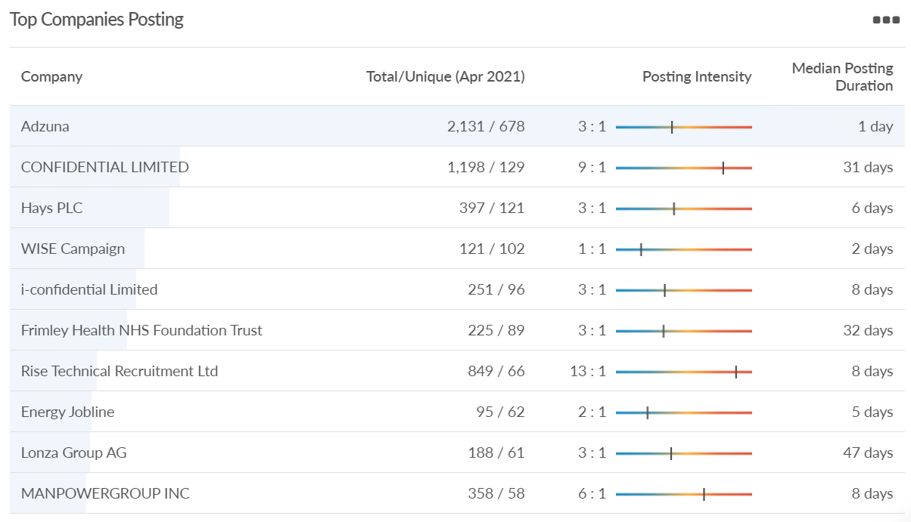
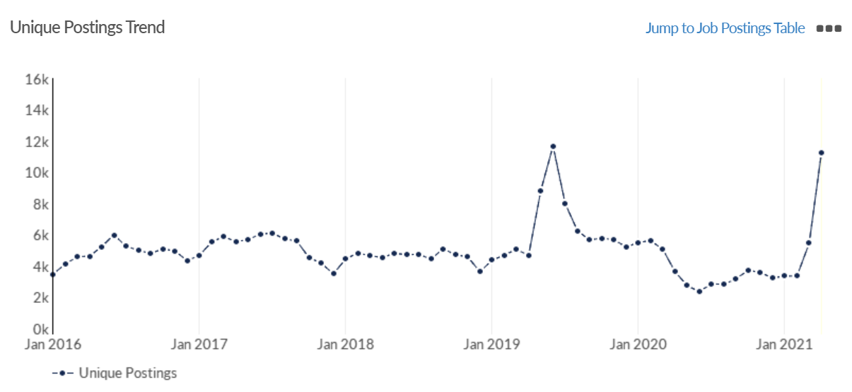
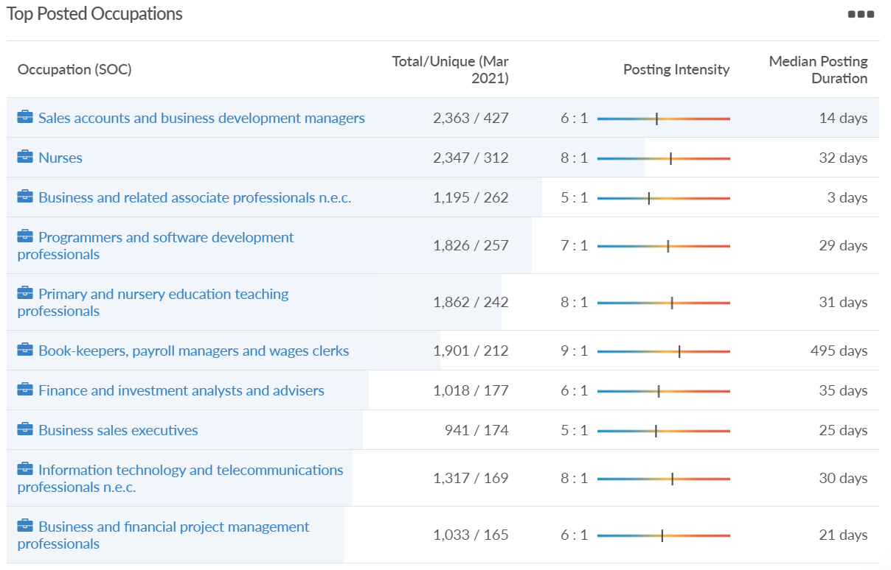
Job posting analytics (EMSI, April 2021)
Unique job postings: 11,263
Total job postings: 45,977
Job posting intensity: 4:1
Unique job postings (April 2020): 3,648

Slide 36
Reading

Slide 37
Impact of COVID-19 up to 10th May 2021
COVID-19 cases (to 10th May 2021) – Source: Public Health Berkshire COVID-19 Dashboard, May 2021
10,978 total cases
1 new case daily
Claimant unemployment (to February 2021)
7,195 claimants (6.7% of the working age population) in Reading UA
Notable business news
Arena Business Centres, the flexible office space provider, is moving to Winnersh Triangle next month as part of an £8 million project. With workspaces for groups of two people up to 500, it wants to help businesses relocate, upsize and downsize with ease. Helen Deverill, marketing director at Arena Business Centres, said: “This is an exciting project to help businesses around Reading and the Thames Valley find a new way of working in the coming months.” “Now more than ever we are helping businesses of every size from entrepreneurs, SMEs to corporates with their flexible office space requirements.”
Source: Wokingham Today, April 2021

Slide 38
Industries hit hardest by COVID shutdown
Reading has been marginally less affected by the COVID shutdowns as Great Britain has on average, with 15.16% of jobs within industries which have been most severely impacted by the shutdowns. The Local Authority is 1.26% better off than the average of the Thames Valley Berkshire area.
Source: EMSI, March 2021 (definition for industries hit hardest provided on slide 56)

Slide 39
Industry risks and opportunities (2020-2021)
Critical industries
Food and drink retail: 6,192 employees (11% above the national average)
Energy/utilities: 3,350 employees (163% above the national average)
Health and social care: 13,464 employees (5% below the national average)
Freight/logistics: 1,513 employees (49% below the national average)
Insurance: 2,076 employees (100% above the national average)
Banking and financial services: 1,688 employees (34% below the national average)
Sectors most impacted
Hospitality and tourism: 6,567 employees (25% below the national average)
Arts, entertainment and recreation: 1,811 (31% below the national average)
Admin and support: 9,212 (58% above the national average)
Aviation: <10 employees
Non-food retail and wholesale: 8,626 (18% above the national average)
Manufacturing: 2,000 (77% below the national average)
Construction: 2,273 (55% below the national average)
Source: EMSI, January 2021

Slide 40
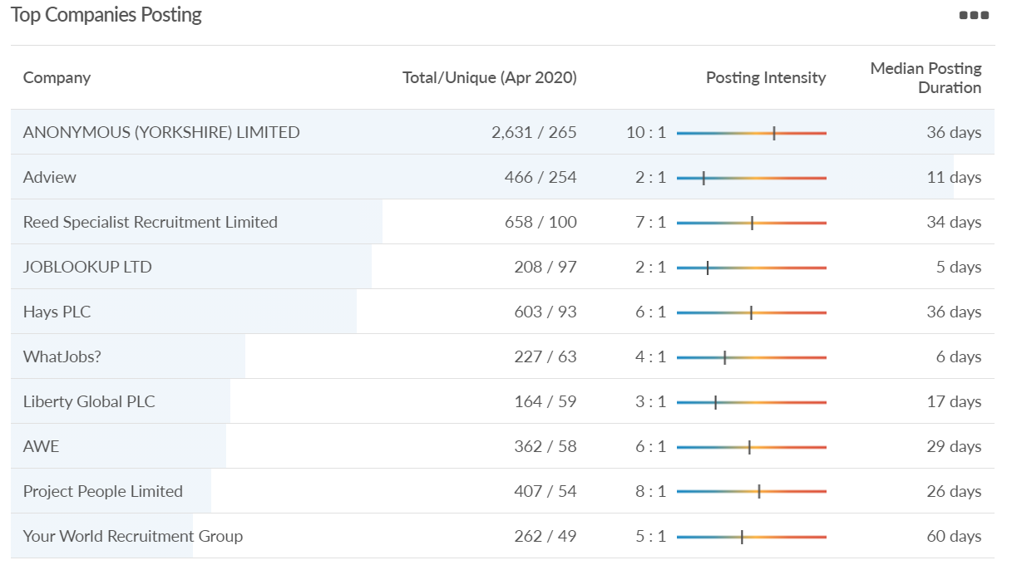
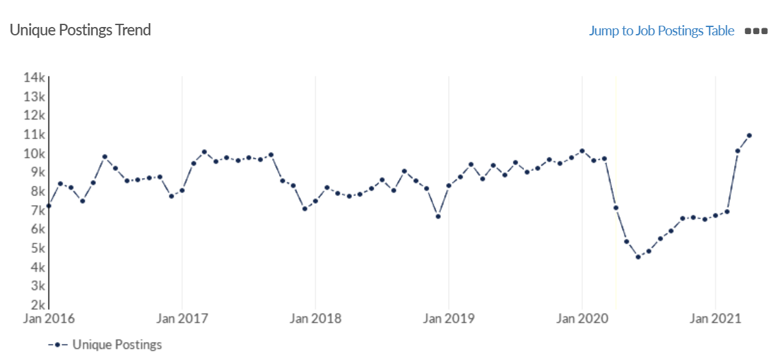
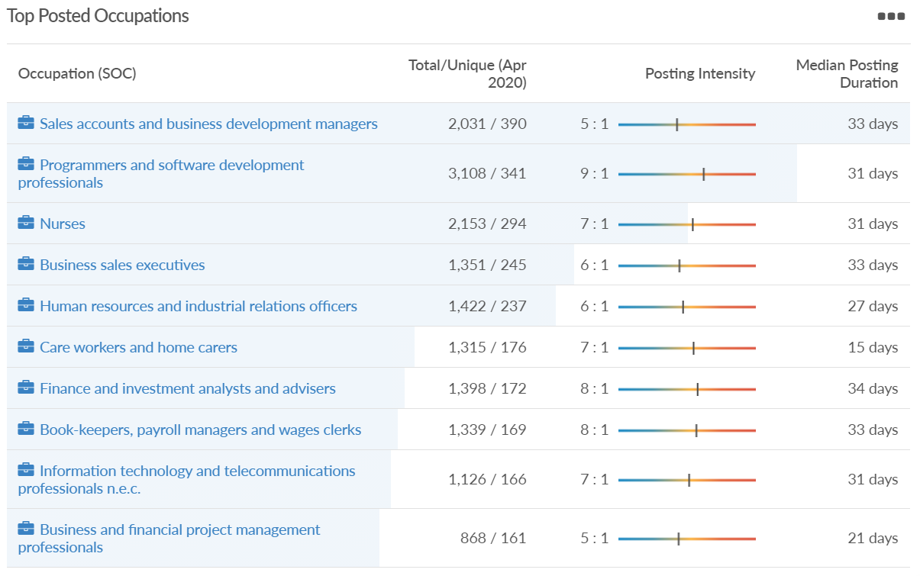
Job posting analytics (EMSI, April 2021)
Unique job postings: 10,890
Total job postings: 96,002
Job posting intensity: 9:1
Unique job postings (April 2020): 7,082

Slide 41
Wokingham

Slide 42
Impact of COVID-19 up to 10th May 2021
COVID-19 cases (to 10th May 2021) – Source: Public Health Berkshire COVID-19 Dashboard, May 2021
8,274 total cases
2 new cases daily
Claimant unemployment (to February 2021)
3,625 claimants (3.5% of the working age population) in Wokingham UA
Notable business news
A Wokingham showroom is a finalist in a prestigious industry competition. Ripples Wokingham, based on Rose Street, has been nominated for ‘New Bathroom Retailer of the Year’ at the kbbreview awards. The retailer, which opened last year, offers a range of bathroom products and design advice. Imran Azam, showroom director at Ripples, said: “I’m delighted that Ripples Wokingham has been shortlisted for such a distinguished industry award. “We’ve worked hard to create a bathroom business which inspires our clients with products and design ideas they won’t find elsewhere, so it’s great to receive recognition from within the industry. “I hope we’ll be able to add this award to the list of those achieved by the other established Ripples showrooms.”
Source: Wokingham Today, April 2021

Slide 43
Industries hit hardest by COVID shutdown
Wokingham is in a similar position to Slough in that is has been significantly less affected by the COVID shutdowns than both the Thames Valley Berkshire area and Great Britain as a whole. This is likely due to the high levels of employment from the Tech sector (Microsoft etc. based at TVP) as this industry is able to work well from home.
Source: EMSI, March 2021 (definition for industries hit hardest provided on slide 56)

Slide 44
Industry risks and opportunities (2020-2021)
Critical industries
Food and drink retail: 3,883 employees (17% below the national average)
Energy/utilities: 1,434 employees (35% above the national average)
Health and social care: 7,283 employees (38% below the national average)
Freight/logistics: 886 employees (64% below the national average)
Insurance: 453 employees (48% below the national average)
Banking and financial services: 423 employees (80% below the national average)
Sectors most impacted
Hospitality and tourism: 5,410 employees (25% below the national average)
Arts, entertainment and recreation: 1,831 (16% below the national average)
Admin and support: 6,432 (33% above the national average)
Aviation: 0 employees
Non-food retail and wholesale: 6,494 (6% below the national average)
Manufacturing: 3,731 (48% below the national average)
Construction: 3,115 (26% below the national average)
Source: EMSI, January 2021

Slide 45
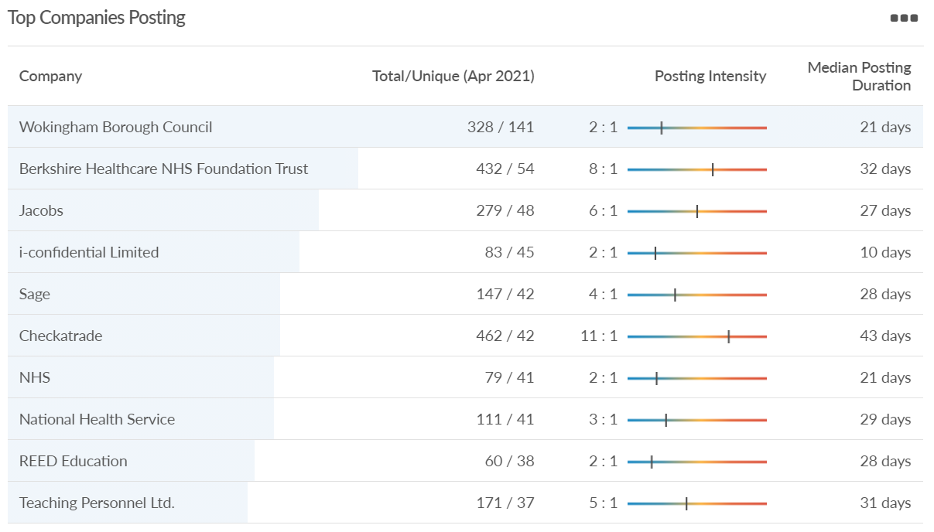
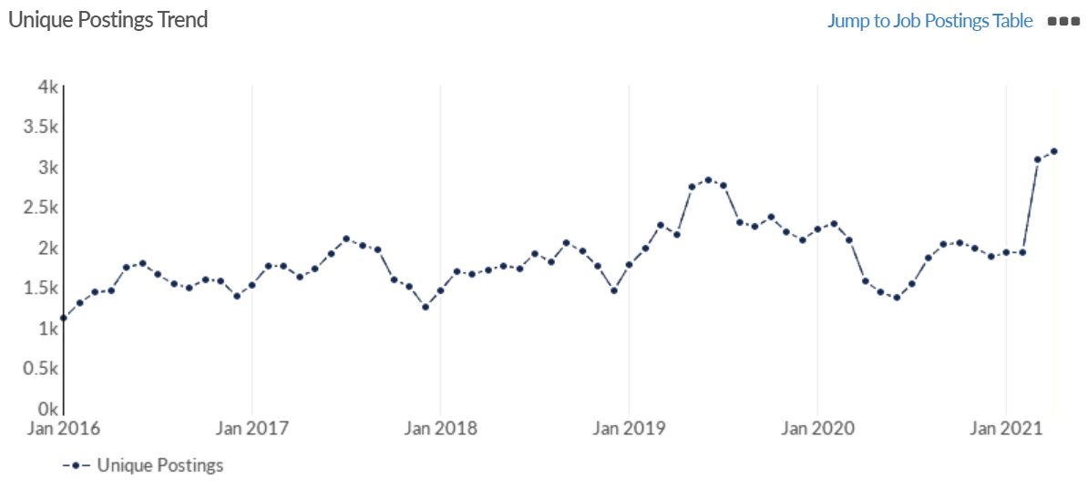
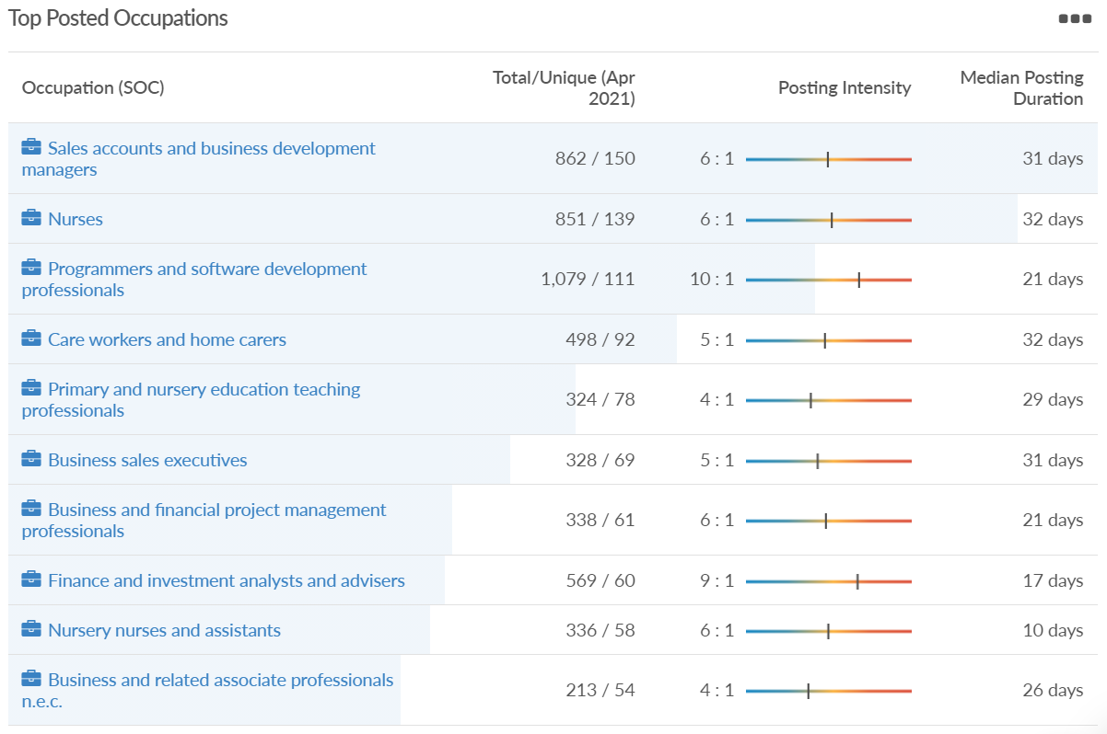
Job posting analytics (EMSI, April 2021)
Unique job postings: 3,181
Total job postings: 18,441
Job posting intensity: 6:1
Unique job postings (April 2020): 1,575

Slide 46
Windsor and Maidenhead

Slide 47
Impact of COVID-19 up to 10th May 2021
COVID-19 cases (to 10th May 2021) – Source: Public Health Berkshire COVID-19 Dashboard, May 2021
8,541 total cases
1 new cases daily
Claimant unemployment (to February 2021)
4,365 claimants (4.7% of the working age population) in Windsor and Maidenhead UA
Notable business news
Legoland Windsor Resort's new attraction is to open in May. The theme park is creating a 25m-high (82ft) ride and two 13m-high (43ft) drop tower rides as part of the new Mythica attraction. The resort, run by Merlin Entertainments Limited, said its new "multimillion-pound" attraction would also feature a water ride, as well as 13 "mythical creatures" made from 1.7 million Lego bricks.
Source: BBC News, March 2021

Slide 48
Industries hit hardest by COVID shutdown
Windsor and Maidenhead appears to be the most severely affected of all the Local Authorities which make up Berkshire in terms of percentage of jobs hit hardest by the COVID shutdowns. This is likely due in part to the enormous hit the leisure/tourism sector has taken and how key of an employer Legoland Windsor to the region.
Source: EMSI, March 2021 (definition for industries hit hardest provided on slide 56)

Slide 49
Industry risks and opportunities (2020-2021)
Critical industries
Food and drink retail: 3,733 employees (17% below the national average)
Energy/utilities: 882 employees (13% below the national average)
Health and social care: 8017 employees (29% below the national average)
Freight/logistics: 748 employees (68% below the national average)
Insurance: 434 employees (48% below the national average)
Banking and financial services: 1,252 employees (39% below the national average)
Sectors most impacted
Hospitality and tourism: 9,437 employees (35% above the national average)
Arts, entertainment and recreation: 4,516 (117% above the national average)
Admin and support: 4,207 (10% below the national average)
Aviation: 11 employees (95% below the national average)
Non-food retail and wholesale: 7,834 (18% above the national average)
Manufacturing: 2,523 (64% below the national average)
Construction: 6,201 (54% above the national average)
Source: EMSI, January 2021

Slide 50
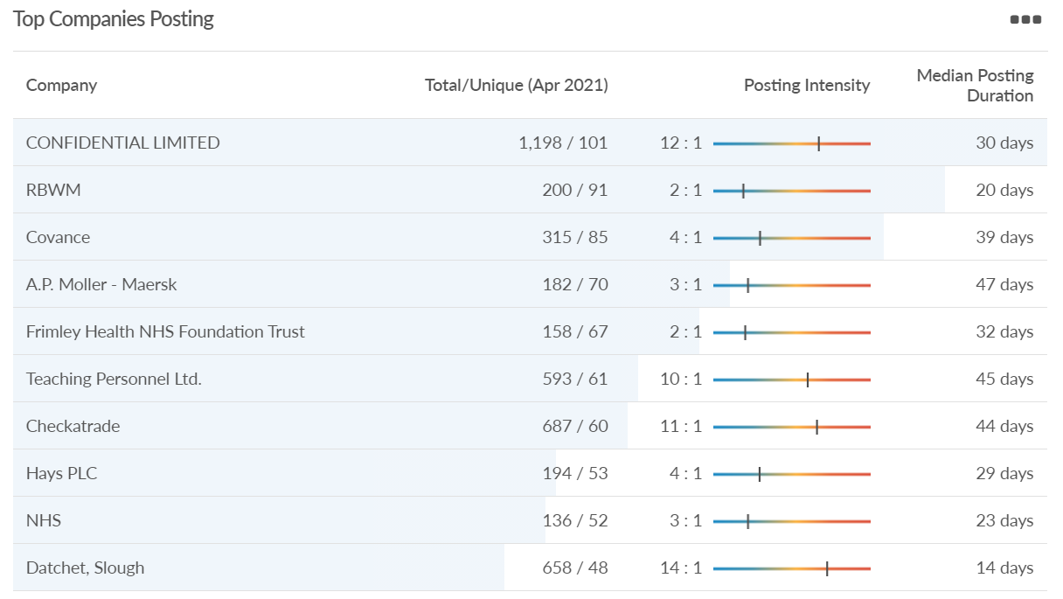
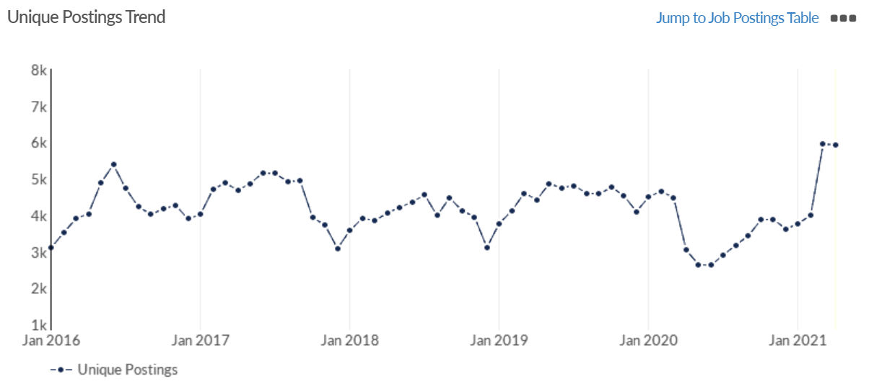
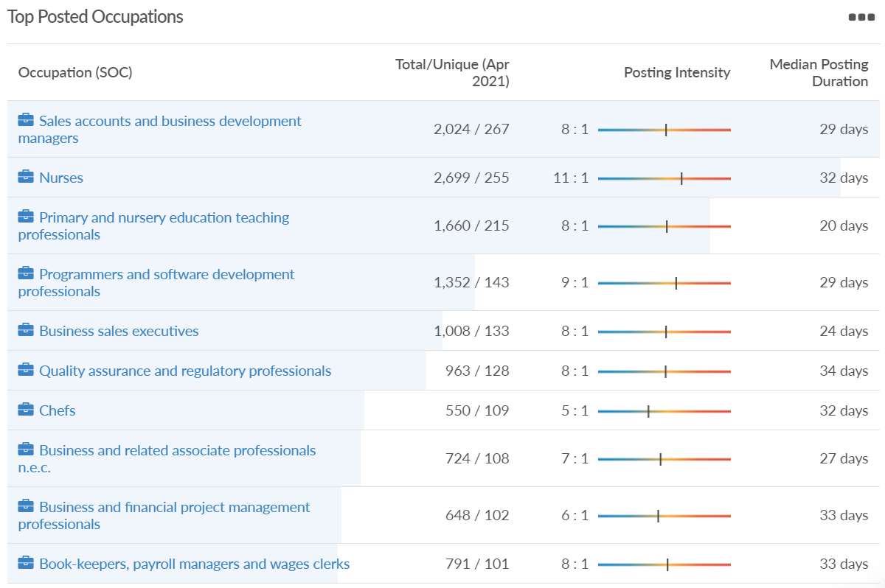
Job posting analytics (EMSI, April 2021)
Unique job postings: 5,935
Total job postings: 43,383
Job posting intensity: 7:1
Unique job postings (April 2020): 3,043

Slide 51
West Berkshire

Slide 52
Impact of COVID-19 up to 10th May 2021
COVID-19 cases (to 10th May 2021) – Source: Public Health Berkshire COVID-19 Dashboard, May 2021
6,436 total cases
4 new case daily
Claimant unemployment (to February 2021)
3,880 claimants (4% of the working age population) in West Berkshire UA
Notable business news
Next is returning to Newbury. The retailer will open its doors this summer in the former John Lewis unit at Parkway Shopping. The company has now exchanged contracts with Parkway Shopping's owner Aberdeen Standard Investment’s Pooled Pension Fund for a new 50,000+ sq ft Next store. The store, which will open in the summer, will carry the full ranges of ladies wear, menswear, kidswear, homeware and will also have a Mamas & Papas concession. There are also plans to incorporate a café into the store. Aberdeen Standard Investments senior asset manager Angus Stenhouse said: “This vote of confidence by Next strengthens Newbury’s reputation as a strong retail destination within its catchment and the M4 corridor. "Having recently closed the retail park store, choosing Parkway shows Next’s belief in the future of the High Street.” Advisers to the deal were Lunson Mitchenall for ASI and Savills for Next. Next has been operating a temporary click and collect store in Parkway during the third lockdown.
Source: Newbury Today, April 2021

Slide 53
Industries hit hardest by COVID shutdown
While West Berkshire hasn’t been as fortunate as Slough in terms of how great of a percentage of jobs have been directly affected by the COVID shutdown, it has fared significantly better than the Thames Valley Berkshire area and better than Great Britain.
Source: EMSI, March 2021 (definition for industries hit hardest provided on slide 56)

Slide 54
Industry risks and opportunities (2020-2021)
Critical industries
Food and drink retail: 4,289 employees (17% below the national average)
Energy/utilities: 1,343 employees (14% above the national average)
Health and social care: 6,773 employees (48% below the national average)
Freight/logistics: 1,574 employees (43% below the national average)
Insurance: 262 employees (73% below the national average)
Banking and financial services: 692 employees (71% below the national average)
Sectors most impacted
Hospitality and tourism: 6,617 employees (18% below the national average)
Arts, entertainment and recreation: 2,674 (10% above the national average)
Admin and support: 4,803 (11% below the national average)
Aviation: <10 employees
Non-food retail and wholesale: 8,432 (9% above the national average)
Manufacturing: 11,330 (41% above the national average)
Construction: 4,813 (3% above the national average)
Source: EMSI, January 2021

Slide 55
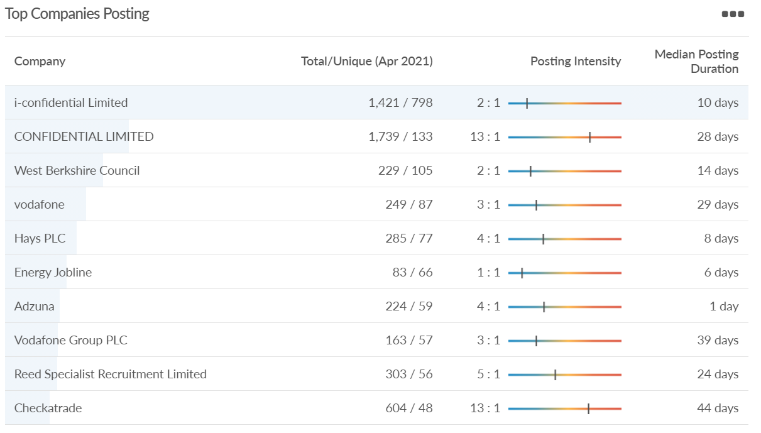
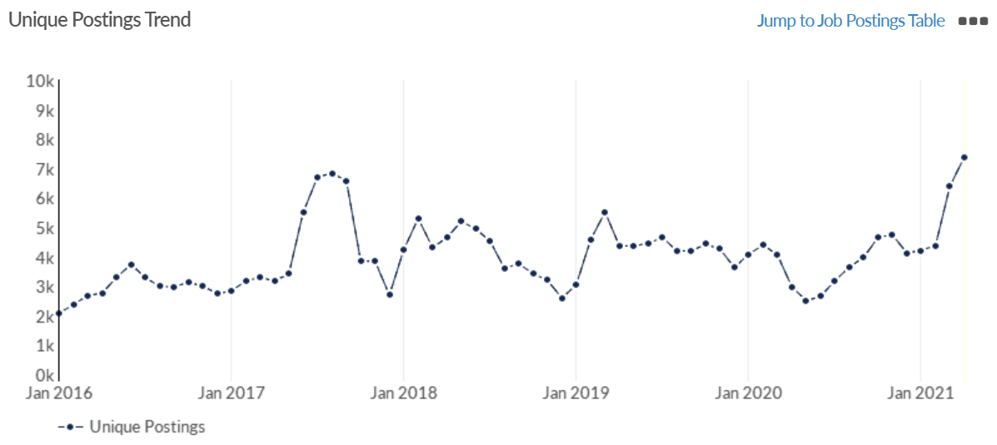
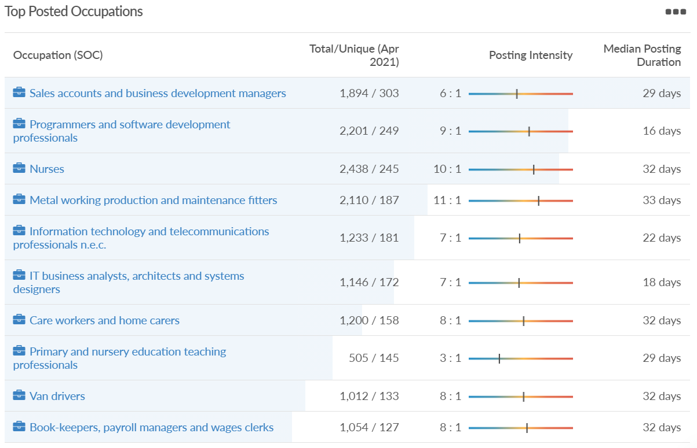
Job posting analytics (EMSI, April 2021)
Unique job postings: 7,382
Total job postings: 51,679
Job posting intensity: 7:1
Unique job postings (April 2020): 2,974

Slide 56
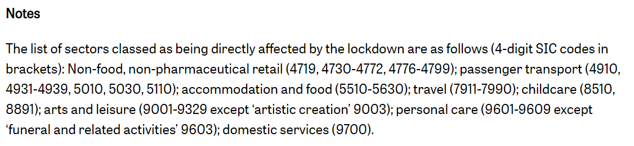
Definitions
Source: Institute for Fiscal Studies, April 2020

