Slide 1
Berkshire Quarterly Economic Briefing
Q2 2023-24 (July-September 2023)

Slide 2
Introduction
This is Berkshire LEP’s Quarterly Economic Update for the second quarter of 2023/24.
Key contents are set out on the next slide. However, each quarter, we aim to have one or two themed features. This quarter, following the party conferences, we will be discussing the conference speeches of the Chancellor, Jeremy Hunt, and his Labour Shadow, Rachel Reeves.
We also feature a lecture delivered in London by Professor Dani Rodrik of Harvard University, entitled ‘Creating a Good Jobs Economy’.
These briefings are evolving documents and their content is dictated in part information requests from our readers.
If there is an economic aspect which you think would be beneficial to include/ expand upon (or you have any queries), we will do our best to help. Please contact timpage@thamesvalleyberkshire.co.uk

Slide 3
Key Contents of this Quarter`s Briefing
Updated global and UK economic forecasts
Key points from the latest Labour Force Survey data
Latest claimant count figures by the Local Authority
Latest remote working figures for Berkshire
Latest ‘notable business news’ by Local Authority
Latest job posting analytics by Local Authority

Slide 4
Global and National Economy
Q2 2023/24

Slide 5
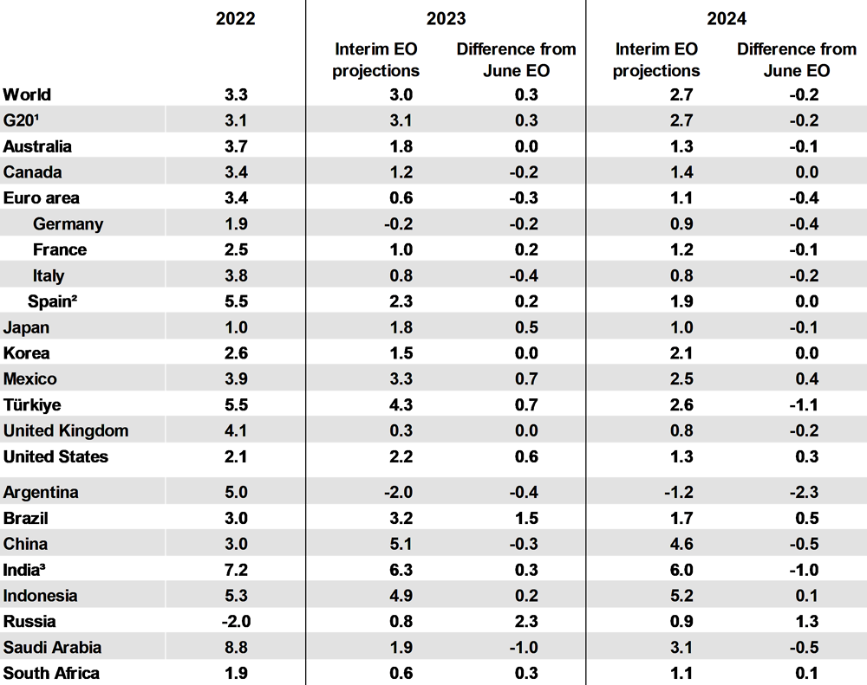
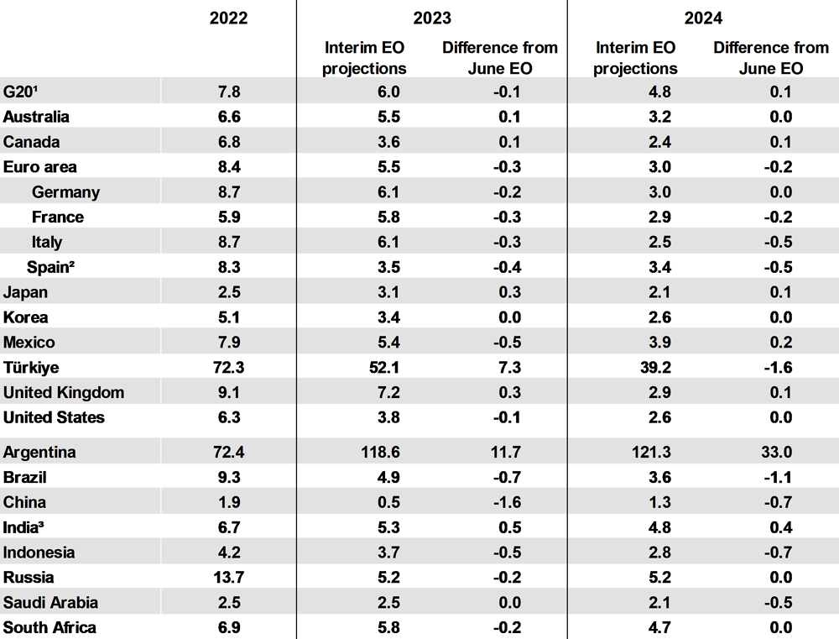
Q2 2023/24
OECD Global Economic Outlook
Global year-to-year real GDP growth is projected to remain moderate
Headline consumer price inflation is declining steadily
Source: OECD, September 2023

Slide 6
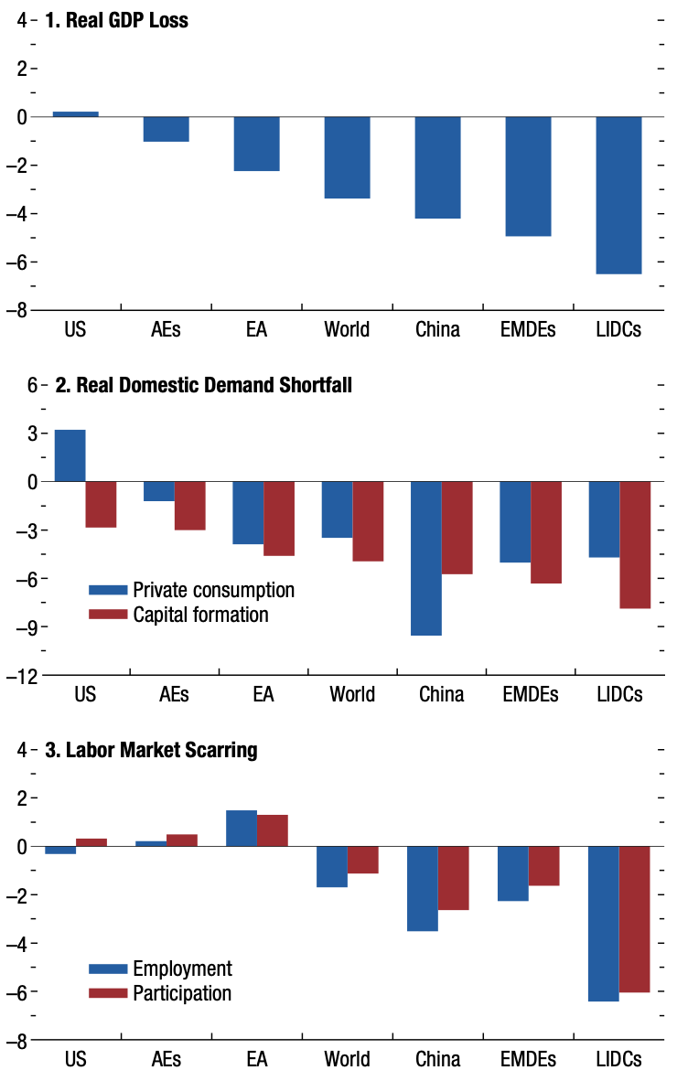
Q2 2023/24
IMF Global Economic Outlook
Global Economic Disparities: The world economy is experiencing a widening gap in growth between regions. Factors contributing to continued slowed recovery include the long-term consequences of COVID-19, Russia's war in Ukraine and other global events. Advanced economies like the U.S. have fared better than emerging markets and developing countries.
Sectoral Trends and Social Implications: Private consumption and labour markets have shown signs of resilience in advanced economies, which have protected workers’ income and helped businesses retain human capital. In contrast, emerging economies suffer from more severe output losses and weaker social protection, exacerbating poverty and unemployment rates.
Investment and Environmental Challenges: Business investment has universally fallen short of pre-pandemic levels due to rising interest rates and the withdrawal of fiscal support. Meanwhile, the pandemic and geopolitical events have also contributed to worsening climate impacts, as well as a reversal in decades-long poverty reduction trends, with 75-95 million more people living in extreme poverty compared to pre-pandemic estimates.
Source: IMF, October 2023

Slide 7

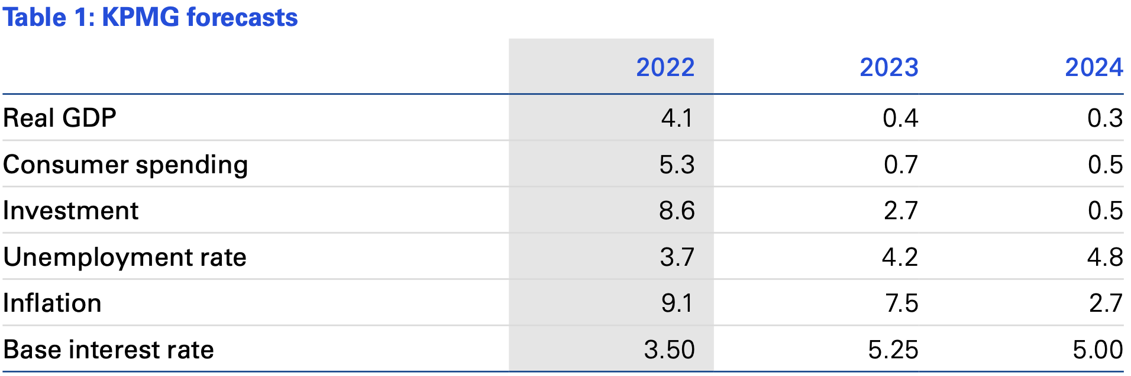
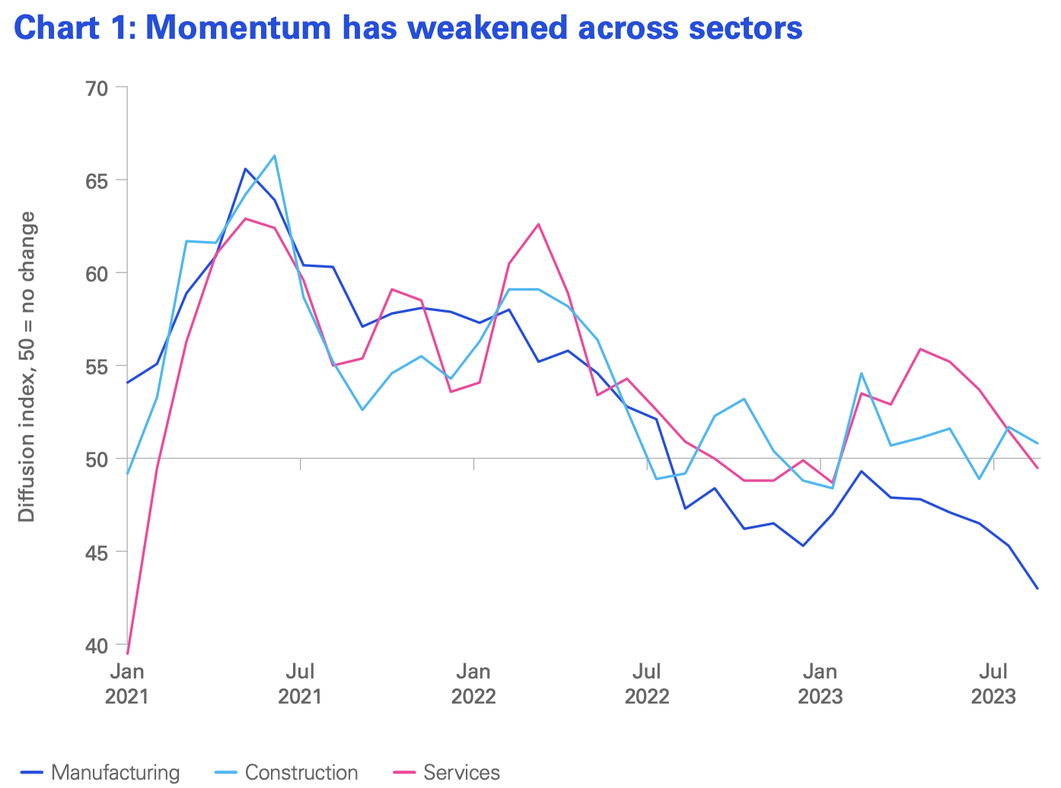
Q2 2023/24
KPMG Economic Outlook
United Kingdom
Growth will slow over the remainder of this year and into 2024. With uncertainty around the upcoming election, the strength of demand and the future trajectory of interest rates, risks to the KPMG forecast are skewed to the downside.
The latest data signal a broad-based slowdown in activity. Construction has been weighed down by a fall in housebuilding, services are exposed to the squeeze on household incomes, while manufacturing has been more sensitive to higher energy prices and interest rates.
Source: KPMG, September 2023

Slide 8
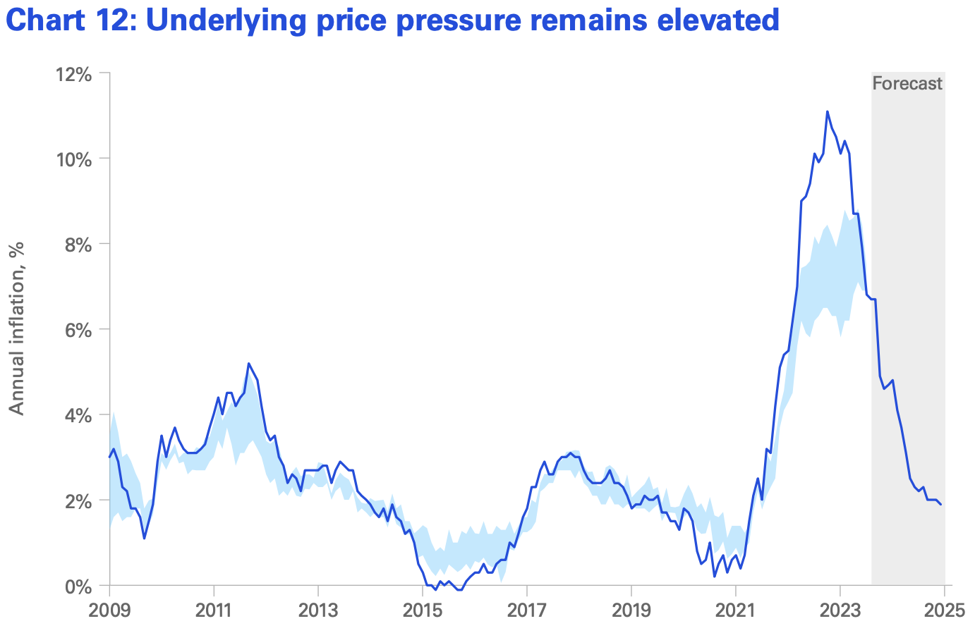

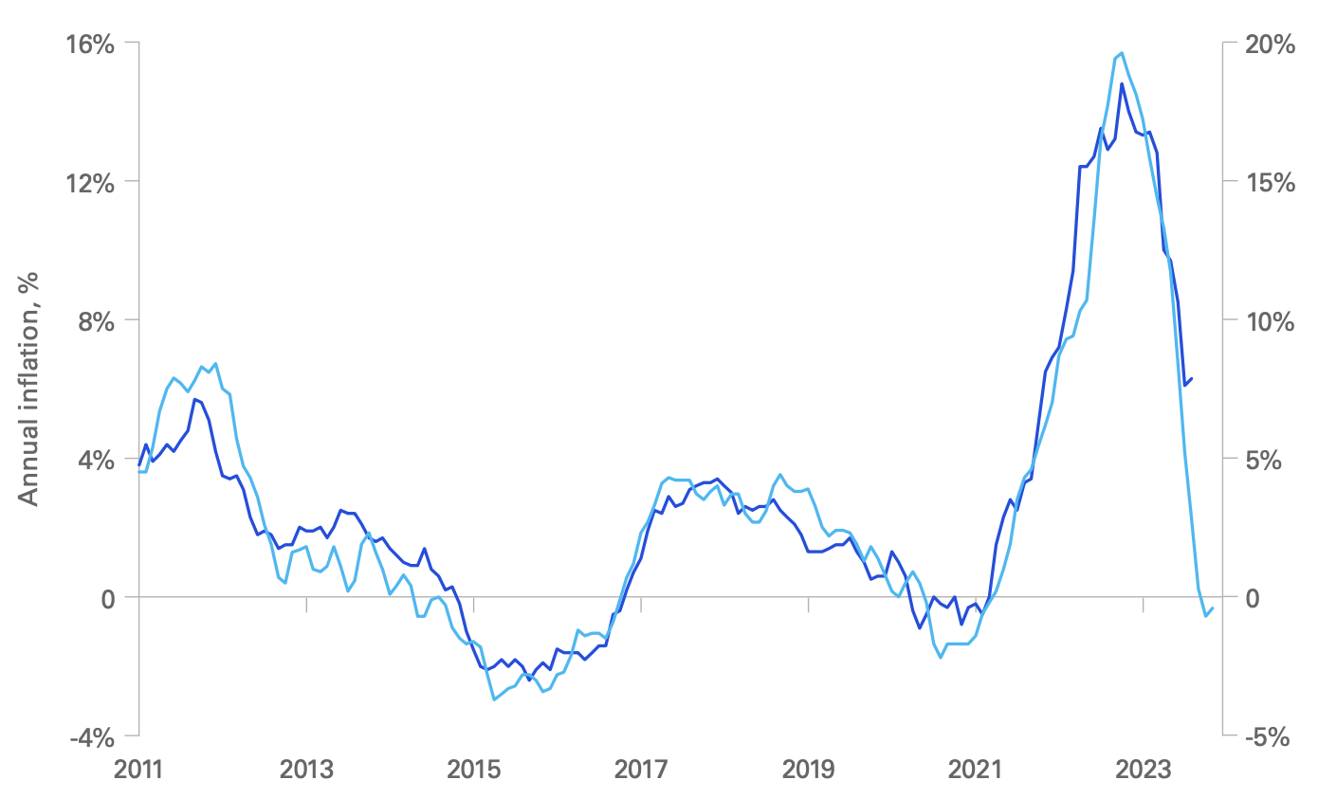
Q2 2023/24
KPMG Economic Outlook
United Kingdom
UK inflation continues to ease but remains above the levels in many western economies. Headline inflation fell to 6.7% in August, down from a peak of 11.1% last October. The latest figure compares to 3.7% in the US and 5.2% in the Eurozone. The decline in inflation has been supported by the fall in wholesale energy prices. External factors have been favourable for UK inflation. Global supply chain improvements reduced shipping costs. As a result, goods inflation has fallen markedly in recent months. Producer price inflation, which tends to lead goods CPI inflation by around three months, points to further easing in the months ahead.
Source: KPMG, September 2023

Slide 9
Q2 2023/24
KPMG Economic Outlook
United Kingdom
The post-pandemic imbalances are starting to normalise. We are now seeing the effects of higher interest rates feeding through to investment intentions, transaction volumes and corporate insolvencies, although the full impact on the household and housing sectors is yet to be felt.
Inflation remains high. While the resolution of global supply chain bottlenecks and the fall in wholesale energy prices have supported the easing of price pressures, domestic influences – supported by strong pay growth – have kept inflation elevated. This could see inflation returning to its 2% target only by the latter part of 2024, especially if businesses continue to pass on higher costs to rebuild margins.
The labour market is starting to feel the weight of slowing activity. Hiring is losing momentum, while workers are less confident to switch positions. With the gap between labour demand and supply closing, coupled with improvements in households’ purchasing power, we expect to see an easing in pay demands and a gradual fall in pay growth.
With interest rates potentially at their peak in this cycle, attention will now turn to fiscal policy. The upcoming general election could see new spending pledges to address more immediate demands such as safety concerns around school buildings or authority deficits. However, longer-term headwinds remain, leaving uncertainty around the fiscal outlook beyond the next election.
Source: KPMG, September 2023

Slide 10
Q2 2023/24
Bank of England Monetary Policy Committee Meeting
Monetary Policy & Inflation Target: The Monetary Policy Committee (MPC) of the Bank of England, in its September 2023 meeting, narrowly decided (5-4) to maintain the Bank Rate at 5.25%. They projected that the CPI inflation would meet the 2% target by 2025 Q2, adjusting for various domestic and external pressures.
Economic Indicators & Global Trends: Global growth has mostly matched the MPC's August predictions, despite regional disparities. Within the UK, July's GDP contracted by 0.5%, and indicators like the S&P Global/CIPS composite output PMI for August showed a decline. However, some metrics predict positive GDP growth.
Labour Market Dynamics & Earnings: The UK labour market, although still tight by historical measures, shows signs of relaxation. The unemployment rate increased to 4.3% in July, and while the Average Weekly Earnings (AWE) grew in the three months to July, its trajectory appeared inconsistent with other pay growth indicators.
CPI Inflation & Monetary Stance: CPI inflation dropped from 7.9% in June to 6.7% in August, with some movements attributed to volatile factors like summer travel.
Source: Bank of England, September 2023

Slide 11
Q2 2023/24
Business Insights and Impact on the UK Economy
Nearly three-quarters (72%) of trading businesses with 10 or more employees reported that they were able to get the goods they needed from within the UK in August 2023 without any form of disruption, up
5 percentage points from July 2023.
In August 2023, 7% of businesses with 10 or more employees experienced global supply chain disruption, broadly stable with July 2023.
Nearly two-thirds (63%) of businesses reported some form of concern for their business for October 2023; this is down from the 66% reported for September 2023 and the lowest percentage reported since the question was introduced in February 2022.
Fewer than 1 in 10 (5%) businesses were affected by industrial action in August 2023, the lowest proportion reported since this question was introduced in June 2022.
More than four in five (84%) businesses are not currently using artificial intelligence (AI) technologies, while 81% of businesses are not planning to adopt AI technologies in the next three months.
In late September 2023, 1 in 10 (10%) businesses reported they were experiencing worker shortages, with more than half (54%) of those businesses reporting they were unable to meet demands as a consequence.
Source: ONS, October 2023

Slide 12
Q2 2023/24
UK Labour Market Overview
Employment & Payroll: The UK employment rate stood at 75.5% from May to July 2023, witnessing a 0.5% decline from the preceding quarter, largely attributed to full-time self-employed individuals. Meanwhile, August 2023 saw only a slight reduction of 1,000 in payrolled employees, stabilizing at 30.1 million.
Unemployment & Inactivity Trends: The unemployment rate increased to 4.3% for May- July 2023, primarily affecting those unemployed for less than a year. The economic inactivity rate edged up by 0.1% to 21.1%, with the 16-24 age group and individuals inactive due to long-term sickness seeing significant rises.
Vacancy Patterns: Between June and August 2023, job vacancies dropped by 64,000 to a total of 989,000, marking a persistent trend with the 14th consecutive quarterly decline.
Wage Growth: For May-July 2023, regular pay growth (excluding bonuses) remained consistent at 7.8%, the highest since 2001. When accounting for bonuses, the total pay growth rate reached 8.5%, notably influenced by specific one-off payments in June and July.
Real-Term Pay Adjustments: Factoring in inflation, the annual growth for total pay was 1.2%, and regular pay experienced a 0.6% annual increase for the same period.
Source: ONS, September 2023

Slide 13
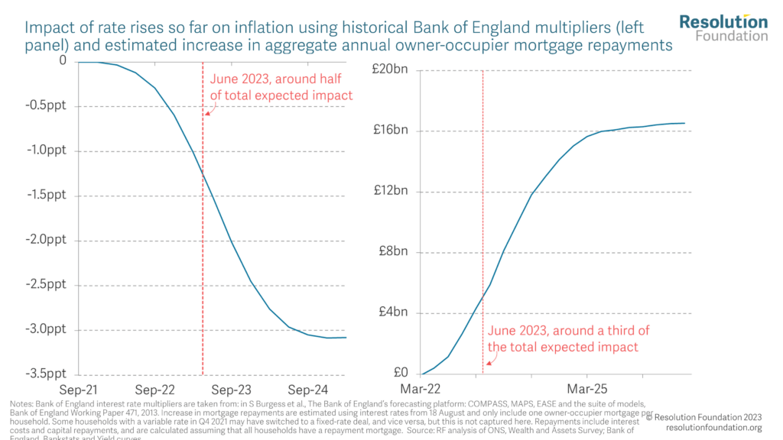
Q2 2023/24
UK Macroeconomic Policy Outlook
Impact of rate rises so far on inflation using historical Bank of England multipliers
As the Bank of England concludes its rate-tightening cycle, the focus shifts from the peak of interest rates to the duration they will remain above 5%. The first, in the upper panel, is based on the impact of rate increases on inflation based on the Bank of England’s own historical estimates. These estimates suggest that around half (48%) of the impact of the rate rises on inflation should be visible in the data by June 2023 (the latest quarterly data point for wage inflation). These estimates cover the period from 1993 to 2007.
The impact of rate rises might be more delayed this time because of the rise of fixed-rate mortgages: more than £9 out of every £10 lent in 2022 was at a fixed rate (96%) whereas this was just £4 in every £10 (41%) from 2004 to 2006. So we also look at how much of the rise in interest rates has fed through to higher mortgage payments. This suggests that only around a third (36%) of the impact should be evident in the data. All this suggests between half and two-thirds of the impact of higher rates is yet to show up in the data.
Estimated increase in aggregate annual owner-occupier mortgage repayments
Source: Resolution Foundation, October 2023

Slide 14
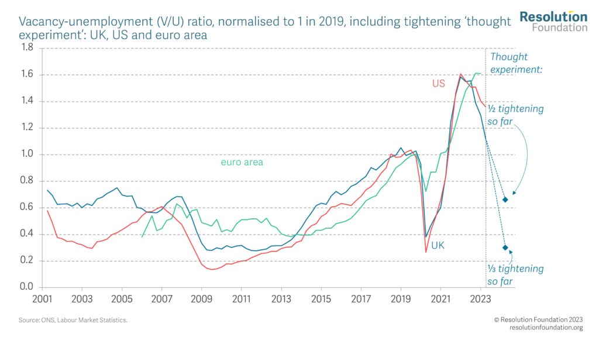
Q2 2023/24
UK Macroeconomic Policy Outlook
Vacancy-unemployment (V/U) ratio, normalised to 1 in 2019, including tightening ‘thought experiment: UK, US and euro area
The UK's labour market is undergoing a faster loosening compared to other markets. The ratio of vacancies to unemployment is declining and there is potential for the labour market to reach levels of looseness not seen since the 2008 financial crisis.
The Bank of England's interest rate strategy is deviating from the Federal Reserve's 'high for long' approach. The Bank of England may find it necessary to cut rates below 5% more quickly than the Fed. If this occurs, it could alleviate financial pressure on around 3 million households in the UK, who otherwise face the prospect of average increases in their mortgage payments of nearly £3,000.
Source: Resolution Foundation, October 2023

Slide 15
Quarterly Spotlight

Slide 16
Q2 2023/24
Jeremy Hunt’s Speech to the Conservative Party Conference 2023
Global Leader: Jeremy Hunt said that the government would make Britain a global leader in the industries of the future – the world’s next Silicon Valley. Hunt said the UK is well on the way to achieving this:
  Last year we became only the third trillion-dollar tech economy in the world
  Our tech sector is now double the size of Germany’s and three times that of France
  We do more offshore wind than anywhere in Europe. We’re Europe’s biggest film and TV production centre
Public Service Reform: Hunt had commissioned his deputy, John Glen, to restart the process of public service reform, starting with the civil service. The expansion of the civil service would be frozen and a plan put in place to reduce its numbers to pre-pandemic levels.
Debanking: The government would tighten the law to stop people being debanked for having the wrong political views.
Welfare Reform: The government would look at the way the sanctions regime works. Hunt said: “It isn’t fair that someone who refuses to look seriously for a job gets the same as someone trying their best.
National Living Wage: This is currently £10.42 an hour. The government would increase the National Living Wage to at least £11 an hour next year- a pay rise for 2 million workers.

Slide 17
Q2 2023/24
Rachel Reeves’ Speech to the Labour Party Conference 2023
Economic Revitalization and "Securonomics": Labour aims to revive economic growth in Britain. In this new age of insecurity, government could not turn a blind eye to where things are made and who is making them. Reeves called this new approach ‘securonomics’. She said we must rebuild our ability to do, make and sell here in Britain so we are less exposed to global shocks.
Fiscal Accountability and Social Reforms: As Chancellor, Reeves would introduce a Charter for Budget Responsibility that mandates independent forecasts for major tax and spending shifts. Labour would end the tax loophole which exempts private schools from VAT and business rates and would put the money raised into helping children in state schools. Labour would enforce the ministerial code on the use of private planes.
Spending Cuts and Strategic Investments: Labour aims to introduce a Covid Corruption Commissioner for increased accountability. A new National Wealth Fund is proposed to catalyze investment, aiming for a 1:3 ratio of public to private funding. Reeves also outlined plans to invest in expanding local authorities’ planning capacity to speed up decision-making.
Gender Pay Gap: Despite the Equal Pay Act being in place for half a century, women in Britain continue to earn 15% less than men on average. To tackle this issue, Rachel Reeves has commissioned Frances O'Grady, the former TUC General Secretary, to study and propose solutions for closing the gender pay gap.

Slide 18
Q2 2023/24
Professor Dani Rodrik – What Does it Take to Build a Good Jobs Economy?
The Challenge: Britain is suffering from a productivity problem. Britain also struggles with very high levels of regional inequality. Outside London and the South East there is a scarcity of good jobs. Inclusive prosperity will require not just improved productivity, but also more productive jobs for the bulk of the labour force. That requires us to address inequality in terms of the jobs that are created.
What is a Good Job: Pay is important, but is not the only aspect of a good job – jobs define who we are. Dignity, autonomy and the ability to progress are important. Respondents to surveys highlight flexibility, automation, and how they are treated at work as features of good jobs.
How to Create Good Jobs: The discussion of good jobs tends to focus on areas like education and training, labour market regulations, the bargaining power of workers and the self-interest of employers. However, these remedies have limits. Education and training, important that it is, is a solution for the future, not the present. Also, high minimum wages lead to trade-offs between job creation and quality of work. So, we need more productive jobs for the workers we have. This is why we need industrial policy, to foster innovation and structural change towards more productive activities.

Slide 19
Q2 2023/24
Professor Dani Rodrik – What Does it Take to Build a Good Jobs Economy?
What Institutions do we need: Rodrik makes the case for local cross sectoral partnerships, to develop local economic development strategies, bringing worker training, skills formation and entrepreneurial assistance. Rather than subsidies and tax incentives, there should be a focus on public inputs – training, business services, regulation, technology assistance etc that is precisely customised to the needs of the users. We need a collaborative relationship between government agencies and firms, rather than a traditional top-down approach. We need ‘soft’ conditionality, only punishing recipients of financial support when they are acting in bad faith. This allows users to take risks. The focus should be on services, among smaller firms, and on medium-productivity activities in the economy.
Good Jobs as a Central Feature of Industrial Policy: Industrial policy tends to focus on manufacturing, the green transition, and global competitiveness, but good jobs are not a central feature of industrial policy. Rodrik argues that good jobs will require their own industrial policy. This should focus as much on the ‘demand’ side of the economy – firms that provide good jobs – as the ‘supply side’, such as skills and training.

Slide 20
Q2 2023/24
Professor Dani Rodrik – What Does it Take to Build a Good Jobs Economy?
What does this Mean for Berkshire: The idea of regional differences, i.e. between London and the South East on the one hand, and the rest of the UK on the other, can be contested. This may be generally true, but there are pockets of deprivation in many communities across the South East, as well as areas of wealth and high productivity in other parts of the UK.
‘A Fresh Start for Berkshire’, to be launched at our Annual Conference on 28 November, calls for a ‘good growth, good jobs’ economy. This focuses on skills, including adaptability, management training and skills for the ‘silver’ economy, thereby addressing the ‘supply side. But it also focuses on the need for good companies, adopting policies around ‘every job being a good job’ on the other.

Slide 21
Economic and Labour Market Insight: Implications for Berkshire

Slide 22
Strategic News
Will Heathrow’s Third Runway Finally Go Ahead?
In ‘The Big Read’, 28 September 2023, the Financial Times discussed the case for and against Heathrow expansion.
Pros:
  Boost to Local Economy: Experts agree that expansion is crucial for economic growth. A third runway would create new jobs, bolster international tourism, and improve both national and regional connectivity.
  Global Competitiveness: Heathrow’s expansion is seen as a way for the UK to maintain and possibly enhance its competitiveness globally.
  Increase in Capacity: The UK government forecasts a 52% rise in air travel demand by 2050. A third runway would help Heathrow meet this projected demand and continue its role as a vital "hub" airport.
Cons:
  Financial Risk: With Heathrow already in £16 billion of debt, there are concerns about how the airport would finance this large project.
  Inflation and Construction Costs: Rising inflation has increased the cost of financing and construction, adding another layer of financial complexity to the project.
  Environmental Concerns and Regulation: The UK has a legally binding commitment to achieve net zero emissions by 2050. A third runway would increase emissions unless new technologies or fuels can be developed at a commercial scale, which remains uncertain.
Source: Financial Times, September 2023

Slide 23
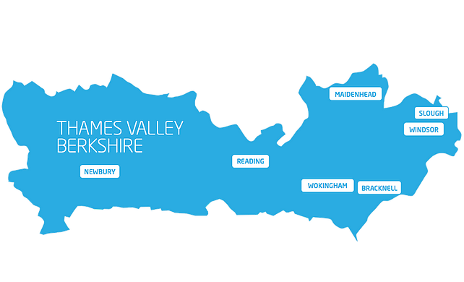
Q2 2023/24
Claimant Count by Unitary Authority
A total of 17,165 claimants (2.8% of the working-age population) in Berkshire.
  1,615 claimants (2.0% of the working-age population) in Bracknell Forest UA
  4,575 claimants (3.8% of the working-age population) in Reading UA
  5,095 claimants (4.9% of the working-age population) in Slough UA
  1,985 claimants (2.0% of the working-age population) in West Berkshire UA
  2,030 claimants (2.1% of the working-age population) in Windsor and Maidenhead UA
  1,865 claimants (1.7% of the working-age population) in Wokingham UA
Varying Dynamics Across Areas: Between August 2022 and 2023, Thames Valley Berkshire saw a slight overall increase in claimant counts and proportions (from 16,445 to 17,165 and 2.7% to 2.8%). Notably, Slough and Reading experienced a significant increase, emphasizing a deepening issue of unemployment or underemployment in these areas.
Notable Anomalies: While most areas recorded increases in both claimant counts and proportions, West Berkshire bucked the trend with a slight decline in claimant counts. Meanwhile, Wokingham, which had the lowest proportion in 2022, saw an increase, potentially signalling emerging employment issues there. Windsor and Maidenhead remained largely stable, suggesting a lesser impact from the broader economic factors affecting its neighbouring localities.
Source: ONS, August 2023

Slide 24
Remote working
In Q3 of 2023, there were 6,203 unique active job postings for remote positions at companies based in Berkshire, around 4.18% higher than the figure of 6,049 for the same period one year before.
Compare this with the South-East, in Q3 2023 there were 35,134 unique active job postings for remote positions; rising from 29,142 in Q3 of the previous year – an increase of 20.56%.
An increase can also be seen at the national level, with a recorded 169,528 unique active remote job postings in England in Q3 of 2023, increasing from 157,411 in Q3 2021 – an increase of about 7.70%.
From these figures, In Q3 2023, remote job postings increased across different regions in England, with varying degrees of growth. Berkshire saw a modest 4.18% rise, while the South-East experienced a huge 20.56% surge. Nationally, remote job postings in England increased by 7.7% compared to Q3 2022. The data highlights a booming remote job market, particularly in the South-East.
Source: EMSI, October 2023

Slide 25
Local Profiles

Slide 26
Bracknell Forest

Slide 27
Unemployment Figures and Notable Business News – Q3 2023
Claimant unemployment to August 2023 (latest)
1,615 claimants (2.0% of the working-age population) in Bracknell Forest UA
Notable business news:
The council's proposed all-age Integrated Carers Strategy for 2024-2029 aims to improve the lives of over 8,700 identified carers in Bracknell Forest through collaborative partnerships in health and the community sector. With 87% of carers currently unidentified by the council, the strategy emphasizes the need to extend support networks and reach carers effectively to help them in their vital roles. One of the key priorities is employment and financial well-being, highlighting the influence of the labour market on carers. Given that many carers often face employment challenges due to their caring responsibilities, the strategy aims to create a more flexible and supportive labour environment. – LINK.

Slide 28
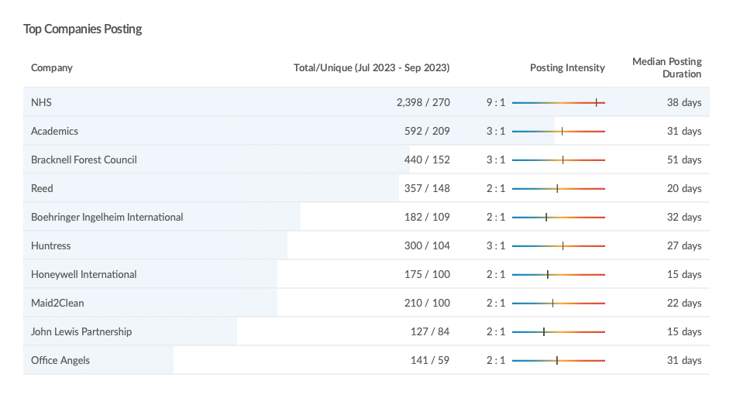
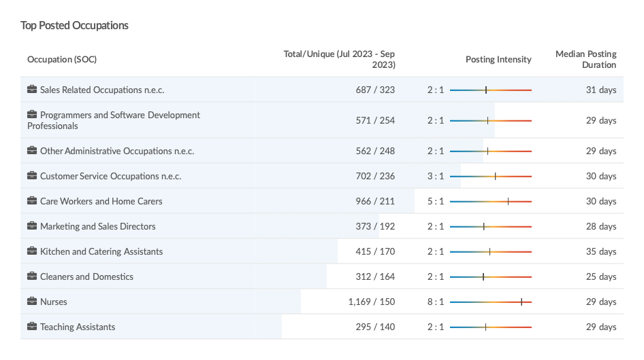
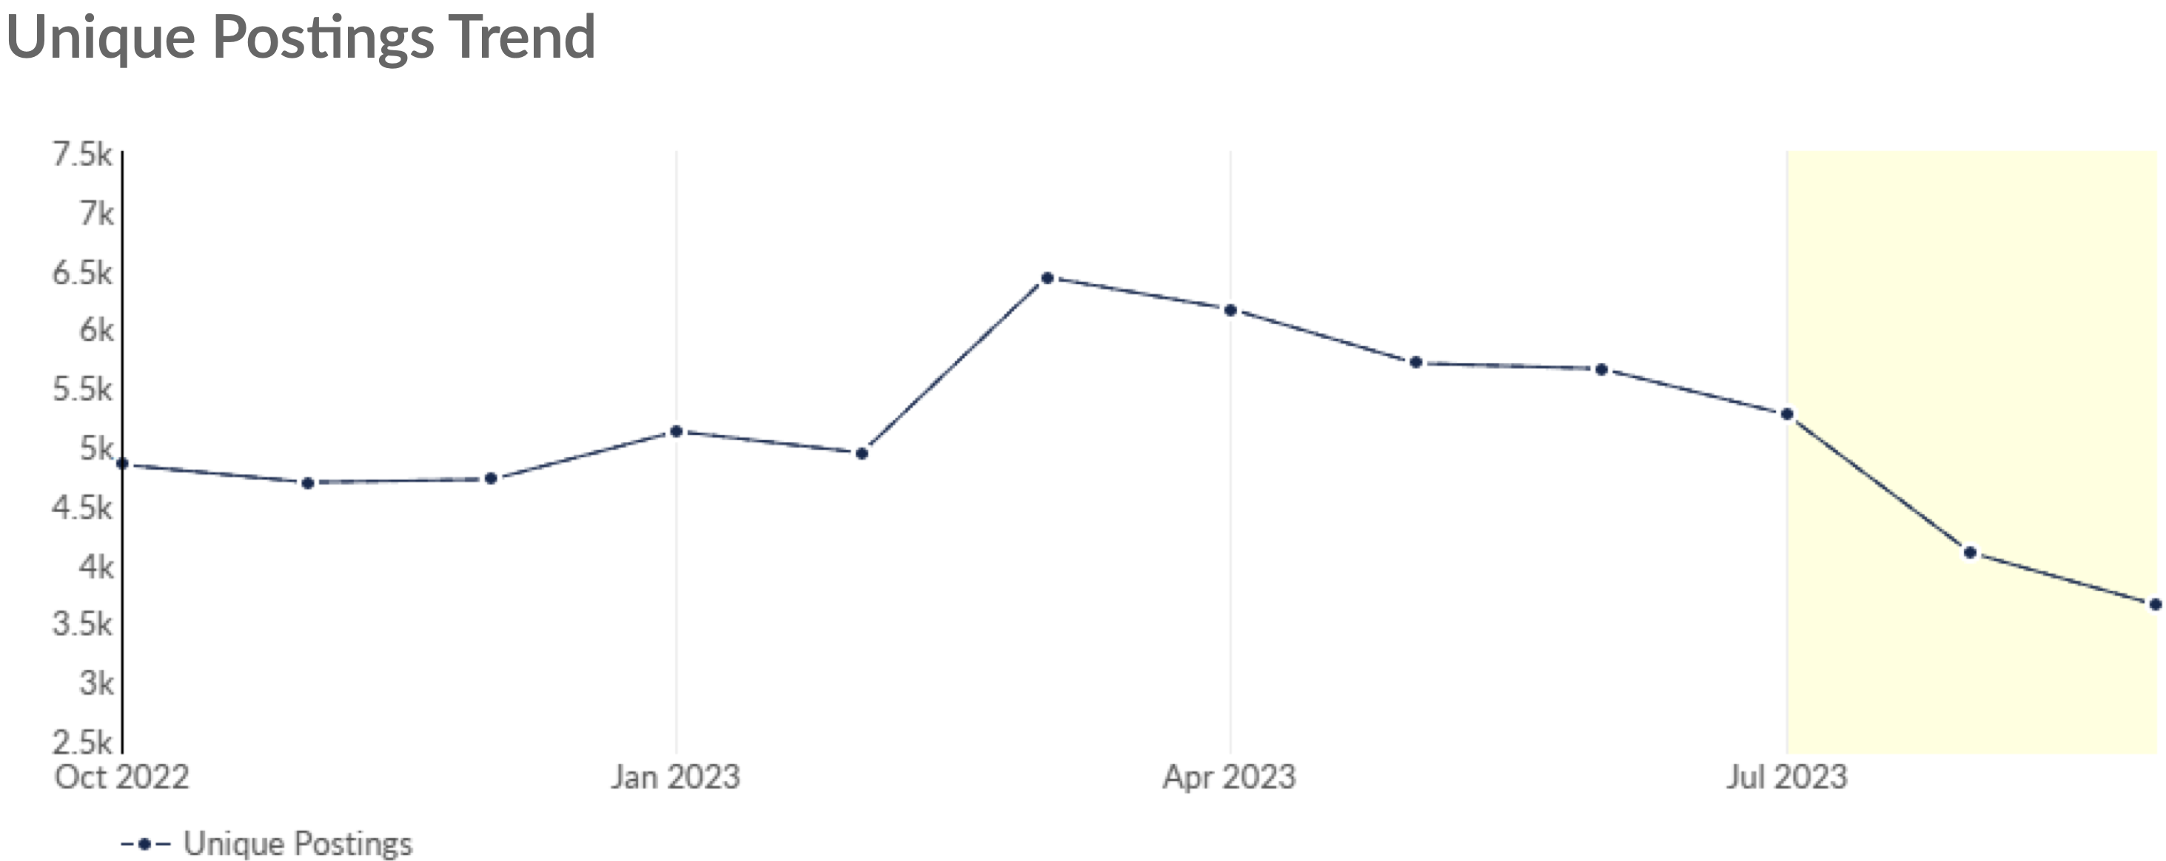
Job Posting Analytics
(Active postings)
Unique job postings: 8,647
Total job postings: 21,763
Job posting intensity: 3:1
Unique job postings (Q3 2022): 9,230
Source: EMSI, October 2023

Slide 29
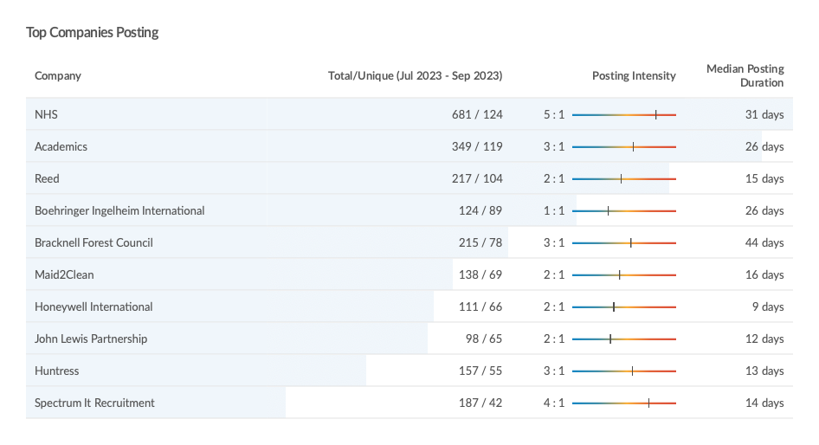
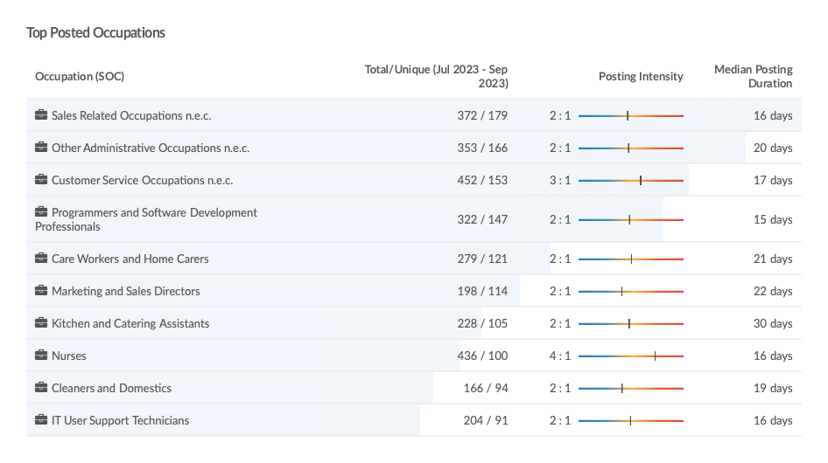
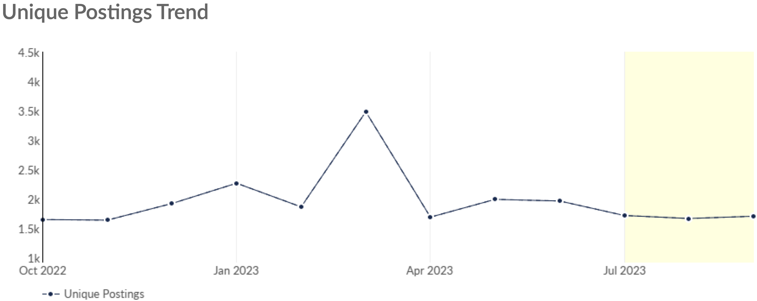
Job Posting Analytics
(Newly posted)
Unique job postings: 5,096
Total job postings: 11,601
Job posting intensity: 2:1
Unique job postings (Q3 2022): 5,235
Source: EMSI, October 2023

Slide 30
Reading

Slide 31
Unemployment figures and notable business news – Q3 2023
Claimant unemployment to August 2023 (latest)
4,575 claimants (3.8 % of the working-age population) in Reading UA
Notable business news:
Reading has emerged as a significant hub for innovative companies, ranking second in the UK, as per a report from the Centre for Cities. The city's strategic clustering of New Economy Firms (NEFs) substantially impacts local employment by providing a wealth of skilled jobs. These NEFs contribute to approximately 1% of the national output and 200,000 jobs. A significant driver of Reading's economic success is its highly skilled workforce, fuelled in part by the University of Reading. The city's diverse innovation sectors range from IT to finance and bio-pharma, offering a variety of employment opportunities for local residents. – LINK.

Slide 32
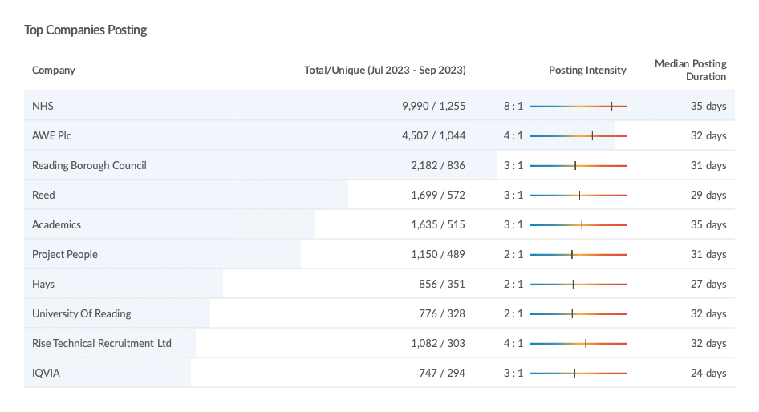
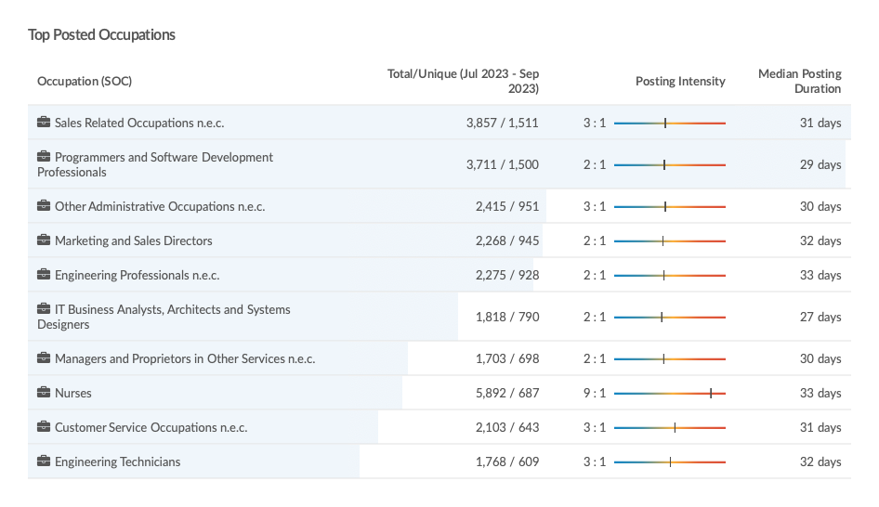
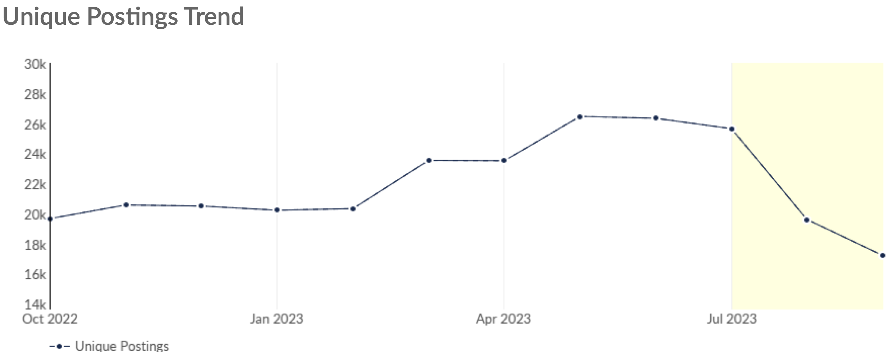
Job Posting Analytics
(Active postings)
Unique job postings: 40,981
Total job postings: 117,467
Job posting intensity: 3:1
Unique job postings (Q3 2022): 31,768
Source: EMSI, October 2023

Slide 33
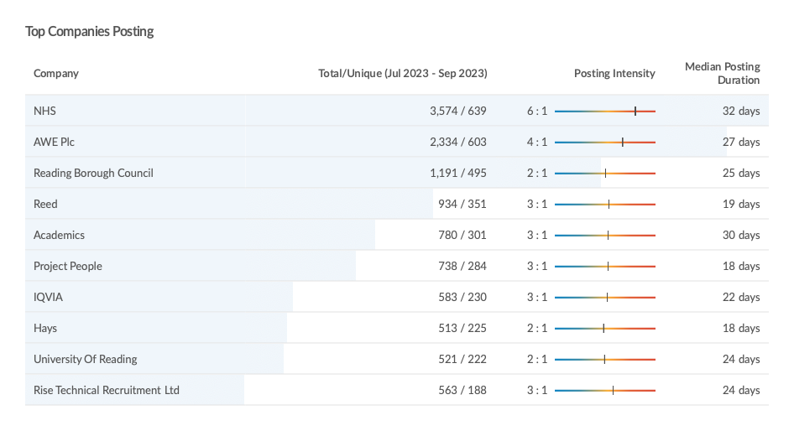
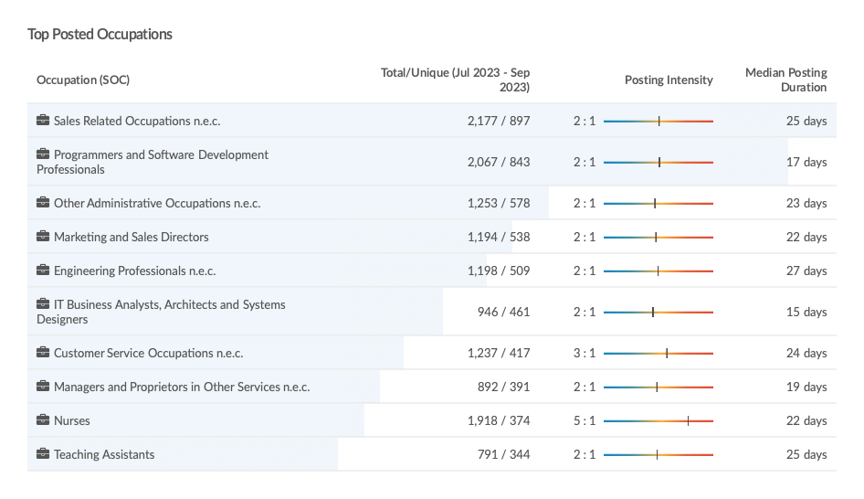
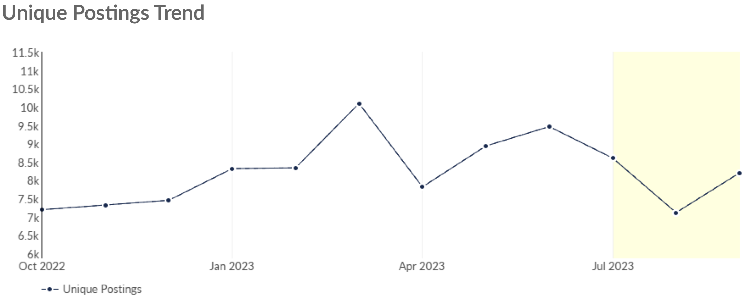
Job Posting Analytics
(Newly posted)
Unique job postings: 23,932
Total job postings: 56,808
Job posting intensity: 2:1
Unique job postings (Q3 2022): 20,134
Source: EMSI, October 2023

Slide 34
Slough

Slide 35
Unemployment figures and notable business news – Q3 2023
Claimant unemployment to August 2023 (latest)
5,095 claimants (4.9 % of the working-age population) in Slough UA
Notable business news:
Slough-based logistics company Best Trading, founded in 2005 by Abdul Waheed, has seen a remarkable 45% boost in profits over the last year, with current revenues reaching £700,000 and a target of £1 million by year-end. Specializing in supplying electromechanical parts for turbines in the industrial and energy sectors, the firm counts major Gulf companies like Saudi Electricity Company and Saudi Aramco among its clients. The surge in profits is attributed to Waheed's completion of the 12-week, 90% government-funded Help to Grow: Management Course from Brunel Business School. The course has enabled Waheed to transition day-to-day operations to his son while focusing on expanding the business. – LINK.

Slide 36
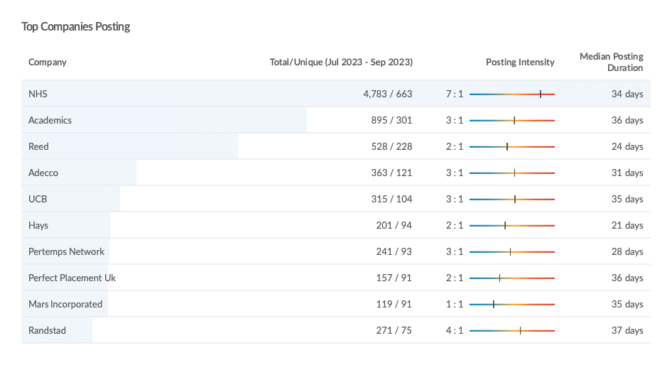
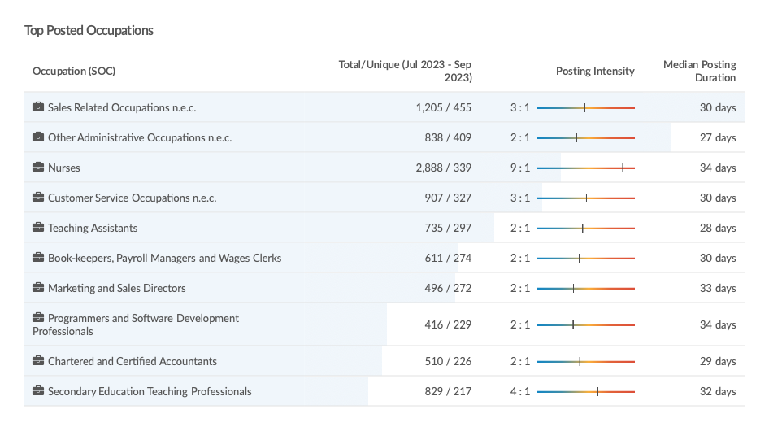
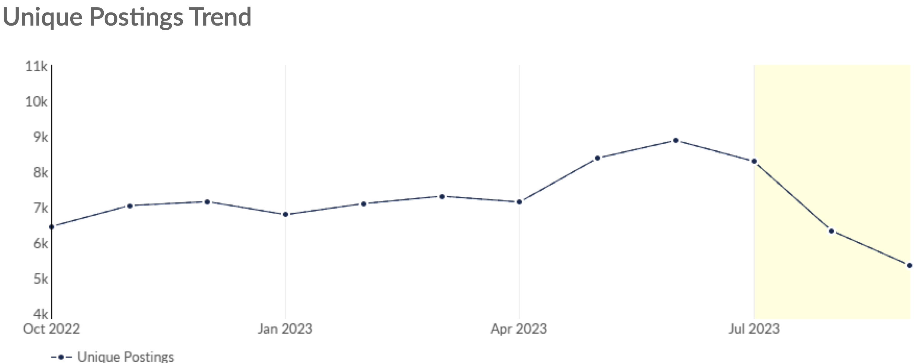
Job Posting Analytics
(Active postings)
Unique job postings: 13,221
Total job postings: 36,273
Job posting intensity: 3:1
Unique job postings (Q3 2022): 10,733
Source: EMSI, October 2023

Slide 37
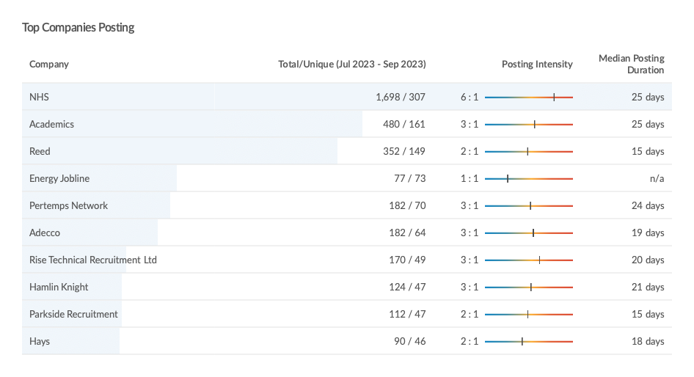
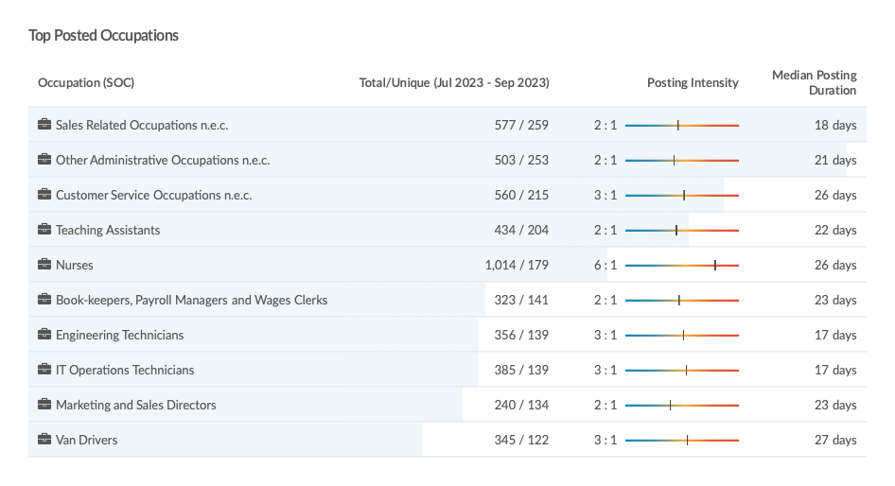
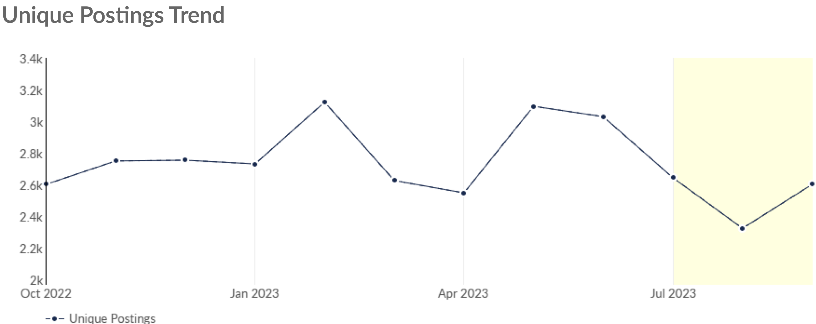
Job Posting Analytics
(Newly posted)
Unique job postings: 7,573
Total job postings: 18,646
Job posting intensity: 2:1
Unique job postings (Q3 2022): 6,888
Source: EMSI, October 2023

Slide 38
West Berkshire

Slide 39
Unemployment figures and notable business news – Q3 2023
Claimant unemployment to August 2023 (latest)
1,985 claimants (2.0 % of the working-age population) in West Berkshire UA
Notable business news:
West Berkshire Council has released a new four-year strategy aimed at economic resilience and growth. Presented to the Council on 5 October, the strategy sets forth a comprehensive agenda that includes delivering new infrastructure and fostering a prosperous West Berkshire. The strategy is based on extensive public consultation and aims to create opportunities for businesses and residents alike. The Council also emphasizes transparent governance, which could be beneficial for local businesses by offering a clearer picture of policy directions and opportunities for public-private partnerships.– LINK.

Slide 40
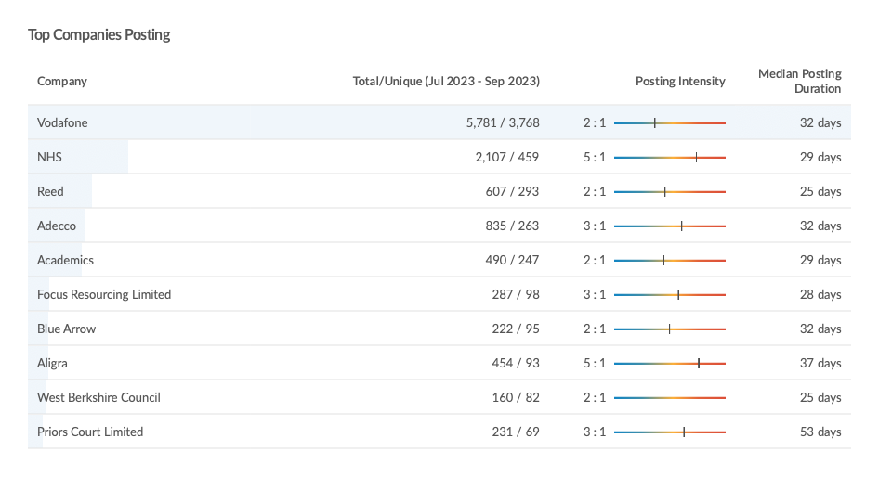
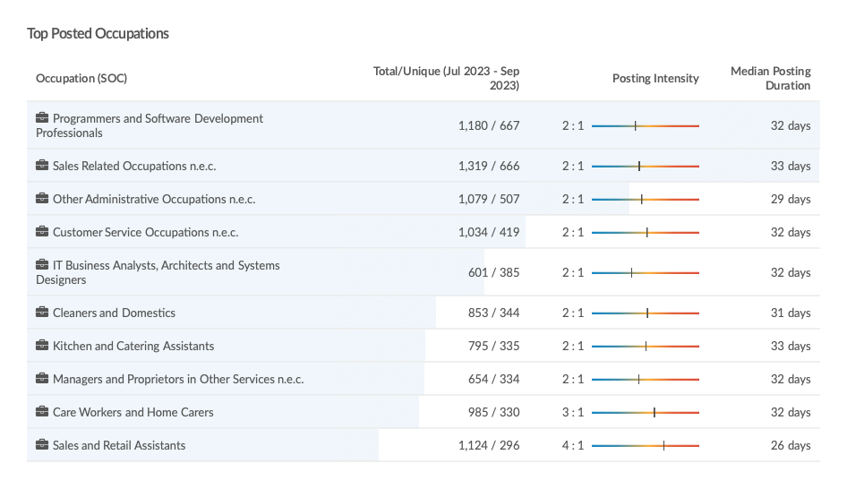
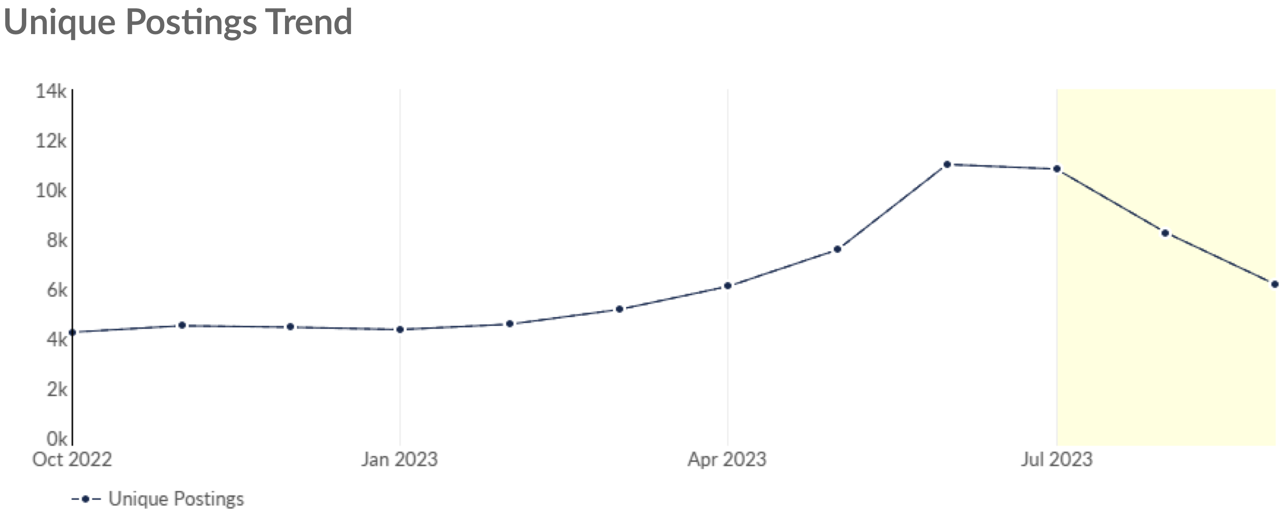
Job Posting Analytics
(Active postings)
Unique job postings: 16,217
Total job postings: 38,031
Job posting intensity: 3:1
Unique job postings (Q3 2022): 7,206
Source: EMSI, October 2023

Slide 41
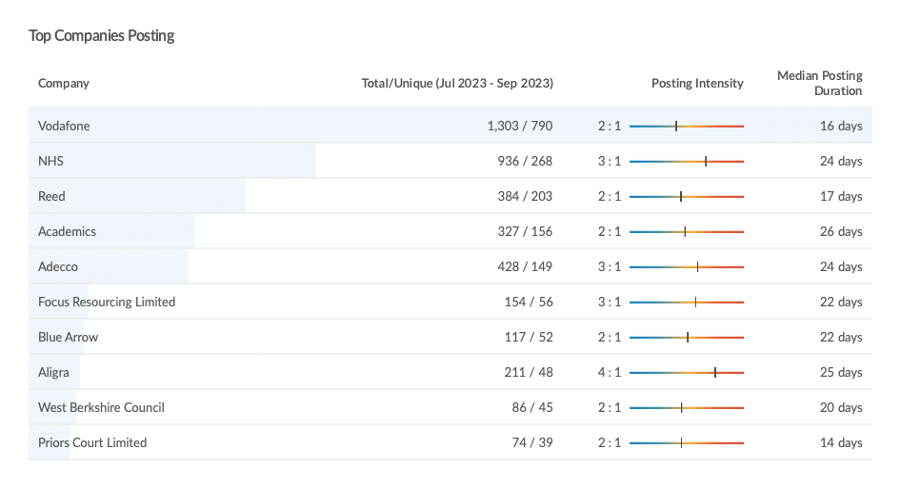
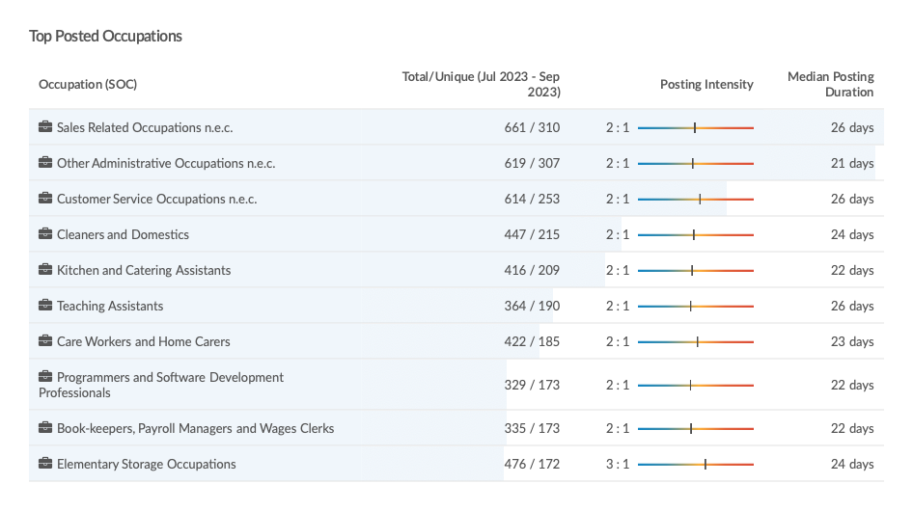
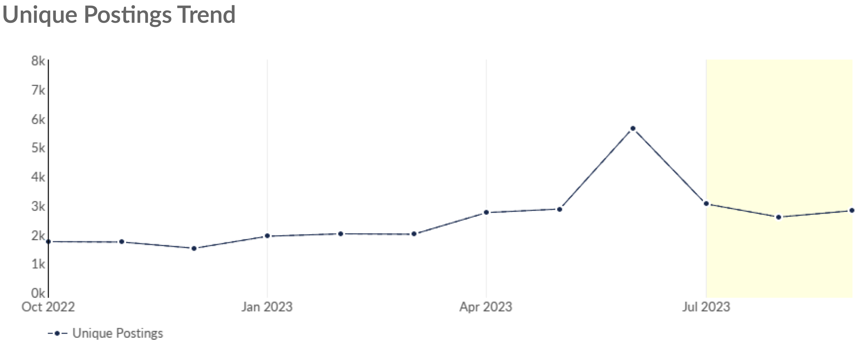
Job Posting Analytics
(Newly posted)
Unique job postings: 8,451
Total job postings: 18,408
Job posting intensity: 2:1
Unique job postings (Q3 2022): 4,611
Source: EMSI, October 2023

Slide 42
Windsor and Maidenhead

Slide 43
Unemployment figures and notable business news – Q3 2023
Claimant unemployment to August 2023 (latest)
2,030 claimants (2.1 % of the working-age population) in Windsor and Maidenhead UA
Notable business news:
The Royal Borough of Windsor & Maidenhead has initiated a £4 million affordable housing project in Maidenhead, set to be completed by autumn 2024. The scheme, overseen by the council’s Property Company, will deliver 14 one- and two-bedroom flats. Construction contractor Helix is collaborating with the Property Company for the first time on this endeavour. The project not only addresses the local housing challenge but is also viewed as a strategic investment, generating future income streams for the council. This marks the first such scheme through the council's Property Company, which is considering similar projects on other council-owned sites. – LINK.

Slide 44
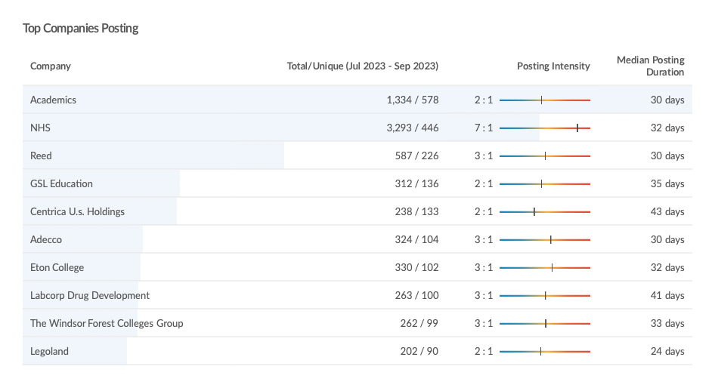
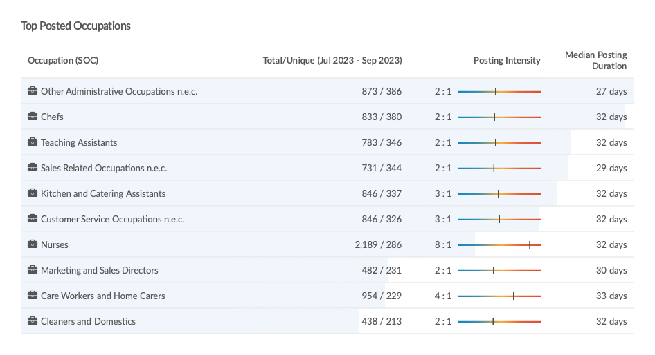
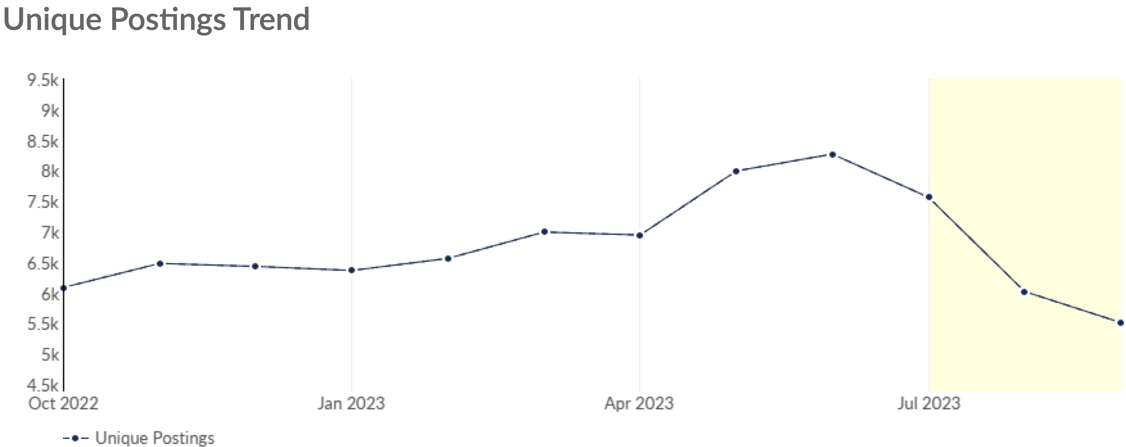
Job Posting Analytics
(Active postings)
Unique job postings: 12,473
Total job postings: 32,055
Job posting intensity: 3:1
Unique job postings (Q3 2022): 10,134
Source: EMSI, October 2023

Slide 45
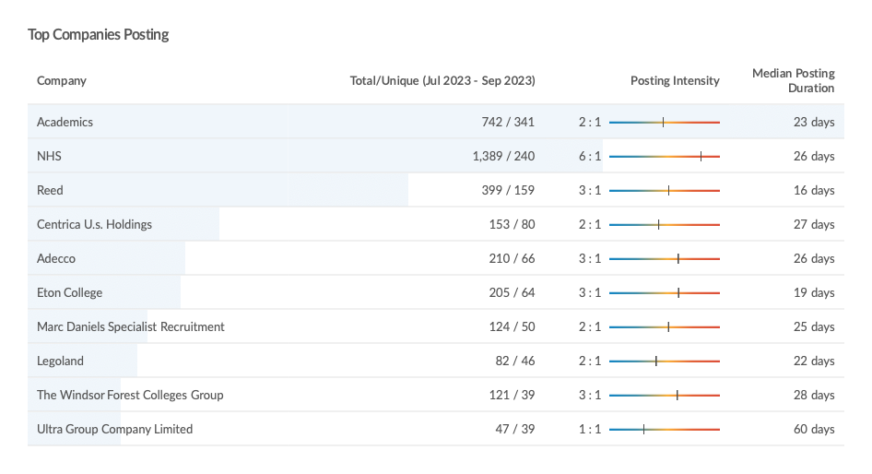
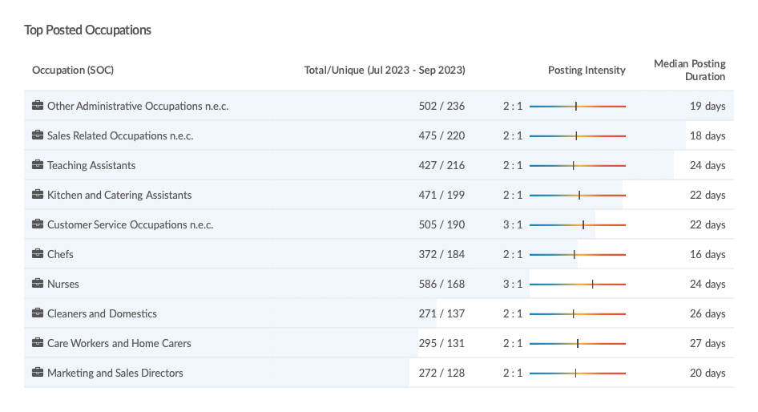
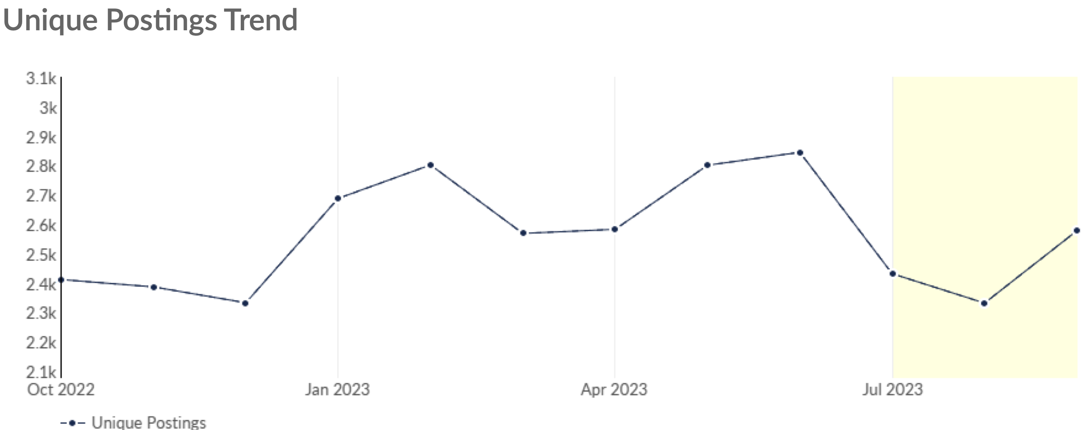
Job Posting Analytics
(Newly posted)
Unique job postings: 7,342
Total job postings: 16,435
Job posting intensity: 2:1
Unique job postings (Q3 2022): 6,488
Source: EMSI, October 2023

Slide 46
Wokingham

Slide 47
Unemployment figures and notable business news – Q3 2023
Claimant unemployment to August 2023 (latest)
1,865 claimants (1.7 % of the working-age population) in Wokingham UA
Notable business news:
Wokingham ranks 19th in England for the percentage of homes sold in the last five years, according to research from House Buyer Bureau. Out of the borough's total housing stock of 73,004, there were 13,944 recorded house sales, constituting 19.1% of the housing market. In contrast, London saw the lowest turnover, with only 11.6% of its total housing stock changing hands during the same period. The report highlights that despite wider market uncertainties and increased borrowing costs, Wokingham remains a relatively active market. The average price for properties sold in Wokingham over the past 12 months was £552,247. – LINK.

Slide 48
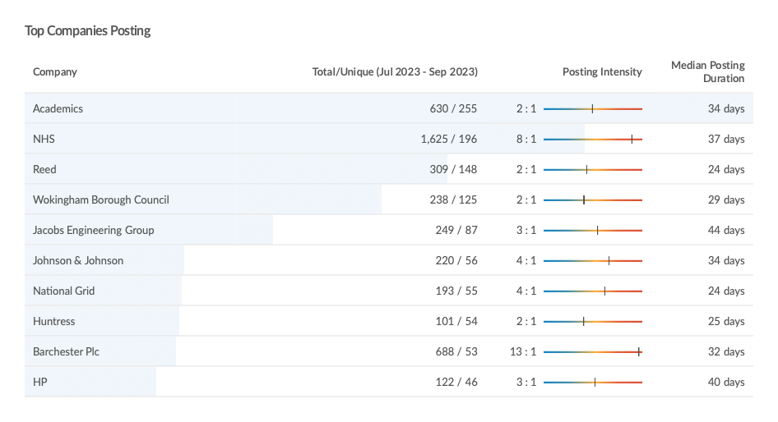
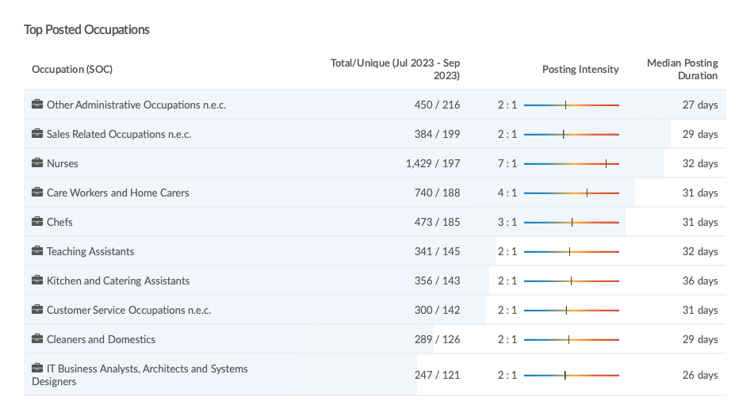
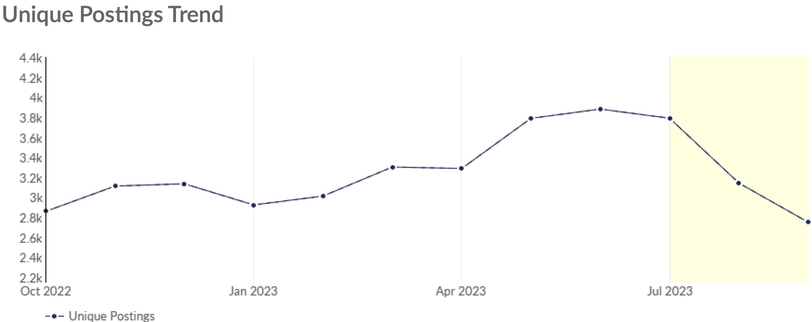
Job Posting Analytics
(Active postings)
Unique job postings: 6,335
Total job postings: 15,824
Job posting intensity: 2:1
Unique job postings (Q3 2022): 5,109
Source: EMSI, October 2023

Slide 49
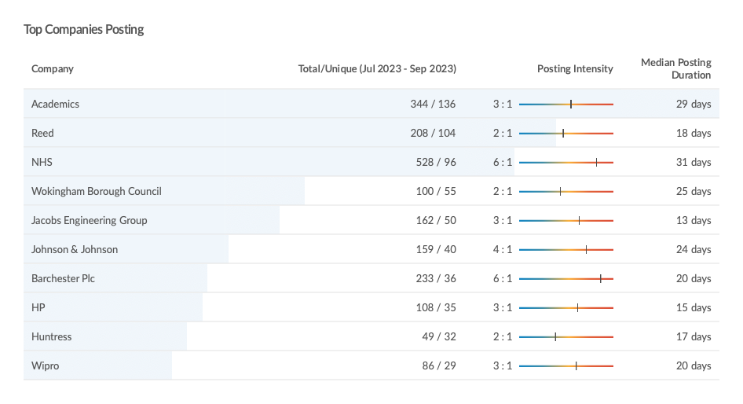
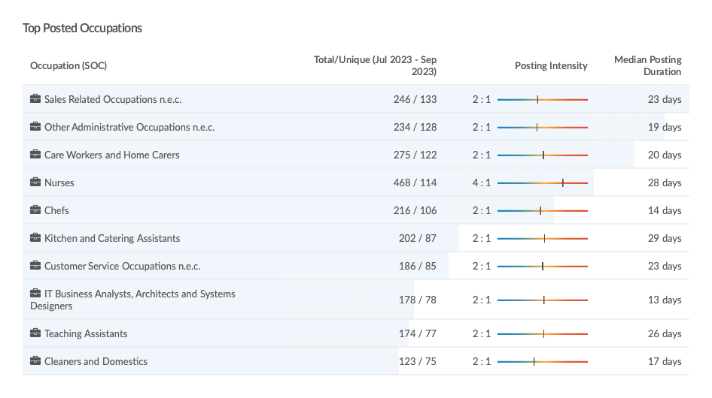
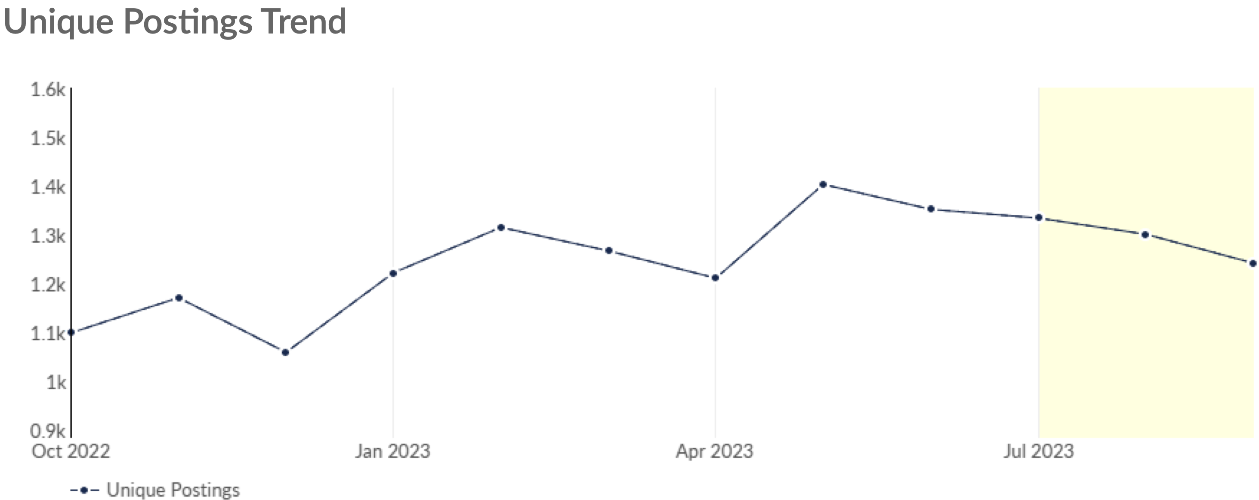
Job Posting Analytics
(Newly posted)
Unique job postings: 3,877
Total job postings: 8,465
Job posting intensity: 2:1
Unique job postings (Q3 2022): 3,079
Source: EMSI, October 2023

