Slide 1
Berkshire Monthly Economic Briefing
December 2022

Slide 2
2022 Refresh
Following on from stakeholder feedback as well as discussions within the LEP over the course of the last year, we have decided to make some additions to the content of our economic briefings, whilst still continuing to report on the bulk of the areas we were last year.
Each month, we aim to have a themed feature. This month, we will be discussing two reports produced by the ONS on demographic and industrial changes between the 2011 and 2021 censuses.
These monthly economic briefings are constantly evolving documents and their content is dictated in part by data/information requests from our readers.
If there is an economic aspect not currently covered within these reports which you think would be beneficial to include/ expand upon (or you have any queries), we will do our best to help. Please contact Dex or Aishwarya in the LEP’s research team at dexterlevick@thamesvalleyberkshire.co.uk or aishwaryachakravarty@thamesvalleyberkshire.co.uk.

Slide 3
Key contents of this month’s briefing
Updated global and UK economic forecasts
Monthly Spotlight – demographic and industrial changes between the 2011 and 2021 censuses
Key points from the latest Labour Force Survey data
Latest claimant count figures by Local Authority
Latest remote working figures for Berkshire
Latest ‘notable business news’ by Local Authority
Latest job posting analytics by Local Authority

Slide 4
Global and National Economy
December 2022

Slide 5
December 2022
Global Economics Intelligence executive summary, November 2022
Many global economic indicators for October and November pointed to slower growth or contraction, as central banks continue to raise policy interest rates in the battle against inflation.
Recent signs suggest, however, that absent unforeseen shocks, inflation may have peaked. Wholesale energy and food prices—the major inflation drivers—have come down sharply from earlier spikes.
Natural gas prices in Europe are still twice the pre-war level but have fallen below €150 per megawatt hour from an August peak of €340.
The FAO Food Price Index has eased to 135.7 in November. The peak reading was 159.7 in March, immediately following Russia’s invasion of Ukraine. Food prices are still high, however, and the current reading is still one-third higher than pre-war or pre-pandemic levels.
Forecasting institutions are trimming growth projections, citing a number of challenges, including cuts to government spending, higher interest rates, inflation, Russia’s invasion of Ukraine, and ongoing disruptions related to the COVID-19 pandemic.
Source: McKinsey, December 2022

Slide 6
December 2022
World Economic Situation and Prospects
Energy crisis poses threat to Europe’s industrial sector
Governments, households, and firms across Europe are grappling with the energy and cost-of-living crisis. The recent decline in natural gas prices has, however, fuelled hopes that massive gas shortages, rationing, and industrial shutdowns can be avoided.
Europe’s energy-intensive industries have been hit particularly hard by soaring energy costs. These industries play an important role for the region’s economy, especially given linkages with other sectors.
Persistently high energy prices could create lasting damage for Europe’s industry, eroding competitiveness, causing losses in market share, and prompting companies to relocate to countries with lower energy costs.
Policy responses have so far mainly focused on the short-term management of the energy crisis. Going forward, policies will have to increasingly address longer-term challenges to the region’s industrial competitiveness.
Source: UN, December 2022

Slide 7
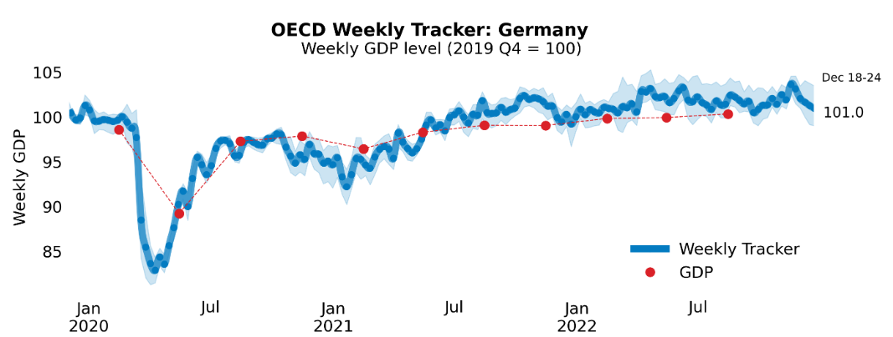
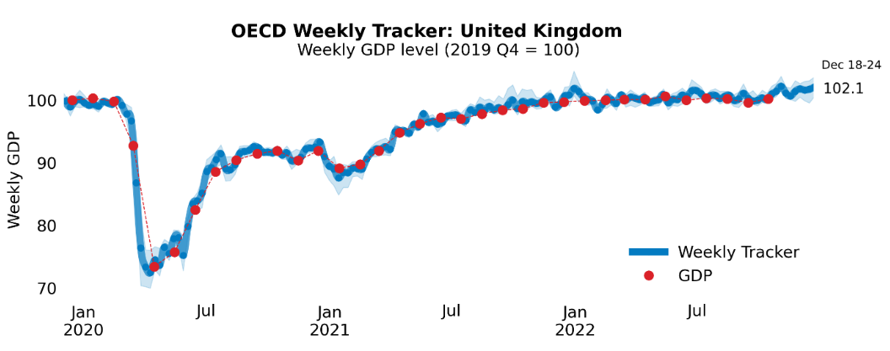
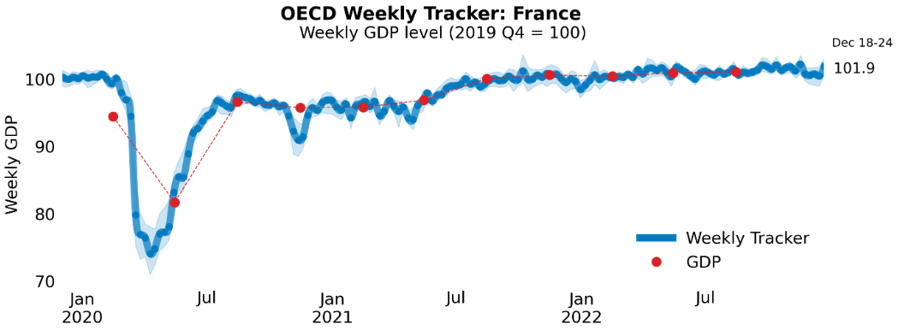
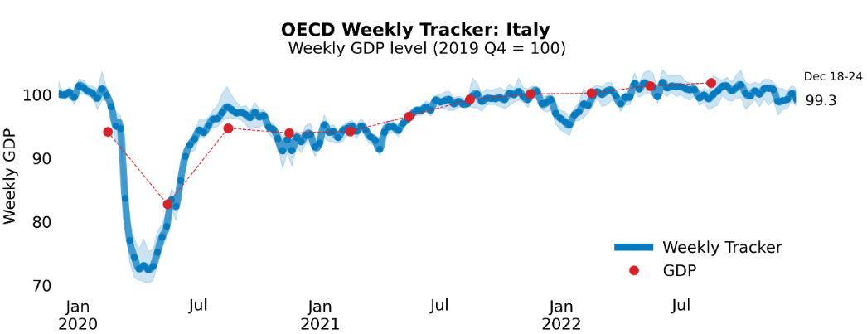
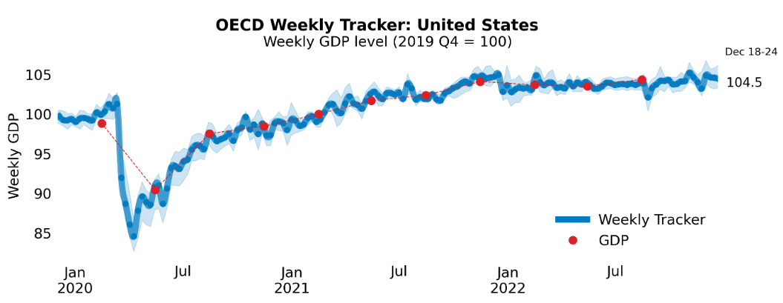
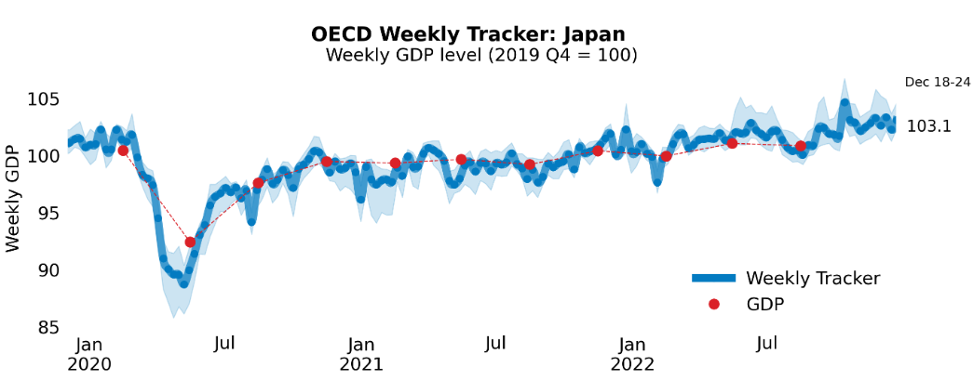
Global Economy
OECD GDP Tracker
The Weekly Tracker is an estimate of weekly GDP relative to the pre-crisis trend, which is proxied by the OECD Economic Outlook forecasts.
Source: OECD, December 2022

Slide 8
December 2022
Bank of England Financial Stability Report
Since the July Financial Stability Report, the outlook for growth and unemployment in the UK and globally has deteriorated further. Prices have continued to rise rapidly, in considerable part reflecting steep increases in energy and food prices.
In response, central banks around the world, including the Bank of England, have been increasing interest rates. These rate rises, and the expectation that they will rise further, have caused the cost of borrowing to rise for households and businesses.
UK businesses have seen their earnings rise and debt fall as the effects of the Covid pandemic have receded. But higher costs, lower demand, rising interest rates, and continued disruption to supply chains are putting pressures on earnings for some businesses. Those most affected may find it harder to repay debts.
UK banks are strong enough to support creditworthy households and businesses through the current downturn due to large financial buffers they have built up since the 2008 global financial crisis.
Source: Bank of England, December 2022
Notes:
data

Slide 9
December 2022
Business insights and impact on the UK economy
In early December 2022, 29% of trading businesses reported that they expect their turnover to decrease in January 2023, while 10% expect their turnover to increase; the accommodation and food service activities industry had the largest percentage of businesses expecting turnover to decrease, at 66%.
Of trading businesses, 42% reported an increase in the price of goods or services bought in November 2022 compared with October 2022, while 19% reported an increase in the price of goods or services sold over the same period.
In early December 2022, 30% of trading businesses reported they expect to increase the prices of goods or services sold in January 2023; 39% of those businesses reported energy prices as the main reason for considering doing so.
In early December 2022, 39% businesses had some level of concern about the impact climate change may have on the business; the manufacturing industry had the highest proportion of businesses indicating concern, at 52%.
Source: ONS, December 2022
Notes:
data

Slide 10
Employment in the UK
Labour Force Survey – December 2022
Key points:
August to October 2022 estimates show an increase in the employment and unemployment rates compared with the previous three-month period (May to July 2022), and a decrease in the economic inactivity rate.
Total hours worked decreased compared with the previous three-month period and are still below pre-coronavirus (COVID-19) pandemic levels.
The UK employment rate was estimated at 75.6%, 0.2 percentage points higher than the previous three-month period and 1.0 percentage points lower than before the pandemic (December 2019 to February 2020).
The UK unemployment rate was estimated at 3.7%, 0.1 percentage points higher than the previous three-month period and 0.3 percentage points below pre-pandemic levels.
The UK economic inactivity rate was estimated at 21.5%, 0.2 percentage points lower than the previous three-month period and 1.3 percentage points higher than before the pandemic.
Source: ONS, December 2022

Slide 11
Job quality in the UK
Analysis of job quality indicators: 2021
Satisfactory hours: Employees who work ‘satisfactory hours’ usually work fewer than 48 hours a week, do not wish to work more hours in their current role and are not looking for an additional or replacement job that offers more hours.
Satisfactory hours (as a % of employed population) were lowest in Slough (76.52%) and highest in West Berkshire (80.99%) in 2021.
Satisfactory hours (as a % of employed population) decreased from 2020 to 2021 in all local authorities except Bracknell Forest and Wokingham.
Low pay employment (local): Employees in low pay are earning less than two-thirds of the median pay of their subnational authority of residence (subnational authority refers to the combination of unitary authority and county geographies).
Low pay employment (local) was lowest in Slough (13.53%) and highest in Reading (21.99%) in 2021.
Between 2015 and 2021, the proportion of employed population in low pay employment (local) decreased across all local authorities except Reading.
Source: ONS, December 2022

Slide 12
Job quality in the UK
Analysis of job quality indicators: 2021
Desired contract: Employees with a desired contract are those that report either a permanent contract or a non-permanent contract for a reason other than “Could not find a permanent job”. In simpler words, they are either working under a permanent contract or willingly working under a non-permanent contract.
West Berkshire (100%) and Slough (98.3%) had the highest and lowest percentage of employed population having desired contracts respectively.
Reading, West Berkshire and Wokingham have shown an increase in the percentage of employed population having desired contracts between 2015 and 2021.
Paid overtime: Employees on paid overtime report working paid overtime hours only and do not report working any unpaid overtime.
Slough (11.2%) and Wokingham (7.4%) had the highest and lowest percentage of employed population reporting paid overtime respectively.
West Berkshire (14.1%) reported the highest percentage of women with paid overtime and Slough (14.0%) reported the highest percentage of men with paid overtime.
Source: ONS, December 2022

Slide 13
Job quality in the UK
Analysis of job quality indicators: 2021
Career progression: Employee has good career progression opportunities if they “agree” or “strongly agree” with the statement “My job offers good opportunities for career progression” when asked as part of the Annual Population Survey (APS).
Slough (57.9%) and Windsor and Maidenhead (42.7%) had the maximum and minimum percentage of employed population reporting good career progression opportunities respectively.
West Berkshire (55.0%) reported the maximum percentage of employed women with good career progression opportunities. Slough (61.0%) reported the maximum percentage of men with good career progression opportunities.
Zero-hour contract: Employee reports ‘zero-hour contract’ working arrangement in which the employer does not guarantee the individual any hours of work.
Reading (3.7%) and Slough (3.6%) have the highest percentage of employed population reporting zero-hour work contracts, more than twice the percentage of employed population reporting zero-hour work contracts in West Berkshire (1.7%).
Source: ONS, December 2022

Slide 14
December 2022
Monthly Spotlight: How Berkshire has changed at a local level between the 2011 and 2021 censuses
Indicator | Bracknell Forest | South East/ England
Population | 10.1% increase, from just over 113,200 in 2011 to around 124,600 in 2021 | South East: 7.5% increase England: 6.6% increase
Age | Median age of 39 years in 2021 (up from 37 years in 2011) The number of people aged 50 to 64 years rose by 21.2% and the number of residents aged 4 years and under fell by 11.3%. | South East: Median age of 41 years in 2021 England: Median age of 40 years in 2021
Economic activity | Bracknell Forest residents (aged 16+) who were economically active and employed (excluding full-time students) decreased from 67.2% in 2011 to 65.2% in 2021. | South East: decreased from 59.0% to 57.6% England: decreased from 56.5% to 55.7%
Economic inactivity | In 2021, 3.8% of Bracknell Forest residents (aged 16+) said they were economically inactive because they were looking after their family or home (marginally down from 3.9% in 2011). | South East: increased from 4.0% to 4.4% England: decreased from 4.0% to 4.8%
Working hours | Bracknell Forest saw the South East's largest percentage-point fall in the share of people aged 16 years and over and in employment who said they usually worked over 49 hours per week (from 15.8% in 2011 to 11.7% in 2021). | South East: decreased from 14.6% to 11.9% England: decreased from 13.3% to 11.1%
Ethnic group | In 2021, 7.1% of Bracknell Forest residents identified their ethnic group within the "Asian, Asian British or Asian Welsh" category, up from 5.0% in 2011. | South East: increased from 5.2% to 7.0%. England: increased from 7.8% to 9.6%.
Source: ONS, December 2022

Slide 15
December 2022
Monthly Spotlight: How Berkshire has changed at a local level between the 2011 and 2021 censuses
Indicator | Slough | South East/ England
Population | 13.0% increase, from around 140,200 in 2011 to around 158,500 in 2021. | South East: 7.5% increase England: 6.6% increase
Age | Median age is 34 years in 2021 (up from 32 years in 2011) The number of people aged 50 to 64 years rose from 13.7% to 15.3% and the number of residents aged 4 years and under fell from 9.1% to 7.4%. | South East: Median age of 41 years in 2021 England: Median age of 40 years in 2021
Economic activity | Of Slough residents aged 16 years and over, 60.1% said they were employed (excluding full-time students) in 2021, a roughly similar percentage as in 2011 (60.6%). | South East: decreased from 59.0% to 57.6% England: decreased from 56.5% to 55.7%
Economic inactivity | Slough saw the South East's largest percentage-point rise in the share of people who were economically inactive because they were looking after their family or home (from 6.2% in 2011 to 7.9% in 2021). | South East: increased from 4.0% to 4.4% England: decreased from 4.0% to 4.8%
Working hours | In 2021, 8.6% of Slough residents aged 16 years and over and in employment said they worked over 49 hours per week. This figure decreased from 10.8% in 2011. | South East: decreased from 14.6% to 11.9% England: decreased from 13.3% to 11.1%
Ethnic group | In 2021, 46.7% of Slough residents identified their ethnic group within the "Asian, Asian British or Asian Welsh" category, up from 39.7% in 2011. | South East: increased from 5.2% to 7.0%. England: increased from 7.8% to 9.6%.
Source: ONS, December 2022

Slide 16
December 2022
Monthly Spotlight: How Berkshire has changed at a local level between the 2011 and 2021 censuses
Indicator | Reading | South East/ England
Population | 11.9% increase, from just under 155,700 in 2011 to around 174,200 in 2021 | South East: 7.5% increase England: 6.6% increase
Age | Median age is 35 years in 2021 (up from 33 years in 2011) The number of people aged 50 to 64 years rose by 28.7% and the number of residents aged 4 years and under fell by 14.2%. | South East: Median age of 41 years in 2021 England: Median age of 40 years in 2021
Economic activity | Of Reading residents aged 16 years and over, 60.4% said they were employed (excluding full-time students) in 2021, a similar percentage as in 2011 (60.1%). | South East: decreased from 59.0% to 57.6% England: decreased from 56.5% to 55.7%
Economic inactivity | In 2021, 4.9% of Reading residents (aged 16+) said they were economically inactive because they were looking after their family or home (up from 4.3% in 2011). | South East: increased from 4.0% to 4.4% England: decreased from 4.0% to 4.8%
Working hours | In 2021, 9.3% of Reading residents aged 16 years and over and in employment said they worked over 49 hours per week. This figure decreased from 11.7% in 2011. | South East: decreased from 14.6% to 11.9% England: decreased from 13.3% to 11.1%
Ethnic group | In 2021, 17.7% of Reading residents identified their ethnic group within the "Asian, Asian British or Asian Welsh" category, up from 13.6% in 2011. | South East: increased from 5.2% to 7.0%. England: increased from 7.8% to 9.6%.
Source: ONS, December 2022

Slide 17
December 2022
Monthly Spotlight: How Berkshire has changed at a local level between the 2011 and 2021 censuses
Indicator | Wokingham | South East/ England
Population | 15.0% increase, from around 154,400 in 2011 to around 177,500 in 2021. | South East: 7.5% increase England: 6.6% increase
Age | Median age is 41 years in 2021 (up from 40 years in 2011) The number of people aged 50 to 64 years rose by 15.3%, while the number of residents aged 4 years and under fell by 1.8%. | South East: Median age of 41 years in 2021 England: Median age of 40 years in 2021
Economic activity | Of Wokingham residents aged 16 years and over, 62.2% said they were employed (excluding full-time students) in 2021, down from 64.2% in 2011. | South East: decreased from 59.0% to 57.6% England: decreased from 56.5% to 55.7%
Economic inactivity | The share of people who were economically inactive because they were looking after their family or home rose from 3.9% in 2011 to 4.1% in 2021. | South East: increased from 4.0% to 4.4% England: decreased from 4.0% to 4.8%
Working hours | Wokingham saw the South East's joint third-largest percentage-point fall (alongside West Berkshire) in the share of people aged 16 years and over and in employment who said they usually worked over 49 hours per week (from 15.6% in 2011 to 11.9% in 2021). | South East: decreased from 14.6% to 11.9% England: decreased from 13.3% to 11.1%
Ethnic group | In 2021, 12.9% of Wokingham residents identified their ethnic group within the "Asian, Asian British or Asian Welsh" category, up from 7.4% in 2011. | South East: increased from 5.2% to 7.0%. England: increased from 7.8% to 9.6%.
Source: ONS, December 2022

Slide 18
December 2022
Monthly Spotlight: How Berkshire has changed at a local level between the 2011 and 2021 censuses
Indicator | Windsor and Maidenhead | South East/ England
Population | 6.2% increase, from around 144,600 in 2011 to around 153,500 in 2021. | South East: 7.5% increase England: 6.6% increase
Age | Median age is 42 years in 2021 (up from 40 years in 2011) The number of people aged 50 to 64 years rose by 19.4%, while the number of residents aged 4 years and under fell by 14.4%. | South East: Median age of 41 years in 2021 England: Median age of 40 years in 2021
Economic activity | Of Windsor and Maidenhead residents aged 16 years and over, 60.6% said they were employed (excluding full-time students) in 2021, down from 62.6% in 2011. | South East: decreased from 59.0% to 57.6% England: decreased from 56.5% to 55.7%
Economic inactivity | The share of people who were economically inactive because they were looking after their family or home rose from 4.4% in 2011 to 4.8% in 2021. | South East: increased from 4.0% to 4.4% England: decreased from 4.0% to 4.8%
Working hours | The share of people aged 16 years and over and in employment who said they usually worked over 49 hours per week fell from 18.6% in 2011 to 15.1% in 2021. | South East: decreased from 14.6% to 11.9% England: decreased from 13.3% to 11.1%
Ethnic group | In 2021, 13.1% of Windsor and Maidenhead residents identified their ethnic group within the "Asian, Asian British or Asian Welsh" category, up from 9.6% in 2011. | South East: increased from 5.2% to 7.0%. England: increased from 7.8% to 9.6%.
Source: ONS, December 2022

Slide 19
December 2022
Monthly Spotlight: How Berkshire has changed at a local level between the 2011 and 2021 censuses
Indicator | West Berkshire | South East/ England
Population | 5.0% increase, from around 153,800 in 2011 to around 161,400 in 2021. | South East: 7.5% increase England: 6.6% increase
Age | Median age is 43 years in 2021 (up from 40 years in 2011) The number of people aged 50 to 64 years rose from 19.6% to 21.3% and the number of residents aged 4 years and under fell from 6.5% to 5.1%. | South East: Median age of 41 years in 2021 England: Median age of 40 years in 2021
Economic activity | West Berkshire saw the South East's second-largest percentage-point fall in the share of people aged 16 years and over (excluding full-time students) who were employed (from 65.0% in 2011 to 61.7% in 2021). | South East: decreased from 59.0% to 57.6% England: decreased from 56.5% to 55.7%
Economic inactivity | The share of people who were economically inactive because they were looking after their family or home rose marginally from 3.9% in 2011 to 4.0% in 2021. | South East: increased from 4.0% to 4.4% England: decreased from 4.0% to 4.8%
Working hours | West Berkshire saw the South East's joint third-largest percentage-point fall (alongside Wokingham) in the share of people aged 16 years and over and in employment who said they usually worked over 49 hours per week (from 16.1% in 2011 to 12.4% in 2021). | South East: decreased from 14.6% to 11.9% England: decreased from 13.3% to 11.1%
Ethnic group | In 2021, 3.7% of West Berkshire residents identified their ethnic group within the "Asian, Asian British or Asian Welsh" category, up from 2.5% in 2011. | South East: increased from 5.2% to 7.0%. England: increased from 7.8% to 9.6%.
Source: ONS, December 2022

Slide 20
December 2022
Monthly Spotlight: How industries have changed at a local level between the 2011 and 2021 censuses
Cultural changes have reshaped our industries in the ten years since the 2011 census, with the rise of digital jobs such as programming, shopping online and other social shifts.
An additional 274,000 people said they worked in the programming and computer consultancy industry in 2021 compared with 2011.
The proportion of residents employed in accounting and legal services fell in London but rose slightly in other areas of England, including in the South East.
Transport and storage businesses have increased rapidly in the West and East Midlands, partly because of an increase in people shopping online. However, employment in warehousing businesses declined in the South East.
Telecommunication has seen some shifts toward northern cities and away from areas in the South of England.
Film, TV and music production employed 116,000 people in the 2021 census, an increase of 13% compared to the 2011 census. The South East saw one of the largest gains in employment in this industry between 2011 and 2021.
Source: ONS, December 2022

Slide 21
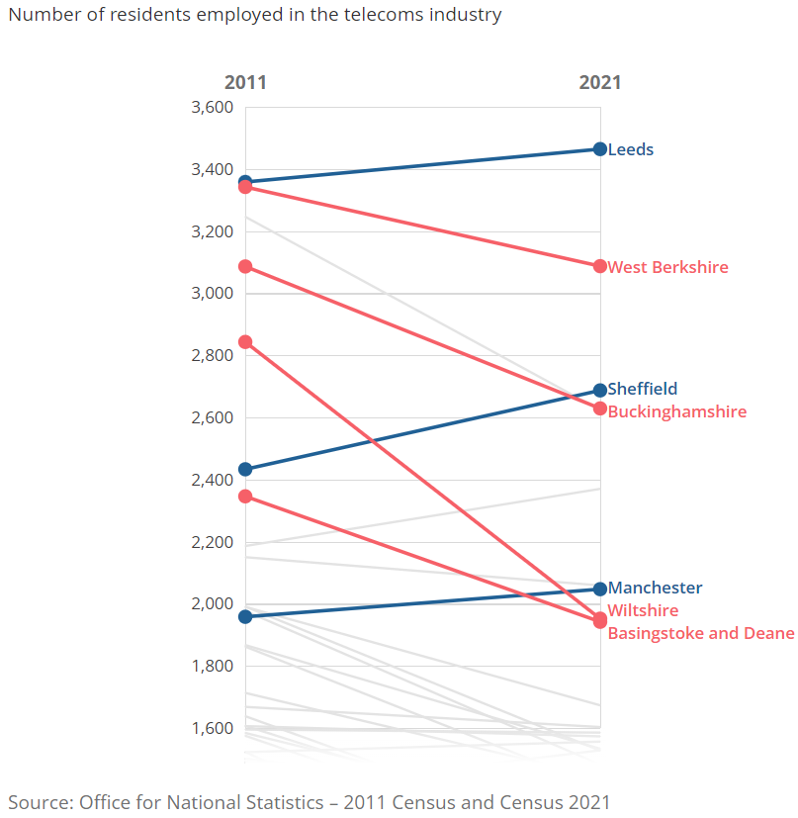
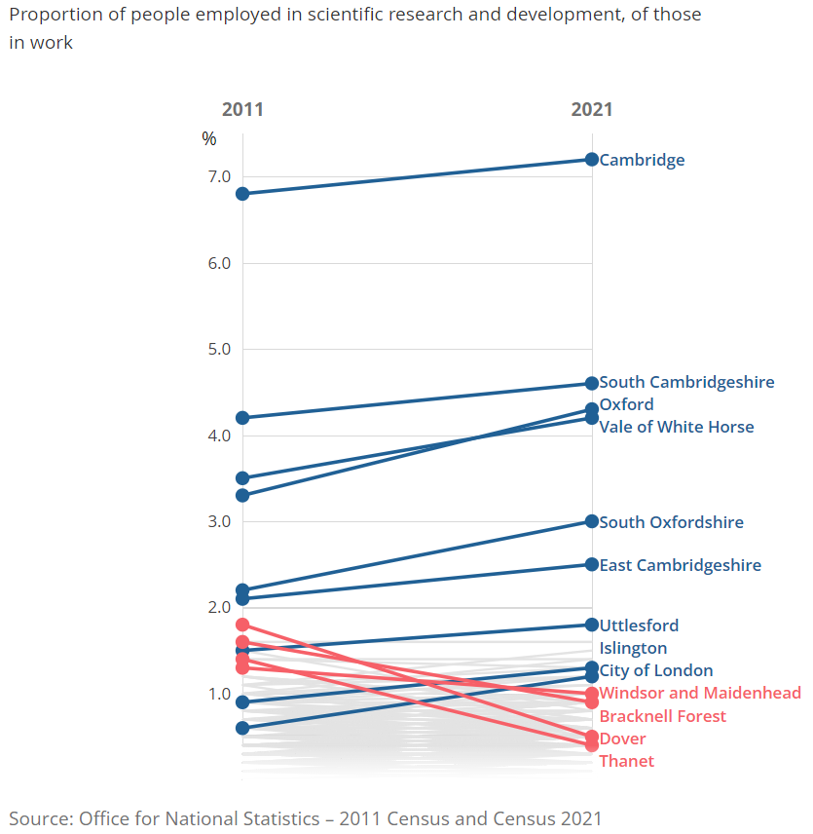
December 2022
Monthly Spotlight: How industries have changed at a local level between censuses
The number of residents employed in the telecoms industry fell in West Berkshire between 2011 and 2021.
The percentage of working people employed in the scientific R&D industry fell in Bracknell Forest and Windsor and Maidenhead between 2011 and 2021.
Source: ONS, December 2022

Slide 22
Economic and Labour Market Insight: Implications for Berkshire

Slide 23
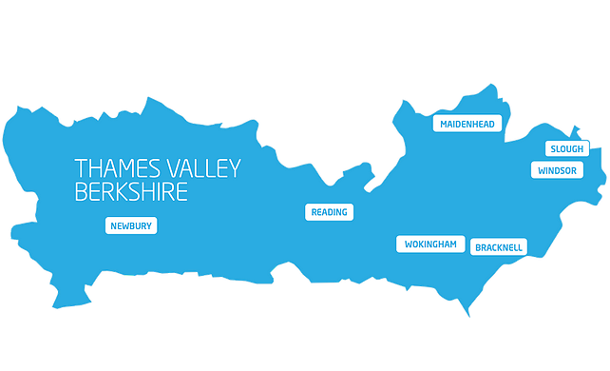
Claimant Count
(Latest data - November 2022)
Total of 16,750 claimants (2.9% of the working age population) in Berkshire.
1,645 claimants (2.1% of the working age population) in Bracknell Forest UA
4,360 claimants (4.1% of the working age population) in Reading UA
4,785 claimants (5.1% of the working age population) in Slough UA
2,095 claimants (2.2% of the working age population) in West Berkshire UA
2,105 claimants (2.3% of the working age population) in Windsor and Maidenhead UA
1,755 claimants (1.7% of the working age population) in Wokingham UA
Across Berkshire, claimant unemployment has fallen significantly from 20,450 in November 2021 to 16,750 in November 2022. Slough had 5.1% of its working age population claim unemployment in November 2022, down significantly from 6.2% in November 2021.
Source: ONS, December 2022

Slide 24
Strategic Issues
Heathrow ups 2022 earnings forecast amid higher revenue from demand
Heathrow SP Ltd, the owner of Heathrow Airport, said it upped its earnings forecast for 2022 as demand is recovering to pre-Covid levels. The company said it forecasts corporate profitability to be £1.67 billion, up from its forecast of £1.40 billion in June. Heathrow said this reflects higher revenue as demand has recovered. This is up from £384 million in 2021, and compares to £1.92 billion in 2019.
For 2022, Heathrow expects traffic to be 61.4 million. This is over 75% of 2019 levels, which recorded 80.9 million passengers travelling through the airport in the year.
Looking ahead, Heathrow expects corporate profitability to increase by 4% to £1.75 million in 2023, and 67.2 million passengers are predicted for the year, which it said represents recovery to 83% of 2019 levels.
Source: London South East, December 2022

Slide 25
An important note on the EMSI figures contained on the following slides: 26, 30, 31, 34, 35, 38, 39, 42, 43, 46, 47, 50 and 51
From February 2022, there has been a methodological change in how EMSI calculates job posting figures compared to those from prior months following a merger between EMSI and Burning Glass Technologies (now rebranded to Lightcast).
Those of you who have read previous economic briefings from Berkshire LEP may notice that the job posting figures contained in post-January 2022 briefings are lower across the board – in some cases quite significantly.
This change in methodology does not invalidate previous figures, but it is important to consider when reporting on job posting data longitudinally.
December 2022 onwards, Berkshire LEP will be reporting using two unique views of job postings:
  Active Postings shows all postings that were live within the selected timeframe (even if originally posted in a previous month but left active by the employer).
  Newly Posted shows all postings that were posted within the selected timeframe.

Slide 26
Remote working
In December 2022, there were 3,386 unique active job postings for remote positions at companies based in Berkshire, rising from 3,065 in December 2021 – a 10.5% increase. There were 1,526 unique new job postings for remote positions at companies based in Berkshire, up from 908 in December 2021 – a rise of 68.0%.
Compare this with the South-East, in December 2022 there were 17,340 unique active job postings for remote positions; rising from 16,364 in December 2021 – an increase of around 6.0%. There were 6,634 unique new job postings for remote positions in December 2022, up from 4,413 in December 2021 – a rise of 50.3%.
A rise can also be seen at national level, with a recorded 128,047 unique active remote job postings in England in December 2022, rising from 122,118 in December 2021 – an increase of about 4.9%. There were 51,191 unique new job postings for remote positions in December 2022, rising from 32,238 in December 2021 – an increase of 58.8%.
From these figures it’s apparent that the massive boost in job postings for explicitly remote roles prompted by the COVID-19 pandemic has somewhat persisted despite the reduction in cases and has seen a boost across all geographies in December. Berkshire has seen a larger increase in vacancies which are remote-based than the South East and England overall.
Source: EMSI, December 2022

Slide 27
Local Profiles

Slide 28
Bracknell Forest

Slide 29
Unemployment figures and notable business news - December 2022
Claimant unemployment to November 2022 (latest)
1,645 claimants (2.1% of the working age population) in Bracknell Forest UA
Notable business news:
Large-scale housing developments are set to continue to transform the look of an ever-changing Berkshire town. Over 400 homes are earmarked for Bracknell after developers set their sights on four key areas. If all are given the go ahead, a total of up to 420 homes will be built in the near future, as well as two new towers potentially going up in the town centre. The ground and first floor levels of the development are set to be reserved for commercial use. It is anticipated that the ground floor will be utilised for retail or café purposes, whilst the first floor could include a communal workspace or gym. - LINK.

Slide 30
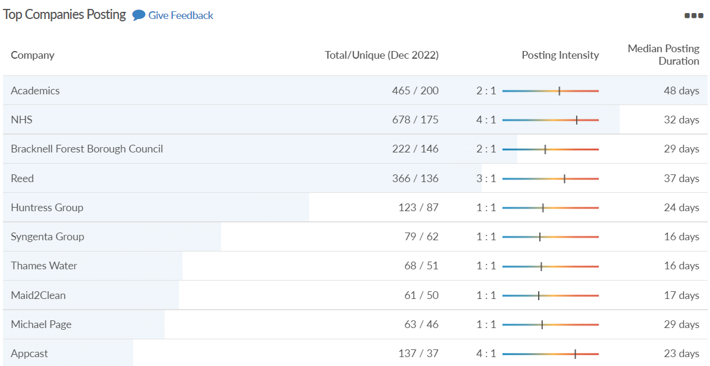
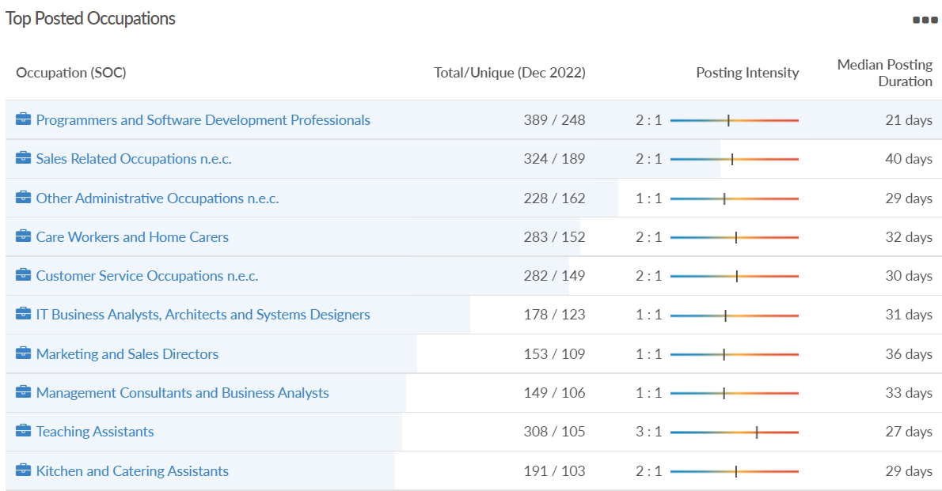
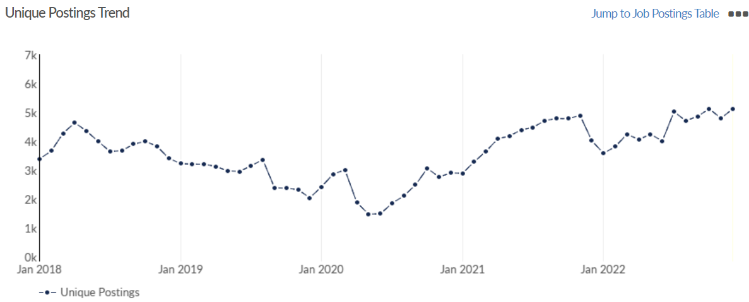
Job posting analytics
(Active postings)
Source: EMSI, December 2022
Unique job postings: 5,122
Total job postings: 9,177
Job posting intensity: 2:1
Unique job postings (December 2021): 4,022

Slide 31
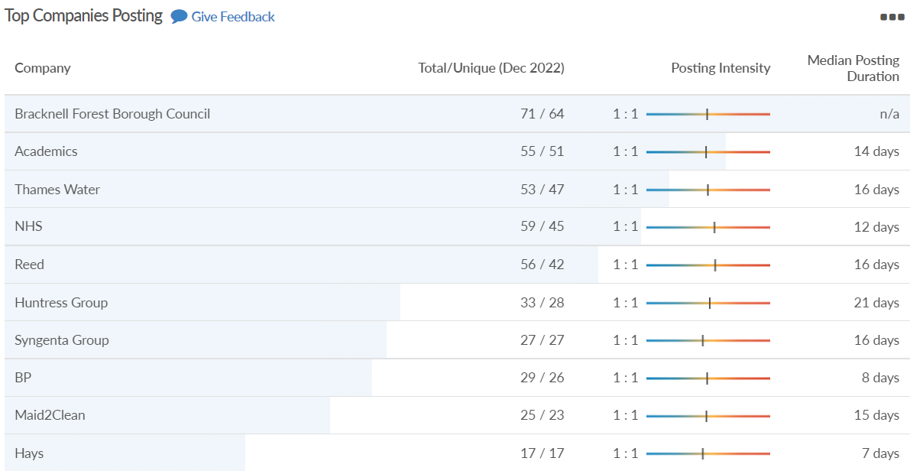
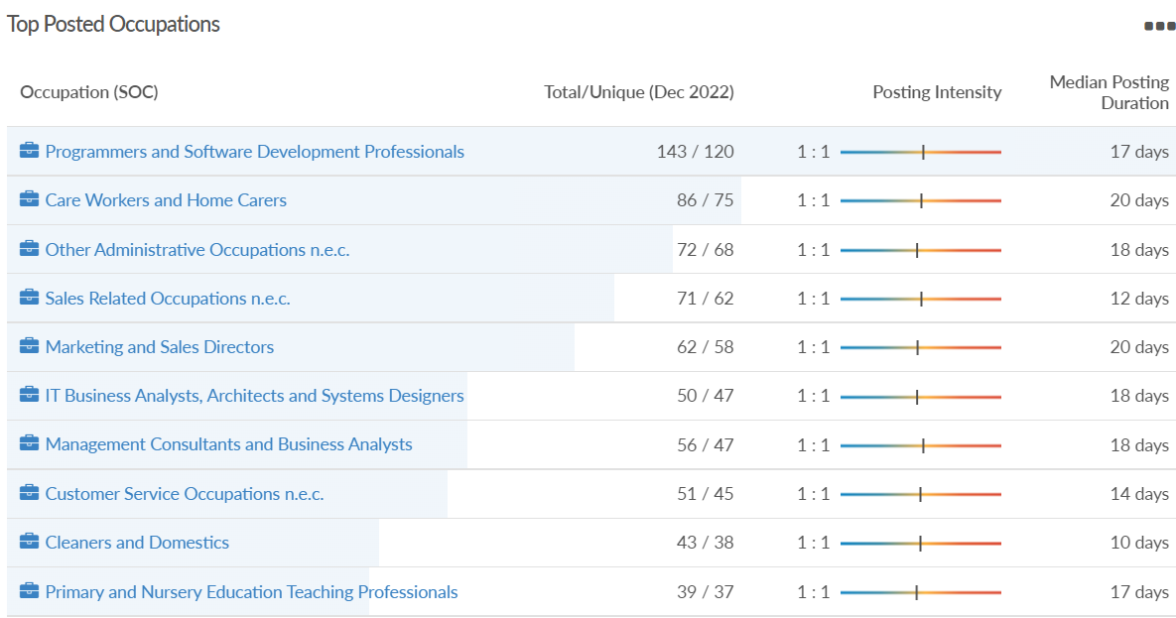
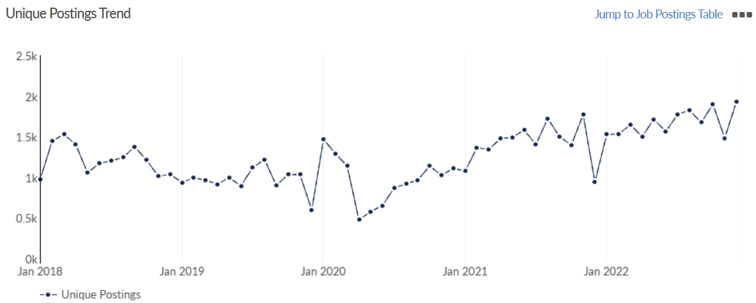
Job posting analytics
(Newly posted)
Source: EMSI, December 2022
Unique job postings: 1,935
Total job postings: 2,196
Job posting intensity: 1:1
Unique job postings (December 2021): 945

Slide 32
Reading

Slide 33
Unemployment figures and notable business news - December 2022
Claimant unemployment to November 2022 (latest)
4,360 claimants (4.1% of the working age population) in Reading UA
Notable business news:
A seven-storey hotel, aparthotel, market square and shops at Queen Victoria Street and Friar Street Reading have been given the go ahead by Reading Borough Council's planning applications. The scheme will see buildings converted into 104 aparthotel rooms - serviced apartments which can be rented. In Friar Street a seven-storey 163-bed Jury's hotel is expected to be built by the summer. Developer, Thackeray Estates, will incorporate The Bugle pub into the hotel after the council gave the pub protected status in July. – LINK.

Slide 34
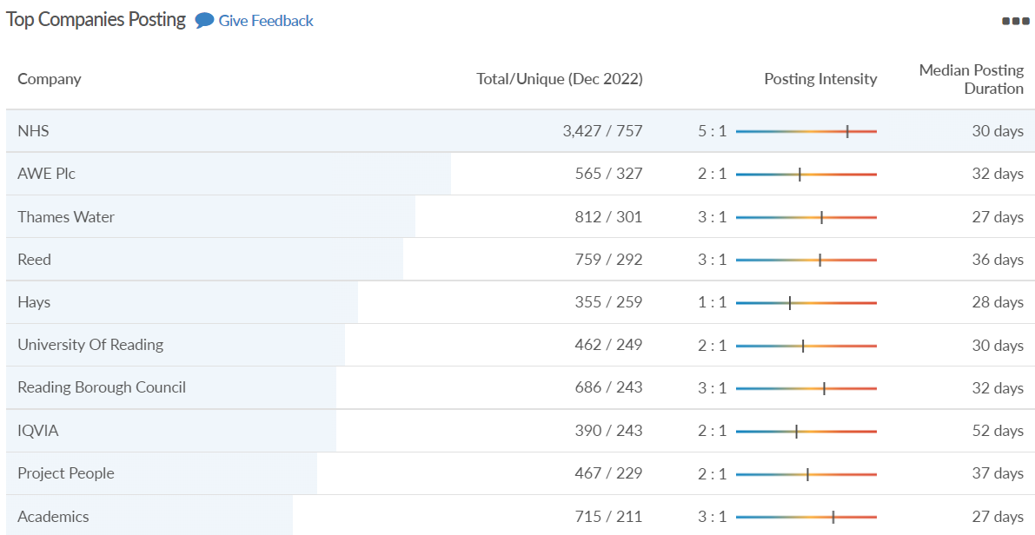
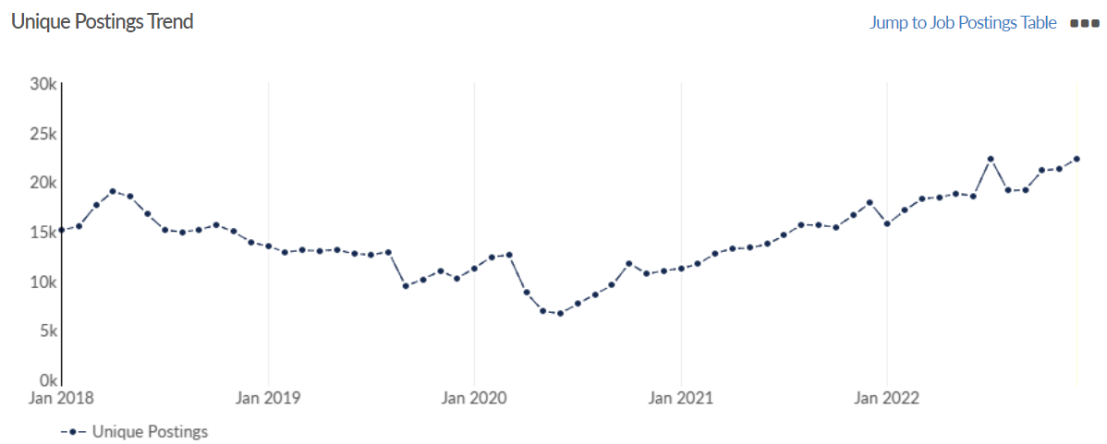
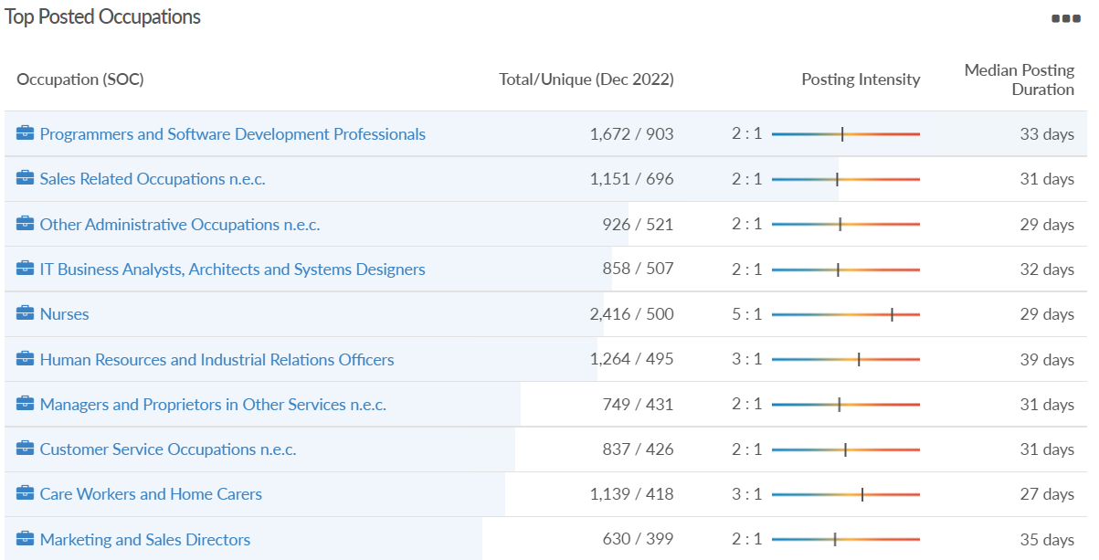
Job posting analytics
(Active postings)
Source: EMSI, December 2022
Unique job postings: 22,326
Total job postings: 44,073
Job posting intensity: 2:1
Unique job postings (December 2021): 17,869

Slide 35
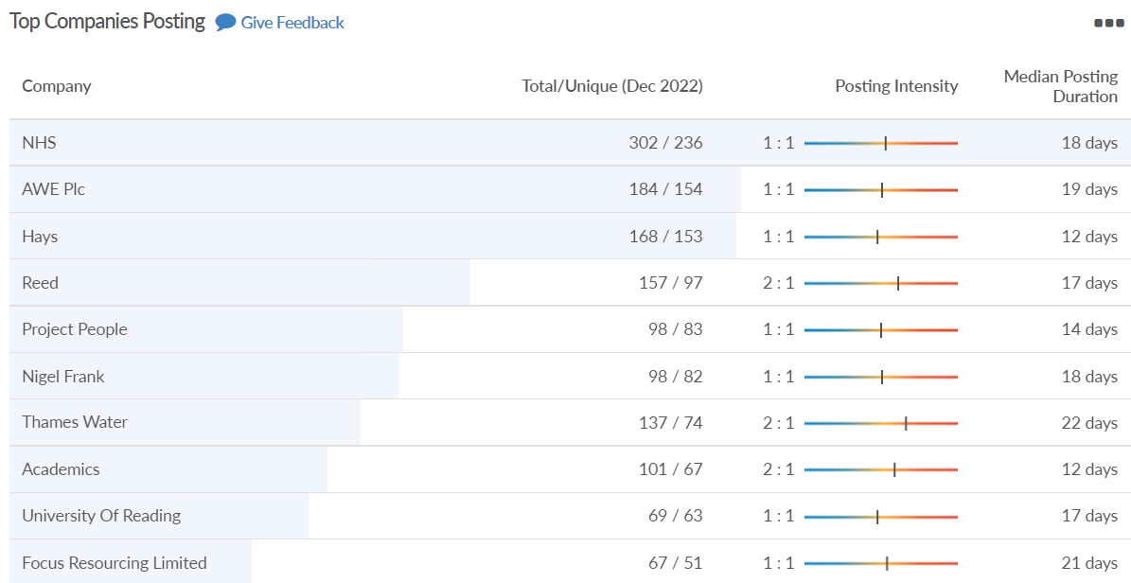
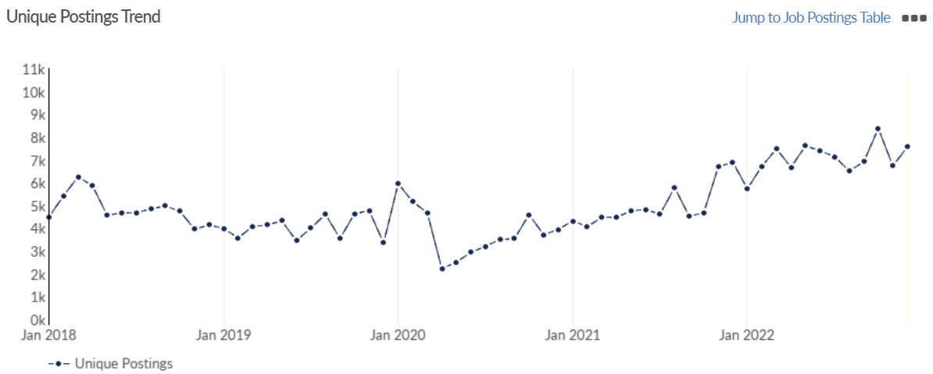
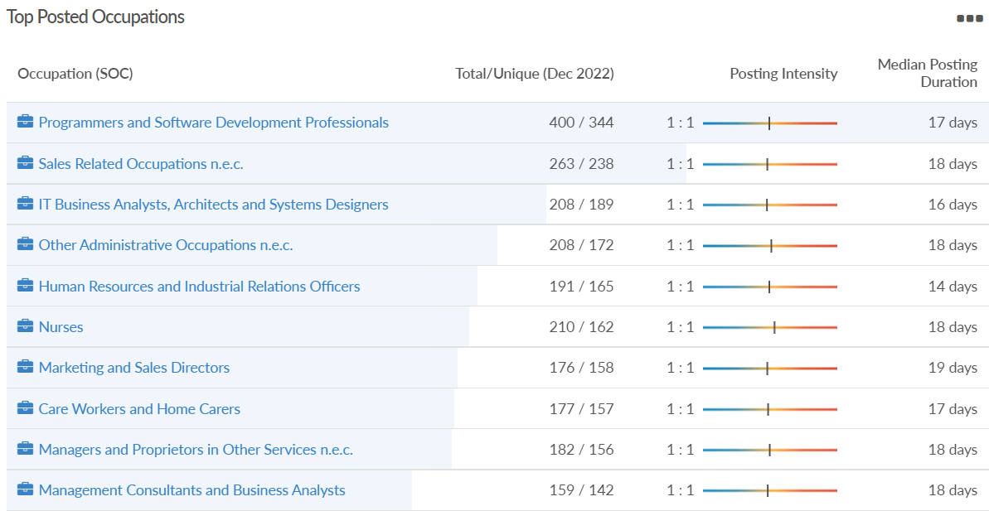
Job posting analytics
(Newly posted)
Source: EMSI, December 2022
Unique job postings: 7,565
Total job postings: 8,879
Job posting intensity: 1:1
Unique job postings (December 2021): 6,897

Slide 36
Slough

Slide 37
Unemployment figures and notable business news - December 2022
Claimant unemployment to November 2022 (latest)
4,785 claimants (5.1% of the working age population) in Slough UA
Notable business news:
Yondr has officially announced plans to develop a UK hyperscale data center campus in Slough. The initial phase will see the development of a 30MW facility, which is expected to be ready for service by the first quarter of 2023. The data center campus will have a total capacity of 100MW when fully developed. The company received permission to build two data center buildings on the site in September. “Being located in Slough will allow us to serve our clients in the most sought-after metro in the United Kingdom,” Paul Hood, Managing Director of Operations, EMEA at Yondr Group said this week. “We are excited to bolster our growing global presence with the addition of Slough, while continuing to transform the data center industry.” – LINK.

Slide 38
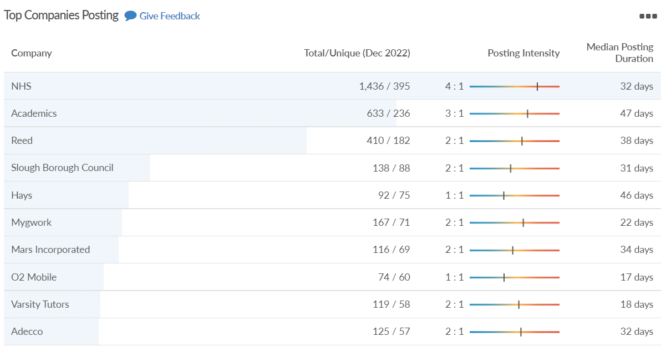
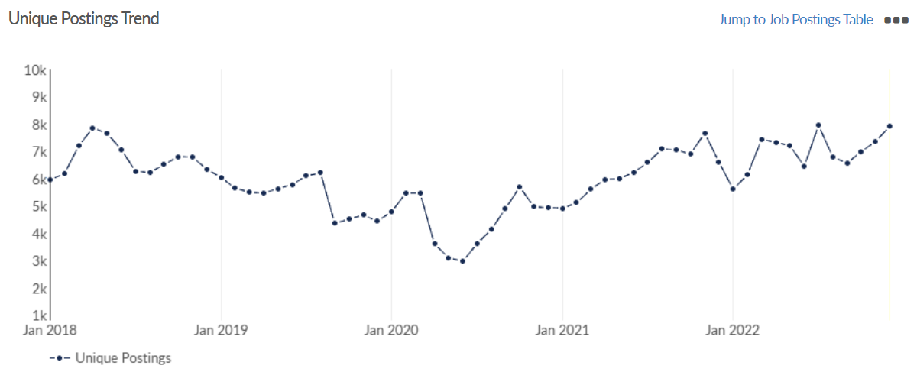
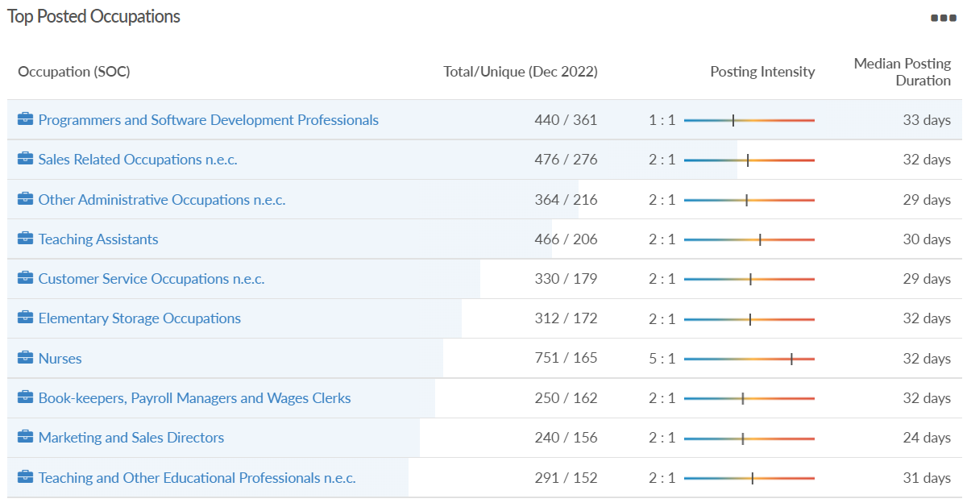
Job posting analytics
(Active postings)
Source: EMSI, December 2022
Unique job postings: 7,906
Total job postings: 14,088
Job posting intensity: 2:1
Unique job postings (December 2021): 6,598

Slide 39
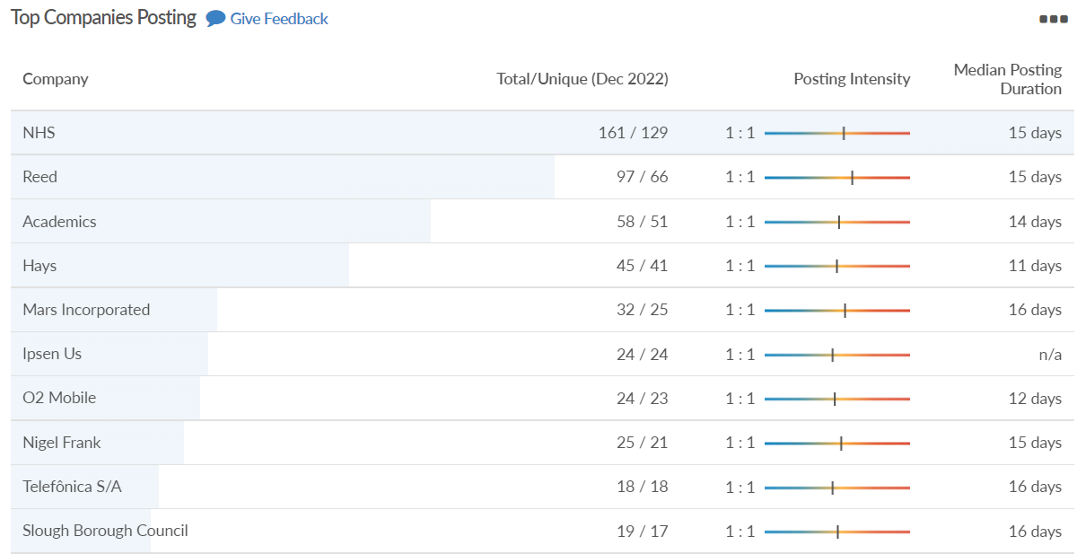
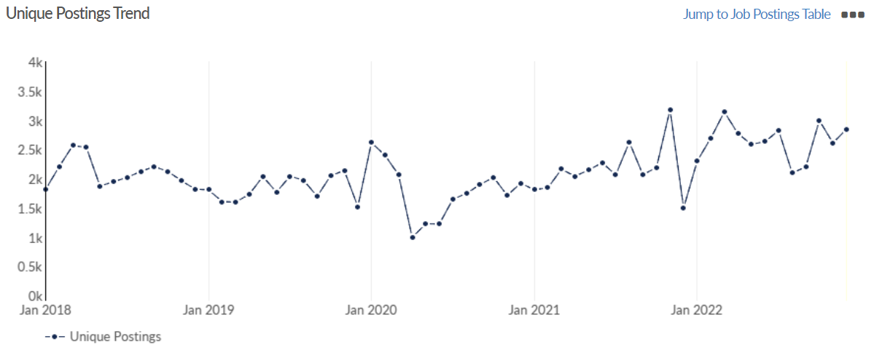
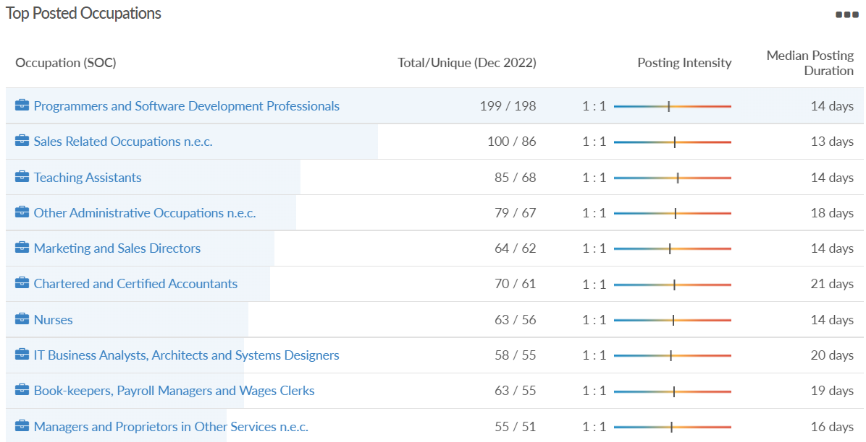
Job posting analytics
(Newly posted)
Source: EMSI, December 2022
Unique job postings: 2,845
Total job postings: 3,126
Job posting intensity: 1:1
Unique job postings (December 2021): 1,497

Slide 40
West Berkshire

Slide 41
Unemployment figures and notable business news - December 2022
Claimant unemployment to November 2022 (latest)
2,095 claimants (2.2% of the working age population) in West Berkshire UA
Notable business news:
Tim Hortons has been given the go-ahead to open in Newbury. The popular restaurant, which will include a drive-thru will open on the retail park. West Berkshire Council has approved the plans for the chain to take over the former Pizza Hut unit. The Canadian coffeehouse will be on land just off Pinchington Lane. Tim Hortons opened its first store in the UK in 2017 and now has 56 units here, with more opening soon. Its current focus is to expand its drive-thru model across the UK, including at the Newbury site. – LINK.

Slide 42
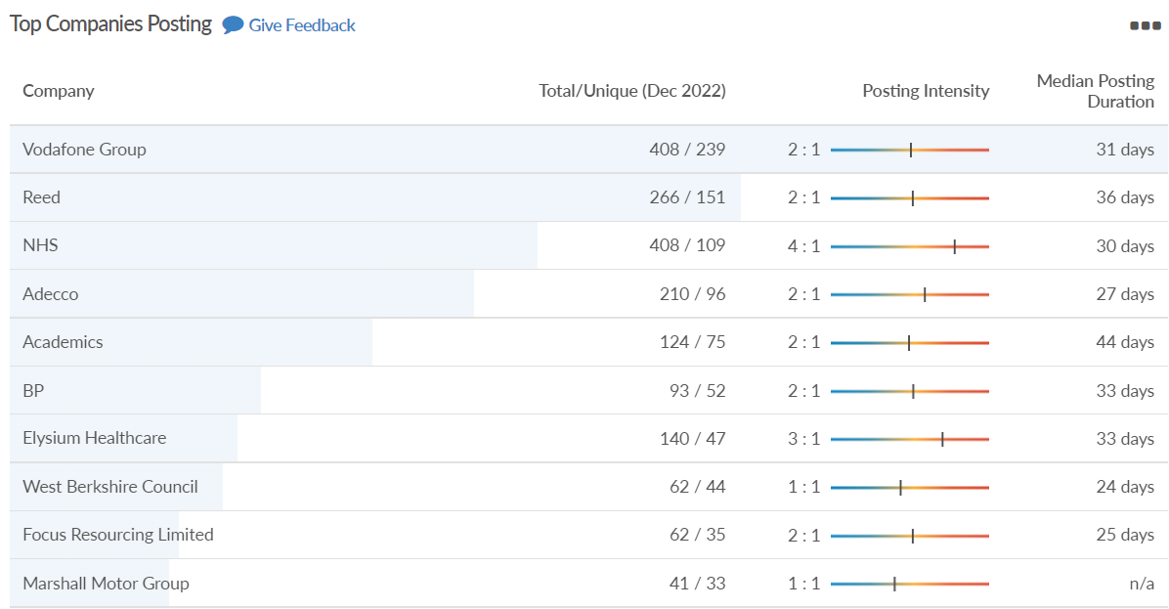
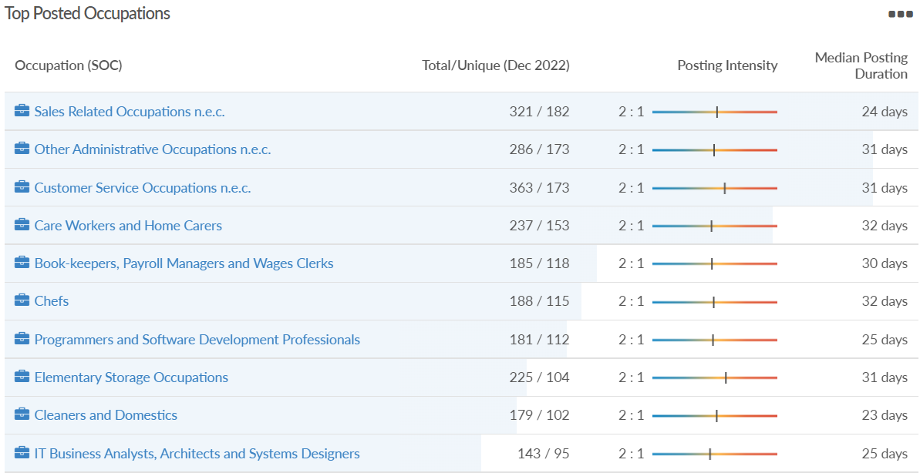
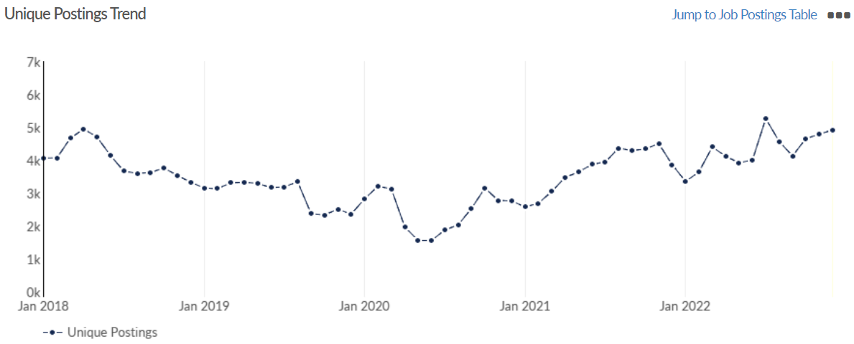
Job posting analytics
(Active postings)
Source: EMSI, December 2022
Unique job postings: 4,926
Total job postings: 8,243
Job posting intensity: 2:1
Unique job postings (December 2021): 3,867

Slide 43
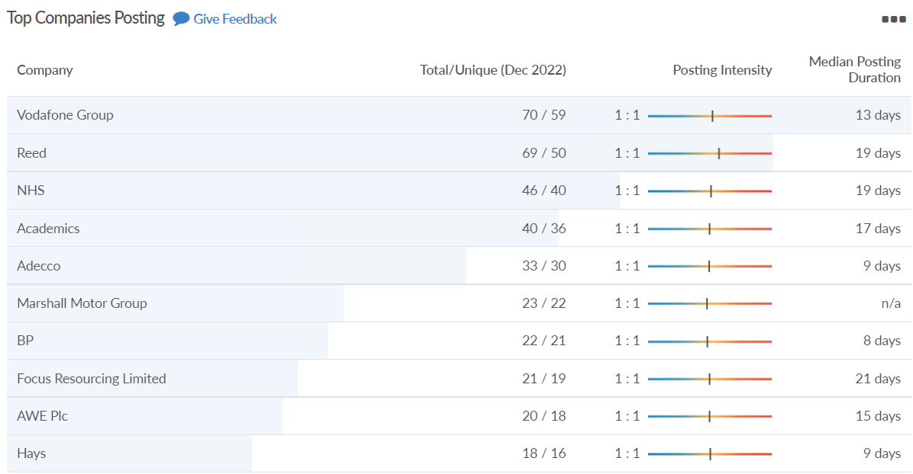
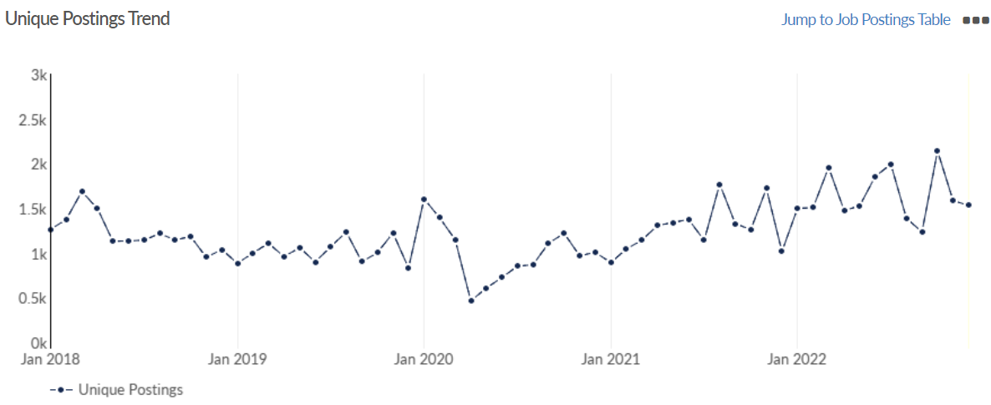
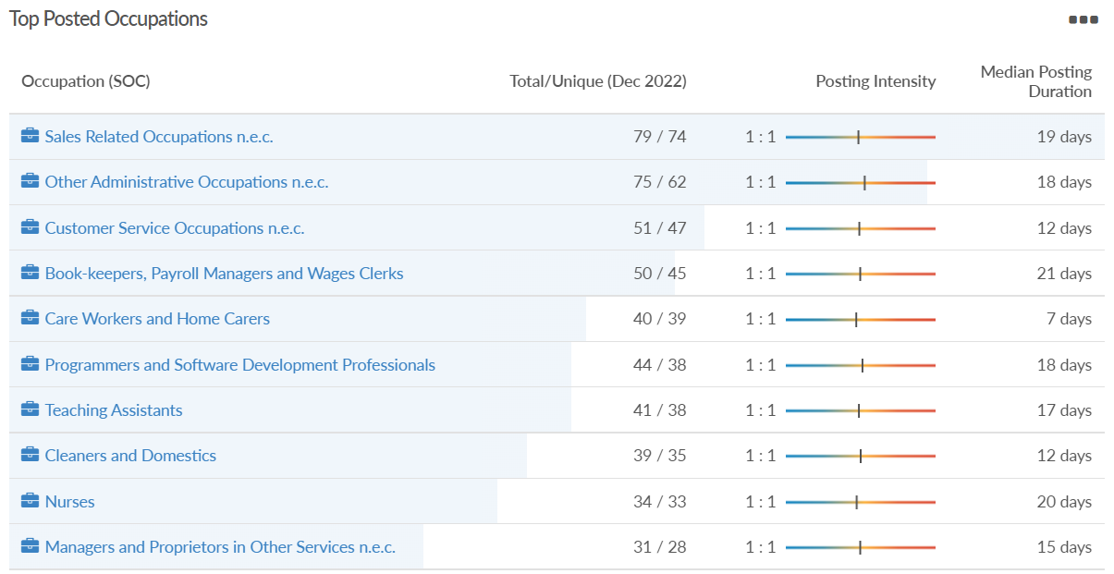
Job posting analytics
(Newly posted)
Source: EMSI, December 2022
Unique job postings: 1,532
Total job postings: 1,704
Job posting intensity: 1:1
Unique job postings (December 2021): 1,017

Slide 44
Windsor and Maidenhead

Slide 45
Unemployment figures and notable business news - December 2022
Claimant unemployment November 2022 (latest)
2,105 claimants (2.3% of the working age population) in Windsor and Maidenhead UA
Notable business news:
Greystoke Land has consulted with residents of Holyport, near Maidenhead in Berkshire, about its proposals to build on a piece of green belt land. It said it was a "rare and fantastic opportunity" to make the area a centre of exceptional film and TV production. It added it would also create 1,500 full-time jobs. The developer has only submitted plans for outline planning permission, further applications would have to be submitted to the Royal Borough of Windsor and Maidenhead before any decision is made. – LINK.

Slide 46
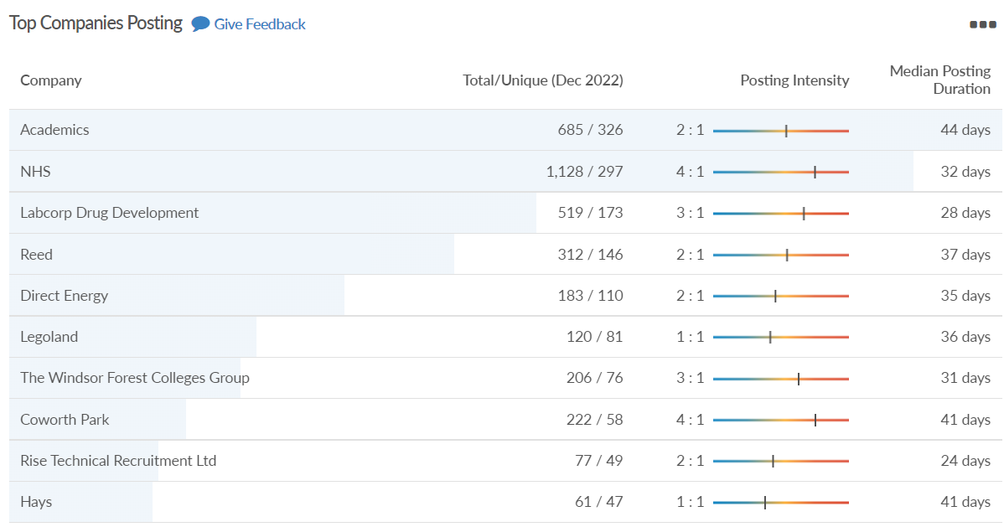
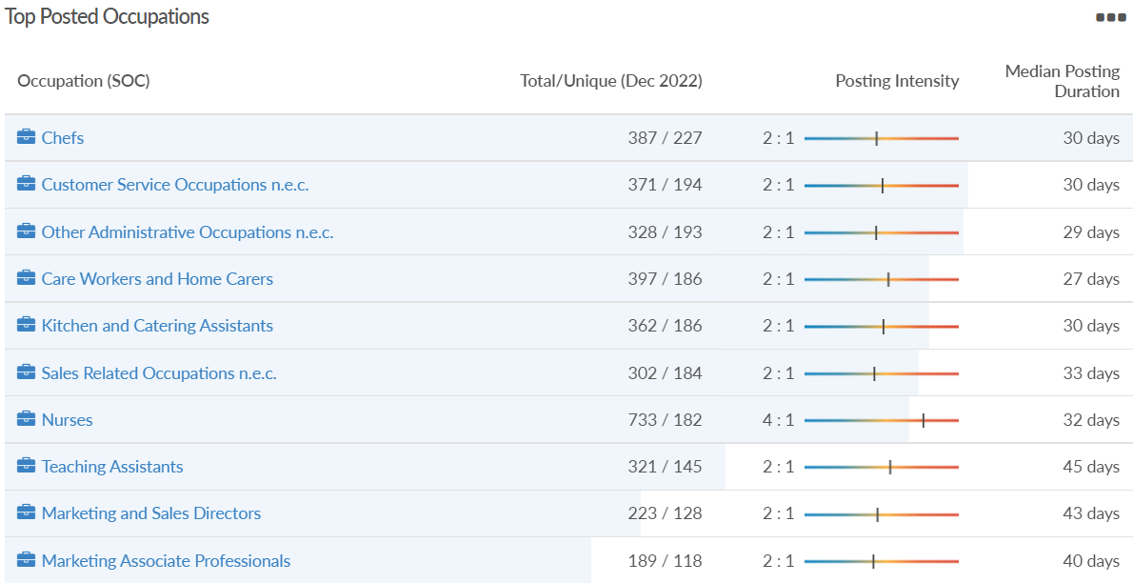
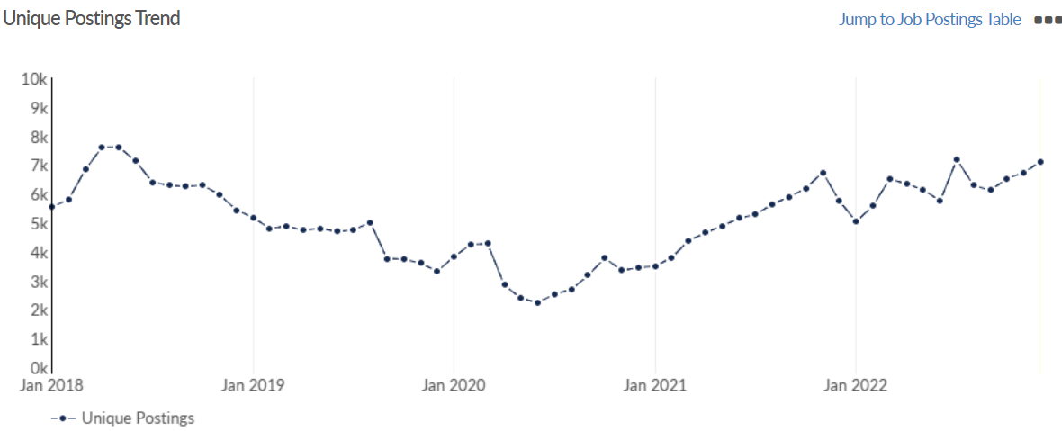
Job posting analytics
(Active postings)
Source: EMSI, December 2022
Unique job postings: 7,111
Total job postings: 13,340
Job posting intensity: 2:1
Unique job postings (December 2021): 5,745

Slide 47
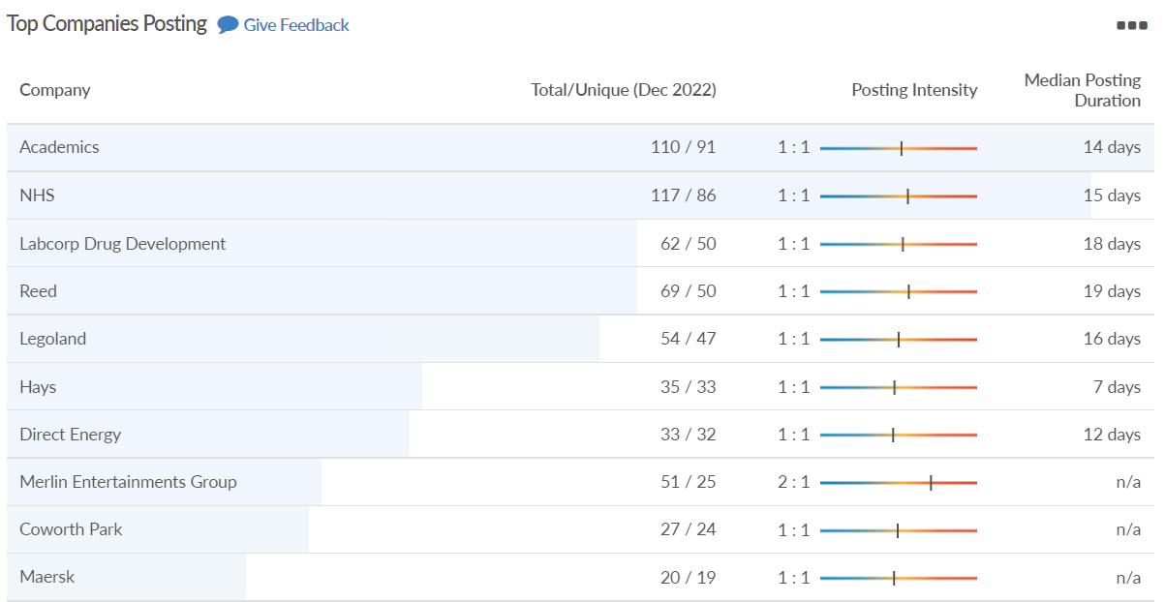
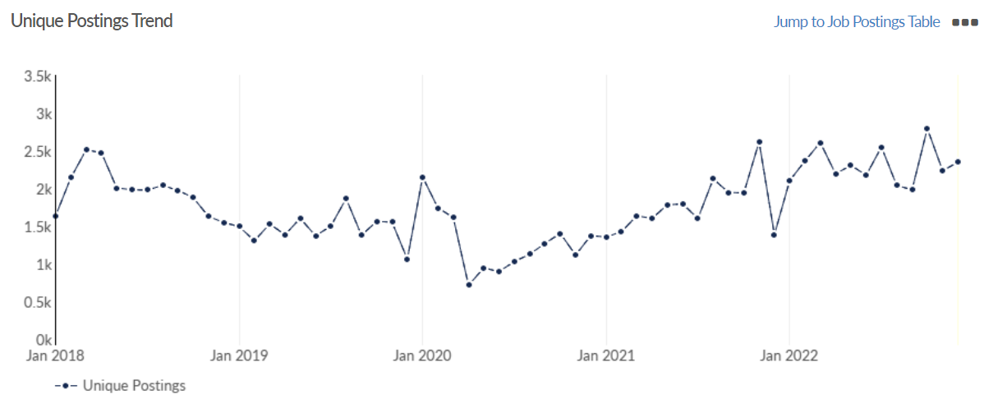
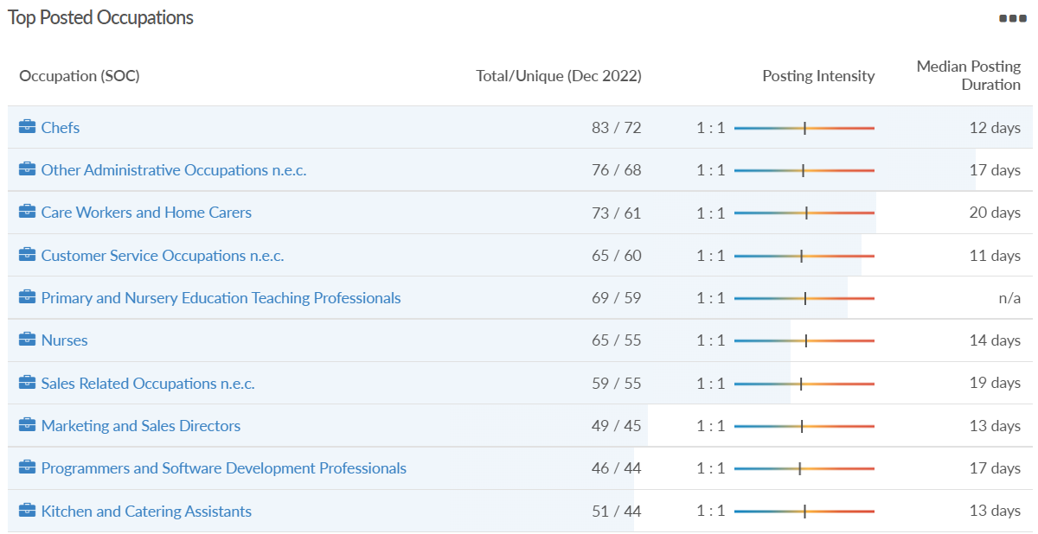
Job posting analytics
(Newly posted)
Source: EMSI, December 2022
Unique job postings: 2,349
Total job postings: 2,682
Job posting intensity: 1:1
Unique job postings (December 2021): 1,388

Slide 48
Wokingham

Slide 49
Unemployment figures and notable business news - December 2022
Claimant unemployment to November 2022 (latest)
1,755 claimants (1.7% of the working age population) in Wokingham UA
Notable business news:
M2M Pharmaecutical has moved into Winnersh Triangle, trading its previous 150 sq. ft space to 2,600 sq. ft. The firm is a contract research organisation, that specialises in understanding microparticles which are often used to treat asthma and other respiratory diseases. It says its services help clients develop better, faster and more economical medicines. – LINK.

Slide 50
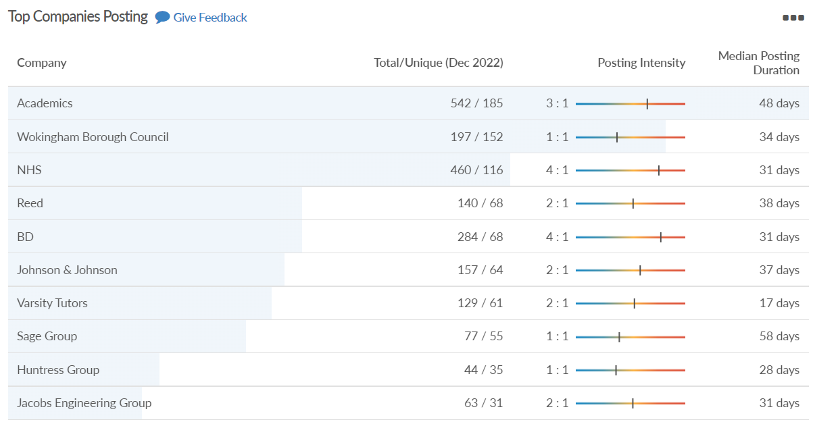
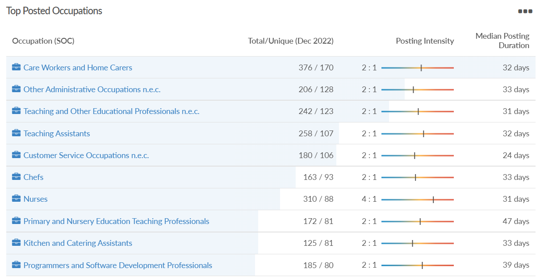
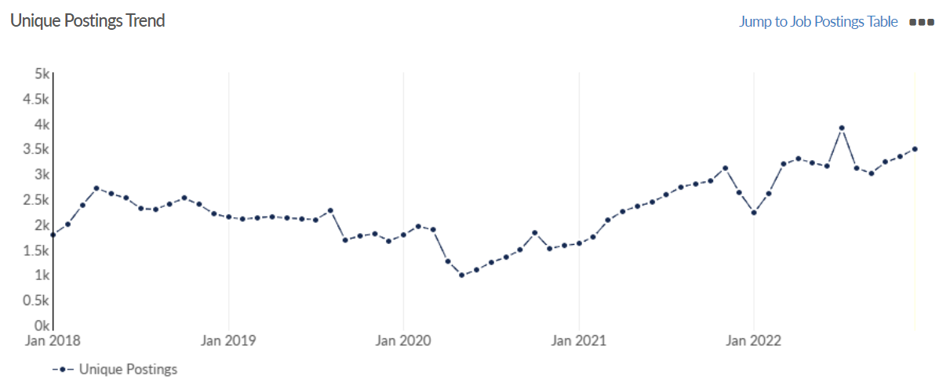
Job posting analytics
(Active postings)
Source: EMSI, December 2022
Unique job postings: 3,496
Total job postings: 6,673
Job posting intensity: 2:1
Unique job postings (December 2021): 2,624

Slide 51
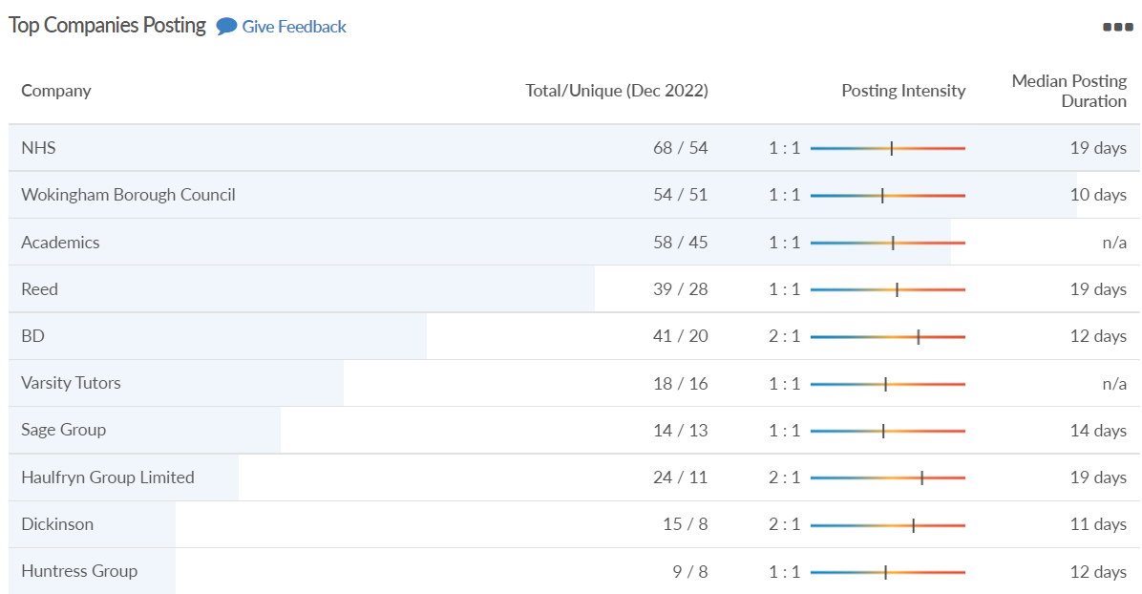
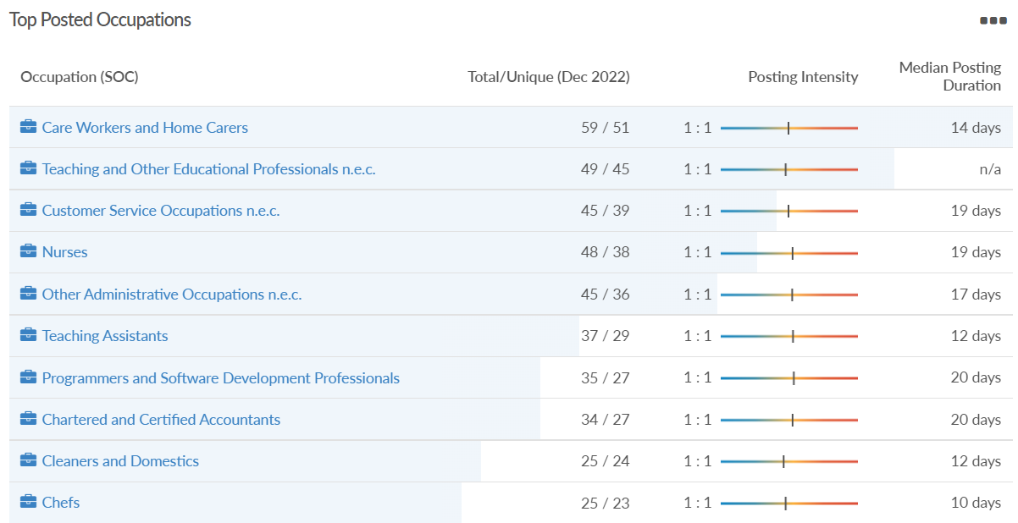
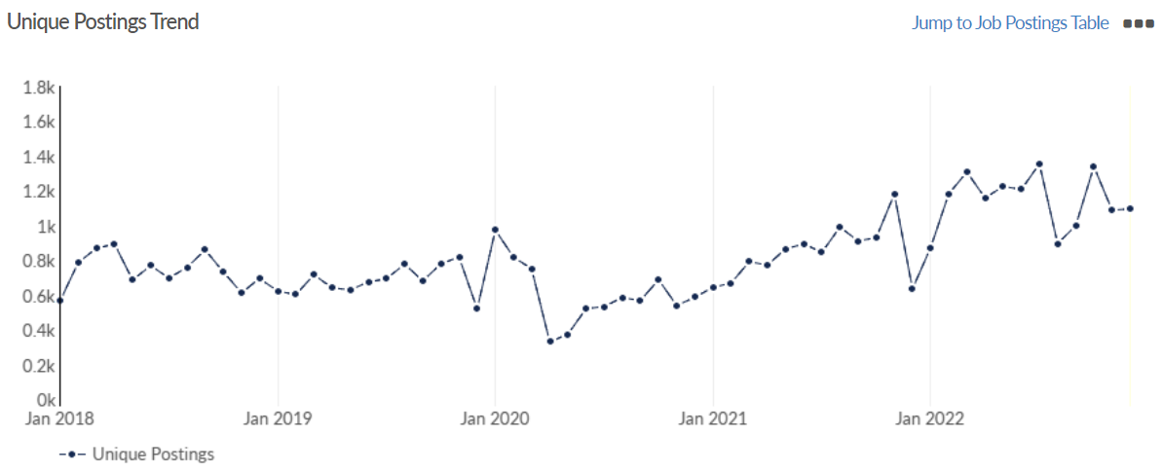
Job posting analytics
(Newly posted)
Source: EMSI, December 2022
Unique job postings: 1,095
Total job postings: 1,285
Job posting intensity: 1:1
Unique job postings (December 2021): 635

