Slide 1
Thames Valley Berkshire
Monthly Economic Briefing
March 2021

Slide 2
Key contents of this month’s briefing
Updated global and UK economic forecasts
Latest furlough, SEISS and claimant count figures by Local Authority
Latest remote working figures for Thames Valley Berkshire
Latest ‘notable business news’ by Local Authority
Latest job posting analytics by Local Authority

Slide 3
Global and National Economy
March 2021

Slide 4
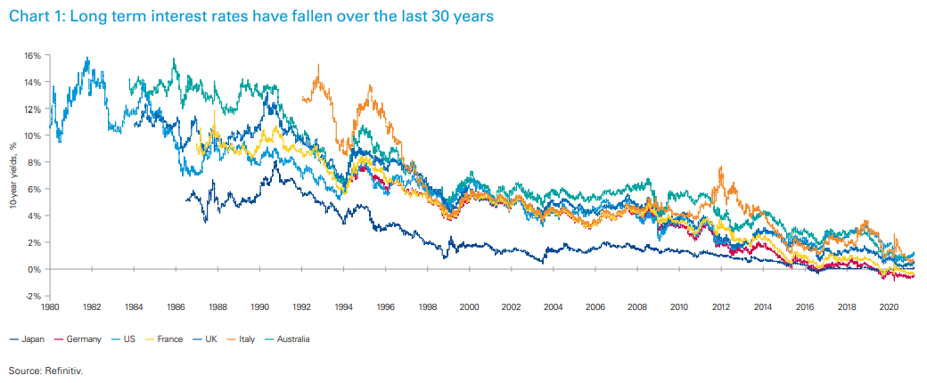
Global Economy
One of the legacies of the COVID pandemic could be a generational shift towards higher government spending, as fiscal policymakers adjust to the new reality of rising demands for government support while interest rates remain low.
The shock of the COVID pandemic has pushed governments to increase spending to record levels, with over 10 trillion USD being allocated around the world. Much of this effort has been financed by additional borrowing, adding to the already large debt piles that governments had accumulated before the pandemic began. However, as interest rates have also fallen around the world – the cost of servicing that debt has remained low, which could mean that some of the extra spending may remain until the crisis period of the pandemic has passed.
Source: KMPG, March 2021

Slide 5
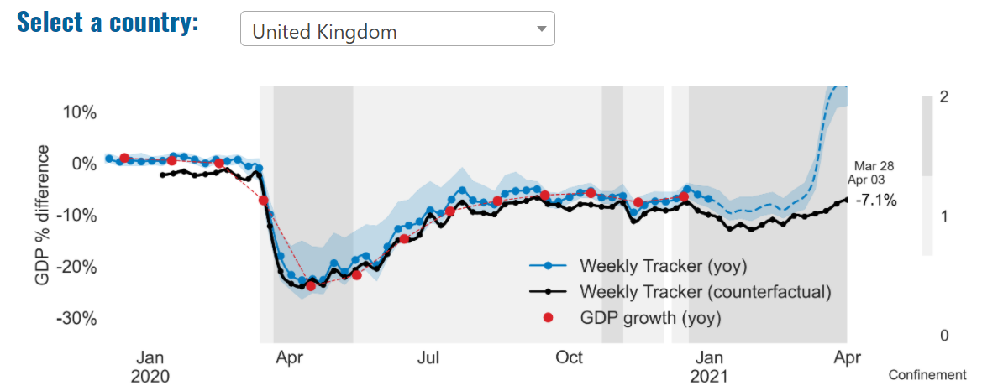
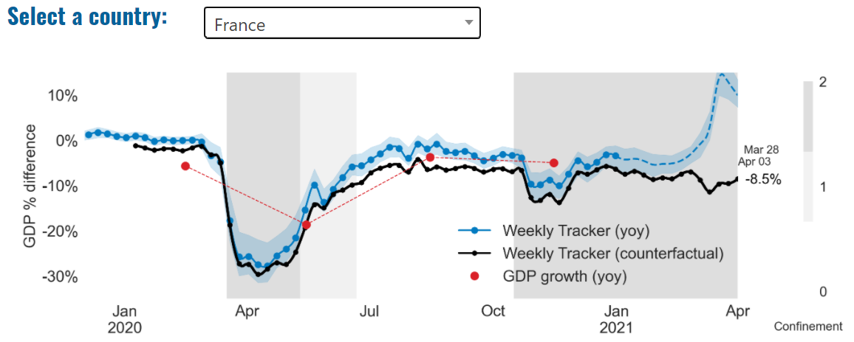
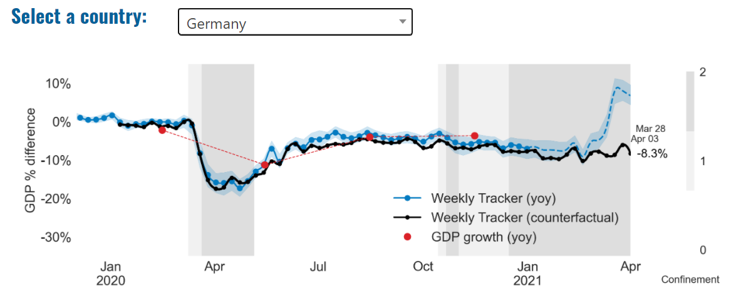
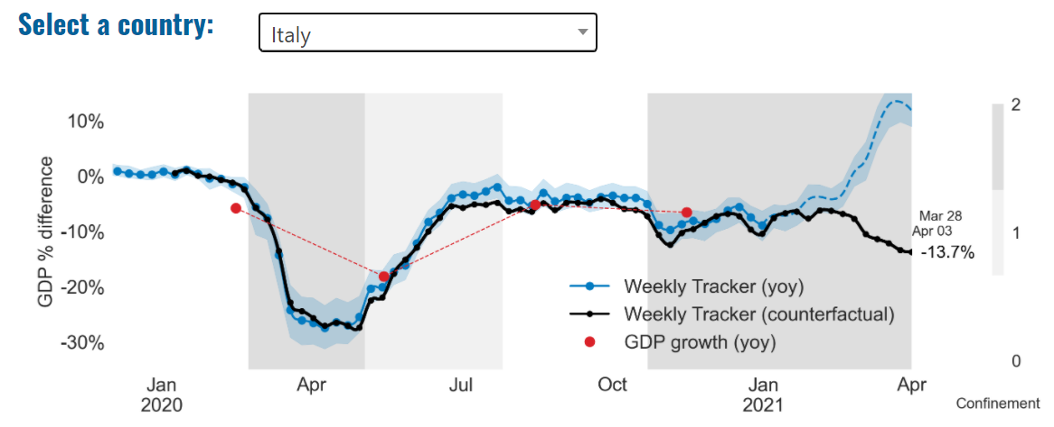
Global Economy – OECD GDP Tracker

Slide 6
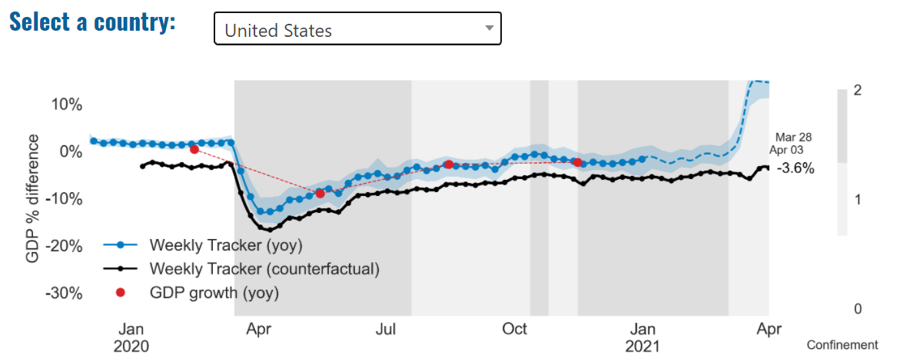
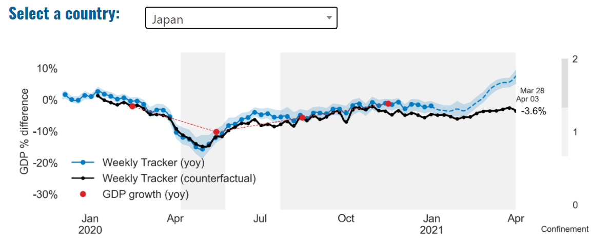
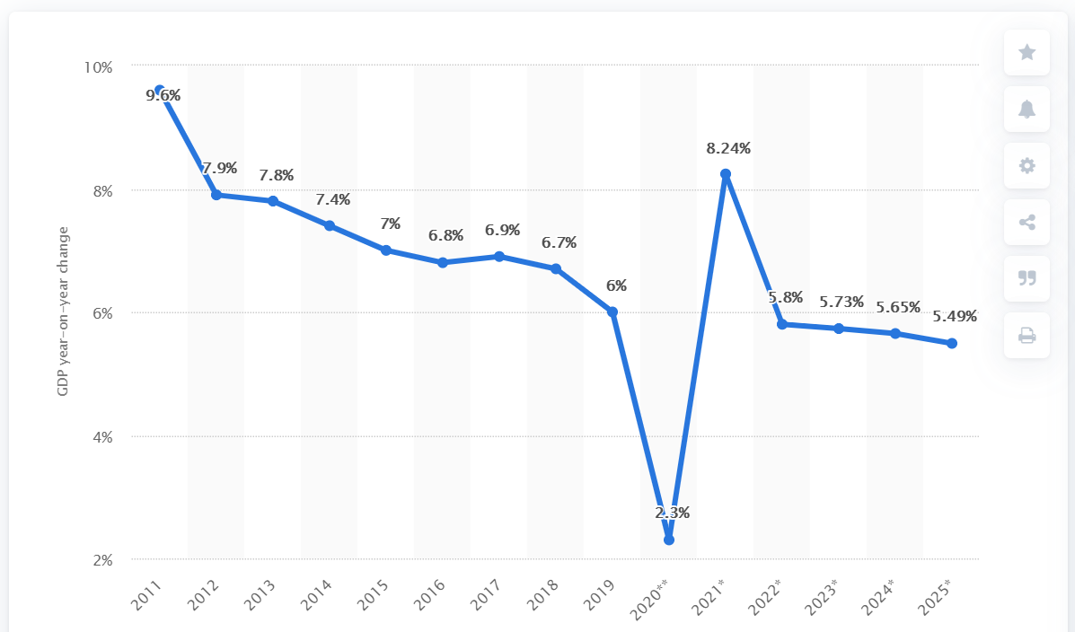
Global Economy – OECD GDP Tracker Continued
China
China is not included within the OECD GDP tracker and so the graph on the left has been compiled using statistics from the IMF and National Bureau of Statistics of China. The 2021 figure is a preliminary figure published by the National Bureau of Statistics of China in January 2021.
Note: The blue confidence band shows 95% confidence intervals. The darkness of the grey background reflects stay-at-home confinement requirement based on the Oxford Blavatnik database (0 - no measures, 1 - recommend not leaving house, 2 - require not leaving house with exceptions, 3 - require not leaving house with minimal exceptions).
Source: OECD, March 2021

Slide 7
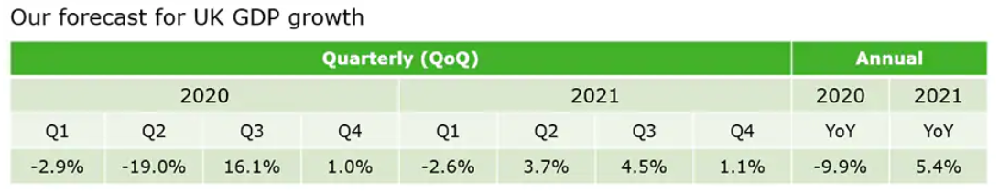
UK Economy
More than a year on from its start, the coronavirus pandemic continues to exact a heavy toll in lives and livelihoods. Around the globe, more than 100 million people have had the virus and around 2½ million have died from it, and world GDP fell by 3½ per cent in 2020 as governments imposed public health restrictions in an attempt to control the virus. The UK has been hit particularly hard. Following a resurgence of infections over the winter, around 1 in 5 people have so far contracted the virus, 1 in 150 have been hospitalised, and 1 in 550 have died, the fourth highest mortality rate in the world. And GDP fell 9.9 per cent in 2020, the largest decline in the G7. While output partially recovered in the second half of last year – and somewhat more strongly than we previously thought – the latest lockdown and temporary disruption to EU-UK trade at the turn of the year is expected to result in output falling again in the first quarter of this year. Source: OBR, March 2021
In our baseline forecast for UK GDP, we expect a contraction in the first quarter of 2021 owing to the impact on activity of restrictions needed to contain the new COVID-19 variant. We expect the downturn in GDP to be smaller than in the first half of 2020, given increased business preparedness and continued fiscal and monetary support. We expect the economy to rebound strongly as restrictions are eased gradually over the second and third quarters, supported by the vaccine rollout, extended UK fiscal support and the boost to global growth from the large US fiscal stimulus. Source: Deloitte, March 2021

Slide 8
UK Economy 2
Britain’s economic prospects are improving as a result of the successful vaccine programme and could perform more strongly than expected over the coming months, the governor of the Bank of England has said. Andrew Bailey said that he now saw “upside risks” to the Bank’s growth forecasts but warned there was still a risk that new Covid-19 variants would derail recovery. The governor, who has been in the job for a year, said rising financial market interest rates were a reflection of growing optimism in the City that the UK was at last emerging from the lockdowns of the past year. “We have seen some increase in interest rates over the last month or so, as have other countries. My assessment so far is that that is consistent, I think, with the change in the economic outlook,” Bailey told BBC Radio 4’s Today programme. Source: Guardian, March 2021

Slide 9
UK Economy 3
January’s smaller than expected fall in GDP means that we now estimate a contraction of 2.4 per cent in the first quarter of 2021. This would leave GDP in the first quarter of 2021 around 9 per cent lower than its level in the last quarter of 2019, before the pandemic struck. Real-time data and NIESR analysis imply that GDP is likely to resume its growth in February and March, by 0.3% and 1.1% respectively, on the back of higher contribution from government services and improving consumer confidence as infection rates come down.
As a result, the first quarter of 2021 is likely to see a smaller contraction than widely anticipated, increasing the upside risks to our latest 2021 forecast of 3.4 per cent. However, the pace of recovery from the second quarter will crucially depend on how the opposing effects of the vaccine roll-out and lifting lockdown affect the path of Covid-19, as well as how consumers and businesses react.
January’s data indicates that – while lockdown has reduced activity in some sectors to the levels of summer 2020 – other parts of the economy seem to have adapted and remain relatively unaffected. The health sector, responsible for rolling out the vaccines, grew by 6 per cent in January. The contraction in manufacturing at the start of 2021 is likely to be partly attributable to the unwinding of December pre-Brexit stockpiling and partly to permanent reductions in UK trade.
Source: NIESR, March 2021

Slide 10
Coronavirus and Recession: Implications for Thames Valley Berkshire

Slide 11
Furloughing (February 2021)
9,500 jobs (15% of total eligible employments) furloughed in Bracknell Forest UA
13,200 jobs (18% of total eligible employments) furloughed in Slough UA
12,800 jobs (14% of total eligible employments) furloughed in Reading UA
10,900 jobs (13% of total jobs) furloughed in Wokingham UA
11,500 jobs (17% of total jobs) furloughed in Windsor and Maidenhead
10,700 jobs (14% of total jobs) furloughed in West Berkshire
Source: HMRC, March 2021
Berkshire has a lower-than-average number of furloughed workers, compared to the rest of the UK, because of its relative strength in sectors of industry that can be continued by workers from home.

Slide 12
SEISS (January 2021)
Total value of claims made for Bracknell Forest UA – SEISS 3: £14,200,000
Total value of claims made for Slough UA – SEISS 3: £18,200,000
Total value of claims made for Reading UA – SEISS 3: £14,700,000
Total value of claims made for Wokingham – SEISS 3: £15,300,000
Total value of claims made for Windsor and Maidenhead – SEISS 3: £13,900,000
Total value of claims made in West Berkshire – SEISS 3: £15,400,000
Source: HMRC, February 2021

Slide 13
Claimant Count (February 2021)
Total of 31,185 claimants (5.4% of the working age population) in Thames Valley Berkshire
3,615 claimants (4.6% of the working age population) in Bracknell Forest UA
8,505 claimants (9% of the working age population) in Slough UA
7,195 claimants (6.7% of the working age population) in Reading UA
3,625 claimants (3.5% of the working age population) in Wokingham UA
4,365 claimants (4.7% of the working age population) in Windsor and Maidenhead UA
3,880 claimants (4% of the working age population) in West Berkshire UA
Across Thames Valley Berkshire, claimant unemployment has almost tripled in the last year, rising from 10,955 in February 2020 to 31,185 in February 2021. Slough had 9% of its working age population claim unemployment in February 2021, up from 3% in January 2020.
Source: ONS, February 2021

Slide 14
Strategic Issues: Heathrow
Heathrow Airport
Responding to the Budget released in March, Heathrow CEO John Holland-Kaye said: “The Chancellor talks about protecting jobs and livelihoods, fixing the public finances and laying the foundations for the future economy, and yet he continues to ignore the UK's aviation sector. He clearly doesn’t understand that all three depend on a strong aviation sector delivering the trade, tourism and investment that power vast parts of the British economy. Failing to even mention aviation, let alone provide full business rates relief for airports in today’s Budget, is a missed opportunity to ensure the sector can play a key role in the country’s economic recovery. The absence of any meaningful support from the Government in the face of tough restrictions which have ground travel to a halt will weaken the sector and limit UK growth at the time it is needed most.”
Passengers have complained of queues of up to seven hours long at Heathrow Airport’s border control. A union for border control workers said Covid security measures designed to reduce infections was leading to inadequate staffing, while the airport has said the government needed to make sure there were enough staff to cope with demand.
Sources: Heathrow Press Release, March 2021; ARGS, March 2021

Slide 15
Strategic Issues: Aviation
Aviation:
Commenting on the Budget 2021, the Airport Operators Association‘s Chief Executive, Karen Dee, said: “Aviation has been the hardest-hit sector in the pandemic, but the Budget is blind to the impact of the near-complete shutdown of international travel. While the extensions of the Job Retention Scheme and airport business rates relief are very welcome, they are not nearly enough given the scale of COVID-19’s impact. Combined with the long‑haul APD increase, which is a very damaging blow to an industry already on its knees, this is not a Budget for a global Britain.”
Michael O’Leary has described the UK government’s support for the airline industry during the pandemic as “lamentable”, as aviation leaders called for fresh help and warned of a long recovery ahead. The Ryanair chief executive said fares would be cut this summer to boost demand and that he hoped for up to 70% of normal passenger numbers from July. O’Leary said vaccines would enable travel, but added that regulations on border controls were “bonkers”. He described hotel quarantine as “completely unpoliceable”, saying the airline had seen no medical evidence to support it. “[It] has been a PR stunt, shambolic and ineffective and plays no role in keeping out the Covid virus,” O’Leary told MPs on the transport select committee on Wednesday. Sources: International Airport Review, March 2021; The Guardian, March 2021

Slide 16
Demand and Supply Conditions: Businesses, Hiring, Restructuring, Investment, Labour and Skills Supply

Slide 17
Household/Consumer Demand
Slough had an overall recovery index score of 41 at the start of March, putting them in a stronger position in terms of recovery (closer to pre-lockdown levels) than Reading which had a recovery index score of 23.
Source: Centre for Cities, March 2021
Retail sales volumes only partly recovered in February 2021 with an increase of 2.1% when compared with the 8.2% fall seen in the previous month, and sales were still down by 3.7% on a year earlier before the impact of the coronavirus (COVID-19) pandemic.
Non-food stores provided the largest positive contribution to the monthly growth in February 2021 sales volumes, aided by strong increases of 16.2% and 16.1% in department stores and household goods stores respectively.
Clothing retailers reported the largest fall, of 50.4%, in sales volumes when compared with February 2020 before the coronavirus pandemic; automotive fuel stores also reported a large annual decline of 26.5% as travel restrictions continued to hit sales in that sector.
In the three months to February 2021, retail sales volume fell by 6.3% when compared with the previous three months, with strong declines in both clothing stores and other non-food stores.
The proportion spent online increased to 36.1% in February 2021, the highest on record; this compares with 35.2% in January 2021 and 20.0% reported in February 2020.
Source: ONS, March 2021

Slide 18
Industries at Risk
MANUFACTURING
28,000 people work in manufacturing in Berkshire – with 11,000 in West Berkshire alone and 2,487,000 across the whole of Great Britain (ONS, 2020)
Half of all UK manufacturing firms have made redundancies. A further 20% plan to make more redundancies in the next six months (Make UK, October 2020)
37% of manufacturers think it will take more than a year to return to normal trading conditions (Make UK, October 2020)
HOSPITALITY & TOURISM
The hospitality and tourism sector in Berkshire employed 35,842 people in 2020 – an increase of 0.8% on the previous year (EMSI, 2021)
In June, ‘Pathways to Recovery’, a report by the All Party Parliamentary Group on Hospitality and Tourism, found that just 11% of hospitality businesses had been able to operate normally during the first lockdown and international tourist arrivals were likely to be down 59% for the year.
Kate Nicholls, CEO of UK Hospitality, told the BBC (December 2020) that 30,000 hospitality businesses – most of them SMEs and one-third of the total – could be lost by the end of 2020.
According to Sky News in December, at least 38,653 hospitality jobs had been lost during the pandemic.
CONSTRUCTION
21,000 people work in construction in Berkshire – with only 1,500 of these working in Bracknell Forest and 2,164,000 across the whole of Great Britain (ONS, 2020)
The level of construction output in August 2020 was 10.8% below the February 2020 level (ONS, 2020)
Construction output grew by 18.5% in the three months to August 2020 compared with the previous three-month period, but this followed 10 consecutive periods of decline (ONS, 2020)
NON-FOOD RETAIL & WHOLESALE
More than 45,000 people work in non-motor vehicle retail in Berkshire – with 12,500 of them working in Reading (EMSI, 2021). The offline retail sector has struggled during the pandemic. At least 39,000 jobs had been lost in retail as of 3 December. Redundancy announcements include 7,000 at Marks and Spencer (August), 4,000 at Debenhams (August) and 4,000 at Boots (July) - Sky News, 2020.
The pre-pandemic trend of on-line shopping has strengthened in 2020; a record total of 31.4% of shopping was done on line in November 2020 (ONS, 2020), a trend that will have profound implications for the high street.
In November, retail sales volume decreased by 3.8% (vs October figures) as a result of COVID-19. Despite this, overall sales remain above their pre-pandemic levels (ONS, 2020).
ARTS, ENTERTAINMENT & RECREATION
12,000 people work in arts, entertainment and recreation in Berkshire. 4,500 of them – more than one third – work in Windsor and Maidenhead and 925,000 across the whole of Great Britain (ONS, 2020)
Between 19 Nov and 1 Dec, 24 per cent of arts, entertainment and recreation venues had temporarily closed or paused trading. (ONS, 2020)
52% of eligible employments in arts, entertainment and recreation were on furlough on 31 July 2020 – a figure that had fallen to 24% as at 31 October. (HMRC, 2020)
AVIATION
Aviation has an estimated value of £28 billion to the UK economy, employing 230,000 workers at over 40 commercial airports. (House of Commons Transport Committee, June 2020)
76,000 people work in over 400 business across Heathrow Airport. Many of these people live in Slough, in Berkshire. (Heathrow local recovery plan, 2020)
There were 5,800 passenger flights in April 2020 compared to 201,000 a year earlier: a reduction of 97%. The impact is several times more severe than the aftermath of the global financial crisis in 2008, when passenger flights reduced by around 67,000 to 134,000 per month. (House of Commons Transport Committee, June 2020)
The UK aviation industry has been hit harder than any European country by the pandemic with IATA calculating that the “coronavirus crisis will cost 780,000 British jobs and cost £46bn in lost GDP.” (International Air Transport Association, 2020).
ADMINISTRATION & SUPPORT
More than 51,000 people in Berkshire work in admin and support services – including 10,000 in Wokingham and 10,000 in West Berkshire and 2,752,000 across the whole of Great Britain (ONS, 2020)
More than 600,000 admin and support workers – 27% of the total – were furloughed as at 31 October (HMRC, 2020)

Slide 19
Industries more likely to be resilient/grow – IT and Healthcare
Technology HQ have outlined the following 5 industries as some of the highest growth/most resilient in 2021
  Transport and logistics
  FinTech
  Construction
  Digital marketing and advertising
  Energy
Furthering this, TechRepublic have underlined just how resilient the digital tech sector has been in the face of COVID-19/Brexit with a 700% increase in demand for Ruby developers, followed by Java specialists (+300%). Marketing jobs have also made a strong comeback after being hit the hardest in April 2020, with over 100% more jobs. Overall, U.K. tech job vacancies are at a record high with 110,000 live roles currently available according to Adzuna data, making up 13% of total job vacancies. Resilience has been strong within the industry, with a 33% increase in vacancies since April 2020.
Sources: Technology HQ, March 2021; TechRepublic, March 2021
From this analysis, it is apparent that (as alluded to in previous monthly reports) IT, and e-commerce by extension, as well as healthcare related industries and those which have so far demonstrated the greatest resilience in the face of the COVID-19 pandemic and are predicted to see the highest growth throughout 2021.

Slide 20
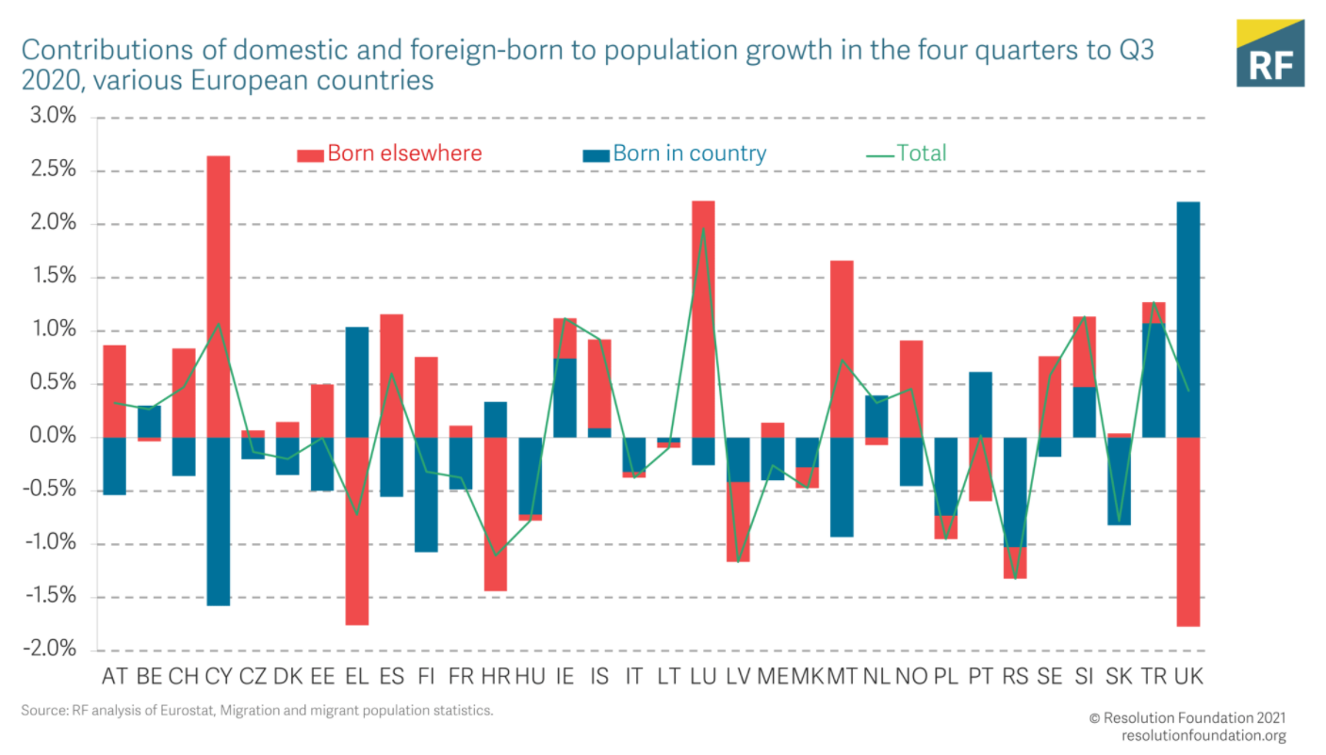
Supply of labour and skills
According to the Labour Force Survey (LFS), the number of people living in the UK but born overseas fell by approximately 1 million between the first and third quarters of 2020, while the number of UK-born UK residents in this same category band rose by 1.3 million over the same period. Some observers have cast doubt on these statistics, suggesting instead that the UK-born population has not changed, but that 1.3 million migrants have left the country.
We think that half a million – still a huge number, and around 5 per cent of the migrants in the UK – could be closer to the truth, with the difference with the other estimates being due to us factoring in a decline in the proportion of non-UK born people that participate in the LFS during the pandemic. The LFS is not designed to count the number of migrants. It is important to understand how the estimates of the composition of the UK population are derived from the LFS.
Sources: Resolution Foundation, March 2021;
OECD, October 2020
The negative impact on immigrants’ labour market outcomes is increased still further by the fact that they are strongly overrepresented in those sectors most affected by the pandemic to date. For example, in the particularly hard-hit hospitality industry, a quarter of employees in the EU are foreign-born, twice their share in overall employment.

Slide 21
Remote working
In March of 2021, there were 4,474 unique job postings for remote positions at companies based in Berkshire, over 400% more than the figure of 873 for the same period one year previous.
Compare this with the South East, in March 2021 there were 26,452 unique remote job postings for remote positions; rising from 5,121 in March of the previous year – an increase in line with TVB of over 400%.
A similar rise can be seen at national level, with a recorded 163,821 unique remote job postings in England in March of 2021, rising from 35,331 in March 2020 – an increase of over 360%.
From these figures it’s apparent that the COVID-19 pandemic has, somewhat unsurprisingly, prompted a massive boost in job postings for explicitly remote roles. Berkshire has seen a larger boost in vacancies which are remote-based than both England and the South East.
Source: EMSI, March 2021

Slide 22
Local Profiles

Slide 23
Bracknell Forest

Slide 24
Impact of COVID-19 up to 6th April 2021
COVID-19 cases (to 6th April 2021) – Source: Public Health Berkshire COVID-19 Dashboard, April 2021
7023 total cases
3 new cases daily
Claimant unemployment (to February 2021)
3,615 claimants (4.6% of the working age population) in Bracknell Forest UA
Notable business news
Bracknell Forest Council’s decision-making Executive has pledged financial support to Everyone Active so that the borough’s leisure services, which help residents’ physical and mental health, can open as soon as practically possible. Everyone Active runs: Bracknell Leisure Centre, Downshire Golf Complex and Coral Reef Waterworld. They will be supported until at least June through a combination of government grants and council underwriting. This will enable the key leisure sites to open as soon as the government’s roadmap allows. Source: Bracknell Forest Council, March 2021

Slide 25
Industries hit hardest by COVID shutdown
As illustrated by the above graph, Bracknell Forest has suffered very similarly to Great Britain in terms of the percentage of jobs within industries which have been hit hardest by COVID shutdowns. Thames Valley Berkshire area has seen an additional 0.77% of jobs of jobs affected worst by the COVID shutdowns when compared to Bracknell Forest.
Source: EMSI, March 2021 (definition for industries hit hardest provided on slide 53)

Slide 26
Industry risks and opportunities (2020-2021)
Critical industries
Food and drink retail: 3,234 employees (1% below the national average)
Energy/utilities: 257 employees (65% below the national average)
Health and social care: 6,193 employees (25% below the national average)
Freight/logistics: 515 employees (70% below the national average)
Insurance: 186 employees (69% below the national average)
Banking and financial services: 1,291 employees (13% below the national average)
Sectors most impacted
Hospitality and tourism: 3,743 employees (26% below the national average)
Arts, entertainment and recreation: 1,148 (24% below the national average)
Admin and support: 2,694 (21% below the national average)
Aviation: 0 employees
Non-food retail and wholesale: 8,508 (75% above the national average)
Manufacturing: 1,549 (69% below the national average)
Construction: 1,771 (40% below the national average)
Source: EMSI, January 2021

Slide 27
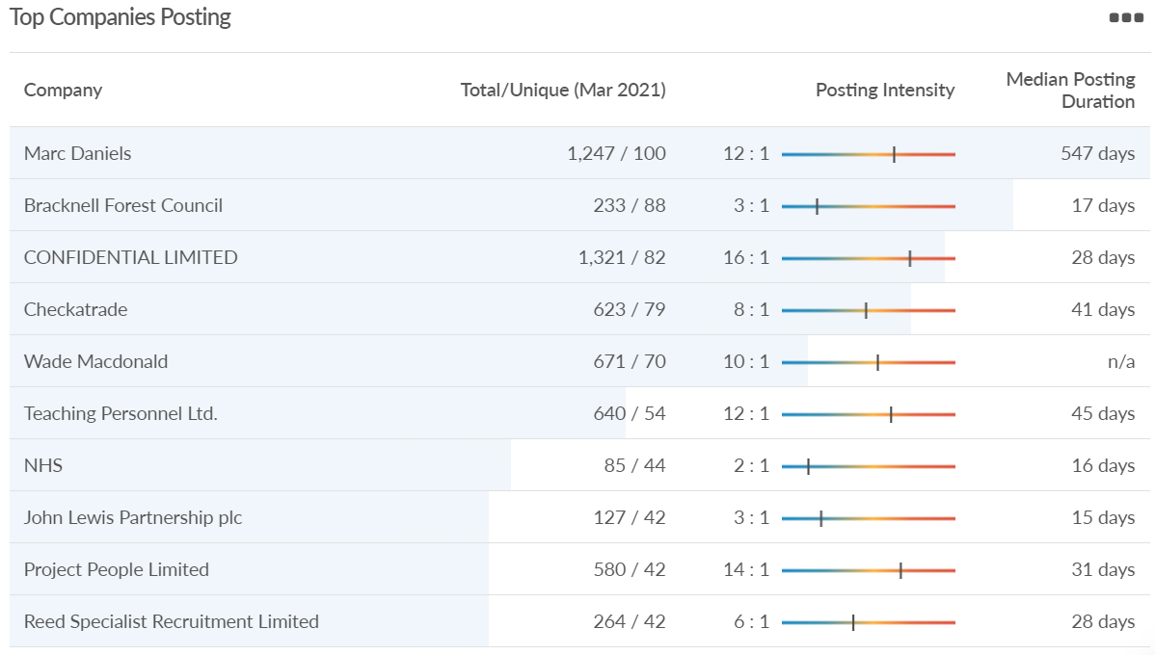
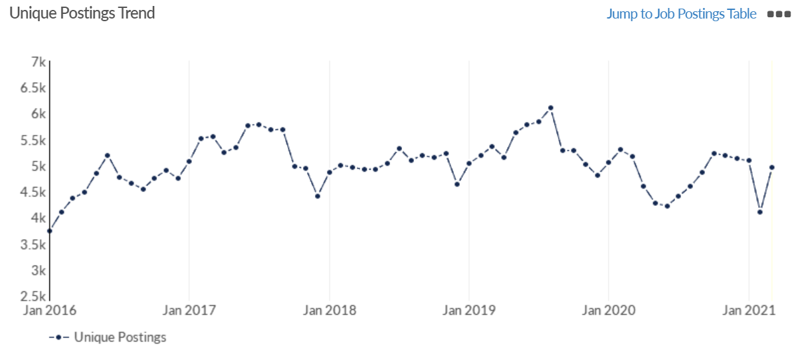
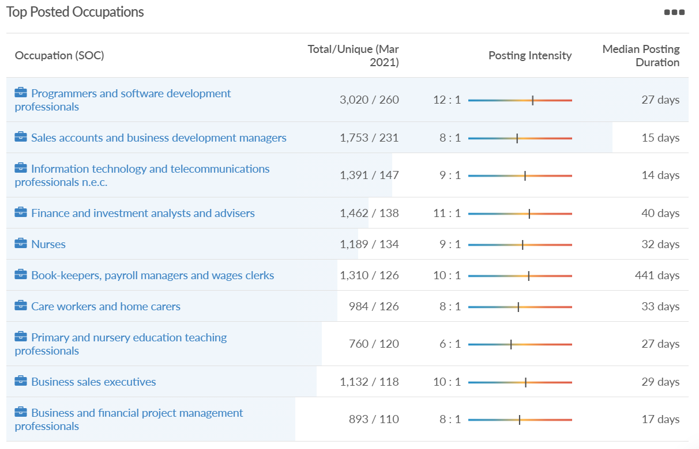
Job posting analytics (EMSI, March 2021)
Unique job postings: 4,952
Total job postings: 40,735
Job posting intensity: 8:1
Unique job postings (March 2020): 5,169

Slide 28
Slough

Slide 29
Impact of COVID-19 up to 6th April 2021
COVID-19 cases (to 6th April 2021) – Source: Public Health Berkshire COVID-19 Dashboard, April 2021
15,227 total cases
11 new cases daily
Claimant unemployment (to February 2021)
8,505 claimants (9% of the working age population) in Slough UA
Notable business news
Morgan Sindall and Muse Developments have completed a major series of schemes worth £48m for Slough Urban Renewal including a double-decker hotel, six-weeks ahead of schedule. This project has been a joint venture between Slough Borough Council, Morgan Sindall and Muse Developments. The nine-storey development features two new Marriott International hotels stacked on top of each other. The Moxy hotel boasts 152 luxury bedrooms in total, while the Residence Inn features 92 long-stay suites. Next door is Novus Apartments, a collection of 64 apartments, with 4,100 square feet of restaurant and retail space on the ground floor. The new development is located in the town centre at the site of the former library.
Source: PBC Today, April 2021

Slide 30
Industries hit hardest by COVID shutdown
When compared to both Thames Valley Berkshire and Great Britain, Slough has seen a significantly lower percentage of jobs affected by COVID shutdowns – perhaps somewhat surprising given the LA’s proximity to Heathrow and the almost complete shutdown of the aviation sector.
Source: EMSI, March 2021 (definition for industries hit hardest provided on slide 53)

Slide 31
Industry risks and opportunities (2020-2021)
Critical industries
Food and drink retail: 6,656 employees (47% above the national average)
Energy/utilities: 2,820 employees (174% above the national average)
Health and social care: 8,201 employees (28% below the national average)
Freight/logistics: 4,640 employees (93% above the national average)
Insurance: 121 employees (86% below the national average)
Banking and financial services: 731 employees (65% below the national average)
Sectors most impacted
Hospitality and tourism: 3,780 employees (46% below the national average)
Arts, entertainment and recreation: 442 (79% below the national average)
Admin and support: 9,765 (107% above the national average)
Aviation: 262 employees (16% above the national average)
Non-food retail and wholesale: 6,719 (0% above the national average)
Manufacturing: 5,071 (28% below the national average)
Construction: 2,620 (36% below the national average)
Source: EMSI, January 2021

Slide 32
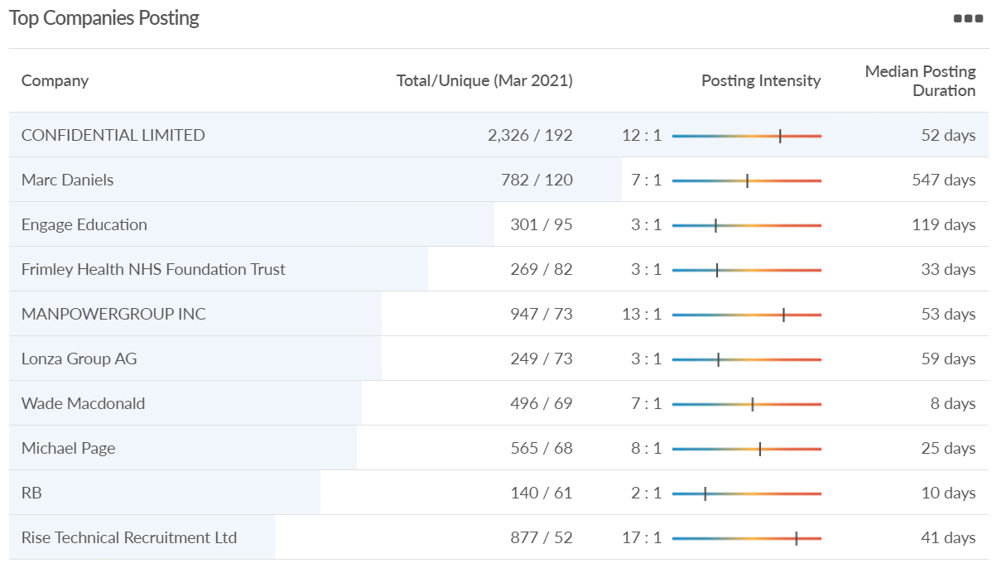
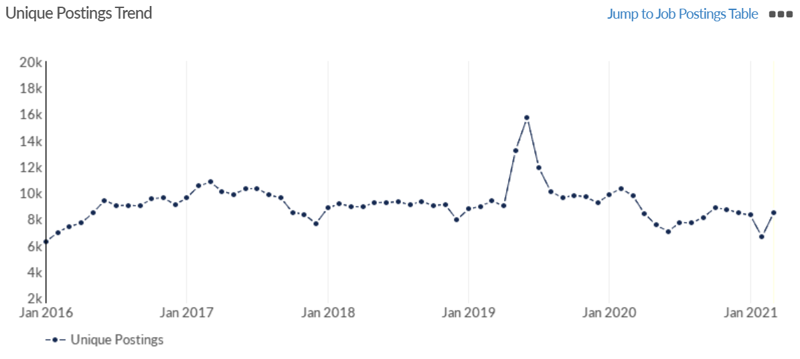
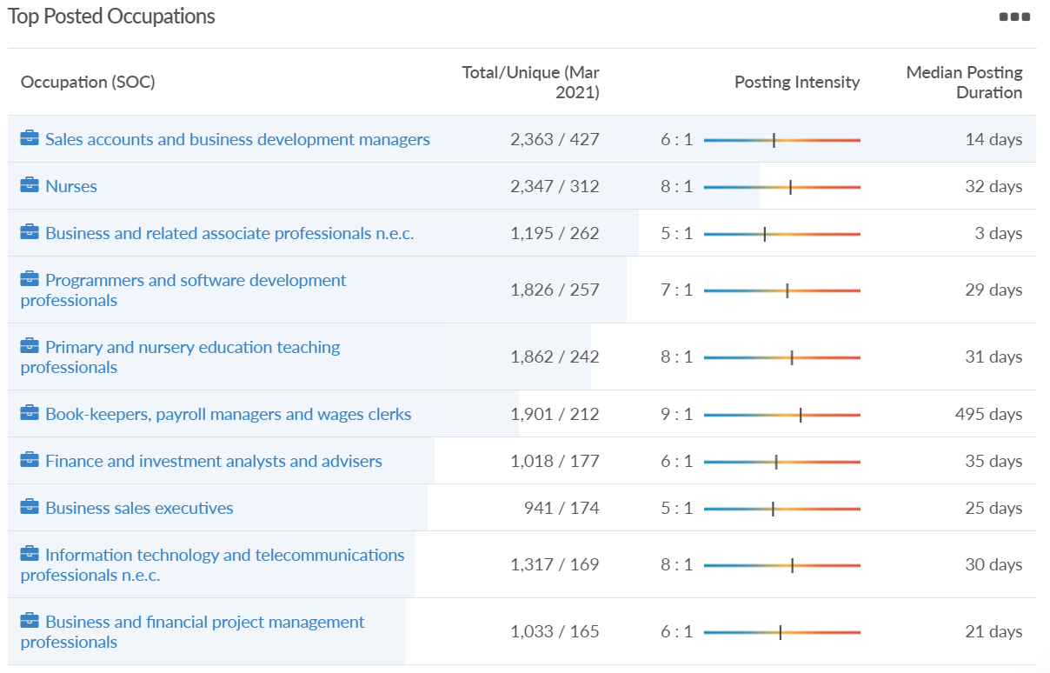
Job posting analytics (EMSI, March 2021)
Unique job postings: 8,488
Total job postings: 54,628
Job posting intensity: 6:1
Unique job postings (March 2020): 9,769

Slide 33
Reading

Slide 34
Impact of COVID-19 up to 6th April 2021
COVID-19 cases (to 6th April 2021) – Source: Public Health Berkshire COVID-19 Dashboard, April 2021
10,790 total cases
1 new case daily
Claimant unemployment (to February 2021)
7,195 claimants (6.7% of the working age population) in Reading UA
Notable business news
Reading Market taken over by Blue Collar Street food as major revamp launched. The revamped Reading Market will be a "celebration" of the town's local traders - its new boss has confirmed. Glen Dinning of Blue Collar Street Food says he is "so proud and excited" the company is in charge of a major revamp of the tired market in Hosier Street. The company has become popular in Reading for its street food markets in Market Place and events in Forbury Gardens, and now is taking control of the market. It also held markets at Reading FC matches before the coronavirus pandemic but was removed - much to the irritation of fans. The centrepiece of the new market is hoped to be a new building made from shipping containers that will house four permanent food operators.
Source: Berkshire Live, March 2021

Slide 35
Industries hit hardest by COVID shutdown
Reading has been marginally less affected by the COVID shutdowns as Great Britain has on average, with 15.16% of jobs within industries which have been most severely impacted by the shutdowns. The Local Authority is 1.26% better off than the average of the Thames Valley Berkshire area.
Source: EMSI, March 2021 (definition for industries hit hardest provided on slide 53)

Slide 36
Industry risks and opportunities (2020-2021)
Critical industries
Food and drink retail: 6,192 employees (11% above the national average)
Energy/utilities: 3,350 employees (163% above the national average)
Health and social care: 13,464 employees (5% below the national average)
Freight/logistics: 1,513 employees (49% below the national average)
Insurance: 2,076 employees (100% above the national average)
Banking and financial services: 1,688 employees (34% below the national average)
Sectors most impacted
Hospitality and tourism: 6,567 employees (25% below the national average)
Arts, entertainment and recreation: 1,811 (31% below the national average)
Admin and support: 9,212 (58% above the national average)
Aviation: <10 employees
Non-food retail and wholesale: 8,626 (18% above the national average)
Manufacturing: 2,000 (77% below the national average)
Construction: 2,273 (55% below the national average)
Source: EMSI, January 2021

Slide 37
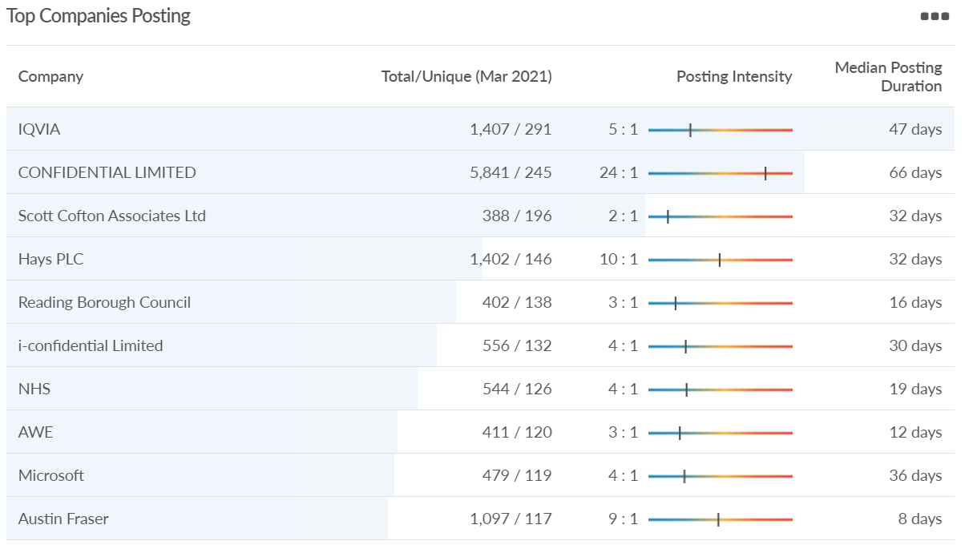
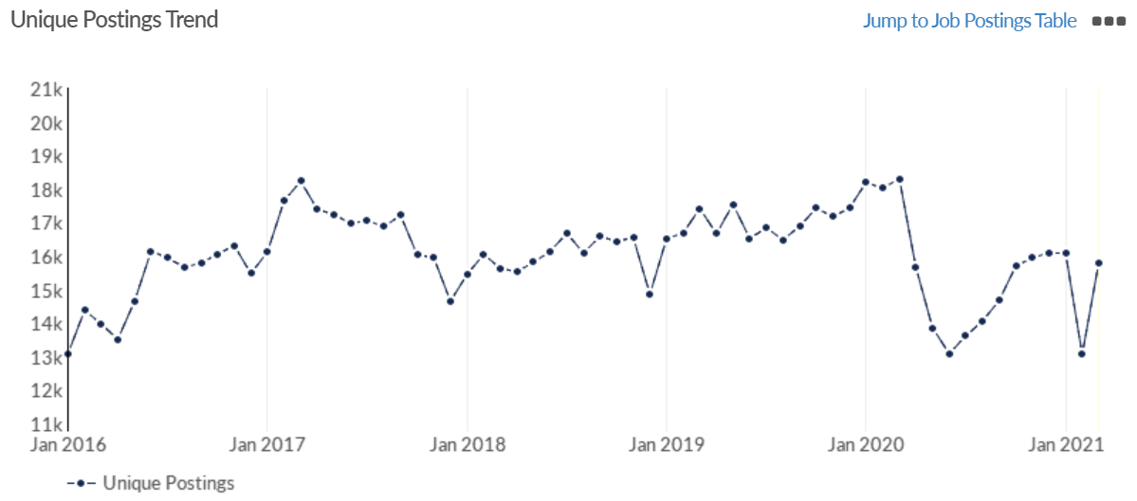
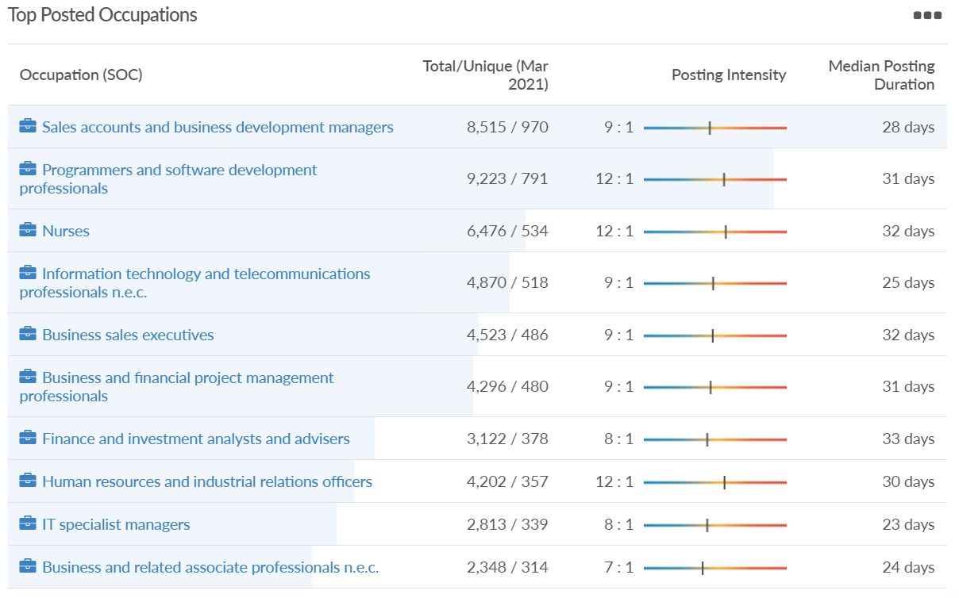
Job posting analytics (EMSI, March 2021)
Unique job postings: 15,808
Total job postings: 154,398
Job posting intensity: 10:1
Unique job postings (March 2020): 18,303

Slide 38
Wokingham

Slide 39
Impact of COVID-19 up to 6th April 2021
COVID-19 cases (to 6th April 2021) – Source: Public Health Berkshire COVID-19 Dashboard, April 2021
8,156 total cases
7 new cases daily
Claimant unemployment (to February 2021)
3,625 claimants (3.5% of the working age population) in Wokingham UA
Notable business news
A medical technology firm has its sights set on Reading and wants to help young people kickstart their own careers. Occuity, a start-up company researching optical technology, is planning to make more jobs available to local residents, including those in Wokingham borough, soon. After launching in 2019, the company now has more than 20 employees and plans to grow its team with an extra 30 members in the coming year.
Seventy new jobs will be created in Wokingham in a bid to help power the country with green electricity. National Grid ESO is looking for engineers, data analysts and digital and commercial operatives for Warwick head office and its borough-based control centre.
Sources: Wokingham Today, March 2021; Wokingham Today, March 2021

Slide 40
Industries hit hardest by COVID shutdown
Wokingham is in a similar position to Slough in that is has been significantly less affected by the COVID shutdowns than both the Thames Valley Berkshire area and Great Britain as a whole. This is likely due to the high levels of employment from the Tech sector (Microsoft etc. based at TVP) as this industry is able to work well from home.
Source: EMSI, March 2021 (definition for industries hit hardest provided on slide 53)

Slide 41
Industry risks and opportunities (2020-2021)
Critical industries
Food and drink retail: 3,883 employees (17% below the national average)
Energy/utilities: 1,434 employees (35% above the national average)
Health and social care: 7,283 employees (38% below the national average)
Freight/logistics: 886 employees (64% below the national average)
Insurance: 453 employees (48% below the national average)
Banking and financial services: 423 employees (80% below the national average)
Sectors most impacted
Hospitality and tourism: 5,410 employees (25% below the national average)
Arts, entertainment and recreation: 1,831 (16% below the national average)
Admin and support: 6,432 (33% above the national average)
Aviation: 0 employees
Non-food retail and wholesale: 6,494 (6% below the national average)
Manufacturing: 3,731 (48% below the national average)
Construction: 3,115 (26% below the national average)
Source: EMSI, January 2021

Slide 42
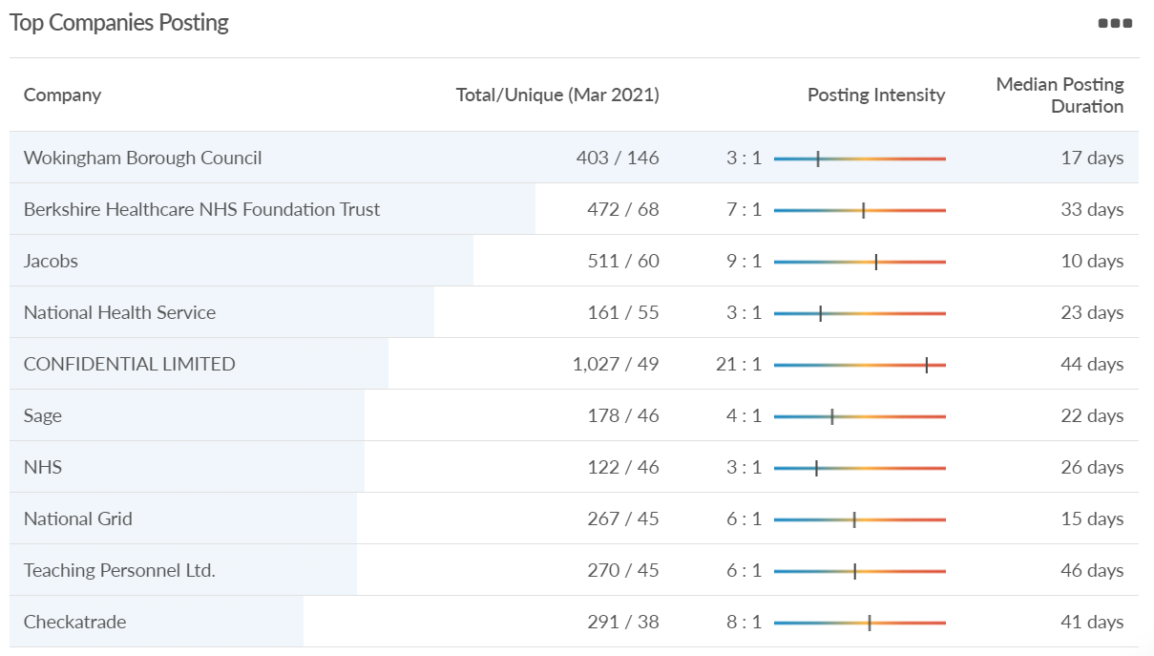
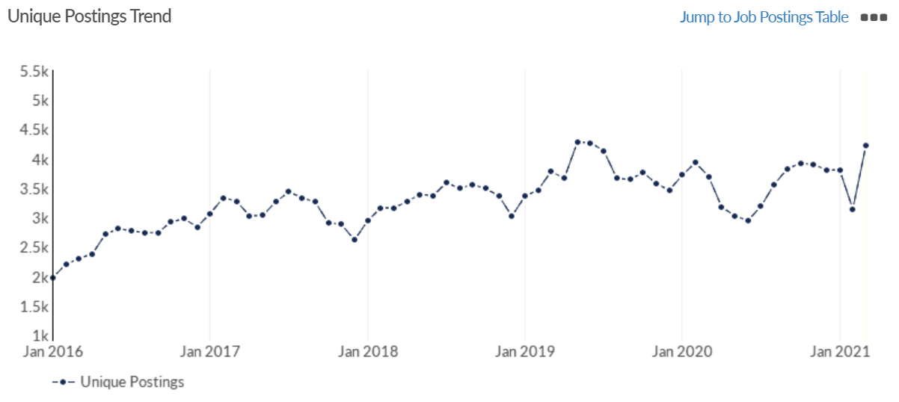
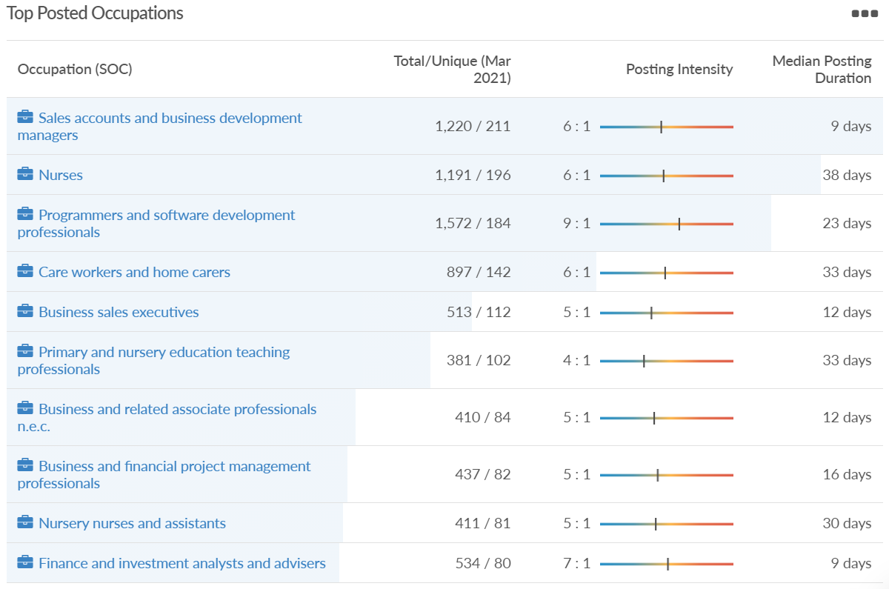
Job posting analytics (EMSI, March 2021)
Unique job postings: 4,221
Total job postings: 22,422
Job posting intensity: 6:1
Unique job postings (March 2020): 3,696

Slide 43
Windsor and Maidenhead

Slide 44
Impact of COVID-19 up to 6th April 2021
COVID-19 cases (to 6th April 2021) – Source: Public Health Berkshire COVID-19 Dashboard, April 2021
8,373 total cases
7 new cases daily
Claimant unemployment (to February 2021)
4,365 claimants (4.7% of the working age population) in Windsor and Maidenhead UA
Notable business news
Powers to force 13 tenants to sell up their property in Maidenhead town centre were approved by senior councillors - but will be used as a precautionary, a meeting heard last week. Cabinet members unanimously agreed to use compulsory purchase orders (CPO), which forces homeowners to sell up if their property obstructs a regeneration project, on 13 retailers near the Nicholson’s Shopping Centre if negotiations stall.
In the report, Denhead S.A.R.L., which is developing out the site, needs assistance with acquiring the interests of the remaining landowners and leaseholders to help deliver the regeneration of the Maidenhead town centre. Duncan Sharkey, managing director of the Windsor and Maidenhead council, said negotiations with the remaining retailers have been ongoing for over a year and hopes 'reasonable agreements' will be reached.
Source: Maidenhead Advertiser, March 2021

Slide 45
Industries hit hardest by COVID shutdown
Windsor and Maidenhead appears to be the most severely affected of all the Local Authorities which make up Berkshire in terms of percentage of jobs hit hardest by the COVID shutdowns. This is likely due in part to the enormous hit the leisure/tourism sector has taken and how key of an employer Legoland Windsor to the region.
Source: EMSI, March 2021 (definition for industries hit hardest provided on slide 53)

Slide 46
Industry risks and opportunities (2020-2021)
Critical industries
Food and drink retail: 3,733 employees (17% below the national average)
Energy/utilities: 882 employees (13% below the national average)
Health and social care: 8017 employees (29% below the national average)
Freight/logistics: 748 employees (68% below the national average)
Insurance: 434 employees (48% below the national average)
Banking and financial services: 1,252 employees (39% below the national average)
Sectors most impacted
Hospitality and tourism: 9,437 employees (35% above the national average)
Arts, entertainment and recreation: 4,516 (117% above the national average)
Admin and support: 4,207 (10% below the national average)
Aviation: 11 employees (95% below the national average)
Non-food retail and wholesale: 7,834 (18% above the national average)
Manufacturing: 2,523 (64% below the national average)
Construction: 6,201 (54% above the national average)
Source: EMSI, January 2021

Slide 47
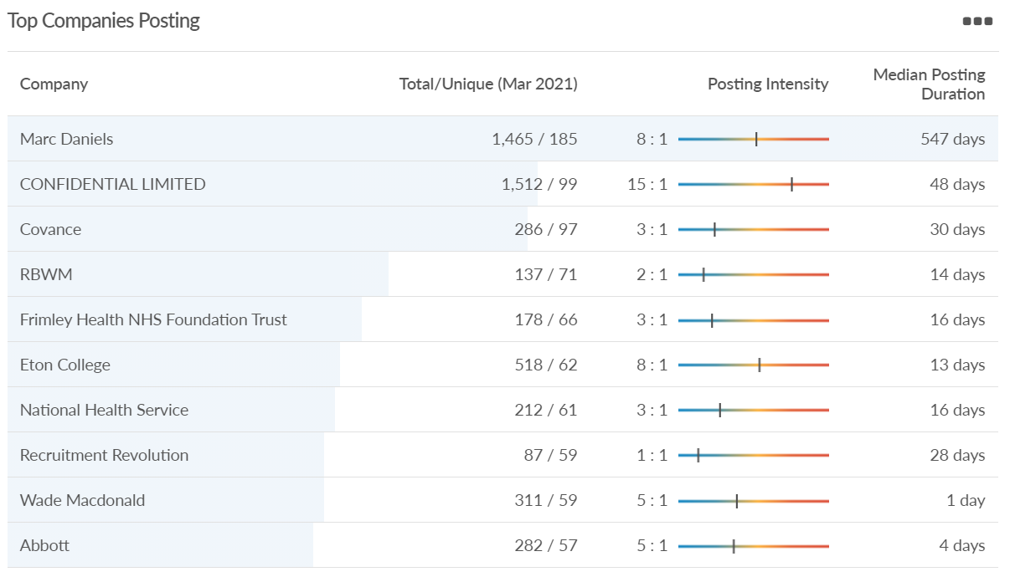
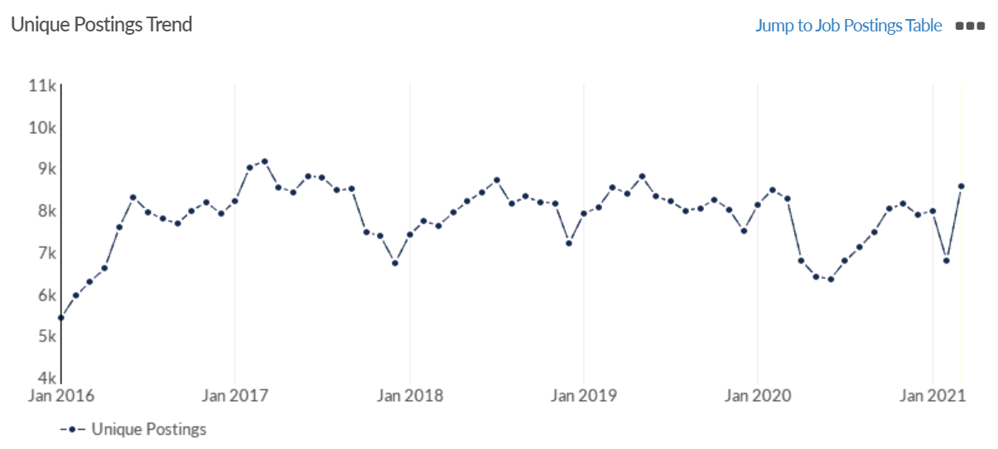
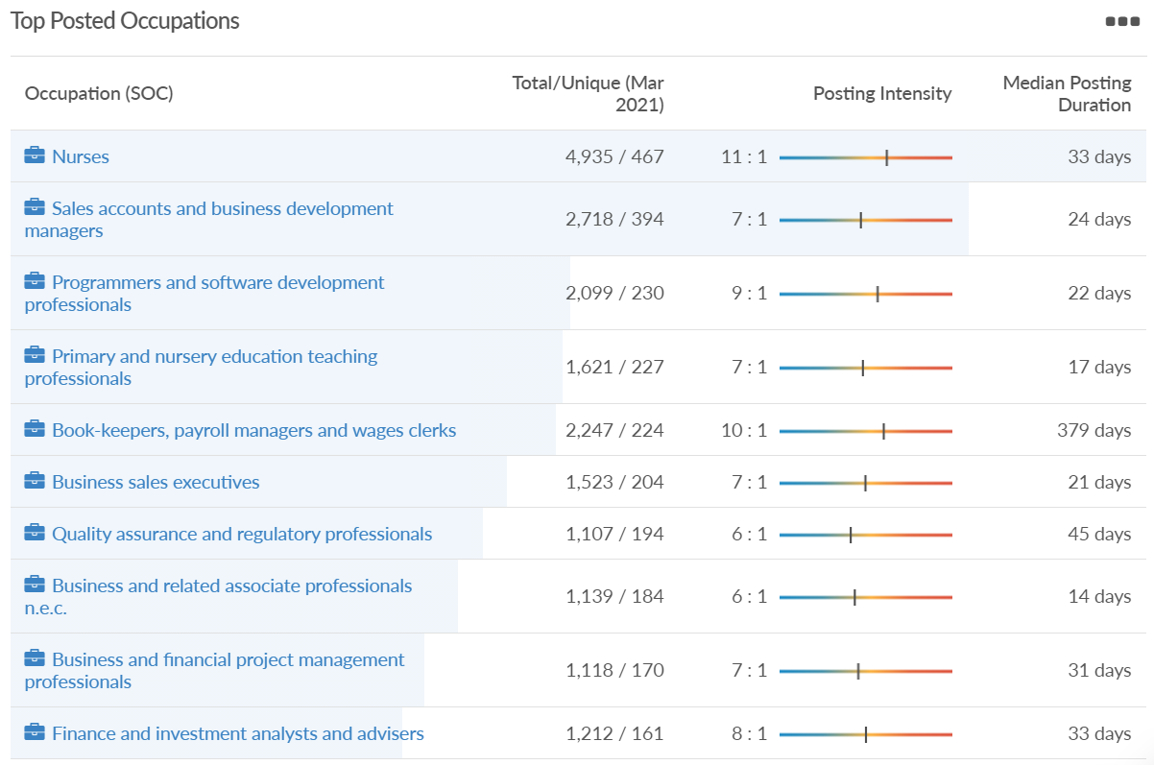
Job posting analytics (EMSI, March 2021)
Unique job postings: 8,556
Total job postings: 63,899
Job posting intensity: 7:1
Unique job postings (March 2020): 8,262

Slide 48
West Berkshire

Slide 49
Impact of COVID-19 up to 6th April 2021
COVID-19 cases (to 6th April 2021) – Source: Public Health Berkshire COVID-19 Dashboard, April 2021
6,311 total cases
1 new case daily
Claimant unemployment (to February 2021)
3,880 claimants (4% of the working age population) in West Berkshire UA
Notable business news
Rate-paying businesses in West Berkshire will be able to access 'Restart' grants of up to £18,000, thanks to Government funding, which will be distributed by West Berkshire Council. The grants, which are available to businesses in the retail, hospitality, leisure, accommodation, personal care and gym industries which have had to close, replace the previous Local Restrictions Support Grants and will be distributed by the Council from 1 April. The grants aim to assist businesses with the costs and adaptations relating to reopening in line with the Government's Covid-19 Recovery Roadmap. Grants will be distributed automatically, so businesses will not be required to reapply unless they have not received grant funding from the Council under previous schemes. As the grants apply to the period from 1 April, no funds will be released until after this date.
Source: West Berkshire Council, March 2021

Slide 50
Industries hit hardest by COVID shutdown
While West Berkshire hasn’t been as fortunate as Slough in terms of how great of a percentage of jobs have been directly affected by the COVID shutdown, it has fared significantly better than the Thames Valley Berkshire area and better than Great Britain.
Source: EMSI, March 2021 (definition for industries hit hardest provided on slide 53)

Slide 51
Industry risks and opportunities (2020-2021)
Critical industries
Food and drink retail: 4,289 employees (17% below the national average)
Energy/utilities: 1,343 employees (14% above the national average)
Health and social care: 6,773 employees (48% below the national average)
Freight/logistics: 1,574 employees (43% below the national average)
Insurance: 262 employees (73% below the national average)
Banking and financial services: 692 employees (71% below the national average)
Sectors most impacted
Hospitality and tourism: 6,617 employees (18% below the national average)
Arts, entertainment and recreation: 2,674 (10% above the national average)
Admin and support: 4,803 (11% below the national average)
Aviation: <10 employees
Non-food retail and wholesale: 8,432 (9% above the national average)
Manufacturing: 11,330 (41% above the national average)
Construction: 4,813 (3% above the national average)
Source: EMSI, January 2021

Slide 52
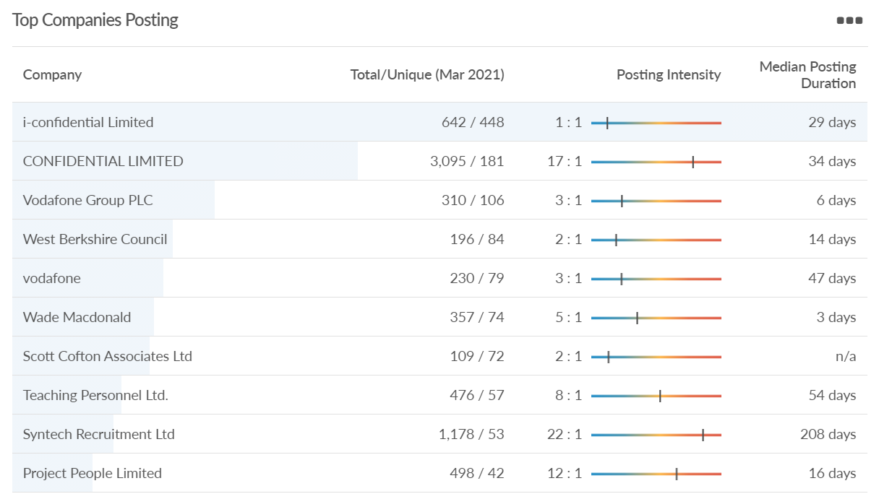
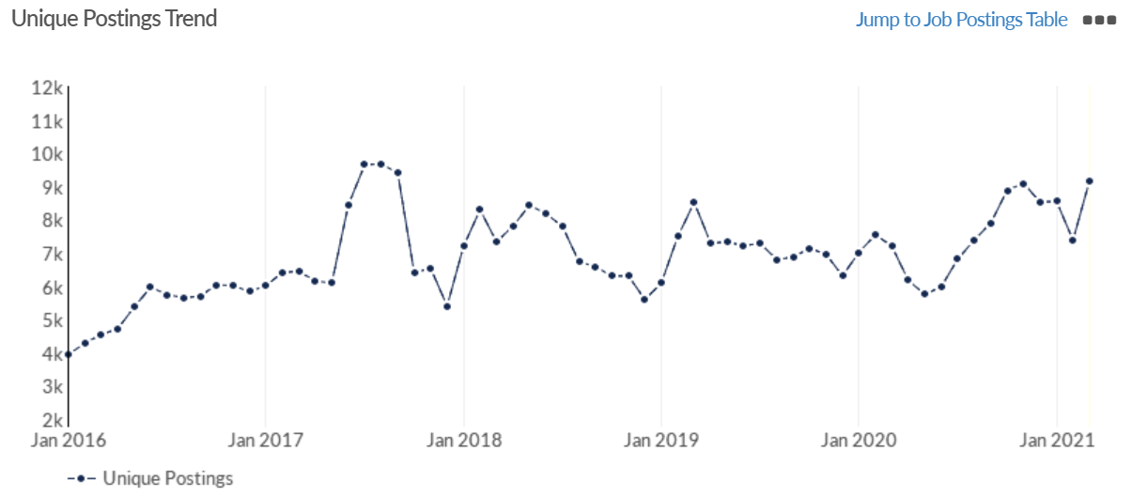
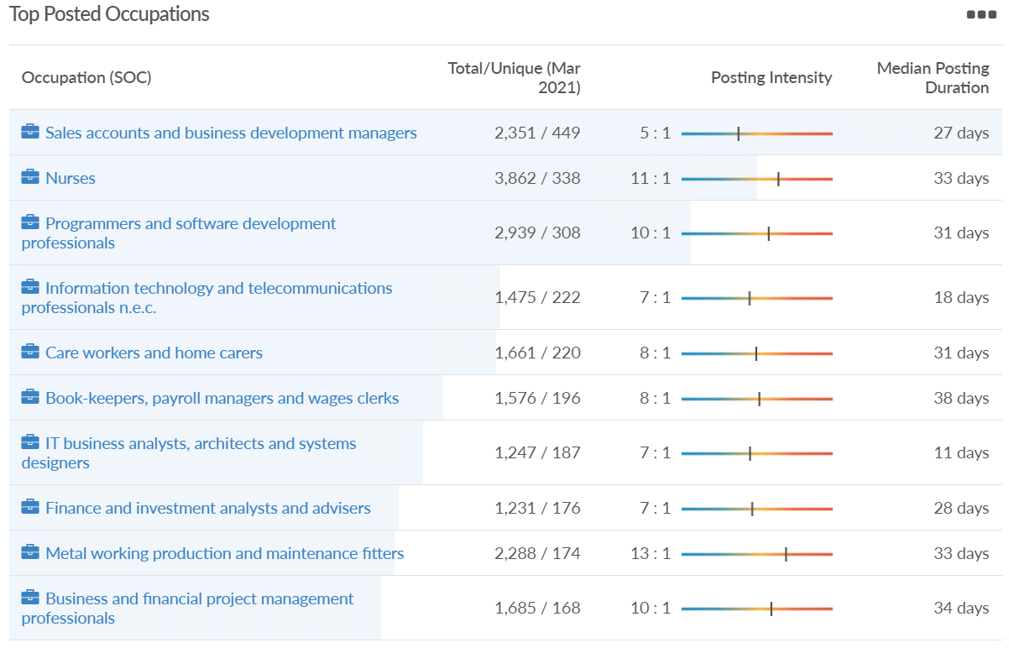
Job posting analytics (EMSI, March 2021)
Unique job postings: 9,166
Total job postings: 70,234
Job posting intensity: 8:1
Unique job postings (March 2020): 7,205

Slide 53
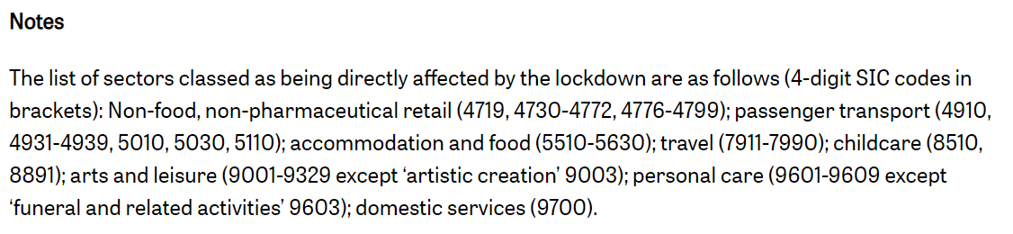
Definitions
Source: Institute for Fiscal Studies, April 2020

