Slide 1
Thames Valley Berkshire
Monthly Economic Briefing
September 2022

Slide 2
2022 Refresh
Following on from stakeholder feedback as well as discussions within the LEP over the course of the last year, we have decided to make some additions to the content of our economic briefings, whilst still continuing to report on the bulk of the areas we were last year.
Each month, we aim to have a themed feature. This month, we will be reporting on the fiscal policy announcements in the mini-budget and the reversals that have ensued since.
These monthly economic briefings are constantly evolving documents and their content is dictated in part by data/information requests from our readers.
If there is an economic aspect not currently covered within these reports which you think would be beneficial to include/expand upon (or you have any queries), we will do our best to help. Please contact Dex or Aishwarya in the LEP’s research team at dexterlevick@thamesvalleyberkshire.co.uk or aishwaryachakravarty@thamesvalleyberkshire.co.uk.

Slide 3
Key contents of this month’s briefing
Updated global and UK economic forecasts
Monthly Spotlight – Fiscal policy changes and their implications
Key points from the latest Labour Force Survey data
Latest claimant count figures by Local Authority
Latest remote working figures for Thames Valley Berkshire
Latest ‘notable business news’ by Local Authority
Latest job posting analytics by Local Authority

Slide 4
Global and National Economy
September 2022

Slide 5
September 2022
OECD Economic Outlook, Interim Report
The world economy is paying a high price for Russia’s war against Ukraine. The four main takeaways are:
The world economy is slowing more than anticipated. Global growth is projected to slow from 3% in 2022 to 2¼ per cent in 2023, well below the pace foreseen prior to the war.
Inflation has become more widespread. More than half of the items in the price index show inflation above 4% in the United Kingdom.
Inflation will ease but will remain at high levels. Headline inflation is projected to ease from 8.2% in 2022 to 6½ per cent in 2023 in the G20 economies, and decline from 6.2% in the G20 advanced economies this year to 4% in 2023.
Demand reduction and supply diversification are needed to avoid energy shortages which could push up global energy prices, hit confidence and financial conditions and require a temporary rationing of gas use by businesses. Taken together, these shocks could reduce growth in the European economies by over 1¼ percentage points in 2023, relative to baseline, and raise inflation by over 1½ percentage point.
Source: OECD, September 2022

Slide 6
September 2022
Global Economics Intelligence executive summary
Led by the US Federal Reserve, most central banks are increasing interest rates to fight inflation. With 75-basis-point hikes in September, the Fed and the European Central Bank (ECB) brought policy interest rates to ranges of 3–3.25% and 0.75–1.50%, respectively. In Britain, where inflation is near 10%, the Bank of England (BoE) raised its key interest rate to 2.25%.
Among the factors driving high inflation are high energy costs. The price of petroleum has been receding since June. However, the prices for coal and natural gas have increased rapidly, especially in Europe.
The US dollar strengthened to historic levels against the pound and the euro. The depreciation of the pound accelerated following the news of a government plan for tax cuts and borrowing which set off turmoil in the UK bond market. The BoE announced that it would buy £65 billion in government bonds to secure financial stability.
Despite COVID-19 restrictions, heat waves, and drought, Chinese economic activity showed some signs of recovery in August and September. In India, the economy expanded 13.5% in the second quarter of 2022; industrial production slowed in July but more recent indicators show manufacturing and services growth.
Source: McKinsey, September 2022

Slide 7
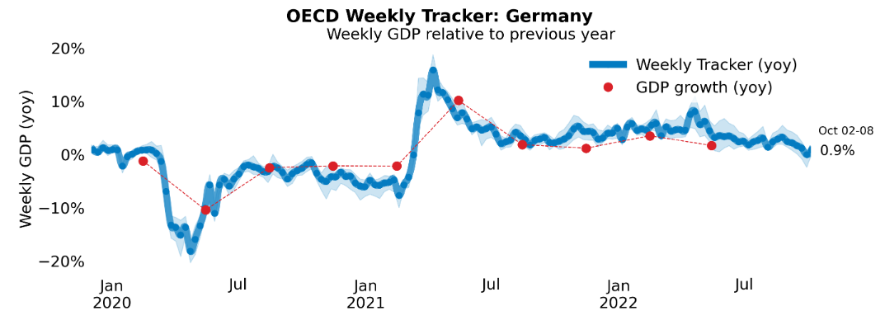
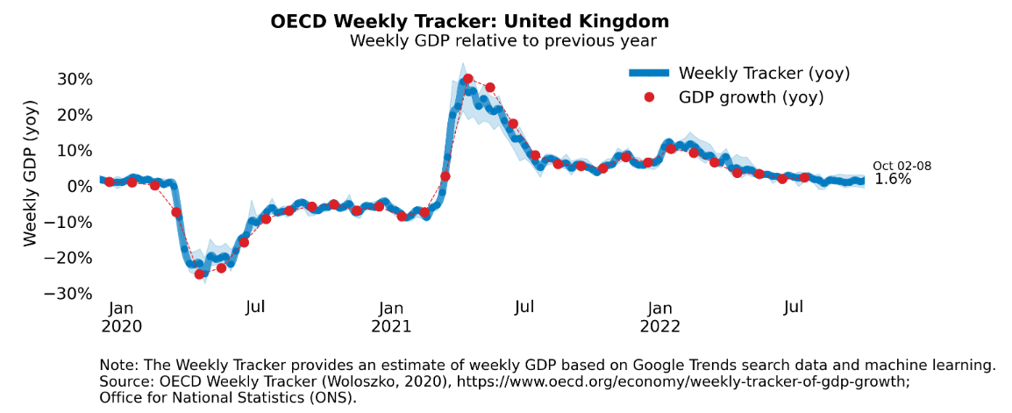
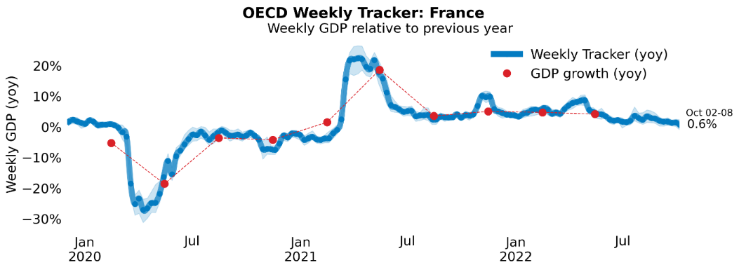
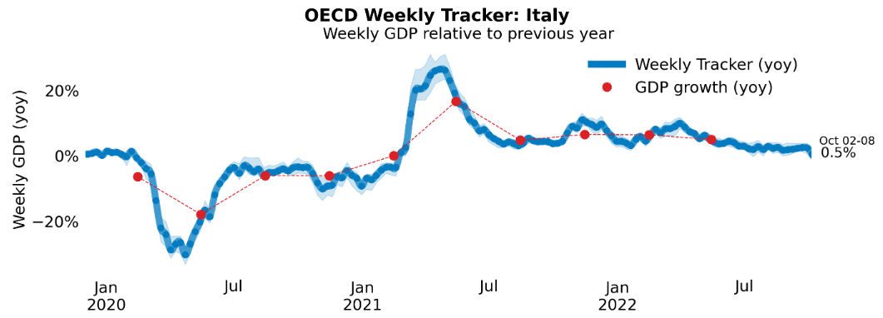
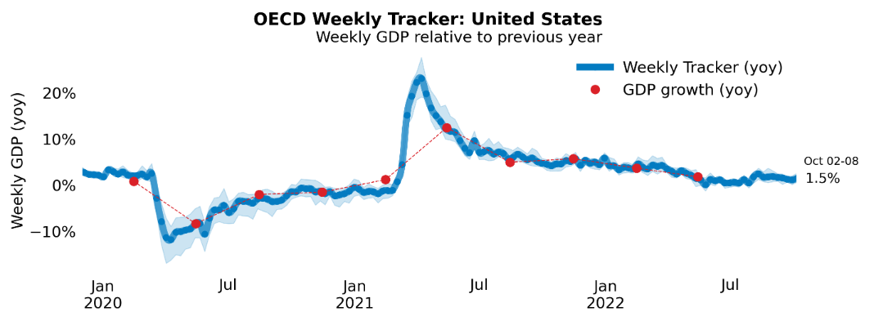
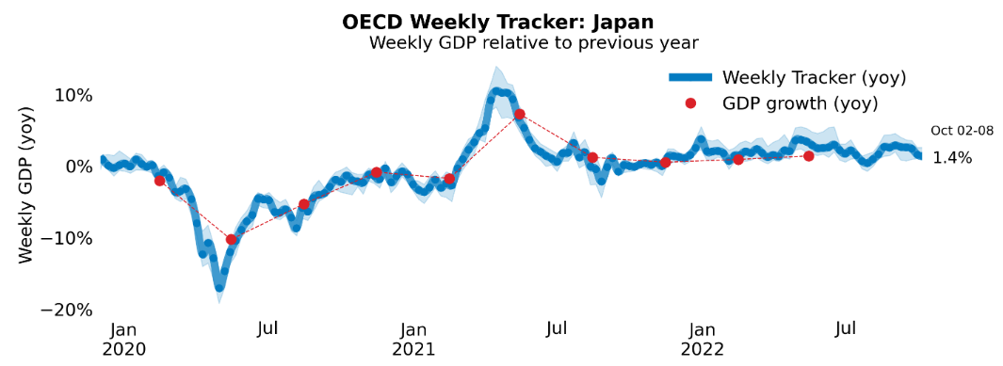
Global Economy
OECD GDP Tracker
The Weekly Tracker is an estimate of weekly GDP relative to the pre-crisis trend, which is proxied by the OECD Economic Outlook forecasts.
Source: OECD, September 2022

Slide 8
September 2022
Bank of England Monetary Policy Summary
The Bank of England’s Monetary Policy Committee (MPC) sets monetary policy to meet the 2% inflation target, and in a way that helps to sustain growth and employment. At its meeting ending on 21 September 2022, the MPC voted to increase Bank Rate by 0.5 percentage points, to 2.25%.
The labour market is tight and domestic cost and price pressures remain elevated. In and of itself, the Government’s Energy Price Guarantee will lower and bring forward the expected peak of CPI inflation in the near term, but it also means that household spending is likely to be less weak than projected. This would add to inflationary pressures in the medium term.
The Committee also voted unanimously to reduce the stock of purchased UK government bonds, financed by the issuance of central bank reserves, by £80 billion over the next twelve months, to a total of £758 billion. However, the first gilt sale operations were postponed in light of current market conditions and are scheduled to take place on 31 October and proceed thereafter.
Source: Bank of England, September 2022
Notes:
data

Slide 9
September 2022
Business insights and impact on the UK economy
In late September 2022, of businesses who reported on the frequency that they pay their energy bills, 34% reported they have fixed or hedged electricity contacts, this percentage was 29% for gas; of these, 18% are expecting their electricity bills to increase by more than 300% at the end of their contract, and 17% expect the same for their gas bills.
In late September 2022, 42% of trading businesses reported they had not passed on their higher costs to customers, with businesses in the professional, scientific and technical activities industry reporting the highest proportion, at 66%.
For October 2022, input price inflation and energy prices continue to remain the top two concerns reported by businesses, at 24% and 23%, respectively.
In late September 2022, of not permanently stopped trading businesses, nearly half (46%) reported they were not concerned about the impact climate change may have on their business.
Source: ONS, September 2022
Notes:
Data source

Slide 10
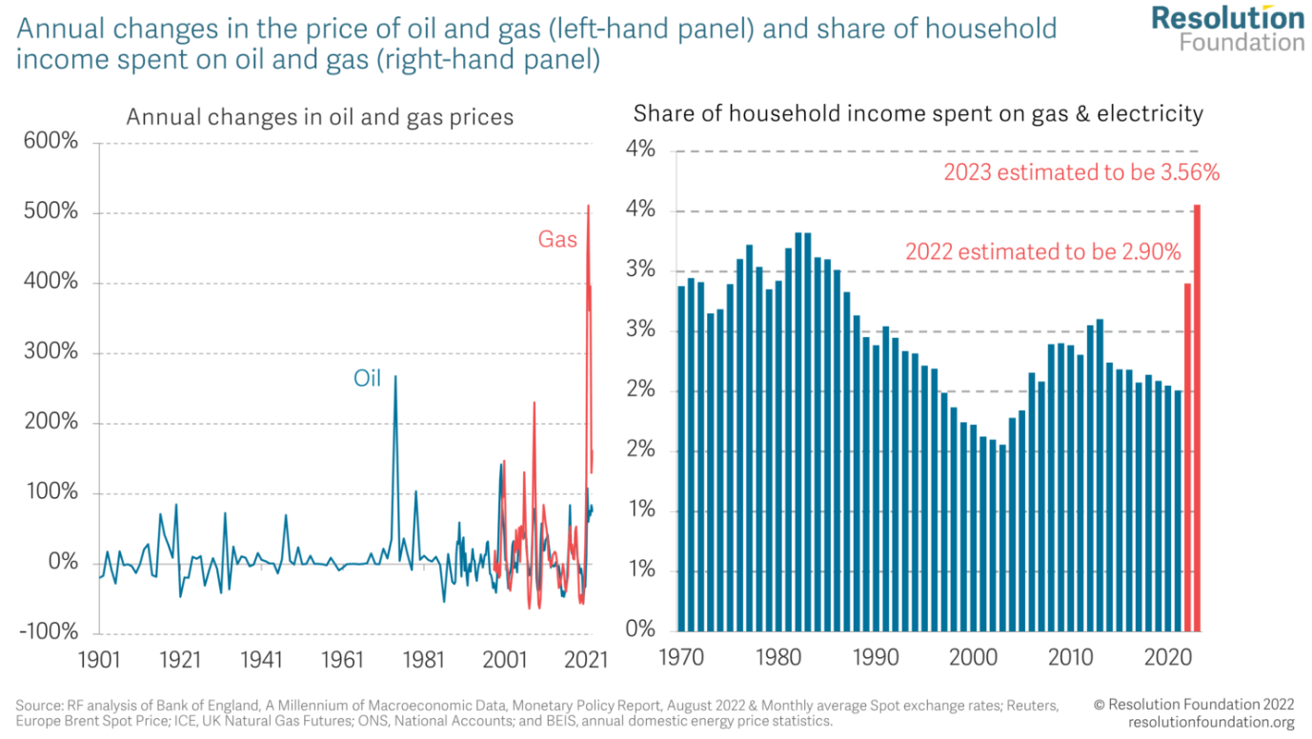
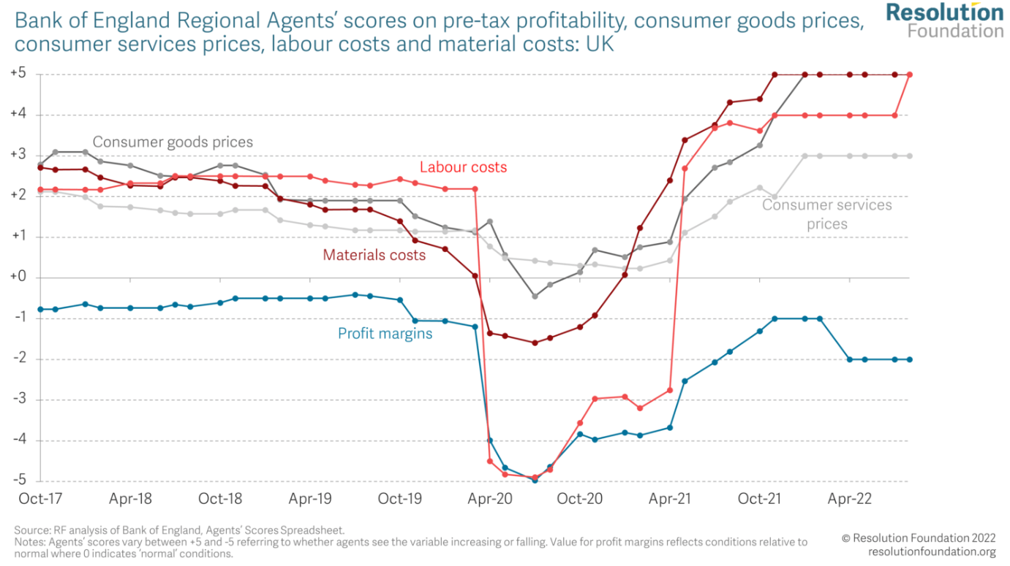
September 2022
Macroeconomic Policy Outlook: Q3 2022
Wholesale gas prices have risen by a factor of 10 since 2019. If families consumed as much gas and electricity this year and next as they did in 2019, energy-bill spending would still rise by 1.6 percentage points as a share of disposable income despite recent falls in energy prices.
The Bank of England’s network of Regional Agents’ survey scores shows that while prices, particularly those of consumer goods, have been rising rapidly over the past year, these have been matched by a sharp increase in the labour costs and material costs over the same period. The net effect of this is that firms are reporting that their margins are under pressure relative to ‘normal’ conditions suggesting that recent increases in prices are still consistent with firms decreasing profits as part of the adjustment to higher energy prices.
Source: Resolution Foundation, September 2022
Notes:
Data source

Slide 11
September 2022
Monthly Spotlight: Fiscal policy changes
The then Chancellor, Kwasi Kwarteng, delivered his ‘Growth Plan’ on the 23rd of September 2022. Kwarteng announced a new era of “growth” driven by tax cuts to the tune of £45bn. The unfunded nature of these cuts led the financial markets to dramatically raise the cost of UK government bonds with serious consequences for the interest rate on all debt, including mortgages.
The yields on 10-year gilts – UK government bonds – surged after Kwarteng’s announcement, rising from 3.5% to 4.3% before falling back to about 4% after the Bank of England triggered an emergency £65bn bond-buying programme to stem the crisis, which put entire pension funds at risk of insolvency.
The British pound hit its lowest level against the US dollar in almost four decades - falling to $1.1407.
Average mortgage interest rates reached the highest levels they have been since the 2008 financial crisis.
The ONS published that the rate of inflation rose to 10.1% in September, equivalent to the 40-year high seen in July, as the economy reeled from the effects of rising prices and the fallout from the mini-budget.

Slide 12
September 2022
Monthly Spotlight: Fiscal policy changes
The IFS and Citi’s “Green Budget” estimated that £62bn of fiscal tightening will be needed to stabilise debt as a share of national income in 2026-27 – a sum that would imply the return of austerity and is equivalent to adding 9.5p to the base rate of income tax. This shortfall is a consequence of measures announced since the Truss government took office, including its reversal of various tax increases such as corporation tax and national insurance, and its Energy Price Guarantee.
The IFS also said deep austerity measures will be needed to stabilise debt in the medium term as it forecast a £1,500 hit to households from surging interest rates.
Following the consequences of the mini-budget, Jeremy Hunt was appointed chancellor on the 14th of October after the Prime Minister sacked Kwasi Kwarteng.
Hunt has reversed nearly all tax measures announced in the mini-budget. Official Treasury estimates suggest the revenue raised to be around £32bn by 2026-27, more than two-thirds of the original £45bn package of tax cuts. On October 31, Hunt will be presenting a new fiscal strategy alongside economic and fiscal forecasts from the Office for Budget Responsibility.

Slide 13
September 2022
Monthly Spotlight: Fiscal policy changes
 | What was announced | What remains now
Income tax – basic rate | The basic rate was to be cut to 19% from April 2023. The government said this would save 31 million people £170 a year People in England, Wales and Northern Ireland pay 20% on any annual earnings between £12,571 to £50,270 - rates in Scotland are different The rate was already due to be cut in 2024, but this was brought forward | The basic rate of income tax will remain at 20% Cutting it has been put on hold "indefinitely"
Income tax – top rate | 45% rate of income tax for earnings over £150,000 abolished for England, Wales and Northern Ireland taxpayers One single higher rate of income tax of 40% from April next year | Scrapped - the cut to the higher rate is no longer going ahead
Corporation tax | Cancel UK-wide rise in corporation tax which was due to increase from 19% to 25% in April 2023 | Scrapped - UK corporation tax will go up from 19% to 25% in April 2023

Slide 14
September 2022
Monthly Spotlight: Fiscal policy changes
 | What was announced | What remains now
Energy bills - households | The government said a typical household using both gas and electricity would pay £2,500 annually for two years. It announced this before the mini-budget | The energy price guarantee now only covers this winter. It will be in place until April next year A Treasury-led review will look at what measures should be put in place after this date
Energy bills - businesses | The Energy Bill Relief Scheme will reduce wholesale gas and electricity prices for all UK businesses, charities, and the public sector like schools and hospitals. It was announced before the mini-budget The discount under the scheme is applied automatically and covers energy usage from 1 October 2022 to 31 March 2023. | Retained
Alcohol duty | Freeze on alcohol duty rates | Scrapped
VAT | VAT-free shopping for non-UK visitors | Scrapped

Slide 15
September 2022
Monthly Spotlight: Fiscal policy changes
 | What was announced | What remains now
National Insurance | Reverse recent rise in National Insurance (NI) from 6 November Workers and employers have paid an extra 1.25p in the pound since April New Health and Social Care Levy to pay for the NHS will not be introduced | Retained
Dividend tax | Cuts to the tax paid on shareholders' dividends. An increase introduced in April will stay in place, saving about £1bn | Retained
IR35 rules | The government had promised to change the rules on off-payroll working, known as IR35, so companies were no longer responsible for ensuring their contractors were paying the right amount of tax. It said the current system created "unnecessary complexity and cost" for businesses. | Scrapped - this reform, which the government said would have cost £2bn a year, will no longer go ahead.

Slide 16
September 2022
Monthly Spotlight: Fiscal policy changes
 | What was announced | What remains now
Stamp duty | Cut to stamp duty which is paid when people buy a property in England and Northern Ireland No stamp duty on first £250,000 and for first time buyers that rises to £425,000 - comes into operation today 200,000 more people will be taken out of paying stamp duty altogether, government claims | Retained
Benefits | Rules around universal credit tightened, by reducing benefits if people don't fulfil job search commitments Around 120,000 more people on Universal Credit to be asked to take steps to seek more work, or face having their benefits reduced Jobseekers over 50 to be given extra time with work coaches to help them return to job market | Retained
Bankers’ bonuses | Rules which limit bankers' bonuses to twice their fixed salary to be scrapped Package of regulatory reforms to be set out later in the autumn | Retained

Slide 17
Employment in the UK
Labour Force Survey – September 2022
Key points:
May to July 2022 estimates show a decrease in the unemployment rate compared with the previous three-month period (February to April 2022), and a decrease in the employment rate, while the economic inactivity rate increased.
Total hours worked decreased compared with the previous three-month period, and are still just below pre-coronavirus (COVID-19) pandemic levels.
The UK employment rate was estimated at 75.4%, 0.2 percentage points lower than the previous three-month period and 1.1 percentage points lower than before the coronavirus pandemic (December 2019 to February 2020).
The UK unemployment rate was estimated at 3.6%, 0.2 percentage points lower than the previous three-month period, and 0.4 percentage points below pre-coronavirus pandemic levels.
The UK economic inactivity rate was estimated at 21.7%, 0.4 percentage points higher than the previous three-month period, and 1.5 percentage points higher than before the coronavirus pandemic.
Source: ONS, September 2022

Slide 18
Economic and Labour Market Insight: Implications for Thames Valley Berkshire

Slide 19
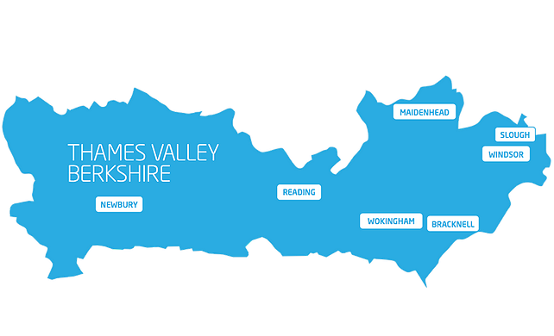
Claimant Count (Latest data - September 2022)
Total of 16,950 claimants (2.9% of the working age population) in Thames Valley Berkshire
1,650 claimants (2.1% of the working age population) in Bracknell Forest UA
4,990 claimants (5.3% of the working age population) in Slough UA
4,370 claimants (4.1% of the working age population) in Reading UA
1,720 claimants (1.6% of the working age population) in Wokingham UA
2,100 claimants (2.3% of the working age population) in Windsor and Maidenhead UA
2,115 claimants (2.2% of the working age population) in West Berkshire UA
Across Thames Valley Berkshire, claimant unemployment has fallen significantly from 22,050 in September 2021 to 16,950 in September 2022. Slough had 5.3% of its working age population claim unemployment in September 2022, down significantly from 6.5% in September 2021.
Source: ONS, September 2022

Slide 20
Strategic Issues
Liz Truss backs construction of a third runway at Heathrow Airport
Liz Truss has reiterated her support for a third runway at Heathrow - but warned the aviation industry it needs to become more environmentally friendly. The PM spoke as she was questioned in the Commons about the expansion of the UK's largest air hub, saying she agreed with Transport Secretary Anne-Marie Trevelyan, who last week backed the project because 'aviation is a really important part of our growth’. 'What we need to do is make sure industries like the air industry become more environmentally friendly. I support the development of low-carbon technology in those sectors, that's the way we will help grow the economy but also serve the environment.'
Paul McGuinness, chairman of the No 3rd Runway Coalition, said: 'Whatever this new administration and Transport Secretary might say now, facts are likely to steer Government away from Heathrow expansion. After all, with forecasts that Heathrow expansion would lead to a loss of activity at regional airports, even embedded in the policy document originally supporting Heathrow's growth, and the Climate Change Committee calculating that Heathrow expansion might require the closure of some regional airports, it is becoming clear that a national aviation strategy is required.’
Source: MSN, September 2022

Slide 21
An important note on the EMSI figures contained on the following slides: 22, 26, 29, 32, 35, 38 and 41
From February 2022, there has been a methodological change in how EMSI calculates job posting figures compared to those from prior months following a merger between EMSI and Burning Glass Technologies (rebranding to Lightcast).
Those of you who have read previous economic briefings from Thames Valley Berkshire LEP may notice that the job posting figures contained in post-January 2022 briefings are lower across the board – in some cases quite significantly.
This change in methodology does not invalidate previous figures, but it is important to consider when reporting on job posting data longitudinally.

Slide 22
Remote working
In September of 2022, there were 3,554 unique job postings for remote positions at companies based in Berkshire, around 1.5% more than the figure of 3,502 for the same period one year before.
Compare this with the South-East, in September 2022 there were 17,132 unique remote job postings for remote positions; falling from 17,780 in September of the previous year – a decrease of 3.6%.
A rise can also be seen at national level, with a recorded 129,430 unique remote job postings in England in September of 2022, falling from 134,941 in September 2021 – a decrease of about 4.1%.
From these figures it’s apparent that the massive boost in job postings for explicitly remote roles prompted by the COVID-19 pandemic has persisted despite the reduction in cases. Berkshire has seen a larger boost in vacancies which are remote-based than in the South-East and England overall.
Source: EMSI, September 2022

Slide 23
Local Profiles

Slide 24
Bracknell Forest

Slide 25
Unemployment figures and notable business news - September 2022
Claimant unemployment to September 2022 (latest)
1,650 claimants (2.1% of the working age population) in Bracknell Forest UA
Notable business news:
The latest and final phase of hundreds of homes being built in Warfield is to go ahead as dozens more get the green light. Land to the north of Harvest Ride and east of West End Lane, dubbed ‘Phase 10’, will also see the construction of new access, parking, landscaping and associated infrastructure following approval by Bracknell Forest Council. It is the latest stage of the huge 750-home Warfield plan, first approved in 2014, which includes a retirement home, primary school, and the north-south link road between Harvest Ride and Forest Ride. - LINK.
Note: The LEP has been previously reporting on COVID-19 case rates in these monthly economic briefings. The dashboards containing this data have been shut down as April 2022 and, as a result, we will no longer be doing so.

Slide 26
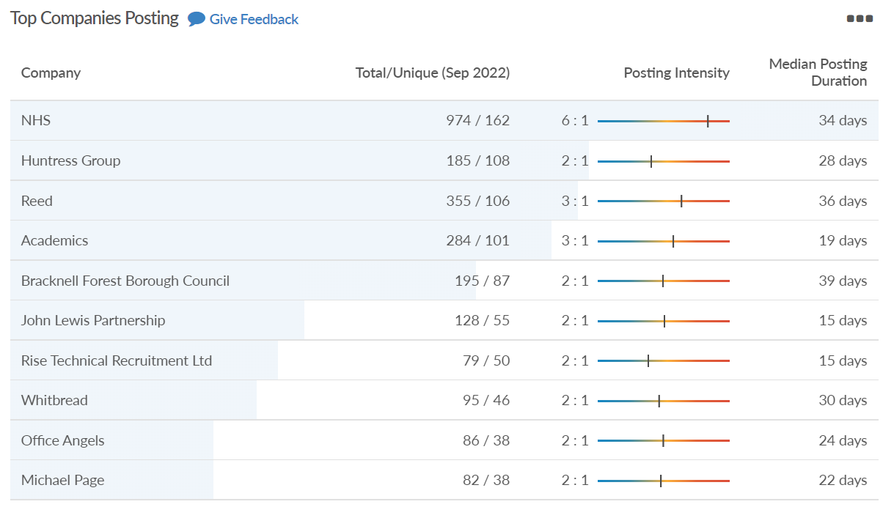
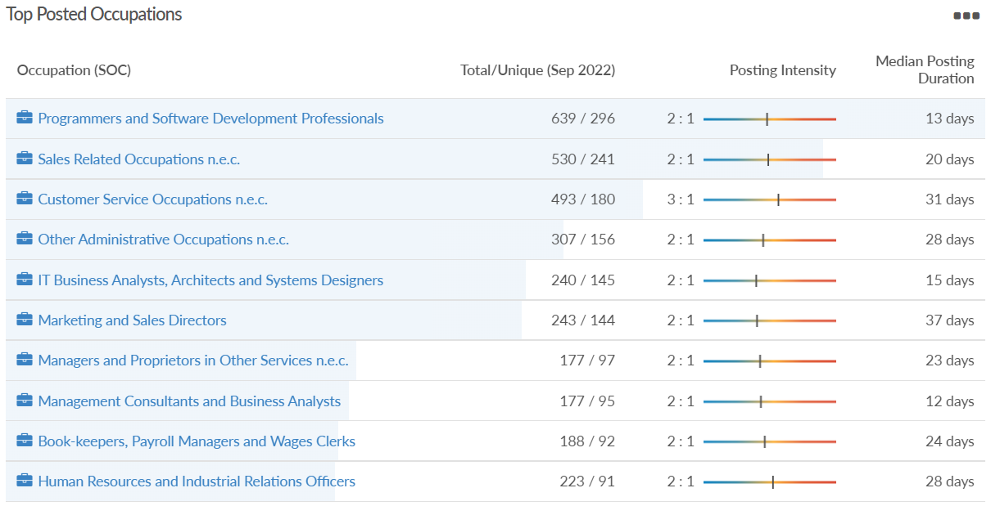
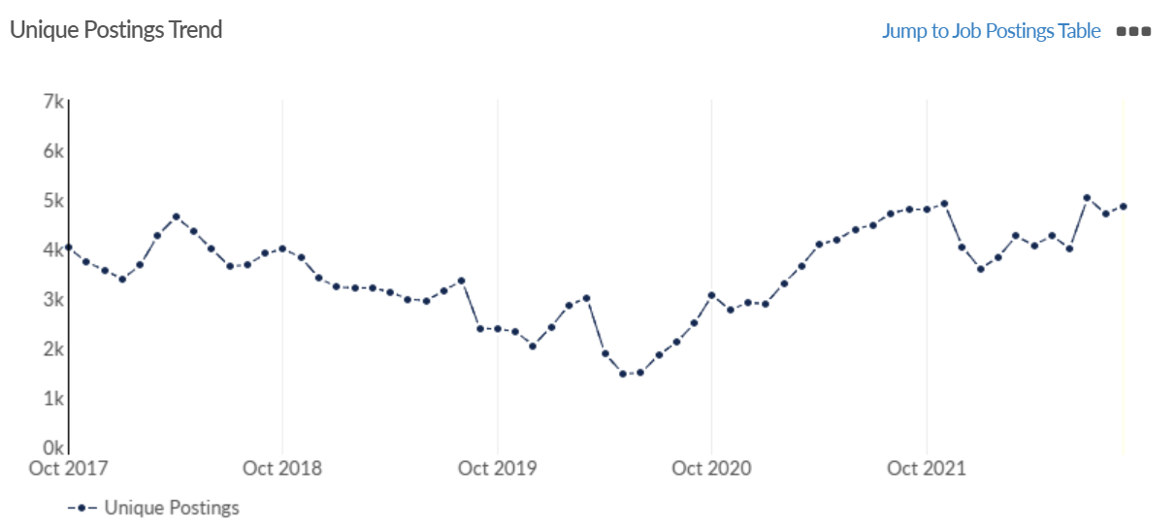
Job posting analytics
Source: EMSI, September 2022
Unique job postings: 4,864
Total job postings: 11,070
Job posting intensity: 2:1
Unique job postings (September 2021): 4,798

Slide 27
Slough

Slide 28
Unemployment figures and notable business news - September 2022
Claimant unemployment to September 2022 (latest)
4,990 claimants (5.3% of the working age population) in Slough UA
Notable business news:
Slough Borough Council announced a Sustainable Travel Grant (STG) for schools and businesses. The STG scheme provides financial assistance to organisations investing in measures aimed at encouraging sustainable travel, such as increasing travel to school or work by public transport, cycling, walking and scooting. STGs could include, but are not limited to secure cycle parking, shower/changing facilities, a survey to develop a travel action plan, cycle training, biker’s breakfasts, cycling promotion event and walking initiative. Grants can range up to £2,000 and will normally be up to 50% of any proposal, although in exceptional circumstances higher awards may be made. The applicant would be required to secure the remaining 50% match funding amount.– LINK.
Note: The LEP has been previously reporting on COVID-19 case rates in these monthly economic briefings. The dashboards containing this data have been shut down as April 2022 and, as a result, we will no longer be doing so.

Slide 29
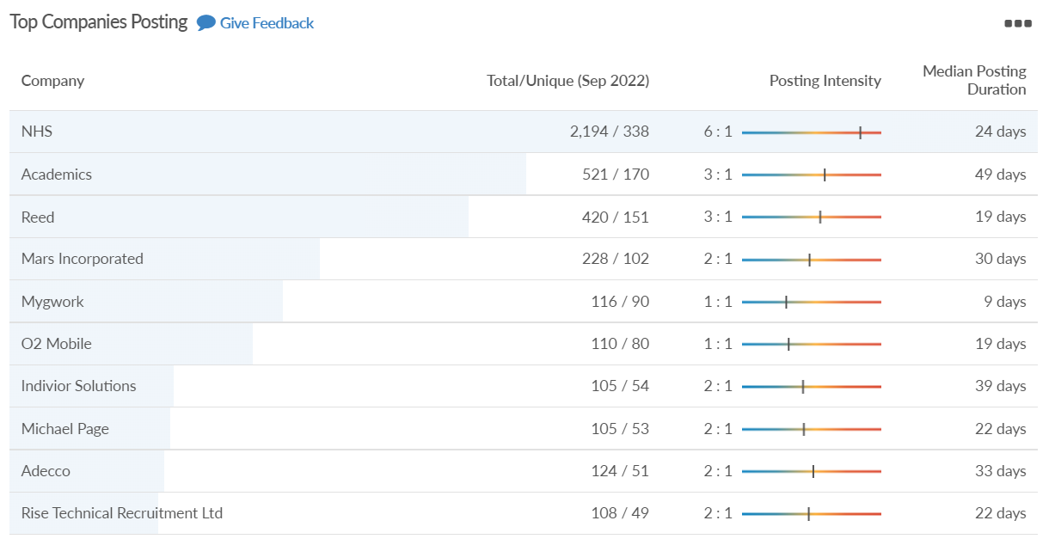
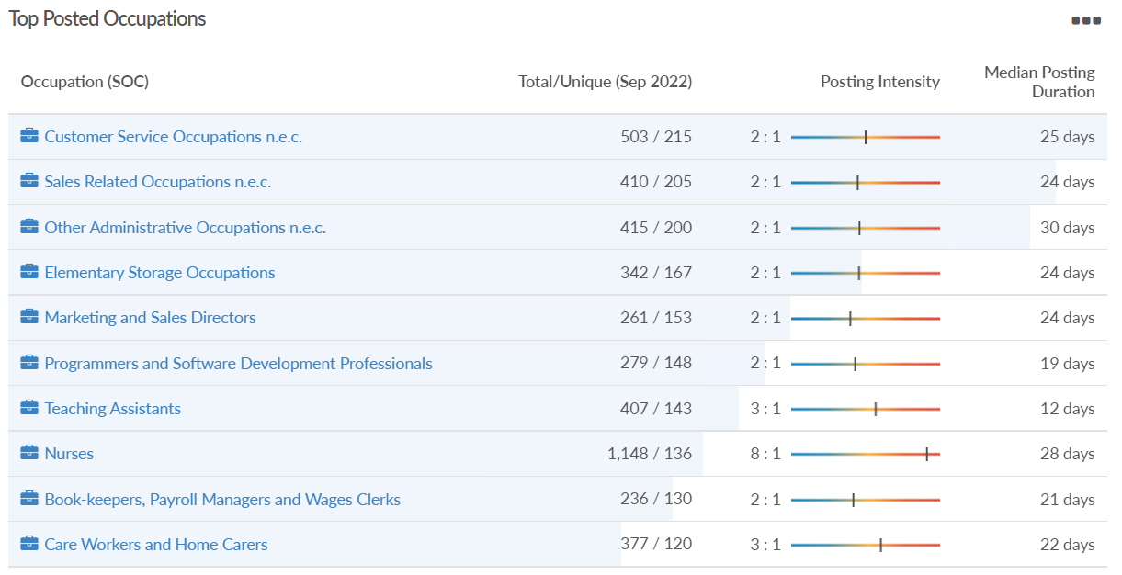
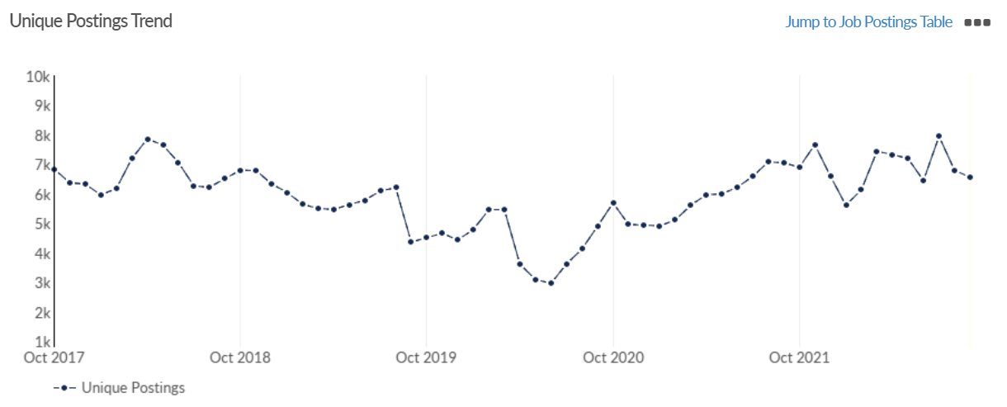
Job posting analytics
Source: EMSI, September 2022
Unique job postings: 6,560
Total job postings: 15,292
Job posting intensity: 2:1
Unique job postings (September 2021): 7,077

Slide 30
Reading

Slide 31
Unemployment figures and notable business news - September 2022
Claimant unemployment to September 2022 (latest)
4,370 claimants (4.1% of the working age population) in Reading UA
Notable business news:
A scheme for a hotel, exciting new courtyard and shopping area which could change a corner of Reading forever will be decided on soon. This summer, landholder Thackeray Estates submitted plans to transform the corner of Queen Victoria Street and Friar Street. If approved, the project would see a new 163 bed hotel, 104 apart-hotel rooms and a new courtyard and shopping area come to the town centre. Recently, the Local Democracy Reporting Service attended a briefing with David Owens, construction director at Thackeray Estates, and Paul Bottomley, planning consultant to get a better idea of their proposals.– LINK.
Note: The LEP has been previously reporting on COVID-19 case rates in these monthly economic briefings. The dashboards containing this data have been shut down as April 2022 and, as a result, we will no longer be doing so.

Slide 32
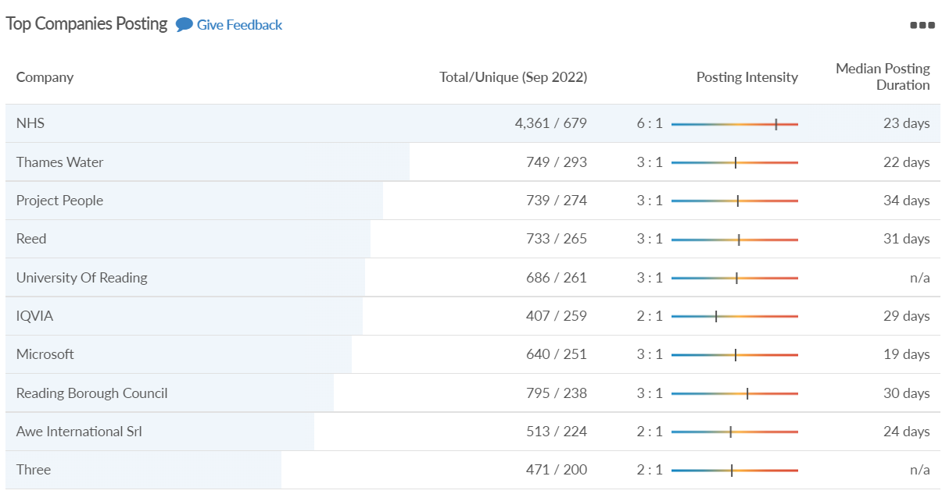
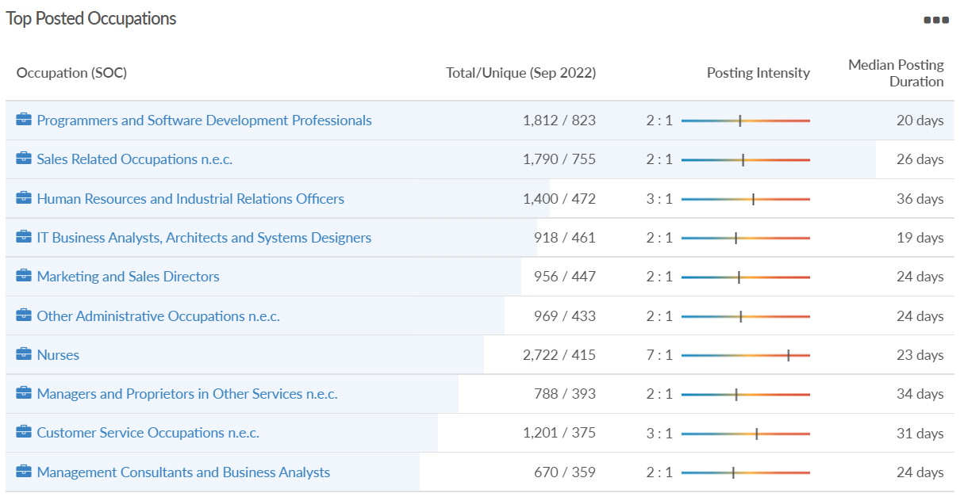
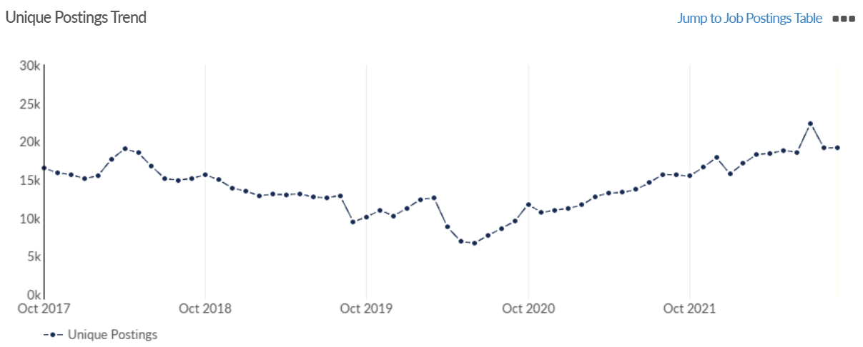
Job posting analytics
Source: EMSI, September 2022
Unique job postings: 19,178
Total job postings: 48,028
Job posting intensity: 3:1
Unique job postings (September 2021): 15,590

Slide 33
Wokingham

Slide 34
Unemployment figures and notable business news - September 2022
Claimant unemployment to September 2022 (latest)
1,720 claimants (1.6% of the working age population) in Wokingham UA
Notable business news:
Mulberry Business Park, Wokingham will see the creation of new employment units after re-development plans were approved by the council. The plan involves the demolition of Nigra House, located on Fishponds Lane, and the construction of 12 new two-storey units with a storage and distribution, research and development, and general industry use. Wokingham Town and Parish Council’s offered no objection to the plans, stating they were “pleased” to see that it would be kept as an industrial site and not be converted into residential properties. It was recommended for approval by a council planning officer, subject to securing an employment plan which provides opportunities for “training, apprenticeship or other vocational initiatives” to develop local employability skills. – LINK.
Note: The LEP has been previously reporting on COVID-19 case rates in these monthly economic briefings. The dashboards containing this data have been shut down as April 2022 and, as a result, we will no longer be doing so.

Slide 35
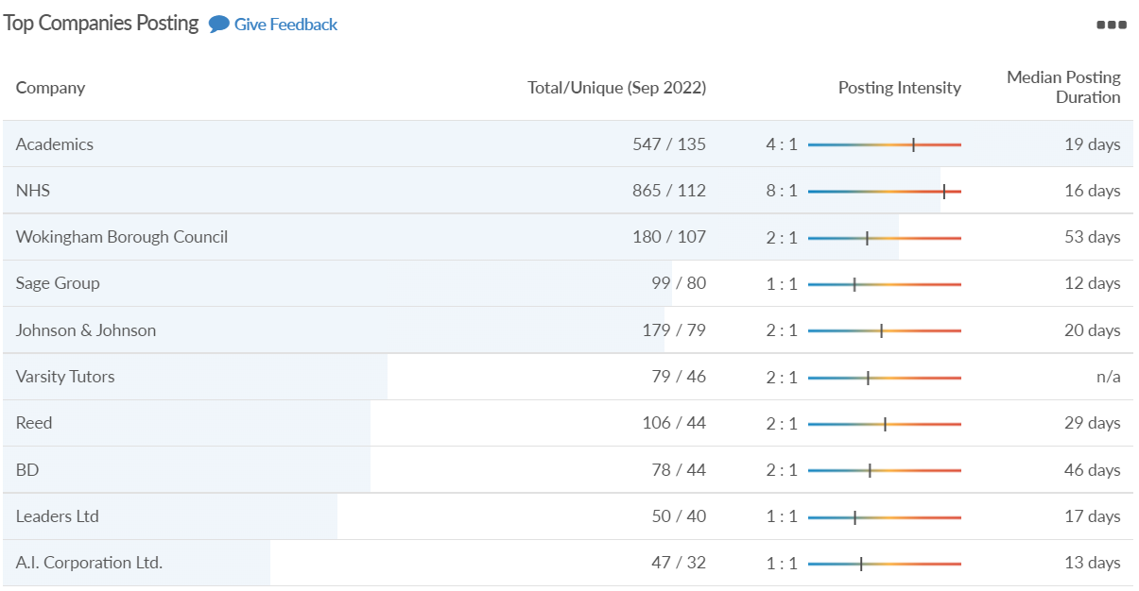
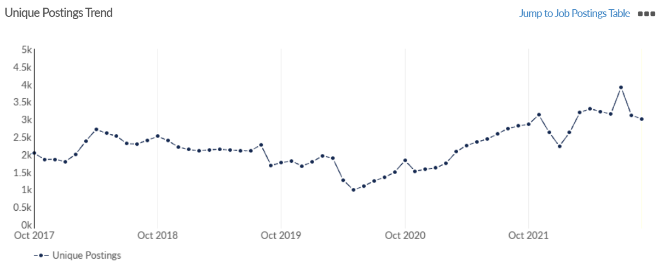
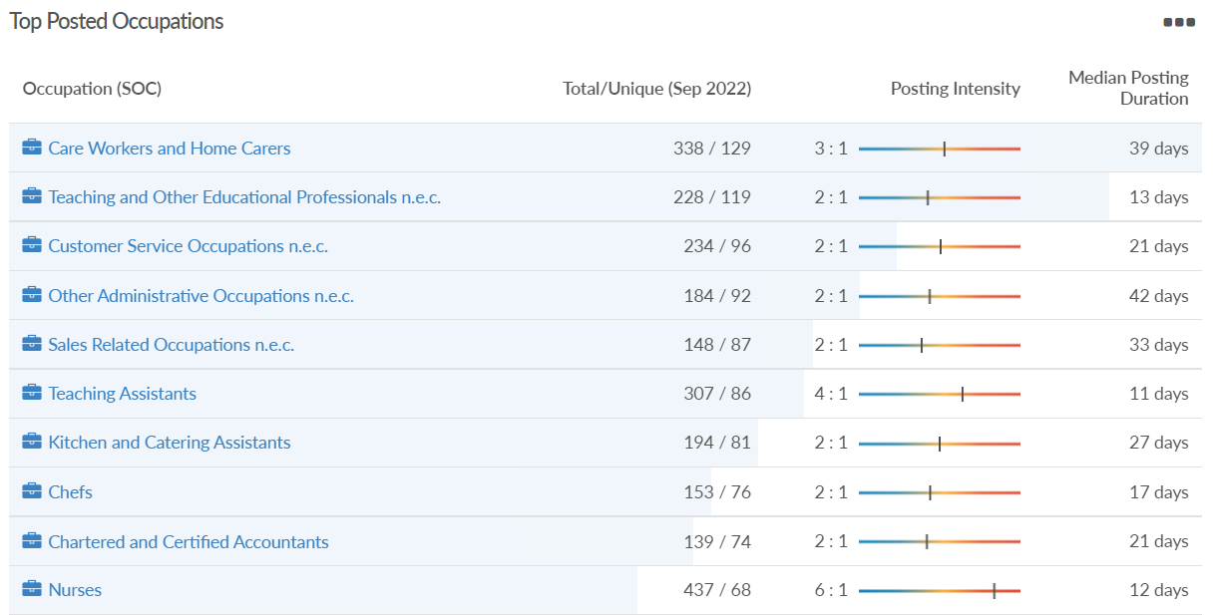
Job posting analytics
Source: EMSI, September 2022
Unique job postings: 3,010
Total job postings: 7,189
Job posting intensity: 2:1
Unique job postings (September 2021): 2,806

Slide 36
Windsor and Maidenhead

Slide 37
Unemployment figures and notable business news - September 2022
Claimant unemployment September 2022 (latest)
2,100 claimants (2.3% of the working age population) in Windsor and Maidenhead UA
Notable business news:
Fi.Fest music festival is set to return to Fifield, Maidenhead next summer. Now in its 5th year, organisers boast that it will be the biggest yet, with chart topping acts to feature in the line-up. The celebration of live music, entertainment and family attractions, will take place on Saturday, July 8, 2023, running through the day and into the night. With something for the whole family, there will be a dedicated kidszone and kids’ stage, and a large variety of refreshment and food options. Further details will be released later this month.– LINK.
Note: The LEP has been previously reporting on COVID-19 case rates in these monthly economic briefings. The dashboards containing this data have been shut down as April 2022 and, as a result, we will no longer be doing so.

Slide 38
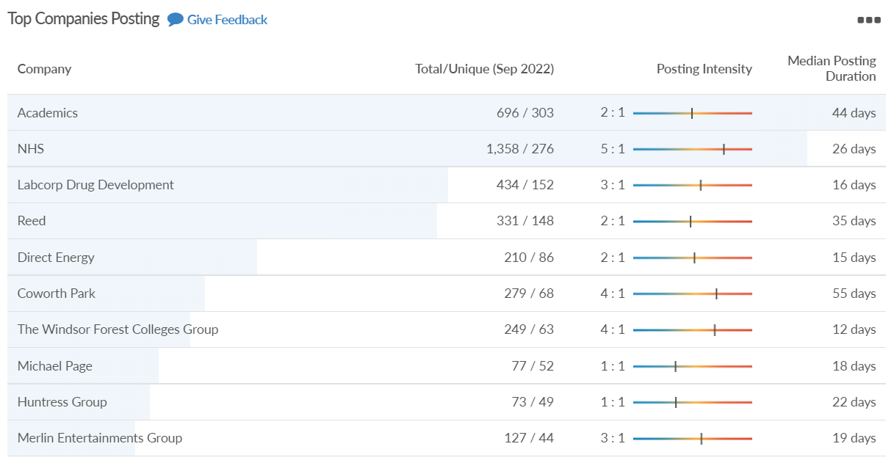
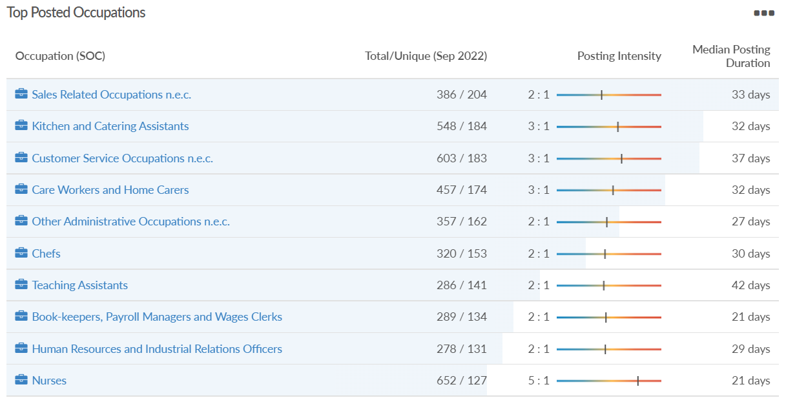
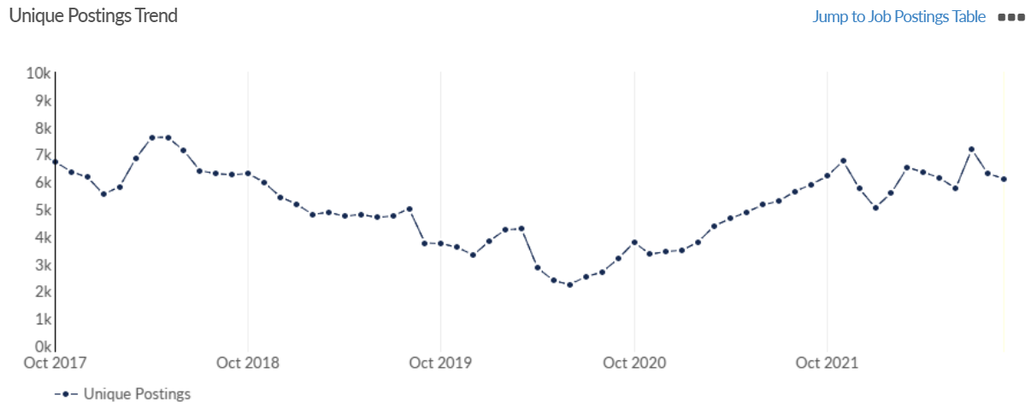
Job posting analytics
Source: EMSI, September 2022
Unique job postings: 6,113
Total job postings: 14,285
Job posting intensity: 2:1
Unique job postings (September 2021): 5,893

Slide 39
West Berkshire

Slide 40
Unemployment figures and notable business news - September 2022
Claimant unemployment to September 2022 (latest)
2,115 claimants (2.2% of the working age population) in West Berkshire UA
Notable business news:
Construction work has begun on three new business units on the south side of Newbury station as the railway station’s multi-million-pound redevelopment continues. Great Western Railway is working with West Berkshire Council and Berkshire Local Enterprise Partnership (LEP) to deliver the scheme, designed to help support the town’s economic development and increase employment opportunities. The three new units which will be located on the south side of the station..– LINK.
Note: The LEP has been previously reporting on COVID-19 case rates in these monthly economic briefings. The dashboards containing this data have been shut down as April 2022 and, as a result, we will no longer be doing so.

Slide 41
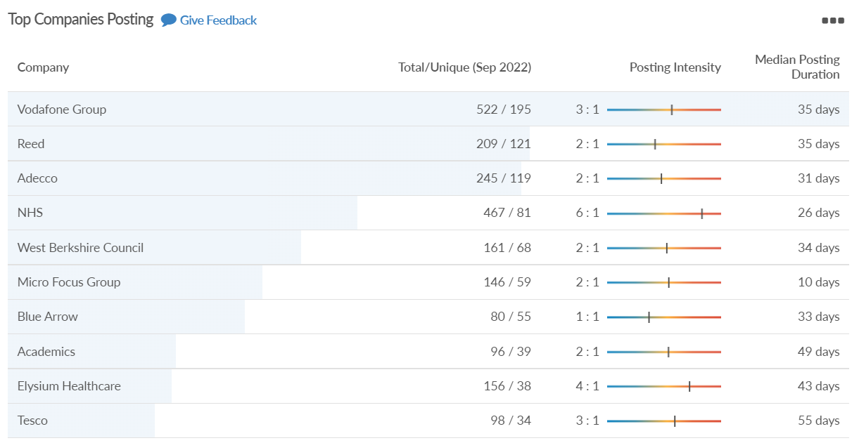
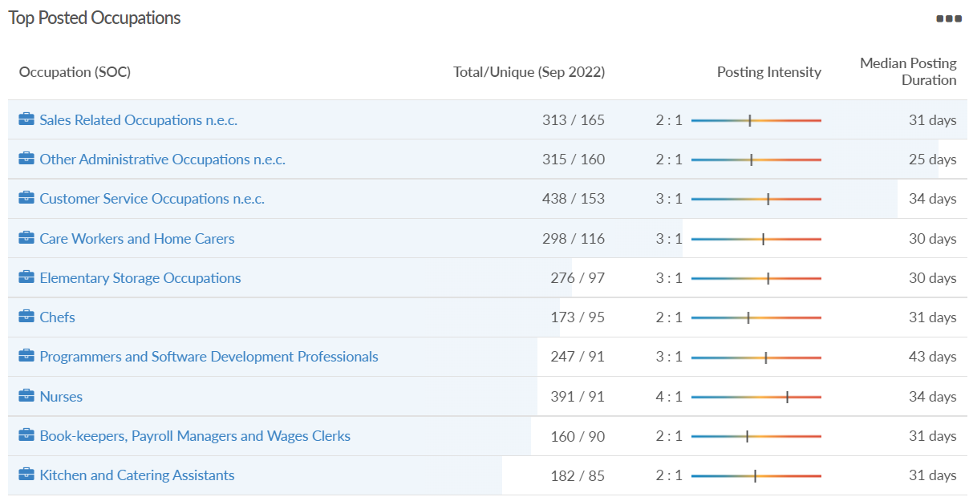
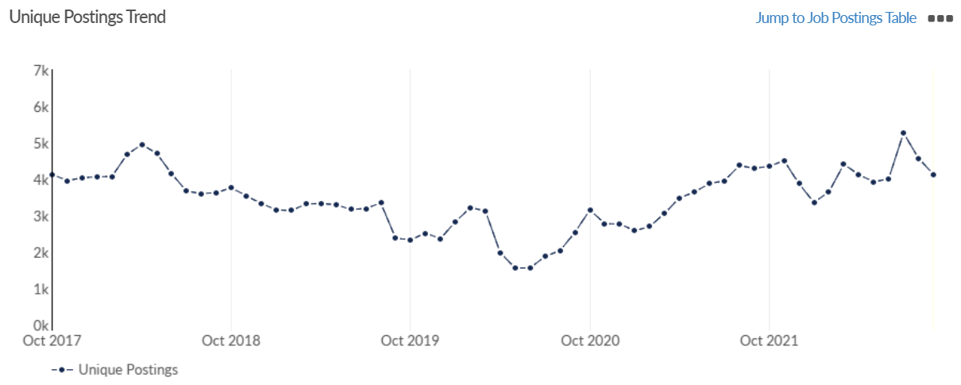
Job posting analytics
Source: EMSI, September 2022
Unique job postings: 4,129
Total job postings: 9,059
Job posting intensity: 2:1
Unique job postings (September 2021): 4,295

